Slide 1
The power of Art

Slide 2
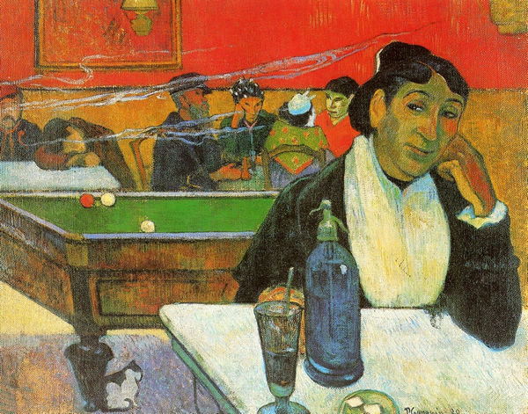
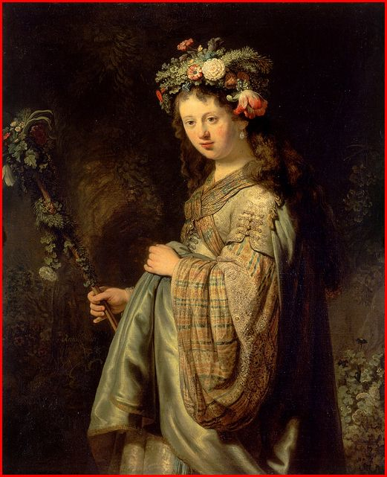
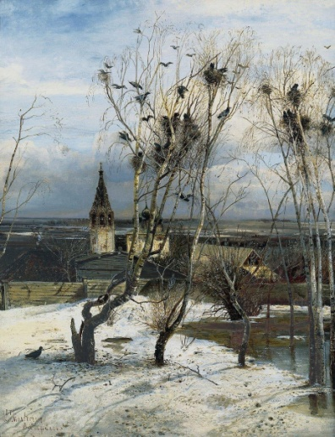
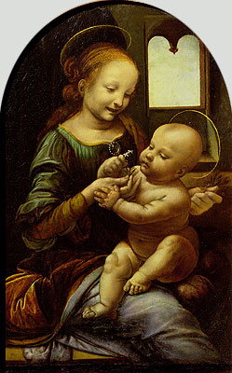
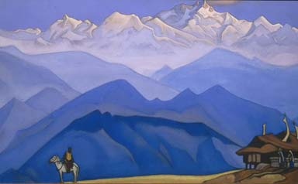
1. Match the artist and the painting
Leonardo
da Vinci
Alexei
Savrasov
Nikolay
Roerich
Paul
Gauguin
Rembrandt
van Rijn

Slide 3

2. What object can NOT be found in the artist’s studio?
Easel
Canvas
Stencil
Tempera
Cubism
Brush

Slide 4
3. Is Realism a genre of painting?

Slide 5
4. Match the style and the definition
Cubism
Classicism
…a sketchy style, trying
to capture the changing
effect of natural light…
.. not lifelike pictures,
distorted space,
angular shapes…
Realism
Impressionism
…balance, regularity and
simpleness of form…
…show things as
they really are…

Slide 6
5. Which of the following is NOT a genre of painting?
Portrait
Genre scene
Abstract art
Landscape
Still life

Slide 7
6. Was Vincent van Gogh an Impressionist?

Slide 8
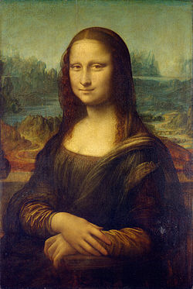
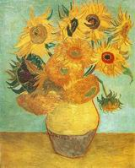
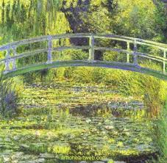
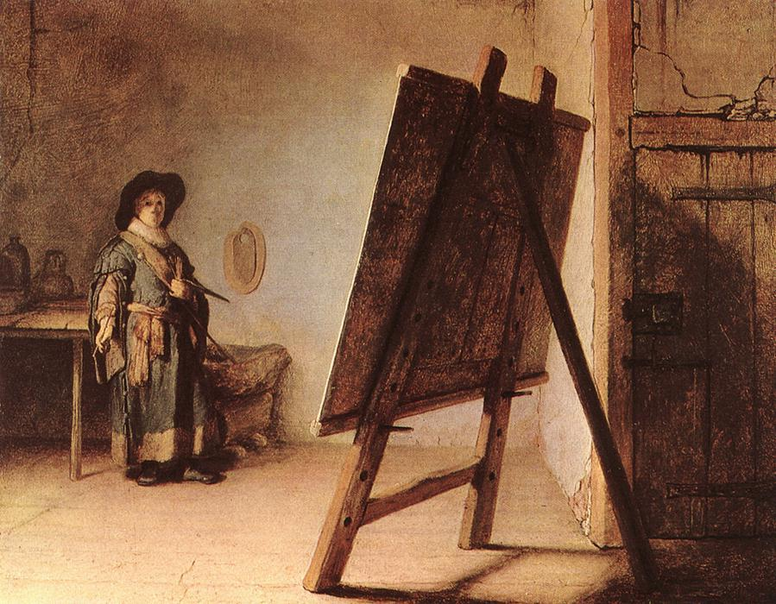
7. Match the painting and the genre.
genre scene
portrait
still life
landscape

Slide 9
8. Which of the following objects
is a kind of paint?
Clay
Watercolours
Plaster
Palette

Slide 10
9. Is photography a kind of visual art?

Slide 11
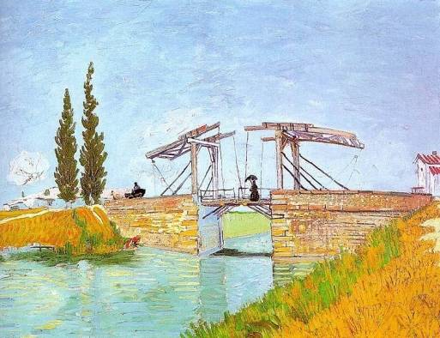
10. Describe the picture using the given plan
the style
the genre
the subject
the composition
the colour scheme
the details
the general
impression
Use as many words related to art as you can!

Slide 12
The end!
Thank you for participation!

