Slide 1


Great Minds
Scientists & Inventors | Art & Literature | People – Legends | Presidents & Rulers | Discoverers & Explorers
G^{M} 100 | G^{M} 100 | G^{M} 100 | G^{M} 100 | G^{M} 100
G^{M} 200 | G^{M} 200 | G^{M} 200 | G^{M} 200 | G^{M} 200
G^{M} 300 | G^{M} 300 | G^{M} 300 | G^{M} 300 | G^{M} 300
G^{M} 400 | G^{M} 400 | G^{M} 400 | G^{M} 400 | G^{M} 400
G^{M} 500 | G^{M} 500 | G^{M} 500 | G^{M} 500 | G^{M} 500

Slide 2

G^{M} 100 SCIENTISTS
He was a great German physicist and philosopher. He is most famous for his Theory of Relativity. He won the Nobel Prize in Physics.

Slide 3
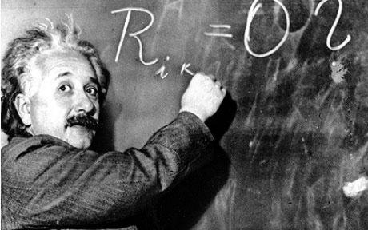

G^{M} 100 SCIENTISTS
What do you know about Albert Einstein?

Slide 4
G^{M} 200 SCIENTISTS
She was a Polish chemist and physicist who lived and worked in France. She created a theory of radioactivity and won two Nobel Prizes.

Slide 5
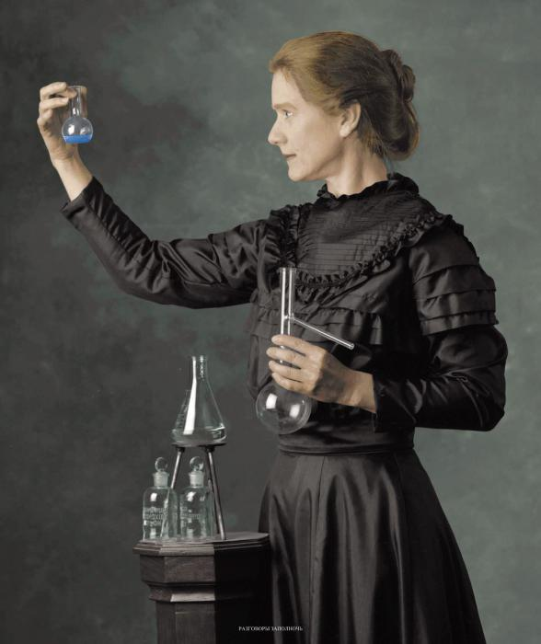
G^{M} 200 SCIENTISTS
What do you know about Marie Curie?

Slide 6
G^{M} 300 SCIENTISTS
He was an English physicist, astronomer, mathematician and philosopher. He invented the first reflecting telescope.

Slide 7
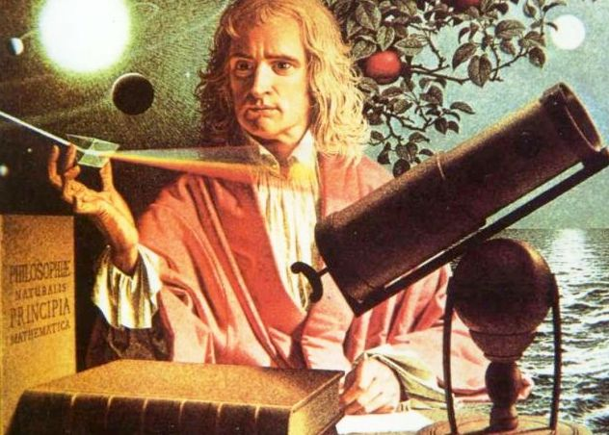
G^{M} 300 SCIENTISTS
What do you know about Isaac Newton?

Slide 8
G^{M} 400 SCIENTISTS
He was a Scottish scientist and inventor. He invented the first working telephone in 1876.

Slide 9
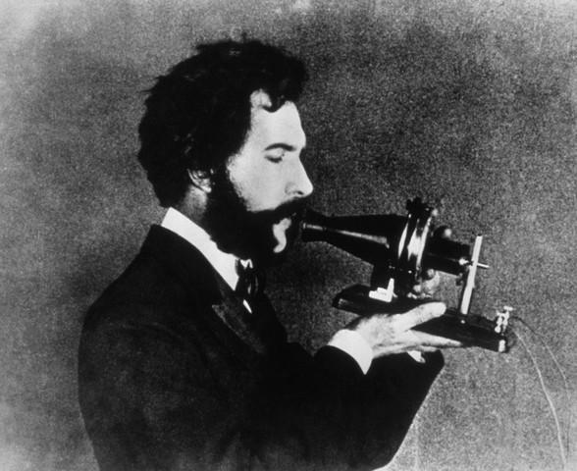
G^{M} 400 SCIENTISTS
What do you know about Alexander Graham Bell?

Slide 10
G^{M} 500 SCIENTISTS
He was a famous Russian scientist. He made a lot of discoveries related to magnetic fields. He won the Nobel Prize in Physics in 1978.

Slide 11
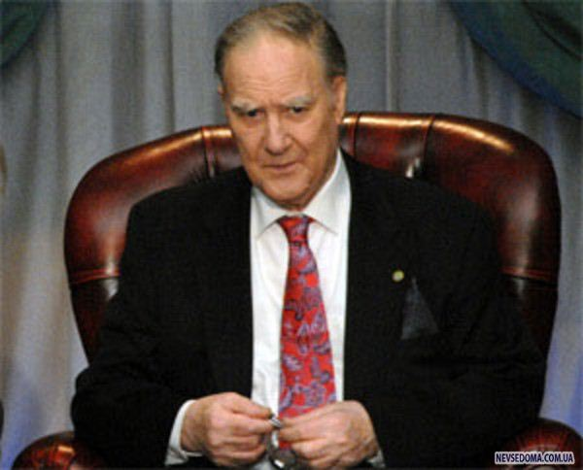
G^{M} 500 SCIENTISTS
What do you know about Pyotr Kapitsa?

Slide 12
G^{M} 100 ART & LITERATURE
He was a famous English writer. Some of his most famous novels are Oliver Twist, David Copperfield and Christmas Carol (about Uncle Scrooge).

Slide 13
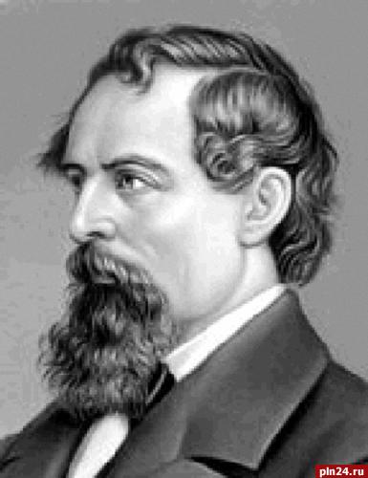
G^{M} 100 ART & LITERATURE
What do you know about Charles Dickens?

Slide 14
G^{M} 200 ART & LITERATURE
He was a famous Russian writer. Some of his most famous novels are War and Peace and Anna Karenina. He also wrote classical tales and fables for children.

Slide 15
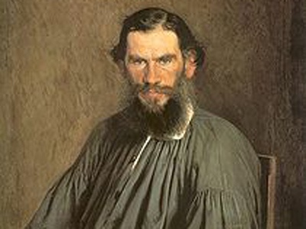
G^{M} 200 ART & LITERATURE
What do you know about Leo Tolstoy?

Slide 16
G^{M} 300 ART & LITERATURE
He was a German composer and pianist. He went completely deaf. He wrote 9 symphonies, 7 concerts, 32 piano sonatas (Moonlight Sonata) and much more.

Slide 17
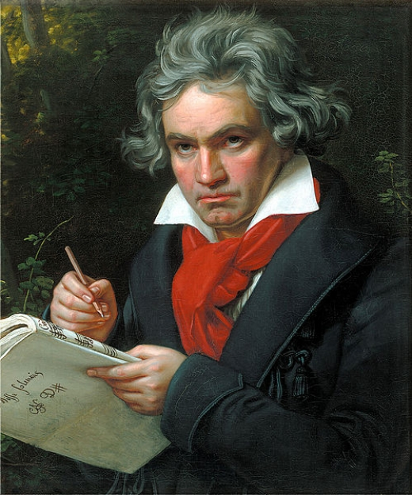
G^{M} 300 ART & LITERATURE
What do you know about Ludwig van Beethoven?

Slide 18
G^{M} 400 ART & LITERATURE
He was a great Russian composer of the 19th century. People all over the world know and love his operas and ballets such as Swan Lake, Sleeping Beauty and The Nutcracker.

Slide 19
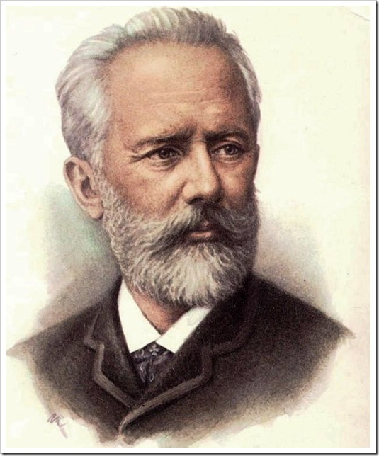
G^{M} 400 ART & LITERATURE
What do you know about Pyotr Tchaikovsky?

Slide 20
G^{M} 500 ART & LITERATURE
She is one of the most famous female artists in the world. She was born in Mexico. Her style combined Mexican folk art with surrealism.

Slide 21
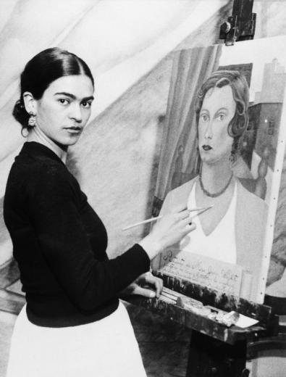
G^{M} 500 ART & LITERATURE
What do you know about Frida Kahlo?

Slide 22
G^{M} 100 PEOPLE - LEGENDS
He was a world-famous pop star from the USA. Guinness World Records call him the most successful entertainer of all time.

Slide 23
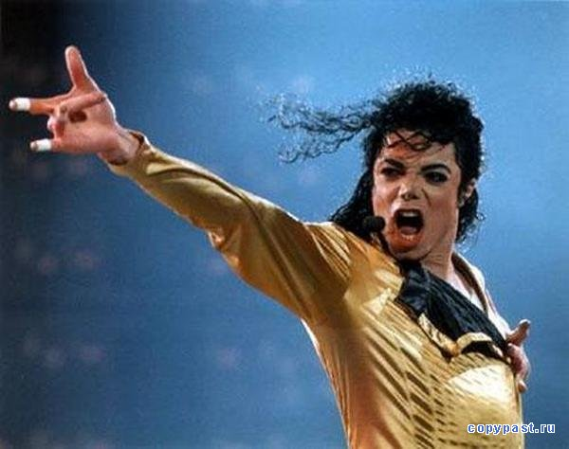
G^{M} 100 PEOPLE - LEGENDS
What do you know about Michael Jackson?

Slide 24
G^{M} 200 PEOPLE - LEGENDS
He was a sculptor, a philosopher, a geologist. He painted the Mona Lisa, designed many machines, sketched plants and animals and studied the anatomy of the human body.

Slide 25
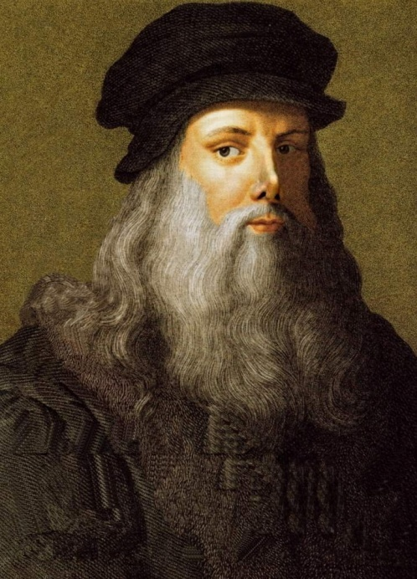
G^{M} 200 PEOPLE - LEGENDS
What do you know about Leonardo da Vinci?

Slide 26
G^{M} 300 PEOPLE - LEGENDS
She was a British nurse and writer. Many people came to know her as 'the lady of the lamp'. She helped people in need.

Slide 27
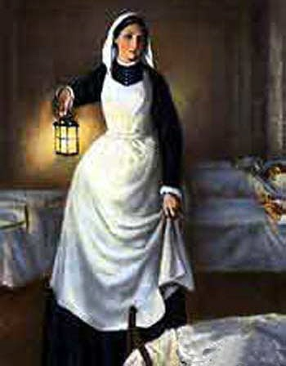
G^{M} 300 PEOPLE - LEGENDS
What do you know about Florence Nightingale?

Slide 28
G^{M} 400 PEOPLE - LEGENDS
They set sail from England to America in 1620 on board the ship “Mayflower” and reached the New World only 66 days later. They started a tradition of Thanksgiving.

Slide 29
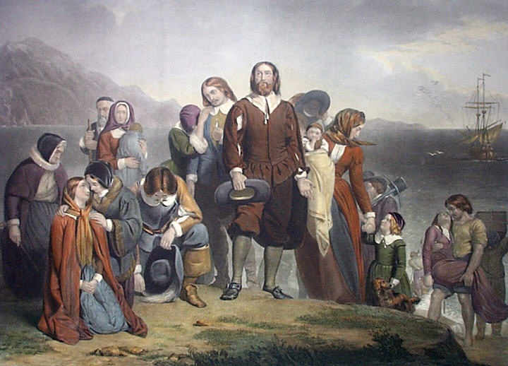
G^{M} 400 PEOPLE - LEGENDS
What do you know about pilgrims?

Slide 30
G^{M} 500 PEOPLE - LEGENDS
By the age of 25, he was the ruler of Greece, Asia Minor, Egypt and Persia. At the time of his death at age 33, his empire stretched over three continents into India.

Slide 31
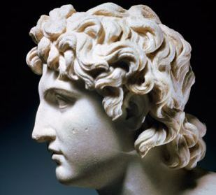
G^{M} 500 PEOPLE - LEGENDS
What do you know about Alexander the Great?

Slide 32
G^{M} 100 PRESIDENTS & KINGS
He is now the president of Russia.

Slide 33
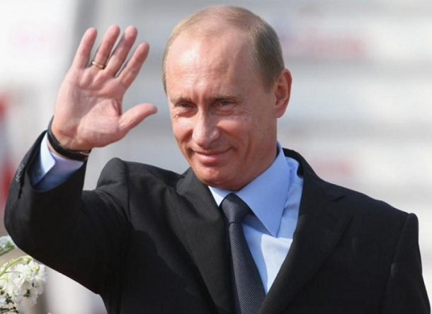
G^{M} 100 PRESIDENTS & KINGS
What do you know about Vladimir Putin?

Slide 34
G^{M} 200 PRESIDENTS & KINGS
He led the army in the Revolutionary War. He was the first president of the USA. People of the USA respect him greatly.

Slide 35
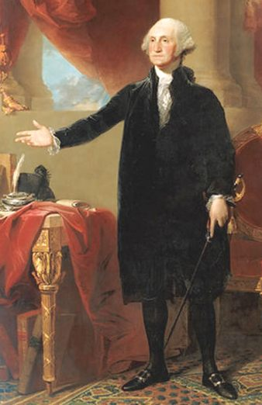
G^{M} 200 PRESIDENTS & KINGS
What do you know about George Washington?

Slide 36
G^{M} 300 PRESIDENTS & KINGS
He was the 16th American president and is famous for the abolition of slavery.

Slide 37
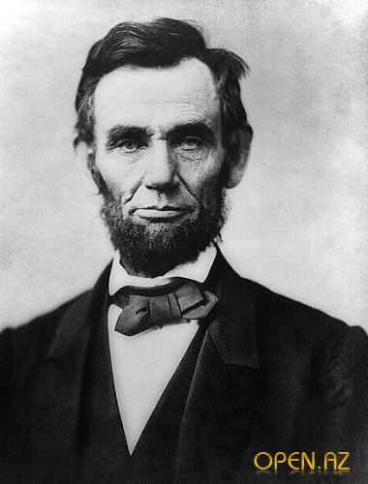
G^{M} 300 PRESIDENTS & KINGS
What do you know about Abraham Lincoln?

Slide 38
G^{M} 400 PRESIDENTS & KINGS
He created a Roman Empire, fought against many armies and won many battles. He said "I came, I saw, I conquered."

Slide 39
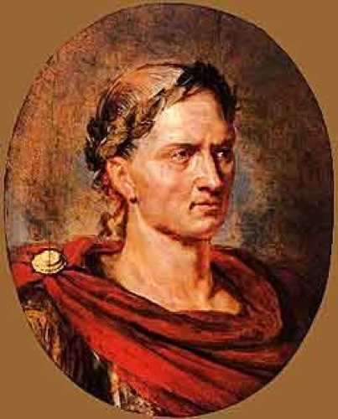
G^{M} 400 PRESIDENTS & KINGS
What do you know about Julius Caesar?

Slide 40
G^{M} 500 PRESIDENTS & KINGS
He became Pharaoh of Egypt at a very young age. He ruled for only 9 years because he died at the age of 18. His tomb had a lot of treasures inside it.

Slide 41
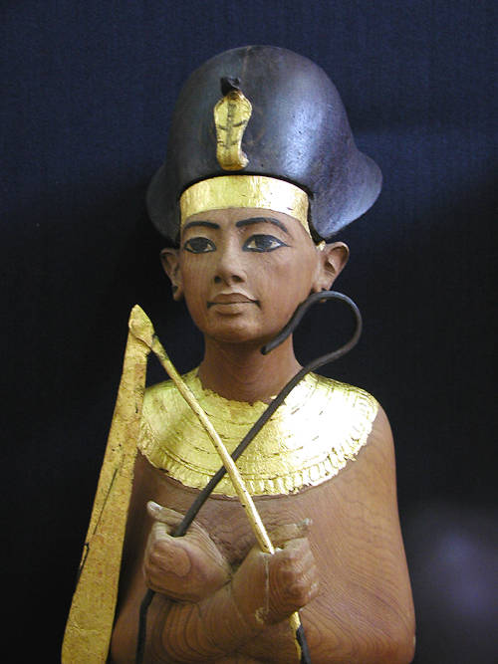
G^{M} 500 PRESIDENTS & KINGS
What do you know about Tutankhamen?

Slide 42
G^{M} 100 DISCOVERERS
& EXPLORERS
He was born in Italy. He wanted to find a way to India but he discovered America in 1492.

Slide 43
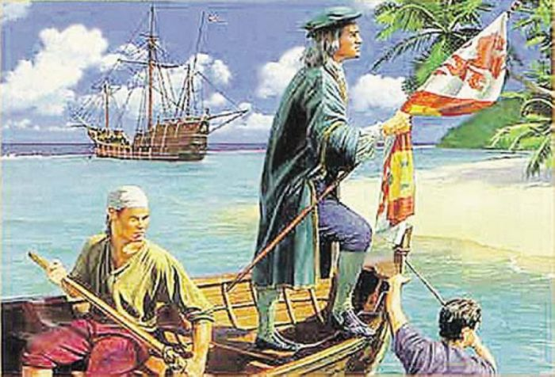
G^{M} 100 DISCOVERERS
& EXPLORERS
What do you know about Christopher Columbus?

Slide 44
G^{M} 200 DISCOVERERS
& EXPLORERS
He was a Russian cosmonaut. He was the first man to fly into space.

Slide 45
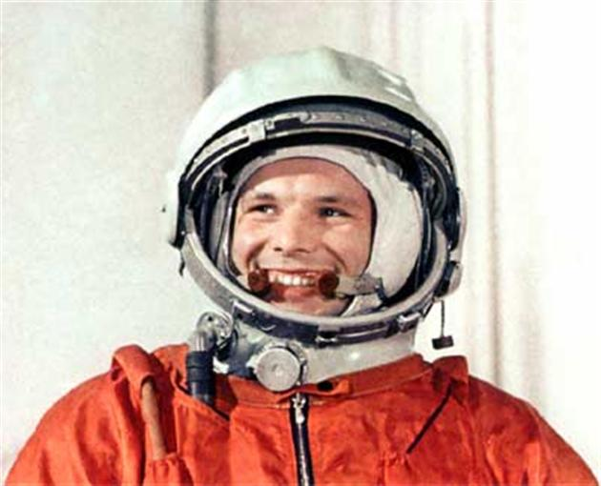
G^{M} 200 DISCOVERERS
& EXPLORERS
What do you know about Yury Gagarin?

Slide 46
G^{M} 300 DISCOVERERS
& EXPLORERS
He was born in Estonia. He wanted to establish direct communication between Russia and China. He did the first Russia’s round-the world voyage.

Slide 47
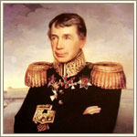
G^{M} 300 DISCOVERERS
& EXPLORERS
What do you know about Ivan Kruzenstern?

Slide 48
G^{M} 400 DISCOVERERS
& EXPLORERS
He set out along the Silk Road in 1271 and returned home only 24 years later. He started the Inca Empire.

Slide 49
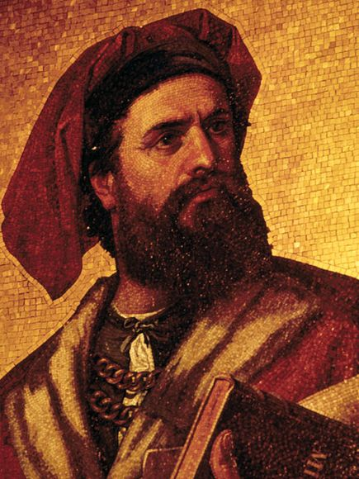
G^{M} 400 DISCOVERERS
& EXPLORERS
What do you know about Marco Polo?

Slide 50
G^{M} 500 DISCOVERERS
& EXPLORERS
He was an Italian explorer. Like Christopher Columbus he wanted to find a new trade route to Asia. He found an unknown land and called it “new found land”.

Slide 51
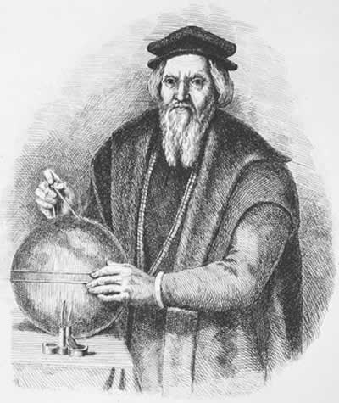
G^{M} 500 DISCOVERERS
& EXPLORERS
What do you know about John Cabot?

Slide 52
Источники иллюстраций
1 | Albert Einstein | http://tainy.net/10358-uchenye-lyudi-zhivushhie-na-verxnix-etazhax-stareyut-bystree.html
2 | Marie Curie | http://www.profi-forex.org/system/news/1_6263.jpg
3 | Isaac Newton | http://img1.liveinternet.ru/images/attach/c/3/76/818/76818937_large_4photo.jpg
4 | Alexander Graham Bell | http://cnx.org/content/m12452/1.3/agbell.jpg
5 | Pyotr Kapitsa | http://aksakal.info/uploads/posts/2012-08/1344952136_65.jpg
6 | Charles Dickens | http://pln-pskov.ru/pictures/120224124319.jpg
7 | Leo Tolstoy | http://www.livenews.ro/site/uploads/images/rss903618207.jpg
8 | Ludwig van Beethoven | http://img.velvet.by/files/resize/userfiles/4467/2_587-520x625.jpg
9 | Pyotr Tchaikovsky | http://www.kolpino.ru/upload/iblock/206/chajkovskij-2.jpg
10 | Frida Kahlo | http://www.art-ag.ru/galery.php?preview=3676&size=2

Slide 53
11 | Michael Jackson | http://copypast.ru/uploads/posts/1220214137_image00008.jpg
12 | Leonardo da Vinci | http://www.eceerken.net/resimler/leonardo-da-vinci-kisa-hayati-0.jpg
13 | Florence Nightingale | http://whateverafter.co.uk/pics/FLO.jpg
14 | pilgrims | http://www.pittsreport.com/wp-content/uploads/2011/08/pilgrims.jpg
15 | Alexander the Great | http://mail.salom.com.tr/uploads/news/b_189541.jpg
16 | Vladimir Putin | http://www.vaseljenska.com/wp-content/uploads/2012/01/vladimir-putin2.jpg
17 | George Washington | http://www.nkfu.com/wp-content/uploads/2011/02/President_George_Washington-1.jpg
18 | Abraham Lincoln | http://open.az/uploads/posts/2011-10/thumbs/1319792182_x_2705ea14.jpg
19 | Julius Caesar | http://i.ensonhaber.com/resimler/galeri/unlulerin_son_sozleri_37.jpg
20 | Tutankhamen | http://www.museumsyndicate.com/images/3/27271.jpg

Slide 54


21 | Christopher Columbus | http://www.edu.cap.ru/Home/5212/andreeva%20l.v/foto/pic%202.jpg
22 | Yury Gagarin | http://www.mukachevo.net/Content/img/news/p_39766_1_gallerybig.jpg
23 | Ivan Kruzenstern | http://www.kunstkamera.ru/images/child1/23/04_.jpg
24 | Marco Polo | http://www.frontpress.ro/wp-content/uploads/2011/10/marco-polo-mosaic_11363_600x450.jpg
25 | John Cabot | http://www.compendium.ro/imgpers/1215.jpg
Thank
you!

Slide 55
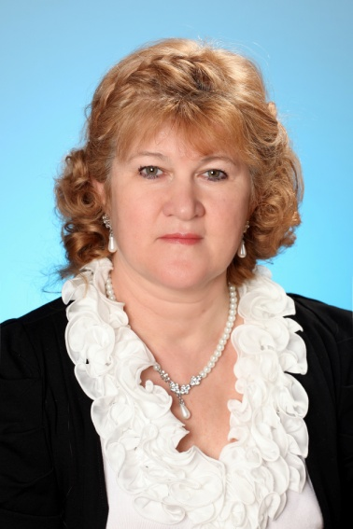
104-199-441
Автор:
Тетерина Ольга Афанасьевна

