Slide 1
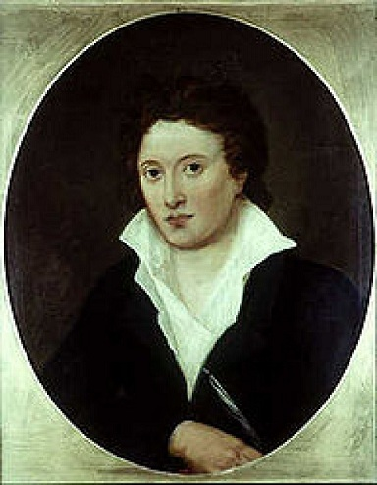
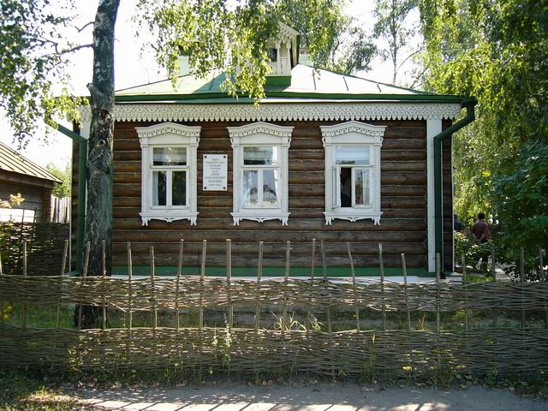
ca
Percy Bysshe Shelley was born in 1792 on the 4 –th of August in a small town – Sooseks. A house where Shelley was born

Slide 2
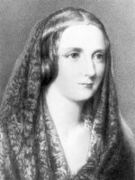
Shelley Mary
(1797 – 1851)
She was a famous English writer. When she was very young she fell in love with Percy Shelley, left her native house and ran with him to Switzerland. It was a very brave step for those times.

Slide 3
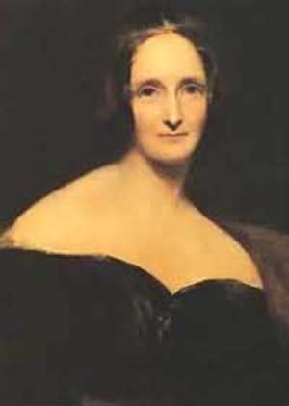
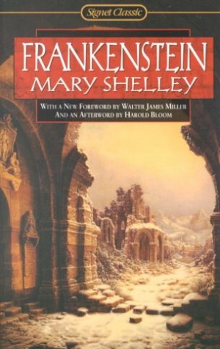
Mary Shelley – poet’s wife (1797 – 1857).She was a daughter of a writer and political philosopher. She was very talented and she earned money writing novels. One of her famous novels is:
“Frankenstein”, it’s a book about a great mistake of a person’s genius.

Slide 4
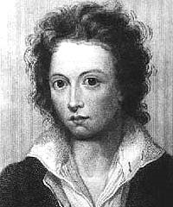
Young Shelley at the University in Iton, England
After school Shelley learned at a famous private school in England. His young soul was wounded when he saw fights and injustice there. He was indifferent to learning, but those times he was interested in the ideas of freedom, justice and quality.

Slide 5
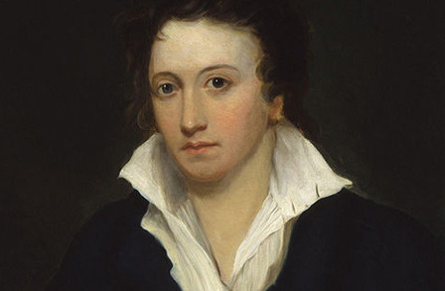
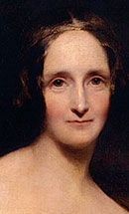

Passionate love
          Percy and Shelley removed many times, changed flats. They had to conceal their intentions. Friends helped them, namely Lord Byron.

Slide 6
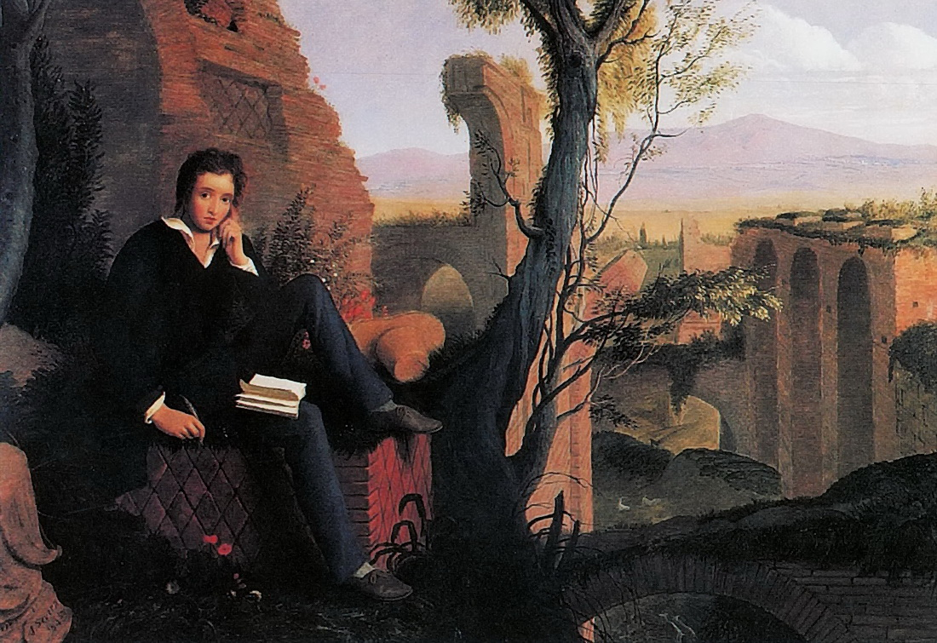
Shelley in Italy
Shelley and Mary went to Italy. Here Shelley spent the best years of his life. The beauty of Italian landscapes inspired Shelley to work much and to write a lot.

Slide 7
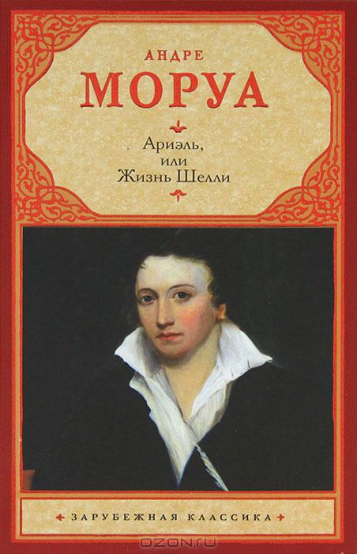
A Great English writer – Andre Morua wrote a book about Shelley’s life

Slide 8

Among readers
The book had a great success
among readers

Slide 9
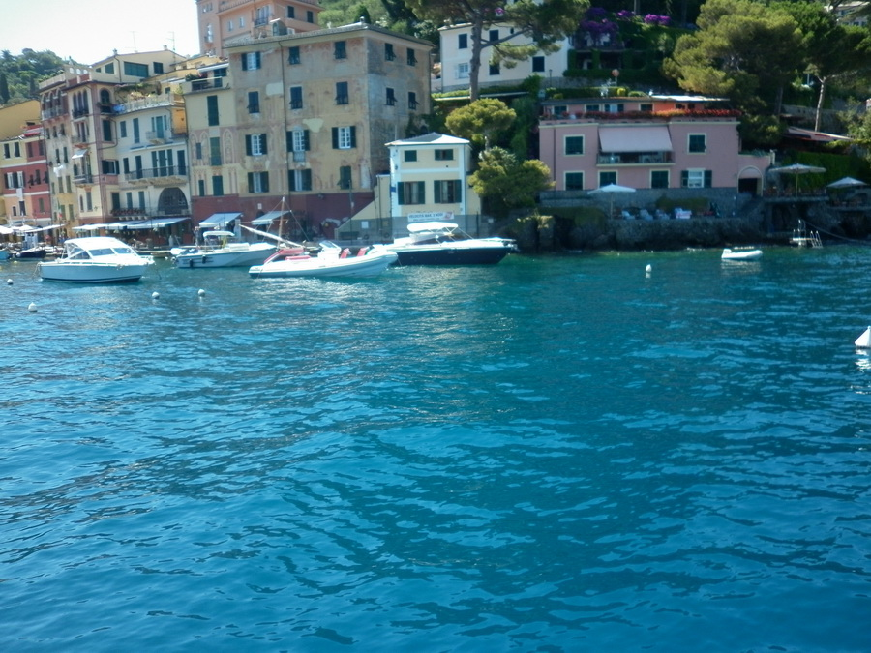
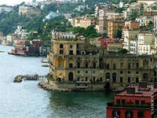

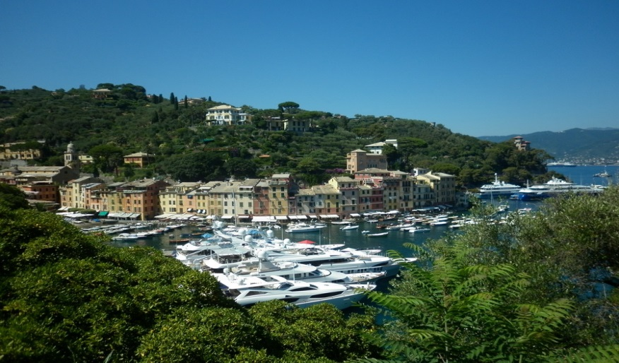
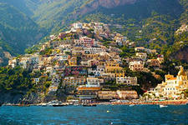
In Italy Percy Shelley wrote his best things: ‘’ Free Prometheus”, “Ellada”. “Chenchy’s tragedy’’.

Slide 10
Шелли
талантливо, убедительно и правдиво писал о мире:
Продажно все: продажен свет небес,
Дары любви, что нам даны землею,
Ничтожнейшие маленькие вещи,
Что в глубине, в далеких безднах скрыты,
Все, что есть в нашей жизни, жизнь сама,
Содружество людей, Свободы проблеск
И те заботы, что людское сердце
Хотело б инстинктивно выполнять -
Все на публичном рынке продается,
И себялюбье может все купить,
Всему своим клеймом поставить цену.
Продажна и любовь; услада скорби
В мученья агонии превратилась...

Slide 11
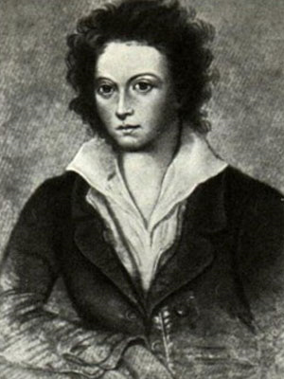
By force or custom? Man who man would be,
Must rule the empire of himself in it
Must be supreme, establishing his throne
On vanquished will, quelling the anarchy
Of hopes and fears, being himself alone.
Young Shelley. In his early poems he expressed
freedom – loving feelings.

Slide 12
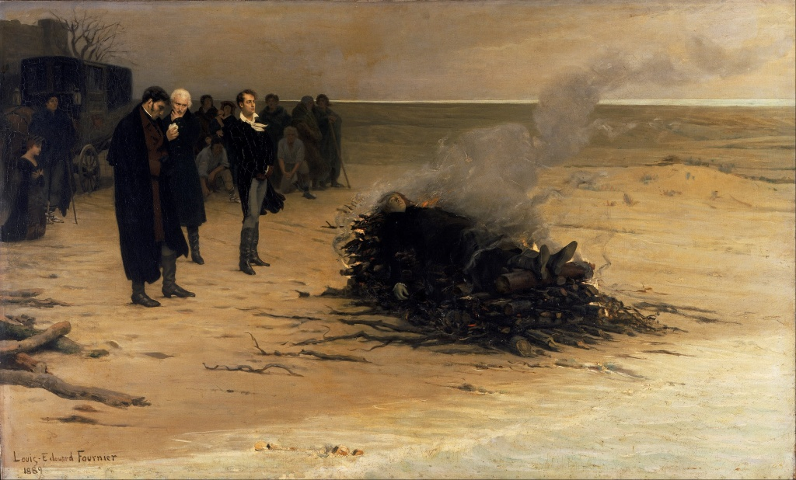
Shelley’s funeral
The Whole Europe was shocked by Shelley’s death, he was burnt on the fire by his close friend Lord Byron.

Slide 13
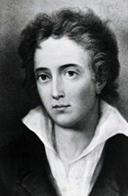
“Queen Mab” is a great Shelley’s poem
This poem was written in 1813. He created political images, saw a picture of the future. He saw himself as a prophet, as a brilliant dreamer, he saw a real picture of the Universe.

Slide 14

“A Freed Prometheus’’ – is a great poem written by Shelley
This poem is about a struggle between two forces: ‘’Zevs’’ and “ Prometheus”. “Zevs”hated people whom Prometheus gifted a fire and light. A “Freed Prometheus” is a fighter , he sent troubles to the whole mankind. He took up a challenge to:”Zevs”, who was a tyrant.

