Slide 1
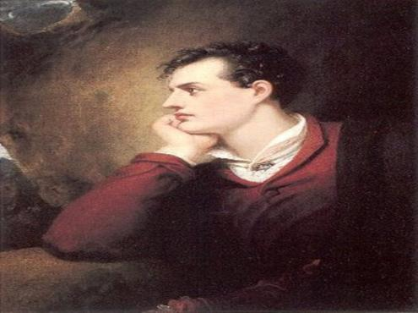
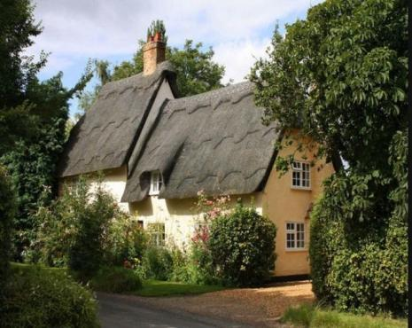
A Great Romantic English poet was born on January 22, 1788 in an old aristocratic family

Slide 2
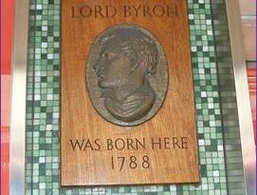
A memorial board on the house, where Byron was born
A memorial board on the house, where Byron was born

Slide 3
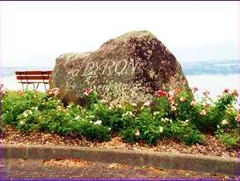
Switzerland. A famous Byron’s stone. Zheneva, a region of beautiful lakes.

Slide 4
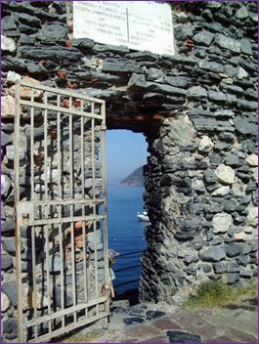
Byron’s grotto, it is situated in Italy. Byron was a nice swimmer. He took an active part in swimming competitions. Every year “Byron’s race” takes place. This place is called today” Byron’s bay”.
Poets from the whole world and artists gather in this place.

Slide 5
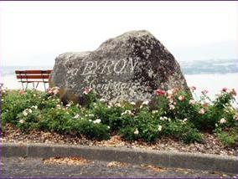
Слова Лорда Байрона о месте, где находится камень
Где – зрелище единственное в мире! –
Из волн встают и храмы и дома
Там бьёт крылом История сама,
И догорая рдеет солнце славы
Над красотой, сводящею с ума.

Slide 6
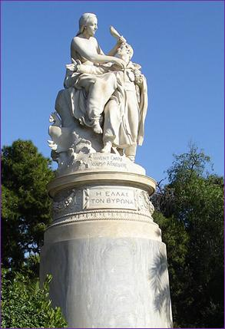
A monument to Byron in Rome, Italy.

Slide 7
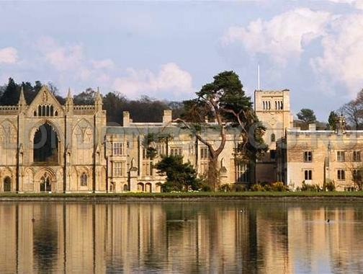
His family
A house where Byron lived with his family

Slide 8
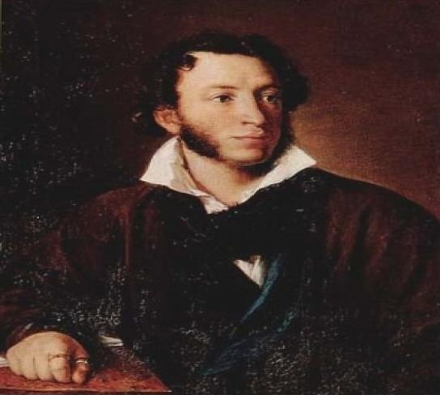
A.S. Pushkin was greatly impressed when Byron died. He devoted a part of his poem « К морю» to Byron as a poet of freedom.

Slide 9
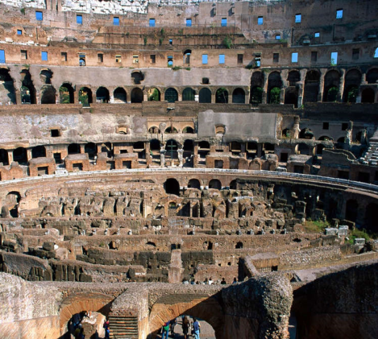
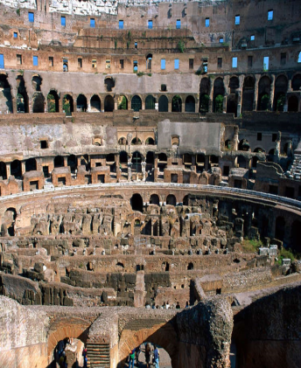
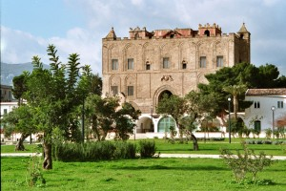
Byron was inspired by the beauty of Italy. He wrote here his best poems and took an active part in the struggle for the national independence of Italy.

Slide 10
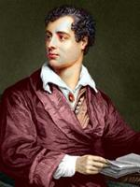
Byron valued a feeling of freedom. He wrote in one of his poems: “ When a man has no freedom to fight for at home, let him fight for that of his neighbours’’

Slide 11
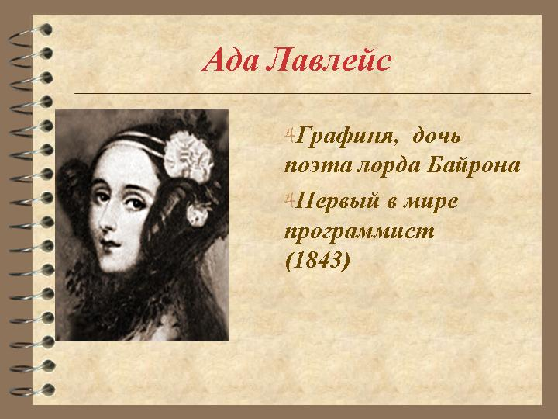
Byron’s daughter

Slide 12
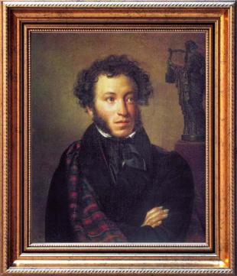
Pushkin devoted a part of his poem: “To the sea” to Byron as a poet of freedom
Другой от нас умчался гений,
Другой властитель наших дум,
Исчез, оплаканный свободой,
Оставя миру свой венец.
Шуми, волнуйся непогодой:
Он был, о море, твой певец.
Твой образ был на нём означен,
Он духом создан был твоим:
Как ты, могущ, глубок и мрачен,
Как ты, ничем неукротим.

Slide 13
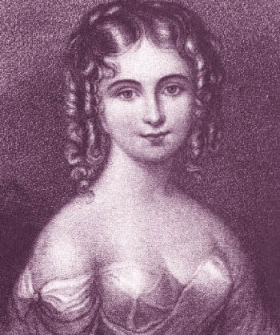
Byron’s last love – Teresa Gvichiolly, she was very beautiful

Slide 14
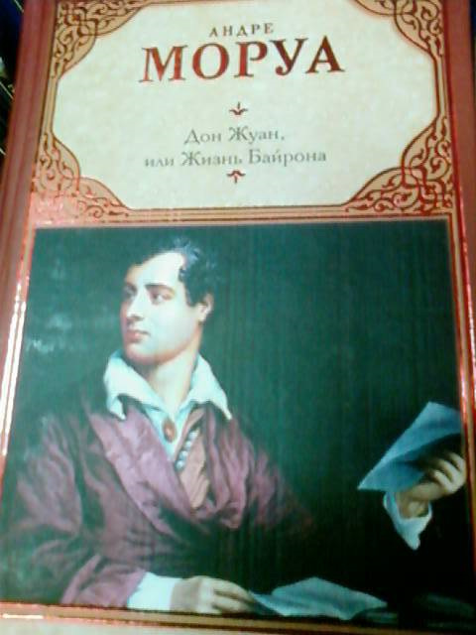
Byron was a very famous English poet and personality. A lot of writers devoted their books to his life. One of them is written by Andre Mourois”, a prominent French writer.

Slide 15
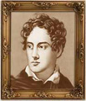
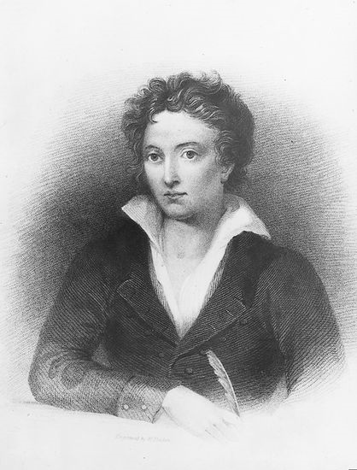
After the divorce Byron went to Switzerland. There he met Percy Shelley and the two poets became friends

Slide 16
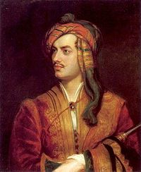
A photo was done in 1816 after the divorce with his wife.
In 1816 Byron’s marriage broke out and it brought a lot of gossips, it was a difficult period for a poet.

Slide 17
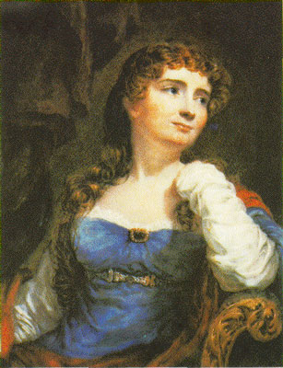
In 1815 Byron married Miss Isabella- a cold and pedantic woman

Slide 18
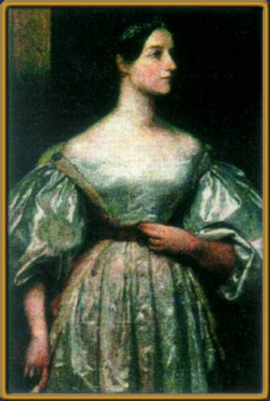
Byron’s Daughter
Ada-

Slide 19
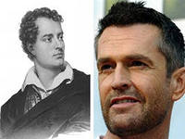
Rupert Everett – a famous English actor, who played the role of Byron

Slide 20
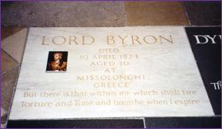
Byron’s grave in Westminster Abbey

