Slide 1
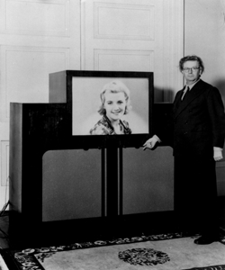
The Greatest inventors and invetentions John Logie Baird invented television
Done by Evteew Leonid
School №9
Stanitsa Baturinskaya
Form 6 «B»
Teacher Belikova M.P.

Slide 2
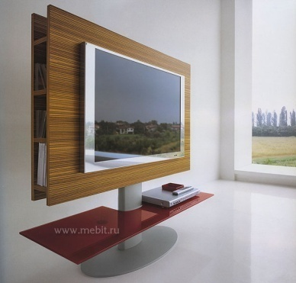
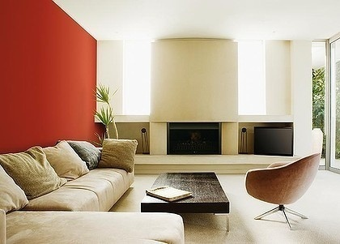
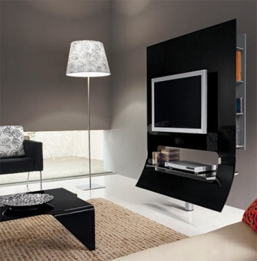
Introduction
Wonderful inventions have been made in science and technology recently. This advances are changing the lifestyle of millions of people all over the world. By the end of the 20th century lots of inventions have been appeared. Some of them have become so commonplace that it is difficult to imagine them things to make our life more comfortable. Almost every day a new technique or product appears in the world. But we always need something more useful, more effective, more comfortable.

Slide 3
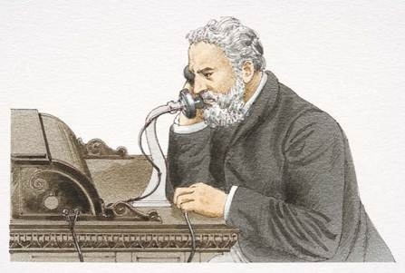
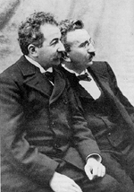
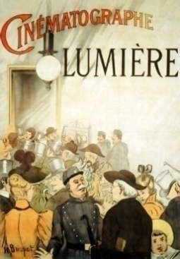
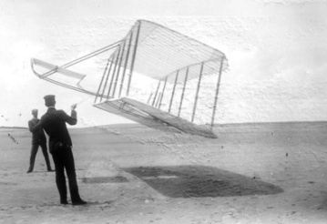
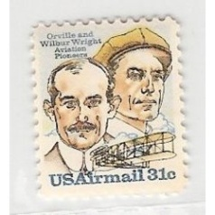
Inventions that shook the world
In1876 Alexander Graham Bell, an American engineer, invented telephone.
In 1895 the Lumiere brothers, Auguste and Louis, patented their cinematography and opened the world`s first cinema in Paris
In 1903 Wilbur and Orville Wright build the first airplane.

Slide 4
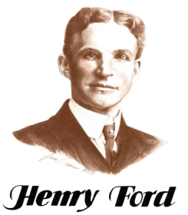
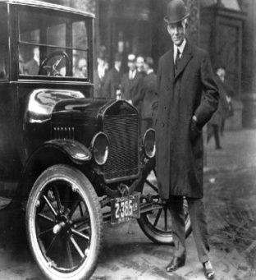
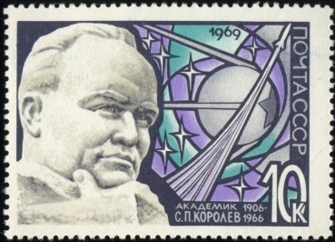
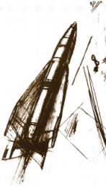
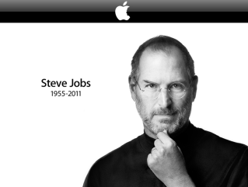
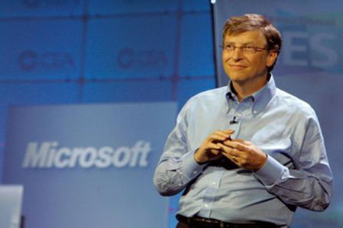
Inventions that shook the world
In 1908 US automobile manufacturer Henry Ford created the world`s first car assembly line.
In 1957 Sergei Korolyev from Russia designed the fist artificial satellite.
In 1981 Bill Gates from USA created Microsoft-DC ( Disk Operating System)

Slide 5
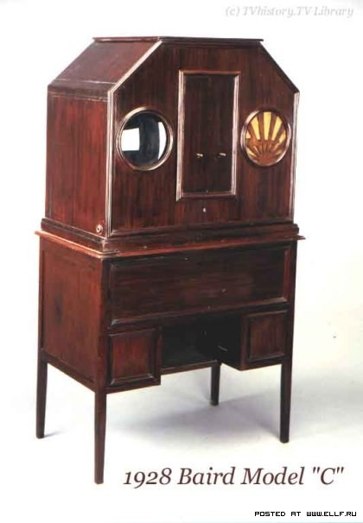
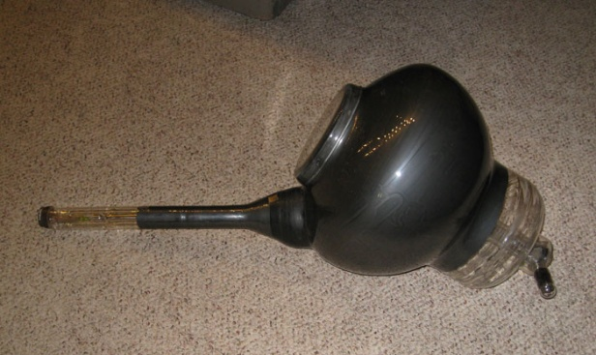
The History of Television
The invention that swept the world and changed leisure habits for countless millions was pioneered by Scottish-born electrical engineer John Logie Baird.
It had been realized for some time that light could be converted into electrical impulses, making it possible to transmit such impulses over a distance and then reconvert them into light.

Slide 6
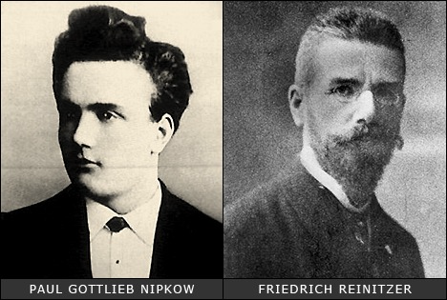
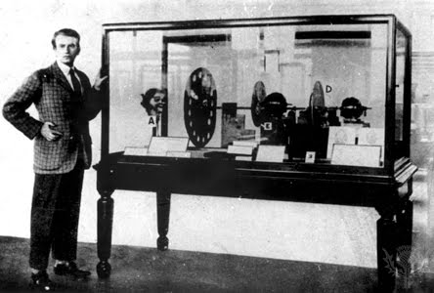
Timeline of TV History
Different experiments by various people, in the field of electricity and radio, led to the development of basic technologies and ideas that laid the foundation for the invention of television.

Slide 7
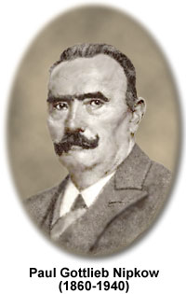
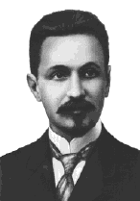
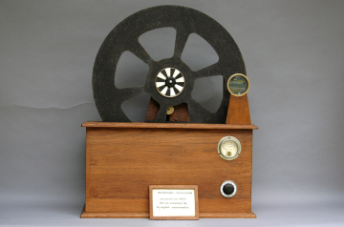
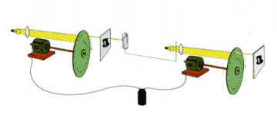
Timeline of TV History
From the experiments of Nipkow and Rosing, two types of television systems came into existence: mechanical television and electronic television.

Slide 8

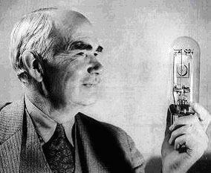
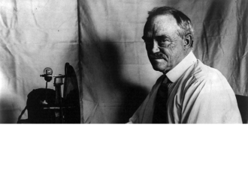
Timeline of TV History
The experiments of Swinton in 1907, with the cathode ray tube for electronic television held great potential but were not converted into reality. Finally, in 1927, Philo Taylor Farnsworth was able to invent a working model of electronic television that was based on Swinton’s ideas.

Slide 9
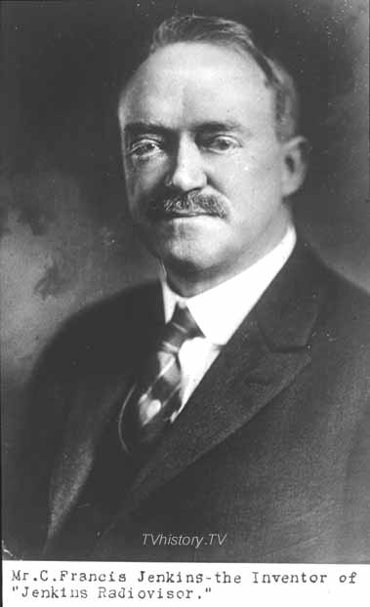
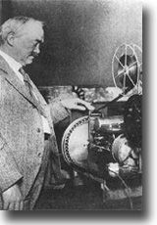
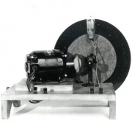
Mechanical Television History
In 1923, an American inventor called Charles Jenkins used the disk idea of Nipkow to invent the first ever practical mechanical television system. By 1931, his Radiovisor Model 100 was being sold in a complete kit as a mechanical television.

Slide 10
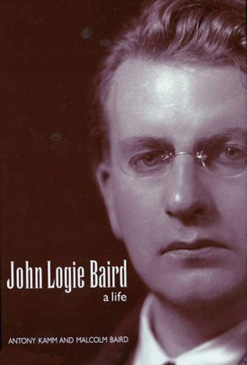
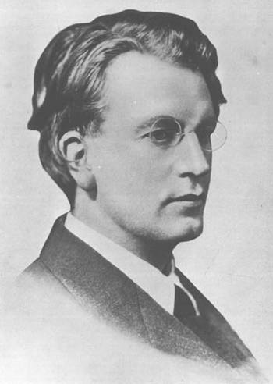
John Logie Baird
John Logie Baird was born in 1888. His father was a graduate in Arts and Divinity of Glasgow University and had moved to Hel­ensburgh, a little town on the Firth of Clyde, to become minister in a small parish church. The boy respected his father and adorned his mother.

Slide 11

JOHN LOGIE BAIRD
John Logie Baird pioneered early television with the mechanical scanning system he developed from 1923 to the late 1930s. He is remembered today as an inventor (178 patents) with considerable insight, who was in many ways ahead of his time. Among his pioneering ideas were early versions of color television, the video disc, large screen television, stereo television, televised sports, and pay television by closed circuit.

Slide 12
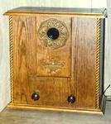
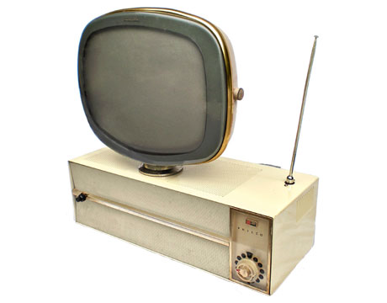
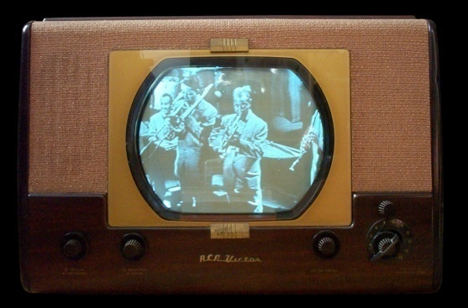
JOHN LOGIE BAIRD
John Logie Baird is remembered as the inventor of mechanical television, radar and fiber optics. Successfully tested in a laboratory in late 1925 and unveiled with much fanfare in London in early 1926, mechanical television technology was quickly usurped by electronic television, the basis of modern video technology.

Slide 13
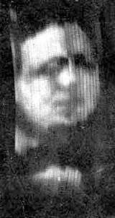
JOHN LOGIE BAIRD
Baird was the first inventor to use Nipkow's disc successfully, creating the first television pictures in his laboratory in October 1925.
By the end of 1940, Baird had designed a high definition colour television receiver and the following year he produced stereoscopic colour. His system of producing colour was by means of rotating colour filters. He was determined to achieve a fully electronic colour television receiver. And he did. On 16th August 1944, he demonstrated the television picture of his favourite tailor’s dummy.

Slide 14
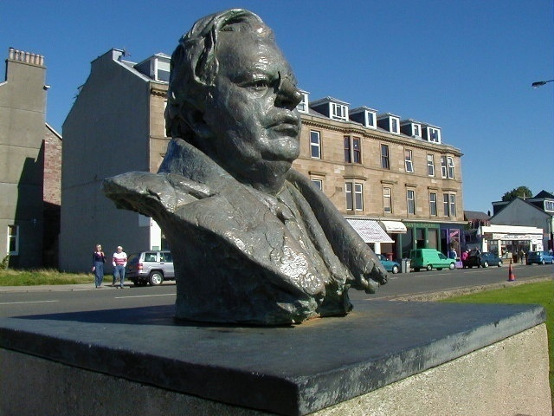
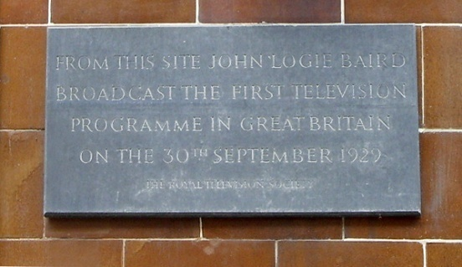
John Logie Baird
Baird died in his sleep on the 14th June 1946, before he could complete his work. There was not any place in Westminster Abbey for this genius, no lavish praise from the BBC, no honours from his country. He was buried in the little churchyard in Helensburgh, the place of his birth.

Slide 15
Conclusion
It goes without saying that television plays a very important part in people`s lives. It`s a wonderful source of information and one of best ways to spend free time and not to feel bored. Television viewing is by far the most popular leisure pastime. Television is a reflection of the modern world. It gives you an opportunity to travel all over the world, to see different countries and people, learn about their customs and traditions. Television keeps you informed about the rest of the world.

Slide 16
Conclusion
As for me I prefer watching different quizzes. That`s why my favourite TV programme is «Who wants to be a millionaire?» The programme is now hosted by Dmitry Dibrov. I think it is the perfect way to be in the known of everything. I find this programme clever and informative.
In short, television does have its good points. Many of the programme that broadcast are educational and can help with schoolwork.

Slide 17

Conclusion

