Slide 1
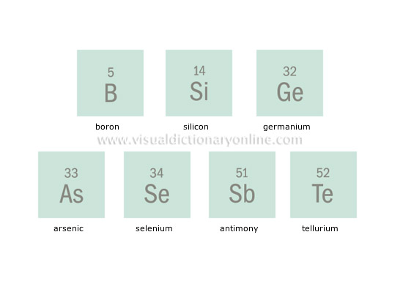
Metalloids

Slide 2
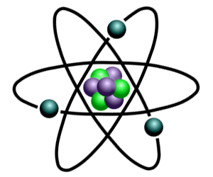
A metalloid is a chemical element that has properties that are n between
of metals or nonmetals and is consequently difficult to classify a metal or a nonmetal.

Slide 3
Metalloids tend to be economically important because of their unique conductivity properties (they only partially conduct electricity), which make them valuable in the semiconductor and computer chip industry. The metalloids are shown in the following illustration.

Slide 4
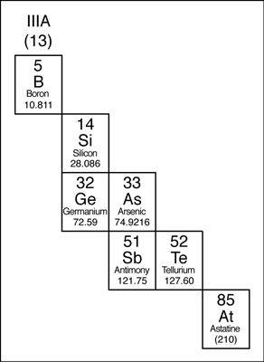
The Metalloids are:
Boron
Silicon
Germanium
Arsenic
Antimony
Tellurium
Astatine

Slide 5
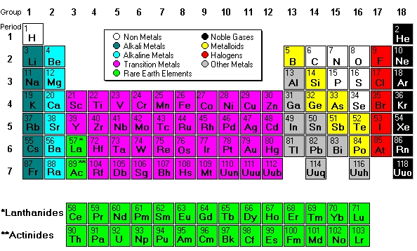

Slide 6
Properties of Metalloids
Physical Properties of Metalloids
State of Matter is Solid
Elasticity is Brittle
Luster is Metallic
Conductivity is Semi-conductive
Chemical Properties of Metalloids

Slide 7
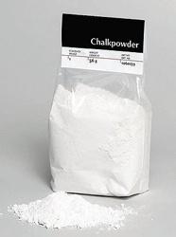
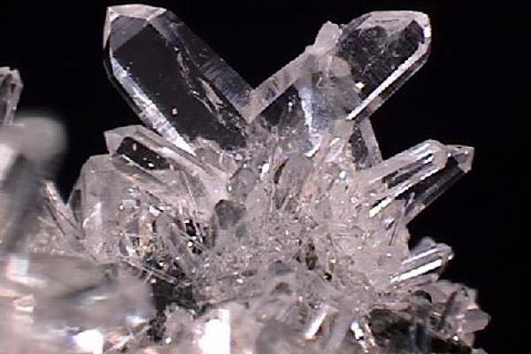
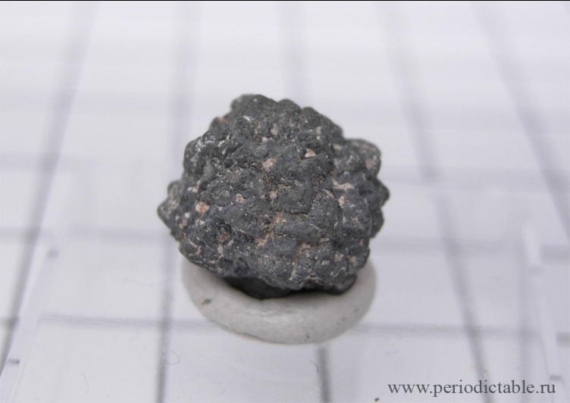
Use
Metalloids are used in various industries. They are used in industry and in many biological processes. For example, boron is used in the manufacture of the borosilicate glass. These derivatives are highly resistant to thermal shock. In the form of sodium tetraborate is used for insulation with fiberglass. Boric yarns used in aerospace structures as they are lightweight, but have a high strength. Boron carbide is used in creating bulletproof vests

Slide 8
Thank you for your attention!

