Slide 1

Nonmetals

Slide 2
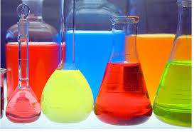
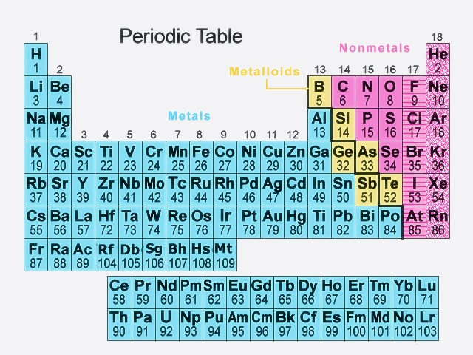
Nonmetals in Periodic Table

Slide 3

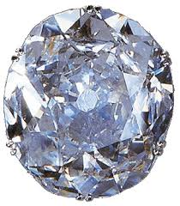
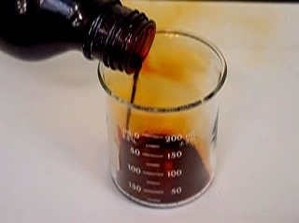
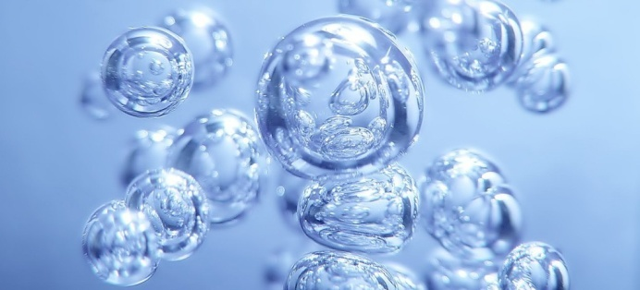
Examples of NONMETALS
Non metals may be solids, liquids or gases.
Examples:
Solids – Carbon, Sulfur, Phosphorus
Liquid – Bromine
Gases – Oxygen, Hydrogen, Nitrogen

Slide 4
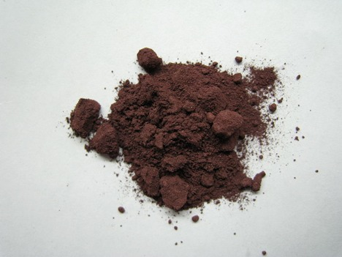
Physical Properties of NONMETALS
Nonmetals have a dull luster.
(They are not shiny!)
Example: Phosphorus

Slide 5

Physical Properties of NONMETALS
Nonmetals are insulators.
They do not conduct electricity or heatwell.
The atoms in nonmetals do not have loose electrons. Therefore, when electricity, or something hot touches a non-metal, the energy does not move quickly through the material.
What would you rather stir a hot pot with—a wooden spoon or a metal spoon?

Slide 6
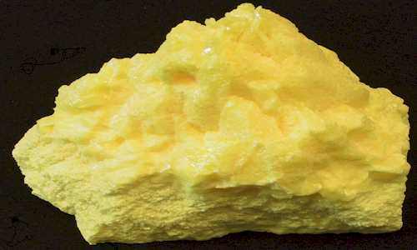
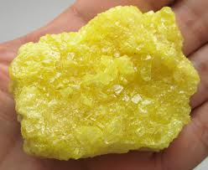
Physical Properties of NONMETALS
Nonmetals are soft (except for diamonds and brittle.
Example: Sulfur

Slide 7
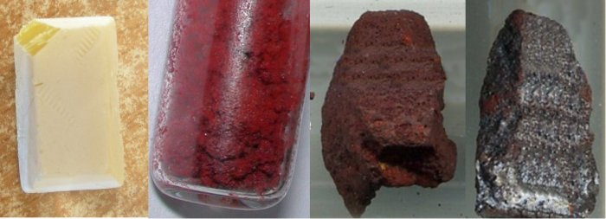
Physical Properties of NONMETALS
Some nonmetals maybe different in color.
Example:
Phosphorus

Slide 8
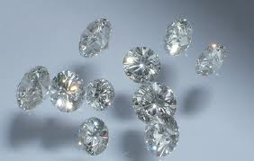
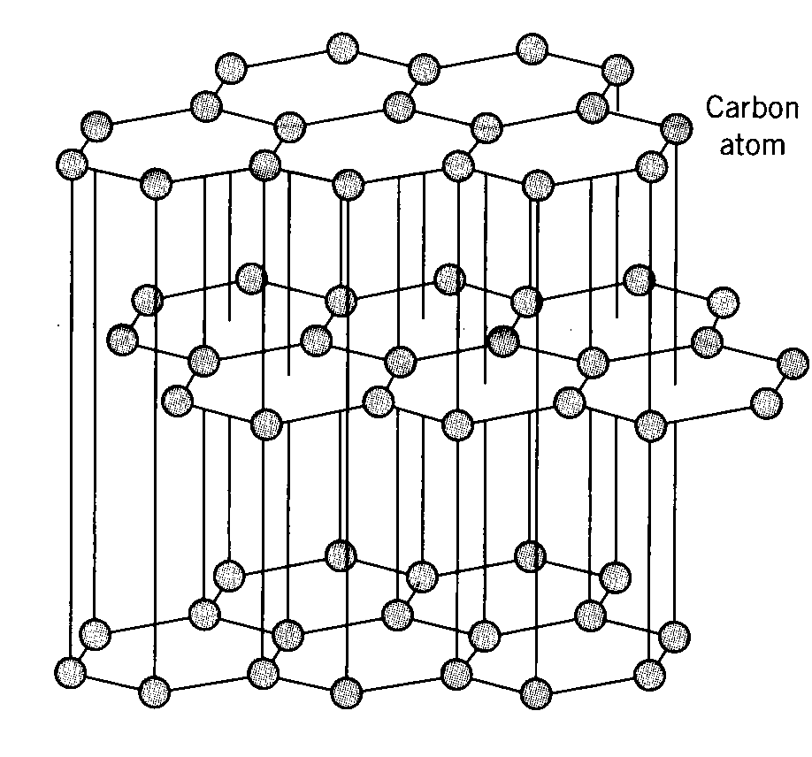
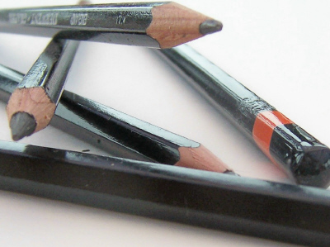
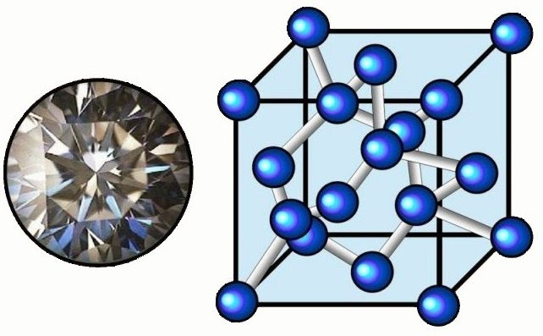
An interesting element: Carbon
Ever break the point of your pencil? That’s because it’s made of graphite, a substance made up completely of Carbon—a brittle nonmetal.
Carbon atoms in graphite
However diamonds, the hardest material of all, are made of the same element: Carbon. Look at how the carbon atoms are arranged in diamonds.
Notes:
You may also want to discuss how we are using carbon to create new materials such as nanotubes, or discuss buckeyballs.

Slide 9
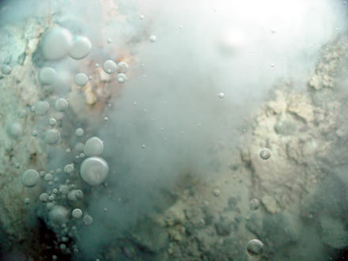
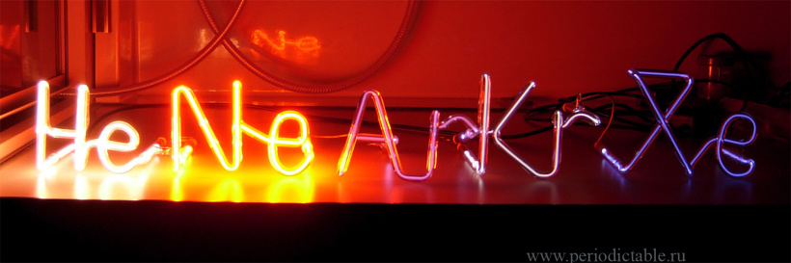
To nonmetals include inert (noble)gases
Each molecule of the inert (noble) gas consists of one atom

Slide 10
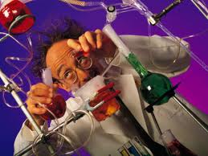
Thank you for
your attention!

