Slide 1
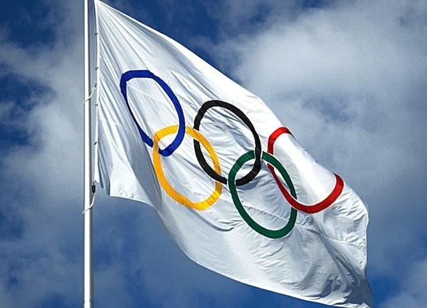
The Olympic Games

Slide 2
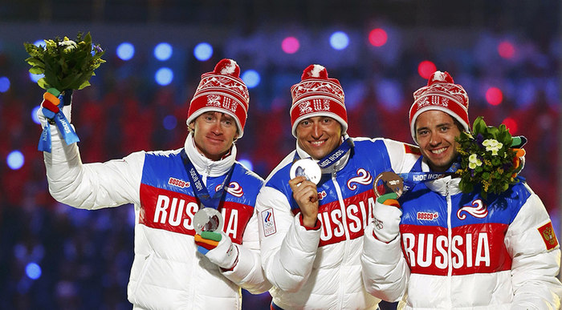
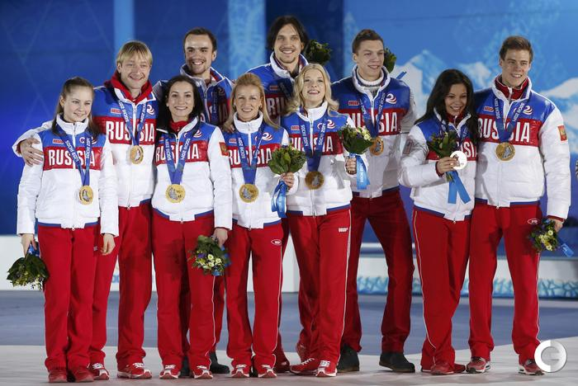
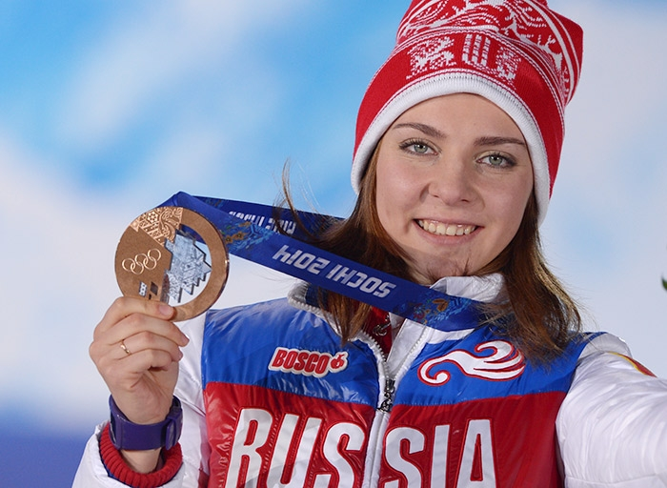
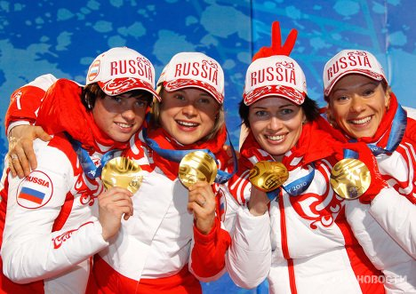

Slide 3
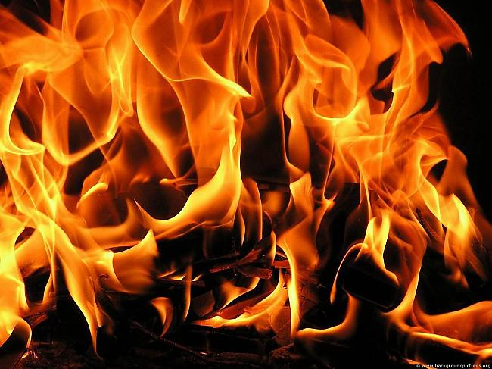
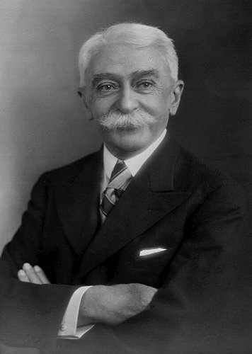
Baron Pierre de Coubertin
Athens
1896

Slide 4
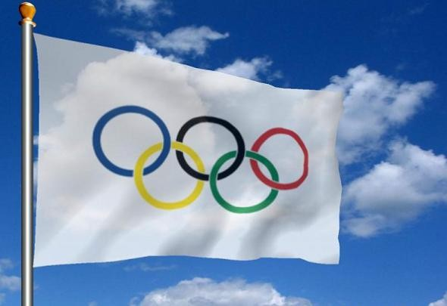
Symbols of the Olympic Games

Slide 5
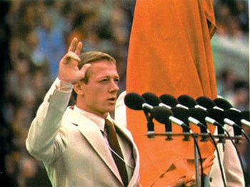
Symbols of the Olympic Games
«Citius, Artius, Fortius»
«Faster, Stronger, Higher»

Slide 6
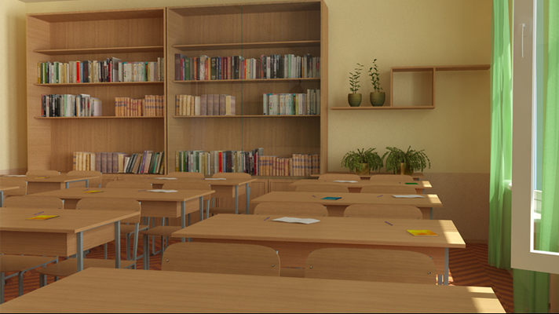

Slide 7
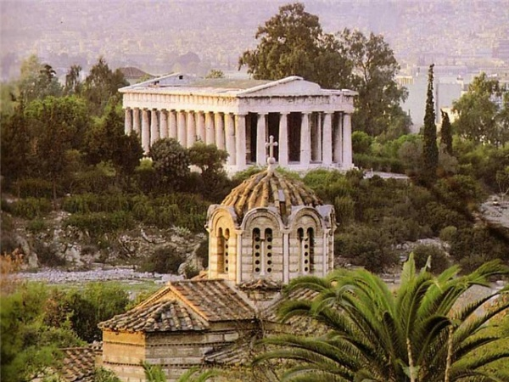


Slide 9
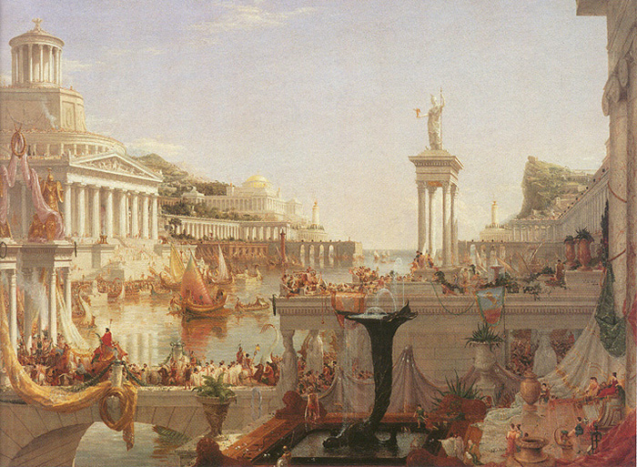

Slide 11
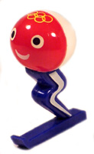
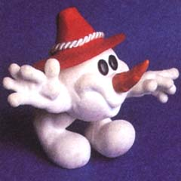
Mascots of the Olympic Games

Slide 12
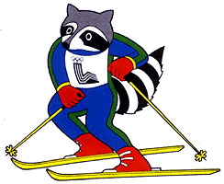
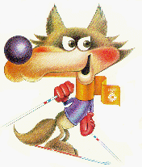
Mascots of the Olympic Games

Slide 13
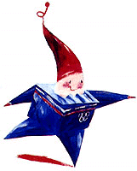
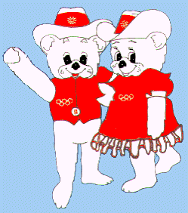
Mascots of the Olympic Games

Slide 14
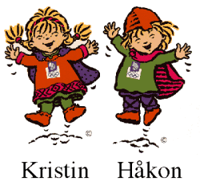
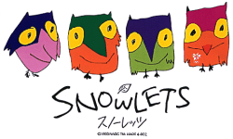
Mascots of the Olympic Games

Slide 15
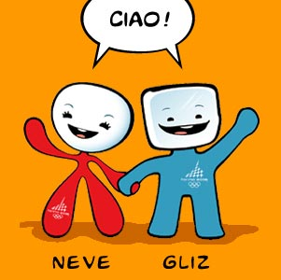
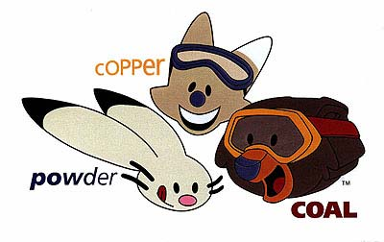
Mascots of the Olympic Games

Slide 16
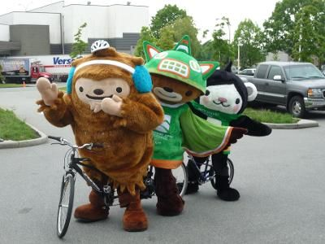
Mascots of the Olympic Games

Slide 17
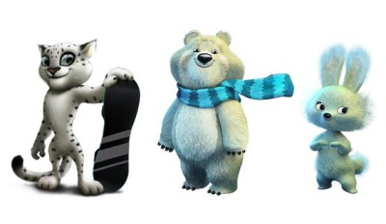
Mascots of Sochi

Slide 18
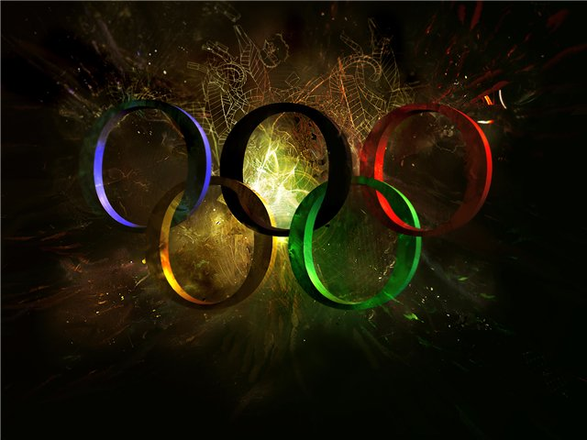
Quizzing Game

Slide 19
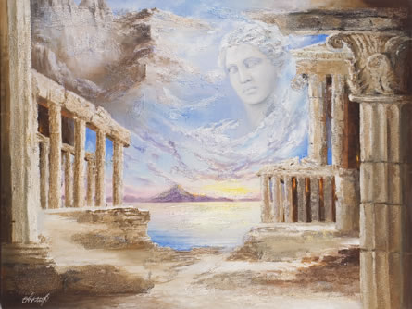
When was the first Olympics held?
A. 776 BC
B. 340 BC
C. 290 AD
D. 1912 AD

Slide 20
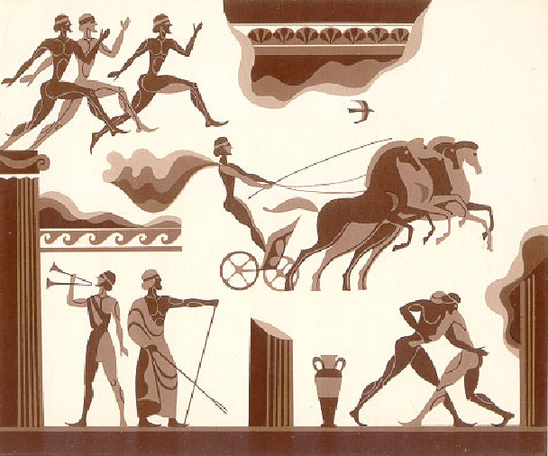
How often was the original Olympics held?

Slide 21
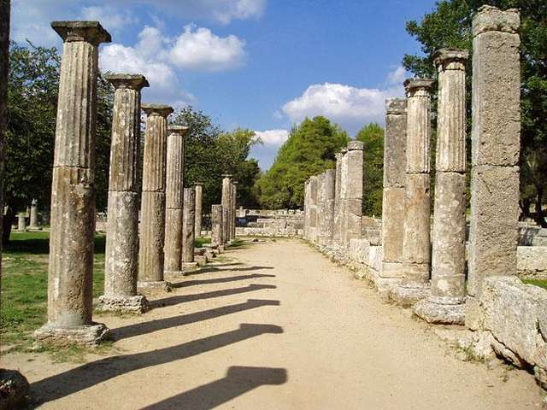
How long did the Olympic games last in Ancient Greece?

Slide 22
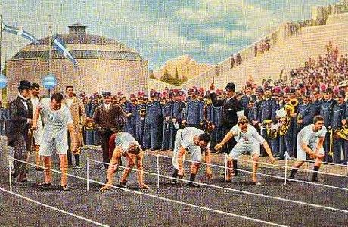
When and where were the first modern Olympic Games held?

Slide 23
Where was the first mascot of Olympic games created?

Slide 24
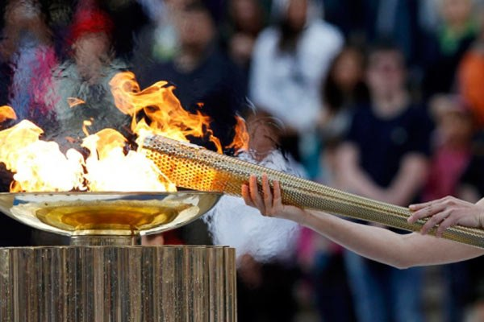
Where is the Olympic Fire set before the beginning of the Olympic Games?

Slide 25
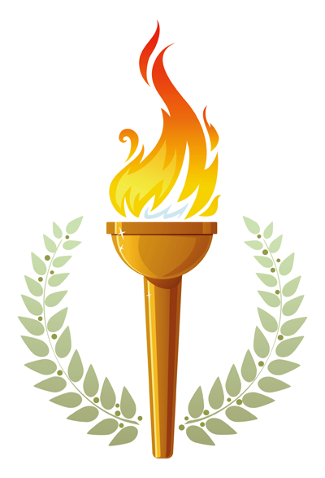
Where was the first fire of modern Olympic games set?

Slide 26
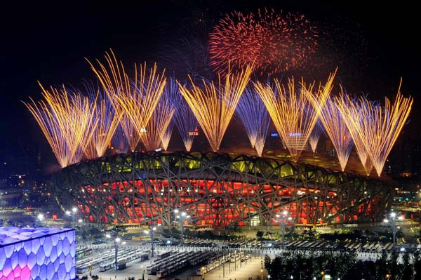
Where were the 2008 Summer Olympics held?

Slide 27
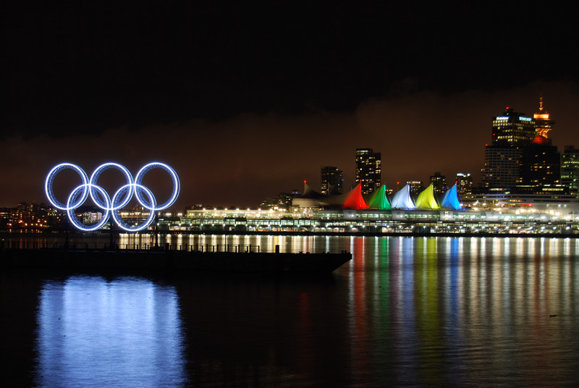
Where were the 2010 Winter Olympics held?

Slide 28
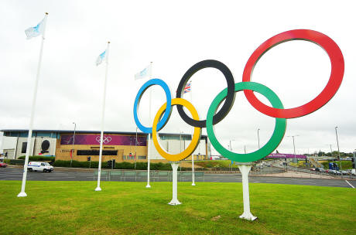
Which country has hosted the Winter Olympics the most times?

Slide 29
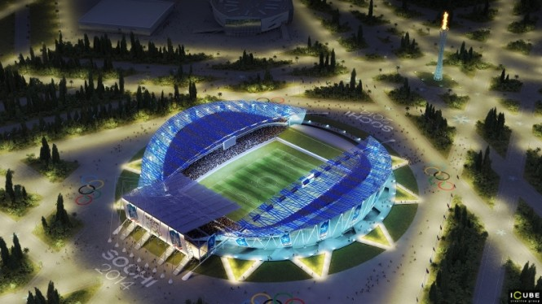
How many medals did the Russian team win in Sochi 2014?

Slide 31
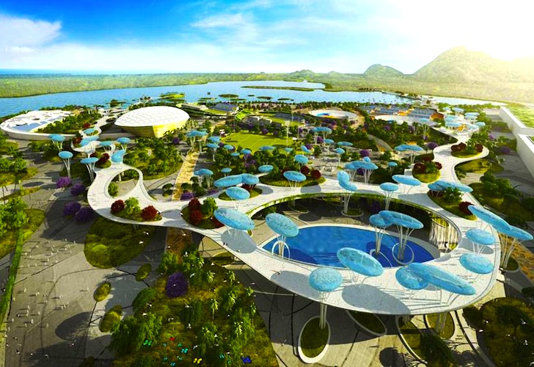
Where will the 2016 Summer Olympics be held?

Slide 32
ANSWERS TO THE QUIZ
1 - A, 2- 4 years, 3 – 5 days,
4 – 1896 Athens, 5 – France 1968,
6 – Athens, Greece, 7- Germany,
8 – China, 9- Canada,
10 – 9 times in the USA,
11- 33 medals, 12 - Brazil

