Slide 1
My collection

Slide 2
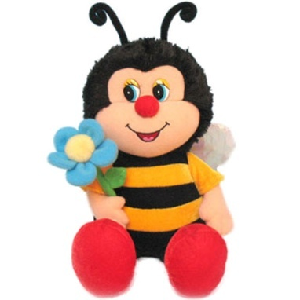
We must
Listen, read, translate new words
Numbers
Dialogues
Read a story about Kate’s collection
Write a short paragraph about your collection

Slide 3
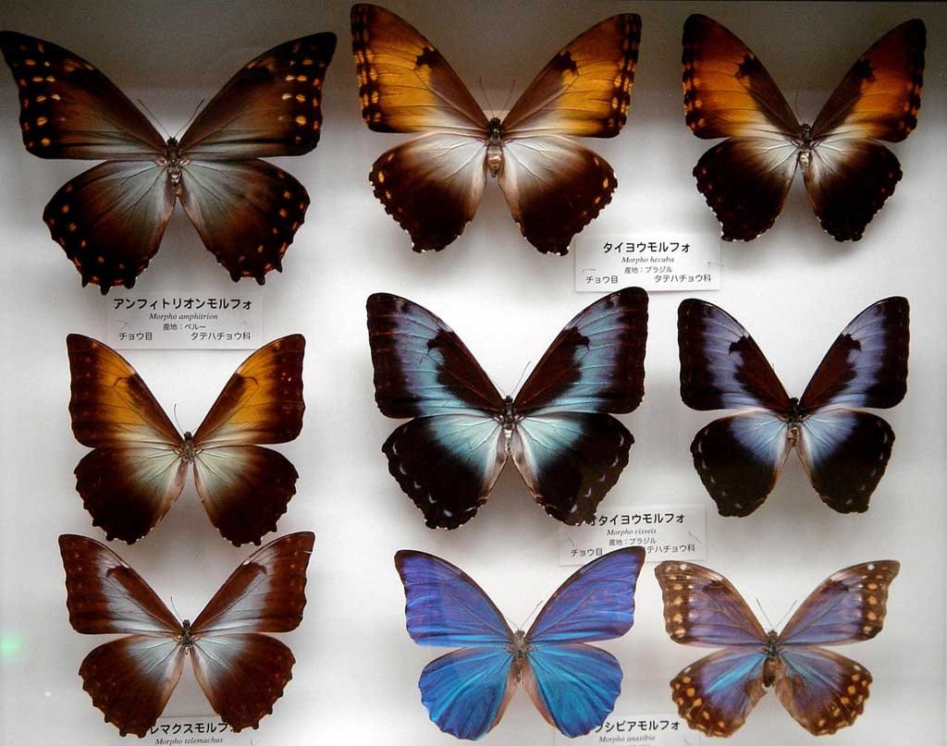
collection

Slide 4
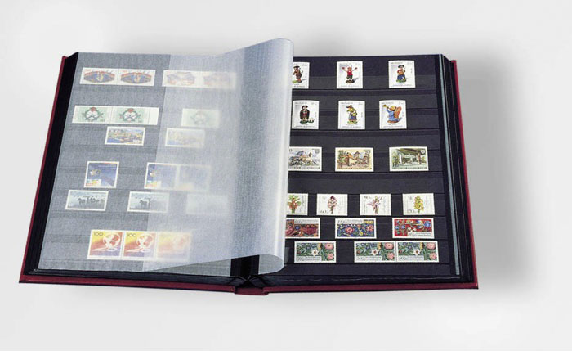
album

Slide 5
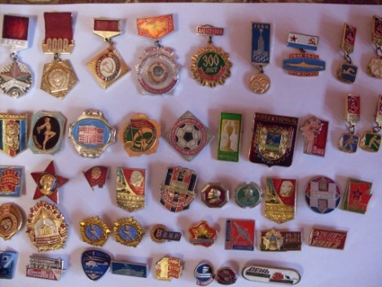
badges

Slide 6

books

Slide 7
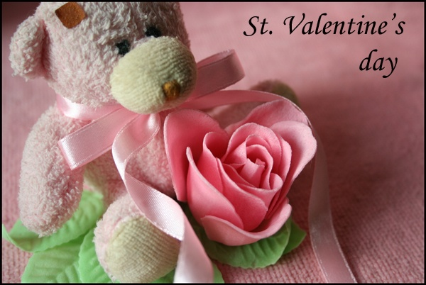
card

Slide 8
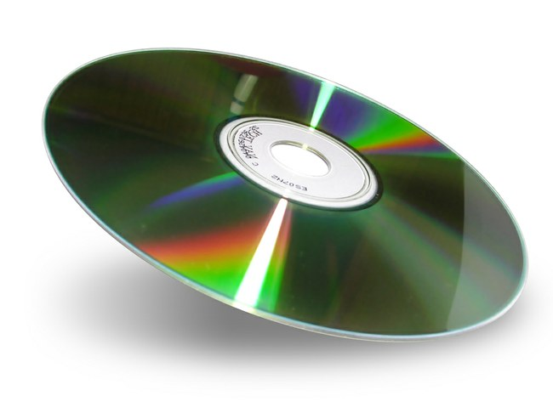
CD

Slide 9
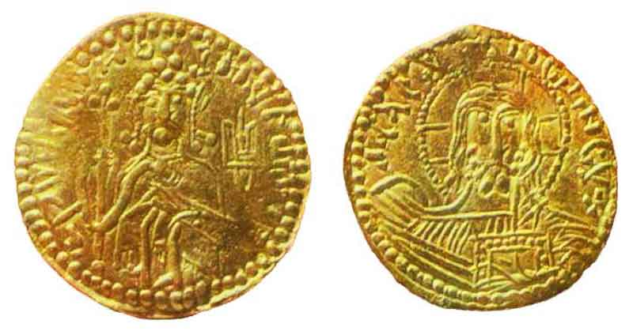
coins

Slide 10
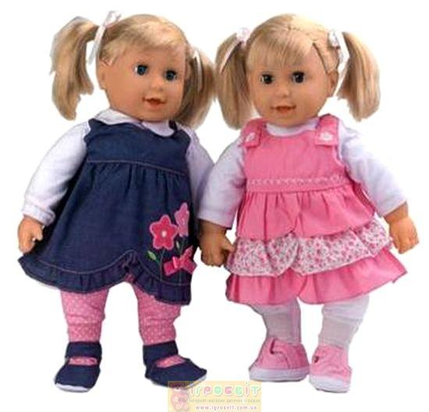
dolls

Slide 11
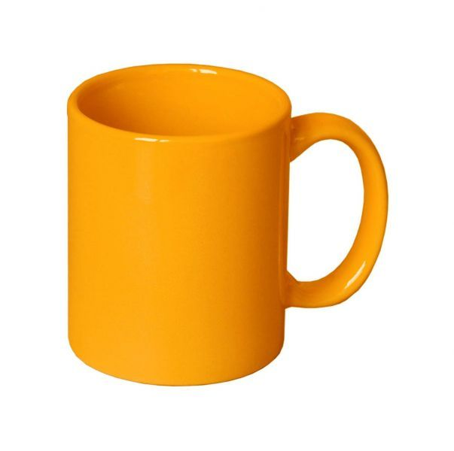
mug

Slide 12
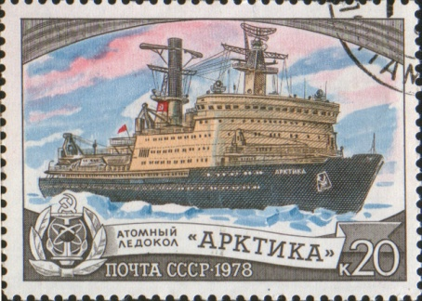
stamp

Slide 13
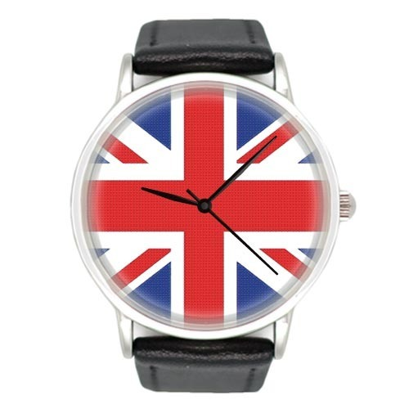
souvenir

Slide 14

stuffed toy

Slide 15
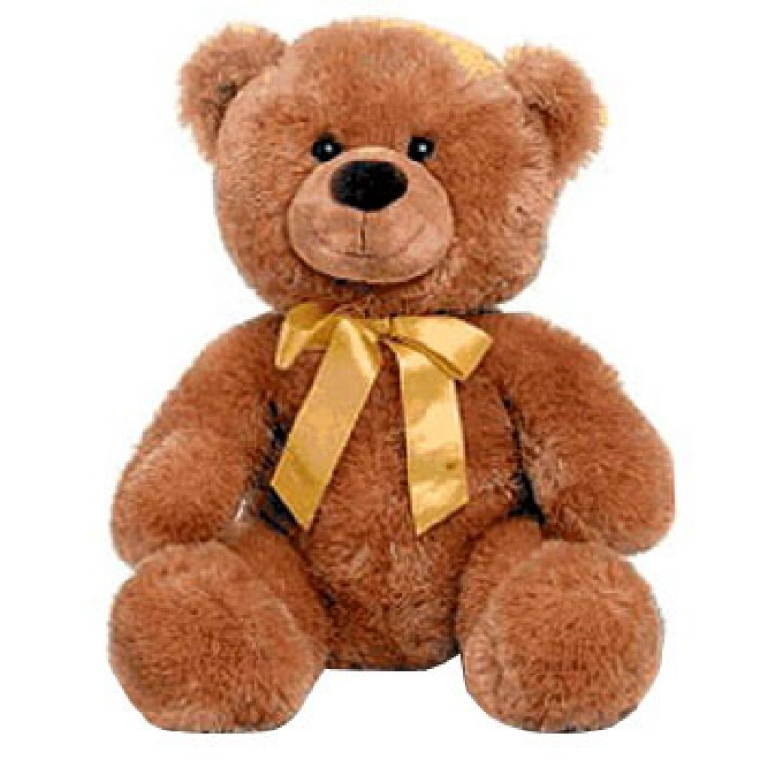
teddy bear

Slide 16
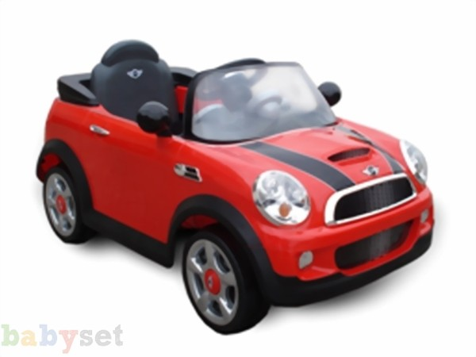
toy car

Slide 17



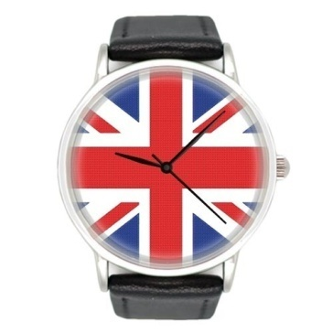
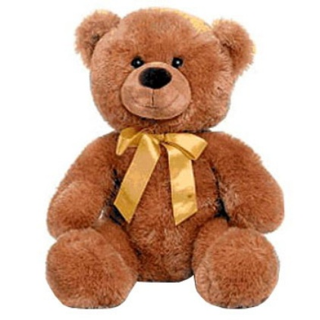


dolls
СD
stamp
badges
books
coins
mug
stuffed toy
souvenir
car
teddy bear
card

Slide 18



Match: 1. How many are there in your collection? 2. How many have you got? 3. How many has it got?
a) There are 17 stuffed toys in my collection.
b) I’ve got 30 CDs.
c) My album has got 23 stamps in it.
I. Thirty
II. Twenty-three
III. Seventeen

Slide 19
Numbers : 1. 21, 35, 57…. twenty + one = twenty-one
2. 13 - 19
SEVEN + TEEN =
SEVENTEEN
3. 20 – 100
SEVEN + TY = SEVENTY

Slide 20

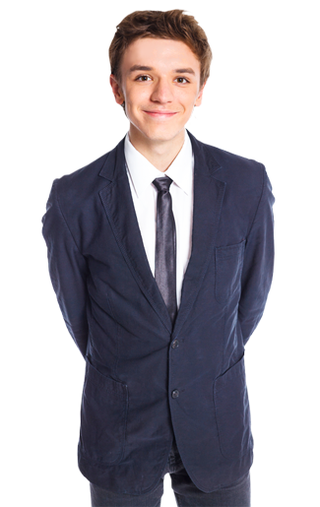

dialogues, ask and answer:
A: How old is she (he) ….?
B: She (he)’s ……
A: Where is she (he) from?
B: She (he)’s from ….
Anna (30) France.
Robert (15) England.
Chen (7) America.

Slide 21

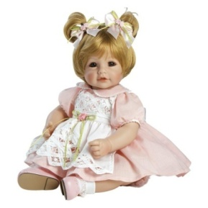
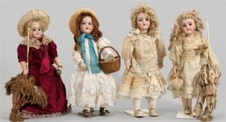




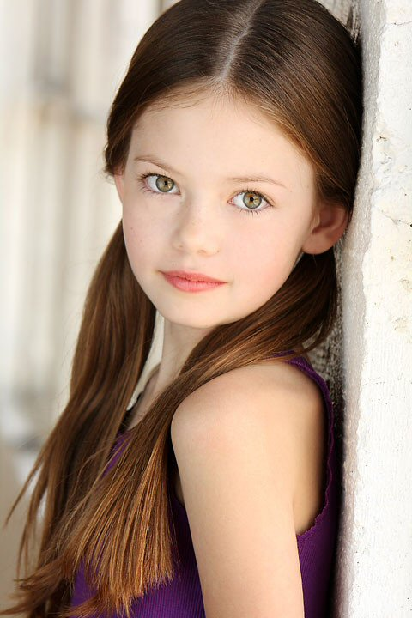

I like dolls!
Hi, my name’s Kate. I’m 11 years old and I’m from 1)
I’ve got a great 2) collection!
My 3) has got 46 dolls in it. My dolls are from
4) , 5) , 6) , 7) .
I like 8) because they are so nice!
Collecting dolls is easy and fun.
I’m proud of my collection.
It makes me happy!

Slide 22
my collection…. Write and tell:
1.Your name
My name is...
2.Your age
I’m……
3. Where are you from
I’m from…..
4. What your collection is
I’ve got …..; My album has got….;
My coins are from…..
5. How you feel about it
I’m proud of….; It makes me happy.

Slide 23
Thank you!

