Slide 1
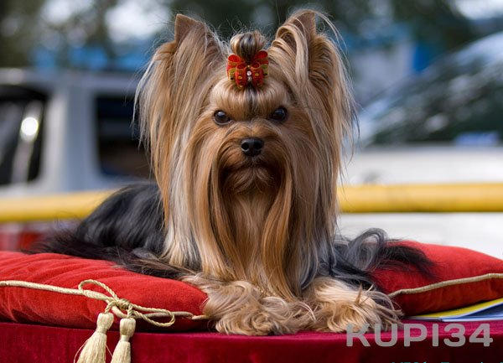
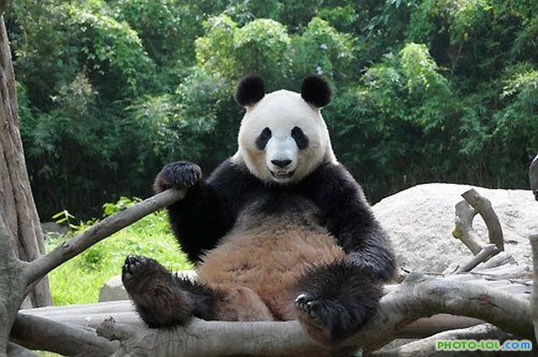
OUR FURRY FRIENDS
Учитель: Михайлова Е.В., МБОУ гимназия г. Советский, 2014 год.
№ 287-958-268
Учебник: «Английский в фокусе» для 4 класса, авторы: Быкова Н., Дж. Дули и др.,
модуль 4.

Slide 2
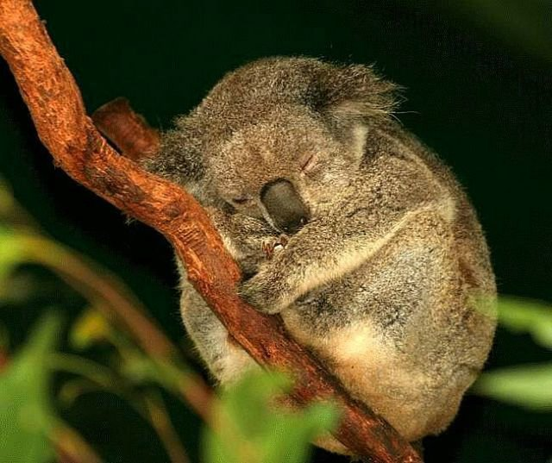
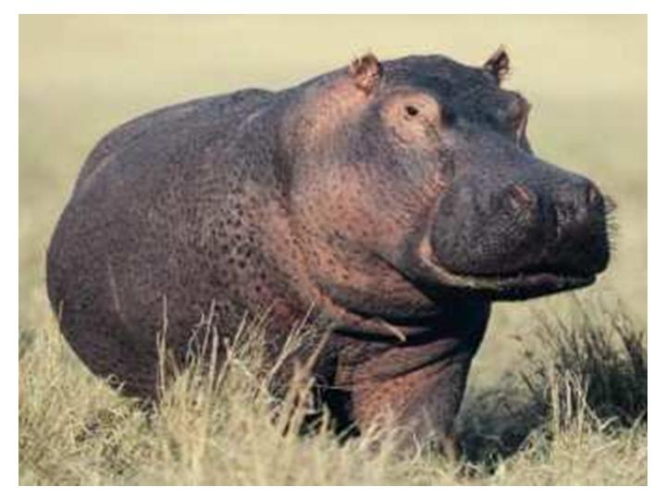
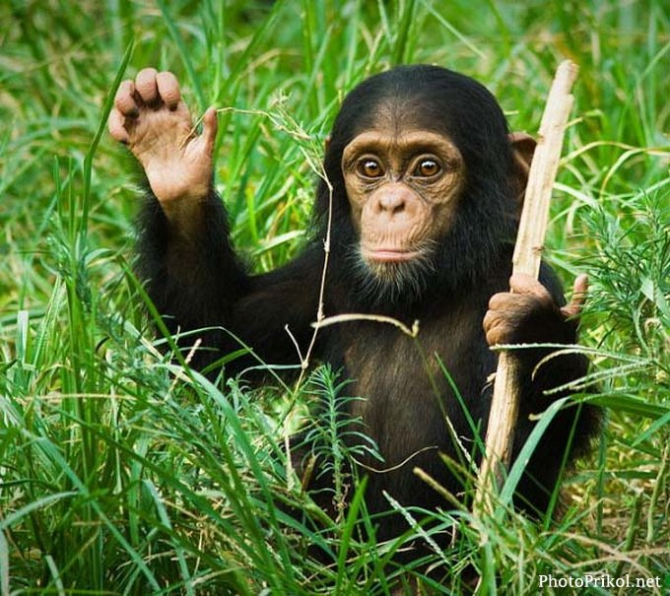
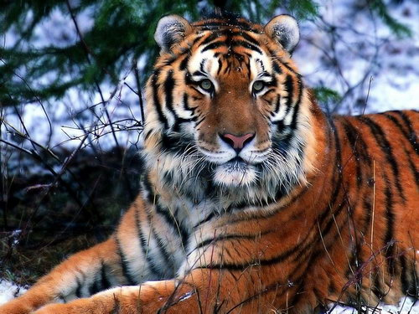
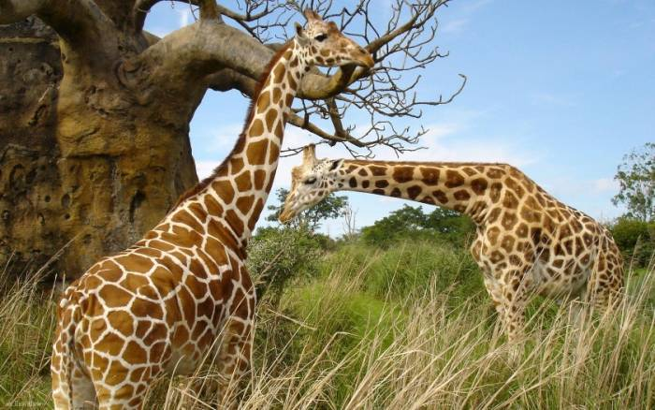
WELCOME TO THE ZOO!
1

Slide 3
[ b ] -bear, bird
[ k ] –
[ l ] -
[ ʤ ] –
[ h ] -
[ d ] -
[ t ] –
[ w ] -
cat, kangaroo, crocodile
lion, lizard
giraffe
hippo, horse
dog, dolphin
tortoise, elephant, tiger
whale
2

Slide 4
1. WARMING - UP
1. What animal has got a long nose?
2. What animal has got a big mouth?
3. What animal has got a fat body?
4. What animal has got a long neck?
5. What animal has got big ears?
6. What animal has got a long body?
3

Slide 5
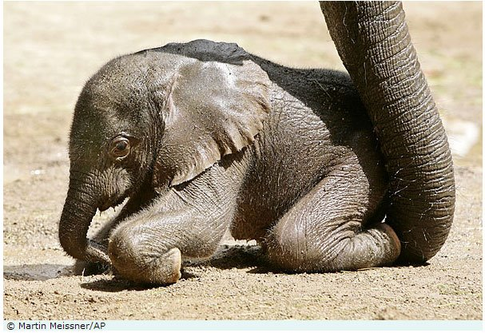
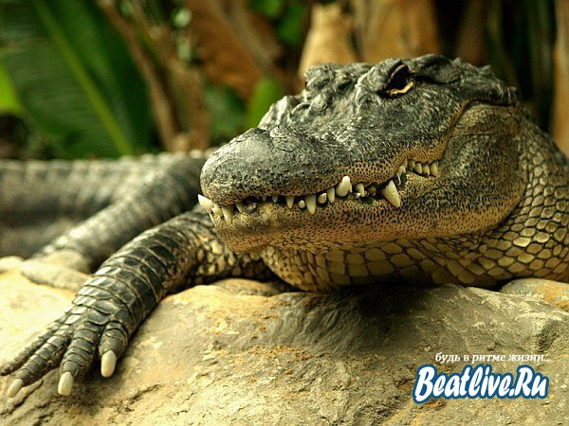
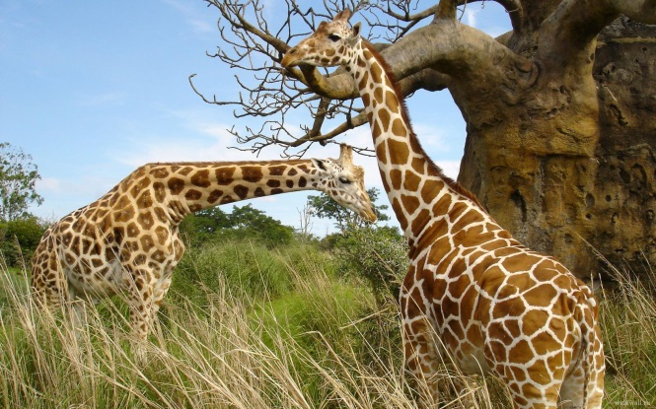
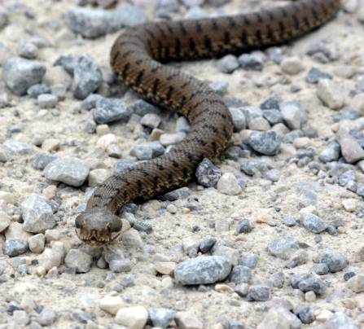
1
3
4
2
5
4

Slide 6
2. A MAGIC SQUARE
* | A | B | W | H | A | L | E | * | D
Q | W | E | R | T | Y | U | I | O | P
A | G | S | D | F | T | I | G | E | R
G | I | M | S | E | A | L | H | L | J
C | R | O | C | O | D | I | L | E | X
K | A | N | * | L | Z | Z | * | P | H
C | F | K | V | B | N | A | M | H | I
* | F | E | Q | W | E | R | R | A | P
T | E | Y | Y | U | I | D | O | N | P
P | D | O | L | P | H | I | N | T | O
5

Slide 7
A MAGIC SQUARE
Whale Seal
Giraffe Monkey
Elephant Hippo
Dolphin Tiger
Crocodile Lizard
6

Slide 8
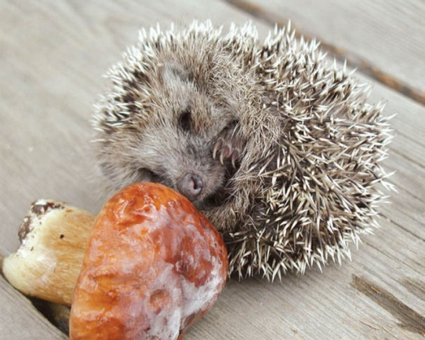
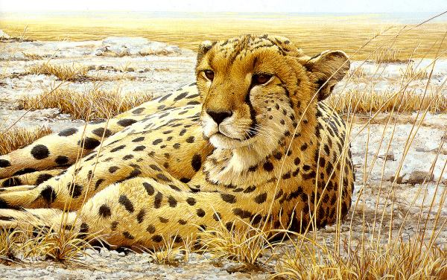
3.
Herbivores eat only plants.
Carnivores eat meat from animals.
Omnivores eat meat and plants – usually fruits and vegetables.
7

Slide 9
Herbivores | Carnivores | Omnivores
8

Slide 10
Herbivores | Carnivores | Omnivores
Giraffe | Seal | Lizard
Monkey | Dolphin
Elephant | Whale
Hippo | Crocodile
 | Tiger
9

Slide 11

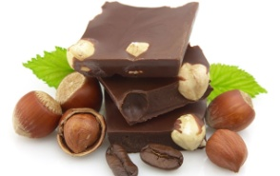
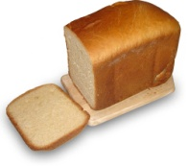
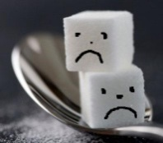
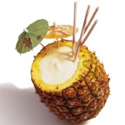
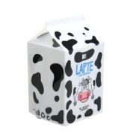
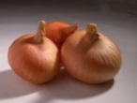
Mango, banana, cheese, meat, carrot, chocolate, fish, chicken, sugar, apple, grass, onion.
Herbivores | Carnivores | Extra
10

Slide 12
Herbivores | Carnivores | Extra
Mango | meat | cheese
banana | fish | chocolate
carrot | chicken | sugar
apple |  | onion
grass
11

Slide 13



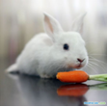
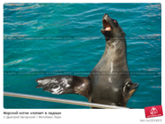

5.
B)
A)
1. clap at lunchtime 2. have lunch 3. have a bath 4. play with a ball 5. catch a fish 6. climb trees
D)
F)
E)
C)
12

Slide 14
6.
1. Who is the cleverest animal at the zoo?
a) dolphin b) monkey c) penguin
2. Who is the biggest animal at the zoo?
a) giraffe b) elephant c) hippo
3. Who is the tallest animal at the zoo?
a) crocodile b) giraffe c) kangaroo
4. Who is the fattest animal at the zoo?
a) seal b) monkey c) hippo
5. Who is the funniest animal at the zoo?
a) monkey b) dolphin c) lizard
13

Slide 15
8. must/ mustn’t
Example: You mustn’t run in the zoo.
1. Feed the animals.
2. Play loud music.
3. Ride a bike.
4. Leave your pets at home.
5. Put your rubbish in the bin.
6. Cry and make a noise.
14

Slide 16
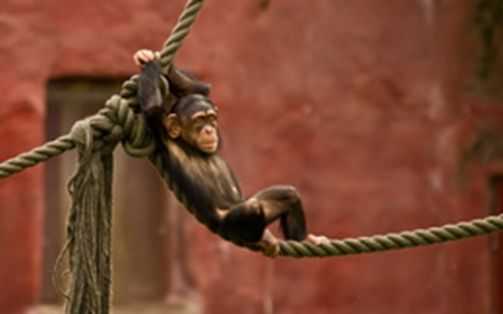
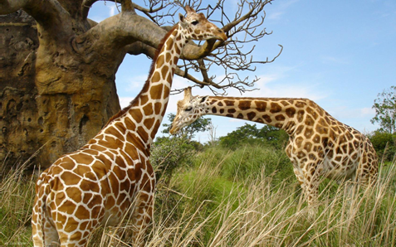
9. RIDDLES
15

Slide 17
10. Make riddles yourselves
1. Укажите цвет. I am …
2. Укажите размер. I am …
3. Напишите про части тела. I have got …
4. Напишите, что умеет делать. I can …
5. Напишите, что не умеет делать. I can’t …
16

Slide 18
11. Sing the song
When I’m at the zoo, what do I see?
Lots of funny animals looking at me.
I see a tall giraffe, eating from a tree.
I see a silly monkey, laughing at me.
I see a clever dolphin, swimming in the sea.
I see a little seal, clapping one, two, three.
I see a lazy lizard, sitting in the sun.
I see a big whale, having lots of fun.
I see a baby hippo, learning how to run.
And one crocodile, crying on its own!
17

Slide 19

You are really very clever and talented!
I hope you’ll improve your English knowledge.
Thank you!
18

