Slide 1
The Boyscouts
BSA
Составил: ученик 9 «А» класса
школы №1206
Вальков Даниил

Slide 2
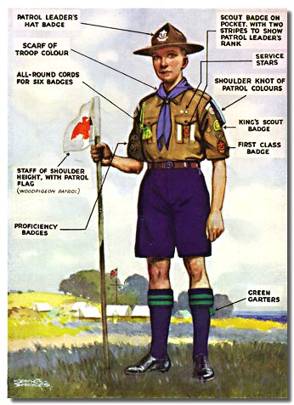
History
Scouting was founded in 1907 in England, Colonel Baden-Powell, who organized the first scout camp on Brownsea Island Lake (Brownsea) and wrote the book "Scouting for Boys".
Colonel was convinced that young Englishmen need more rigorous hardening, physical fitness and life skills.
Originating in England , it spread to many bourgeois countries , and by 1921 his group and the cell operated in 63 countries , spanning the end of the 30 -ies. about 4 million children and adolescents ( USA - 2 million in Britain - 600 thousand in France - about 500 thousand ).

Slide 3
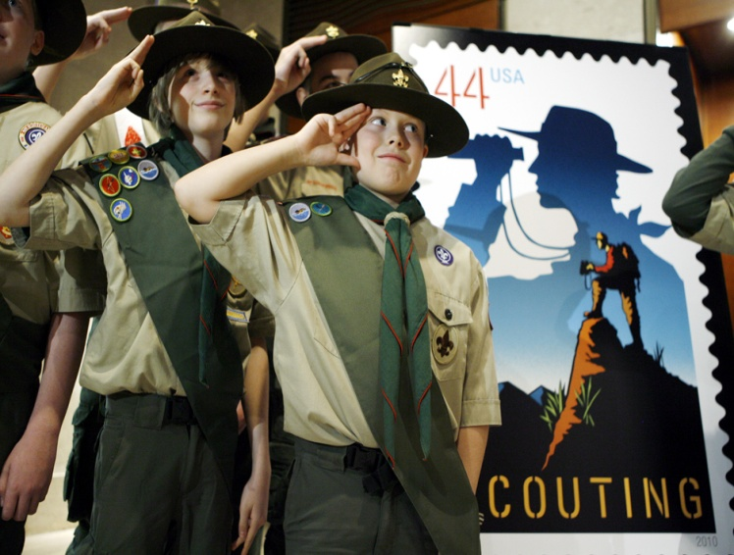
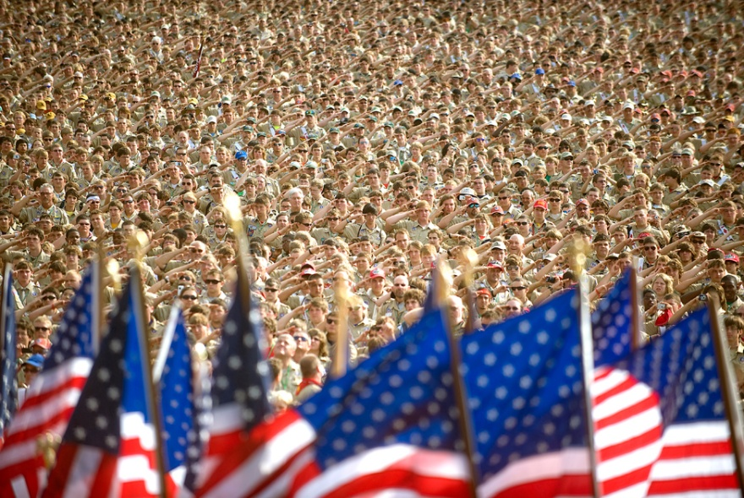
BSA
BSA was founded in Chicago February 8, 1910 by William Boyce. Today, American Scouts celebrated annually on this day Birthday their organization.
Since then, more than 111 million people have passed this training program.
International and long distance scout gatherings held every 3-4 years, and are called "Jamboree"

Slide 4
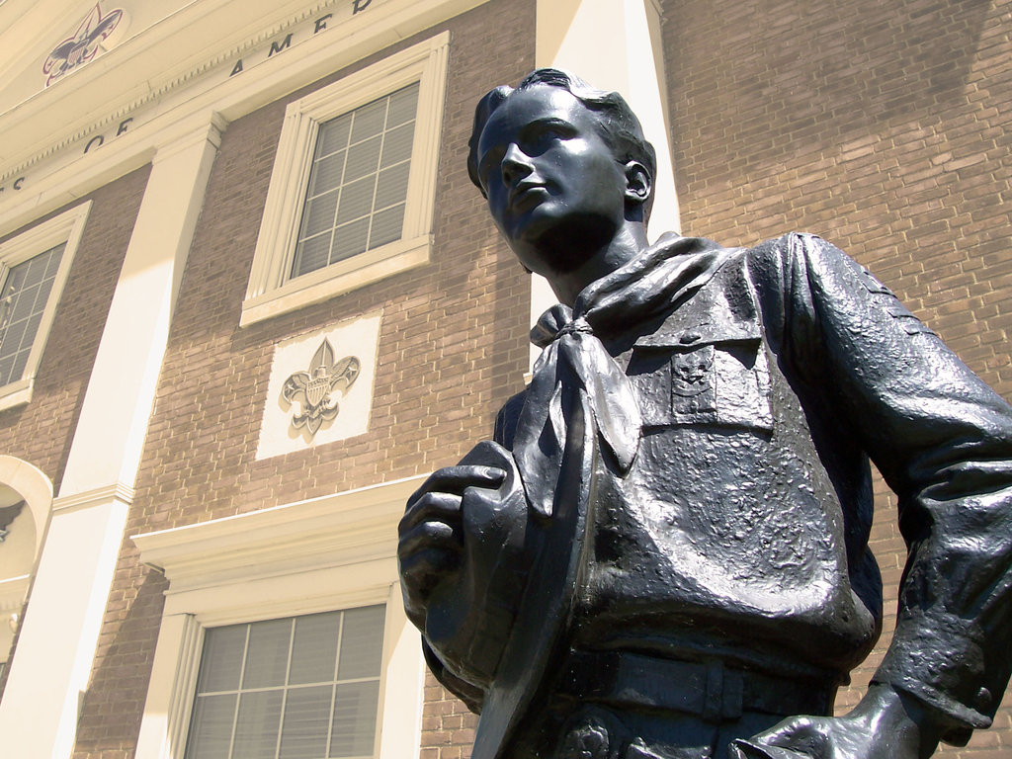
In 1916, the organization was recognized by the American scouts nationwide.
Together with the official recognition, scouts got its own constitution, which enshrines the goals and objectives of the movement, as well as giving its members the right to wear a special kind of uniform.
Today in Scouting around the world participate to 40 million people.
Home Cleveland Statue Scouts of America
"The Ideal Boy Scout"

Slide 5

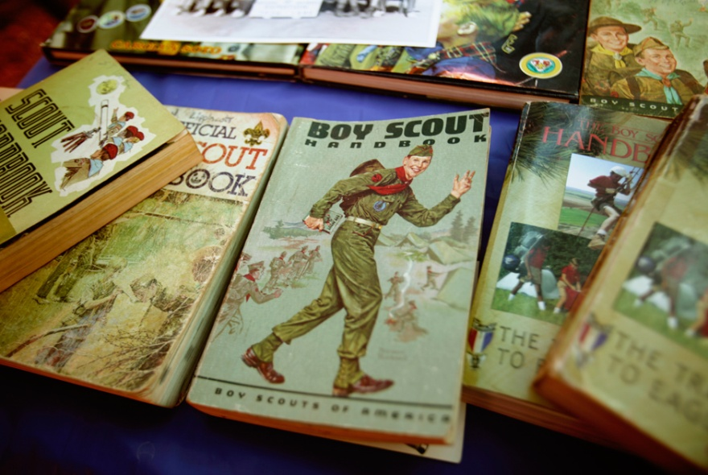
In the Boy Scouts can join American children aged six years and remain there until eighteen or twenty-one years.
BSA program built on a system of "patrol" group of boys not more than 8 (eight were considered "natural number", based on Darwin's theory) aged 11 to 17 years with "old age". Movement is divided into three age groups. Targets in each group according to age put the interests of the Boy Scouts. Boys between the ages of eight to ten years constitute a group Cub Scouts ("Kids"), from eleven to thirteen - Boy Scouts, and in fourteen or older scouts go to the group Explorers.

Slide 6
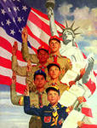
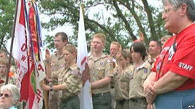
Scout motto – «Be prepared!»
The origin of this phrase is associated with the patriotic nature of the Scout Movement . Baden-Powell wrote in the February 12, 1908 article in the journal " Boyskauting ": " Be prepared to die for their country , if required ; so that when the time comes , get out of the house with confidence and without hesitation that will kill you or not. "

Slide 7
Scout promise
Scout promise: " Honestly I promise that I will do my duty to God and the homeland , and to help others to live by the laws of intelligence «
Basis promises - 3 principles on which the entire scouting:
• Duty to God
• Duty to the Motherland and the surrounding
• Duty to Himself

Slide 8
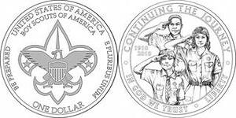
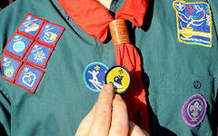
Symbols and traditions
Scout emblem - lily (trefoil). Three late lilies are three elements Scout oath: duty to themselves, before neighbors, before God.

Slide 9
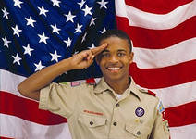
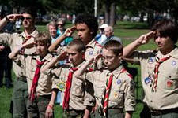
Scout salute
Scout salute is given in full uniform and on special occasions, such as lifting and lowering of the national flag, and when pronouncing Scout oath.

Slide 10
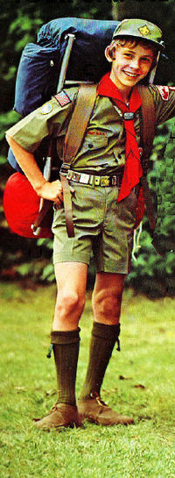
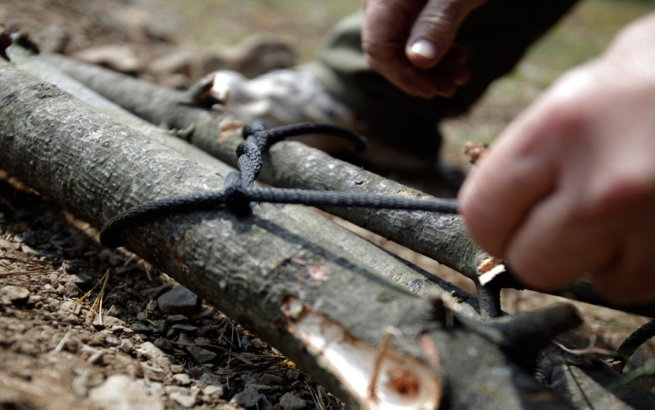
Much attention is paid to the training of the Boy Scouts outings . This can be hiking, parking in the camp, fishing, rock climbing , horseback riding and much more. At the same time , children are taught skills such as lighting fires , orienteering with a map and compass , food production , its preparation , first aid and more.
Scout connects branches special nodes

Slide 11
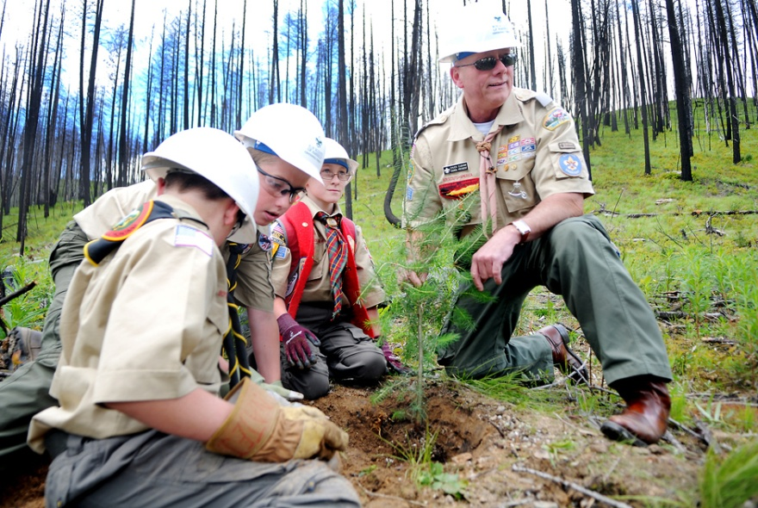

Scouts are taught a wide range of life skills, including first aid, camping, civil rights and obligations. Education system by scouts passes in the gaming entertainment, exercise and competition, talks about the life and exploits of military intelligence.
Participation of children and adolescents in the Boy Scouts organization is not mandatory. In order to maintain its population at a stable level , BSA regularly conducts propaganda campaigns , distribute posters, leaflets , videos .
Scouts plant a tree in a national forest in Montana
Boy Scouts in the Postal Museum in Washington

Slide 12
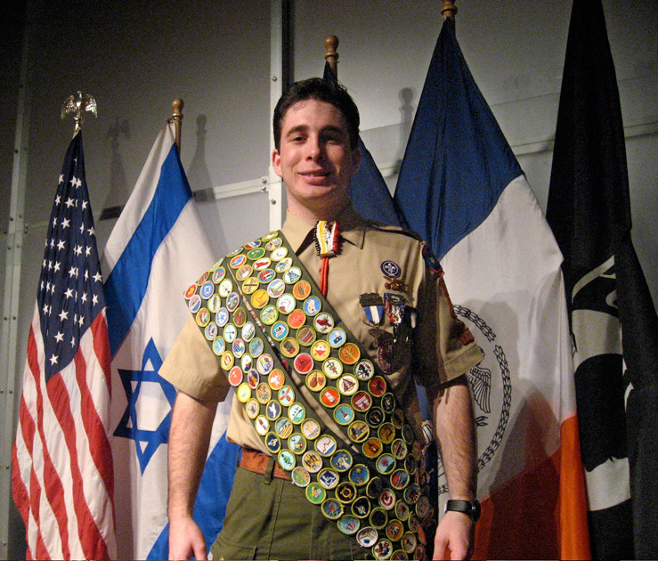
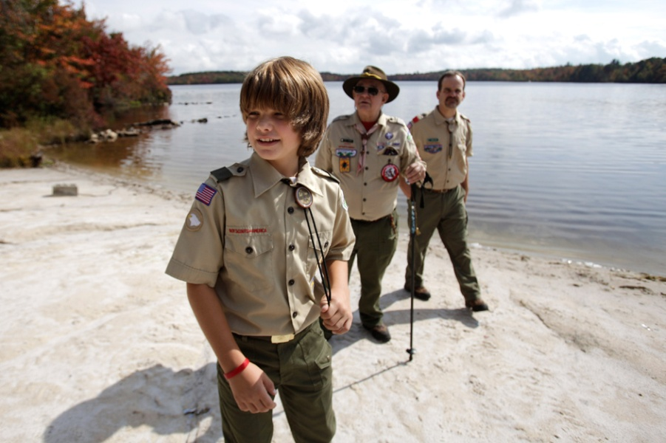
In the organization of " Boy Scouts of America " composed and adults . However, they fall into two categories - professional staff and volunteers . First , as a rule , are engaged in the general management of the organization and its units , while the latter act as counselors and heads of groups of different levels.
Cub with his father and grandfather in the scout camp in Pennsylvania

Slide 13
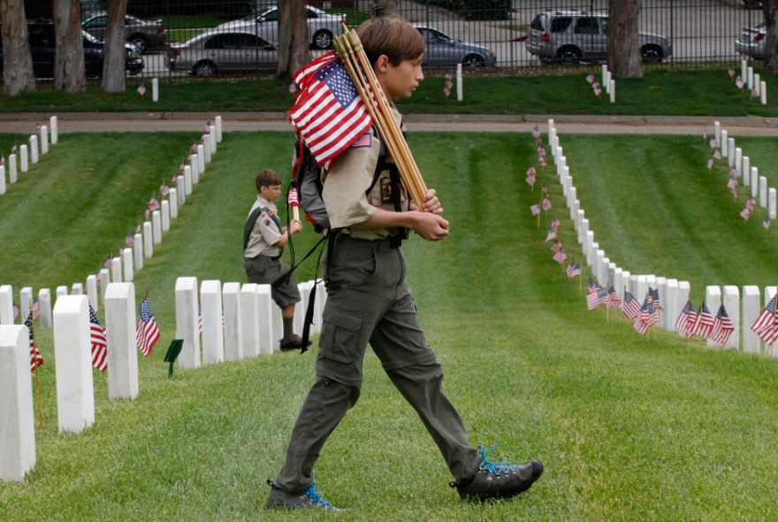
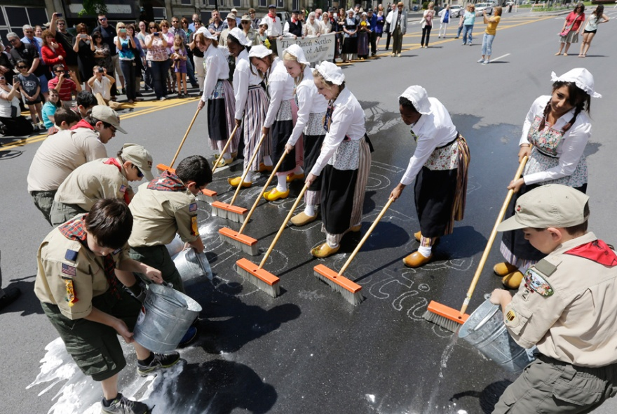
Socially useful things
Boy Scouts are taught that they must be exemplary citizens . To do this, right from the start they are entrusted with a large amount of public works. Range of socially useful tasks that confront scouts fairly wide. This street cleaning, lawn mowing, minor repairs, assistance to the poor and elderly, distributing leaflets. Experienced Scouts can provide first aid, water rescue engage and participate in fire fighting.
Scouts help launder schoolgirls asphalt on the first day tulip festival in Albany, NY
Scout helps set pins at the graves of veterans at the cemetery in Los Angeles

Slide 14
Thank you

