Slide 1

МБОУ Калманская СОШ Калманского района Алтайского края
«Сhristmas-Game»
Автор:
Булатова Наталья Леонидовна
учитель иностранных языков
2015 г.
Notes:
Переход к следующему слайду – по щелчку мыши. Переход к слайду с ресурсами – по управляющей кнопке в левом нижнем углу.

Slide 2
Santa Claus
Decorations
Food
Traditions
Jesus Christ
10
20
30
40
50
10
20
30
40
50
10
20
30
40
50
10
20
30
40
50
10
20
30
40
50
Notes:
Каждое игровое поле с очками является гиперссылкой на соответствующий вопрос.

Slide 3
Santa Claus - 10
What does Santa Claus bring to children on Christmas Eve?
Notes:
Переход к слайду с ответом осуществляется по управляющей кнопке (знак вопроса), к слайду с игровым полем – изображение домика.

Slide 4

Presents
Notes:
Переход к игровому полю осуществляется по управляющей кнопке (домик).

Slide 5
Santa Claus - 20
This piece of clothes is hung by children on Christmas Eve for Santa Claus to fill it with presents and sweets.

Slide 6
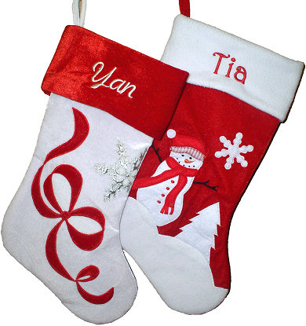
Stocking

Slide 7
Santa Claus - 30
They pull the sleigh of Santa Claus and help him deliver Christmas gifts.

Slide 8
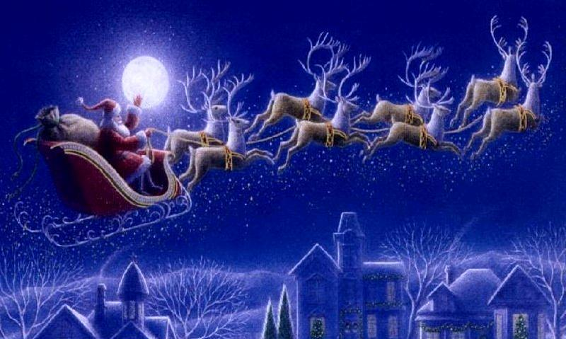
Reindeers

Slide 9
Santa Claus - 40
According to a tradition which can be traced to the 1820s, Santa Claus lives at the … .

Slide 10
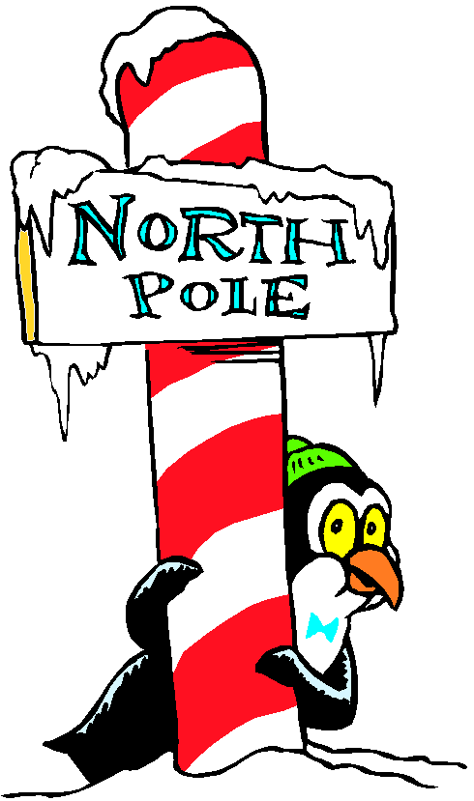
the North Pole

Slide 11
Santa Claus - 50
It is a diminutive creature that lives with Santa Claus in the North Pole and acts as his helper.

Slide 12
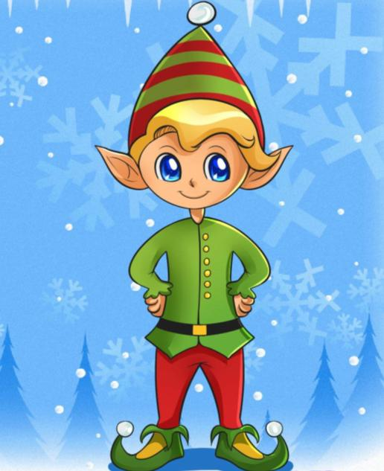
Christmas Elf

Slide 13
Decorations - 10
It is traditionally brought into the home and decorated with Christmas lights (originally candles), ornaments and candy canes.

Slide 14
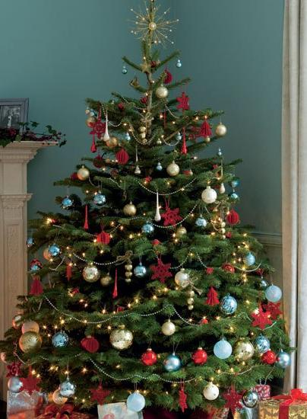
Christmas Tree

Slide 15
Kultur - 20
Decorations - 20
It is one of the most popular Christmas ornament designs.

Slide 16
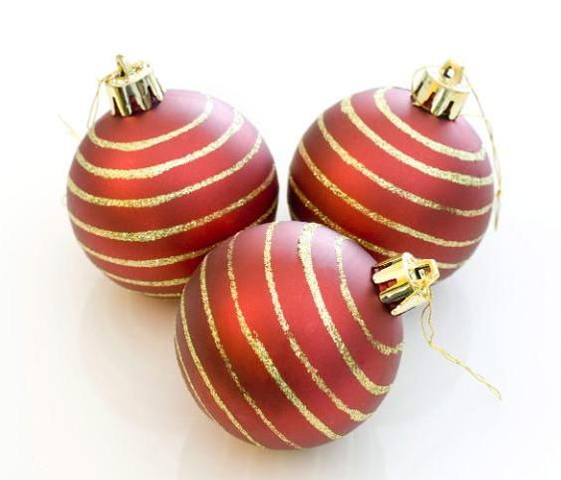
Bauble

Slide 17
Kultur - 30
Decorations - 30
The traditional colours of Christmas decorations are … .

Slide 18
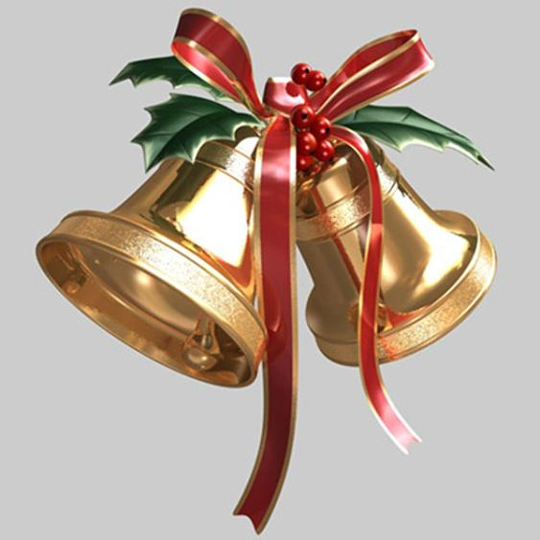
red, green and gold

Slide 19
Kultur - 40
Decorations - 40
It is an integral part of Christmas celebrations. It is typically pulled at the Christmas dinner table or at parties.

Slide 20
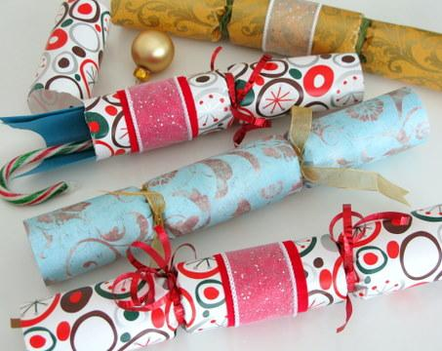
Cracker

Slide 21
Kultur - 50
Decorations - 50
This plant is used as a Christmas decoration, and people often kiss under it.

Slide 22
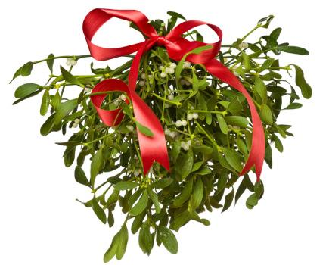
Mistletoe

Slide 23
Food - 10
A roast … is a traditional dish on Christmas Eve.

Slide 24
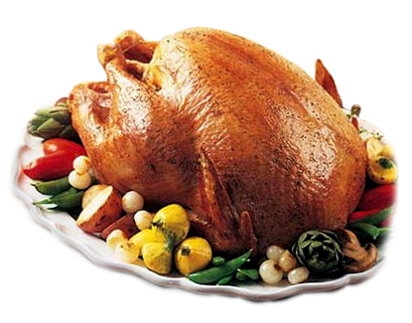
Turkey

Slide 25
Food - 20
It is traditionally served on Christmas Day as dessert.

Slide 26
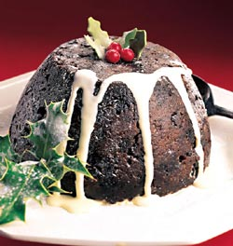
Christmas Pudding

Slide 27
Food - 30
It is a small British fruit-based sweet pie traditionally served during the Christmas season.

Slide 28
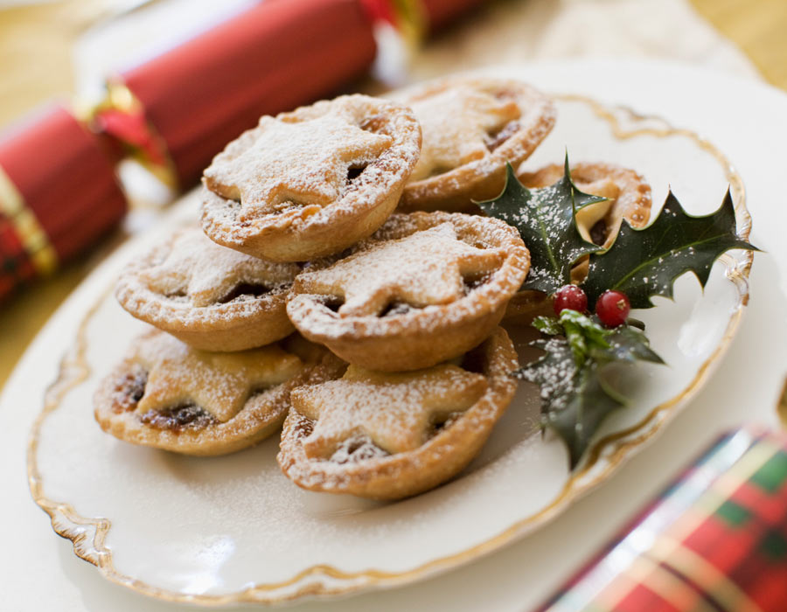
Mince Pie

Slide 29
Food - 40
It is a treat and a decoration made of sugar. It is traditionally white with red stripes.

Slide 30

Candy Cane

Slide 31
Food - 50
Children help their mothers to bake them, which they decorate and then hang on their Christmas trees.

Slide 32
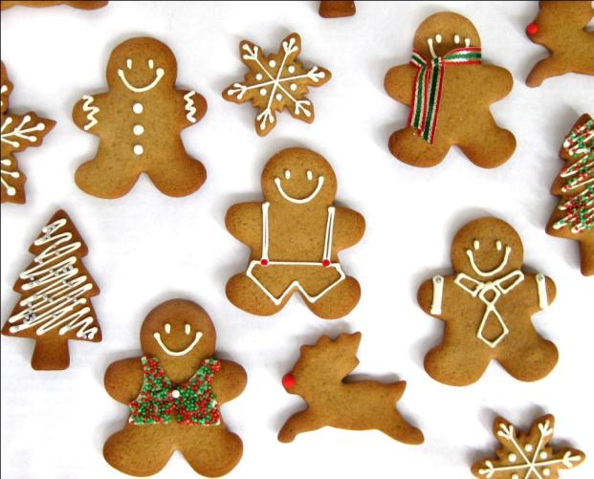
Gingerbread Men

Slide 33
Traditions - 10
The period between Advent Sunday, the Sunday closest to the 30th of November, and Christmas Day.

Slide 34
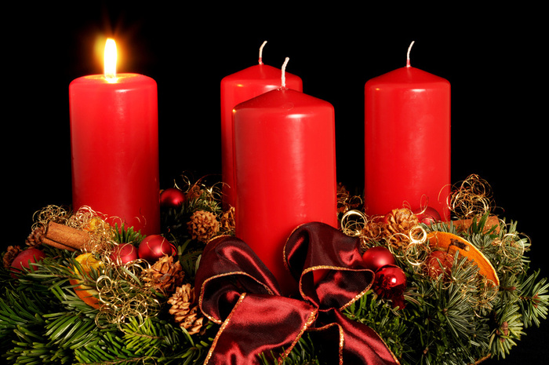
Advent

Slide 35
Traditions - 20
The evening or entire day preceding Christmas Day that takes place on December 25.

Slide 36
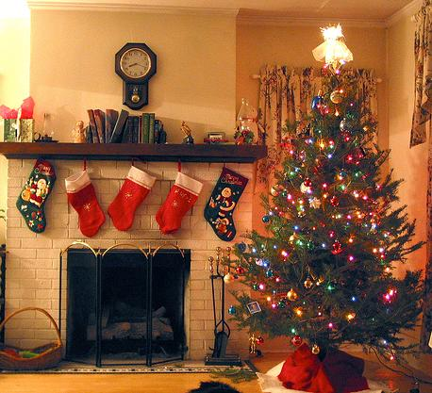
Christmas Eve

Slide 37
Traditions - 30
It is the primary meal traditionally eaten on Christmas Eve.

Slide 38
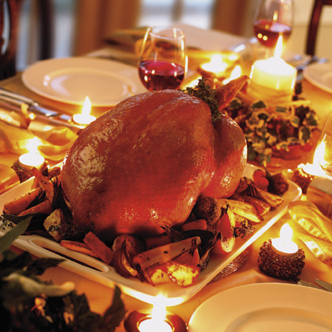
Christmas Dinner

Slide 39
Traditions - 40
Every family sends and receives them at Christmas.

Slide 40
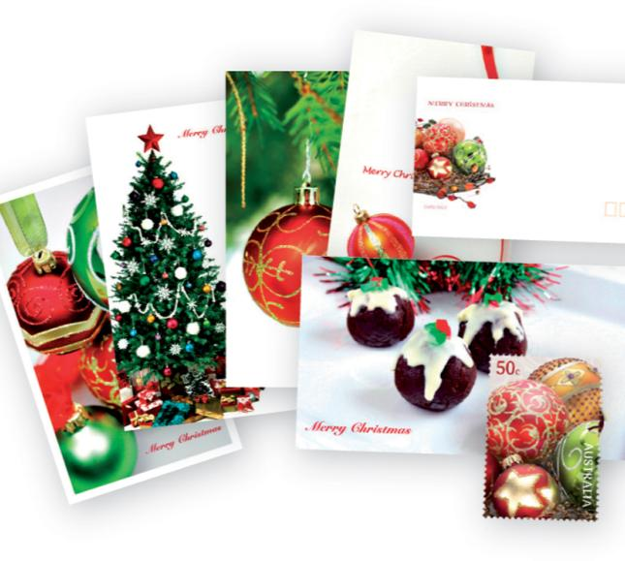
Christmas Cards

Slide 41
Traditions - 50
It is one of the best-known and commonly sung winter songs in the world.

Slide 42
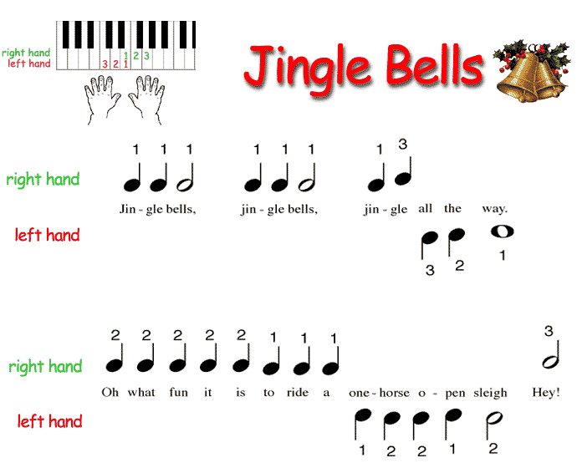
Jingle Bells

Slide 43
Jesus Christ - 10
A Christian religious song that is sung at Christmas.

Slide 44
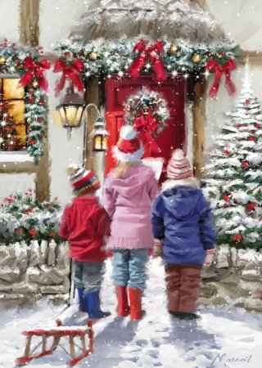
Christmas Carol

Slide 45
Jesus Christ - 20
It is a Christmas decoration to celebrate the birth of Christ.

Slide 46

Christmas Wreath

Slide 47
Jesus Christ - 30
It revealed the birth of Jesus to the magi, or "wise men", and later led them to Bethlehem.

Slide 48

Christmas Star

Slide 49
Jesus Christ - 40
She is a Jewish woman of Nazareth in Galilee. She is identified in the New Testament as the mother of Jesus.

Slide 50
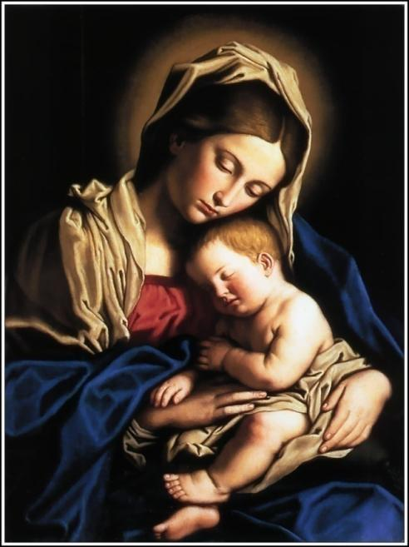
Virgin Mary

Slide 51
Jesus Christ - 50
They visited the infant Jesus in the manger.

Slide 52
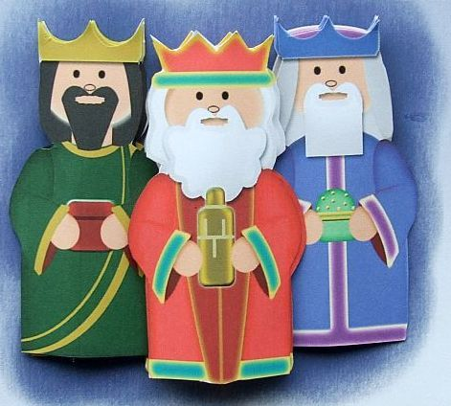
Three Kings or Wise Men

Slide 53
Изображения:
http://textures.photoshop-ramki.ru/wp-content/uploads/2012/11/snezhinki_01/snezhinki_03.jpg
http://pics.livejournal.com/nika_ap/pic/0009a4ft
http://www.turbosquid.com/FullPreview/Index.cfm/ID/282858
http://www.centrinet.com/christmas/images/red-white-velvet-christmas-stockings-group.jpg
http://4.bp.blogspot.com/_ByJb93_6mXU/TPVn2ZHv75I/AAAAAAAAAgA/0roQxXAsVw0/s1600/Xmas%2BTree%2B3.jpg
http://yousearchedfor.com/wp-content/themes/directorypress/thumbs/yousearchedfor-turkey-dinner.jpg
http://snoringscholar.com/wp-content/uploads/2011/06/virgin-mary-0108.jpg
http://www.alpinewreaths.com/images/P/Christmas-Wreaths-Woodland-Christmas-300.jpg
http://www.noelnoelnoel.com/big_note/music/images/bnjingle1.gif
http://blog.maesmieri.org.uk/__oneclick_uploads/2010/08/cup74344_509-card5-christmas-kings.jpg
http://holidaybyte.com/wp-content/uploads/Christmas-Mistletoe.jpg
http://www.benjaminschool.com/ClipArt/NorthPole.gif

Slide 54
http://www.wallcoo.net/holiday/Christmas_Balls_02/images/christmas_presents_and_balls_002010.jpg
http://images.mylot.com/userImages/images/postphotos/2062194.jpg
http://www.millersfield.com/wp-content/uploads/20051211-christmas_eve_santa_sleigh_800.jpg
http://faithcenter.files.wordpress.com/2010/12/christmas-star.gif
http://www.candyhistory.net/images/17/candy-cane-2a.jpg
http://paintermommy.com/wp-content/uploads/2010/12/Christmas-Cards.jpg
http://www.wphcancercharity.org.uk/fefiles/image/Carol%20Singers.jpg
http://www.squawkfox.com/wp-content/uploads/2010/11/christmas-crackers.jpg
http://www.uwesu.org/asset/Event/6410/christmans-dinner.jpg
http://www.dragoart.com/tuts/pics/8/1206/how-to-draw-a-christmas-elf.jpg
http://theexpiredmeter.com/wp-content/uploads/2009/12/Christmas-Tree.jpg
http://thecookieshop.files.wordpress.com/2009/11/gingerbread.jpg
http://db2.stb.s-msn.com/i/9E/36A6F1DBEF3B98E36C2AB3EE97B1F.jpg

