Slide 1
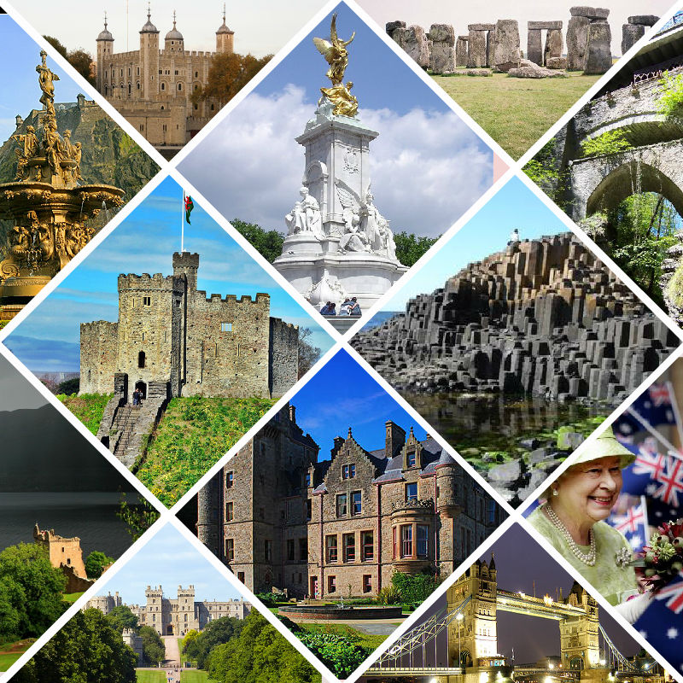
“Great
Britain in pictures”
Игра в форме викторины
«Великобритания
в картинках»

Slide 2
Flags & Coat of arms | Symbols & Capitals | Christmas symbols
Sights of Wales & Northern Ireland | Sights of England | Sights of Scotland
Geography | Holidays | Patron Saints & Royal Family of the UK
HEADINGS
1
1
1
2
3
1
1
2
3
2
2
4
5
6
2
4
5
6
3
3
3
7
8
9
4
4
4
1
1
2
3
1
2
5
1
3
2
4
5
6
3
4
2
3
7
8
1
2
3
1
1
2
3
2
1
2
3
4
5
6
4
5
6
4
3

Slide 3

Whose flag is this?
BACK

Slide 4
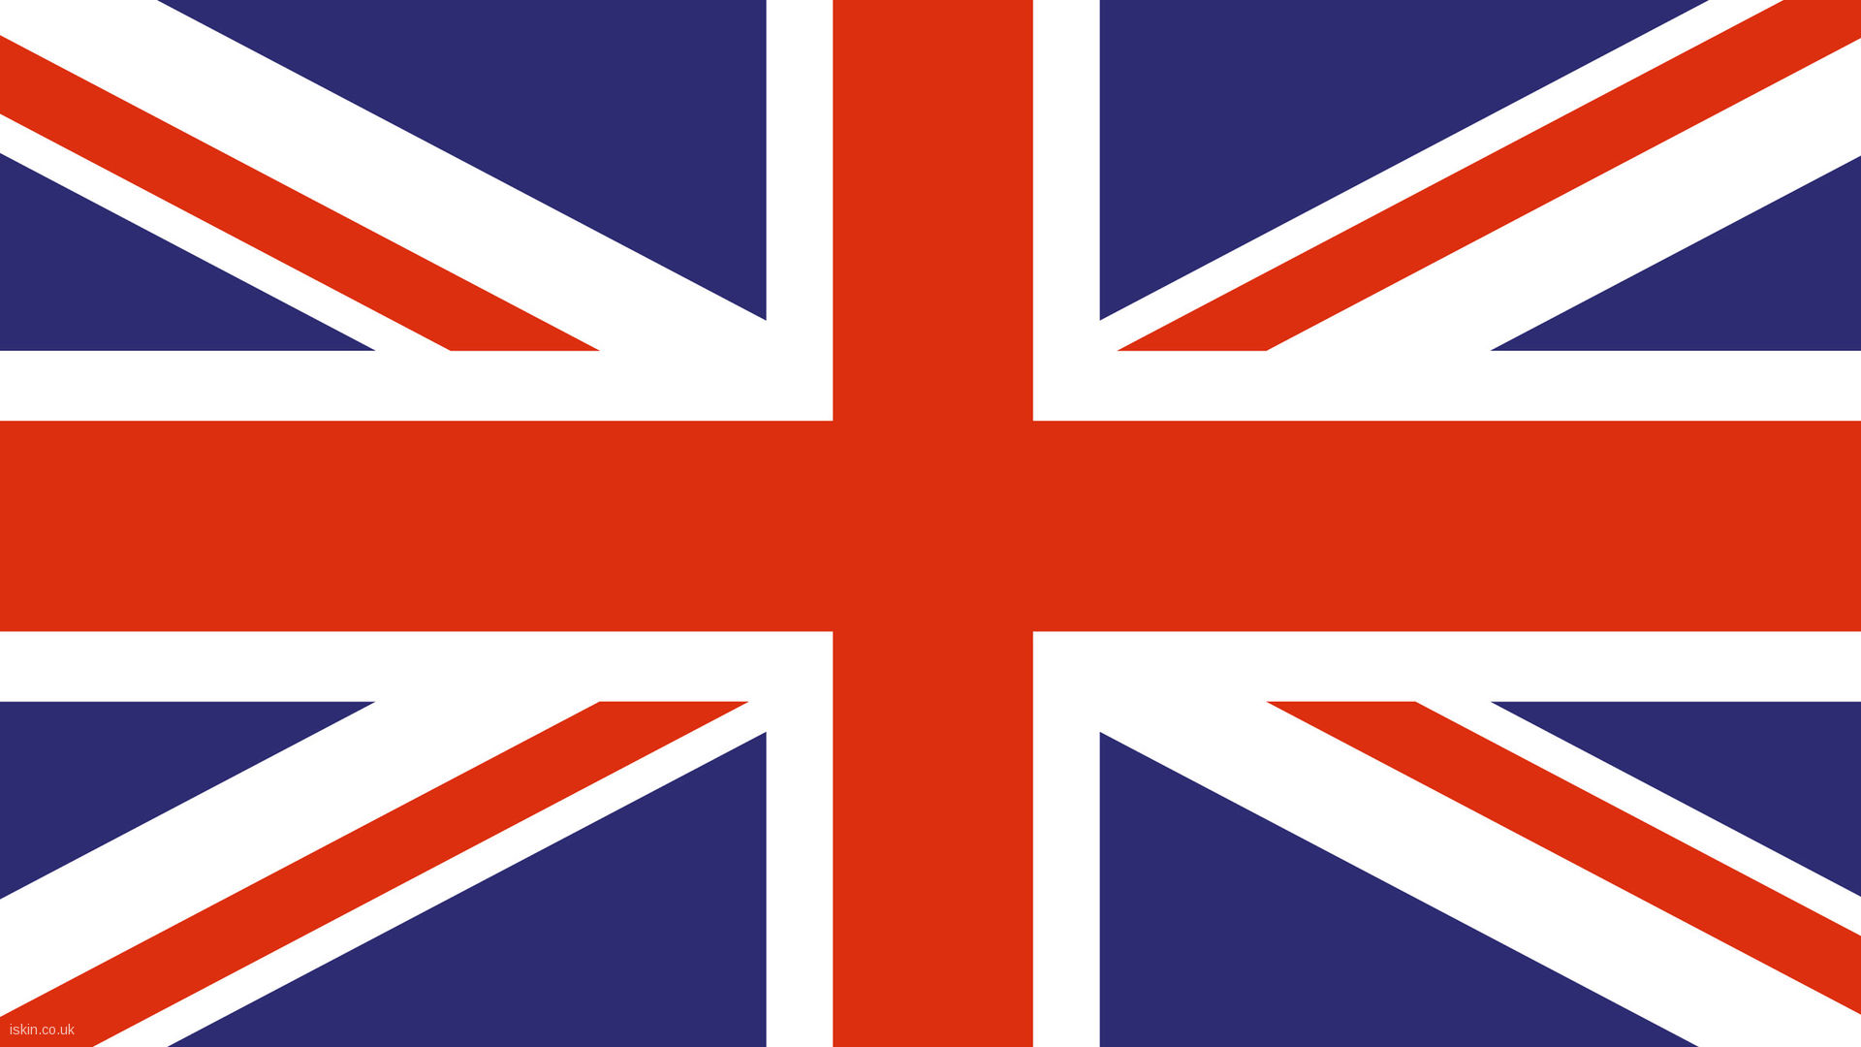
Whose flag is this?
BACK

Slide 5
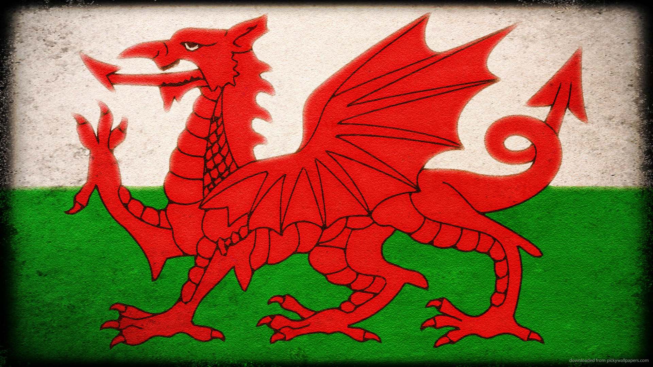
Whose flag is this?
BACK

Slide 6
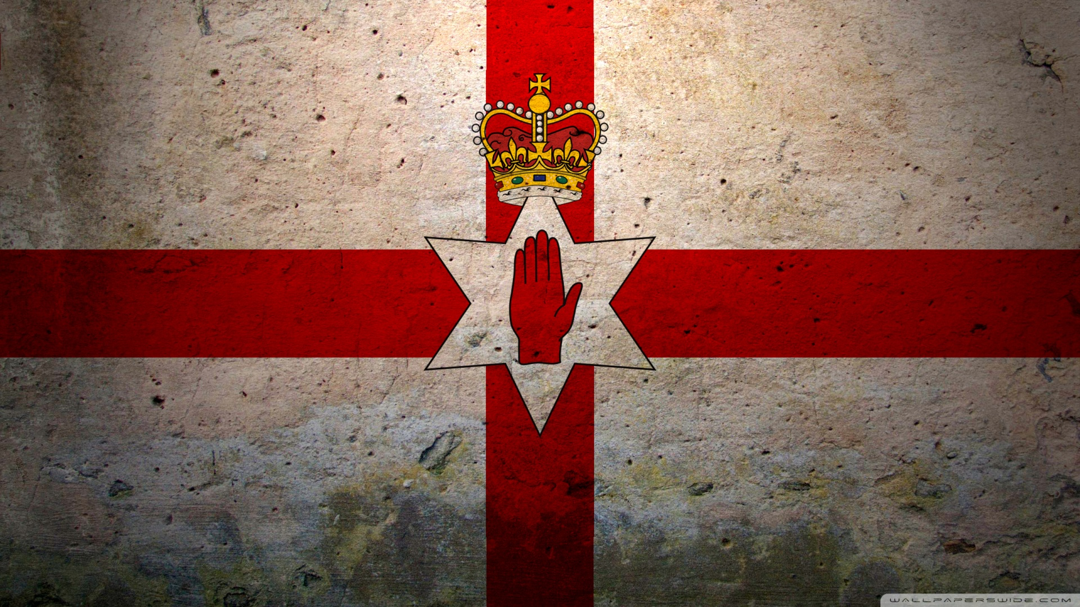
Whose flag is this?
BACK

Slide 7
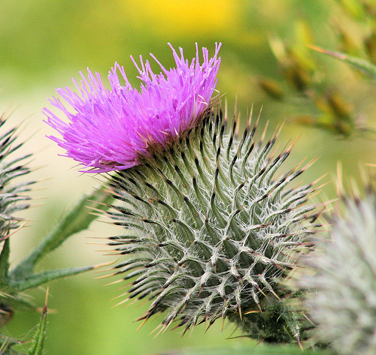
Whose symbol is this?
BACK

Slide 8
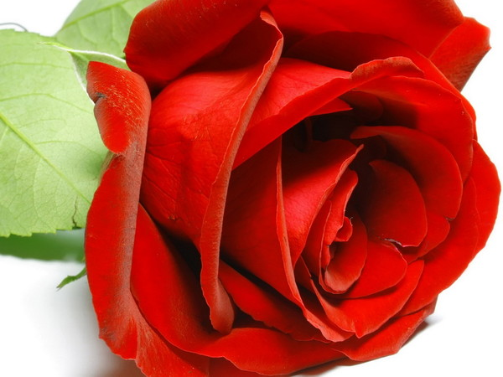
Whose symbol is this?
BACK

Slide 9
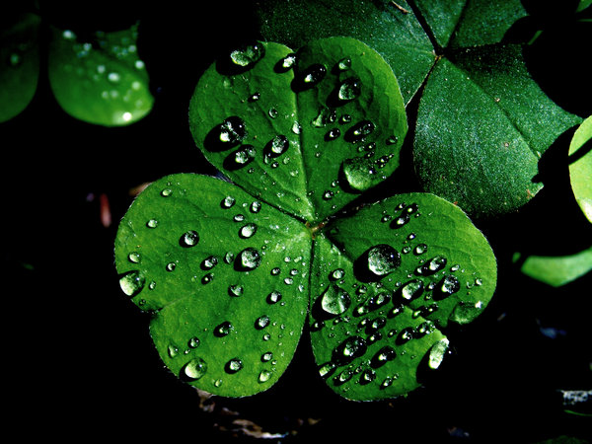
Whose symbol is this?
BACK

Slide 10
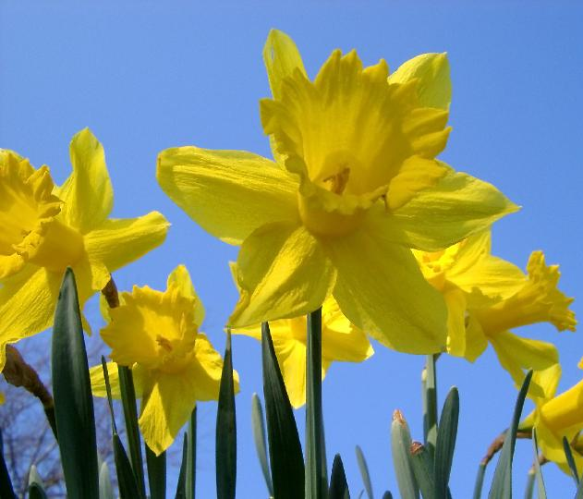
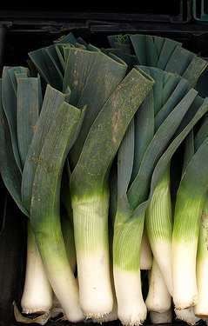
Whose symbol is this?
BACK

Slide 11
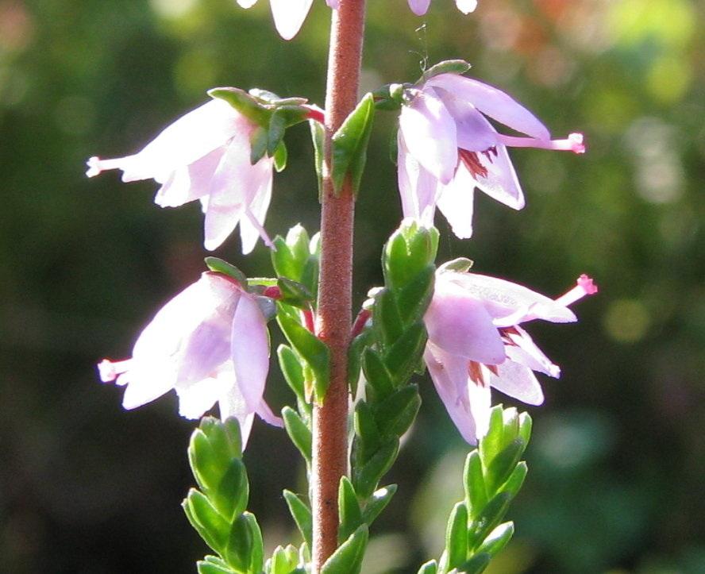
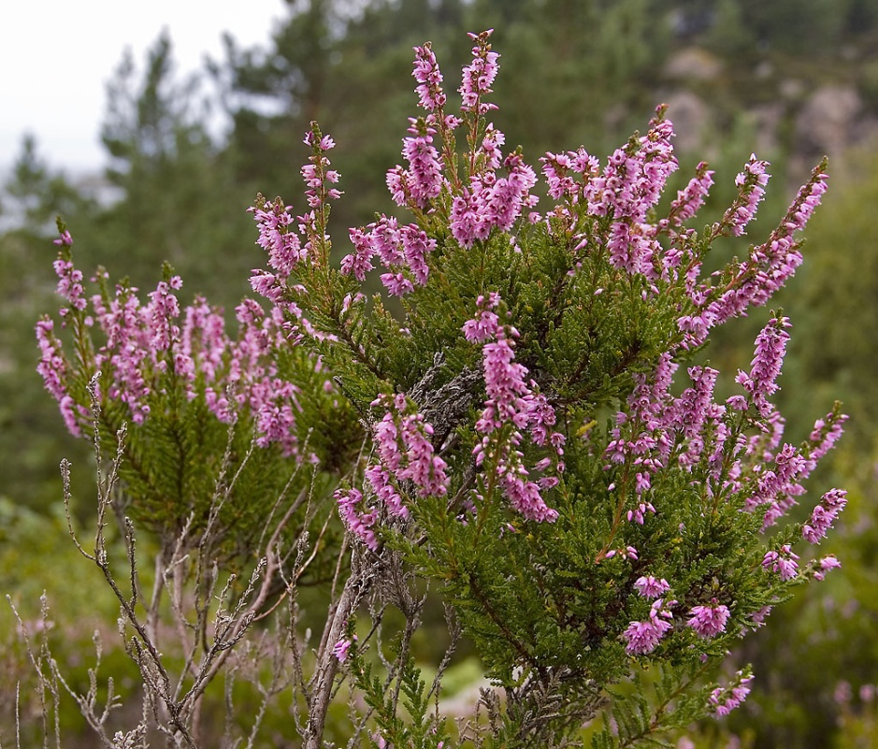
Whose symbol is Heather? Is it true that Wearing a sprig of heather is believed to bring good luck?
BACK

Slide 12
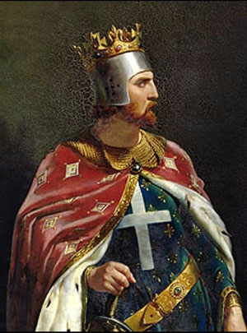
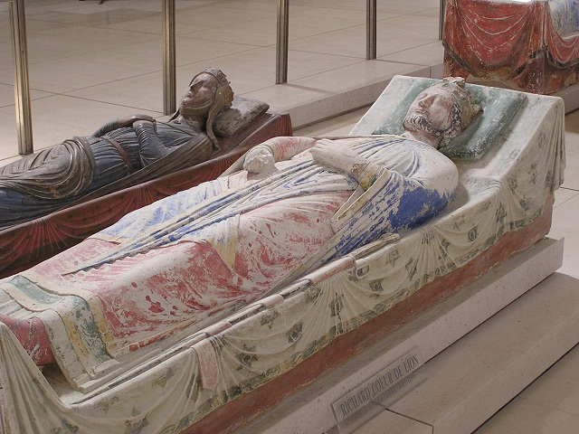
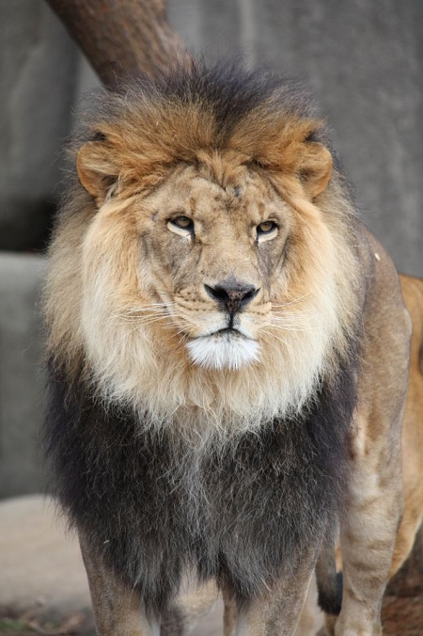
Whose national animal is the lion? Whose medieval warrior nickname was it?
BACK

Slide 13
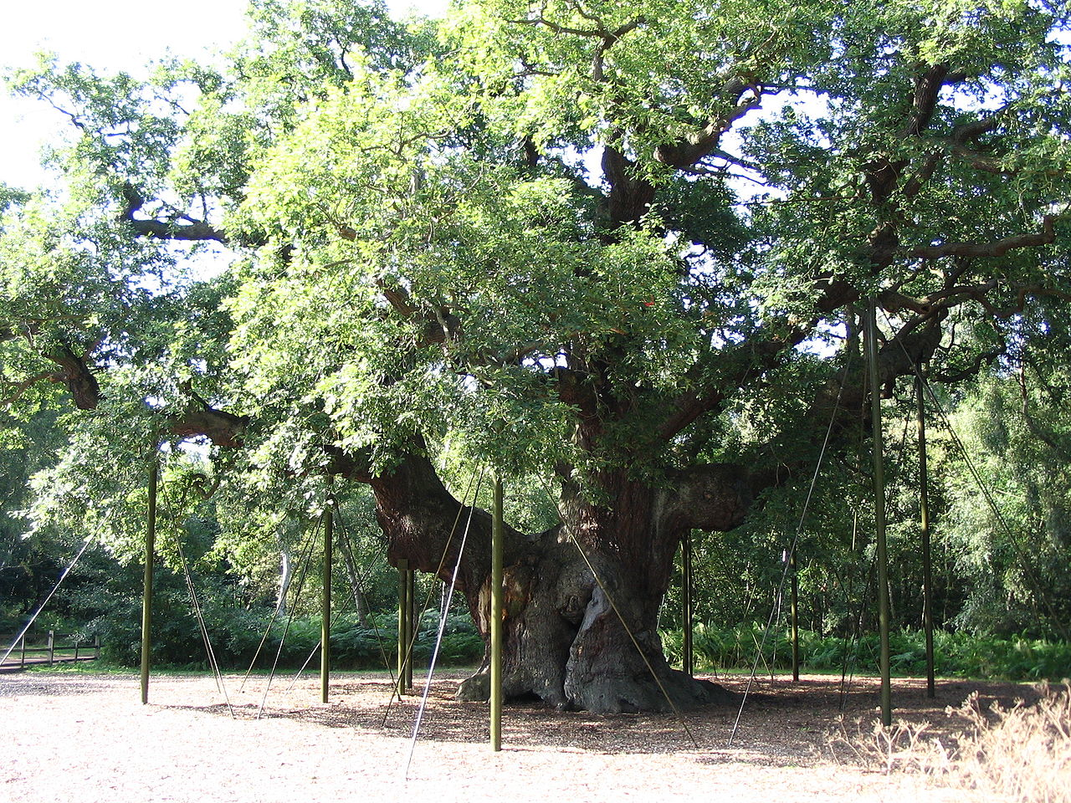
Whose national tree is the oak?
BACK

Slide 14
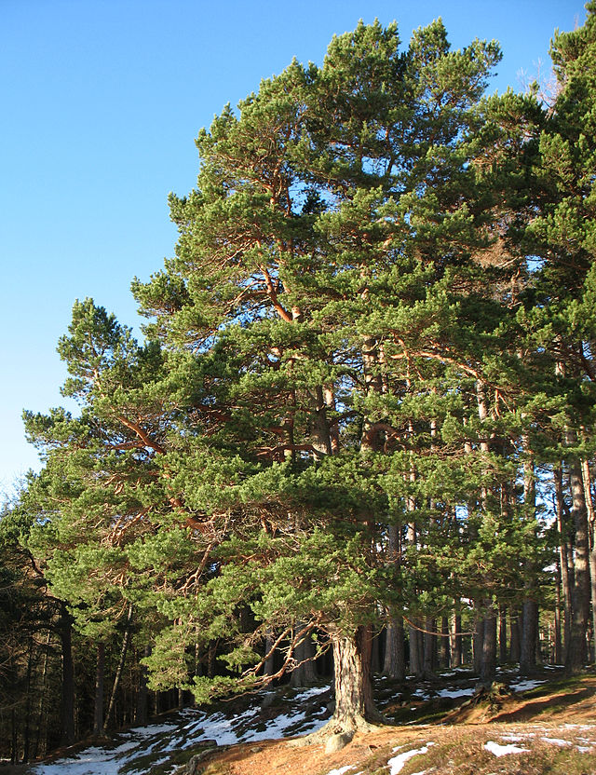
Whose national tree is the pine?
BACK

Slide 15
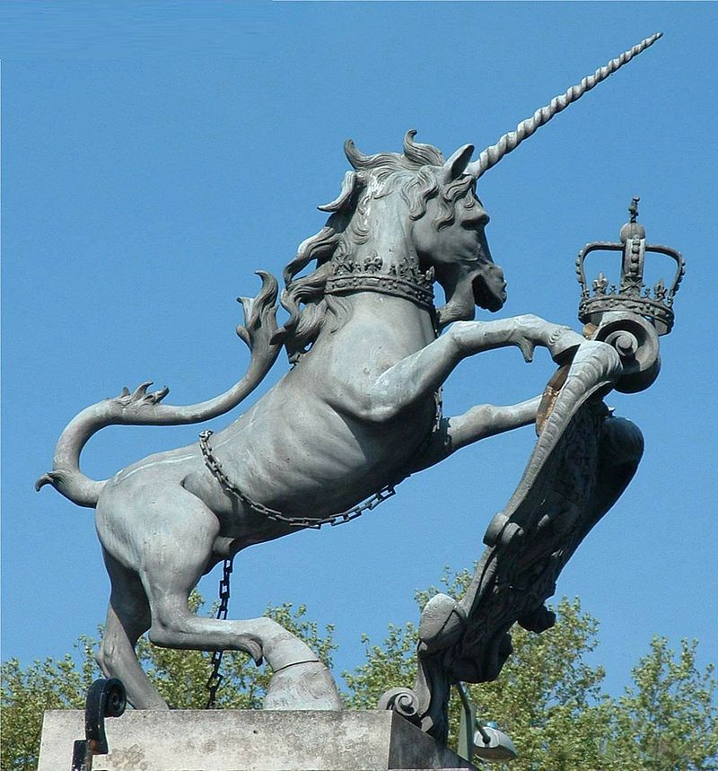
Whose national animal is the unicorn?
BACK

Slide 16
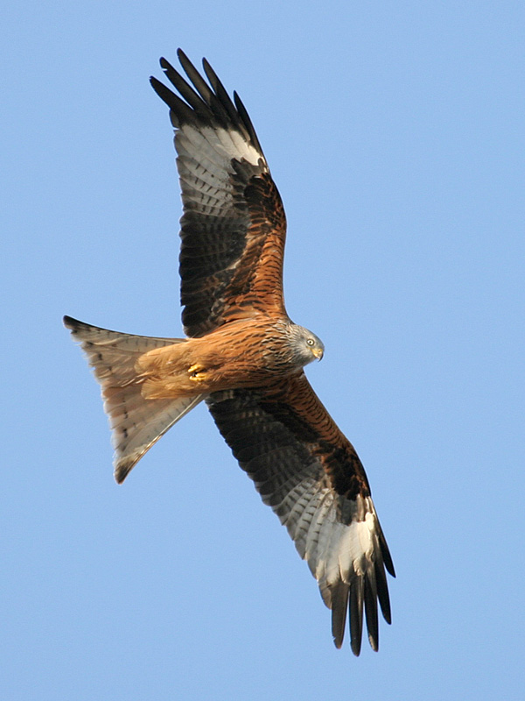
Whose national animal is the red kite?
BACK

Slide 17
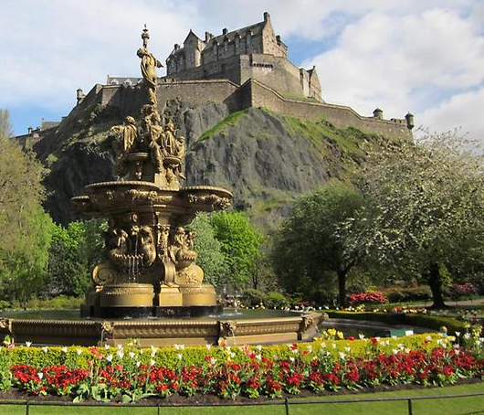
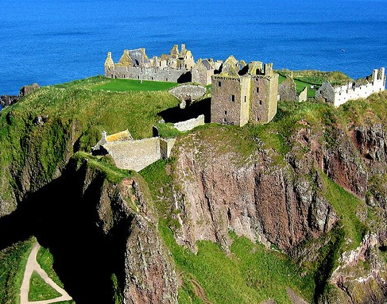
What capital is this?
BACK

Slide 18
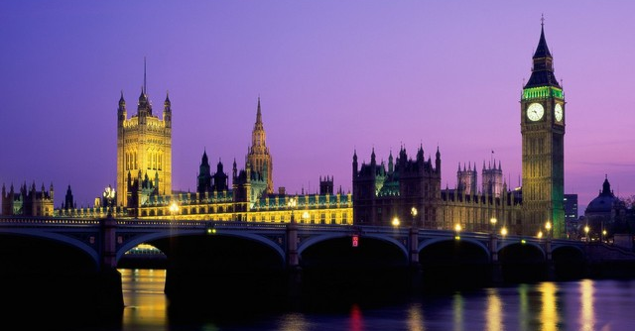
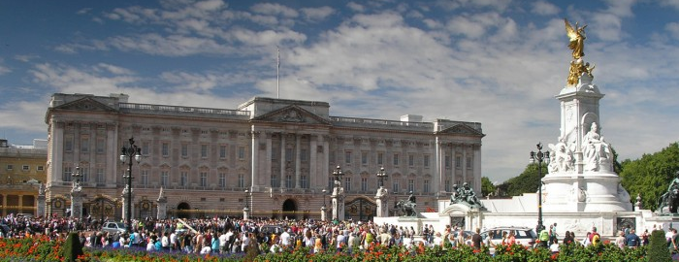
What capital is this?
BACK

Slide 19
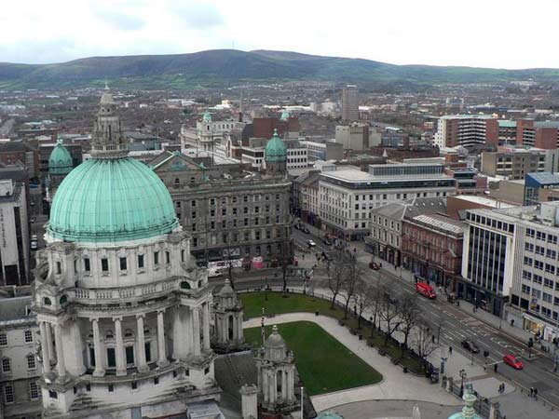
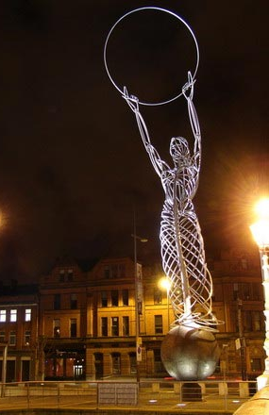
What capital is this?
BACK

Slide 20
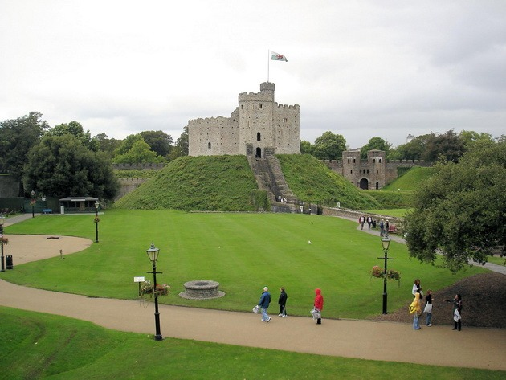
What capital is this?
BACK

Slide 21
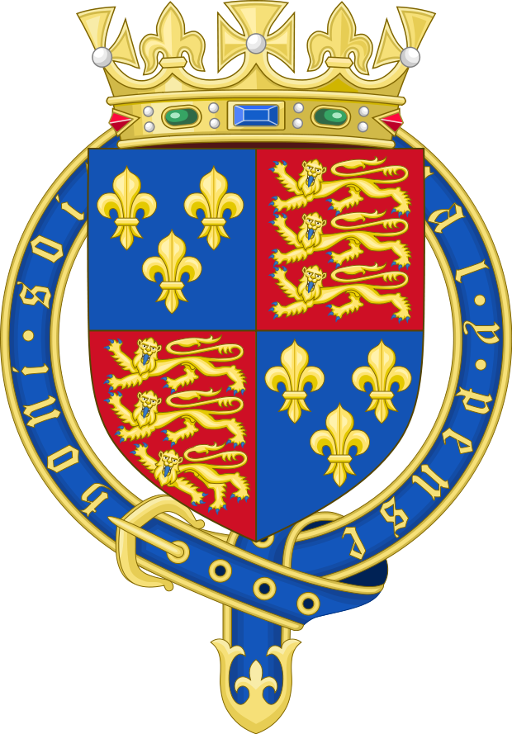
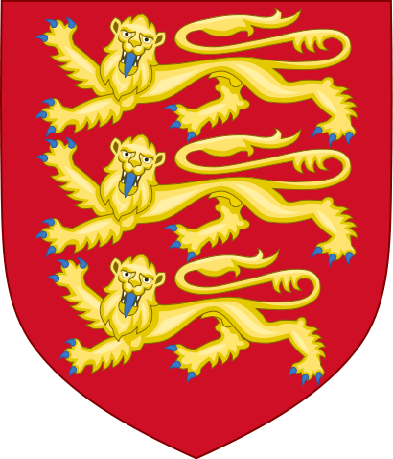
Whose coat of arms is this?
BACK

Slide 22
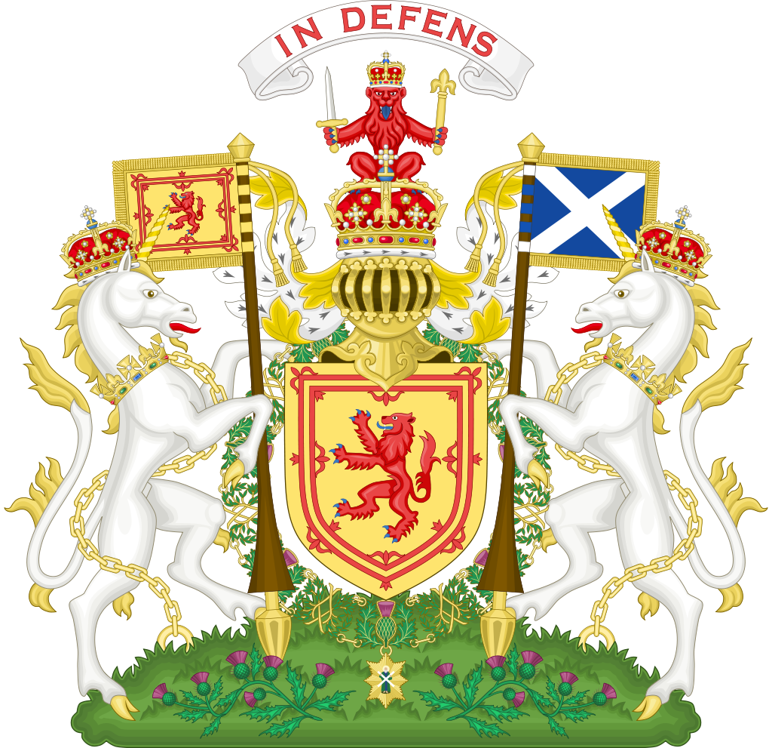
Whose coat of arms is this?
BACK

Slide 23
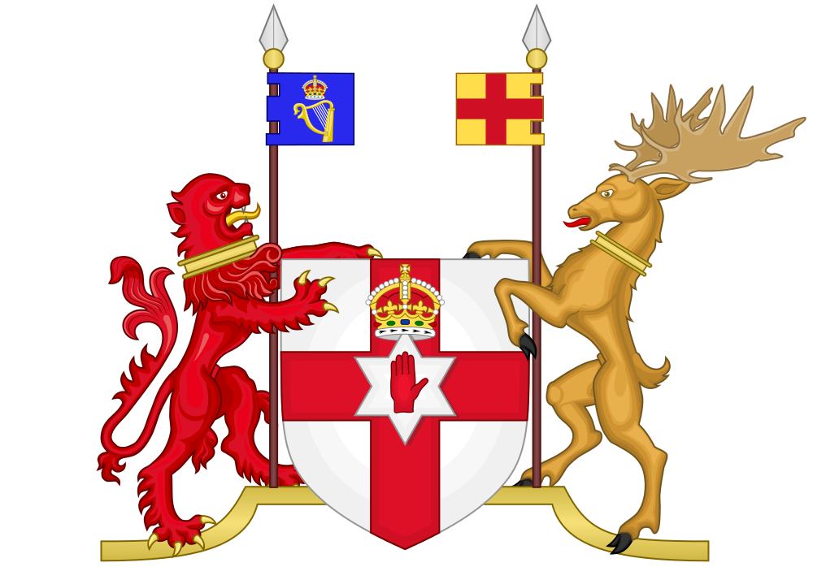
Whose coat of arms is this?
BACK

Slide 24
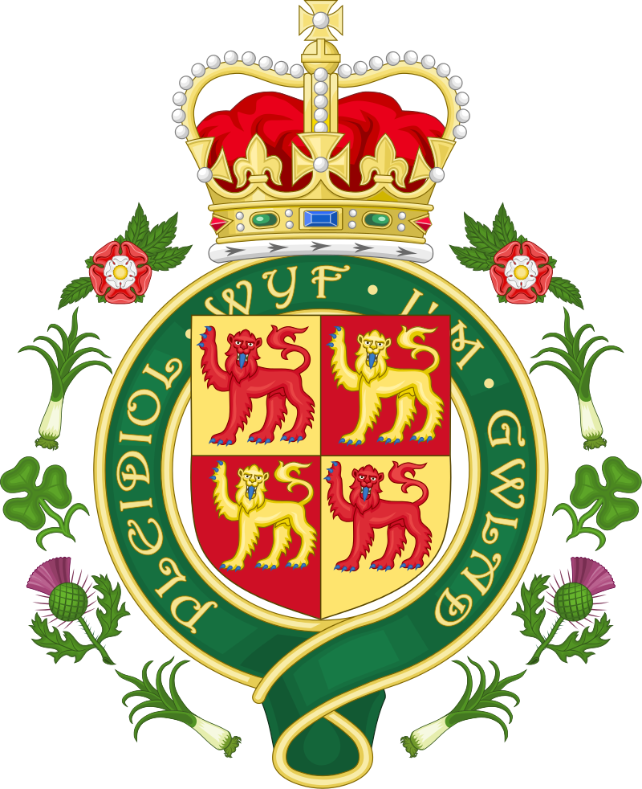

Whose coat of arms is this?
BACK

Slide 25
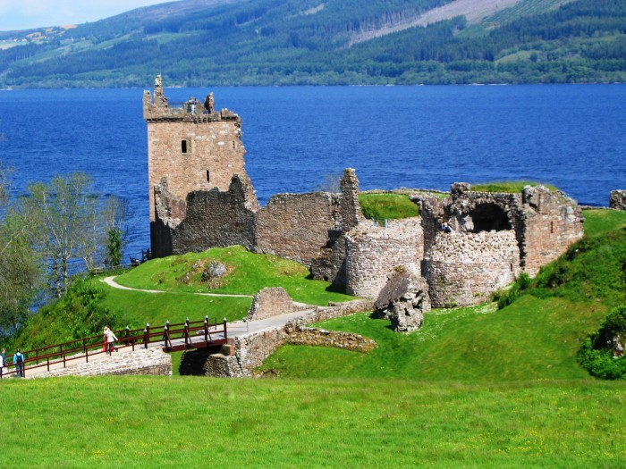
What is the sightseeing?
BACK

Slide 26
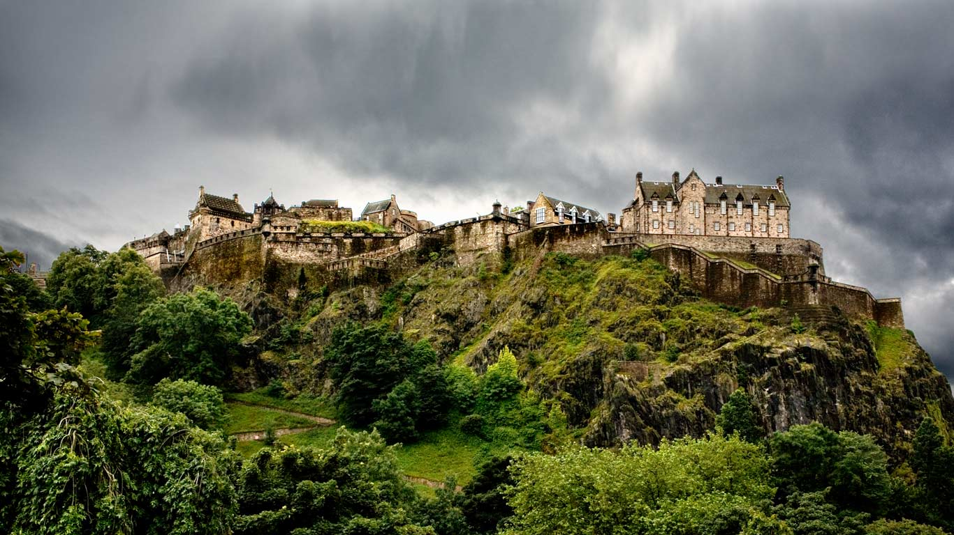
What is the sightseeing?
BACK

Slide 27
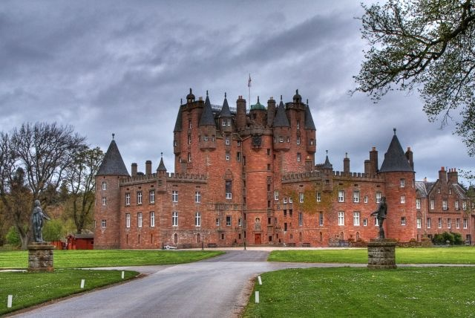
What is the sightseeing?
BACK

Slide 28
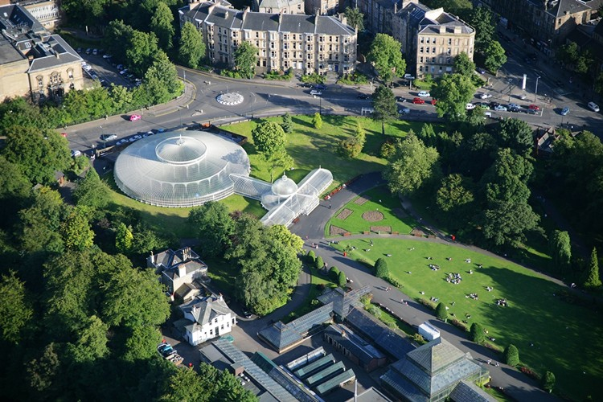
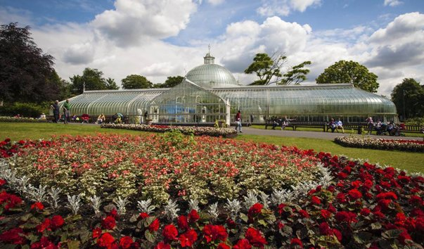
What is the sightseeing?
BACK

Slide 29
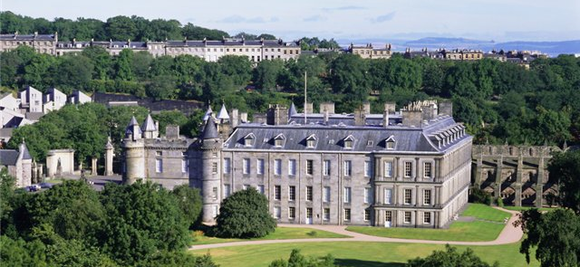
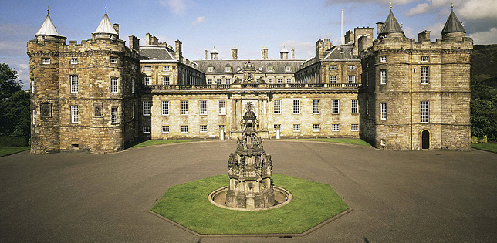
What is the sightseeing?
BACK

Slide 30
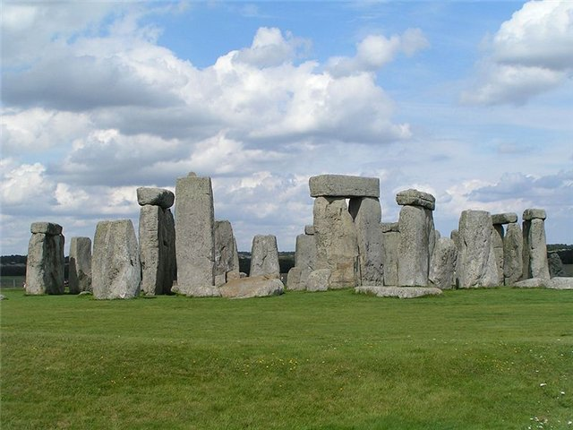
What is the sightseeing?
BACK

Slide 31
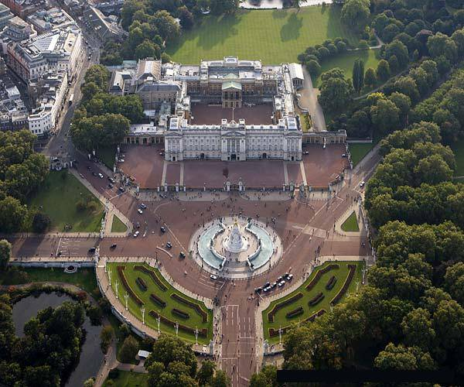
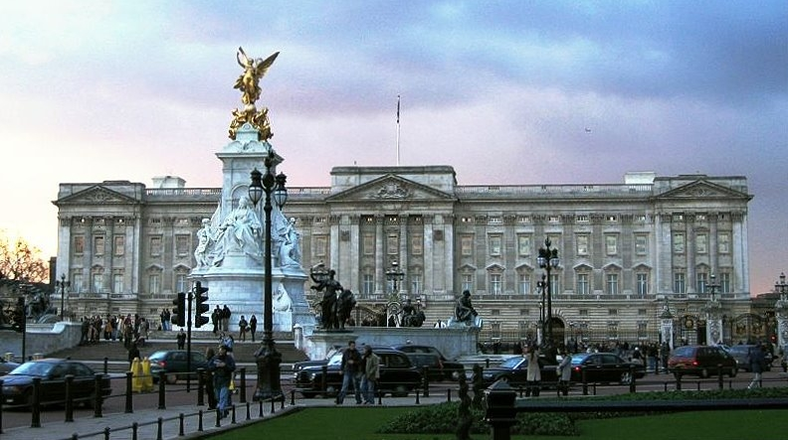
What is the sightseeing?
BACK

Slide 32
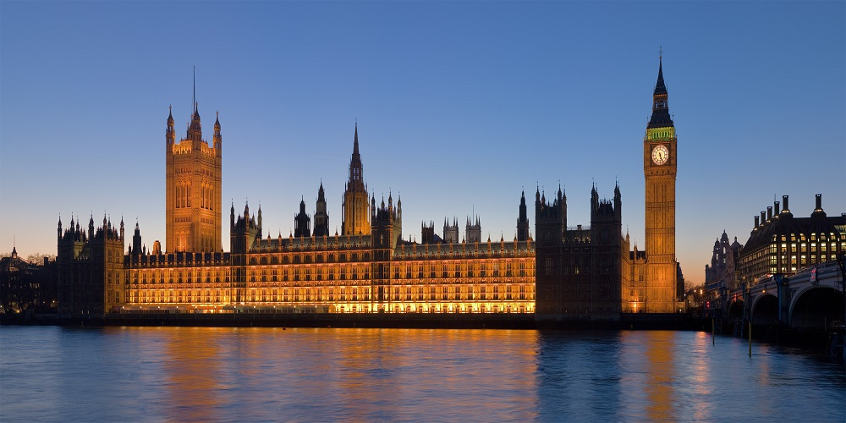
What is the sightseeing?
BACK

Slide 33
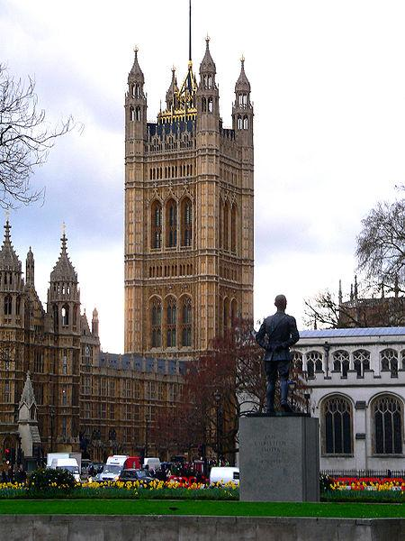
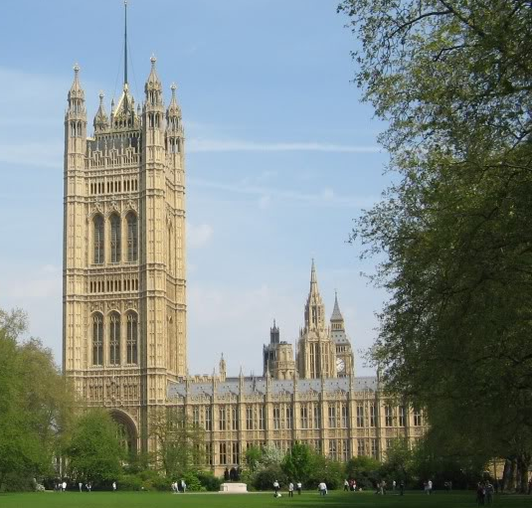
What is the sightseeing?
BACK

Slide 34
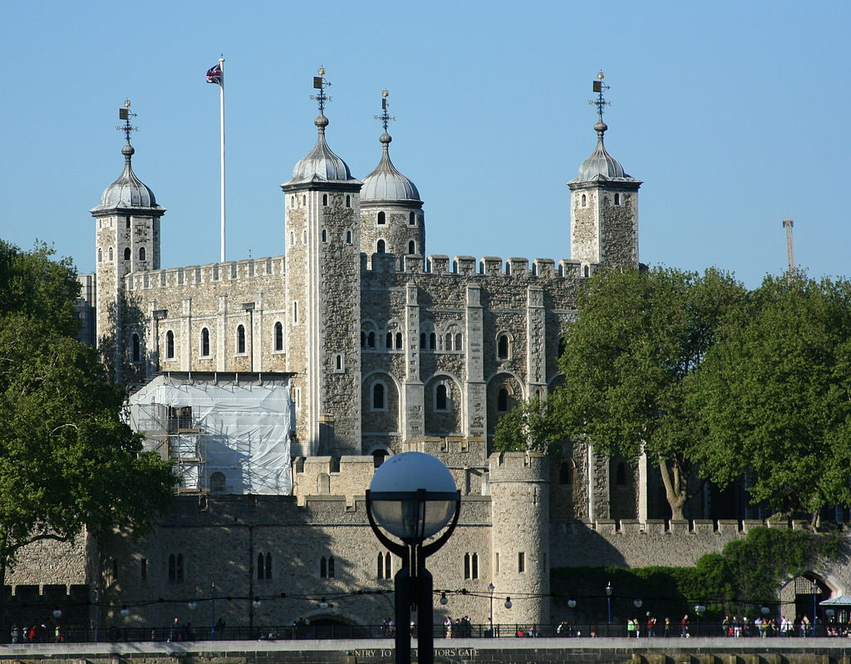
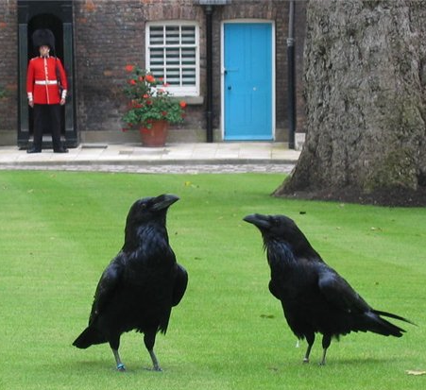
What is the sightseeing?
BACK

Slide 35
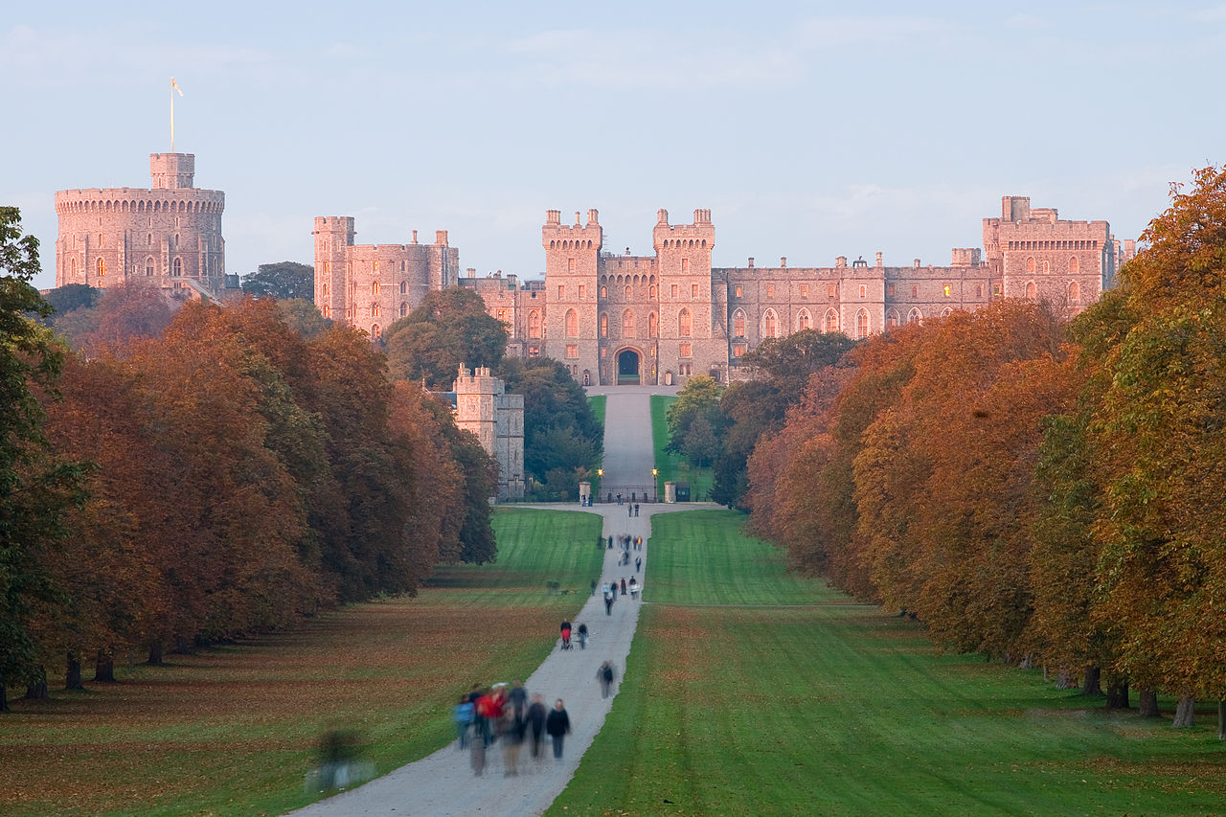
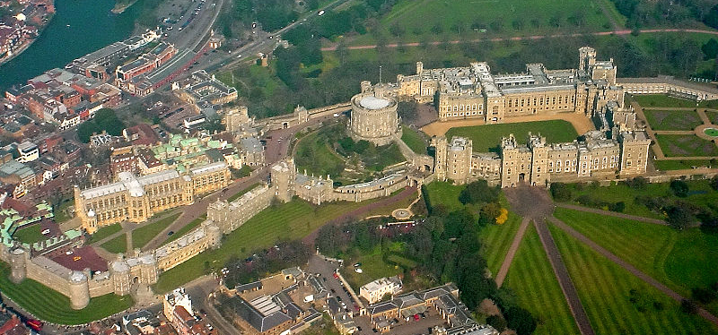
What is the royal residence at Windsor in england?
BACK

Slide 36
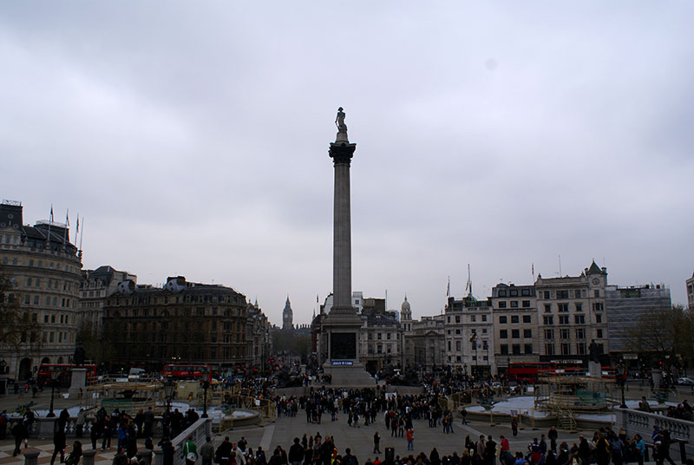
What is the square in the heart of london wit a column of a great British naval hero ?

Slide 37
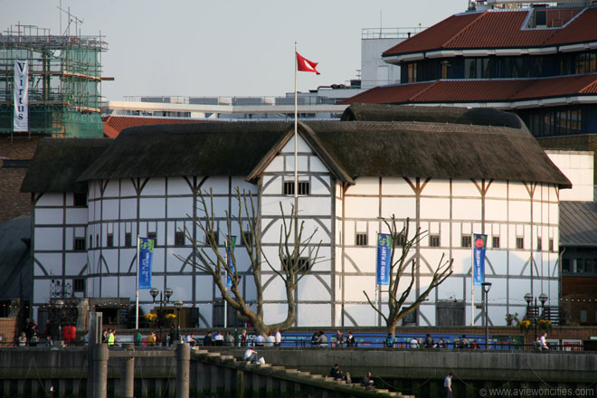
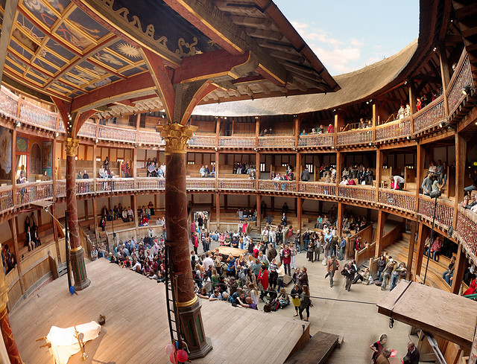
What is the theatre in London associated with William Shakespeare?
BACK

Slide 38


What is the sightseeing?
BACK

Slide 39



What is the sightseeing?
BACK

Slide 40


What is the sightseeing?
BACK

Slide 41

What is the sightseeing?
BACK

Slide 42


What is the sightseeing?
BACK

Slide 43

What is the sightseeing?
BACK

Slide 44



What holiday is it?
When do the British celebrate it?
BACK

Slide 45

What holiday is it?
When do the British celebrate it?
BACK

Slide 46


What holiday is it?
When do the British celebrate it?
BACK

Slide 47


What holiday is it?
When do the British celebrate it?
BACK

Slide 48



What holiday is it?
When do the British celebrate it?
BACK

Slide 49


What holiday is it?
When do the British celebrate it?
BACK

Slide 50

What christmas symbol is it?
BACK

Slide 51

What christmas symbol is it?
BACK

Slide 52


What christmas symbol is it?
BACK

Slide 53


What christmas symbol is it?
BACK

Slide 54



What christmas symbol is it?
BACK

Slide 55

What christmas symbol is it?
BACK

Slide 56


What christmas symbol is it?
BACK

Slide 57


He is the patron saint of….
BACK

Slide 58


He is the patron saint of….
BACK

Slide 59


He is the patron saint of….
BACK

Slide 60


He is the patron saint of….
BACK

Slide 61


What is the highest mountain in Scotland?
BACK

Slide 62


What is the highest mountain in Wales?
BACK

Slide 63

What is the longest river in England and the second longest in the United Kingdom, after the River Severn?
BACK

Slide 64



What is Wales's second largest city after cardiff?
BACK

Slide 65


What is the longest river in the United Kingdom, in Wales (about 354 km)?
BACK

Slide 66


What is the largest city in Scotland?
BACK

Slide 67


the royal house of the United Kingdom that was founded by King George V who changed the name of the British Royal Family from the German Saxe-Coburg and Gotha (a branch of the House of Wettin) to the English.
BACK

Slide 68




What is a royal residence (a castle) at Windsor in the English county of Berkshire?
BACK

Slide 69



Current head of the house of windsor
BACK

