Slide 1

Урок-викторина “Who Wants to Be the Champion?”
Презентация учителя английского языка ГБОУ ЦО №1239 Маккавеевой Е.Е.

Slide 2


1-1.What is your father's sister?
Your father's sister is your aunt .

Slide 3

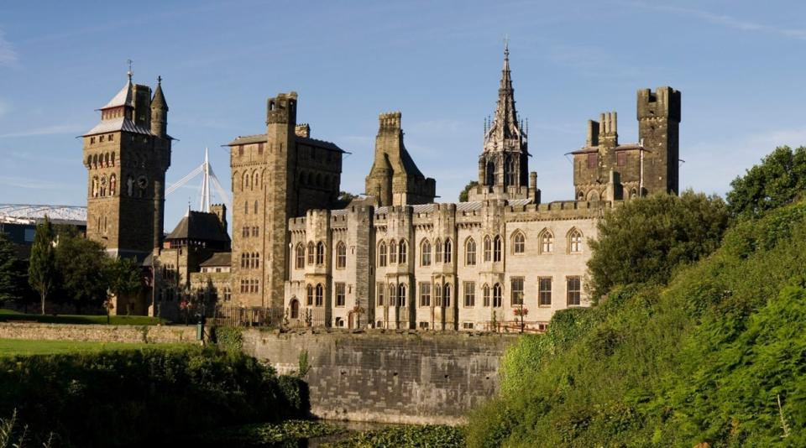
1-2.Cardiff is the capital and largest city in Wales

Slide 4

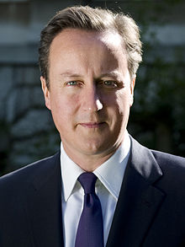
1-3.The Prime Minister David Cameron is the head of the UK government.

Slide 5

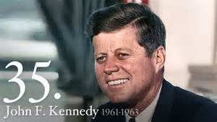
1-4.The youngest president elected to office was John F. Kennedy (age 43 years, 236 days).

Slide 6

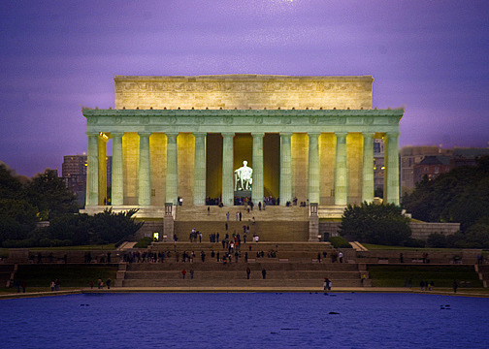
1-5.The Lincoln Memorial in Washington

Slide 7

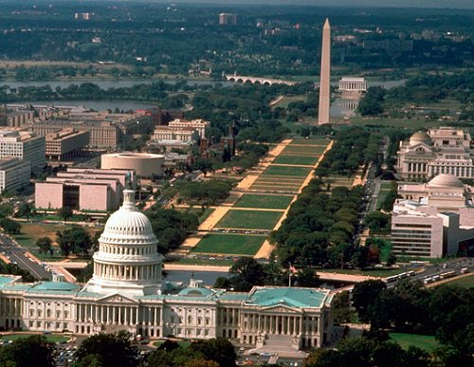
1-6.The City of Washington was founded in 1791 to serve as the new national capital in 1846

Slide 8

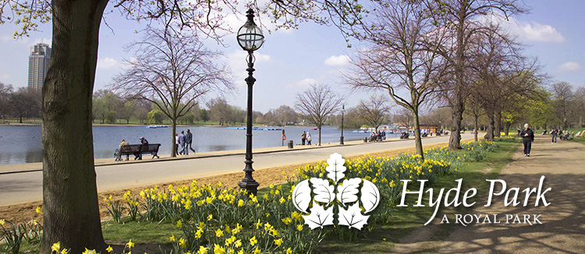
1-7.Location is in London, England.

Slide 9

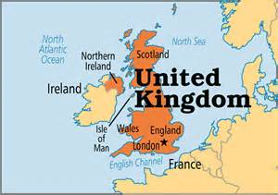
2-1.Great Britain is separated from the mainland by the North Sea and by the English Channel.

Slide 10

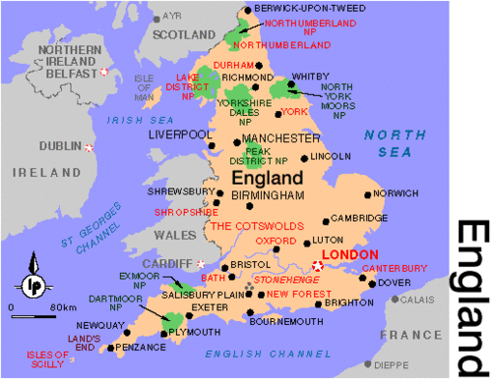
2-2.The nearest neighbour to Great Britain is France

Slide 11

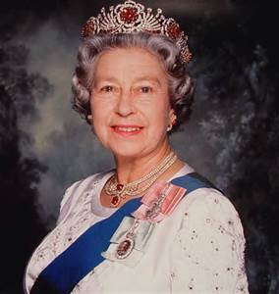
2-3.Queen Elizabeth II is the head of the United Kingdom

Slide 12

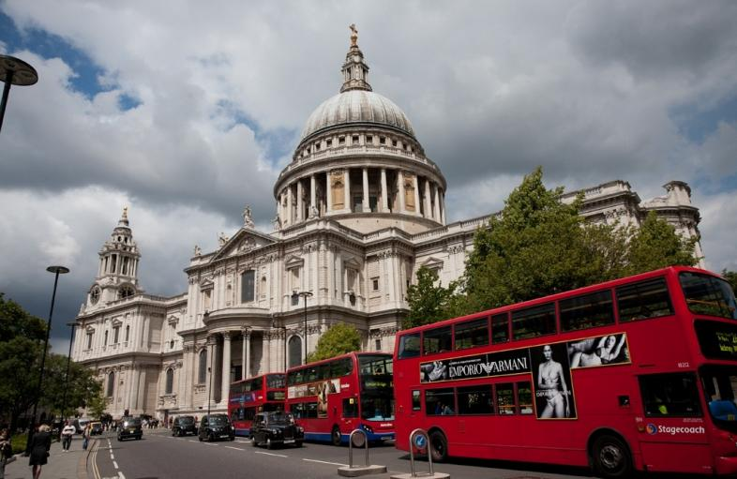
2-4.St Paul’s Cathedral was built by Sir Christopher Wren within his lifetime.

Slide 13

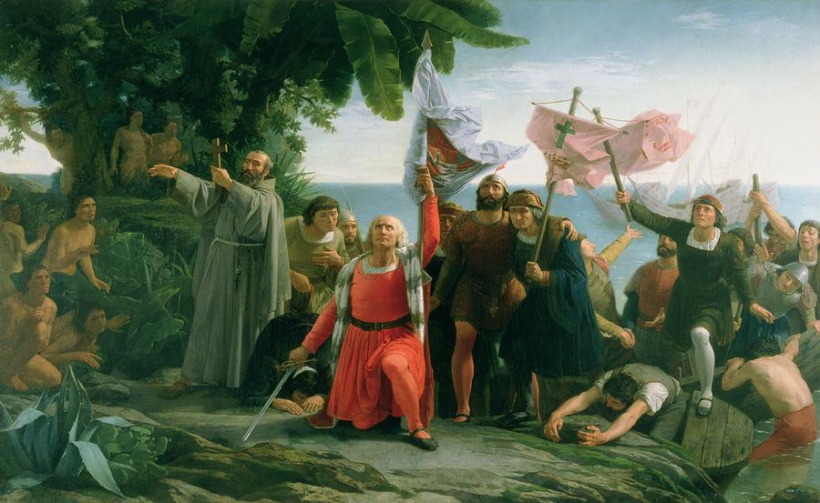
2-5.Christopher Columbus discovered America in October 1492

Slide 14

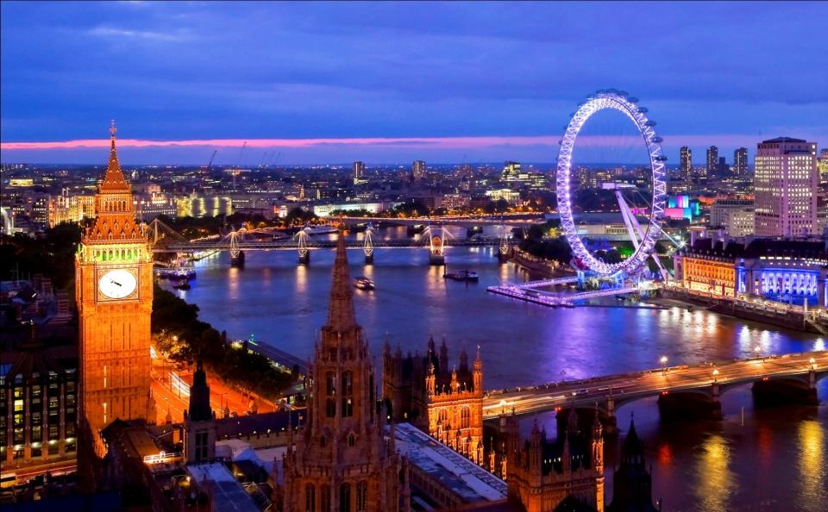
2-6.The oldest part of London is the City

Slide 15

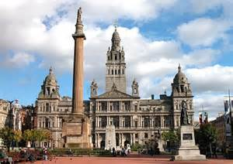
2-7.The biggest city in Scotland is Glasgow

Slide 16


3-1.Independence Day is a federal holiday in the USA commemorating the adoption of the Declaration of Independence on July 4, 1776, declaring independence from Great Britain.

Slide 17

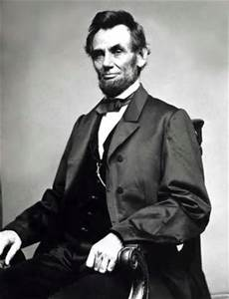
3-2.Abraham Lincoln (February 12, 1809 – April 15, 1865) was the 16-th President of the United States.

Slide 18


3-3.Winter months in Australia are June, July and August.

Slide 19



3-4.Jeans have become one of the most worn pieces of clothing in the world. Everybody wears them.

Slide 20

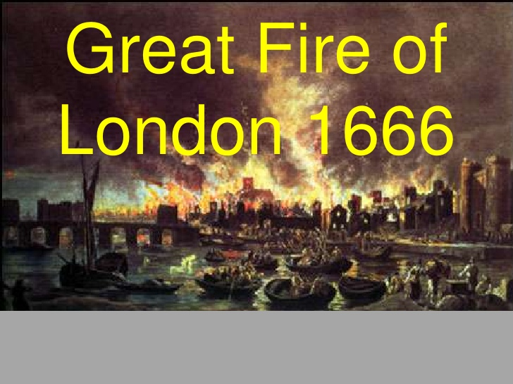
3-5.The Great Fire of London swept through the central parts of the English city of London, from Sunday, 2 September to Wednesday, 5 September 1666.

Slide 21

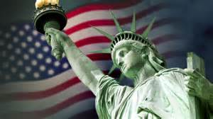
3-6.The official national symbol of the USA is the Statue of Liberty.
Notes:
the

Slide 22


3-7.Перевод: rain: it's raining cats and dogs
[идиома] дождь льет как из ведра

Slide 23

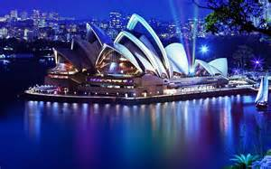
4-1.Sydney is the state capital of New South Wales and the most populous city in Australia.
.
Notes:
capital

Slide 24

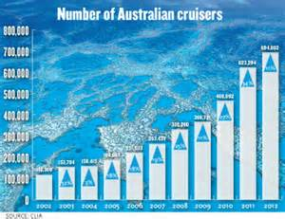
4-2.The term Australian diaspora: refers to the approximately 1,000,000 Australian citizens who today live outside Australia.

Slide 25

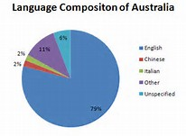
4-3.Australia has no official language, it is largely monolingual with English being de facto the national language. 76.8% of people spoke only English at home (2011 census).

Slide 26

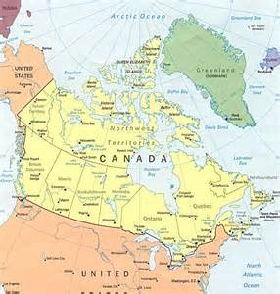
4-4.Canada is the world's largest country that borders only one country

Slide 27


4-5.The national symbol of Canada is the maple leaf.

Slide 28

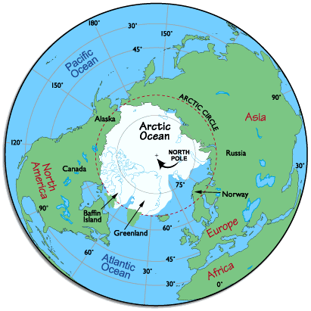
4-6.Currently, under international law, no country owns the North Pole or the region of the Arctic Ocean surrounding it.

Slide 29


4-7.Your friend has a birthday. What do you say?

Slide 30

The Blitz – Questions to Choose the Best

Slide 31
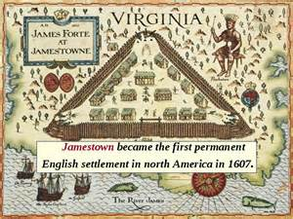

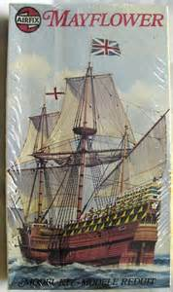

The Blitz

Slide 32
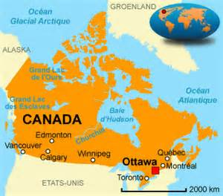

The Blitz
The US President’s term is: US presidents are elected to a four-year term. The maximum number of full terms that a president can serve is two. Presidents who took over for another President and have served more than two years can seek only one additional term

Slide 33

GOOD LUCK!

