Slide 1
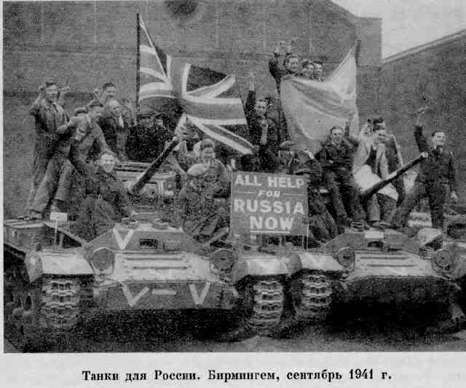
Lend-lease
October 1941–
the USSR, England and the USA have agreed
about the
Anglo-American supplies
to our country of arms
and food
in exchange for strategic raw materials.
Lend-lease
is a form of interstate relations
which means the help
in military equipment, food and goods
to a country-ally.

Slide 2
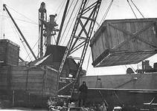
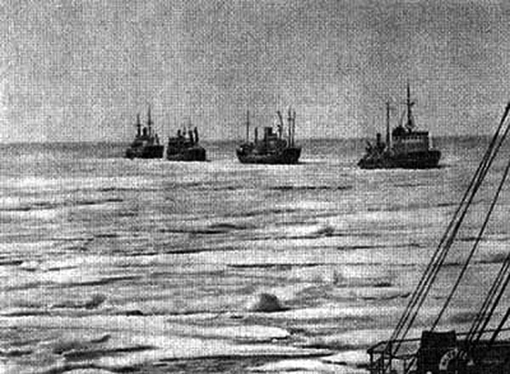
The ships delivered military equipment, food and goods
to the USSR to the ports of Murmansk and Arkhangelsk.

Slide 3
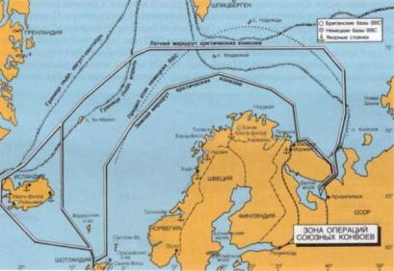
The goods delivered to the USSR by the lend-lease
The supply routes | tonnage, thousand tons | % of total
Pacific | 8 244 | 47,1
Via Iran | 4 160 | 23,8
Arctic convoys | 3 964 | 22,6
Black Sea | 681 | 3,9
Soviet Arctic | 452 | 2,6
All | 17 501 | 100,0

Slide 4
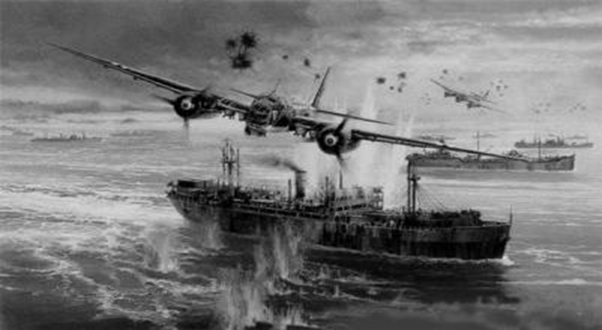
Arctic convoys were the fastest supply routes
but also the most dangerous because
they were bombed by the fascist planes.

Slide 5
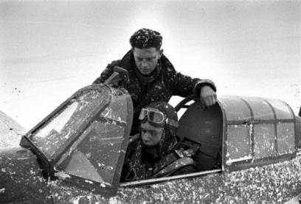
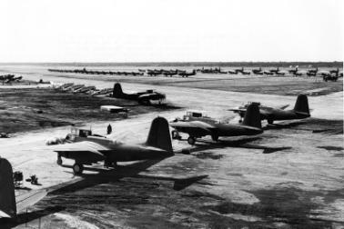
A Soviet fighter-pilot
Maksimovich V.P.
trained driving on
the English fighter "hurricane" under the direction of
an English pilot Votsevis Paul.
A-20 Boston and other aircraft before being sent to the USSR.

Slide 6
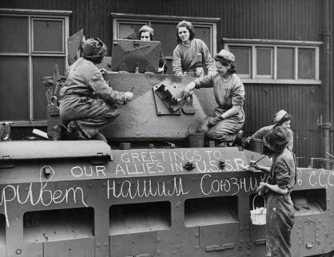
The USA. Women prepared tank "Matilda"
to send to the USSR.

