Slide 1
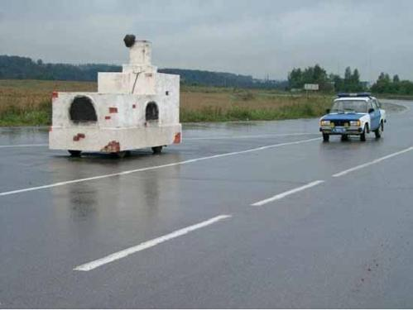
Конкурсная мультимедийная презентация на фестиваль педагогических идей «открытый урок»
2011-2012
Автор разработки: Максимова Ирина Николаевна, учитель английского языка ГБОУ СОШ №197, г. Москвы.
Travelling and Transport
Учебник И.Н. Верещагиной, О.В. Афанасьевой «ENGLISH 4»
Notes:
Good morning, my dear friends! I'm glad to see you! Take your seats, please. Today we'll speak about travelling and transport.

Slide 2
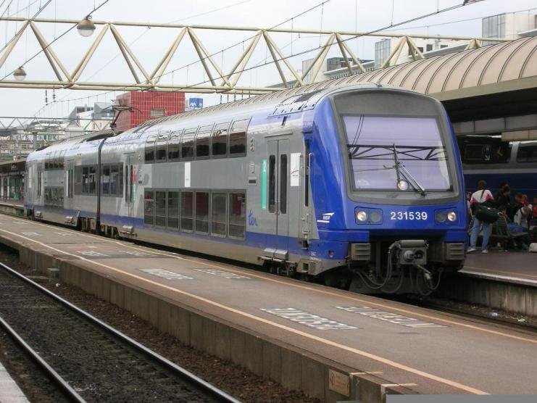
Train
Notes:
Do you like travelling?
What means of travelling do you know?
Look at the slides and name us all kinds of transport you can see.

Slide 3
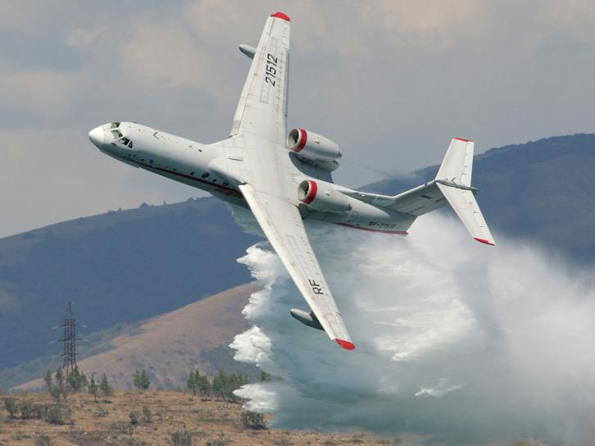
Plane

Slide 4
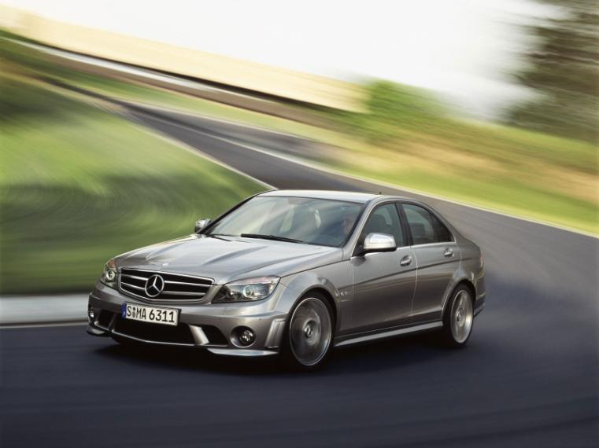
car

Slide 5
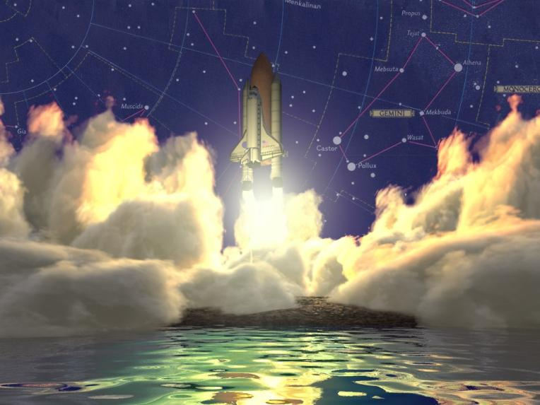
spaceship

Slide 6
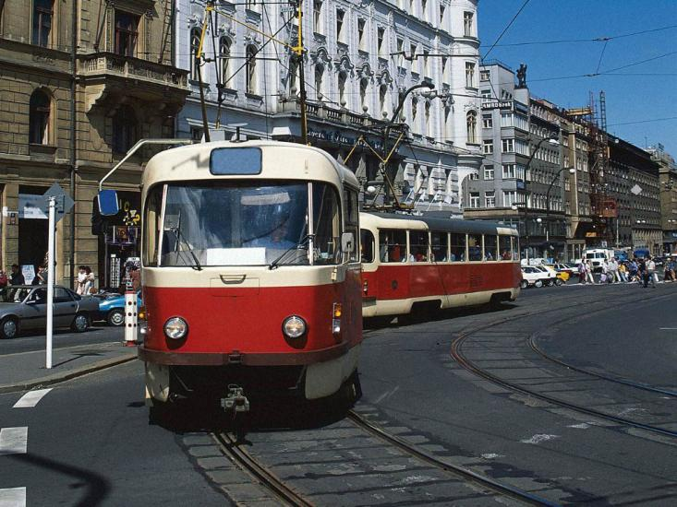
tram

Slide 7
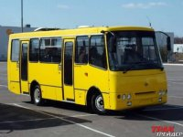
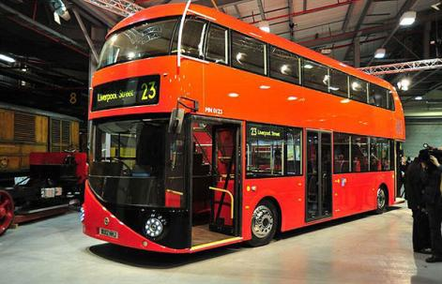
Bus double-decker bus

Slide 8
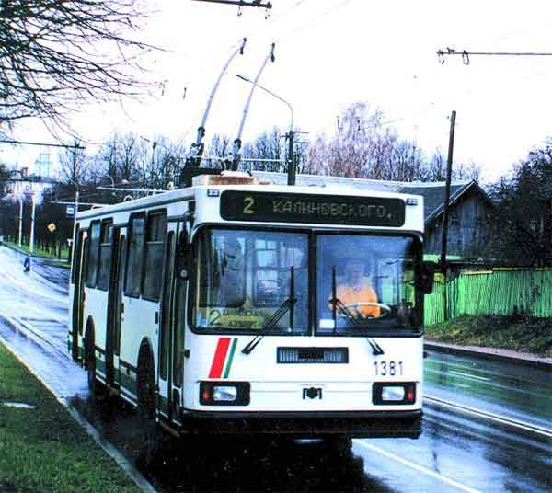
trolleybus

Slide 9
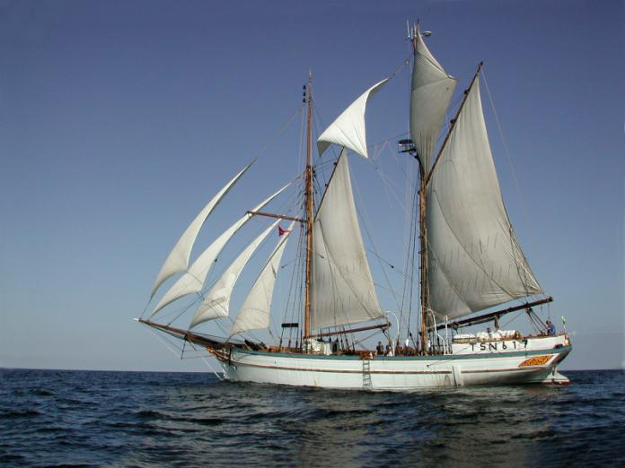
ship

Slide 10
Use the following expressions:
I think (that) ……………
I suppose ………………
I don’t think …………….
In my opinion …………..
I believe ………………...
I don’t believe …………..
Notes:
Which is the quickest method of travelling?
Which one is the slowest?
Which one is the most comfortable?
Which method of transport is the cheapest?
Which one is the most expensive?
Which method is the most comfortable?

Slide 11
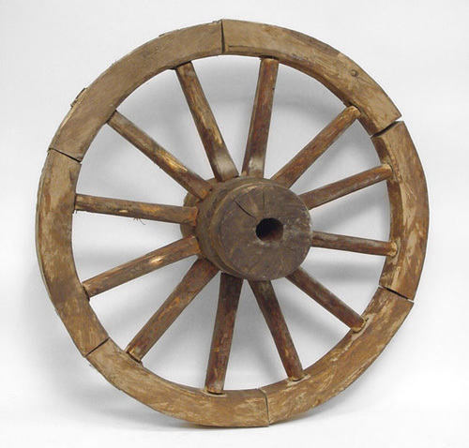
wheel
Notes:
Look at the slide! Everything started with the wheel. Nobody knows who created it but it was one of the greatest inventions of the mankind. Repeat this word!

Slide 12
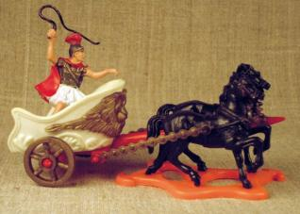
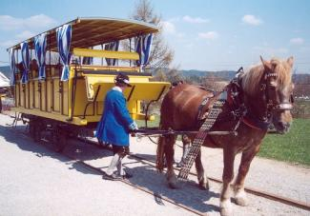
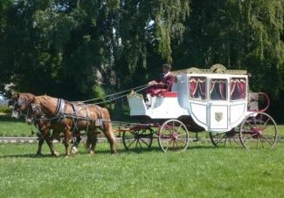
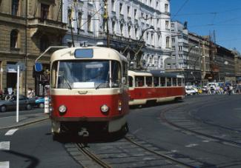
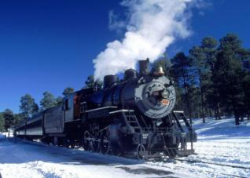
Chariot – carriage - horse tramway – tram - train
Notes:
Now, children, look and repeat the names of different kinds of transport in their historical order.

Slide 13
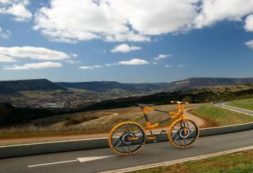
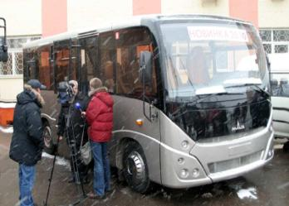
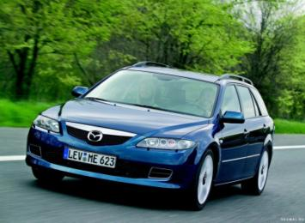
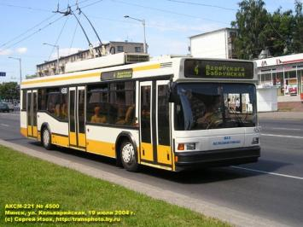
Bicycle – car – bus - trolleybus

Slide 14
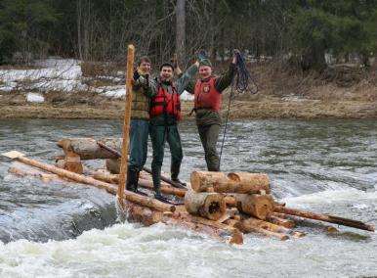
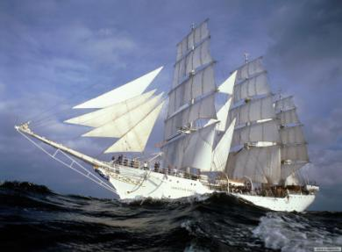
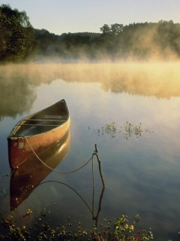
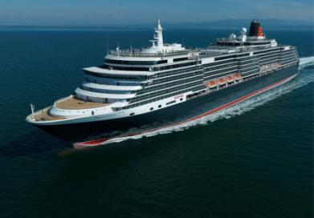
Raft – boat – ship – steamer (steamship)

Slide 15
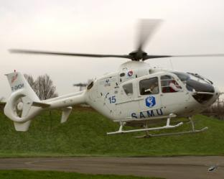
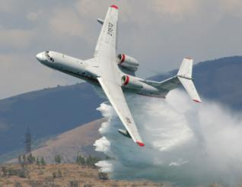
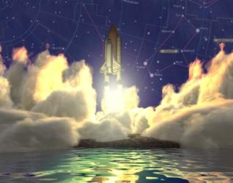
Helicopter – plane - spaceship
Plane
Helicopter
Spaceship

Slide 16
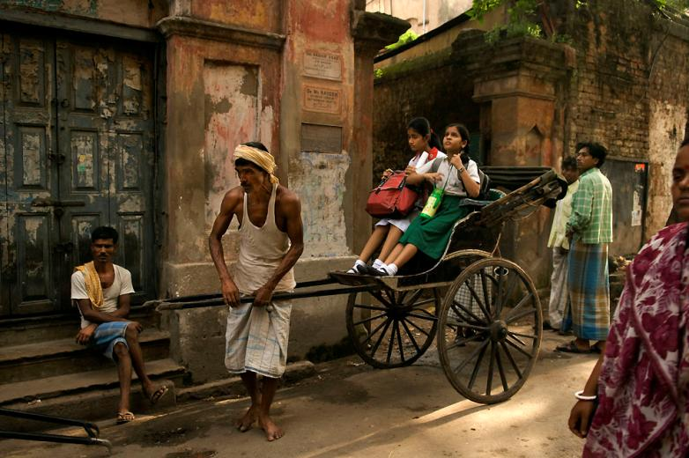
rickshaw
Notes:
But transport differs in different countries. It depends on the geographical position of the country and its economical development. In poor Asian countries like India people still use such kind of transport as rickshaw. Repeat after me this name.

Slide 17
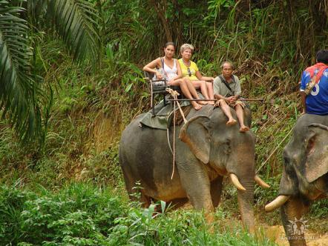
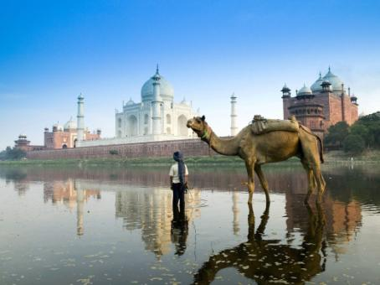
Elephant, camel
Camel
Elephant
Notes:
My dear friends, can you name me some animals which people use for travelling in Asian, African and Nothern countries.

Slide 18
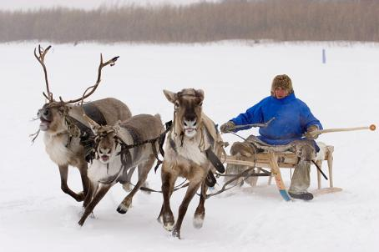
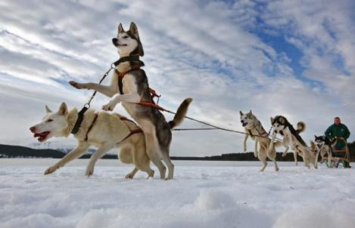
Deer, dogs
Dogs
Deer

Slide 19
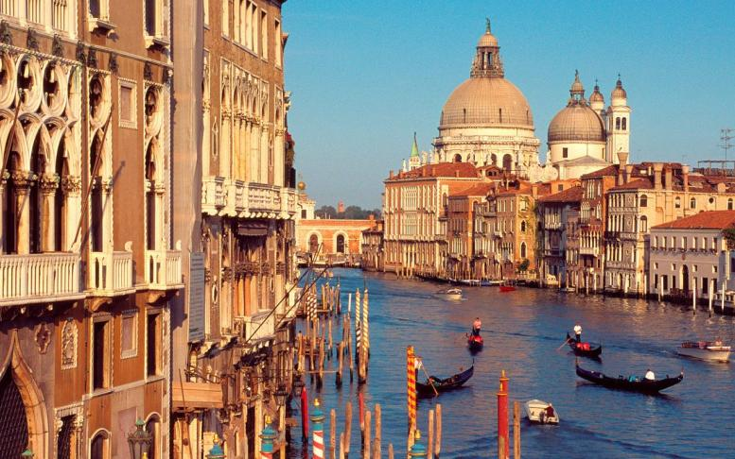
gondola
Notes:
What exotic means of travelling can we see in Italy, in the city of Venice?

Slide 20
crossword
9
6
c
h
r
i
t
c
a
c
1
g o n d o l a
8
10
r
c
k
h
a
t
o
l
l
y
b
u
s
2
h e l i c o p t e r
7
11
3
s p a c e s h i p
t
a
m
l
a
n
e
4
d e e r
5
w h e e l
Notes:
My dear friends, can you tell me what new information you've got from this lesson. Do you remember the names of transport that people used many years ago? Can you name me some extraordinary means of travelling? What modern kinds of transport do people use?
Let’s do the crossword!

Slide 21
WELL DONE!!!
THANK YOU FOR THE LESSON!

