Slide 1
Урок английского языка
по теме
«Дорожная безопасность»
с применением технологии
«развития критического мышления»
6 класс
Автор:
Васильева Е. В.,
учитель ГБОУ лицея № 419 Петродворцового района
Санкт-Петербурга

Slide 2
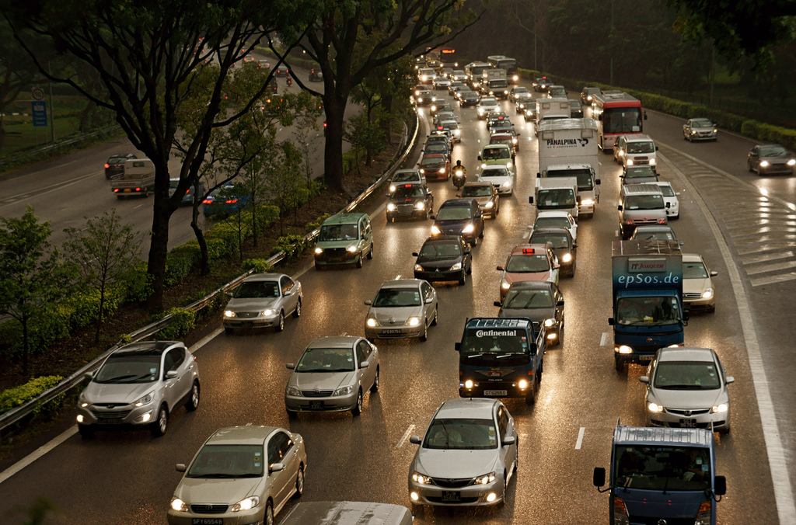

Slide 3
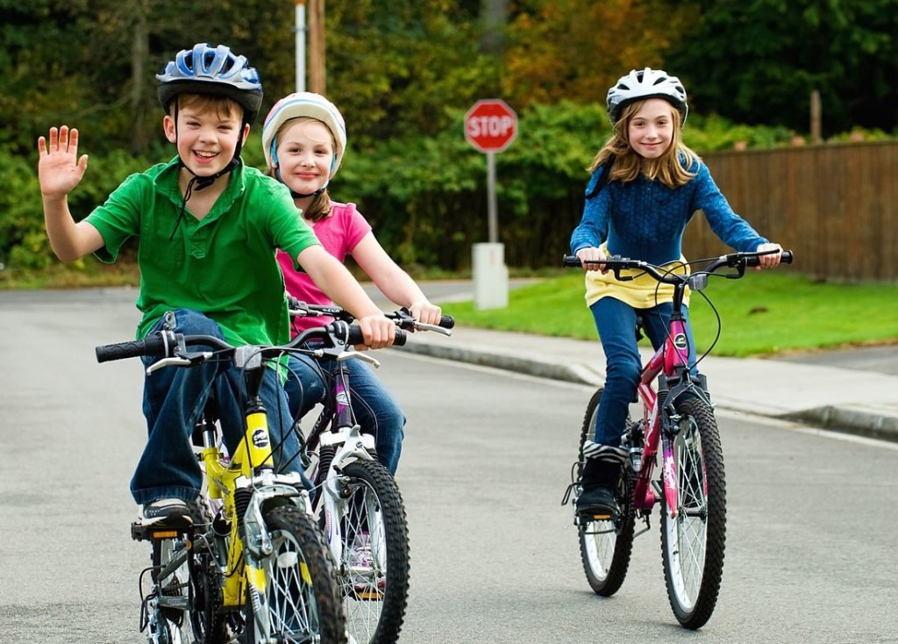

Slide 4
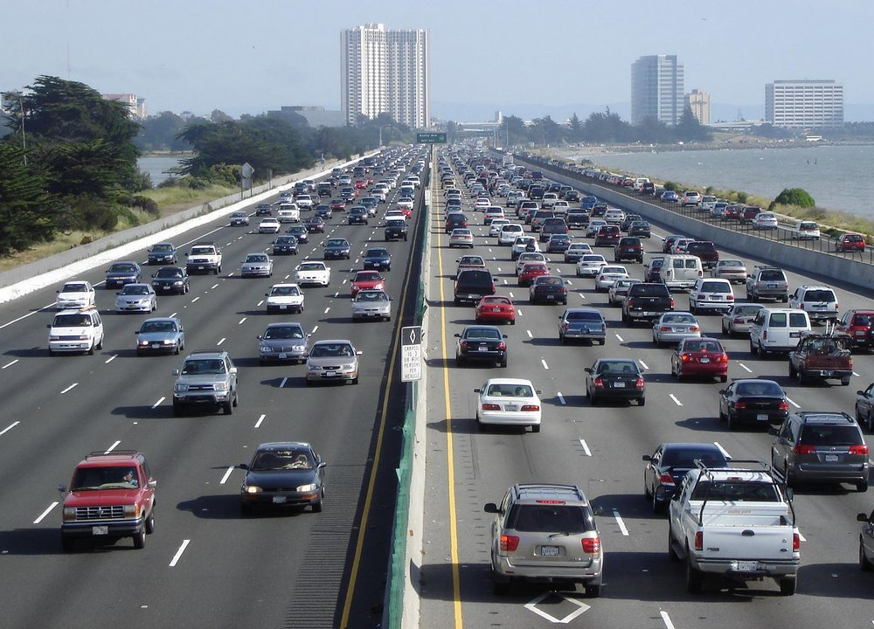

Slide 5
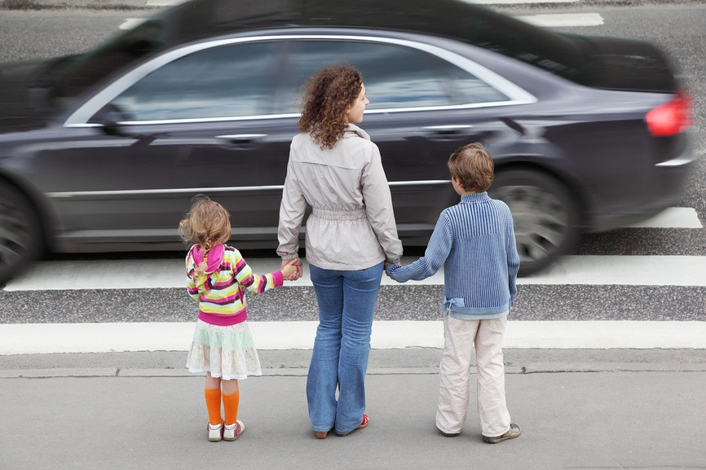

Slide 6
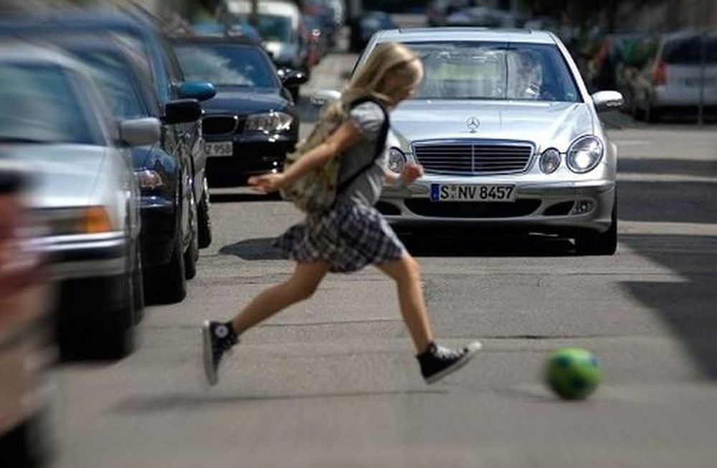

Slide 7
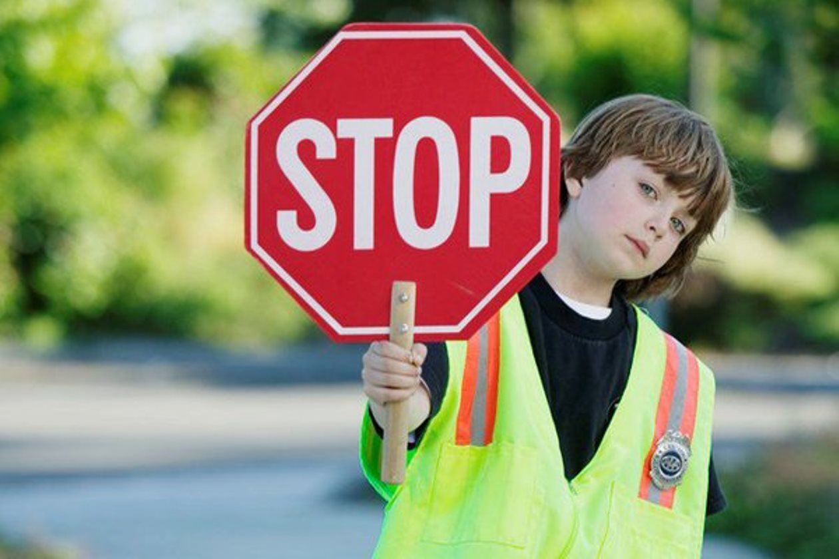
Road safety

Slide 8
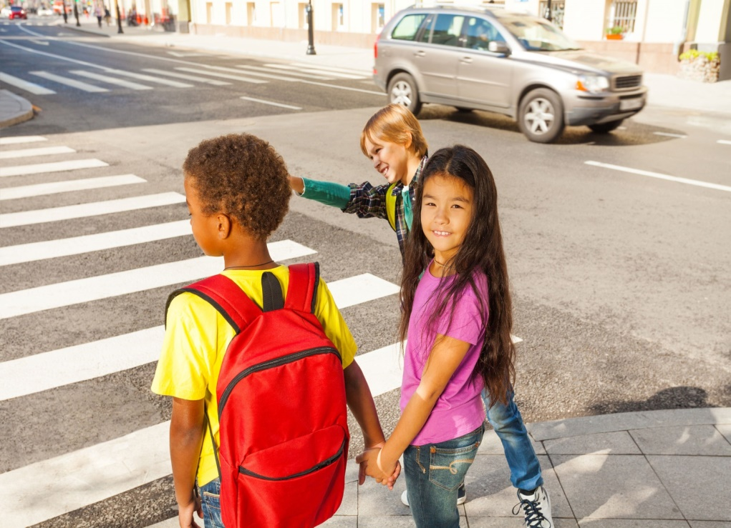
When you cross the street on foot
1. Stand on the pavement;
2. Look both ways for traffic.

Slide 9
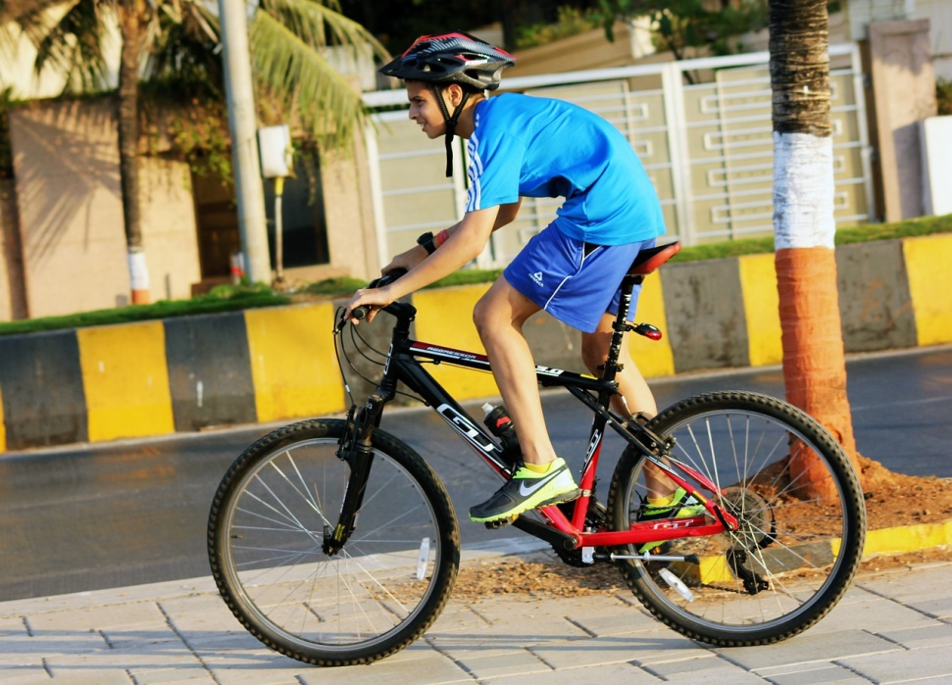
When you ride your bike
1. Ride with the flow of traffic;
2. Use bike lanes;
3. Wear bright clothes.

Slide 10
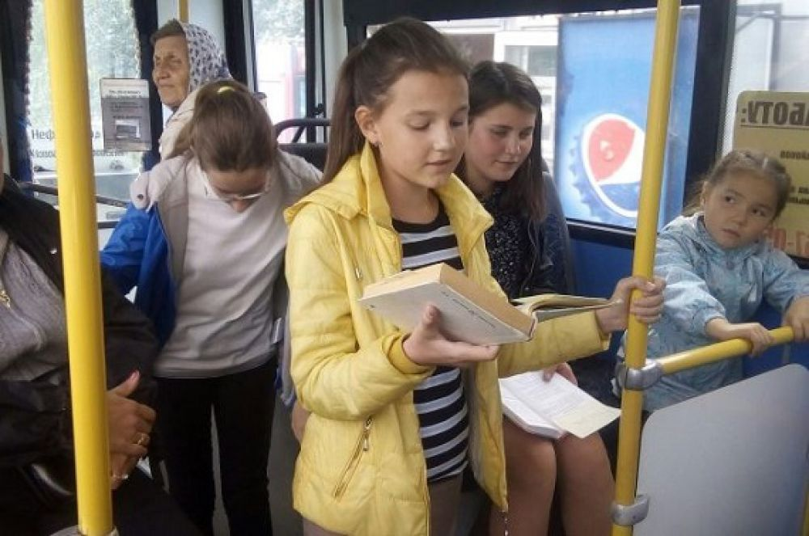
When you travel on a bus
1. Use handgrips;
2. Don’t lean out of the window;
3. Don’t talk to the driver.

Slide 11
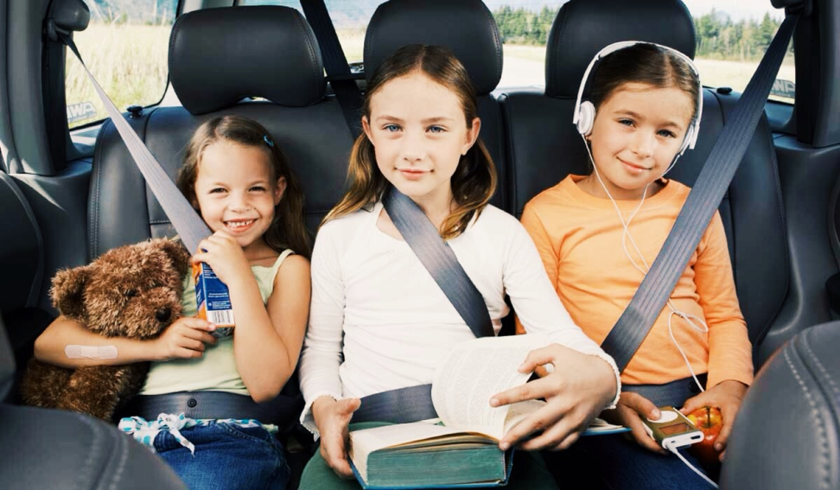
When you travel in a car
1. Wear a seat belt;
2. Don’t block the rear view mirror;
3. Don’t play with the car door handles.

Slide 12
Cluster
bus
driver
breaks
bicycle
car
tyre
bright clothes
seat belt

Slide 13

New words:
1. Kerb 9. Zebra crossing
2. Pavement
3. Traffic lights
4. Flow
5. Traffic warden
6. Bike lanes
7. Seat belt
8. Handgrips

Slide 14
«Thin» and «thick» questions
«Thin» | «thick» questions
Сan you cross the road between parked cars? 2. Do you have to wear a bicycle helmet? 3. Сan you lean out of the car window? etc. | Why do you need to look both ways for traffic? 2. What is the most important idea of the text? 3. What is the difference in road safety using by car or a bike? 4. If you had a lot of money would you buy a car or a bike? Why … ? etc.

Slide 15
Insert
I – interactive: самоактивизирующая "V" – уже знал;
N – noting: системная разметка "+" – новое;
S – system: для эффективного "–" – думал иначе;
E – effective: чтение и размышление "?" – непонятно или же вы хотели бы получить более подробные сведения по данному вопросу.
R – reading
T – thinking

Slide 16
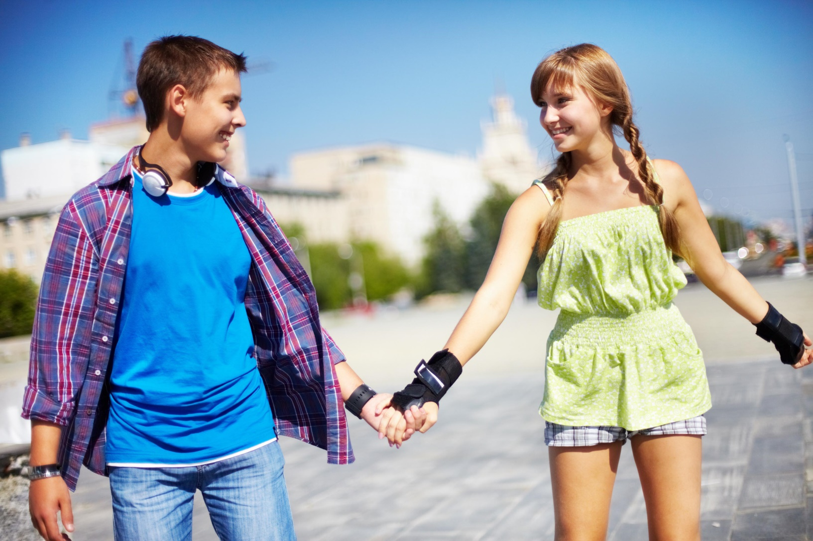
Listen, choose the correct answer:
Paula and David are on the street

Slide 17
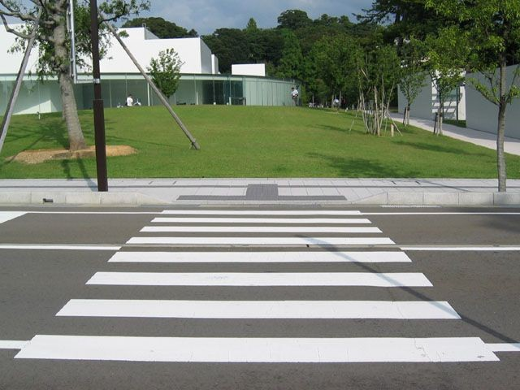
Listen, choose the correct answer:
The zebra crossing is quite far

Slide 18
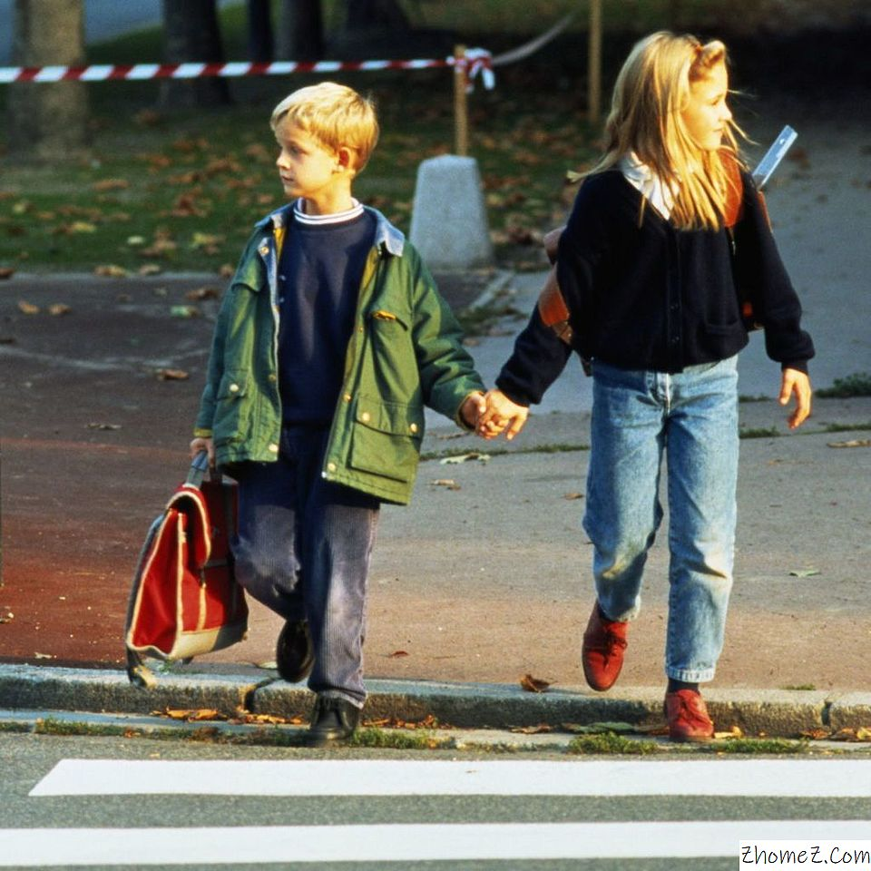
Listen, choose the correct answer:
David tells Paula to go quickly to the other side

Slide 19
Сinquain
1 | a noun | road safety
2 | two adjectives | Main and great
3 | 3 verbs or participles | Protecting, teaching, helping
4 | an expression | It’s so important
5 | a noun | like a traffic warden!

Slide 20

Thank you

