Slide 1
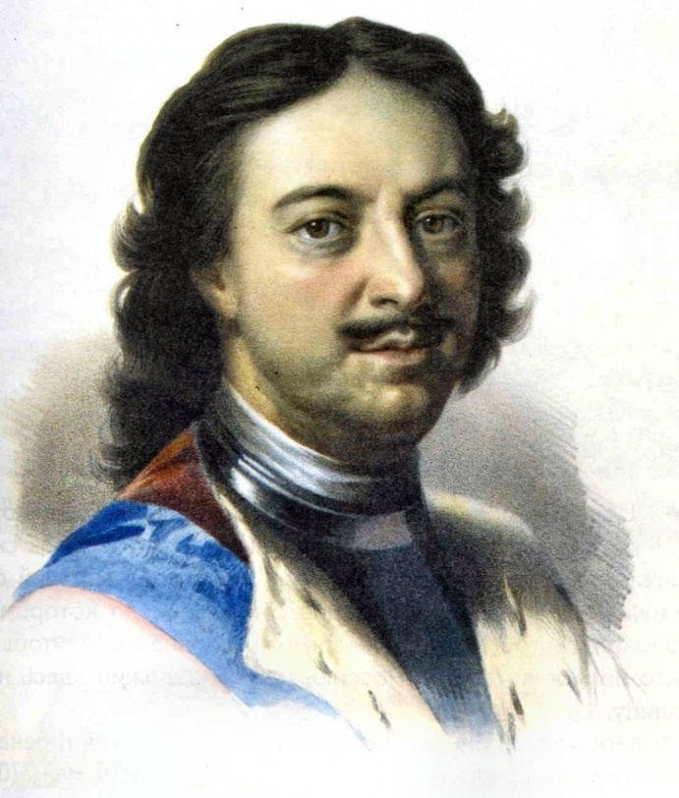
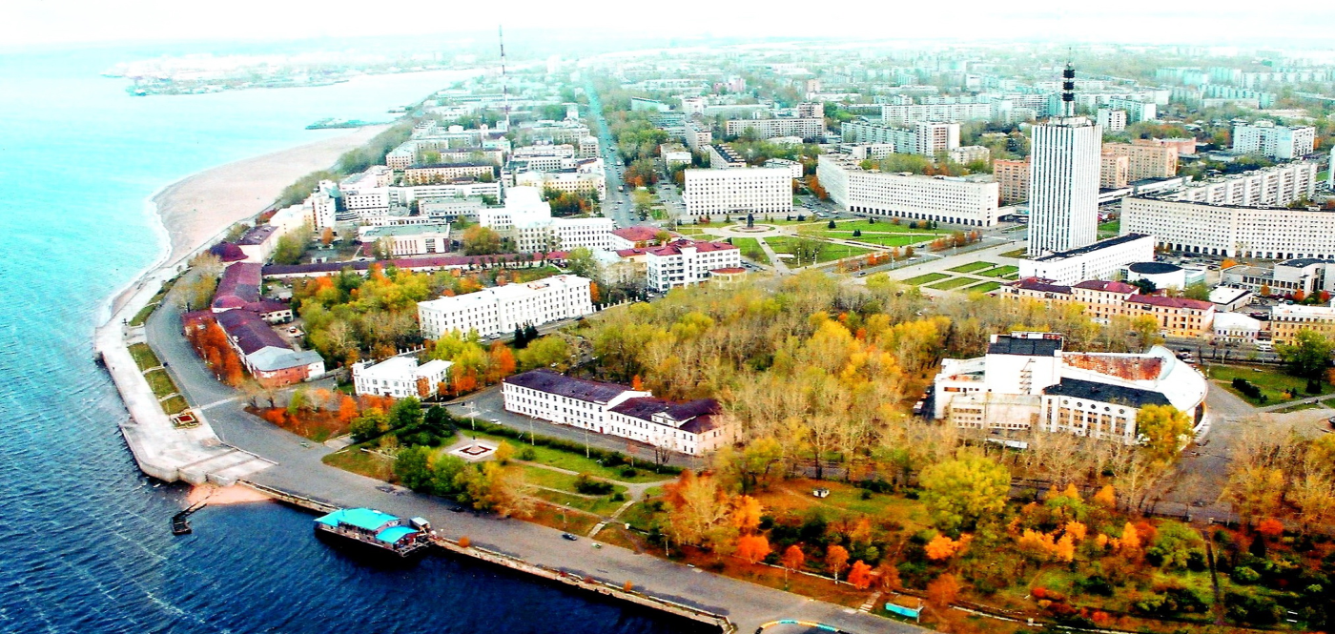
«Памятные петровские места в Архангельске»

Slide 2
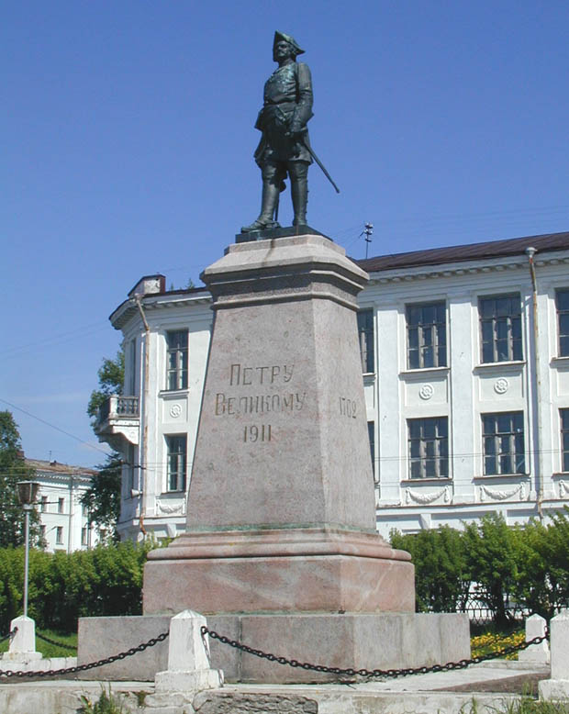
Памятник Петру Первому

Slide 3
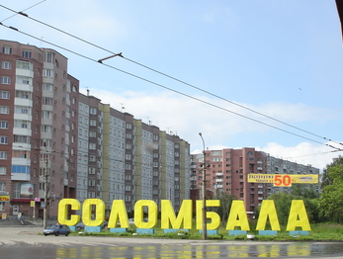
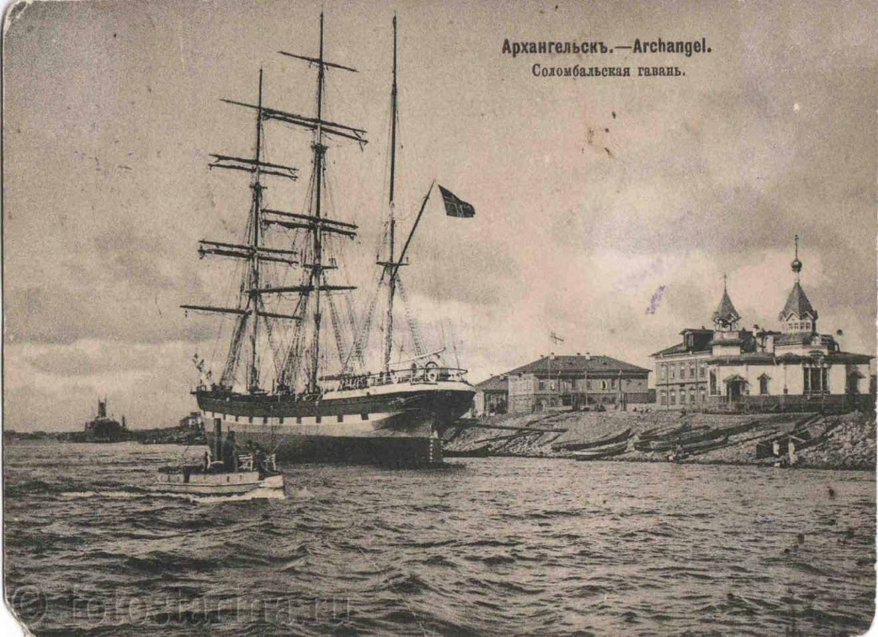
Соломбала

Slide 4
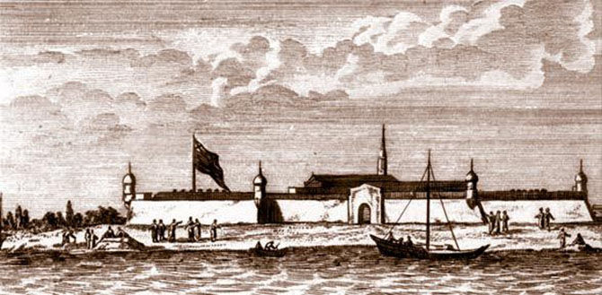
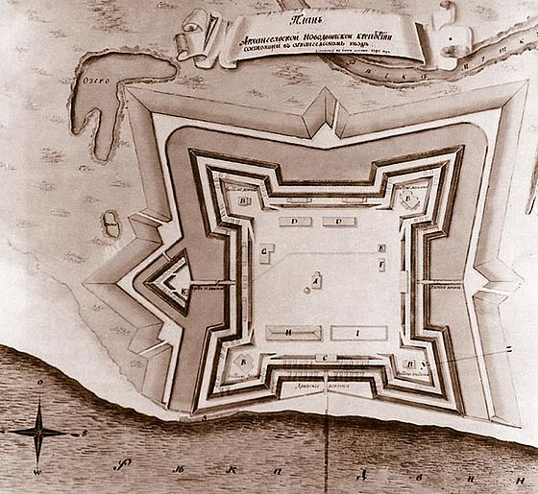
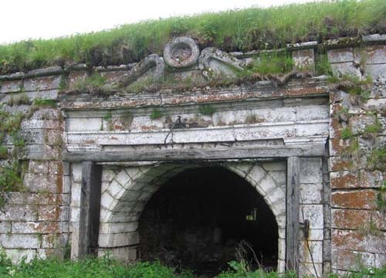
Новодвинская крепость

Slide 5
Интернет - ресурсы
http://library.narfu.ru/rus/TRResources/ThematicBibliographies/PublishingImages/arh_old.jpeg
https://yandex.ru/images/#!/images/search?img_url=http%3A%2F%2Fru-an.info%2FPhoto%2FNews%2Fn3972%2F19.jpg&_=1454876461375&text=%D0%BA%D0%B0%D1%80%D1%82%D0%B8%D0%BD%D0%BA%D0%B0%20%D0%BD%D0%BE%D0%B2%D0%BE%D0%B4%D0%B2%D0%B8%D0%BD%D1%81%D0%BA%D0%B0%D1%8F%20%D0%BA%D1%80%D0%B5%D0%BF%D0%BE%D1%81%D1%82%D1%8C&noreask=1&redircnt=1454964392.1&pos=16&rpt=simage&lr=2
https://yandex.ru/images/#!/images/search?img_url=http%3A%2F%2Fimg.tourbina.ru%2Fphotos.3%2F1%2F0%2F105163%2Fsuper.photo.jpg&_=1454876461375&text=%D0%BA%D0%B0%D1%80%D1%82%D0%B8%D0%BD%D0%BA%D0%B0%20%D0%BD%D0%BE%D0%B2%D0%BE%D0%B4%D0%B2%D0%B8%D0%BD%D1%81%D0%BA%D0%B0%D1%8F%20%D0%BA%D1%80%D0%B5%D0%BF%D0%BE%D1%81%D1%82%D1%8C&noreask=1&redircnt=1454964392.1&pos=6&rpt=simage&lr=2
https://yandex.ru/images/#!/images/search?img_url=http%3A%2F%2Fwww.rus-nations.ru%2Fdata%2Fpics%2Fpetr_778.jpg&_=1454877355093&text=%D0%BF%D0%B0%D0%BC%D1%8F%D1%82%D0%BD%D0%B8%D0%BA%20%D0%BF%D0%B5%D1%82%D1%80%D1%83%20%D0%BF%D0%B5%D1%80%D0%B2%D0%BE%D0%BC%D1%83%20%D0%B2%20%D0%B0%D1%80%D1%85%D0%B0%D0%BD%D0%B3%D0%B5%D0%BB%D1%8C%D1%81%D0%BA%D0%B5&noreask=1&redircnt=1454965281.1&pos=2&rpt=simage&lr=2
https://yandex.ru/images/#!/images/search?img_url=http%3A%2F%2Fstatic.panoramio.com%2Fphotos%2Flarge%2F3761056.jpg&_=1454877781578&text=%D1%81%D0%BE%D0%BB%D0%BE%D0%BC%D0%B1%D0%B0%D0%BB%D0%B0&noreask=1&redircnt=1454965725.1&pos=3&rpt=simage&lr=2
http://fotostarina.ru/file/arhangelsk/345__Arhangelsk._Solombalskaya_gavan._-_kopiya.jpg

