Slide 1

My body!
My face!

Slide 2
head

Slide 3
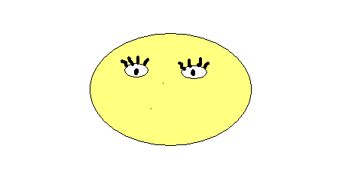
eyes

Slide 4
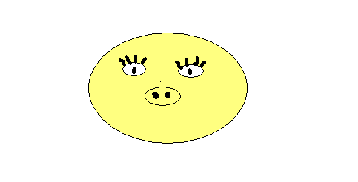
nose

Slide 5
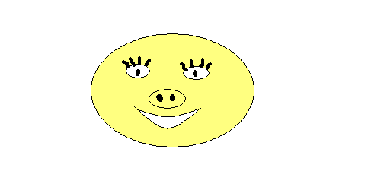
mouth

Slide 6
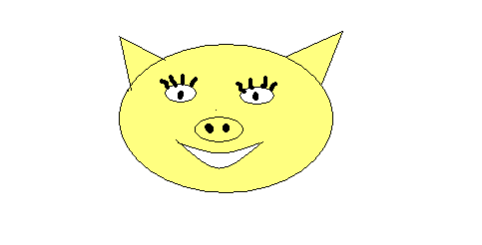
ears

Slide 7
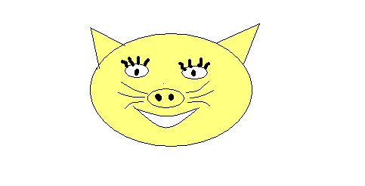
What’s this?
It’s a cat!

Slide 8
Let’s make a dog!

Slide 9
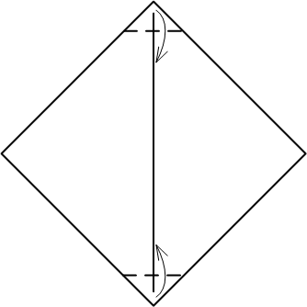
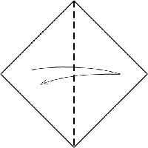
Fold a square sheet of paper:

Slide 10
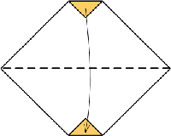
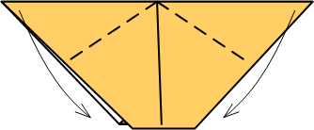
Let’s make a head

Slide 11
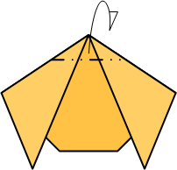
Let’s make ears

Slide 12
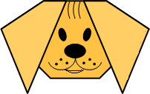
Draw eyes, a nose and a mouth and colour your dog!

Slide 13
Match the words:
Head
Eyes
Ears
Mouth
Nose
Рот
Голова
Нос
Глаза
Уши

Slide 14
The end!

