Slide 1
Food and drink
English lesson

Slide 2
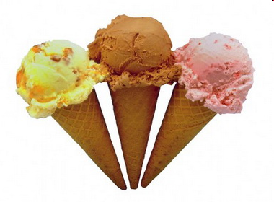
ice cream

Slide 3
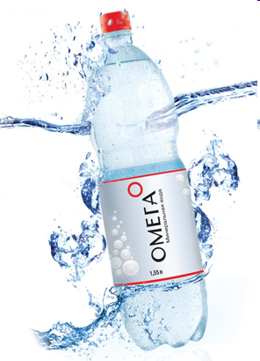
mineral water

Slide 4
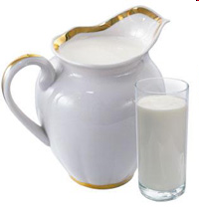
milk

Slide 5
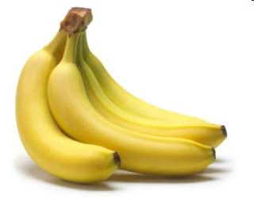
bananas

Slide 6
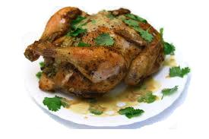
chicken

Slide 7
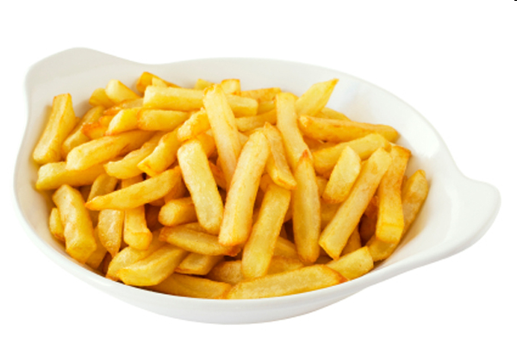
chips

Slide 8
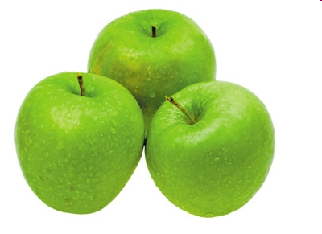
apples

Slide 9
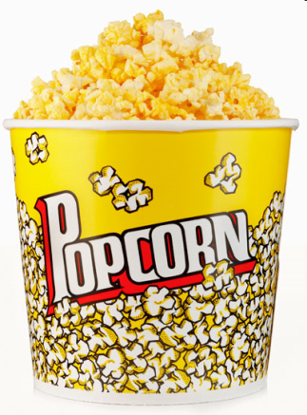
popcorn

Slide 10
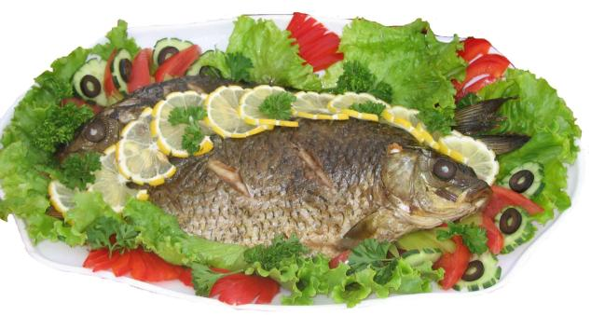
fish

Slide 11
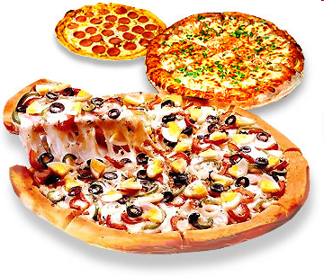
pizza

Slide 12
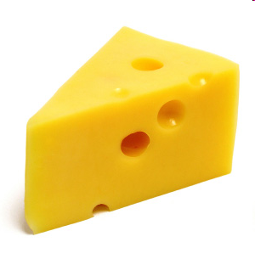
cheese

Slide 13
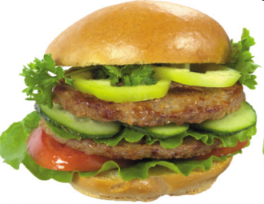
hamburgers

Slide 14
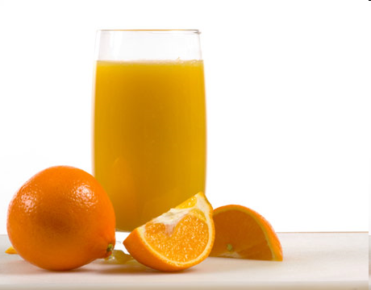
orange juice

Slide 15
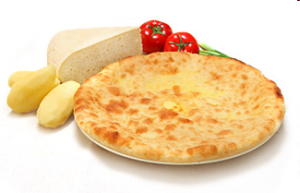
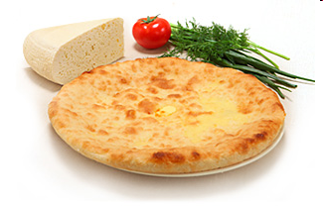
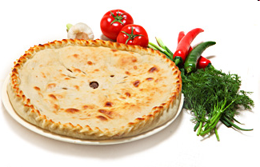
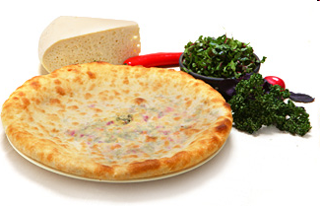
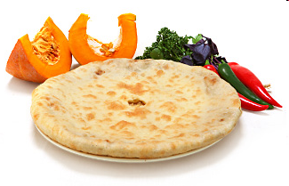
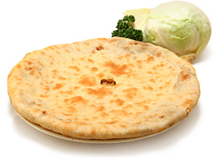
ossetian pies
Kartofchin –
potato pie
Ualibah –
cheese pie
Fydchin –
meat pie
Saharadzhin –
beet leaves pie
Nashchin –
pumpkin pie
Kabushkadzhyn –
cabbage pie

Slide 16
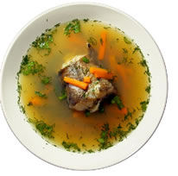
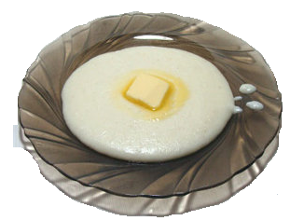
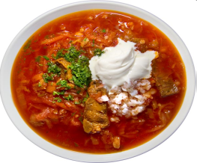
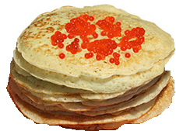
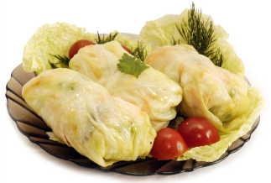
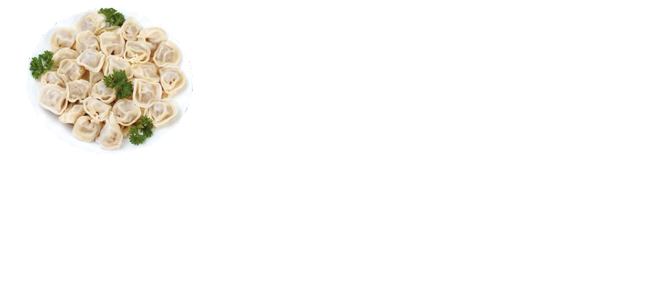
Russian food
Fresh-soup
Kasha
Borscht
Pancakes
Stuffed cabbage
Pelmeni

Slide 17
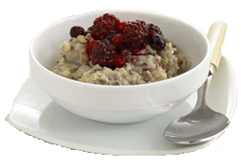
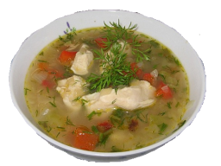
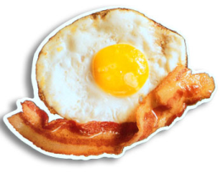
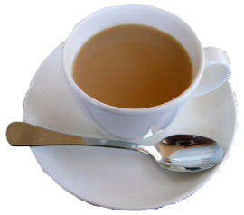
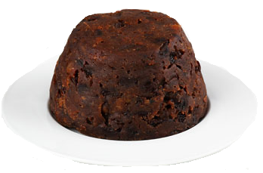
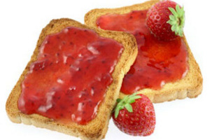
English food
Porridge
Chicken soup with onion
Bacon and eggs
Tea with milk
Pudding
Toast and jam

Slide 18


Do you like… ?
Yes, I do.
No, I don’t.

Slide 19
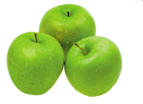

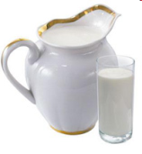
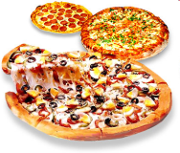
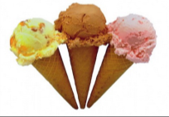

The chant
Do you like ?
Do you like ?
Do you like ?
What do you like?

Slide 20

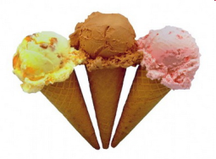


What’s your favourite food?
My favourite food is…

Slide 21
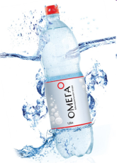

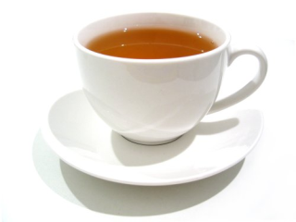
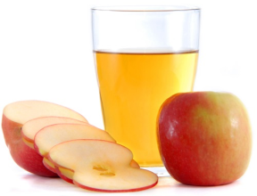

What’s your favourite drink?
My favourite drink is…

Slide 22
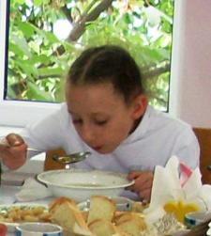







About myself
I like I don’t like My favourite
I like chicken, hamburgers and bananas.
I don’t like fish or cheese.
My favourite food is pizza.
My favourite drink is apple juice.

Slide 23
Now tell about yourself
I like , and .
I don’t like or .
My favourite food is .
My favourite drink is .

Slide 24
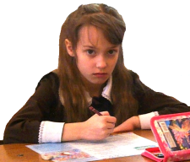
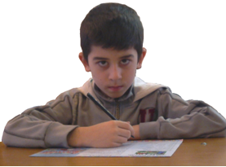
Complete
favourite food
apples
favourite drink
like
don’t
I … fish
and chips.
I … like pizza or … .
My …… is milk.
My …… is chicken.

Slide 25
Resources
“Join Us 4” by Gunter Gerngross & Herbert Puchta, CUP
Pictures Google - Internet

