Slide 1
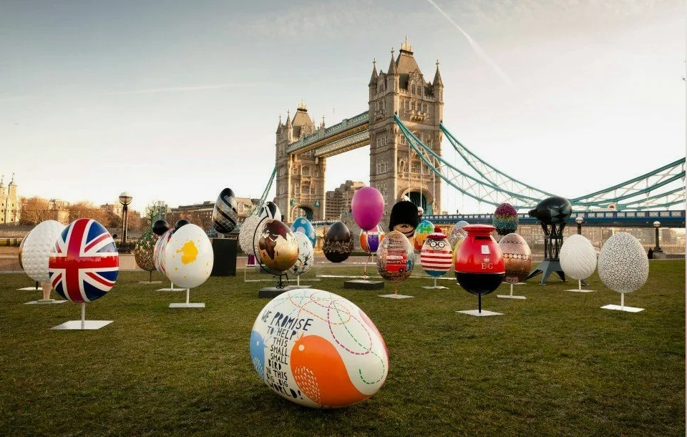
Интерактивное путешествие
в мир английских праздников:
Пасха в Великобритании
Easter in Britain
What a happy Easter day!
Let your fears go away,
Eat and drink,
and have some fun
Under yellow Easter sun!

Slide 2
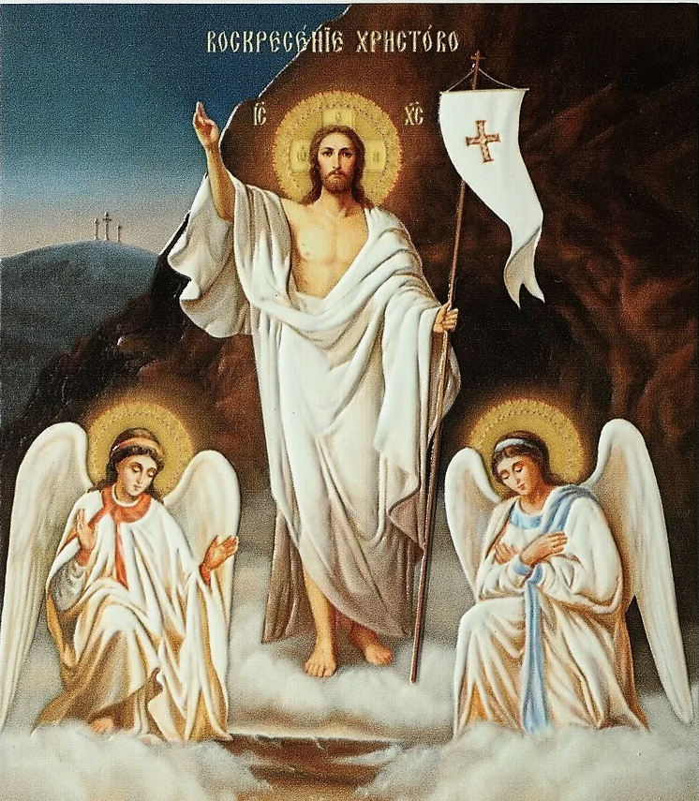
Easter in Great Britain is a significant holiday. It has interesting traditions and symbols.
This holiday is devoted to the Resurrection of our Lord
Jesus Christ.
The exact date of the holiday
changes from year to year.

Slide 3
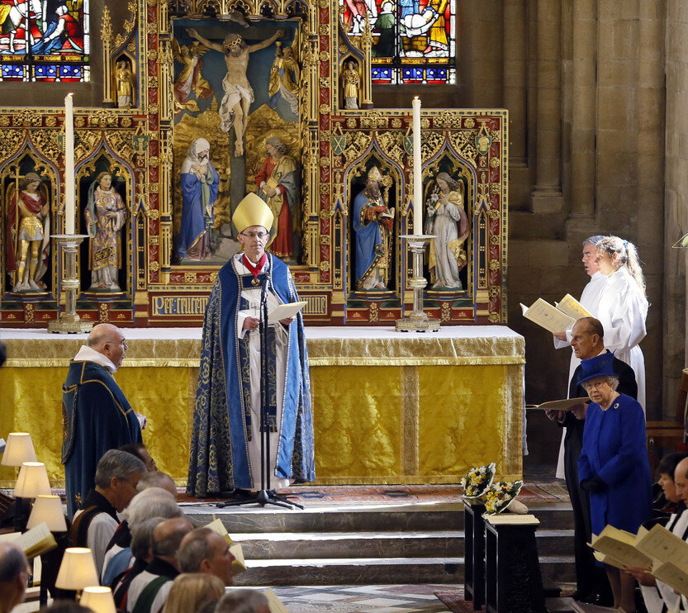
Western Christians celebrate Easter on the first Sunday after the full moon on or after March 21st. It means that Easter can fall between March 22nd and April 25th.

Slide 4
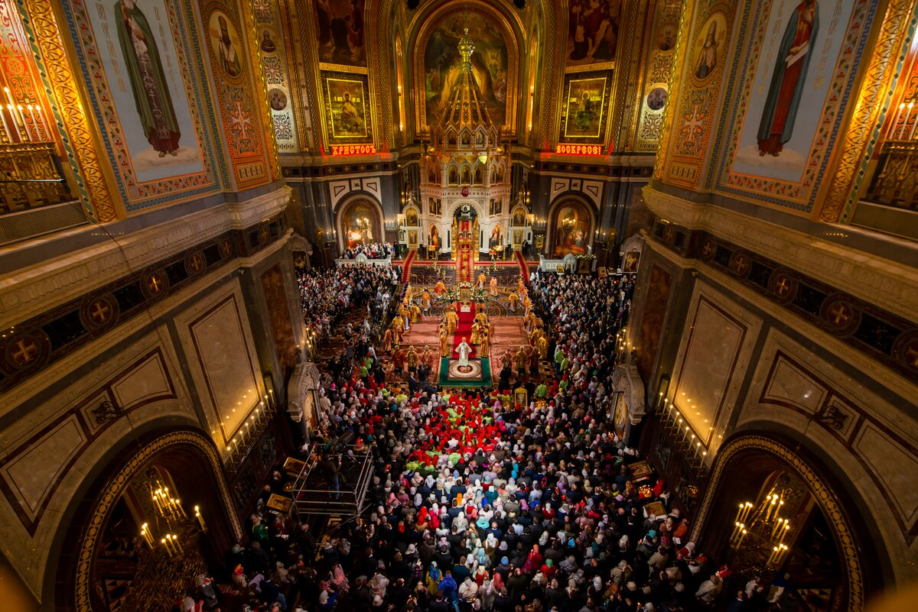
Eastern Orthodox Church follows a slightly different calculation. As a result, the Orthodox Easter, although sometimes coinciding with that of the West, can fall one, four, or five weeks later.

Slide 5
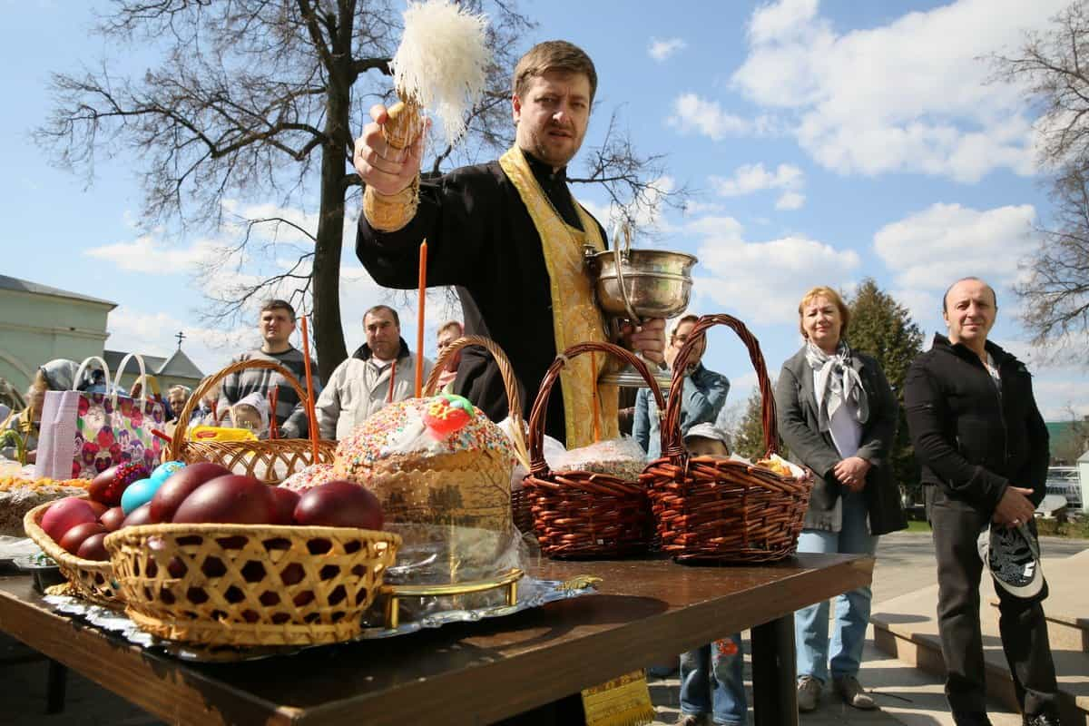
In Russia people
celebrate Easter after
Lent which lasts
for 40 days and Holy Week.
Believers don't eat meat
and animal products during the Lent.

Slide 6
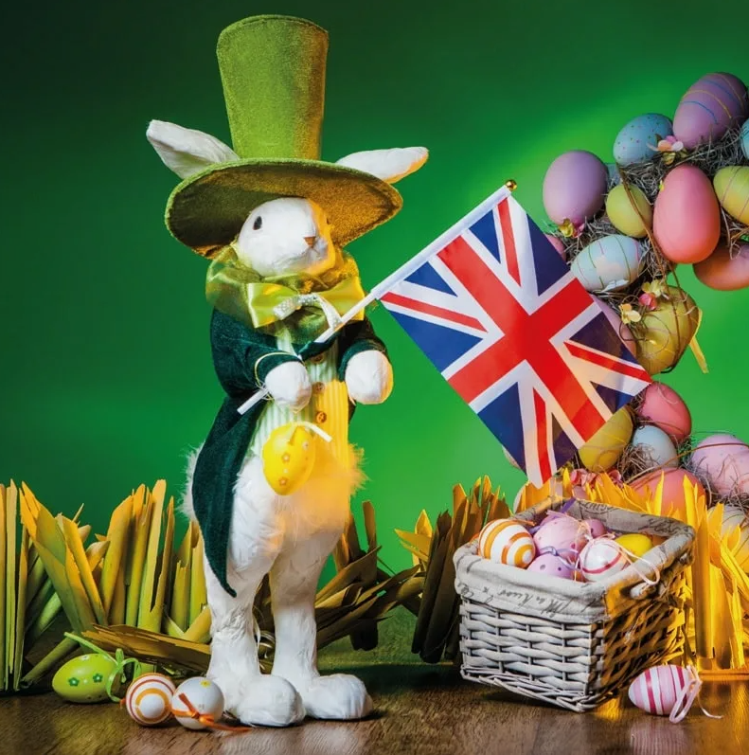
Preparations for Easter
In Britain preparations for Easter start with Lent which
begins on Ash Wednesday and lasts for 40 days (6 weeks except Sundays plus 4 days).

Slide 7
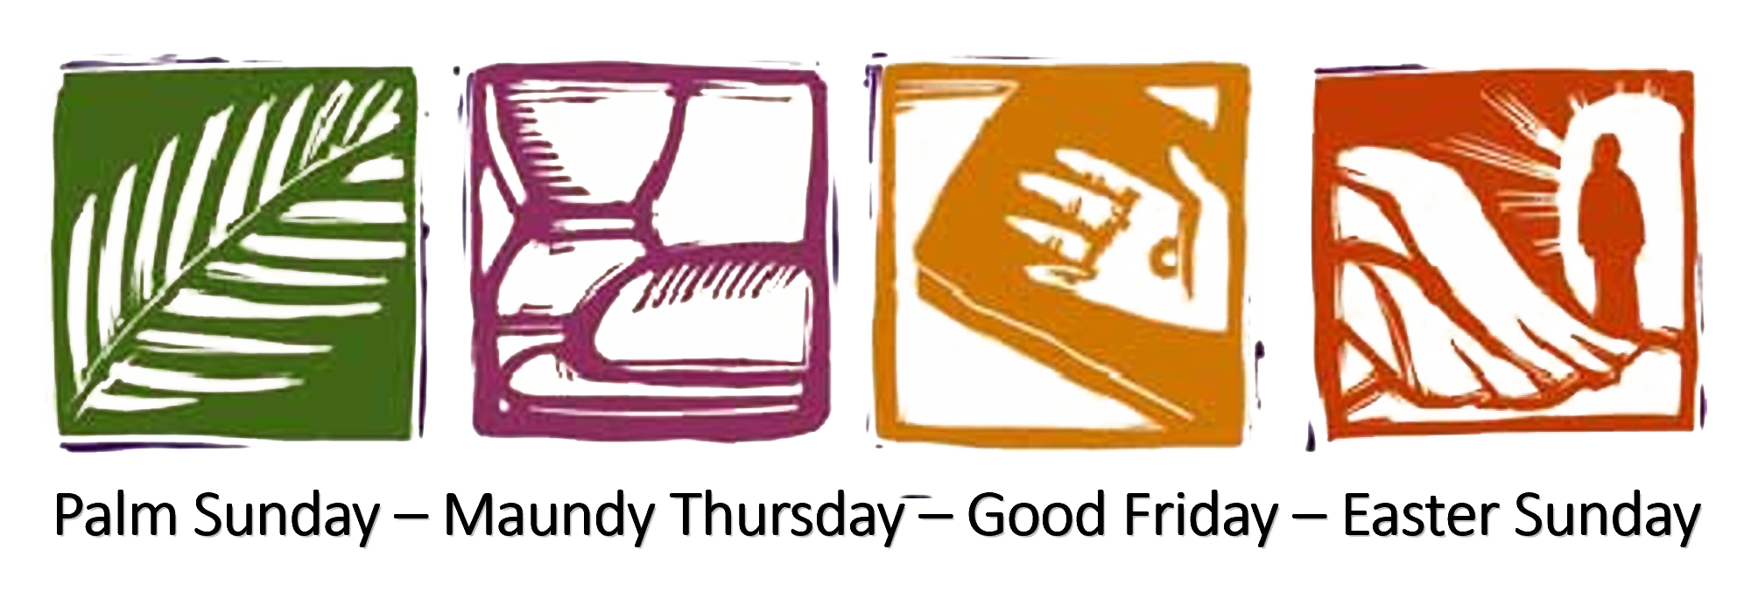
The four most important days of Holy Week are:
Palm Sunday, Maundy Thursday, Good Friday,
Easter Sunday.

Slide 8
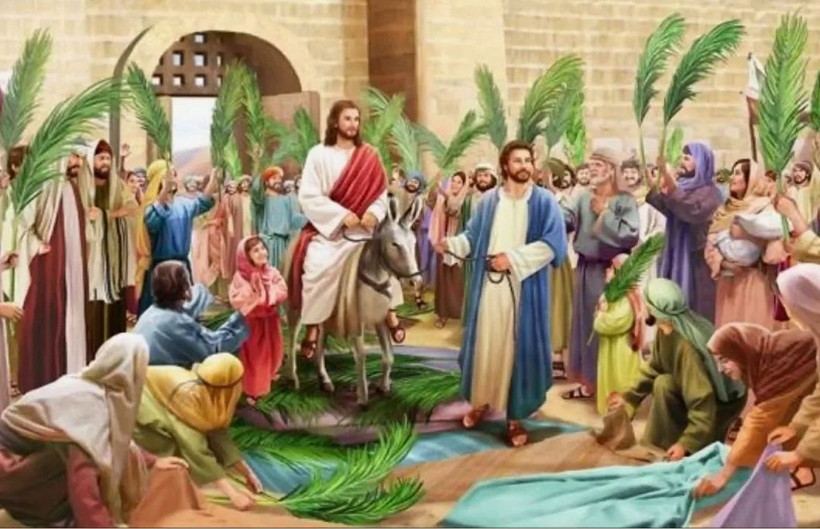
Holy Week before Easter begins with Palm Sunday.
It marks the end of Lent and celebrates Jesus’ triumphal entry into Jerusalem.

Slide 9
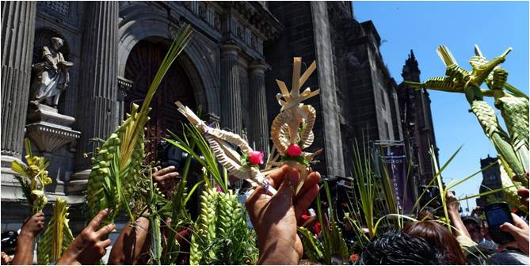
On Palm Sunday people in Great Britain carry palm branches in parades,
and make them into crosses to decorate the Church.

Slide 10
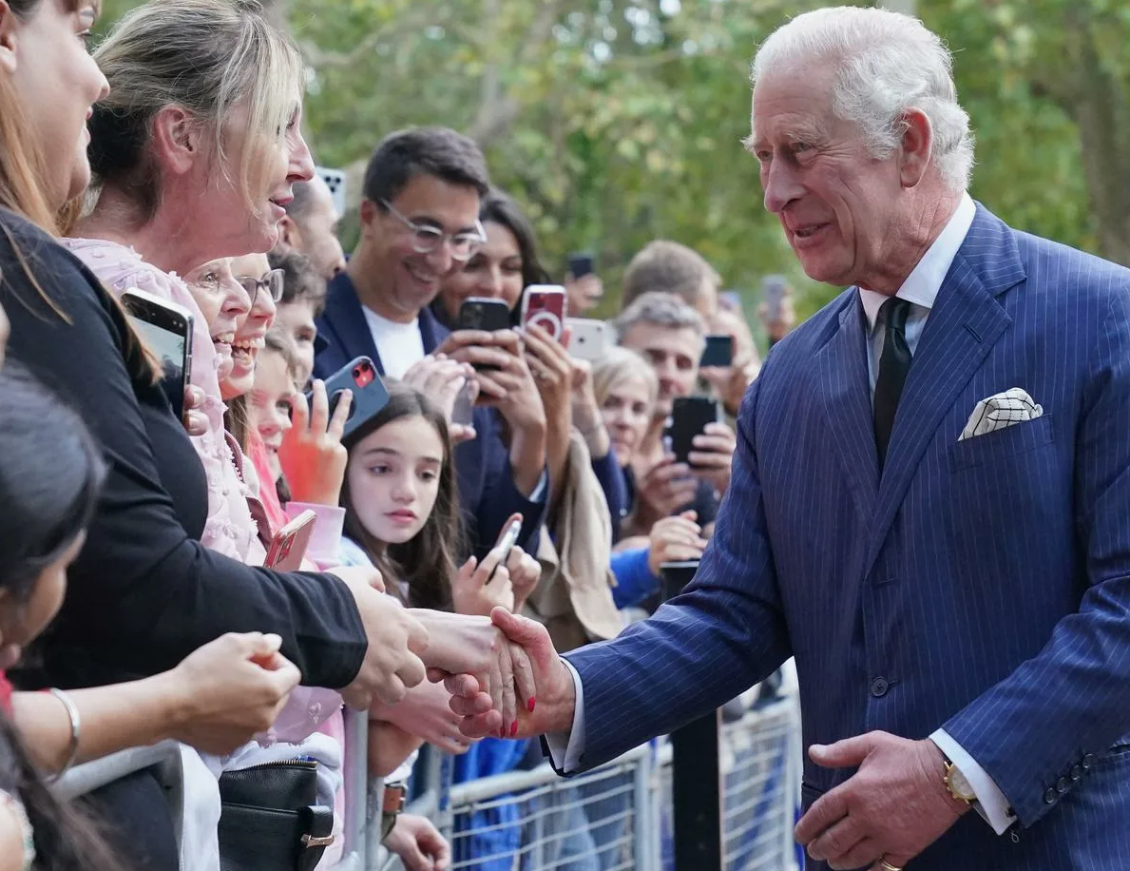
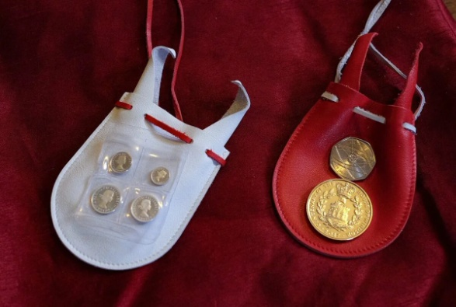
On Moundy Thursday (Clean Thursday in Russia),
the king of England
gives money to poor people. It`s an old tradition.

Slide 11
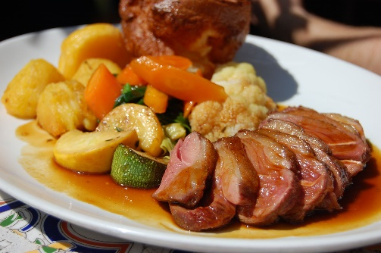
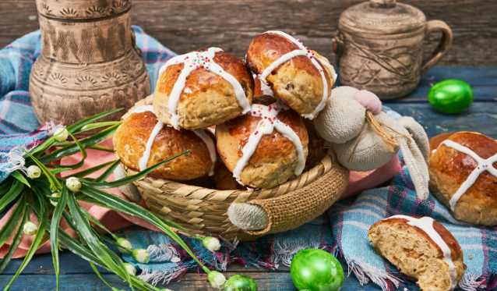
On Easter Sunday people eat a traditional roast dinner with lamb, potatoes and vegetables.
Sunday morning hot cross buns
are given for tea. They are small round sweet cakes with a cross on top
in memory of Christ's death.

Slide 12
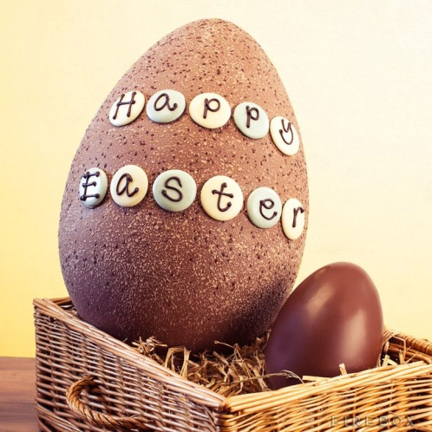
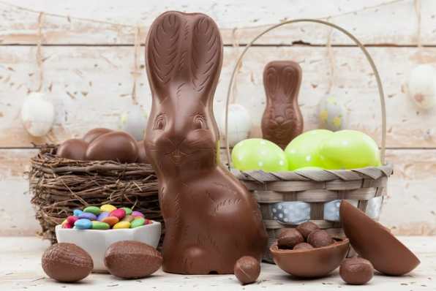
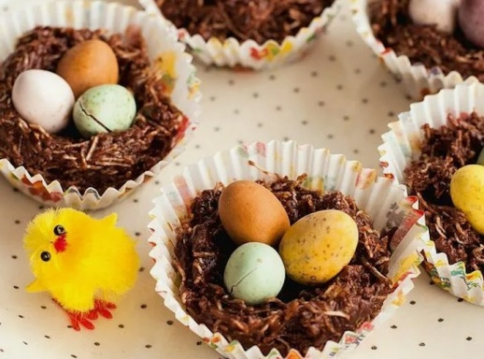
The table is usually decorated
by chocolate nests for eggs,
chocolate eggs and hares.

Slide 13
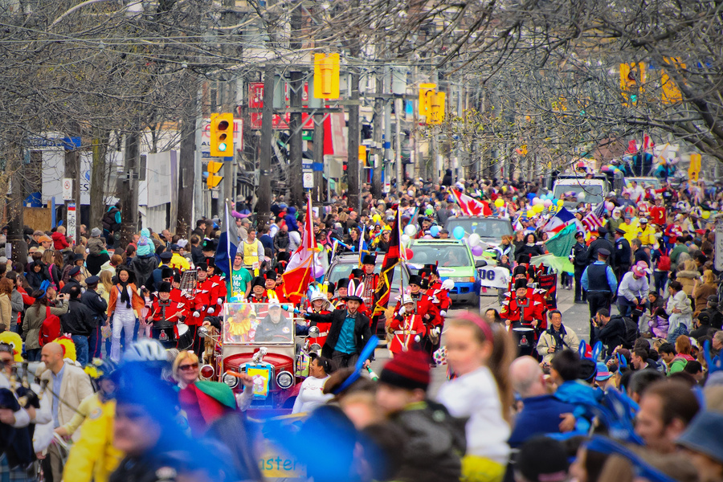
Easter parades often take place on Easter Sunday
to celebrate the arrival of spring.
In Russia people traditionally congratulate each other by saying:
- “Christ is Risen!”
- “He is Risen Indeed !”
While in Britain they mainly say: “Happy Easter!”

Slide 14
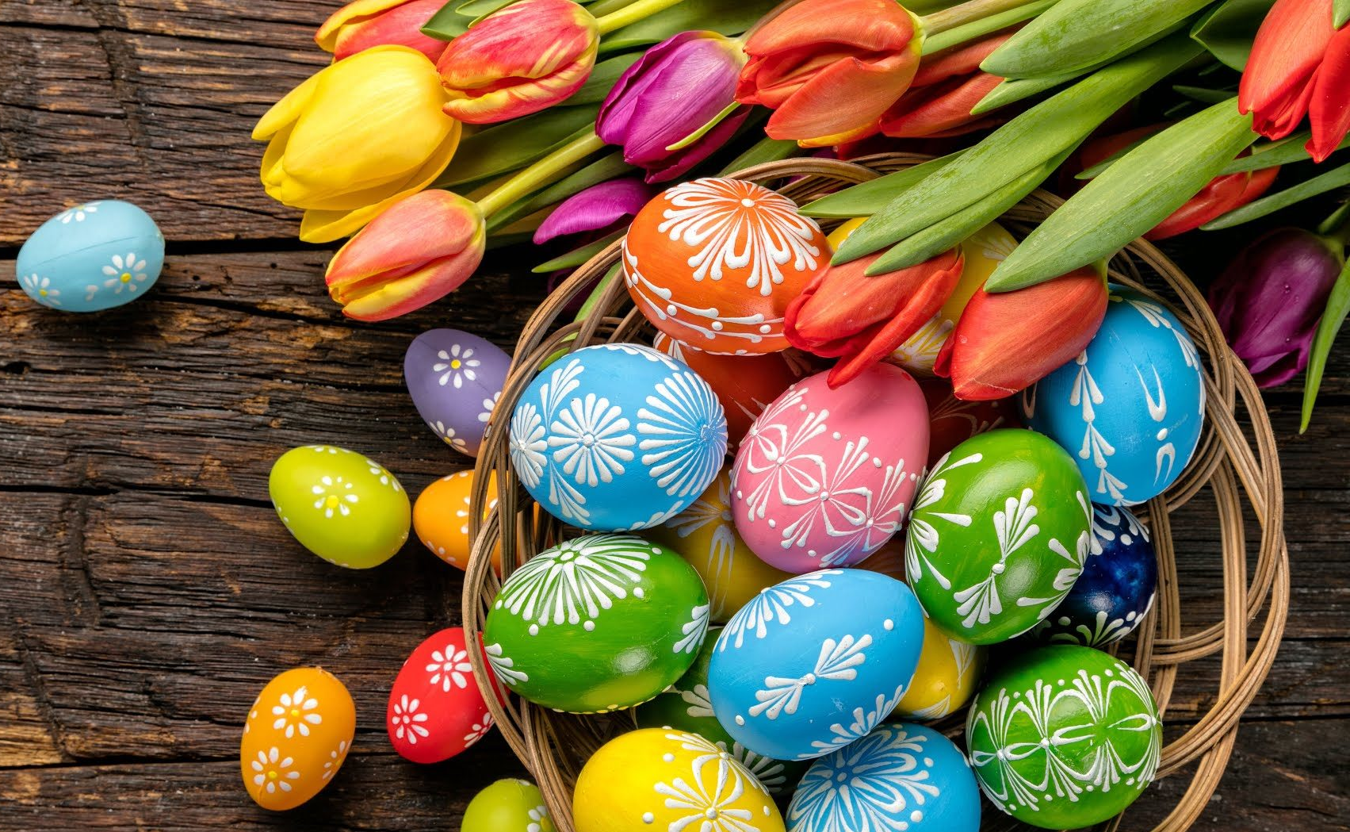
Easter symbols in Britain
The most important symbol in England, as in Russia, is eggs.
They are a symbol of spring and new life.
All families colour eggs and put them into baskets.

Slide 15
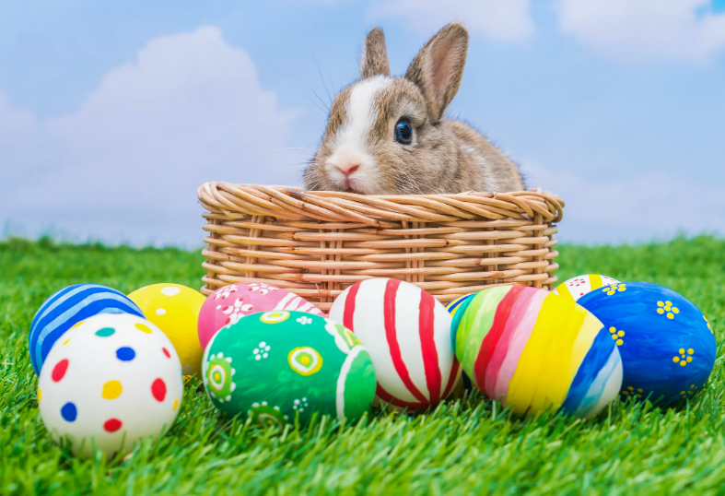
Another Easter symbol in Britain is an Easter Rabbit. It ‘s an innocent animal.
In ancient times the rabbit, or hare, was a symbol of new life and it reminds us of spring and new life.

Slide 16
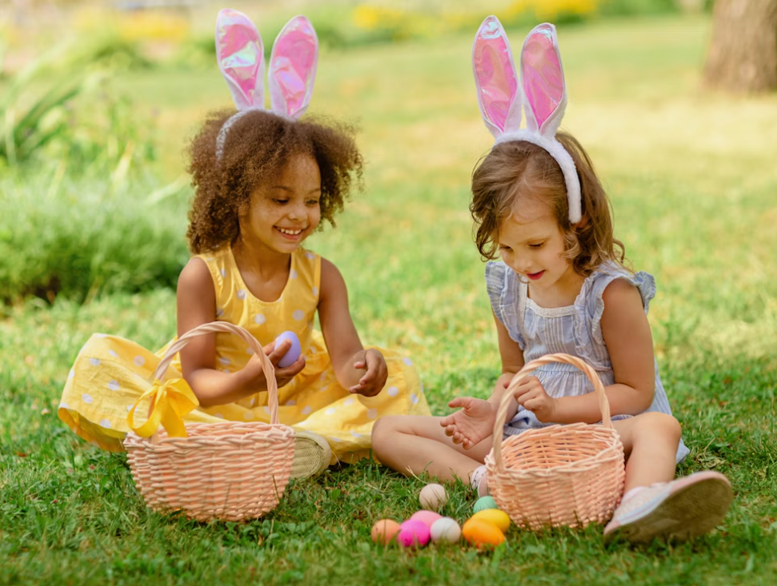
Children in Britain believe the Easter Bunny brings the Easter eggs.
In the morning of Easter Sunday children wake up and find that the Easter Bunny has left baskets of candies and hidden coloured eggs for them.

Slide 17
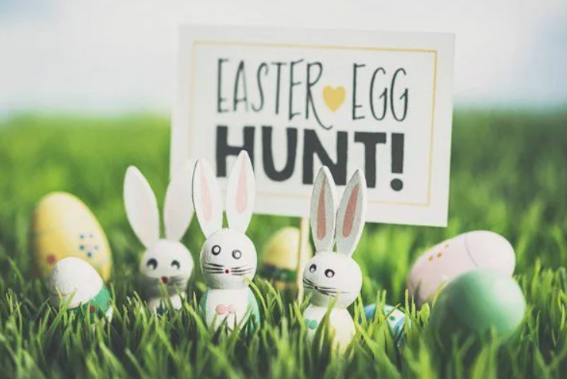
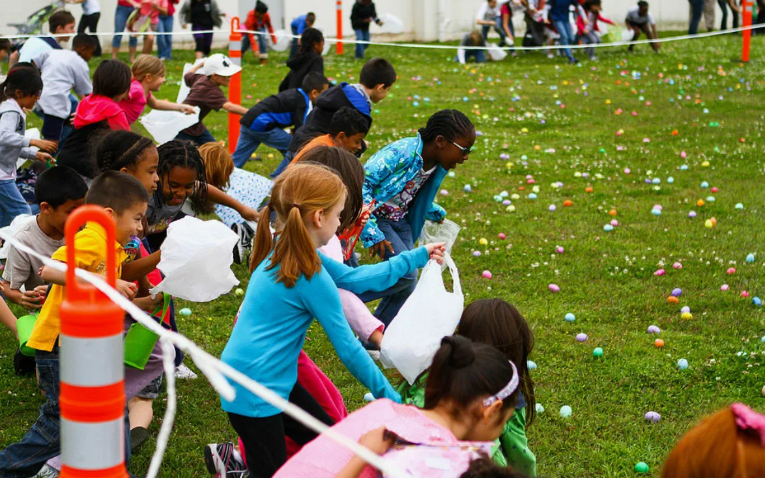
Egg rolling is a traditional game
played with eggs at Easter in Britain.
Each year, hundreds of excited children decorate hard-boiled eggs, ready to take part in the competition.
To play the game, you have to roll your egg down one of the park’s grassy hills. But what if it breaks? Bad, luck. You’re out of the competition.

Slide 18
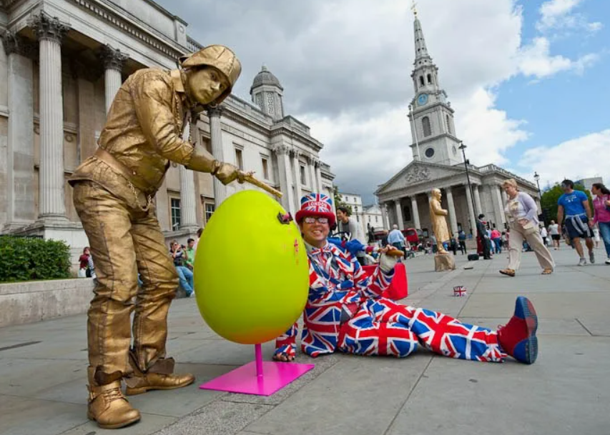
Easter Quiz
1) What day is Easter celebrated in Great Britain?
Friday
Sunday
Saturday

Slide 19
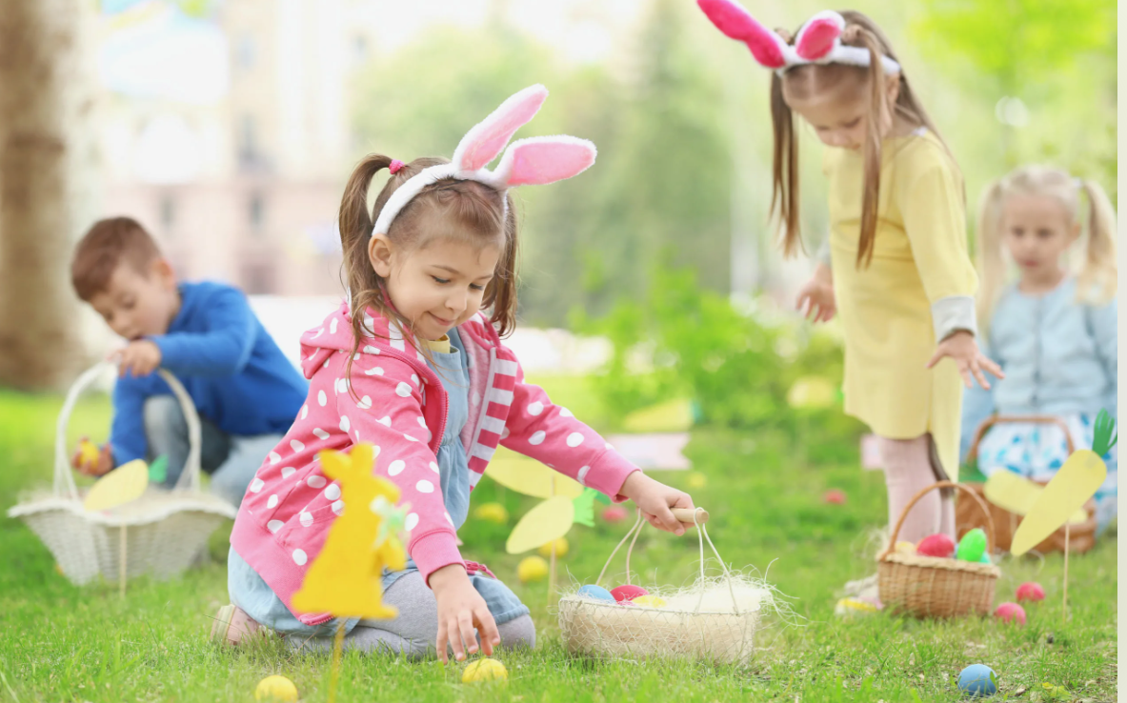
2) What is the first day of Holy Week?
Clean Thursday
Good Friday
Palm Sunday

Slide 20
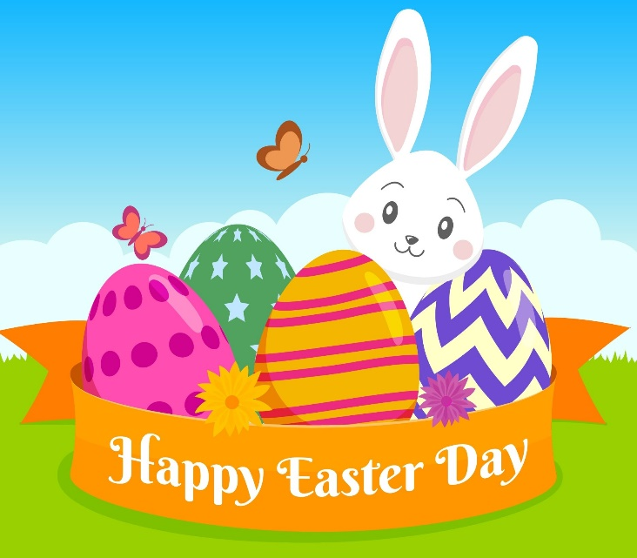
3) What do people in Great Britain carry in parades on Palm Sunday?
a) flowers
b) palm branches
fir branches

Slide 21
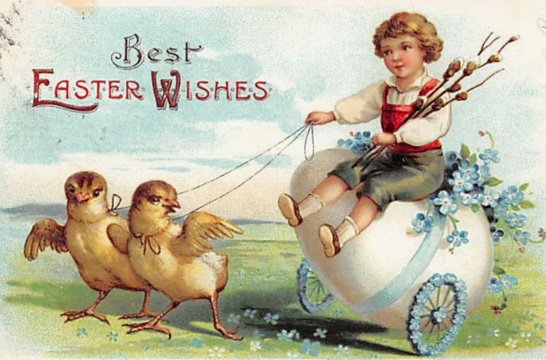
4) On Moundy Thursday
in Great Britain:
a) the king gives money
to poor people
b) people clean their houses
c) the king visits his family

Slide 22
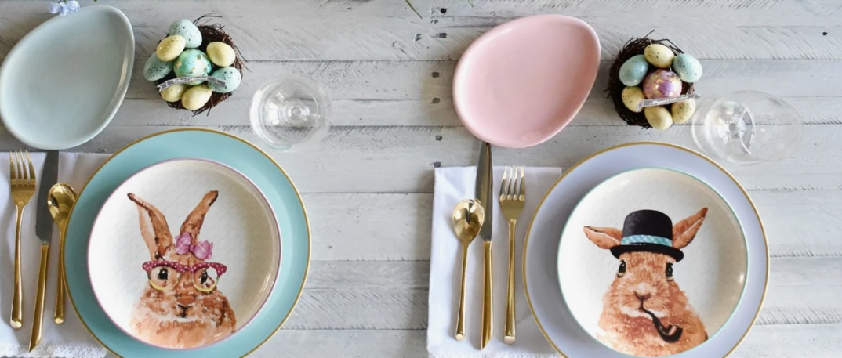
5) Traditional Easter Sunday food is:
chicken, potatoes, vegetables and hot cross buns
chicken, potatoes, vegetables and
hot pancakes
c) lamb, potatoes,
vegetables
and hot cross buns

Slide 23
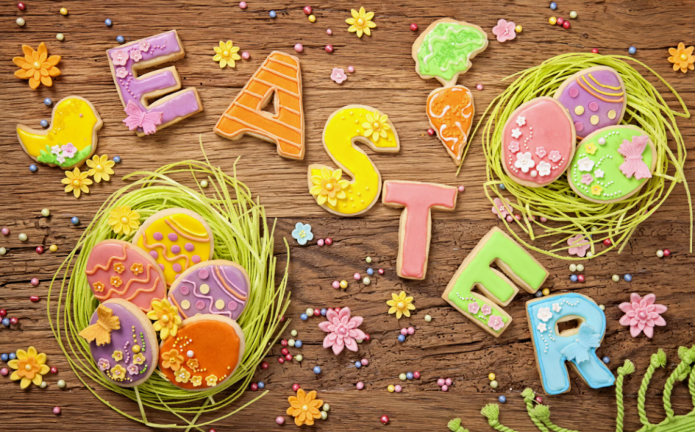
6) Sunday morning hot cross buns are:
a) small round sweet
cakes with a cross
b) pancakes
with a cross
c) small round biscuits with a cross

Slide 24
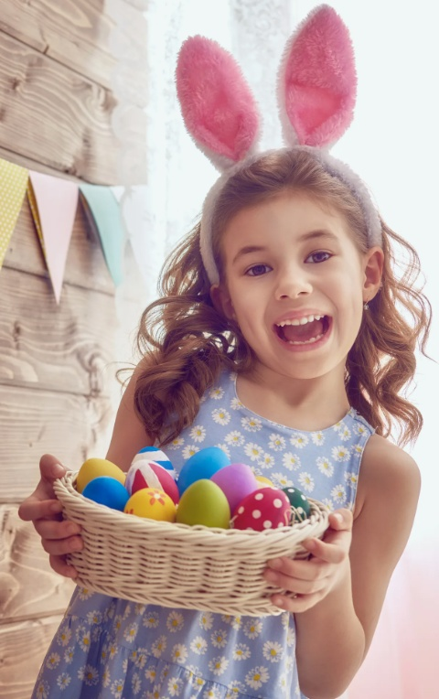
7) What do people in Britain say to each other on Easter?
a) «Happy Easter!»
b) «Marry Easter!»
c) «Have a nice Easter!»

Slide 25
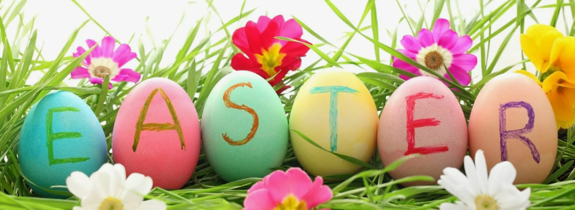
8) Where do British put coloured eggs?
Easter box
basket
nest

Slide 26
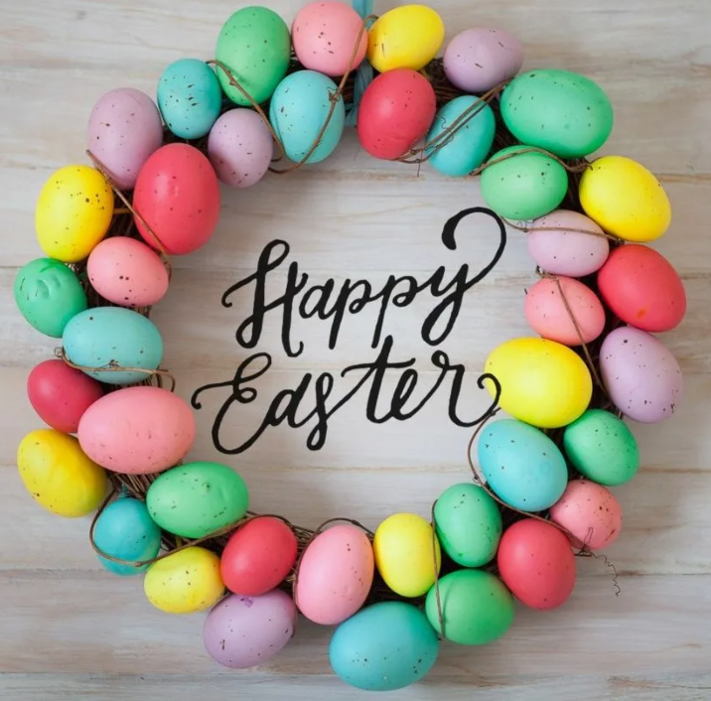
9) What animal is the main symbol of Easter in Britain?
a mouse
a tortoise
a rabbit

Slide 27
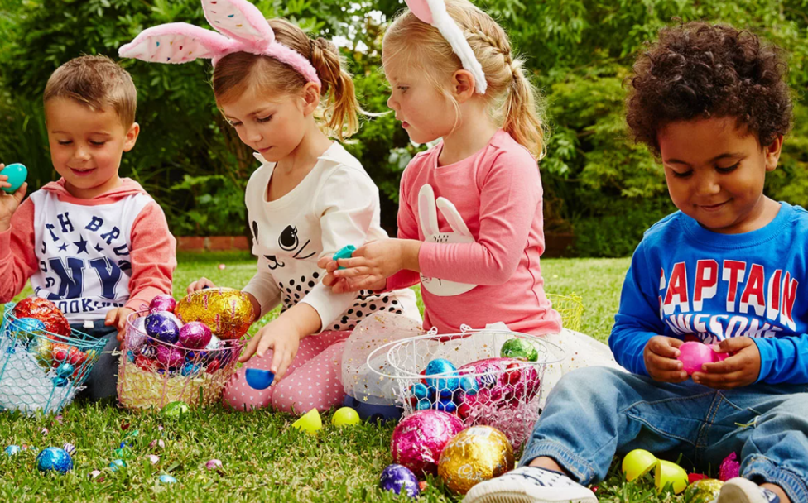
10) British children has an interesting and funny tradition with eggs. What is it?
fight of eggs
egg rolling game
colouring eggs

Slide 28
Ответы викторины:
1 b
2 c
3 b
4 a
5 c
6 a
7 a
8 b
9 с
10 b

Slide 29
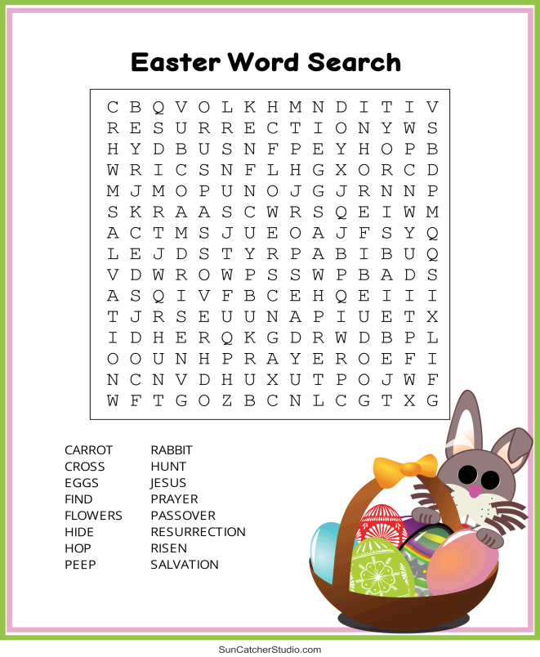

Slide 31
Источники (Sources):
1. Людмила Якушина Пасха в Британии и в России // Английский язык. – 2002. - №14.
https://eng.1sept.ru/article.php?ID=200201401
2. Easter Word Search https://suncatcherstudio.com/printables/word-search/easter-word-search/
3. Иллюстрации взяты их открытых источников Интернета
Thank you for your attention!

