Slide 1
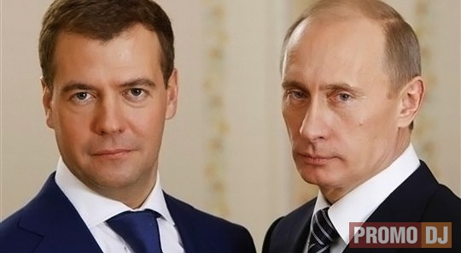
The political system of Russia

Slide 2
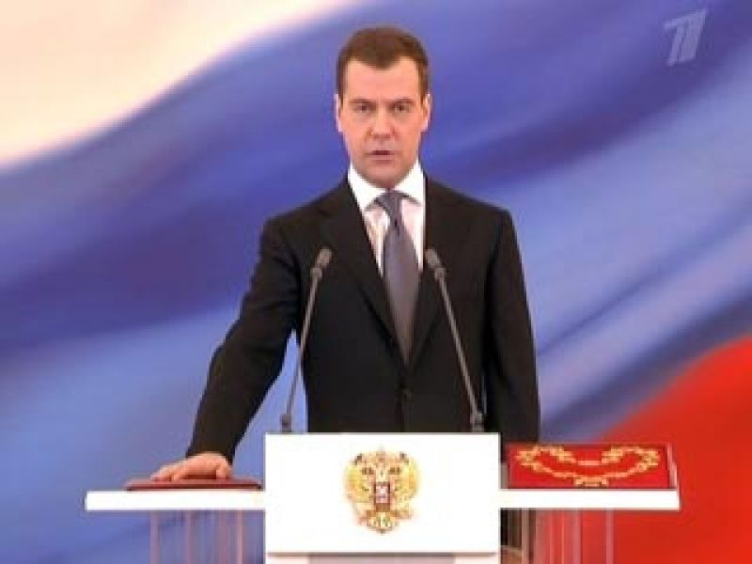
The President of Russian Federation is the head of state. D. Medvedev is our President .

Slide 3
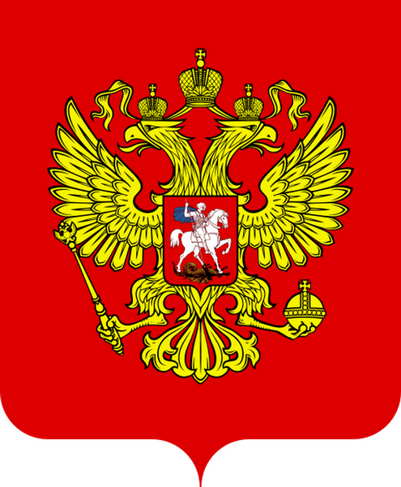
It is a coat-of-arms.

Slide 4
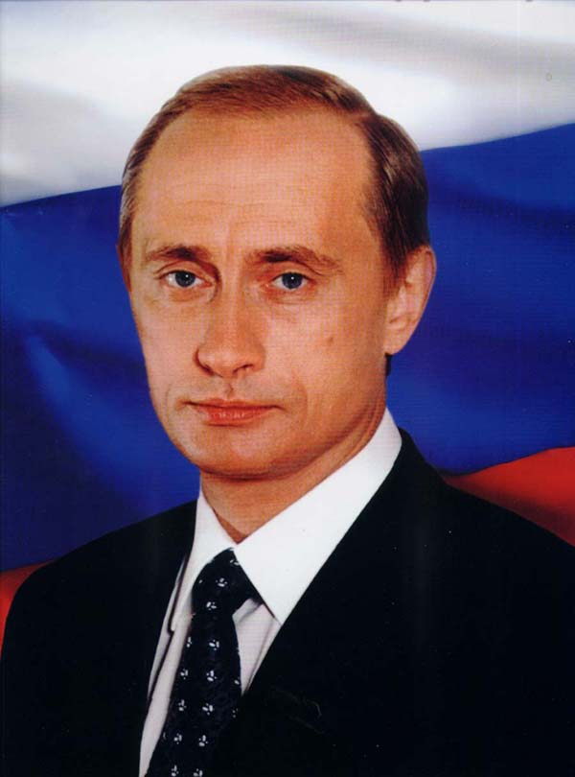
V. Putin is the Prime-Minister

Slide 5
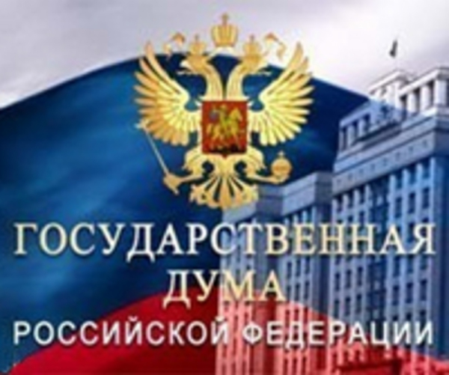
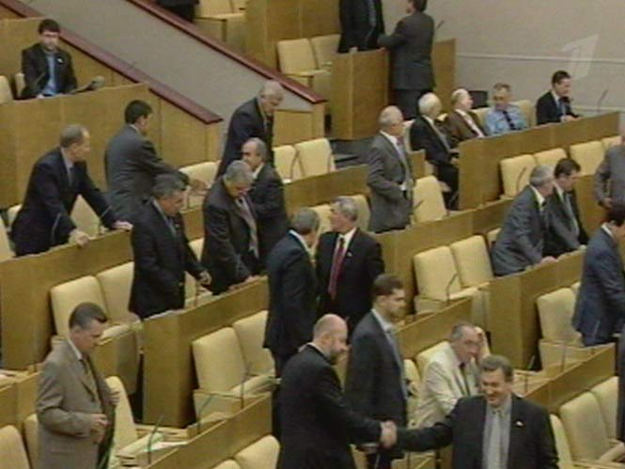
There are a lot of deputies in the Duma. They discuss laws.

Slide 6
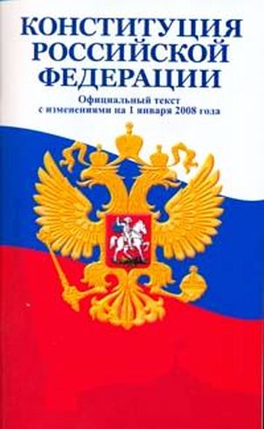
The Constitution of the Russian Federation is the main law.

Slide 7
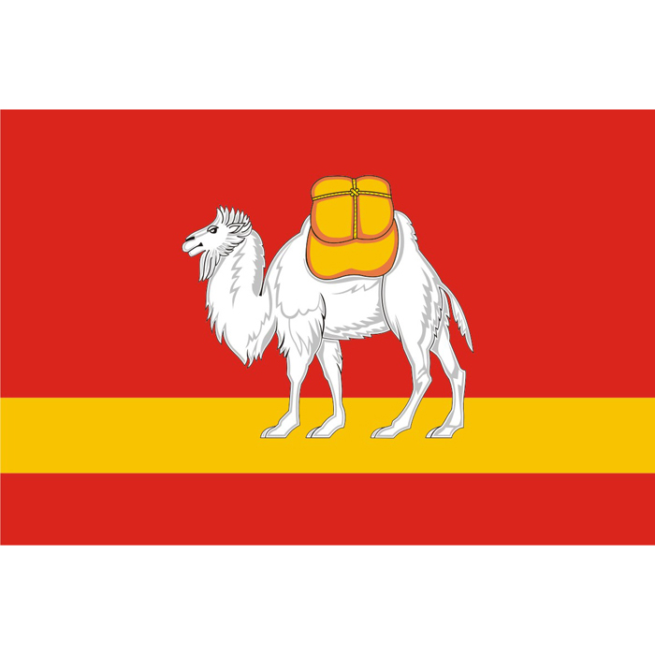
It is flag of Chelyabinsk.

Slide 8
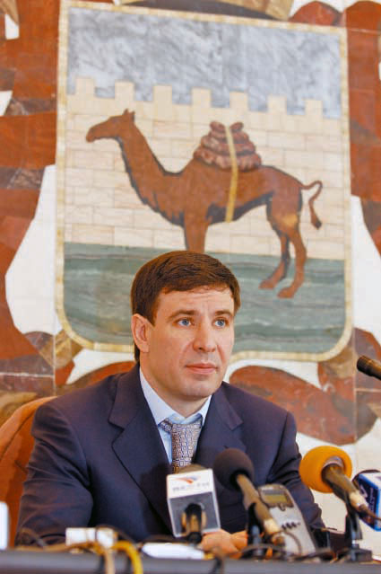
M. Yurevich is the governor of our region.

Slide 9
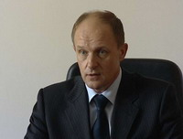
Davydov is our mayor.

