Slide 1


Business English course
Exercises for Senior Class Students
Alice Viktorovna Mettyeva
Moscow
School №2070

Slide 2
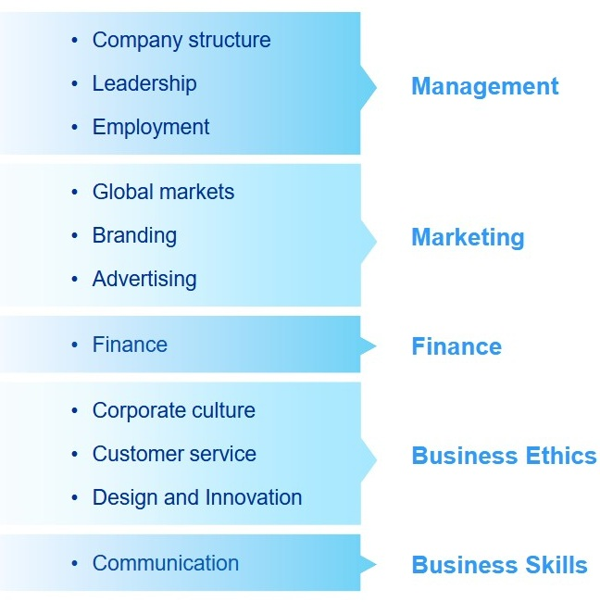
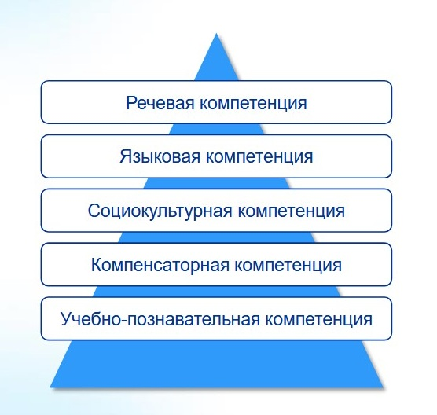

Slide 3

①
Тема: Management
Вид компетенции: Речевая компетенция
Вид речевой деятельности: аудирование, говорение
Форма работы: индивидуальная
Источник материалов:
Listening task 2: A success story –
https://english-practice.net/practice-listening-english-exercises-for-b2-good-business/

Slide 4

A man is talking about Starbucks Corporation. What are the company’s six guiding business principles? Listen and number the principles in the timeline from 1 to 6.
Draw a conclusion for a noobie entrepreneur.
1- Develop satisfied customers all of the time.
2 - Recognize that profitability is a key to our future success.
3 - Contribute to
the community
and our environment.
4 - Apply the highest standards of excellence to the coffee.
5 - Make diversity an important part of the business style.
6 - Provide a great work environment and treat each other with respect and dignity.
№ …
№ …
№ …
1971
1991
2002
№ …
№ …
№ …
1987
2001
2005

Slide 5
Keys
2 - Recognize that profitability is a key to our future success.
6 - Provide a great work environment and treat each other with respect and dignity.
4 - Apply the highest standards of excellence to the coffee.
5 - Make diversity an important part of the business style.
1- Develop satisfied customers all of the time.
3 - Contribute to
the community
and our environment.
№ 2
№ 4
№ 1
1971
1991
2002
№ 6
№ 5
№ 3
1987
2001
2005

Slide 6
Audioscripts
1. Starbucks is a famous coffee company. In big cities, you see Starbucks stores near train stations, in shopping malls, and on many street corners. Starbucks began in nineteen seventy-one in Seattle, Washington, at Pike Place Market. The company was named after a character in the famous book Moby Dick. Today, one of Starbucks’ main business principles is “Recognize that profitability is a key to our future success.” But back in nineteen seventy-one, no one knew just how profitable this little coffee company would become.
2. In nineteen eighty-seven, Howard Schultz acquired Starbucks and changed its name to Starbucks Corporation. As he expanded the company, Schultz wanted Starbucks to be a place where people would enjoy working. He wanted the employees to be happy. An example of how Schultz tried to achieve this is another of the company’s principles, which says, “Provide a great work environment, and treat each other with respect and dignity.” When Schultz took over, Starbucks had just seventeen stores.
3. The new owner of Starbucks, Howard Schultz, was influenced greatly by a business trip he took to Italy. He wanted the taste of the coffee and the look of the cafés to match a coffee bar he had visited in Milan. He thought that serving delicious, high-quality coffee would make Starbucks a successful business. This is demonstrated by the Starbucks company principle “Apply the highest standards of excellence to the coffee.” Schultz’s plan worked, and Starbucks stores began opening in many locations. In nineteen ninety-one, Starbucks opened its first airport location at Sea-Tac International Airport in Seattle. By that year, the number of Starbucks stores was one hundred and sixteen.
4. Ten years later, in two thousand and one, Starbucks opened its three-hundredth store in Japan. It now had shops in seventeen countries including Kuwait, New Zealand, Malaysia, and the Philippines. The international popularity of Starbucks is one result of the company principle that says, “Make diversity an important part of the business style.” By selling a wide variety of products that appealed to a variety of people’s tastes, Starbucks gained success quickly. Between its U.S. and international stores, Starbucks now had a total of four thousand seven hundred and nice store locations.
5. One year later, in two thousand and two, Starbucks launched a new service that added to its popularity. It introduced its own wireless Internet connection and made it available to customers in its cafés. Soon, people started going to Starbucks not just to drink coffee, but to do Internet research, send e-mails, and surf the Web on their own laptop computers. This is one example of the company principle
“Develop satisfied customers all of the time.” Since the previous year, Starbucks had added almost fifteen hundred stores around the world for a total of six thousand one hundred and ninety-three stores.
6. Starbucks is proud of its socially responsible business style. The company’s final business principle is “Contribute to the community and our environment.” In order to do this, the company makes efforts to reduce overall waste at its stores by recycling and using recycled products. The company also donates to various charities. In two thousand and five, Starbucks sold a pre-paid card featuring the image of Ichiro Suzuki, a well-known player for the Seattle Mariners baseball team. The money from the card was to benefit children’s charities. The total number of Starbucks stores in two thousand and five reached nine thousand six hundred and seventy-one. And Starbucks is still growing today.

Slide 7
②
Тема: Management, Marketing
Вид компетенции: Речевая компетенция
Вид речевой деятельности: письмо
Форма работы: индивидуальная
Источник материалов:
https://discoverpraxis.com/blog/5296/what-my-high-school-business-teacher-taught-me-about-entrepreneurship-and-business-classes

Slide 8
You have received an email message from your English-speaking pen friend Linda:
Write an email to Linda. In your message answer her questions and ask 3 questions
about the food business.
FROM: Linda@mail.uk
To:
Subject: My High School Business Teacher
… I have one or two classes that I am fond of. Business class is one of those, precisely because it isn’t a class. Our teacher is a local businessman. He treats us like people – people who can potentially run businesses one day. I am learning so much from this class! Would you like to have any experience of communication with real businessmen during your entrepreneur course? What business issues are you most interested in and what advice would you ask them for? Do you have your own startup ideas in mind? Why? … By the way, my mother has finally agreed to run a food business from home and all our family members are ready to support her …

Slide 9
③
Тема: Business Ethics
Вид компетенции: Языковая компетенция (грамматика, орфография)
Вид речевой деятельности: чтение, письмо
Форма работы: индивидуальная/парная
Источник материалов:
Business English supplementary exercises (pre-intermediate). Учебное пособие по деловому английскому языку - Самара, Издательство Самарского государственного экономического университета, 2018.

Slide 10
Fill in the gaps with the grammatically correct forms of the words in capitals.
Sending a Strong Message: Protecting Your Employees
In 1985, a film company 1 ____________________ financial pressure hired a new president. In an effort to cut costs, the president asked the 2 __________________ leaders of a division, Ed and Alvy, to conduct layoffs. Ed and Alvy resisted - eliminating employees 3 ____________________ the 4 ____________________ value. The president issued an ultimatum: a list of names was due to him at nine o’clock the next morning.
When the president 5 ____________________ the list, it contained two names: Ed and Alvy.
No layoffs 6 ____________________, and 7 ____________________ months later Steve Jobs bought the division from Lucasfilm and started Pixar with Ed Catmull and Alvy Ray Smith.
Employees were grateful that “managers would put their own jobs on the line for the good of 8 ____________________ teams,” marvels Stanford’s Robert Sutton, noting that even a quarter century 9 ____________________, this “still drives and inspires 10 ____________________ at Pixar.”
FACE
SECOND
DILUTE
COMPANY
RECEIVE
CONDUCT
FEW
THEY
LATE
PERSON

Slide 11
Keys
Sending a Strong Message: Protecting Your Employees
In 1985, a film company 1 facing financial pressure hired a new president. In an effort to cut costs, the president asked the 2 two leaders of a division, Ed and Alvy, to conduct layoffs. Ed and Alvy resisted - eliminating employees 3 would dilute the 4 company’s value. The president issued an ultimatum: a list of names was due to him at nine o’clock the next morning.
When the president 5 received the list, it contained two names: Ed and Alvy.
No layoffs 6 were conducted, and 7 a few months later Steve Jobs bought the division from Lucasfilm and started Pixar with Ed Catmull and Alvy Ray Smith.
Employees were grateful that “managers would put their own jobs on the line for the good of 8 their teams,” marvels Stanford’s Robert Sutton, noting that even a quarter century 9 later, this “still drives and inspires 10 people at Pixar.”
FACE
SECOND
DILUTE
COMPANY
RECEIVE
CONDUCT
FEW
THEY
LATE
PERSON

Slide 12
④
Тема: Finance
Вид компетенции: Социокультурная компетенция, Речевая компетенция
Вид речевой деятельности: письмо, говорение
Форма работы: индивидуальная/парная/групповая
Источник материалов: http://www.myenglishteacher.net/

Slide 13
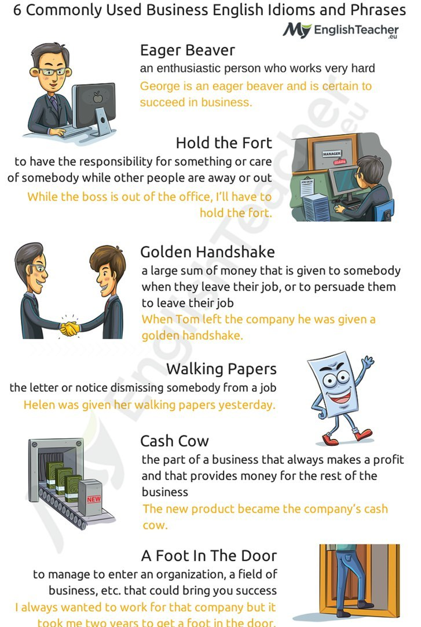
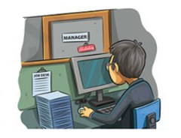

Look at these commonly used business idioms and phrases. Try to guess their meaning and put down their definitions from the context (use a dictionary if necessary).
Make up your own sentences with these expressions.
Eager beaver - … Hold down the fort - … Golden handshake - … | 4. Walking papers - … 5. Cash cow - … 6. To get a foot in the door - …
George is an eager beaver and is certain
to succeed in business.
Helen was given her walking papers yesterday.
While the boss is out of the office, I’ll have to
hold the fort.
The new product became the company’s cash cow.
When Tom left the company, he was given a golden handshake.
I always wanted to work for that company but it took me two years to get
a foot in the door.

Slide 14
Keys
Eager beaver (трудоголик/добросовестный работник) – an enthusiastic person who works very hard. Hold down the fort (вести дела (в отсутствие кого-либо)/оставаться "на хозяйстве") – to have the responsibility for something or care of somebody while other people are away or out. Golden handshake («золотой парашют», большое выходное пособие (служащему, от которого хотят избавиться)/увольнение с большой финансовой компенсацией/ценный подарок в связи с выходом на пенсию) – a large sum of money that is given to somebody when they leave their job, or to persuade them to leave their job. | 4. Walking papers («волчий билет», извещение об увольнении) – the letter or notice dismissing somebody from a job. 5. Cash cow (пользующийся спросом товар/курица, несущая золотые яйца (о бизнесе, приносящем его владельцу баснословные доходы) – the part of a business that always makes a profit and that provides money for the rest of the business. 6. To get a foot in the door (начинать карьеру (в определённой компании или сфере) – to manage to enter an organization, a field of business, etc. that could bring you success.

Slide 15
⑤
Тема: Marketing
Вид компетенции: Компенсаторная компетенция
Вид речевой деятельности: чтение
Форма работы: индивидуальная/парная/групповая
Источник материалов:
Business Result (pre-intermediate). Student’s Book / David Grant, Jane Hudson and Robert McLarty. - New York: Oxford University Press.

Slide 16
Read these descriptions of some companies. Complete their names.
The biggest national companies
The biggest national companies rank a high place in the world. They are large suppliers of production. The biggest national companies have a greater sphere of influence. For example:
This company provides many different Internet services, including news, online shopping, and email. Most of its sales come from advertising on its website. Its head office is in Sunnyvale, California. Y _ _ _ _
This company produces tyres for cars and other vehicles. It is based in France, but it has more than 125,000 employees all over the world. It is also well known for its red and green travel guides. M _ _ _ _ _ _ _
This northern European company operates in the retail market. It specializes in low-price products, including furniture, bathrooms, and kitchens. I _ _ _
It's a subsidiary of the European Aeronautic Defence and Space Company (EADS). The company makes planes for the commercial aircraft market, where its main competitor is Boeing. A _ _ _ _ _
This company makes many different electrical and electronic products, such as TVs, computers, and mobile phones. It is South Korea's largest company and exporter.
S _ _ _ _ _ _

Slide 17





Keys
The biggest national companies
The biggest national companies rank a high place in the world. They are large suppliers of production. The biggest national companies have a greater sphere of influence. For example:
This company provides many different Internet services, including news, online shopping, and email. Most of its sales come from advertising on its website. Its head office is in Sunnyvale, California.
This company produces tyres for cars and other vehicles. It is based in France, but it has more than 125,000 employees all over the world. It is also well known for its red and green travel guides.
This northern European company operates in the retail market. It specializes in low-price products, including furniture, bathrooms, and kitchens.
It's a subsidiary of the European Aeronautic Defence and Space Company (EADS). The company makes planes for the commercial aircraft market, where its main competitor is Boeing.
This company makes many different electrical and electronic products, such as TVs, computers, and mobile phones. It is South Korea's largest company and exporter.

Slide 18
⑥
Тема: Business skills
Вид компетенции: Компенсаторная компетенция
Вид речевой деятельности: говорение
Форма работы: индивидуальная/парная
Источник материалов:
Writing – page 10
https://ege.fipi.ru/bank/index.php?proj=4B53A6CB75B0B5E1427E596EB4931A2A

Slide 19
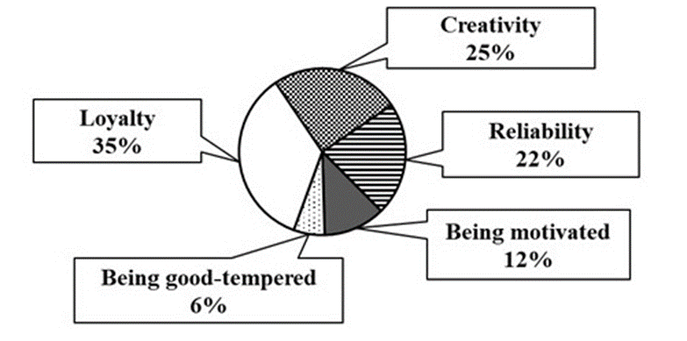
You can see a pie-chart with the results of the survey. What kind of information do you think is presented in the diagram?

Slide 20
Keys
What qualities employers appreciate most in their employees

Slide 21
⑦
Тема: Business skills
Вид компетенции: Учебно-познавательная компетенция
Вид речевой деятельности: говорение, письмо
Форма работы: парная/групповая
Источник материалов:
https://www.google.com/search?q=%D1%81%D0%BE%D1%86%D0%B8%D0%BE%D0%BB%D0%BE%D0%B3%D0%B8%D1%87%D0%B5%D1%81%D0%BA%D0%B8%D0%B9+%D0%BE%D0%BF%D1%80%D0%BE%D1%81+%D0%BA%D0%BB%D0%B0%D1%81%D1%81%D0%B0+%D0%BD%D0%B0+%D1%82%D0%B5%D0%BC%D1%83+%D0%B1%D0%B8%D0%B7%D0%BD%D0%B5%D1%81%D0%B0

Slide 22
Work in pairs or small groups. Survey your classmates to find out their attitudes towards business. Prepare questions before you start. You want to find out: - what they expect from their future job in business; - what knowledge and skills they want to acquire for their future career in business; - what types of business attract their classmates; - what are the reasons for the choice (parents' experience/their own little experience/market demand/other); - whether they are well aware of the basics of entrepreneurship – ask them to evaluate their knowledge from 1 to 5; - who drew up the business plan and calculated the budget: the initial capital, the expenses, the risks; - from which sources they plan to get funds for the project (a business loan/financial assistance from their parents/government support of business/other); - whether they are prepared to assume the responsibility as CEO (chief executive officer) at the initial stage or they consider it necessary to work as an employee for a period of time in order to gain experience; - who they think is more reliable to build a business with (relatives/friends/employees/other); - how sure they are that when the time comes to share the profits, they will be honest with their partners. | Carry out your survey making notes of your classmates’ answers and the total number of people interviewed. Draw graphics (a table, a bar chart, a pie chart) presenting the findings of the survey.

