Slide 1
Module 4
УМК Spotlight 5 класс
Майя Лаврентьевна Казарян, учитель английского языка 1КК

Slide 2
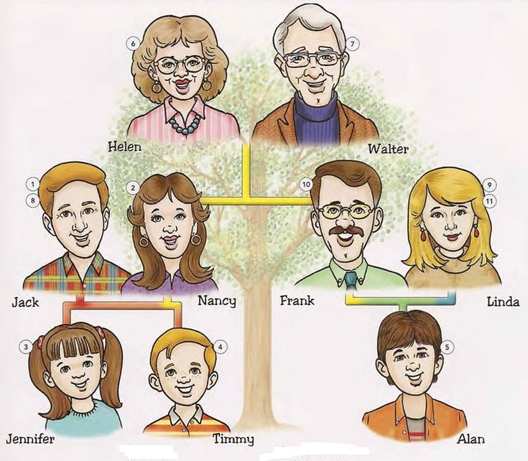
Family members

Slide 3
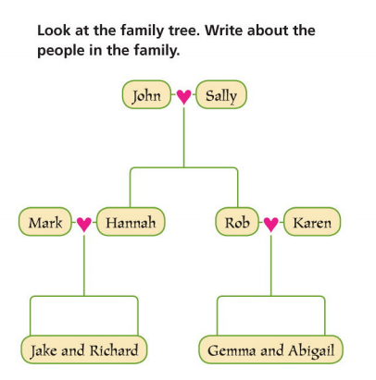

Slide 4

mother
A
бабушка
B
мама
C
дедушка
D
папа
>
tekhnologic

Slide 5
father
A
мама
B
дядя
C
папа
D
сын
>
tekhnologic

Slide 6
sister
A
брат
B
сестра
C
дядя
D
племянник
>
tekhnologic

Slide 7
brother
A
дядя
B
брат
C
папа
D
сестра
>
tekhnologic

Slide 8
uncle
A
тётя
B
дядя
C
папа
D
племянница
>
tekhnologic

Slide 9
aunt
A
дядя
B
мама
C
тётя
D
дочь
>
tekhnologic

Slide 10
двоюродный брат
A
uncle
B
mum
C
son
D
cousin
>
tekhnologic

Slide 11
дочь
A
son
B
daughter
C
nephew
D
niece
>
tekhnologic

Slide 12
grandmother
A
дедушка
B
папа
C
бабушка
D
мама
>
tekhnologic

Slide 13
grandfather
A
папа
B
дядя
C
дедушка
D
племянник
>
tekhnologic

Slide 14
son
A
дочь
B
сын
C
дядя
D
брат
>
tekhnologic

Slide 15
племянник
A
brother
B
niece
C
nephew
D
uncle
>
tekhnologic

Slide 16
племянница
A
sister
B
father
C
daughter
D
niece
>
tekhnologic

Slide 17
папа
A
grandfather
B
father
C
grandmother
D
uncle
>
tekhnologic

Slide 18
мама
A
aunt
B
sister
C
mother
D
grandmother
>
tekhnologic

Slide 19
daughter
A
тётя
B
дочь
C
племянница
D
сын
>
tekhnologic

Slide 20
niece
A
тётя
B
дочь
C
племянница
D
дядя
>
tekhnologic

Slide 21
nephew
A
племянник
B
дядя
C
племянница
D
сестра
>
tekhnologic

Slide 22
дедушка
A
father
B
grandfather
C
grandmother
D
uncle
>
tekhnologic

Slide 23
бабушка
A
aunt
B
mother
C
grandmother
D
niece
>
tekhnologic

Slide 24

Глагол can
(уметь, мочь)

Slide 25
I
They
We
You + CAN + глагол
He
She
It

Slide 26
I
They
We
You + CAN’T + глагол
He
She
It

Slide 27
I
They
We
CAN + You + глагол ?
He
She
It

Slide 28
Образуй отрицательную форму глагола can.
Jane can sing.
Nina can paint.
My father can ride a horse.
I can swim.
You can ride a bike.
She can read.

Slide 29
Образуй вопросительную форму глагола can.
They can dance.
She can play tennis.
I can write.
He can play the piano.
We can cook.

Slide 30
Что ты умеешь делать, а что нет
I can…….
I can’t………..

Slide 31
Переведи на русский язык.
I can skate.
Can you cook?
They can ski.
Can she speak English?
It can’t fly.
He can make a snowman.
They can watch TV.

Slide 32
Переведи на английский язык.
Я не умею плавать.
Ты умеешь готовить?
Вы умеете читать?
Она умеет кататься на велосипеде.
Он не умеет рисовать.
Они умеют играть на гитаре.
Он умеет играть в теннис?
Я не умею играть в футбол.

Slide 33
Hello! My name is John. I am ten. I can run and jump. I can swim and play football but I can’t ski or play tennis. I can read, write, swim and ride a bike.

Slide 34
Расположи слова в правильном порядке.
tennis can they play
write you can English
ride can she bike a
skate can brother your
you the can play piano

Slide 35
ответь на вопросы
Can you swim?
Can you sing?
Can you dance?
Can you skate?
Can you drive a car?
Can you ride a bike?

Slide 36
Can you speak English?
Can you read?
Can you fly?
Can you write?
Can you cook?
Can you ride a horse?
Can you make a sandwich?
Can you play football?

Slide 37
прочитай текст
Hello! I am Jack. I am seven. I can play football and basketball but I can’t play volleyball. I can read, write and count. I can speak English, and you? I have got a friend. His name is Pete. He can dance and sing. He can’t play tennis.

Slide 38
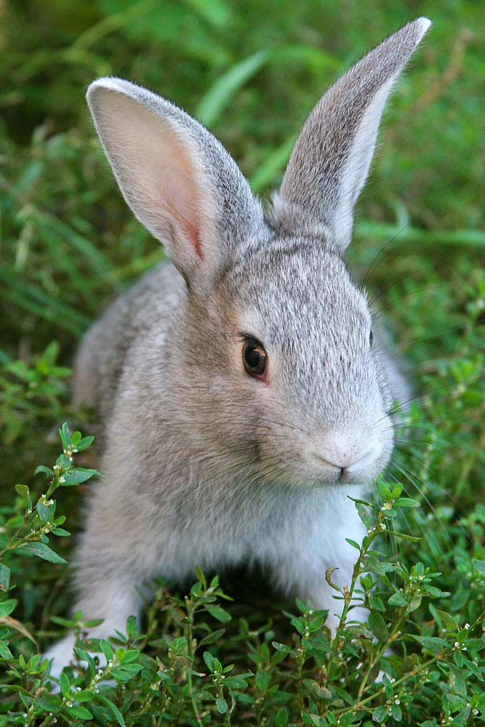
Can it run? Can it jump?

Slide 39
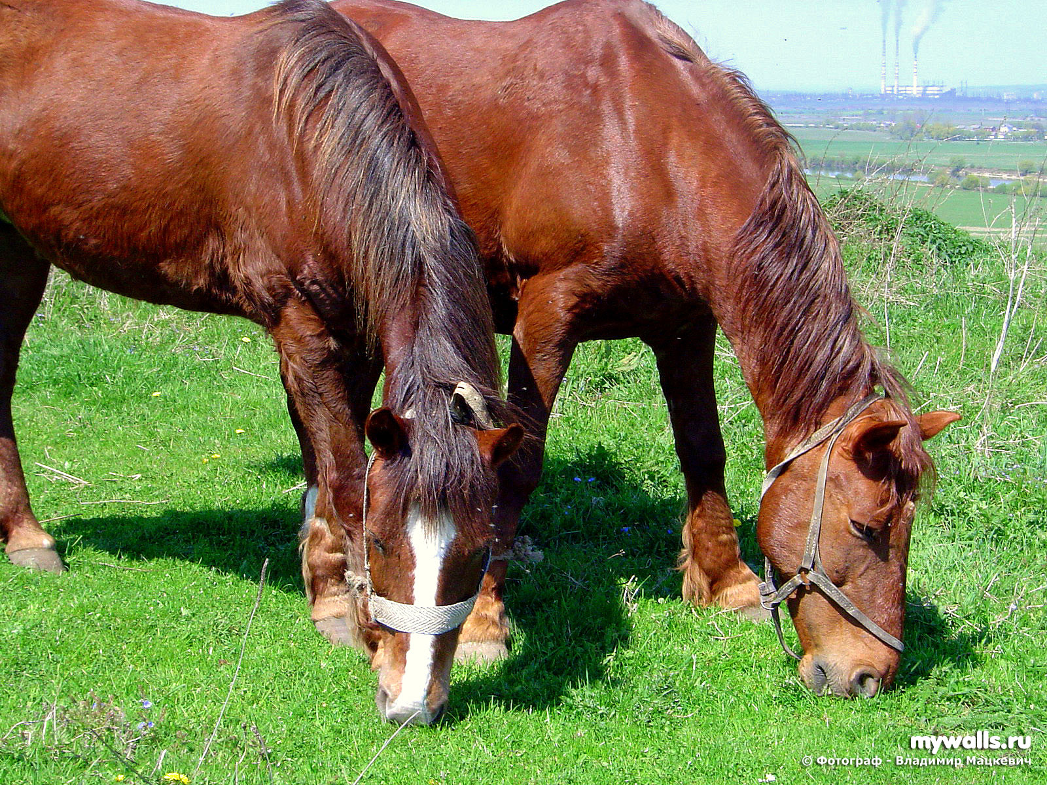
Can they fly?

Slide 40
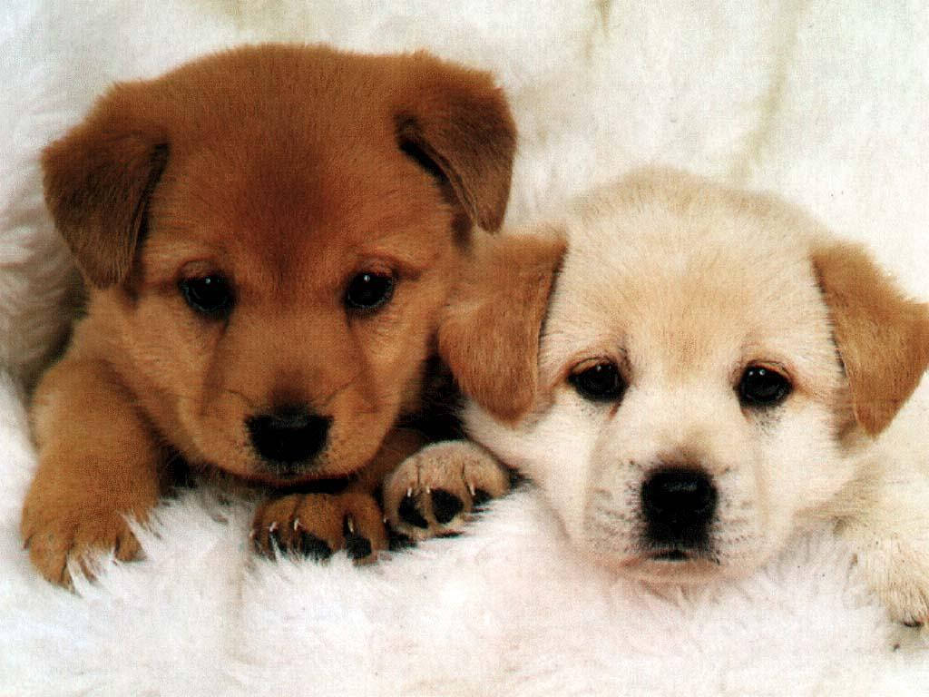
Can they sleep?

Slide 41
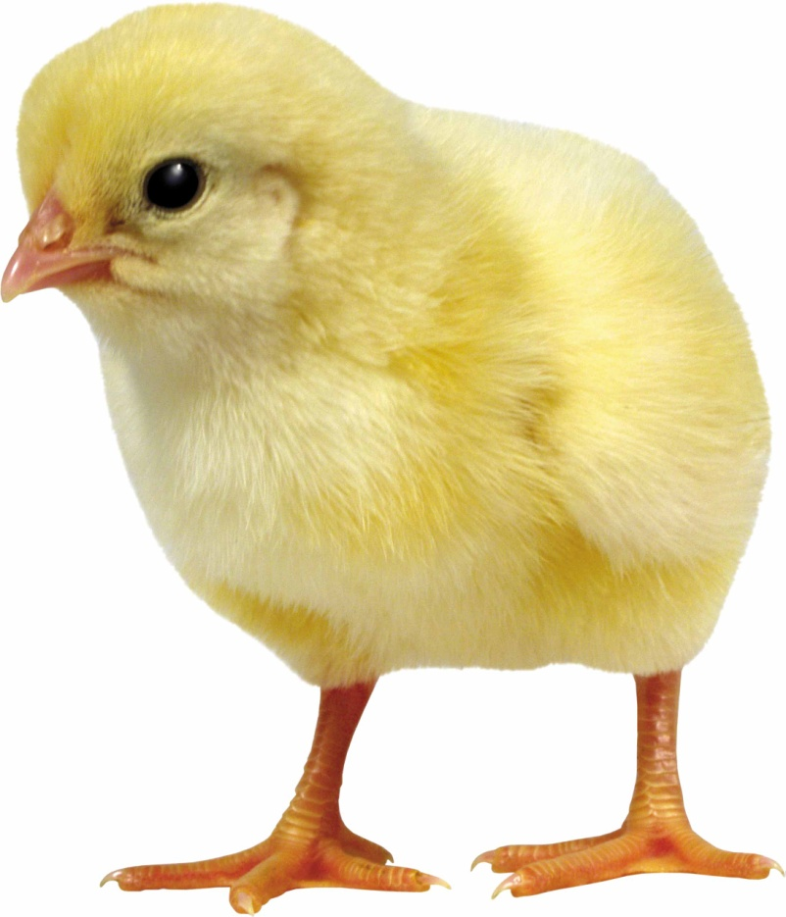
Can it read?

Slide 42
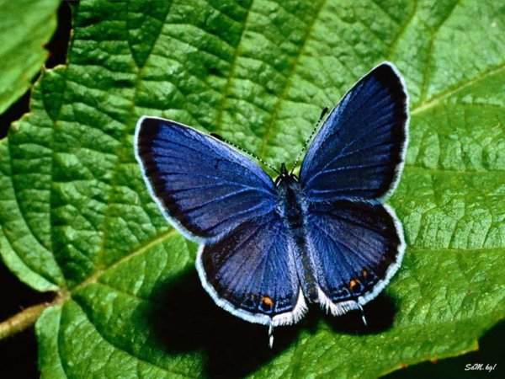
Can it fly?

Slide 43

Can it swim?

Slide 44
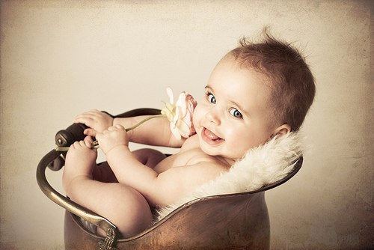
Can he ride a bike?

Slide 45
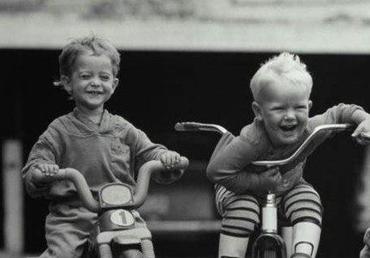
Can they ride a bike?

Slide 46
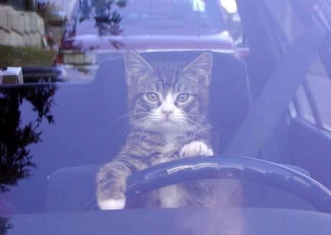
Can it drive a car?

Slide 47
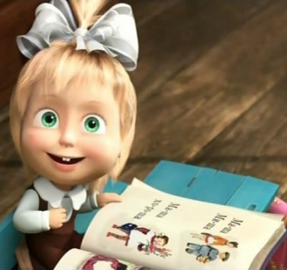
Can she read?

Slide 48
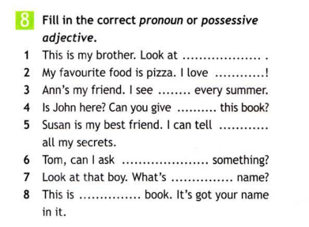

Slide 49
4b Appearance
Describe these people

Slide 50
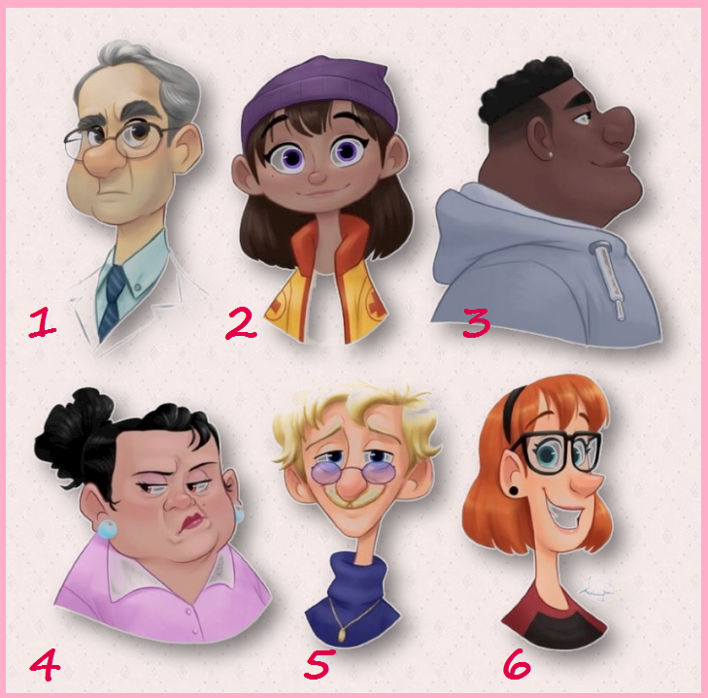

Slide 51
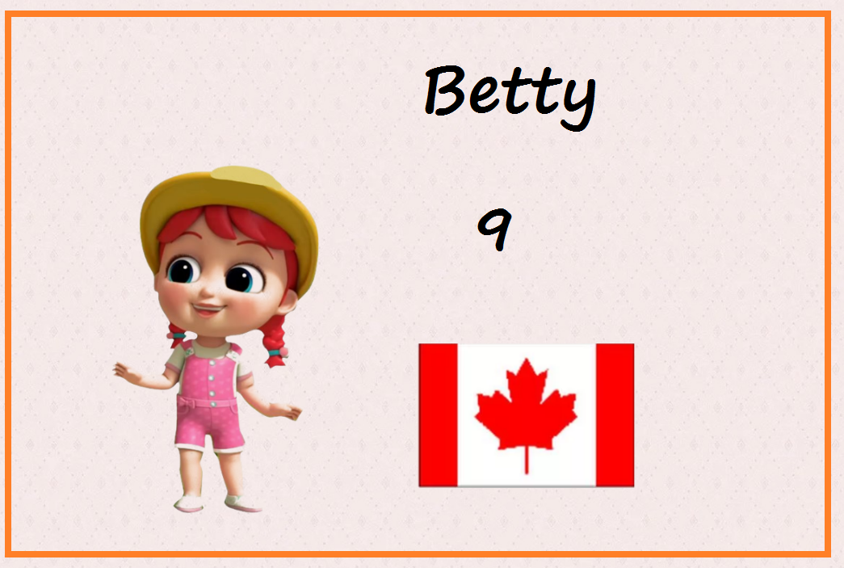
Asking for personal information
Name? Country? Age?

Slide 52
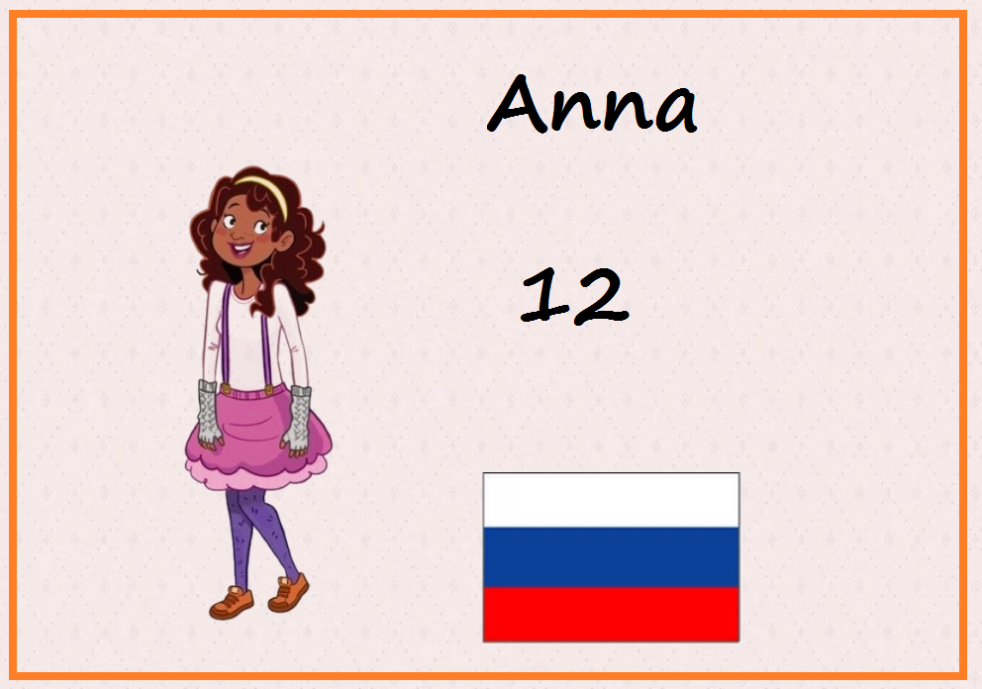
Asking for personal information
Name? Country? Age?

Slide 53
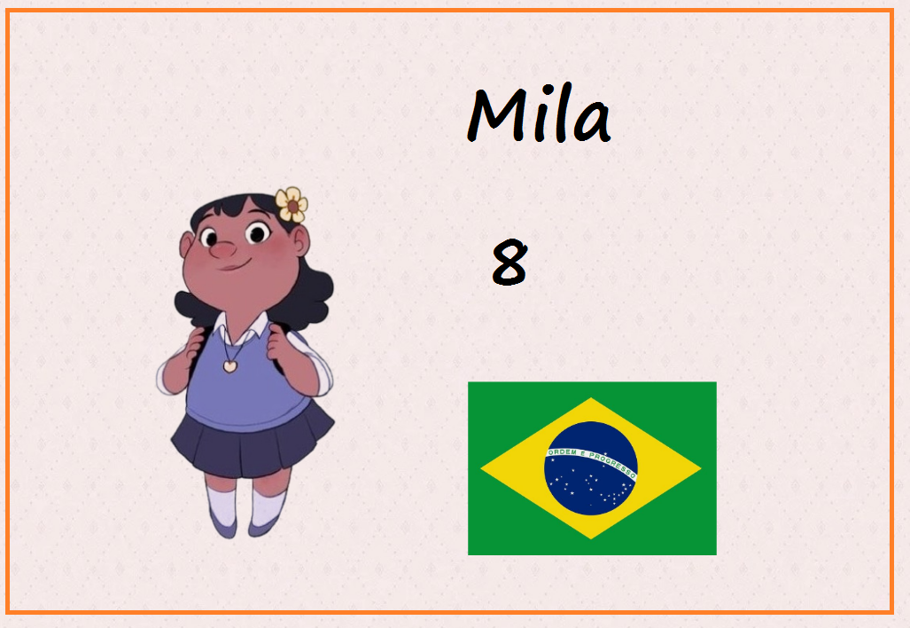
Asking for personal information
Name? Country? Age?

Slide 54
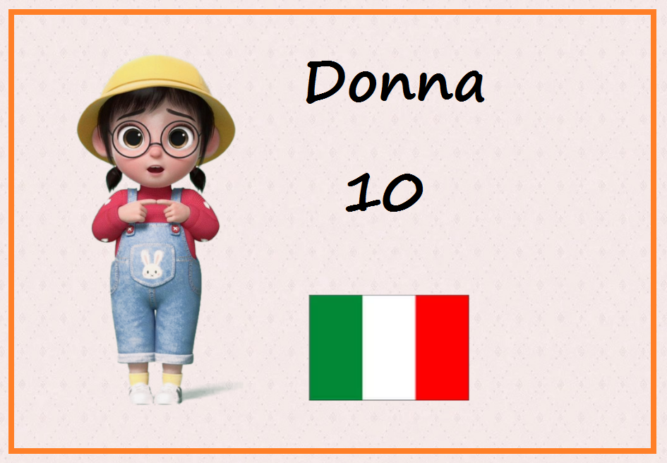
Asking for personal information
Name? Country? Age?

Slide 55
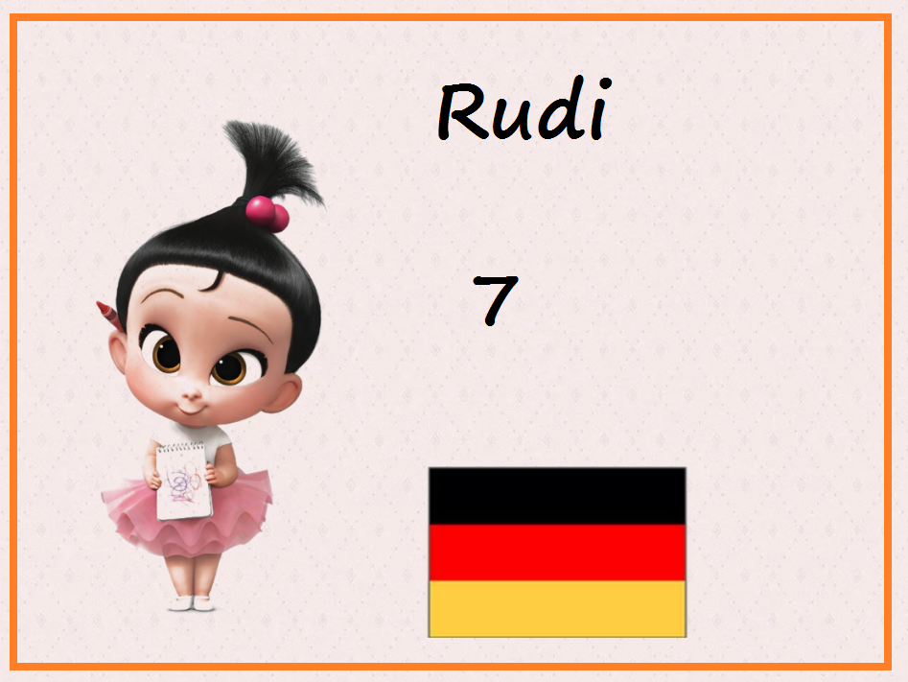
Asking for personal information
Name? Country? Age?

Slide 56
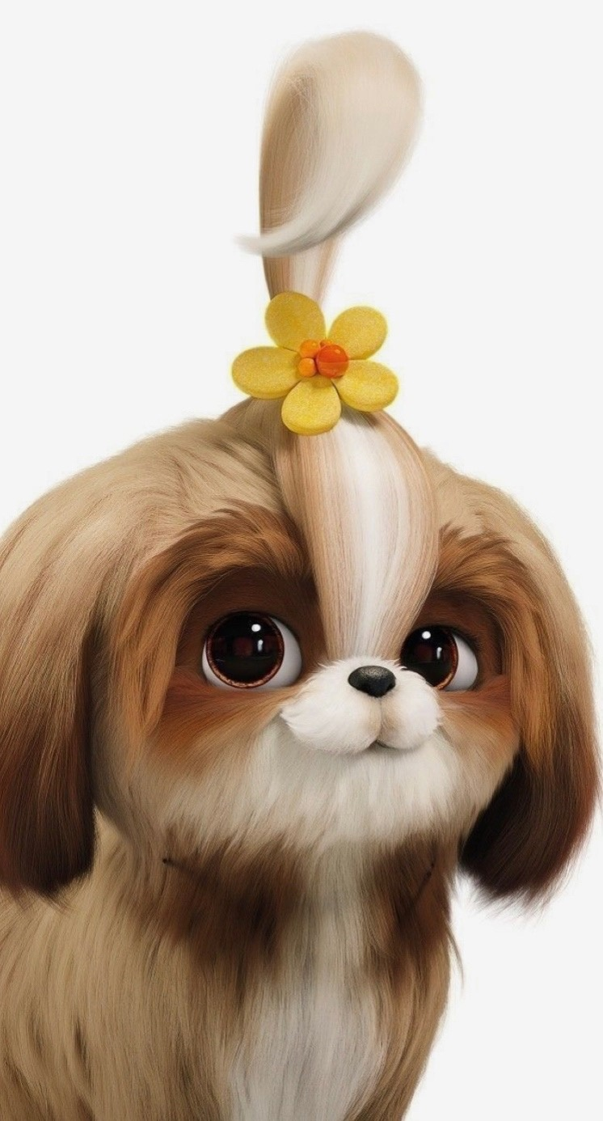
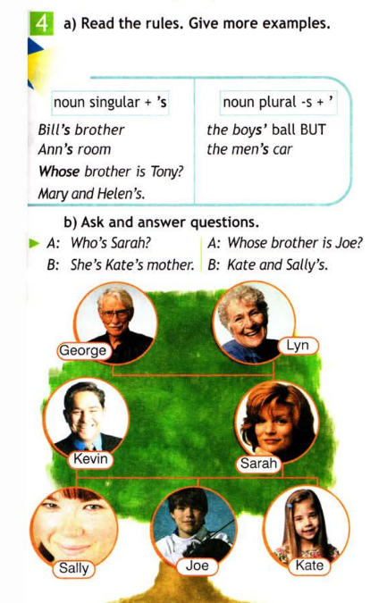
4b

Slide 57
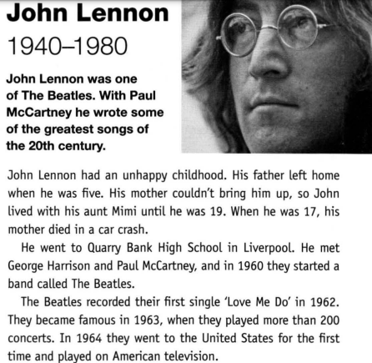
4c Famous people

Slide 58
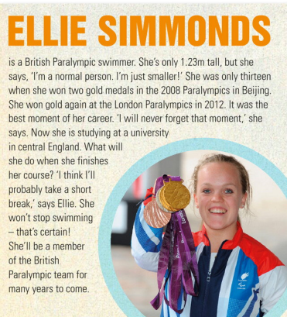

Slide 59
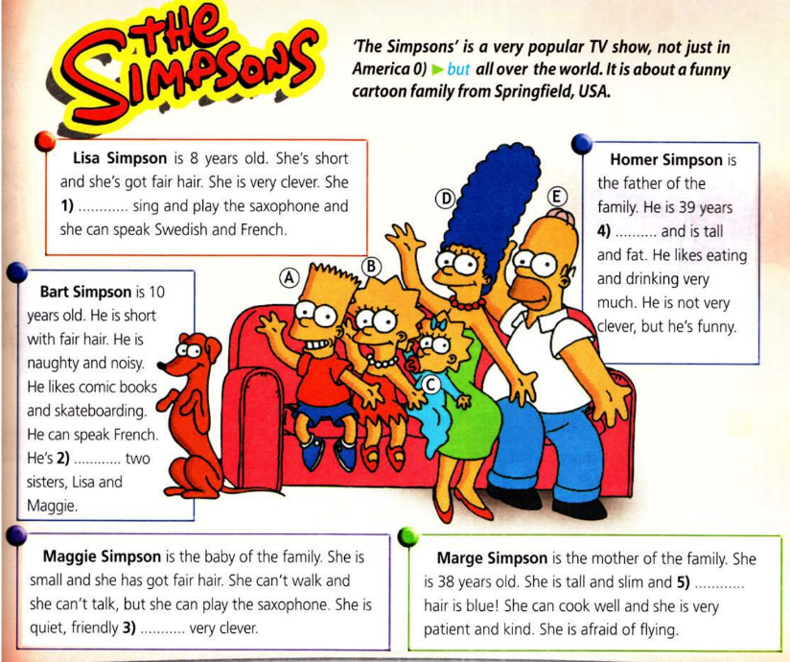

Slide 60
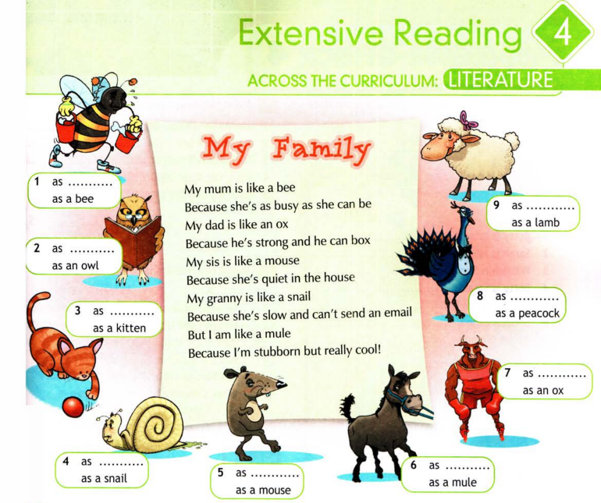

Slide 61
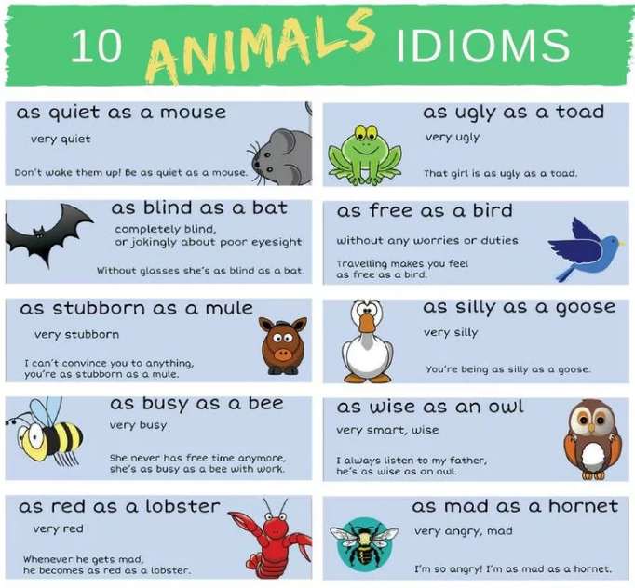

Slide 62
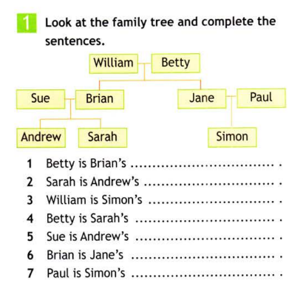
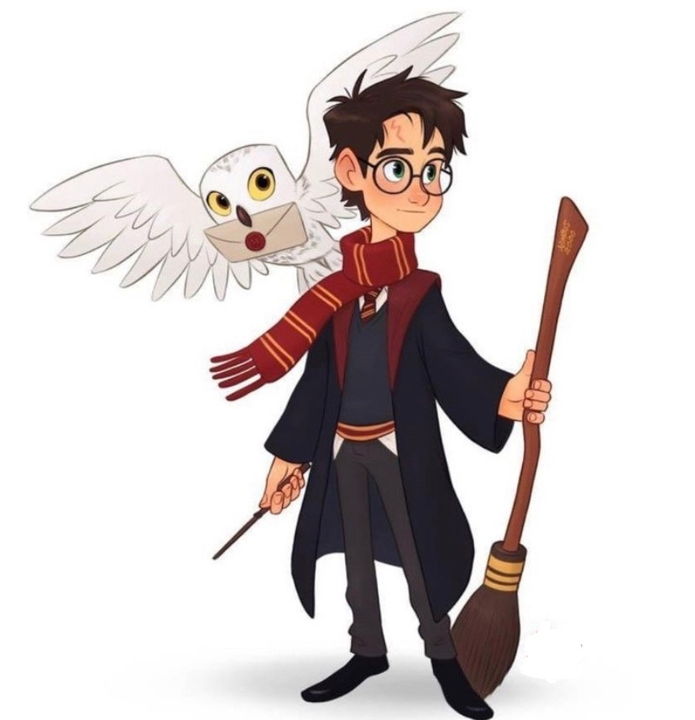
Progress check

Slide 63
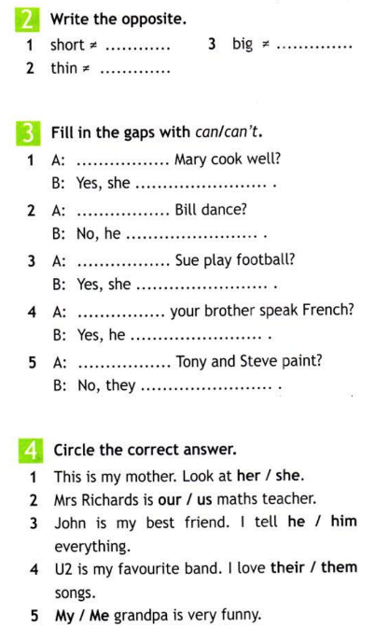
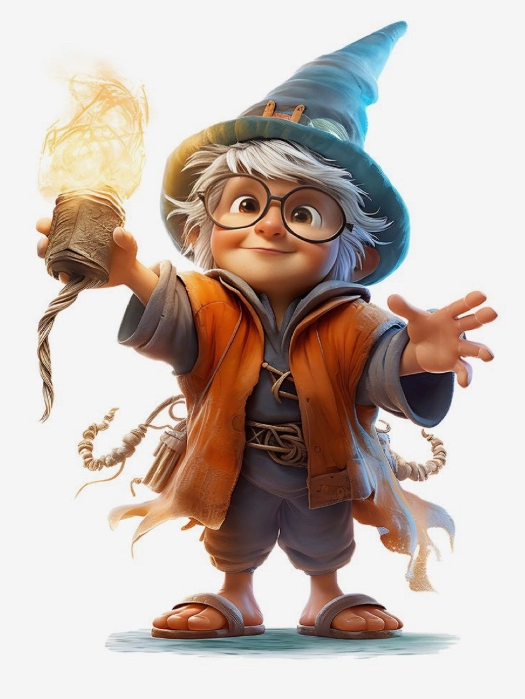

Slide 64
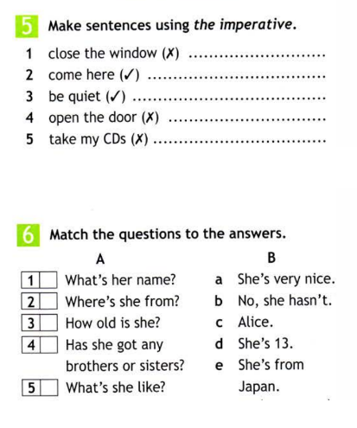
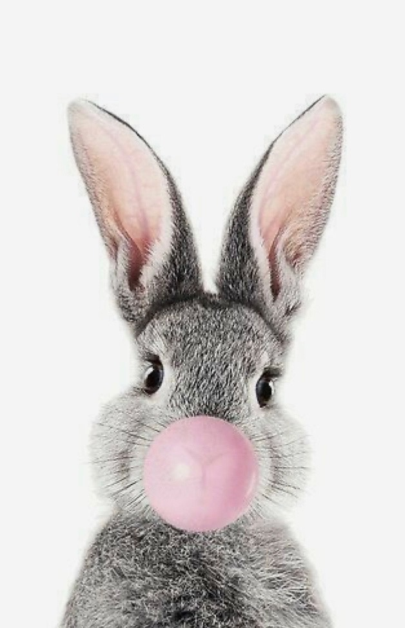

Slide 65


