Slide 1
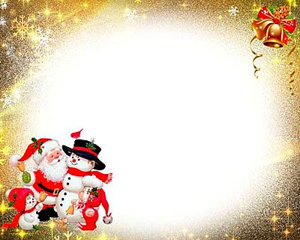
Santa Claus

Slide 2
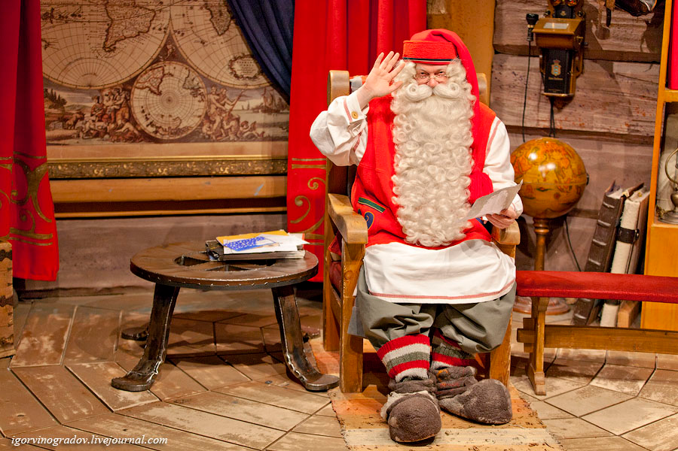
Who is he?
Father Christmas, the Western European and North American fabulous (folk) character who brings gifts to children on Christmas.

Slide 3
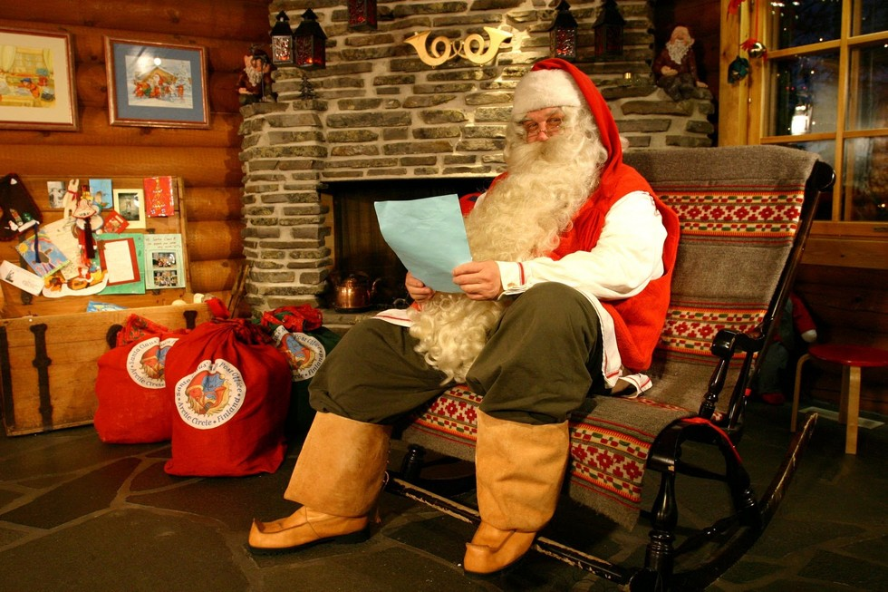
The origin of Santa Claus
In 1823, Clement Clarke Moore published a poem "The Night Before Christmas, or visit St. Nicholas", in which he told about Santa Claus - fairy-tale characters, giving gifts to children. This poem, which became very popular, was reprinted in 1844.

Slide 4
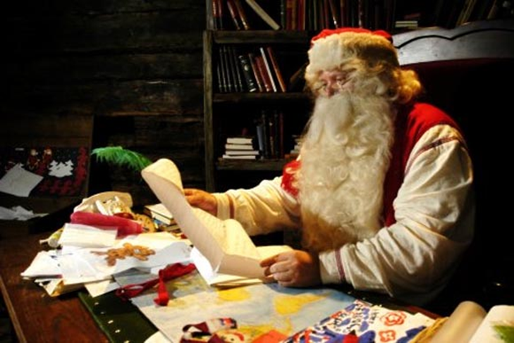
Home of Santa Claus
House Santa Claus traditionally includes living quarters and studio, where he creates - often with the help of elves and other supernatural beings - the gifts, which he delivers to good children on Christmas.

Slide 5
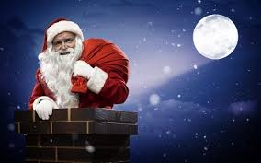
The traditions of Santa Claus
Santa Claus Tradition entrance through the chimney in a house typical of many European a country seasonal gifts.

Slide 6
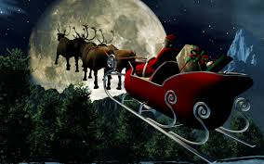
Real Santa Claus
It is believed that Santa Claus travels on a sleigh pulled by reindeer:
Dasher, Dancer, Prenser, Vixen, Comet, Kyupid,
Donner, Blitzen.

Slide 7
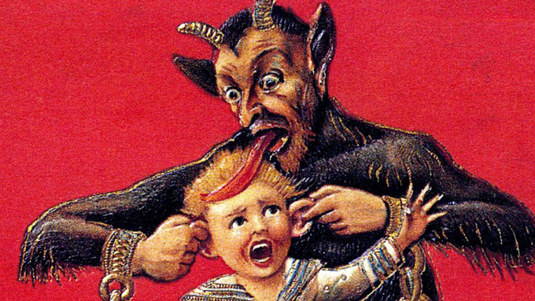
Satellites Santa Claus
In various traditions of Santa Claus appears accompanied by other characters, good or bad. So, in the folklore of the Alpine region and at the same time companion antipode St. Nicholas is hairy and horny Krampus, who punishes naughty children and scares them.

Slide 8
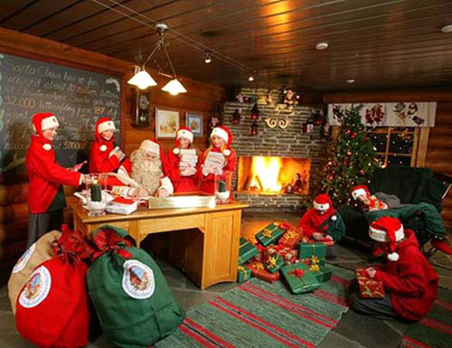
Christmas elves
In modern Western Christmas traditions assistants [Santa Claus, living with him at the North Pole and making toys, which he gives to children. They are usually represented in the form of small, often older men in suits of red and green in the caps on his head.

Slide 9
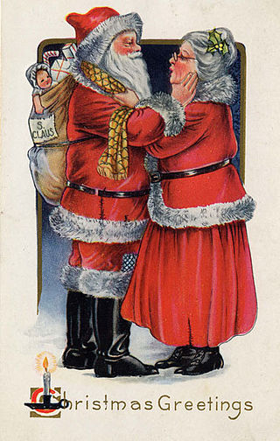
Mrs. Claus
Wife and companion, "giver of Christmas" Santa Claus in late European and North American Christmas traditions, helping him in charge of management and leadership elves or other spirits are made gifts for children.

Slide 10
Thank you for attention

