Slide 1

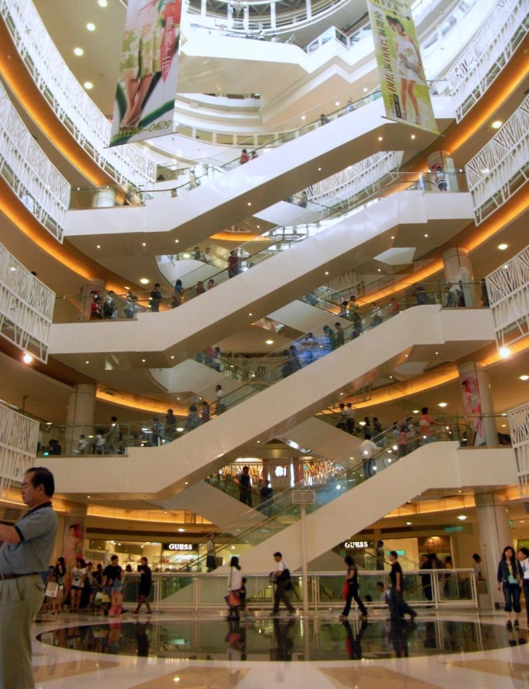

Покупки. Финансовая грамотность/
Shopping. Financial Literacy
Урок-исследование, 10 класс
Сенцова Оксана Ивановна, учитель иностранного языка МАОУ «Лицей №5», Камышловский городской округ

Slide 2

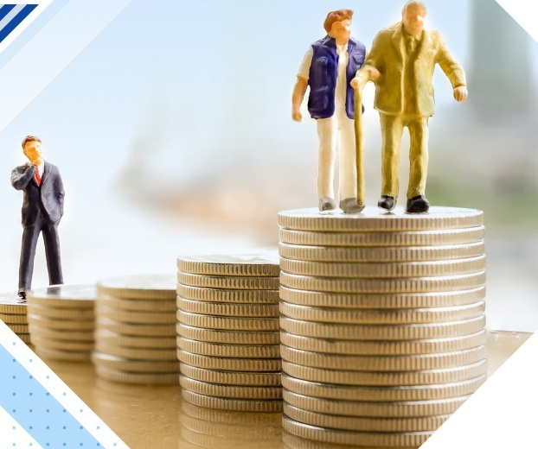
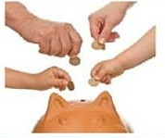
Words of Wisdom
The art is not in making money, but in keeping it.
(Author unknown)

Slide 3


*Методологические аспекты урока
* обсуждение совместно с обучающимися
1. Актуальность темы
5. Задачи
2. Проблема
Тема: «Покупки. Финансовая грамотность»/
«Shopping. Financial Literacy»
4. Цель урока
3. Гипотеза

Slide 4
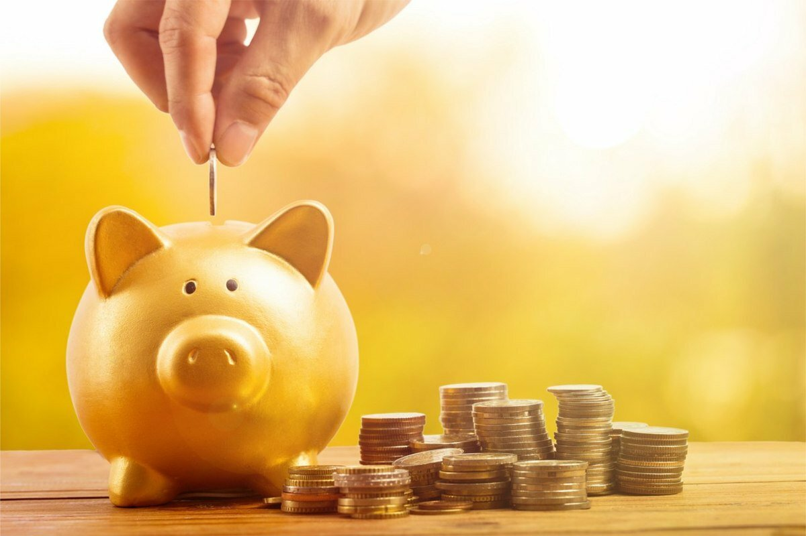
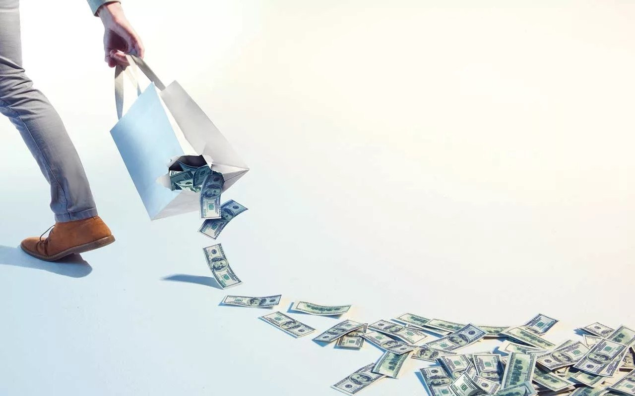
QUIZ
Are You a Saver
or
a Spender?

Slide 5
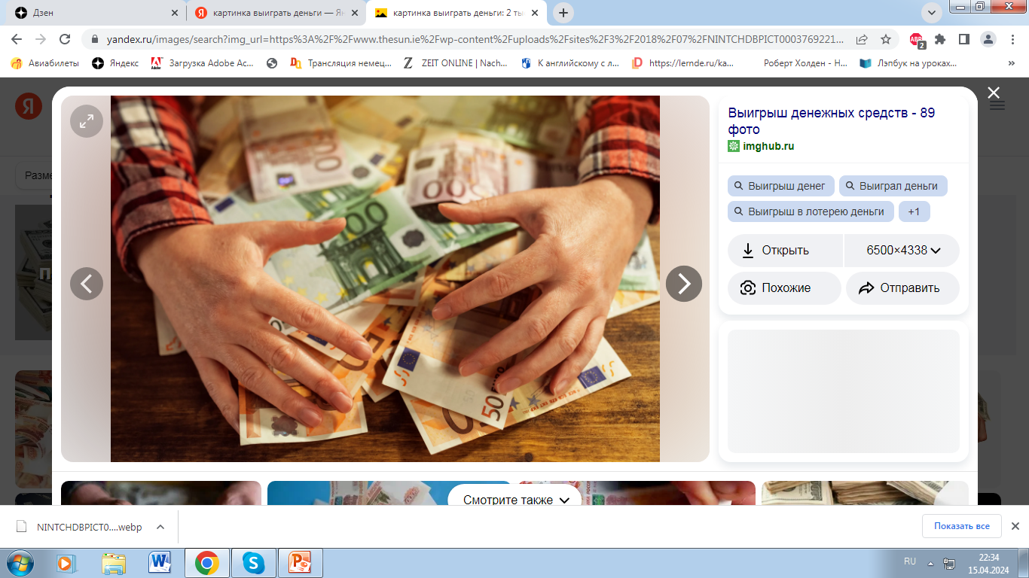

1. Imagine you win £100 . What do you do?
I go shopping and spend it all.
I save it all to buy something big later.
I save £50 and then buy presents for my family.

Slide 6
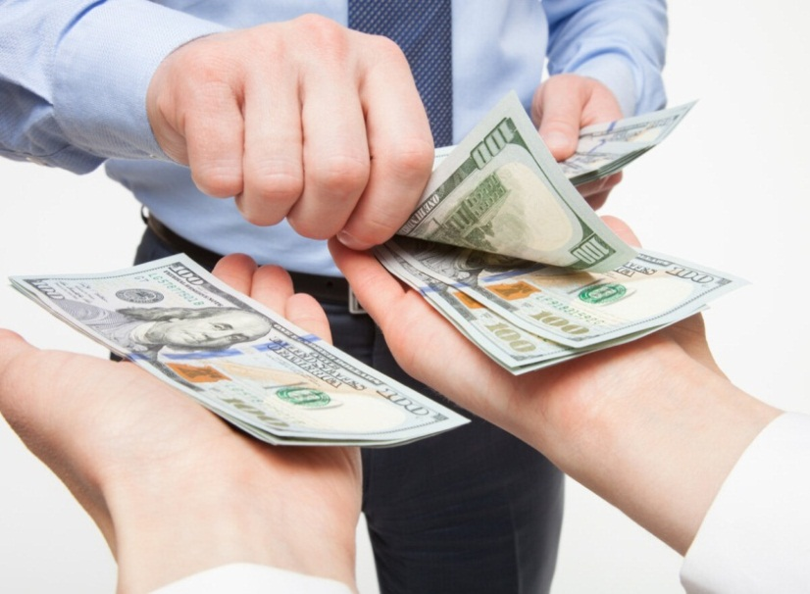
2. Do you ever borrow money?
No, never. But I sometimes lend it to my friends.
Yes, I do. I often borrow money from my parents and friends.
Sometimes, but I always return it quickly.

Slide 7
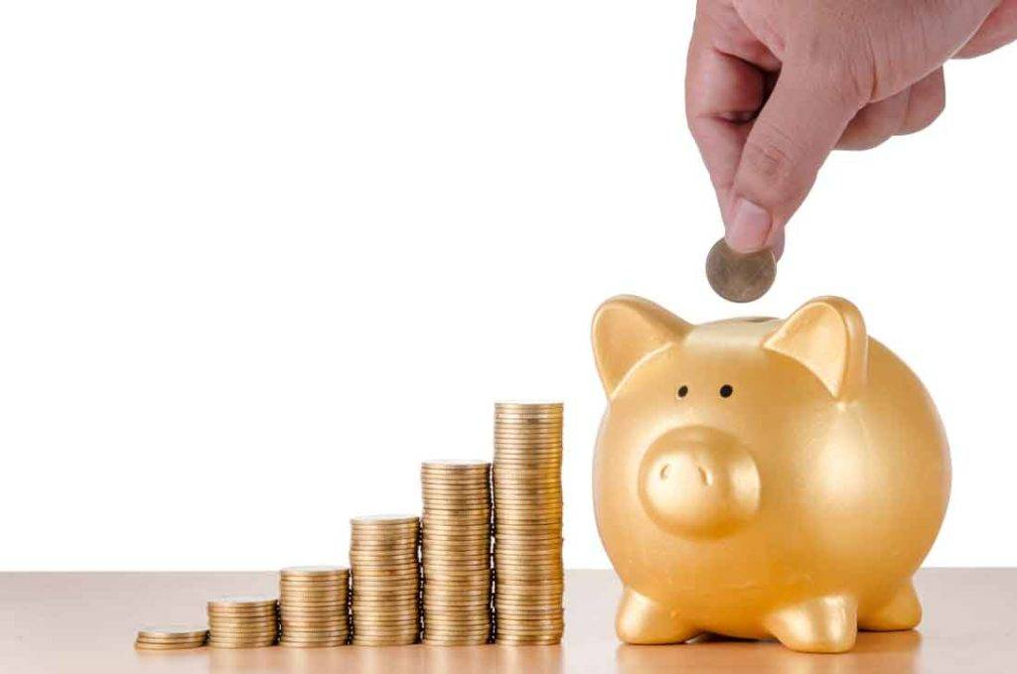
3. How much money do you usually spend every week?
It depends. Some weeks I spend a lot, but other weeks I save money.
Too much. I always spend all my pocket money – it’s never enough.
I don’t spend much – I always save all my pocket money.

Slide 8
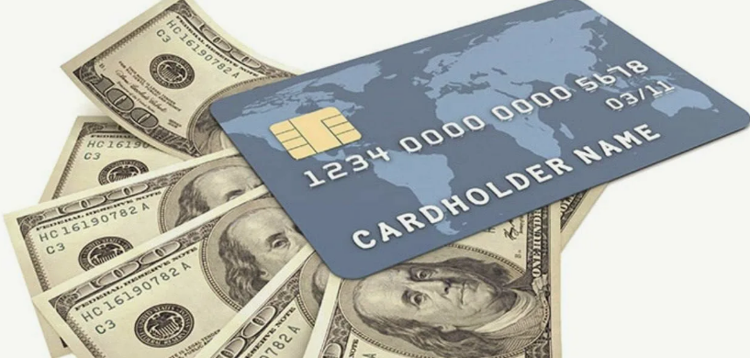
4. Have you got a bank account?
Yes, I have. I always put my birthday and Christmas money in there.
Yes, I have – but I haven’t got much money in it.
No, I haven’t. But I know I should open one soon.

Slide 9
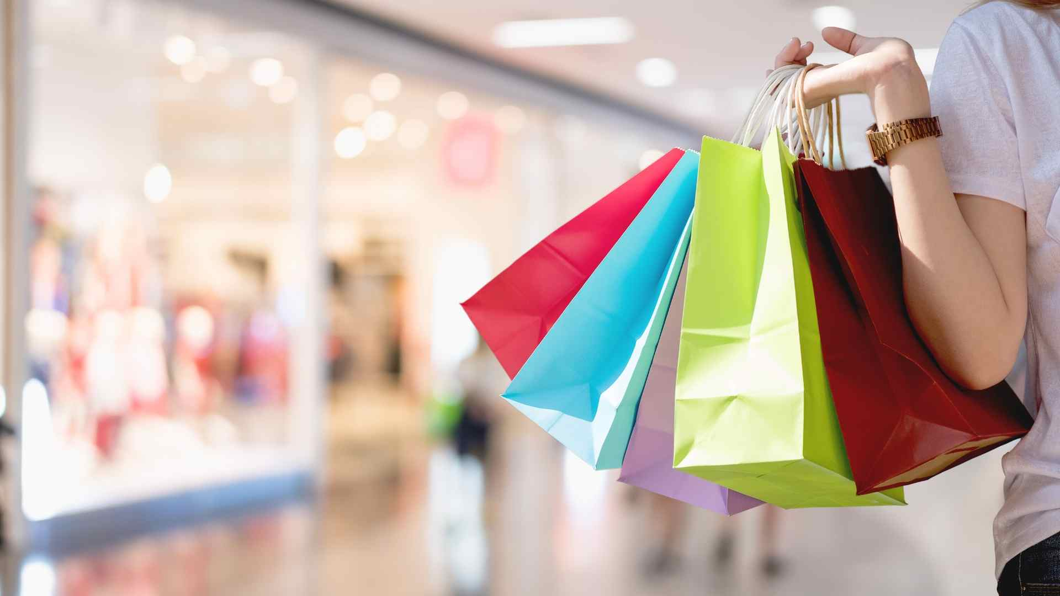
5. How many times a month do you go shopping?
Probably about once or twice a month. I buy clothes or CDs.
Too many times. I love going shopping and I buy too many things.
I usually just go “window shopping” – I look but I don’t buy.

Slide 10

6. What are your hopes for the future?
I want to travel round the world and have an interesting life.
I want to buy a nice house and a car, and have enough money to be comfortable.
I just want to be happy – money isn’t really important.

Slide 11
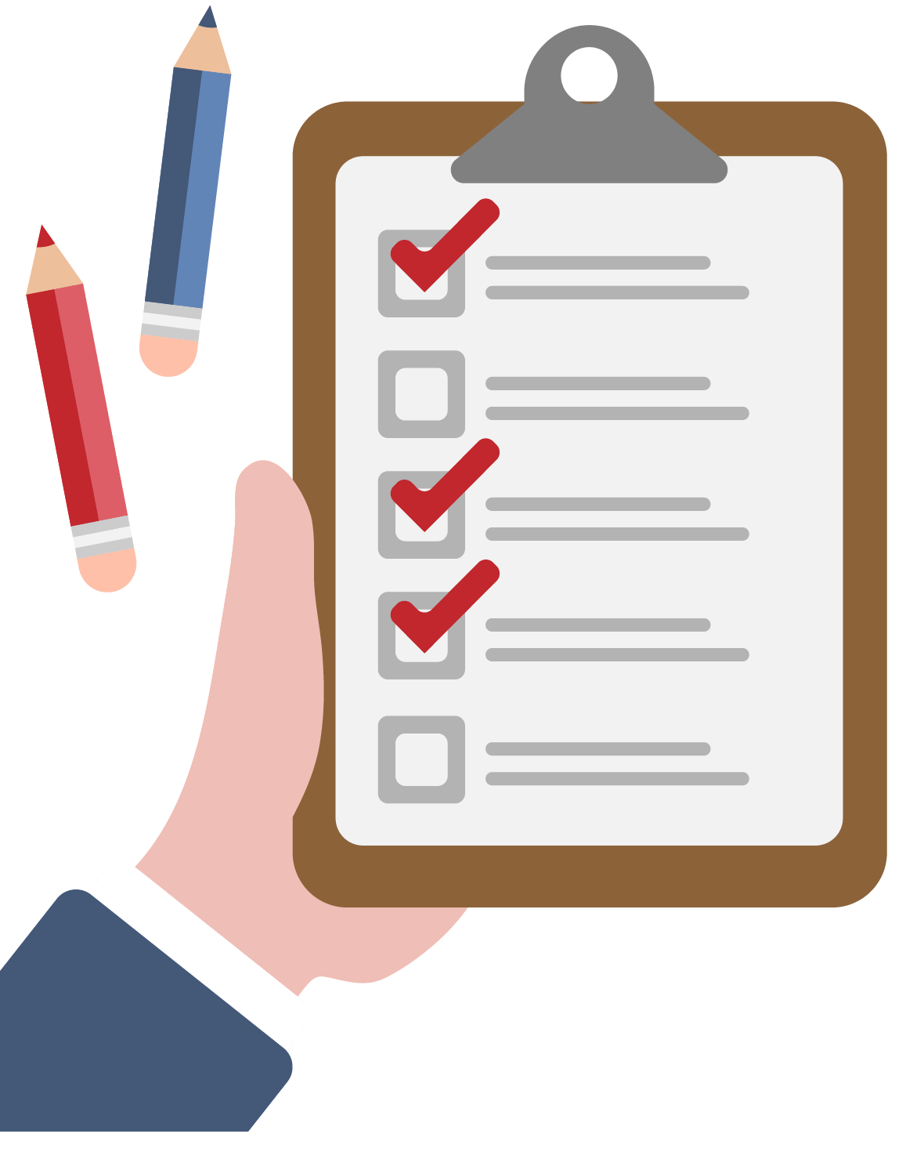
Scores
Are You a Saver or a Spender?
a: 3 b: 1 c: 2
a: 1 b: 3 c: 2
a: 2 b: 3 c: 1
a: 1 b: 2 c: 3
a: 2 b: 3 c: 1
a: 3 b: 1 c: 2

Slide 12
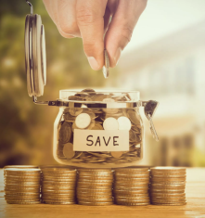
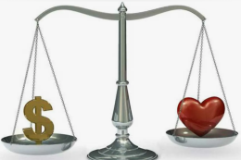
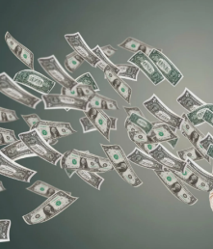
Are You a Saver or a Spender?
6 – 9 You’re a saver. You’re good with money, but don’t forget to have some fun too.
10 – 14 You’ve got a healthy attitude to money. You’re generous and balanced.
15 – 18 You’re a big spender. You enjoy life to the maximum, but just remember: money doesn’t grow on trees.

Slide 13
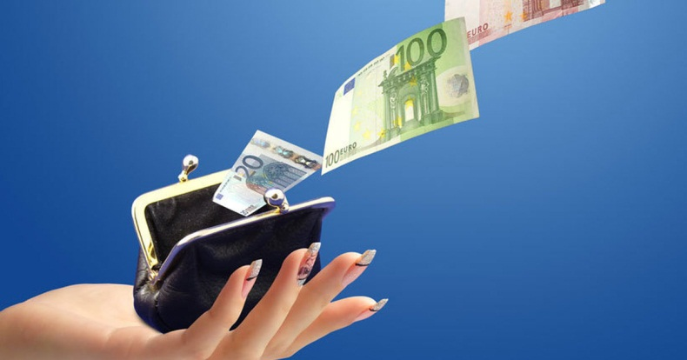
Vocabulary
Spending money
1. What do you think teenagers in your country spend their money on? Choose from the list.
clothes and accessories
supermarket shopping
eating out
mobile phone cards
sweets and snacks
rent
computer games
going out (cinema, concerts, sporting evens)

Slide 14

Vocabulary
Spending money
2. Complete with: waste, pay, cost, lend, borrow, save. Answer the questions about yourself.
How do you … for things you buy: in cash, by cheque or by credit card?
Do you ever … money to your friends?
Do you ever … money from your friends?
Do you … up buy something you want, e.g. a new bike?
Do you think teenagers … their money on things they don’t really need?
Which of the things you buy … a lot and which are reasonably priced?

Slide 15
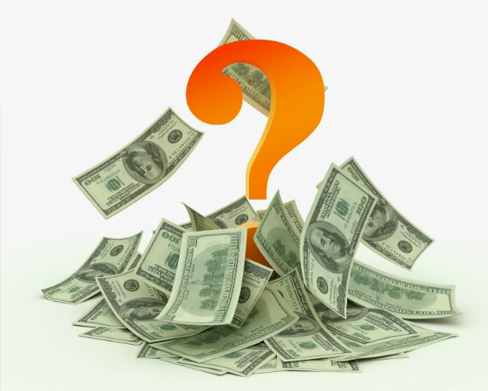
Speaking
3. Work in pairs. Discuss the questions.
how much money you get
where you get your money from
what you spend your money on
whether you are good with money

Slide 16
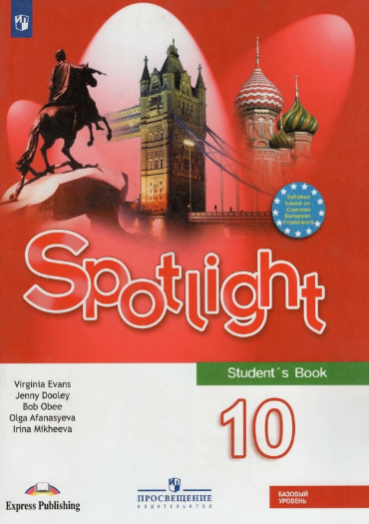
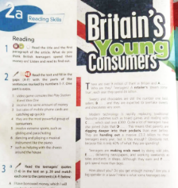
Reading
4. What do you think British teenagers spend their money on? Read to find out.
p. 28, ex. 2, 3

Slide 17
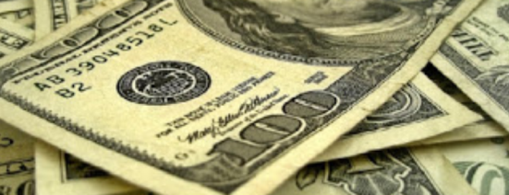
Can Money Buy Happiness?
BEFORE WATCHING
5. Discuss the questions.
Do you believe that money can buy happiness?
How much money would you need to make to live comfortably in your culture?
What kinds of things do people with a lot of money buy?
What kinds of things would you spend extra money on? Why?

Slide 18
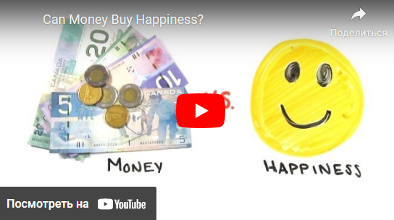
Can Money Buy Happiness?
Ссылка на видео:
https://www.youtube.com/watch?v=JSIkdWxotKw&t=5s

Slide 19
Can Money Buy Happiness?
WHILE WATCHING
6. Complete the sentences.
1. Humans are very … … .
2. Well, … … … that the problem may actually be in the way we spend money.
3. The same principle has been tested on … … … as well.
4. This has been seen in both … … … … .
5. … … … … … are even detectable at the neural level.
6. Travelling or going to an event is … … … … … of people in the long run.

Slide 20
Can Money Buy Happiness?
AFTER WATCHING
7. Answer the questions.
1. Do you agree with the idea that how you spend your money can increase your happiness?
2. Do you agree that people should spend more money on travel and experiences than material things?
3. If you had the choice of an amazing trip or an amazing car, what would you choose? Why?

Slide 21


Тема: «Покупки. Финансовая грамотность»/
«Shopping. Financial Literacy»
Гипотеза, Цель, Задачи
Обсуждение,
Выводы,
(включая результаты опроса)
Рекомендации (на будущее)

Slide 22

Homework
Writing
«What Is Financial Literacy and Why Is It Important?»
What is your opinion?
Write 150-200 words
(make an introduce,
express your personal
opinion, make
a conclusion)

Slide 23
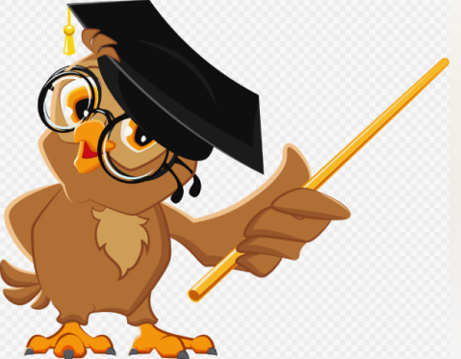
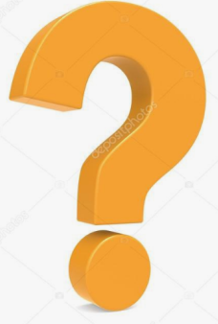
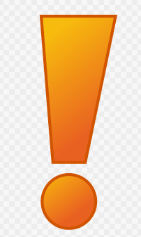
Summarizing the results of the lesson
What new information have you learned at the lesson?
What was the most interesting and useful to you at the lesson?
Did you have any difficulties?
How did you feel at the lesson?

Slide 24
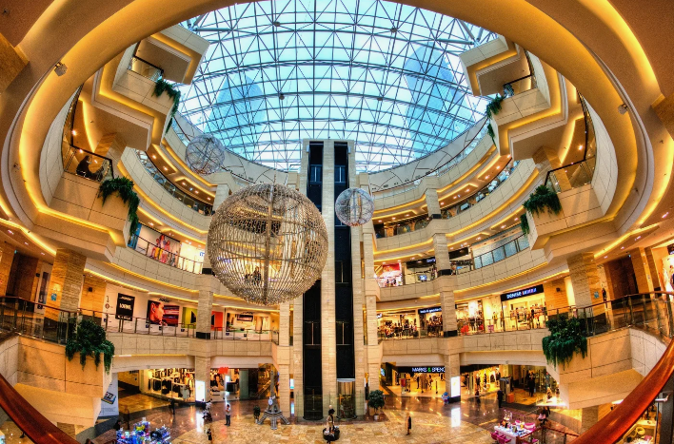
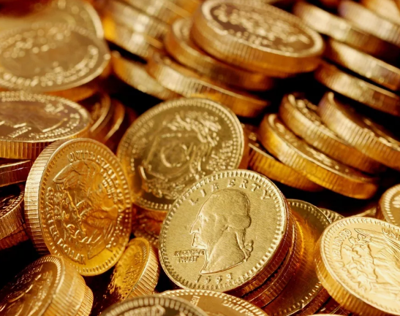
Thank you for your attention!!!

