Slide 1
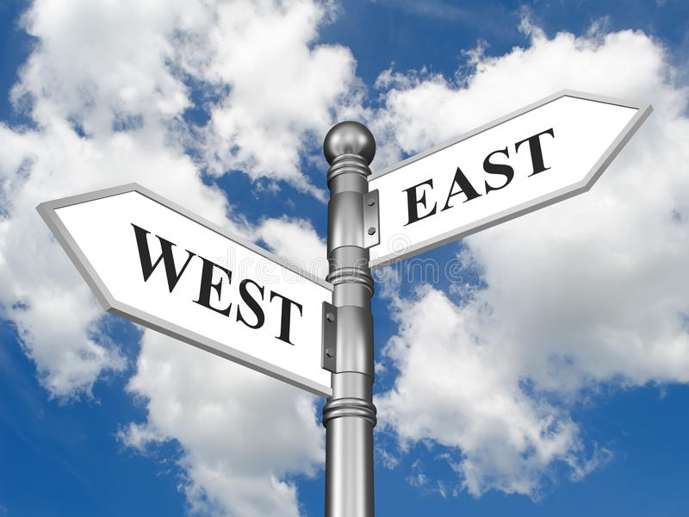
Eastern and Western lifestyle
МБОУ гимназия №1 города Белово
Попова Е.А.

Slide 2

ng
A good beginning makes a good ending.
East or west home is best.
Better late than never.
4. Strike while the iron is hot.
5. First things first.
6. Good things come to those who wait.

Slide 3


Slide 4
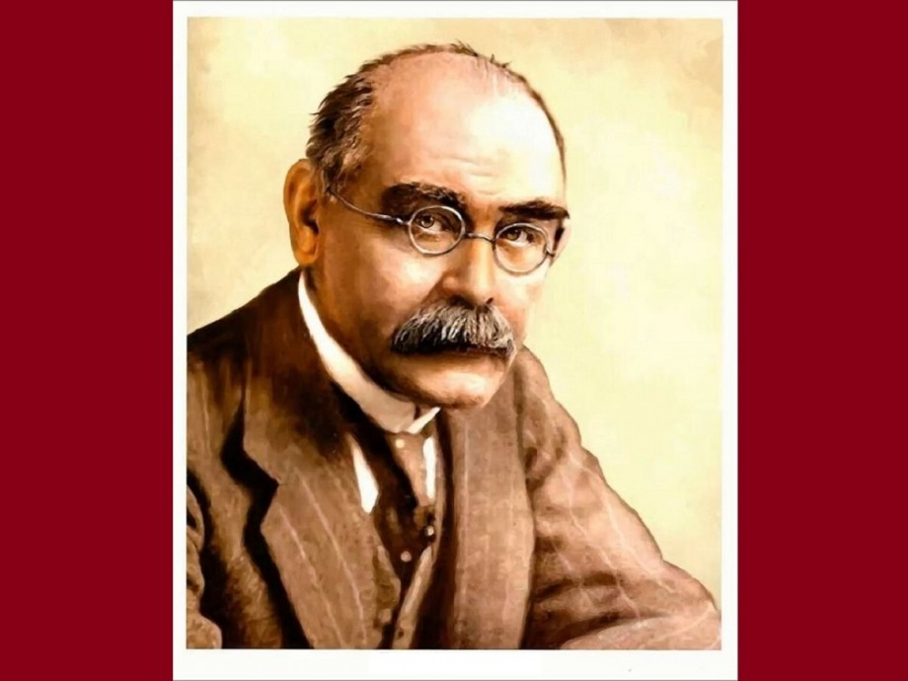
“Oh, East is East and West is West, and never the two shall meet…”
(Rudyard Kipling “The Ballad of East and West)

Slide 5

The theme of the lesson
“Eastern and Western lifestyle”

Slide 6
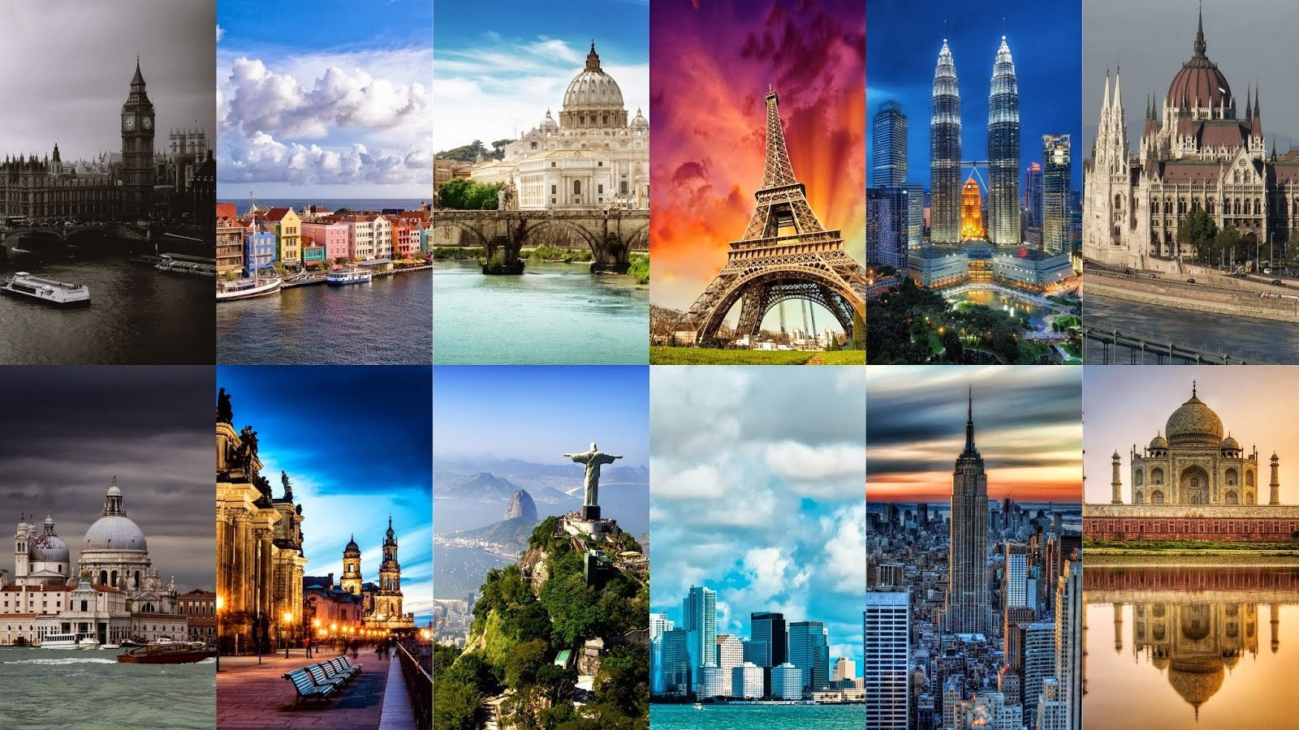
The problem of the lesson is “Different countries – different lifestyles”

Slide 7
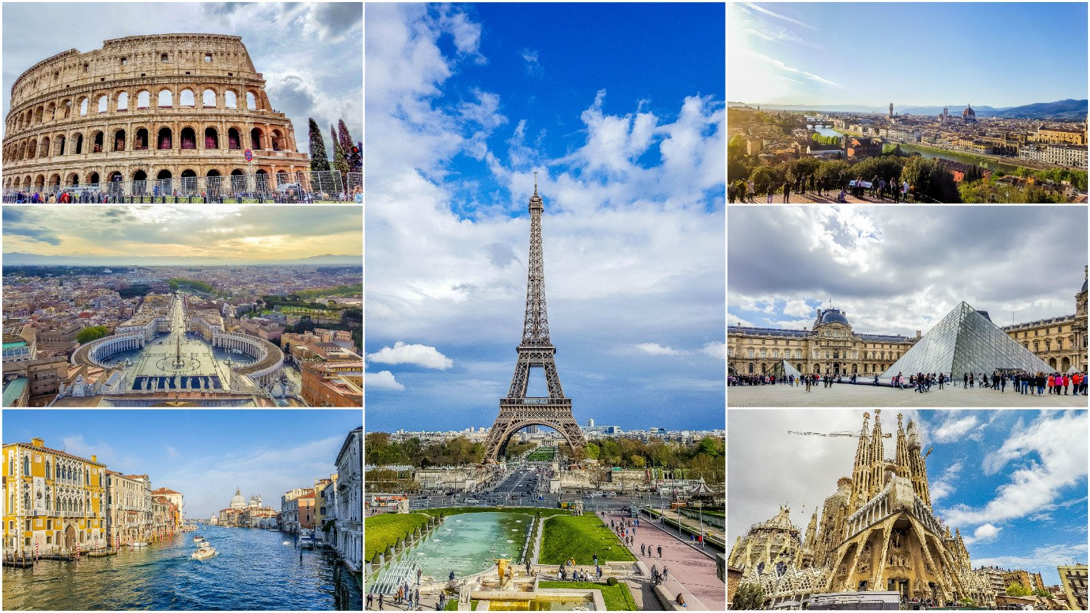

Slide 8
Words | Countries
Lady | England
Hot-dog | The USA
koala | Australia
olives | Greece
tea | China
pizza | Italy
cactus | Mexico
tulips | The Netherlands
baguette | France
suchi | Japan

Slide 9
Words | Countries
quickly changing, urban, fashionable | Japan
technological, advanced, quickly changing | The USA
not fast, fashionable | Italy

Slide 10
№ | Statement | True | False | Not stated
1. | The majority of the population in Japan have migrated to cities.
2. | Italians don’t love to chat over a coffee.
3. | The Italian lifestyle is slow and relaxed.
4. | In the average American Family typically the father spends around 9-10 hours a day at work.

Slide 11

The dynamic pause.
Look left, right
Look up look down
Look around.
Look at your nose
Look at that rose
Close your eyes
Open, wink and smile.
Your eyes are happy again.

Slide 12
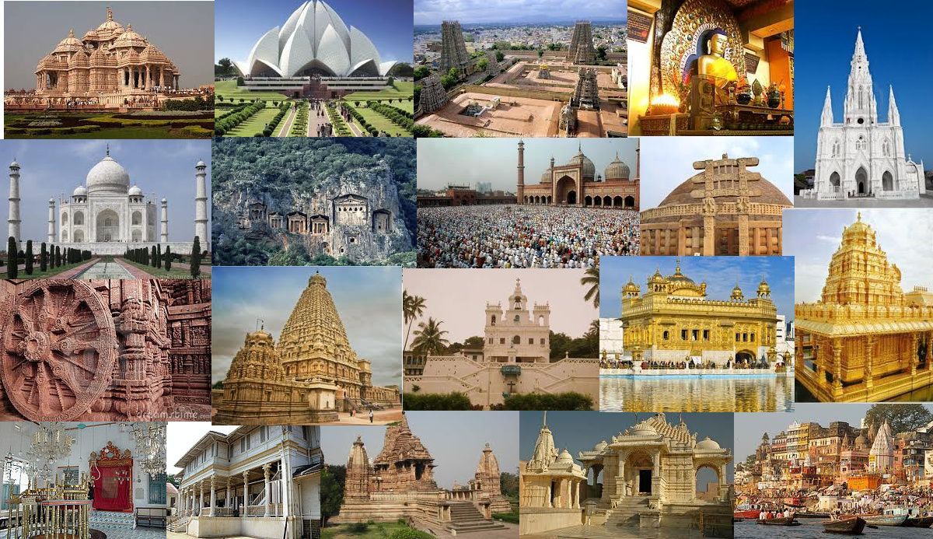
Global trends (2)
The ‘Japanese” way of living (1)
A simple but aesthetic life (5)
Looking for a different lifestyle (7)
Much work and a bad health (6)
Bar culture, café and conversation (4)
Family life (3)

Slide 13
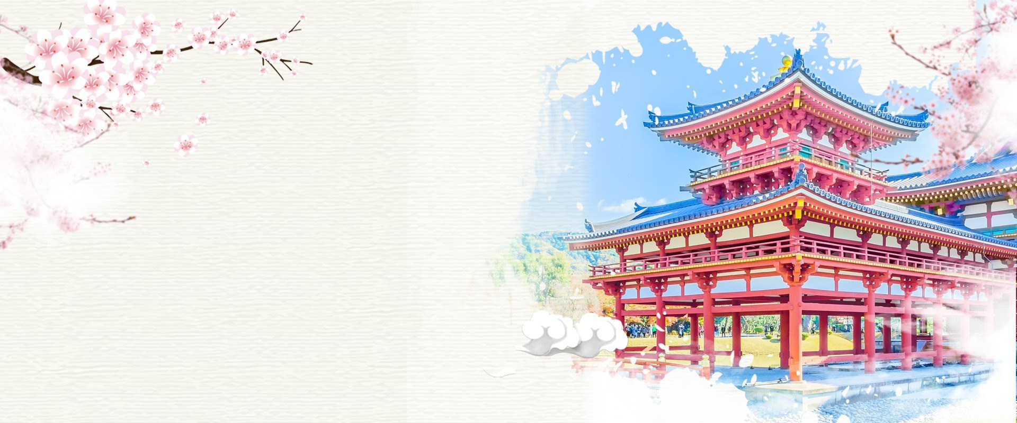

Slide 14
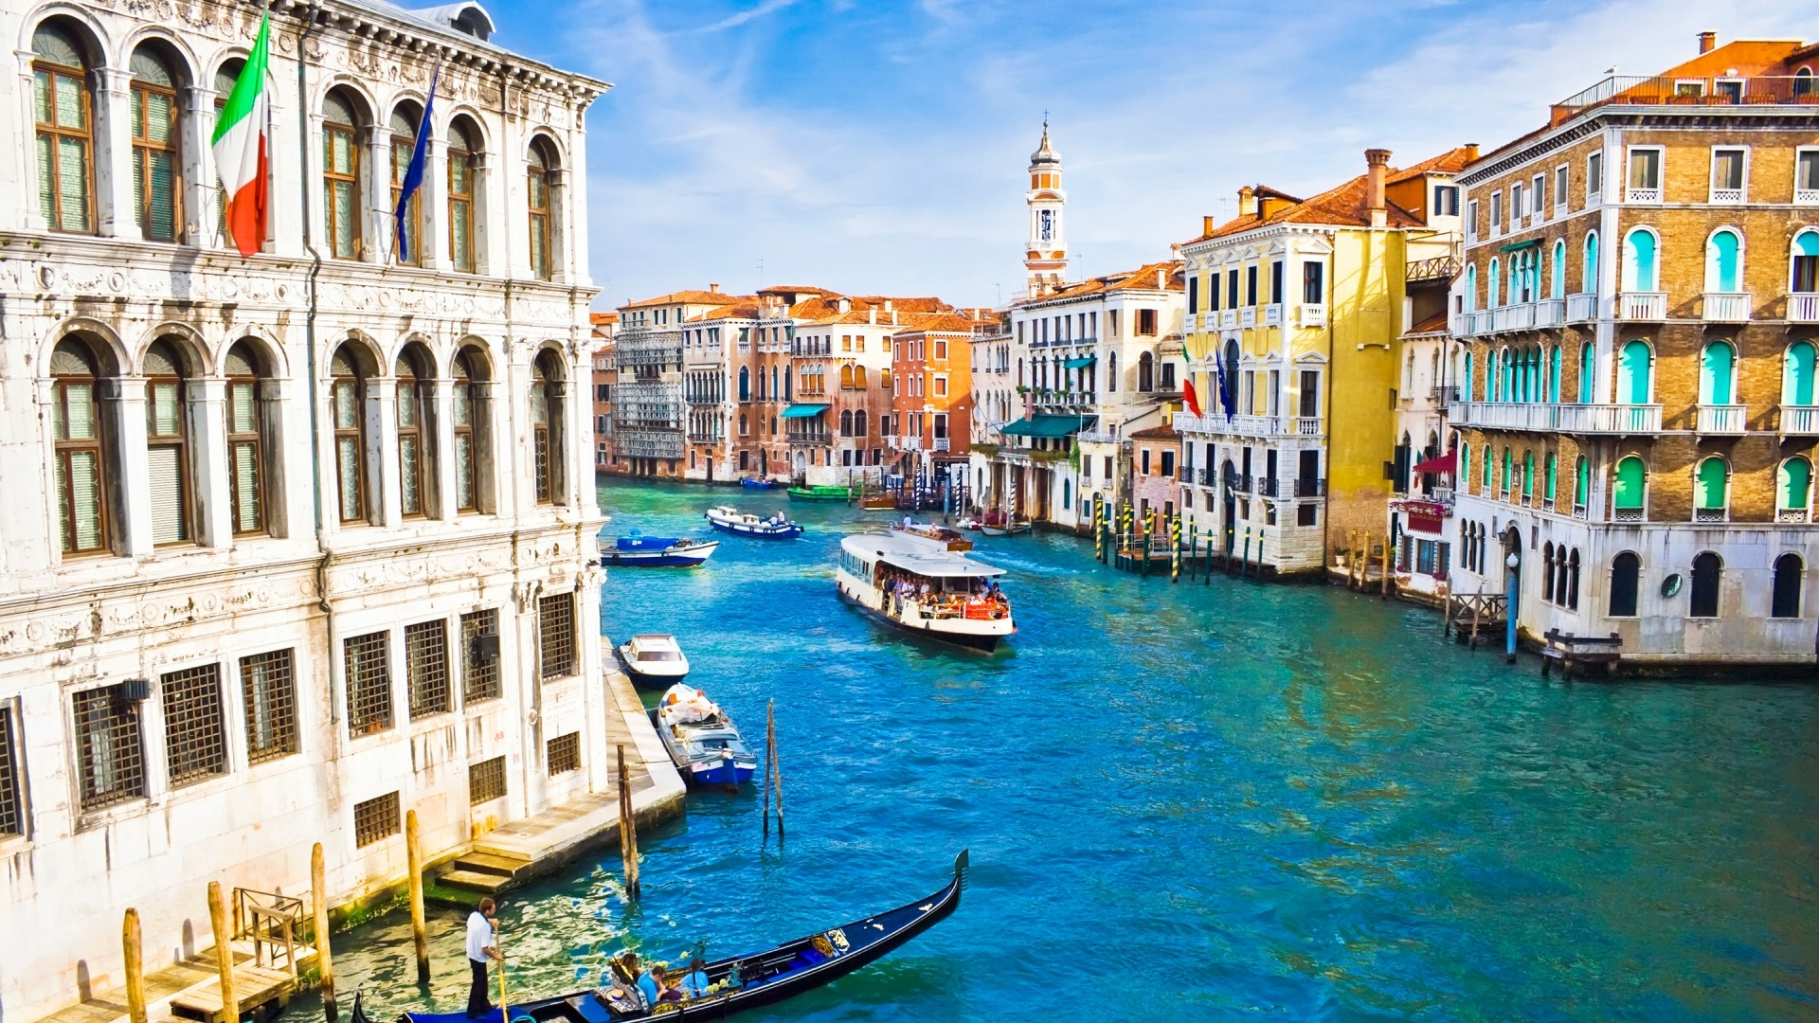

Slide 15
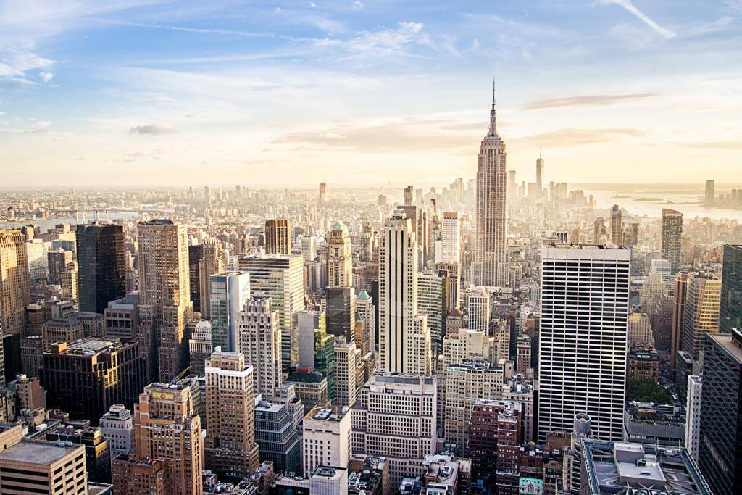

Slide 16
 | Sentences | Countries
1. | Family values are important. | Japan, Italy
2. | The pace of life is rather slow. | Italy
3. | Long working days influence one’s lifestyle a lot. | The USA
4. | People feel depressed because of the fast pace and peer pressure. | Japan, The USA
5. | The pace of life has increased recently. | Japan, The USA
6. | Global trends have influenced people’s lifestyle. | Japan
7. | People have got more interested in travelling. | Japan
8. | People are looking for quieter places to live and work. | The USA
9. | People combine their love of the arts with everyday things. | Italy
10. | New fashion trends have been created. | Italy

Slide 17
1. | What is common about these countries? What are the differences?
2. | Which countries would you like to visit?
3. | Would you rather go to the West or to the East?

Slide 18
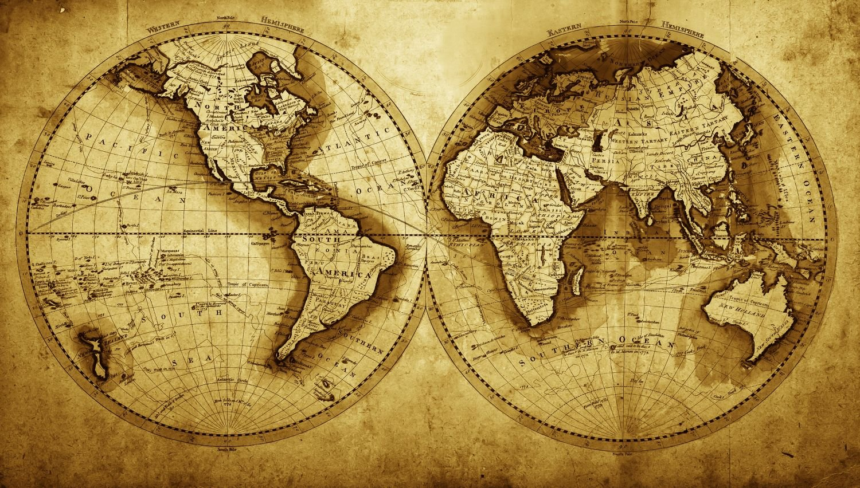
So different countries have different lifestyle. Because they have different culture, religious and philosophy. The upbringing and behavior of people are completely different.

Slide 19

Write an essay “The lifestyle in the USA, Italy and Japan”
in which you must compare:
working habits (hours and intensity work);
eating habits;
hobbies and pastimes

Slide 20


