Slide 1
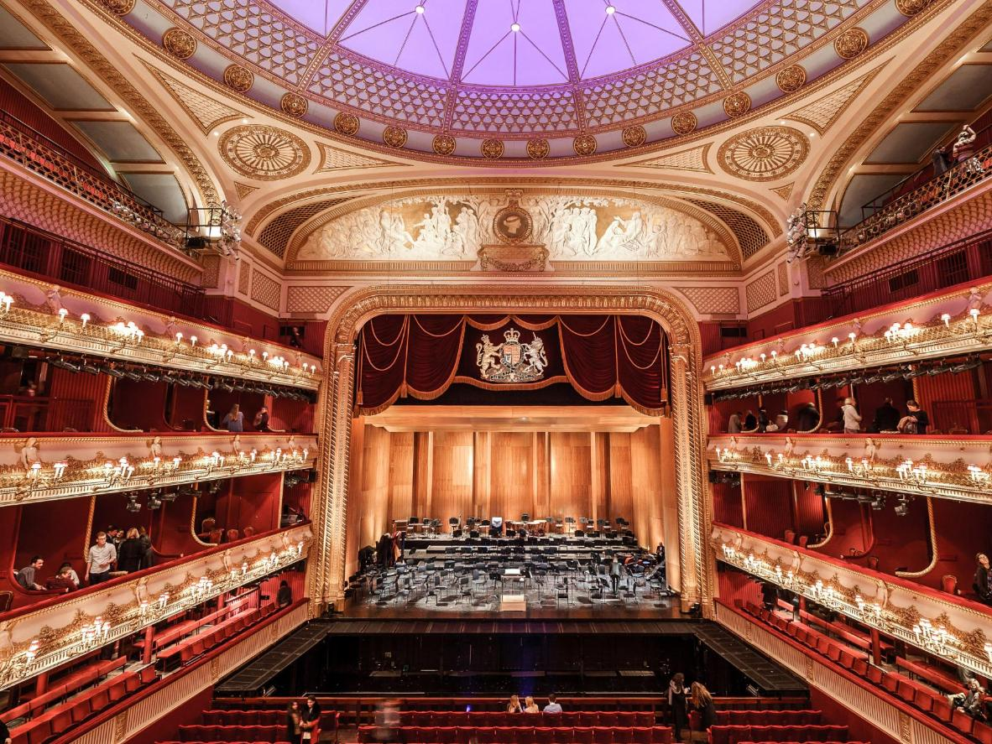
Private educational institution of Moscow School “Lotos”
Theatrical art
Completed by: Agapina Olga,
Evchenko Timofey
7th graders of school “Lotos”
Project director: Ivchenko Olga Vladimirovna
English teacher of school “Lotos”

Slide 2

The aim of the project work
To attach the younger generation to the theatrical culture of Great Britain
and interest in theatrical performances.
The project work tasks
To learn about historical events and people.
To inform the younger generation about theatrical culture of Great Britain.
To realize yourself as a creative person.
Hypothesis
Theatrical art has a great influence on the formation of personality.

Slide 3
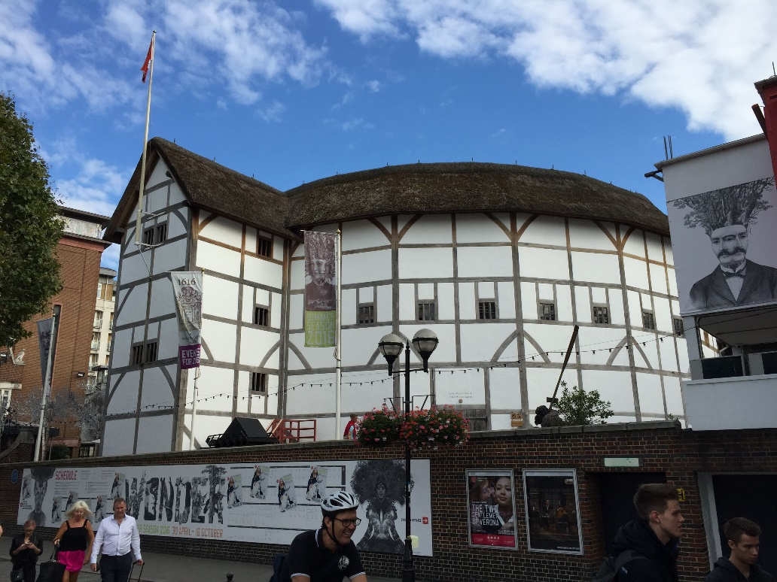
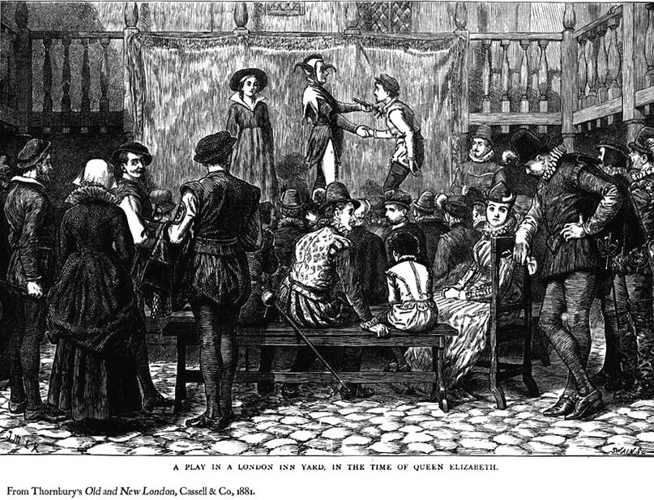
There are 1300 theatres of various genres in the UK.
Early theatres

Slide 4
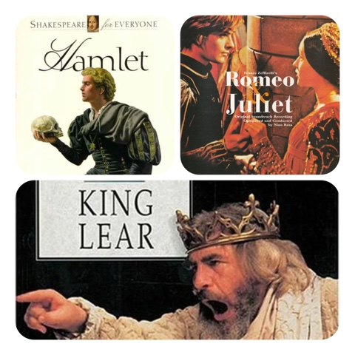
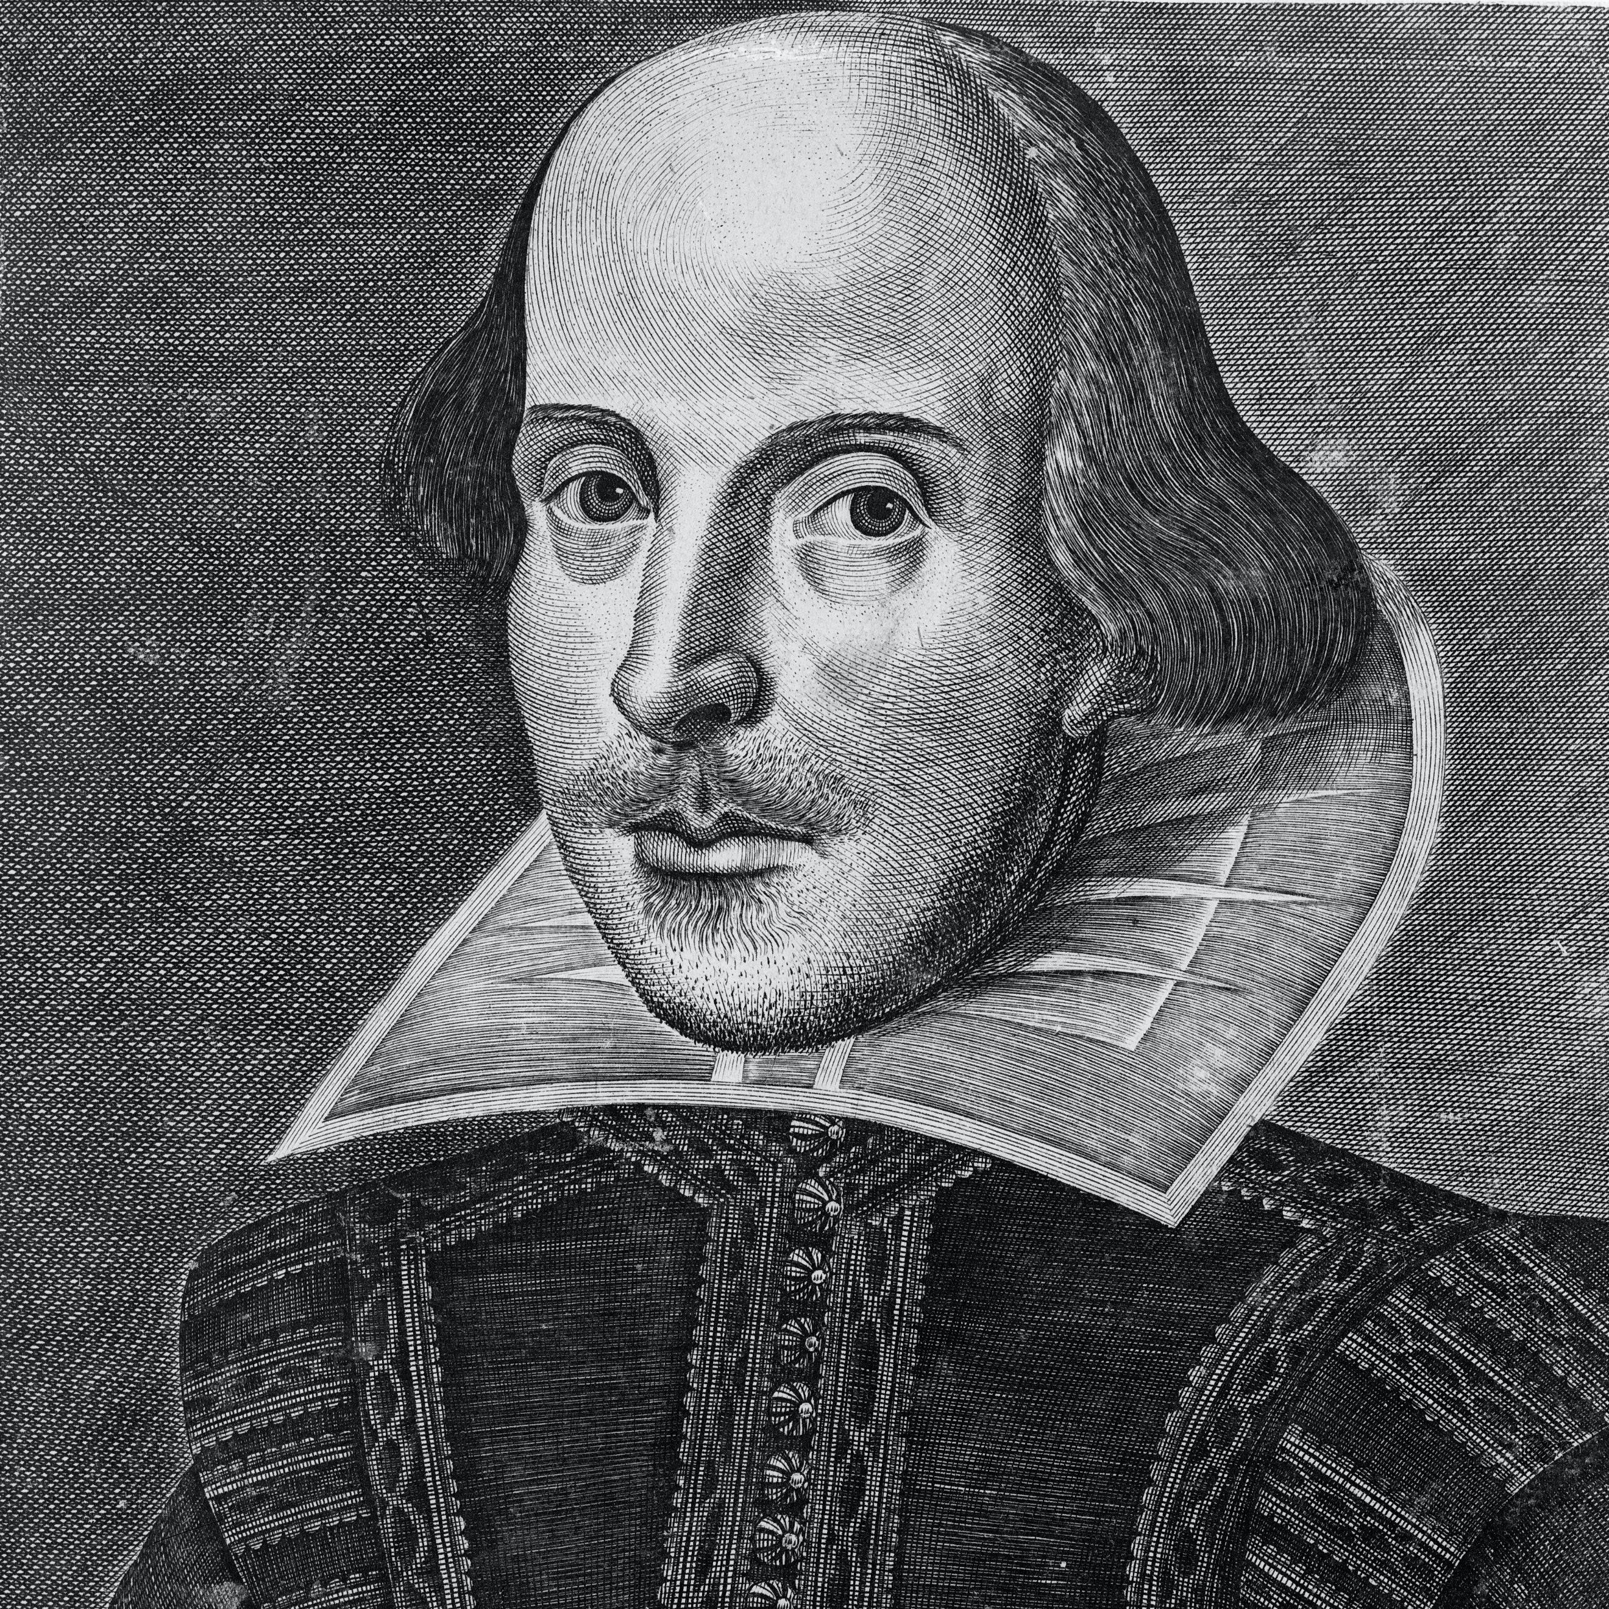
Shakespeare’s plays became the most popular.

Slide 5
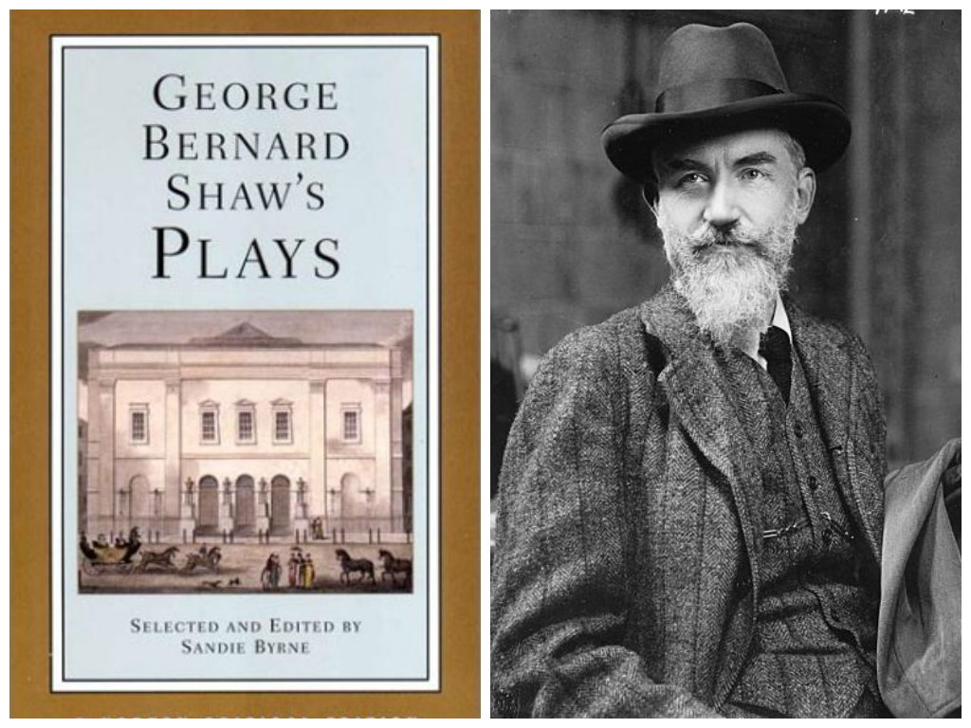
Bernard Shaw became the creator of the modern English drama “Caesar and Cleopatra”.

Slide 6
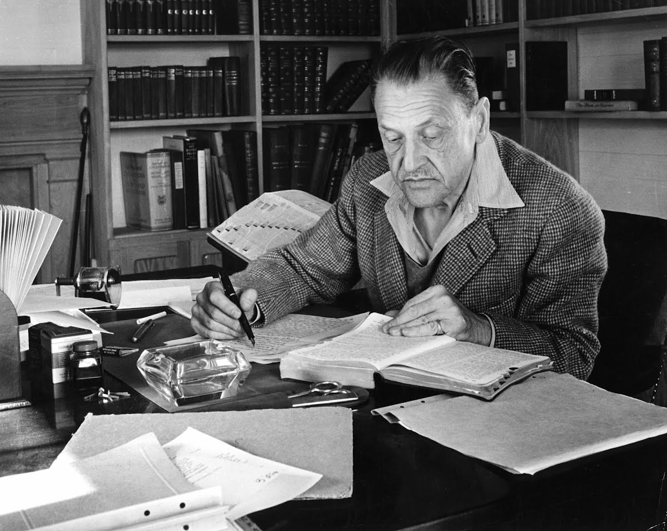

The famous director Somerset Maugham showed a brilliant dialogue as the main thing in his comedies.

Slide 7
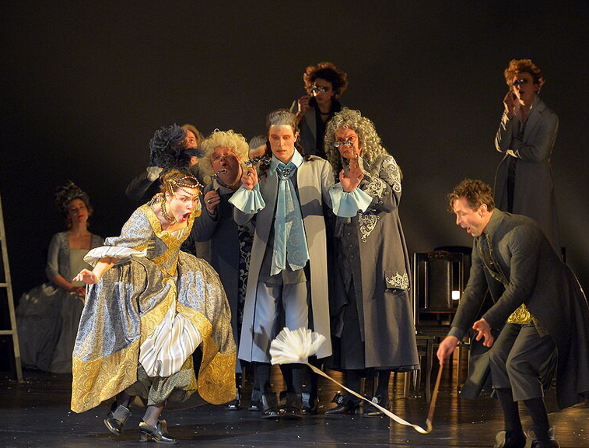
The famous director Somerset Maugham showed a brilliant dialogue as the main thing in his comedies.

Slide 8
Do you like going to the theatre?

Slide 9
What theatrical performances do you prefer most of all?

Slide 10
Would you like to see
a performance in an English theatre?

Slide 11
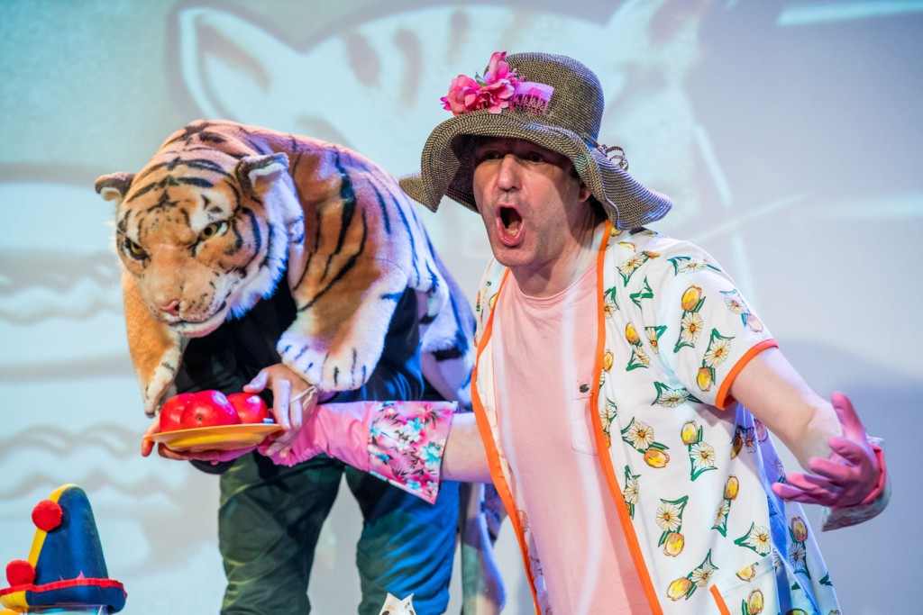
“Tiger who came to tea”
The British have a great epithet for everything that is happening on the theatrical stage and it sounds
like “ vibrant”.

Slide 12
Conclusion
Theatre can captivate a teenager.
Develop communicative skills.
Theatre can be a hobby.
Theatrical art has a great influence on the formation of personality.

Slide 13
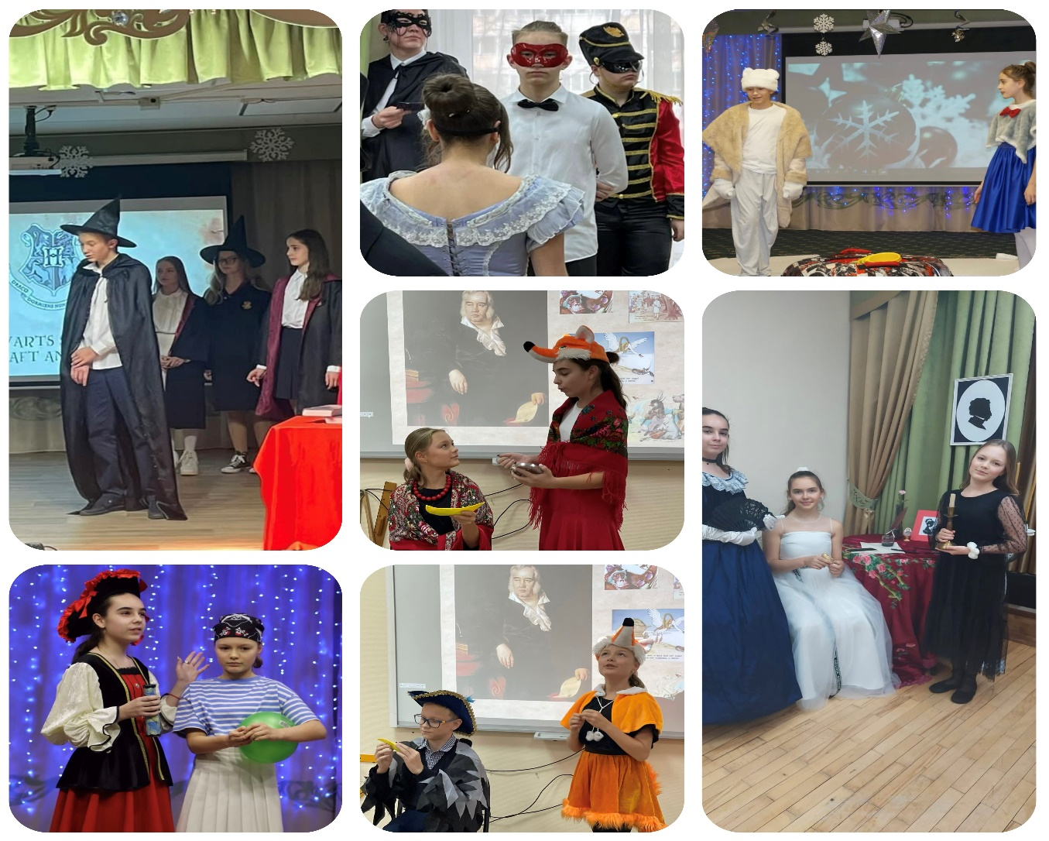
Our performances

Slide 14
Bibliography
1.https://en.wikipedia.org/wiki/Theatre of the United Kingdom
2. https://the history of English theatre.org/
3. https://en.wikipedia.org/wiki/Theatre of the United Kingdom
4. L.Smernova G.Galperina – “Popular history of the theatre.” Moscow 1999.

