Slide 1


Slide 2
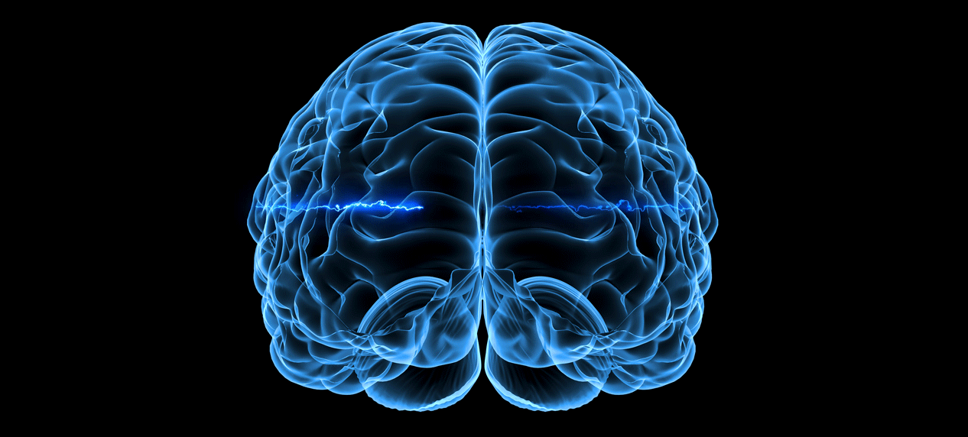
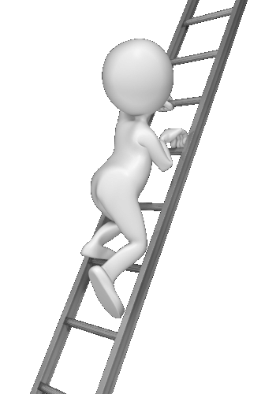
O
w
E
P
R
YOUR
B
N
R
A
I

Slide 3
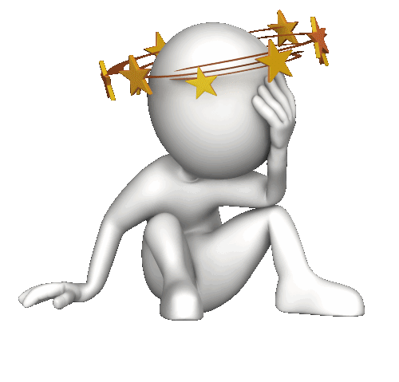
QUIZ4YOU

Slide 4

Quiz 4u
Round 1
Round 2
Final Round

Slide 5

Round 1
Compound Words
1
2
3
4
5
6
7
8
9
10
Listening
1
2
3
4
5
6
7
8
9
10
Because, Because of or So
1
2
3
4
5
6
7
8
9
10
Round 2

Slide 6

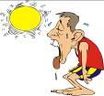



+
What are compound words?
A compound word is a combination of two or more words that form one new word with a new meaning.
Guess the compound words by putting the pictures together.
=
hot
dog
hotdog

Slide 7


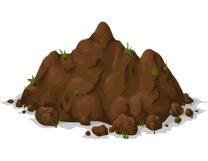

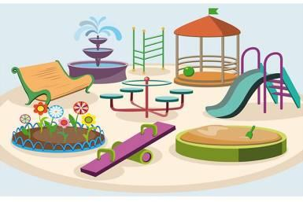

+
Guess the compound and make
a sentence with it
1
11
15
14
13
12
10
09
08
07
06
05
04
03
02
01
00
=
play
ground
playground

Slide 8
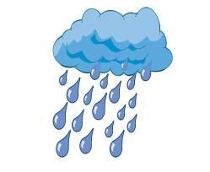
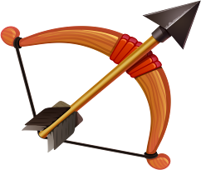

+
Guess the compound and make
a sentence with it
2
15
14
13
12
11
10
09
08
07
06
05
04
03
02
01
00
=
rain
bow
rainbow

Slide 9



+
Guess the compound and make
a sentence with it
3
15
14
13
12
11
10
09
08
07
06
05
04
03
02
01
00
=
light
house
lighthouse

Slide 10


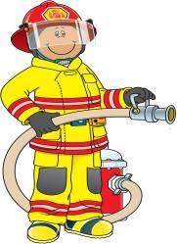
+
Guess the compound and make
a sentence with it
4
11
15
14
13
12
10
09
08
07
06
05
04
03
02
01
00
=
fire
man
fireman

Slide 11

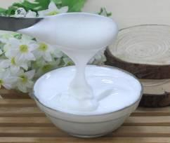
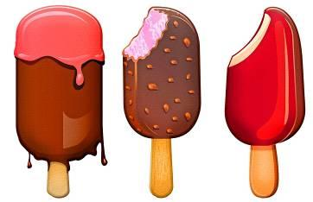
+
Guess the compound and make
a sentence with it
5
15
14
13
12
11
10
09
08
07
06
05
04
03
02
01
00
=
ice
cream
ice-cream

Slide 12



+
Guess the compound and make
a sentence with it
6
15
14
13
12
11
10
09
08
07
06
05
04
03
02
01
00
=
sun
flower
sunflower

Slide 13
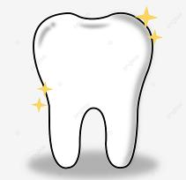


+
Guess the compound and make
a sentence with it
7
15
14
13
12
11
10
09
08
07
06
05
04
03
02
01
00
=
tooth
brush
toothbrush

Slide 14
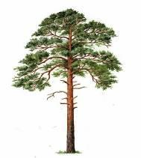
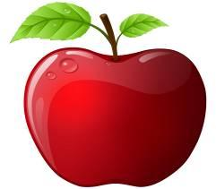

+
Guess the compound and make
a sentence with it
8
15
14
13
12
11
10
09
08
07
06
05
04
03
02
01
00
=
pine
apple
pineapple

Slide 15
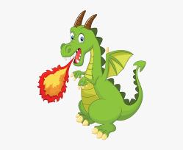
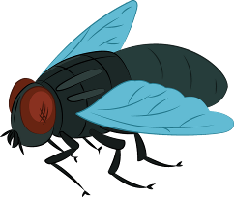
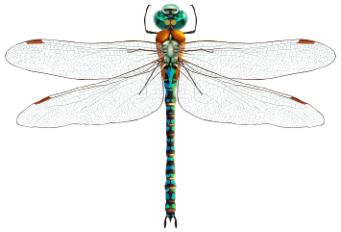
+
Guess the compound and make
a sentence with it
9
11
15
14
13
12
10
09
08
07
06
05
04
03
02
01
00
=
dragon
fly
dragonfly

Slide 16

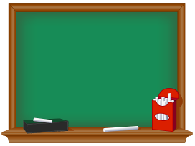
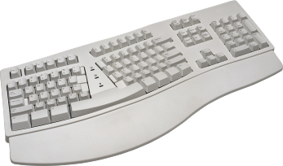
+
Guess the compound and make
a sentence with it
10
11
15
14
13
12
10
09
08
07
06
05
04
03
02
01
00
=
key
board
keyboard

Slide 17


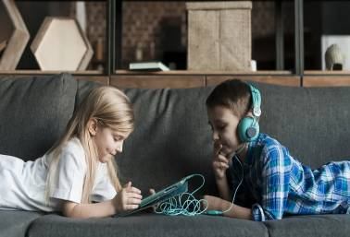
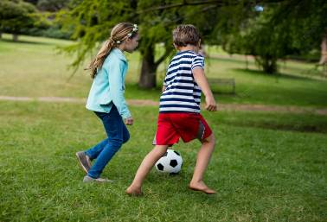

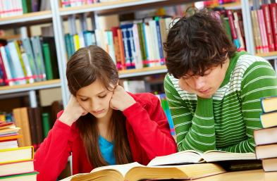
They both like …
1
A
B
C

Slide 18
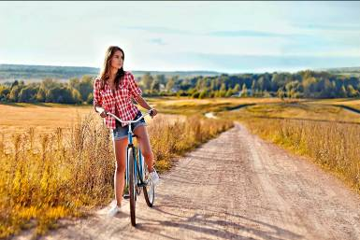
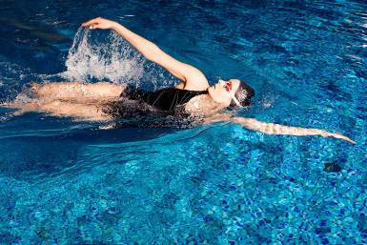
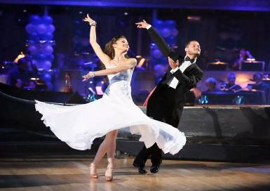
What is Mia doing today?
2
A
B
C

Slide 19
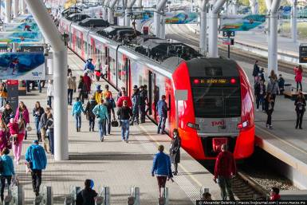
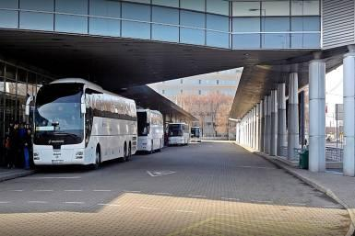
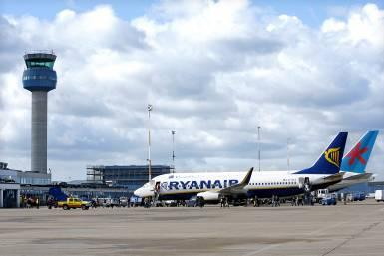
What sort of transport is the message about?
3
A
B
C

Slide 20
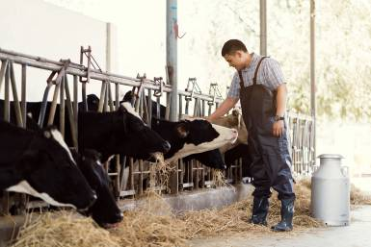

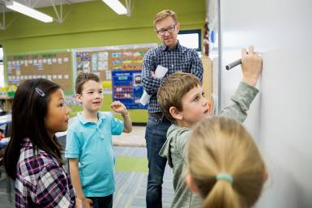
What does he do?
4
A
B
C

Slide 21
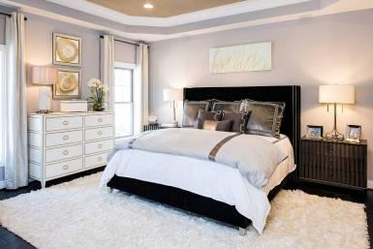
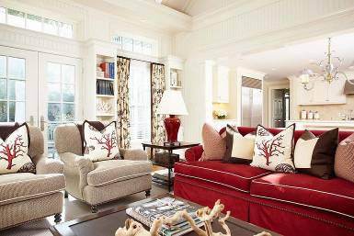
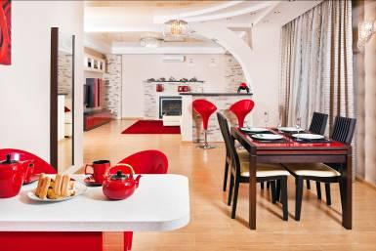
What is his favourite room?
5
A
B
C

Slide 22
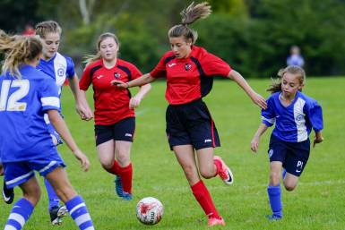
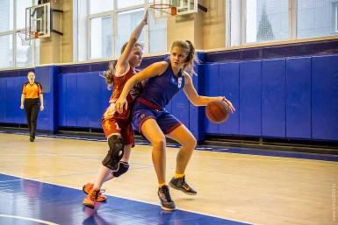
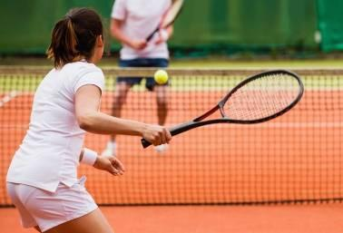
Which sport did Sue play?
6
A
B
C

Slide 23
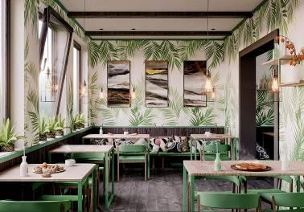
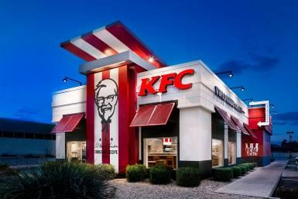
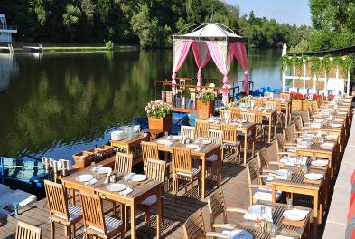
Where are they going for a dinner?
7
A
B
C

Slide 24
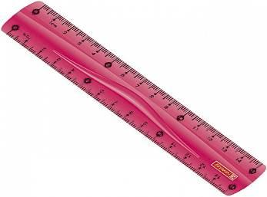
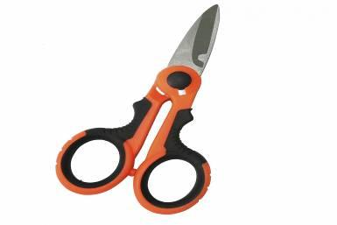
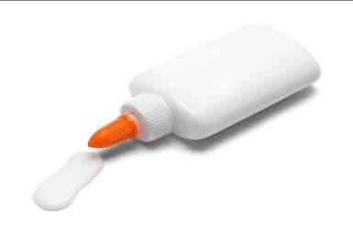
What must Sue bring for class?
8
A
B
C

Slide 25
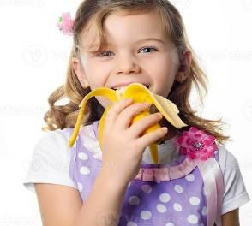
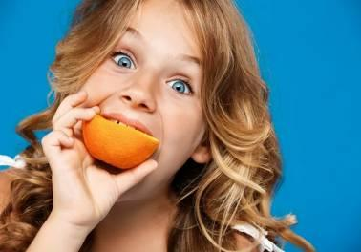
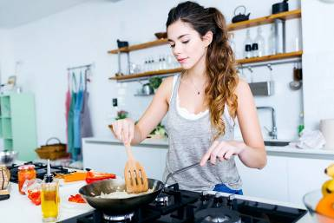
Which is Kim?
9
A
B
C

Slide 26
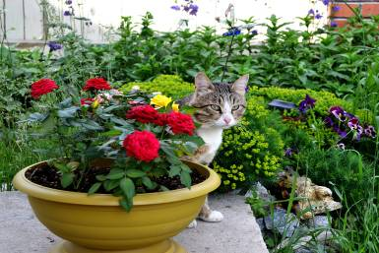
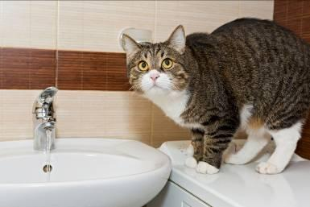
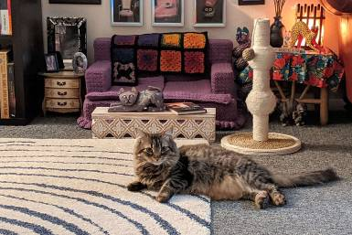
Where is the cat?
10
A
B
C

Slide 27

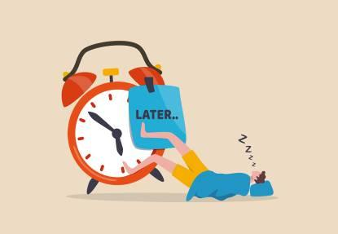
1
Because, Because of or So?
11
15
14
13
12
10
09
08
07
06
05
04
03
02
01
00
We postponed our picnic _____________ the rain that started in the morning.
because
because of
so

Slide 28
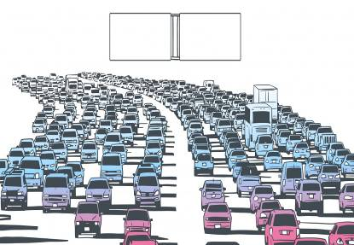
2
Because, Because of or So?
11
15
14
13
12
10
09
08
07
06
05
04
03
02
01
00
They came home late _____________ there was heavy traffic on the highway.
because
because of
so

Slide 29

3
Because, Because of or So?
11
15
14
13
12
10
09
08
07
06
05
04
03
02
01
00
Terry didn’t go to school two days ago _____________ the terrible flu he had.
because
because of
so

Slide 30

4
Because, Because of or So?
11
15
14
13
12
10
09
08
07
06
05
04
03
02
01
00
We can’t visit the museum tomorrow _____________ it is not open.
because
because of
so

Slide 31

5
Because, Because of or So?
11
15
14
13
12
10
09
08
07
06
05
04
03
02
01
00
Kate wanted to learn English _____________ she took an English course.
because
because of
so

Slide 32

6
Because, Because of or So?
11
15
14
13
12
10
09
08
07
06
05
04
03
02
01
00
Jack had a toothache _____________ he went to the dentist.
because
because of
so

Slide 33

7
Because, Because of or So?
11
15
14
13
12
10
09
08
07
06
05
04
03
02
01
00
Jim had to give up jogging _____________ his sprained ankle.
because
because of
so

Slide 34

8
Because, Because of or So?
11
15
14
13
12
10
09
08
07
06
05
04
03
02
01
00
_____________ the lift didn’t work, we had to walk up six flights of stairs.
Because
Because of
So

Slide 35

9
Because, Because of or So?
11
15
14
13
12
10
09
08
07
06
05
04
03
02
01
00
Sue’s eyes were red _____________ she had been swimming in a chlorinated water.
because
because of
so

Slide 36

10
Because, Because of or So?
11
15
14
13
12
10
09
08
07
06
05
04
03
02
01
00
_____________ the wet and muddy ground the football players had difficulties playing the match.
Because
Because of
So

Slide 37

Round 2
Complete the Proverbs
1
2
3
4
5
6
7
8
9
10
Questions
1
2
3
4
5
6
7
8
9
10
The Flags of the World
1
2
3
4
5
6
7
8
9
10
Final

Slide 38


1
Complete the Proverb
15
14
13
12
11
10
09
08
07
06
05
04
03
02
01
00
A penny saved is _________________.
a penny earned
a penny lost
a penny spent

Slide 39

2
Complete the Proverb
15
14
13
12
11
10
09
08
07
06
05
04
03
02
01
00
A watched pot never ________________.
cools down
boils
overflows

Slide 40

3
Complete the Proverb
15
14
13
12
11
10
09
08
07
06
05
04
03
02
01
00
The early bird catches the ___________.
fish
worm
fly

Slide 41

4
Complete the Proverb
15
14
13
12
11
10
09
08
07
06
05
04
03
02
01
00
Honesty is the best _____________.
policy
weapon
defense

Slide 42

5
Complete the Proverb
15
14
13
12
11
10
09
08
07
06
05
04
03
02
01
00
The grass is always greener ___________________________.
on the other side of the fence
when it rains
in the morning

Slide 43

6
Complete the Proverb
15
14
13
12
11
10
09
08
07
06
05
04
03
02
01
00
Where there is smoke, there’s _____________.
panic
fire
danger

Slide 44

7
Complete the Proverb
15
14
13
12
11
10
09
08
07
06
05
04
03
02
01
00
Don’t bite the hand that _____________.
feeds you
guides you
helps you

Slide 45

8
Complete the Proverb
15
14
13
12
11
10
09
08
07
06
05
04
03
02
01
00
You can’t teach an old dog _____________.
useful tricks
new tricks
any tricks

Slide 46

9
Complete the Proverb
15
14
13
12
11
10
09
08
07
06
05
04
03
02
01
00
All’s fair in love and _____________.
war
happiness
peace

Slide 47

10
Complete the Proverb
15
14
13
12
11
10
09
08
07
06
05
04
03
02
01
00
Don’t judge a book by its ____________.
cover
titles
author

Slide 48

1
Ask the question to the
underlined word
11
15
14
13
12
10
09
08
07
06
05
04
03
02
01
00
Judy often plays with her dolls in the bedroom.
Where does Judy often play with her dolls?

Slide 49

2
Ask the question to the
underlined word
11
15
14
13
12
10
09
08
07
06
05
04
03
02
01
00
I promised Andrew to come on Saturday.
When did you promise Andrew to come?

Slide 50

3
Ask the question to the
underlined word
11
15
14
13
12
10
09
08
07
06
05
04
03
02
01
00
My aunt Mary will be sixty-four next year.
How old will your aunt Mary be next year?

Slide 51

4
Ask the question to the
underlined word
11
15
14
13
12
10
09
08
07
06
05
04
03
02
01
00
Sophie has bought six copy-books today.
How many copy-books has Sophie bought today?

Slide 52

5
Ask the question to the
underlined word
11
15
14
13
12
10
09
08
07
06
05
04
03
02
01
00
Pam is crying because she has skinned her knee.
Why is Pam crying?

Slide 53

6
Ask the question to the
underlined word
11
15
14
13
12
10
09
08
07
06
05
04
03
02
01
00
They got to London by plane on Wednesday.
How did they get to London on Wednesday?

Slide 54

7
Ask the question to the
underlined word
11
15
14
13
12
10
09
08
07
06
05
04
03
02
01
00
Ken reads sports magazines every day.
Who reads sports magazines every day?

Slide 55

8
Ask the question to the
underlined word
11
15
14
13
12
10
09
08
07
06
05
04
03
02
01
00
Andy’s bag costs only thirty-five dollars.
How much does Andy’s bag cost?

Slide 56

9
Ask the question to the
underlined word
11
15
14
13
12
10
09
08
07
06
05
04
03
02
01
00
We wrote a test in physics two days ago.
What did you write in physics two days ago?

Slide 57

10
Ask the question to the
underlined word
11
15
14
13
12
10
09
08
07
06
05
04
03
02
01
00
His new bike is red.
What colour is his new bike?

Slide 58


1
The Flags of the World
15
14
13
12
11
10
09
08
07
06
05
04
03
02
01
00
What colour is the most commonly found on the world’s country flags?
red
blue
white
The Unified flag of the Earth

Slide 59



2
The Flags of the World
11
15
14
13
12
10
09
08
07
06
05
04
03
02
01
00
Only two countries in the world use this
color. Purple can be found on the flag of
Nicaragua and the flag of Dominica.
What is the rarest colour to be used in all flags?
green
purple
black

Slide 60


3
The Flags of the World
11
15
14
13
12
10
09
08
07
06
05
04
03
02
01
00
What is depicted on the flag of Cambodia and on the flag of Afghanistan?
a shield
and arrows
buildings
mountains

Slide 61


4
The Flags of the World
15
14
13
12
11
10
01
09
08
07
06
05
04
03
02
00
What country has the oldest flag in the world?
The flag of Denmark was created in 1219.
Great Britain
Denmark
Egypt

Slide 62


5
The Flags of the World
15
14
13
12
11
10
09
08
07
06
05
04
03
02
01
00
What country has the newest flag in the world?
The flag of South Sudan was adopted on July 9, 2010.
South Sudan
Mozambique
Chile

Slide 63




6
The Flags of the World
15
14
13
12
11
10
09
08
07
06
05
04
03
02
01
00
Bhutan, Wales and Malta are the only countries in the world whose flags have dragons on them.
How many countries have dragons on their flags?
2
3
4

Slide 64

7
The Flags of the World
15
14
13
12
11
10
09
08
07
06
05
04
03
02
01
00
There are 4 flags in the world that feature firearms. The flag of
Mozambique depicts an AK-47 crossed with a farming mattock on top of a book.
The flag of which country depicts an
AK-47 ?
Mozambique
Angola
Bolivia

Slide 65

8
The Flags of the World
15
14
13
12
11
10
09
08
07
06
05
04
03
02
01
00
What does the Sun seen on many South American flags, such as Argentina, Bolivia, and Ecuador symbolize?
The Sun is a reference to the Incan god of the Sun, Inti.
The Incan God of the Sun
The Incan God of Love
The Incan God of War

Slide 66


9
The Flags of the World
15
14
13
12
11
10
09
08
07
06
05
04
03
02
01
00
The flag of what country is flown with the red side on the upper side in times of war and the blue side on the upper side during times of peace?
North Korea
The Philippines
Afghanistan

Slide 67

10
The Flags of the World
15
14
13
12
11
10
09
08
07
06
05
04
03
02
01
00
What animal could be depicted on the flag of Canada instead of a maple leaf?
a squirrel
a beaver
a grizzly

Slide 68




Final Round
History
Numerals
Music
Senses
Chess
Languages
Road Signs

Slide 69

History
07
06
05
04
03
02
01
00
Place your bets

Slide 70

11
15
14
13
12
10
09
08
07
06
05
04
03
02
01
00
Which historical leader is associated with “Crossing the Rubicon”?
Alexander
the Great
Napoleon
Bonaparte
Julius Caesar

Slide 71
Numerals
07
06
05
04
03
02
01
00
Place your bets

Slide 72


11
15
14
13
12
10
09
08
07
06
05
04
03
02
01
00
What digit does not exist in Roman numerals?
infinity
zero
one hundred

Slide 73
Music
07
06
05
04
03
02
01
00
Place your bets

Slide 74


11
15
14
13
12
10
09
08
07
06
05
04
03
02
01
00
What was the first and only band to play on all seven continents?
Metallica
Scorpions
Queen

Slide 75
Senses
07
06
05
04
03
02
01
00
Place your bets

Slide 76

11
15
14
13
12
10
09
08
07
06
05
04
03
02
01
00
The loss of which sense is ageusia?
smell
taste
sight

Slide 77
Chess
07
06
05
04
03
02
01
00
Place your bets

Slide 78

11
15
14
13
12
10
09
08
07
06
05
04
03
02
01
00
What is the only chess piece that cannot be taken?
the pawn
the king
the queen

Slide 79
Languages
07
06
05
04
03
02
01
00
Place your bets

Slide 80

11
15
14
13
12
10
09
08
07
06
05
04
03
02
01
00
What is the name of the oldest written language known to mankind?
Sanskrit
Sumerian
Latin

Slide 81
Road Signs
07
06
05
04
03
02
01
00
Place your bets

Slide 82

11
15
14
13
12
10
09
08
07
06
05
04
03
02
01
00
What geometric shape is generally used for Stop signs?
hexagon
octagon
pentagon

Slide 83


