Slide 1
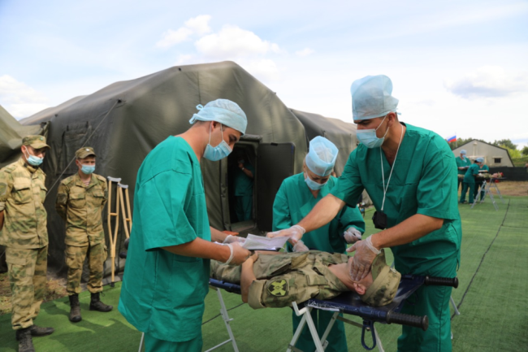
Faulty
Author
Haunted mansion
Cartoon characters
Pirate ship
Theme park
Assignment
Called
Tech
*In shoulder surgery some surgeons sew soldiers’ shoulders.

Slide 2
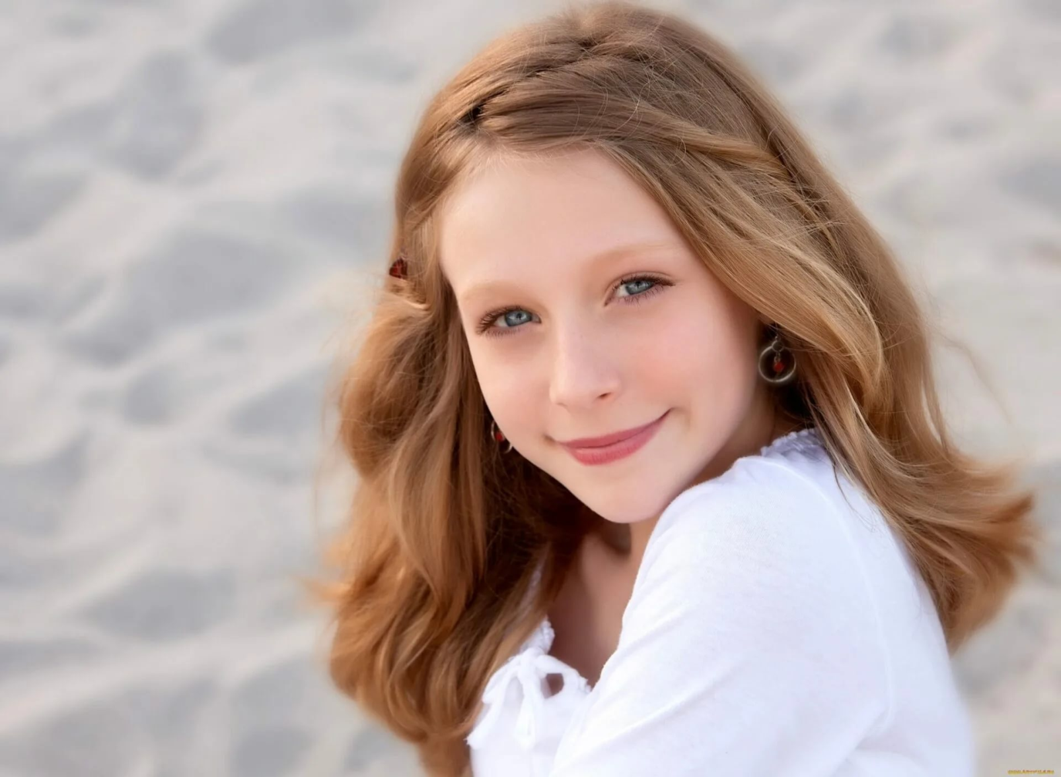

Slide 3

Types of camps
Activities to do
Why should you go
What makes a good camp

Slide 4

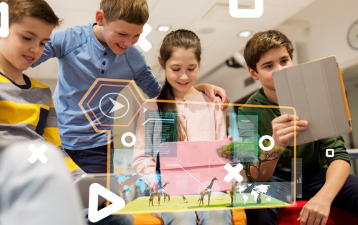
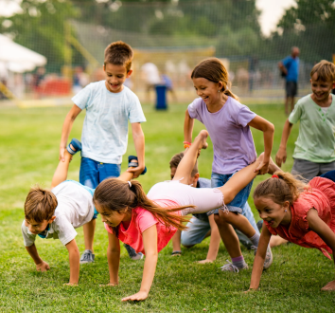

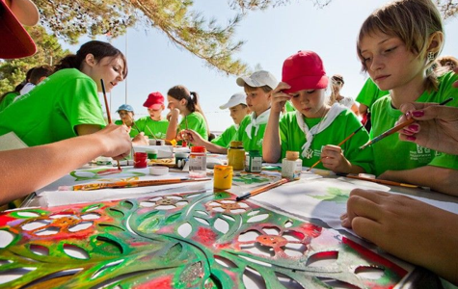
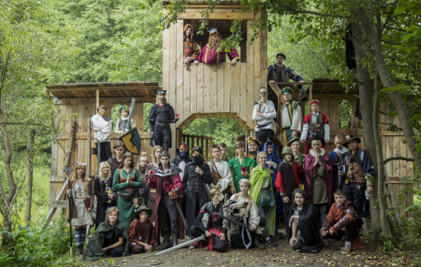
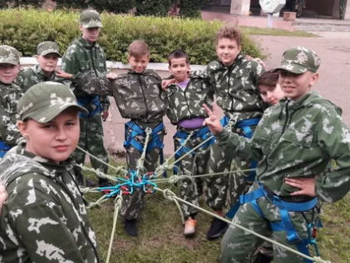
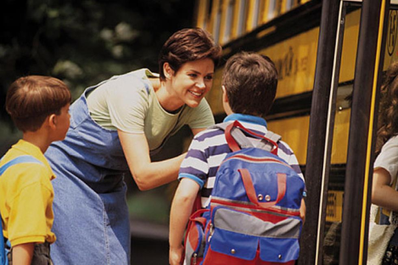
1
2
3
1
4
5
6
7
Have you ever been to a summer camp? If not, would you like to go and why? If yes, what was the most memorable (памятный) experience?
What do children typically do at a summer camp?
What types of summer camps do you know?
Why do parents send their children to a summer camp? *
What makes a perfect camp? *

Slide 5



6
b

Slide 6


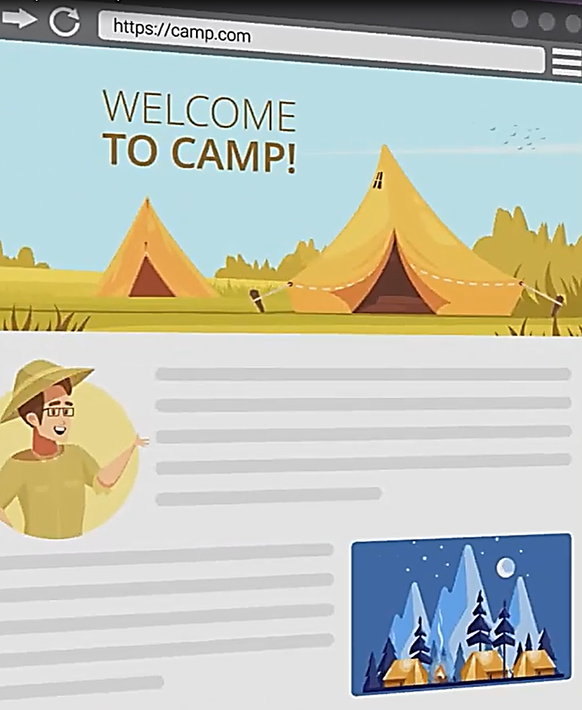
посещать уроки актерского мастерства
teen camp
have acting classes
лагерь для подростков
музыкальный инструмент
ходить в поход
instrument
go hiking
web-page
set up a tent
интернет страница
ставить палатку
book
survive
бронировать
выживать
плавать
tree house
go swimming
домик на дереве
делать робота
go rafting
have/make a robot
сплавляться на плотах
изучать компьютерные технологии
video games
have it classes
видео игры

Slide 7
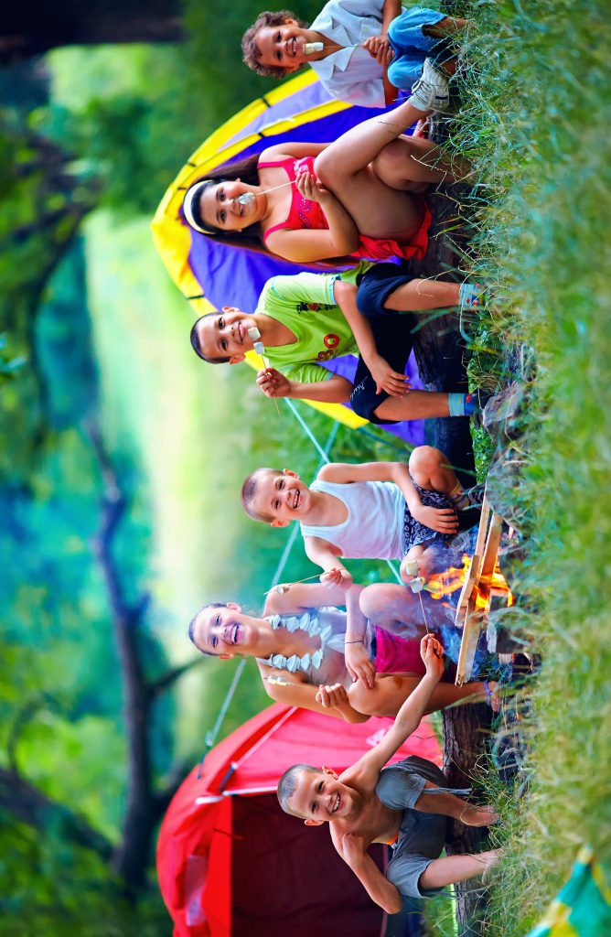
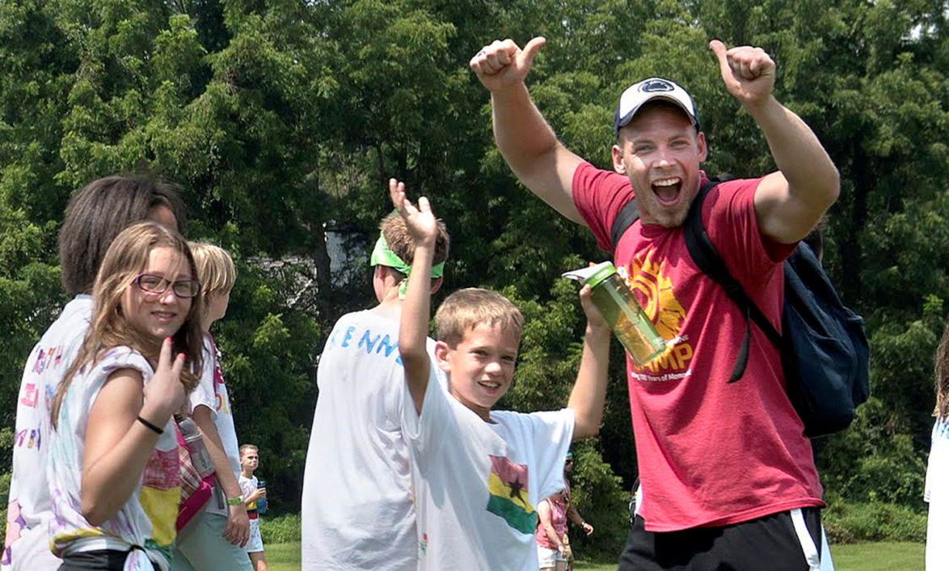
Camps are great because …
A camp counselor

Slide 8




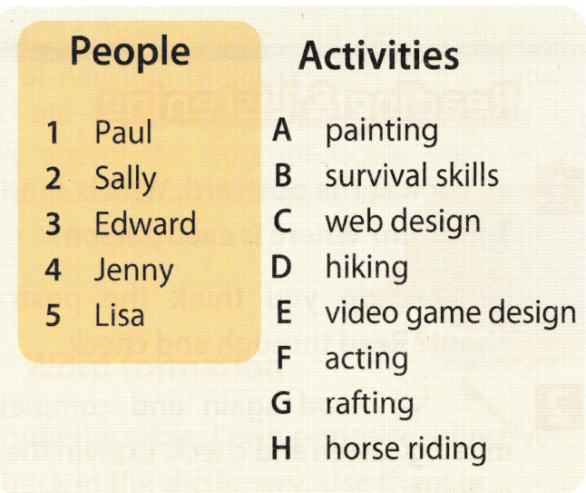



Slide 9
Types of camps
Activities to do
Why should you go
What makes a good camp

Slide 10
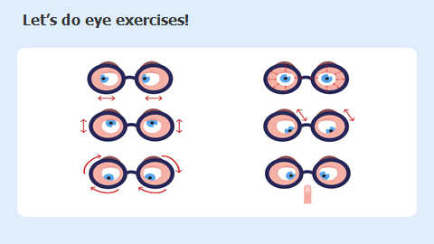

Slide 11
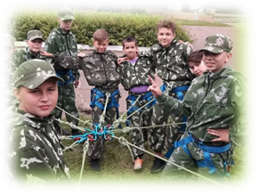

Slide 12

https://www.youtube.com/watch?v=I_Iqi2J4VUw
The boys in the camp are handling real Kalashnikov machine guns loaded with real bullets. (FALSE)
Nikita is attending the military summer camp for the first time, and he is from a city near Moscow. (TRUE)
The camp instructors create scenarios for the boys based on real-life operations of the Russian Army. (TRUE)
Although the camp is open to girls, the camp counselor thinks it is mainly for boys. (TRUE)
The camp receives government funding to support its activities. (FALSE)

Slide 13


Slide 14

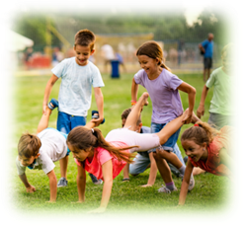
Letter to Ann
Hello, Ann
Let me tell you about the summer camps.
Firstly, …..
Secondly, ….
What is more, …
Lastly, ….
Hope it’ll help you to make the right choice.
All the best,
…

Slide 15

WHAT DID YOU KNOW AT THE LESSON TODAY?
What was the theme of our lesson?
What was the aim of our lesson?
What have you learned about Teen Camps?
What can you do there?
What did you learn at this lesson?
What do you remember?
The most useful and interesting things were….
I was good at…….
I was bad at….

Slide 16
Home assignment
the dialogue p. 58 SB. Complete and learn in pairs.
* Text about the computer camp. Write 5 questions.

Slide 17
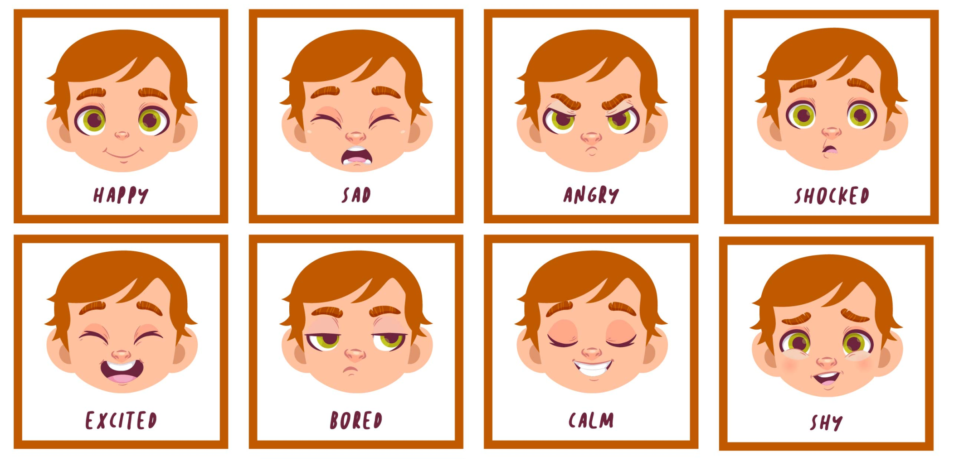
How are you feeling?

