Slide 1

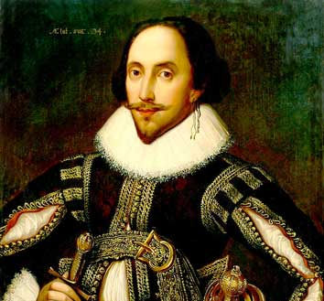
William Shakespeare
(1564–1616)

Slide 2
«WILLIAM SHKESPEARE… THE BRILLIANT POET, THE MARVELOUSE DRAMATIST, THE GREATEST OF THE GREAT. HE WAS NOT FOR AN AGE, BUT FOR ALL TIME.»
Ben Jonson

Slide 3


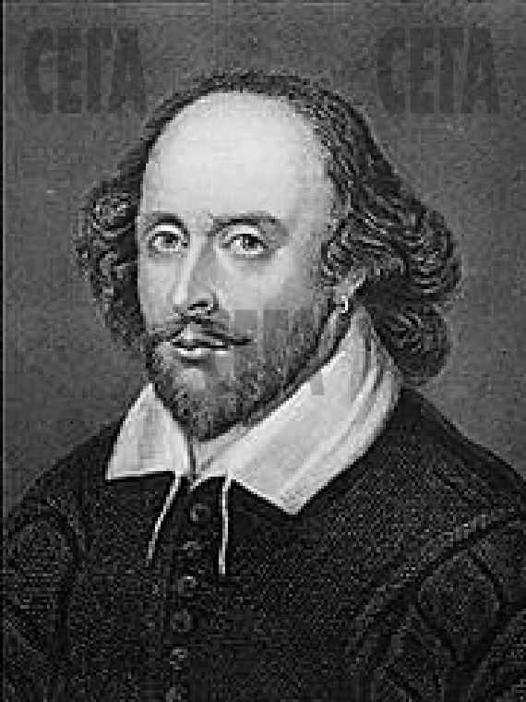
BIOGRAPHY FACTS
He was born on April 23, 1564
His mother was the daughter of a rich farmer.
His father was a glove-maker.
William was the eldest of eight children.

Slide 4
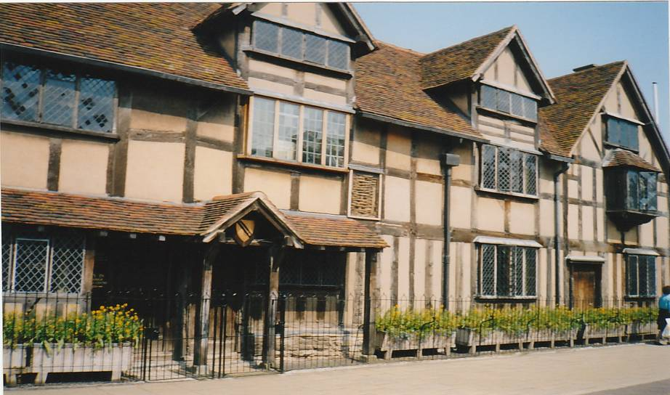
W.SHAKESPEARE’S BIRTHPLACE Stratford–upon–Avon, Henly Street

Slide 5
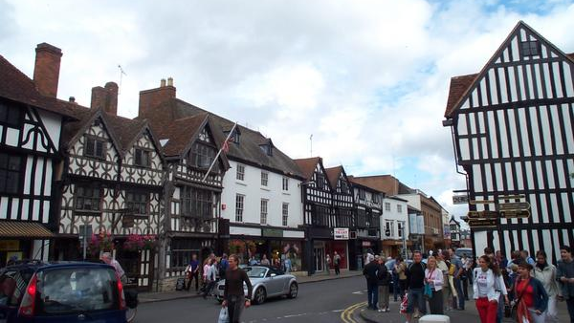
STRATFORD-UPON-AVON NOWADAYS

Slide 6
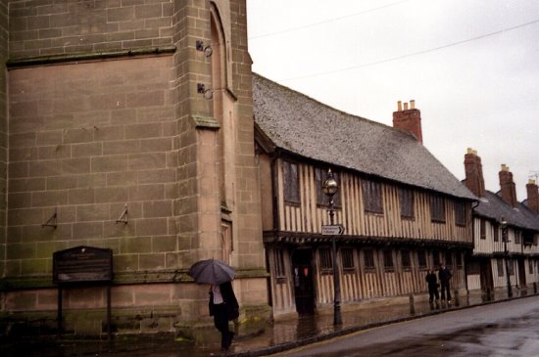
William went to a grammar school in Stratford and had quite a good education. There he learned Latin and Greek.
When he was 13 he left school and began to help his father in the trade.

Slide 7
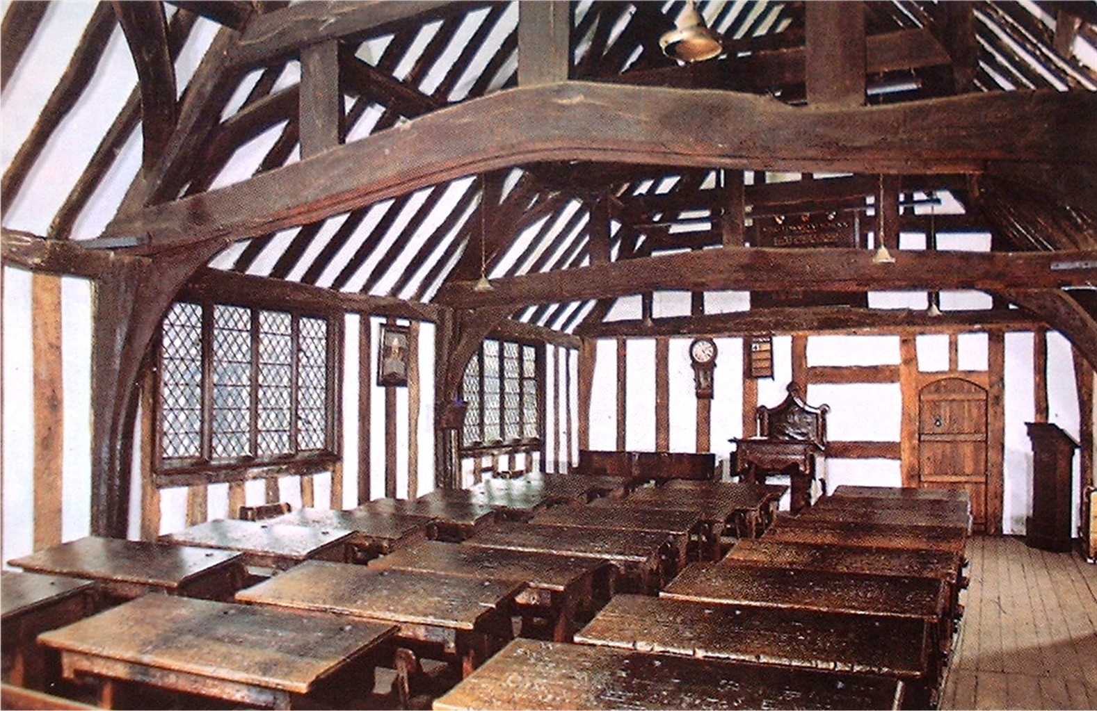
The classroom
"... around 40 boys would have been taught in this room ..."
This is the schoolroom where Shakespeare was educated. It is still in use.

Slide 8

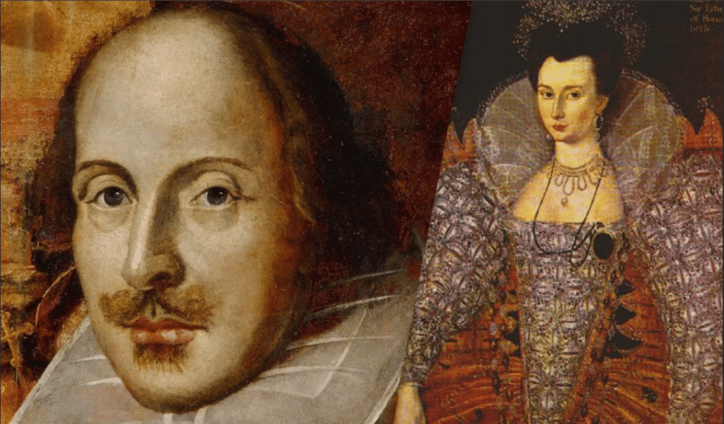


Family life
He Married to Anne Hathaway in 1582.
Anne was 26, he was 18.
They had 3 children.
The youngest, Hamnet, died at the age of 11.
Anne did not love theatre

Slide 9
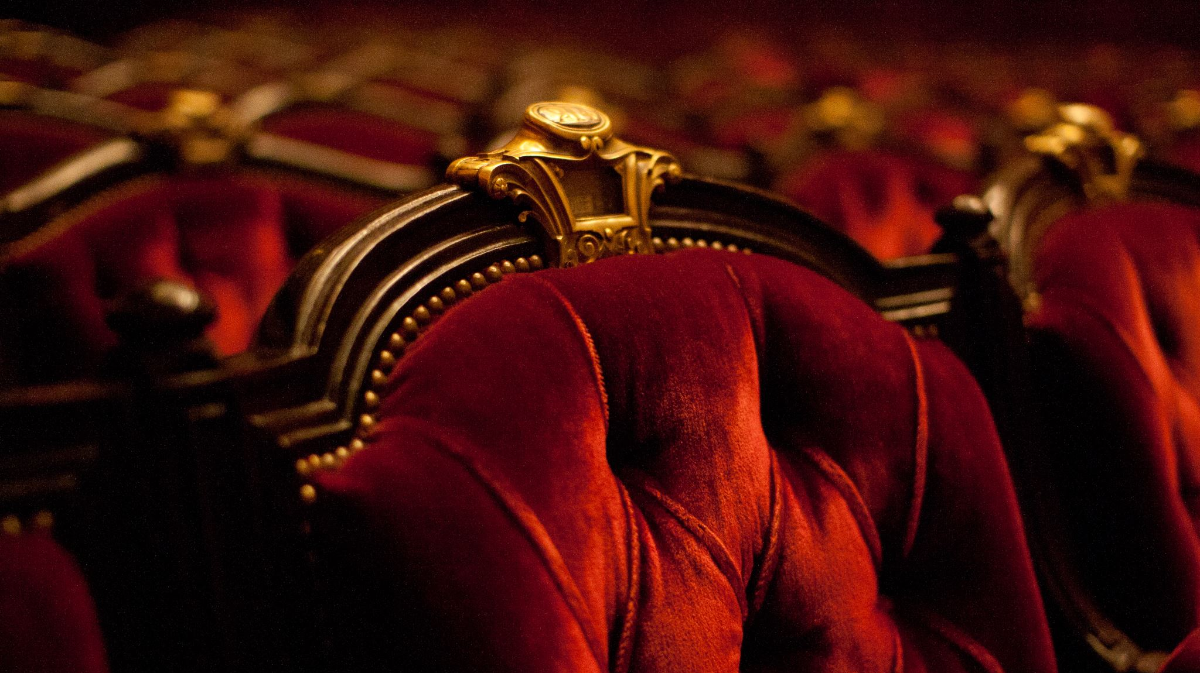
It`s known that when Sheakspeare was 21 he went to London to find a job, where he began writing plays staged at the Globe Theatre. By 1592 he had been an important member of a well-known acting company. In 1612 he returned in Stratford-upon-Avon

Slide 10
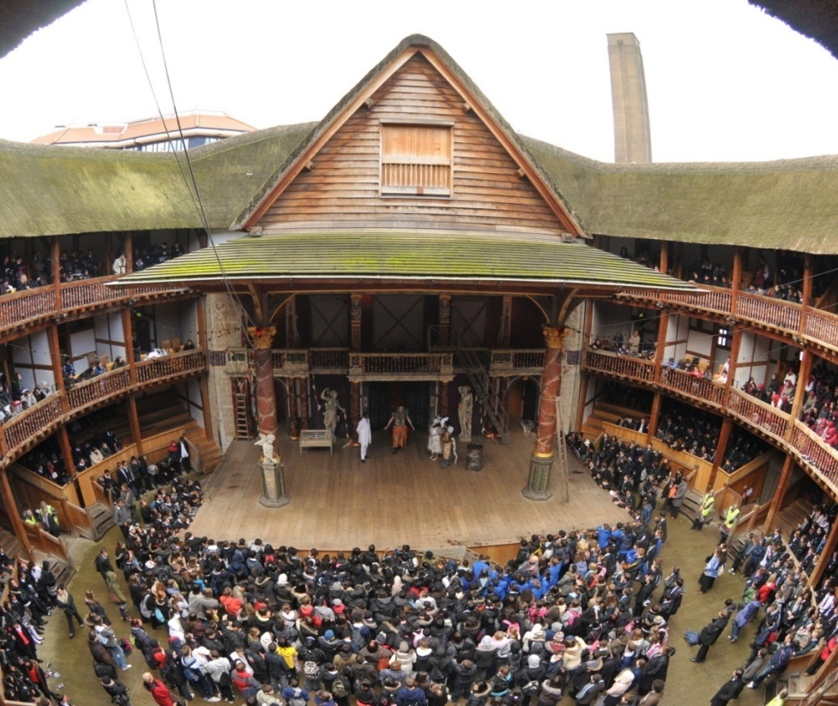
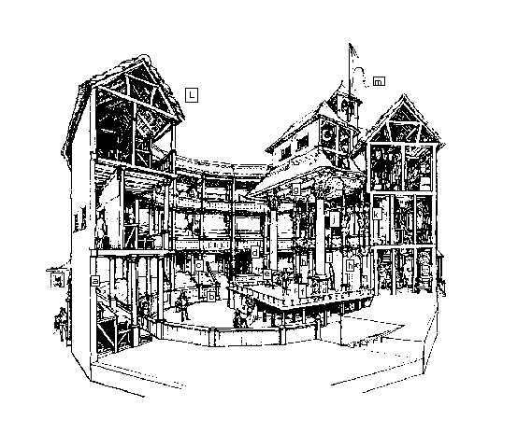
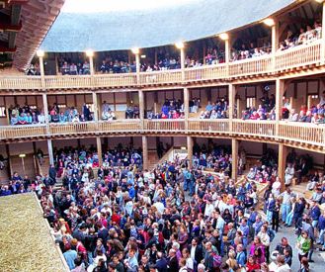
The Globe

Slide 11
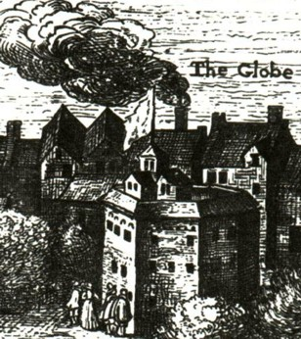
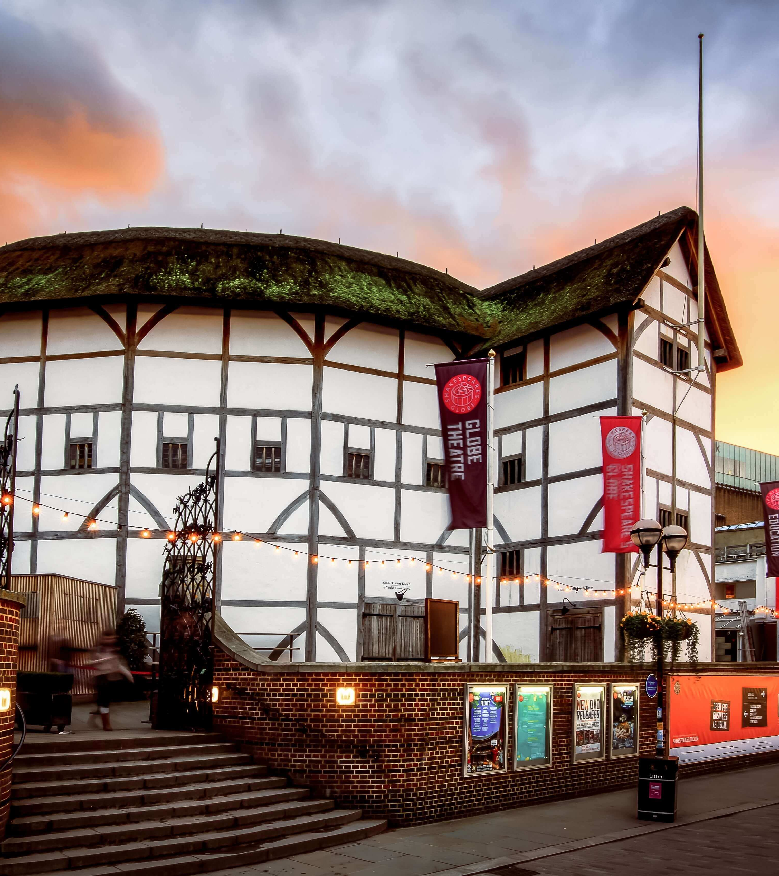
The Globe Theatre (Театр Шекспира «Глобус»)

Slide 12
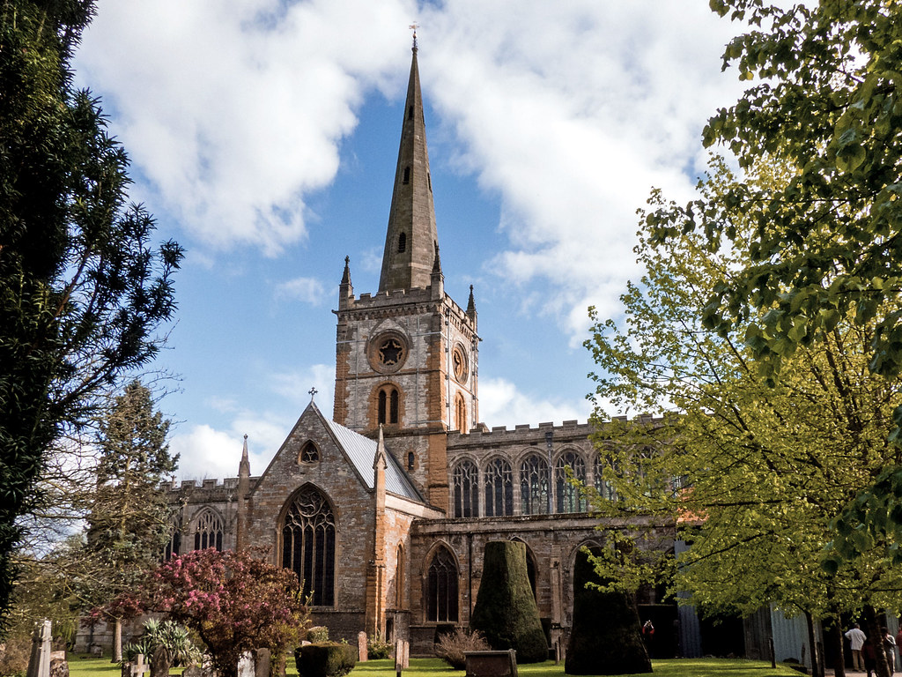
This is the Holy Trinity Church in Stratford- upon-Avon where Shakespeare was buried. It is interesting that he died on his birthday, 23 April, 1616, when he was 52.

Slide 13

True or False

Slide 14
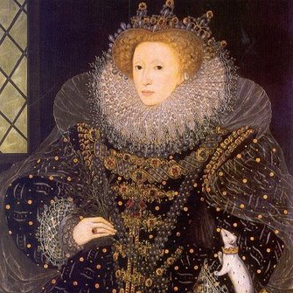
QUEEN ELIZABETH I
The last half of the 16th and the beginning of the 17th centuries are known as the Golden Age of English Renaissance and sometimes are called “The Age of Shakespeare”.

Slide 15
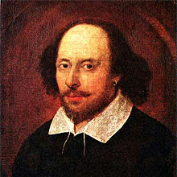
Looking back
Shakespeare wrote:
37 plays
154 sonnets
2 poems

Slide 16
Shakespeare's language
Thou-you - ты
Thee-you - тебя
Thy-your - твой
Memorai- memory- память
Throw-believe - верить
Main-sea - море

Slide 17

Shakespeare’s sonnet
As an unperfect actor on the stage, Who with his fear is put besides his part, Or some fierce thing replete with too much rage, Whose strength's abundance weakens his own heart;
So I, for fear of trust, forget to say The perfect ceremony of love's rite, And in mine own love's strength seem to decay, O'ercharged with burden of mine own love's might:
O let my books be then the eloquence And dumb presagers of my speaking breast, Who plead for love, and look for recompense, More than that tongue that more hath more expressed.
O learn to read what silent love hath writ: To hear with eyes belongs to love's fine wit.

Slide 18
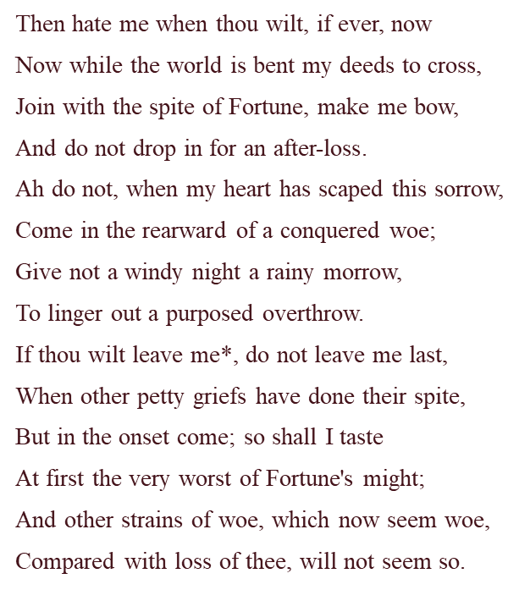
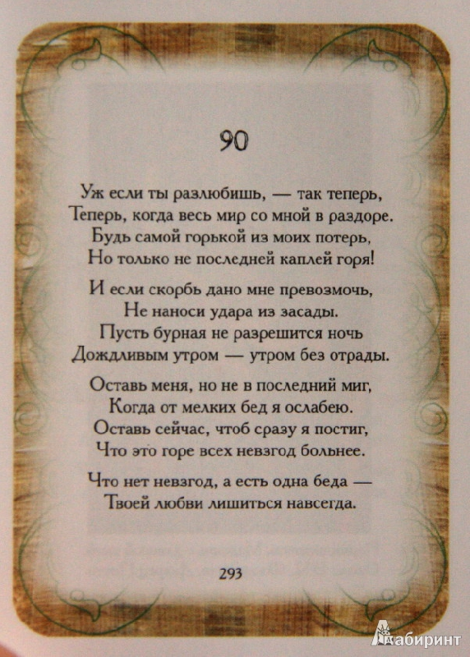
Sonnet 90 by William Shakespeare

Slide 19
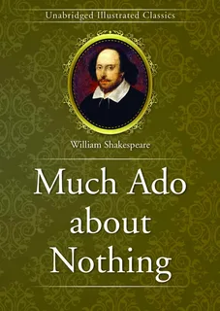

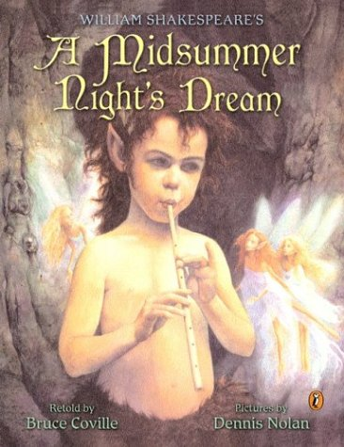
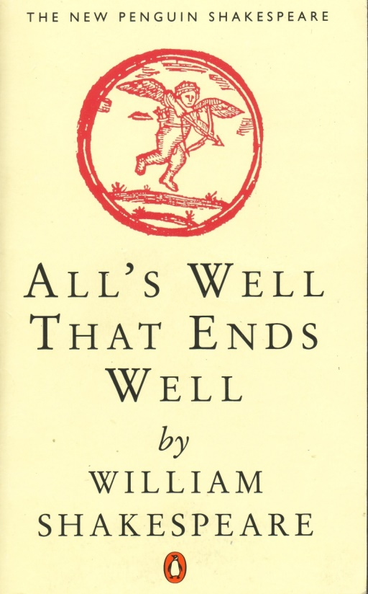
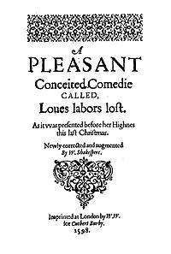
Shakespeare’s comedies

Slide 20
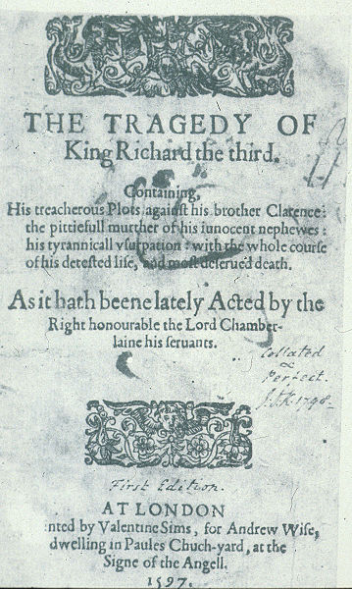
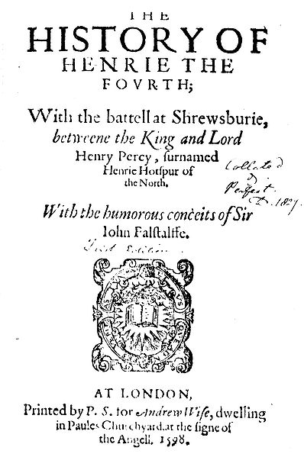
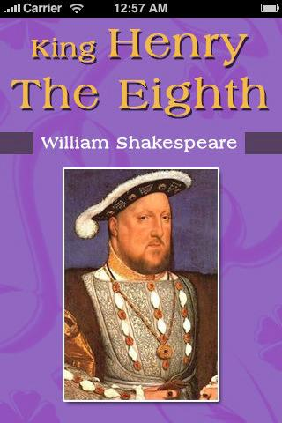
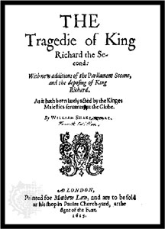
Shakespeare’s Historical dramas

Slide 21
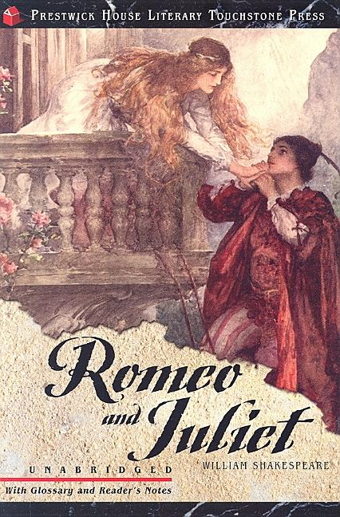
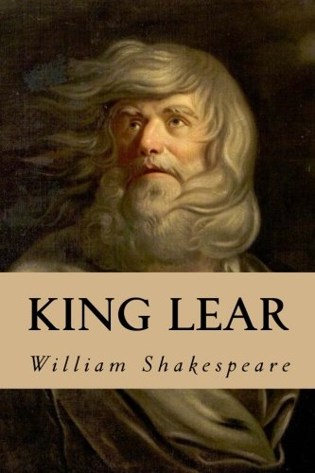
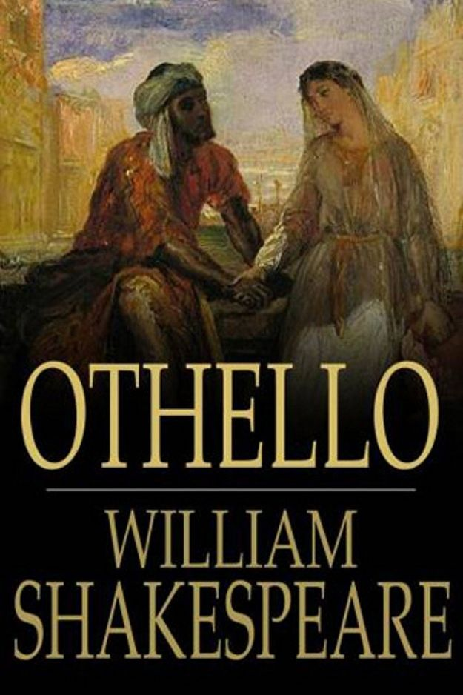
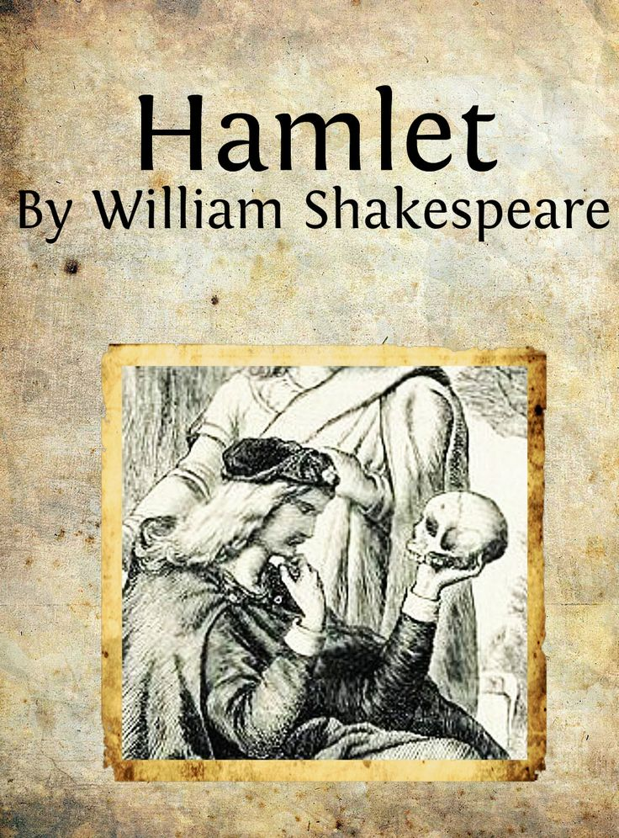
Shakespeare’s tragedies

Slide 22
For never was a story of more woe than this of Juliet and her Romeo.
W. SHAKESPEARE «Romeo and Juliet»

Slide 23
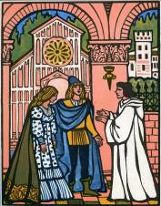
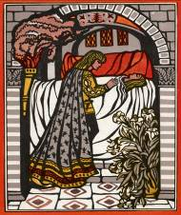
«Romeo and Juliet»- an optimistic tragedy. Staged in all kinds of theatres.
This wonderful love story is about two lovers Romeo and Juliet. Unfortunately, they died, but they didn’t stop loving each other. They stayed young forever!

Slide 24
Shakespeare’s quotations
1. Весь мир-театр, и все мы в нем актёры.
2. Любовь-слепа
3. Краткость-сестра таланта
4. Начало конца
5. Из жалости я должен быть жесток
6. Всё хорошо, что хорошо кончается
7. Жизнь прожить – не поле перейти
8. Быть или не быть: вот в чём вопрос
9. Лучше прикидываться дураком, и быть умным,
чем умничать, будучи дураком.
10. Не всё то золото, что блестит

Slide 25
Сatch phrases
Action is eloquence.
Действие — это красноречие
Brevity was the soul of wit.
Краткость была душой остроумия
Coward people die many times before their deaths.
Трусливые люди умирают много раз перед своей смертью.
I am fortune's fool.
Удача обманула меня.
Let every man be master of his time.
Позвольте каждому человеку быть хозяином своего времени.
Live in thy shame, but die not shame with thee!
Живи в позоре, но умри без позора!
My soul is in the sky.
Моя душа находится в небе.

Slide 26
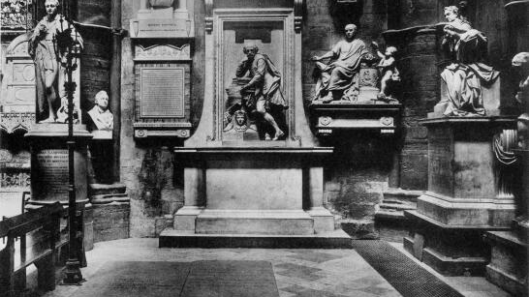
POET’S CORNER IN WESTMINSTER ABBЕY

Slide 27
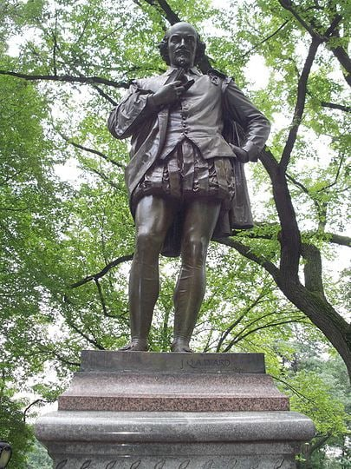
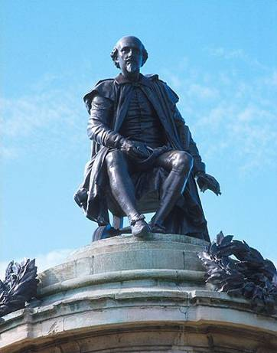
MONUMENTS
NEW YORK
STRATFORD ON AVON

Slide 28
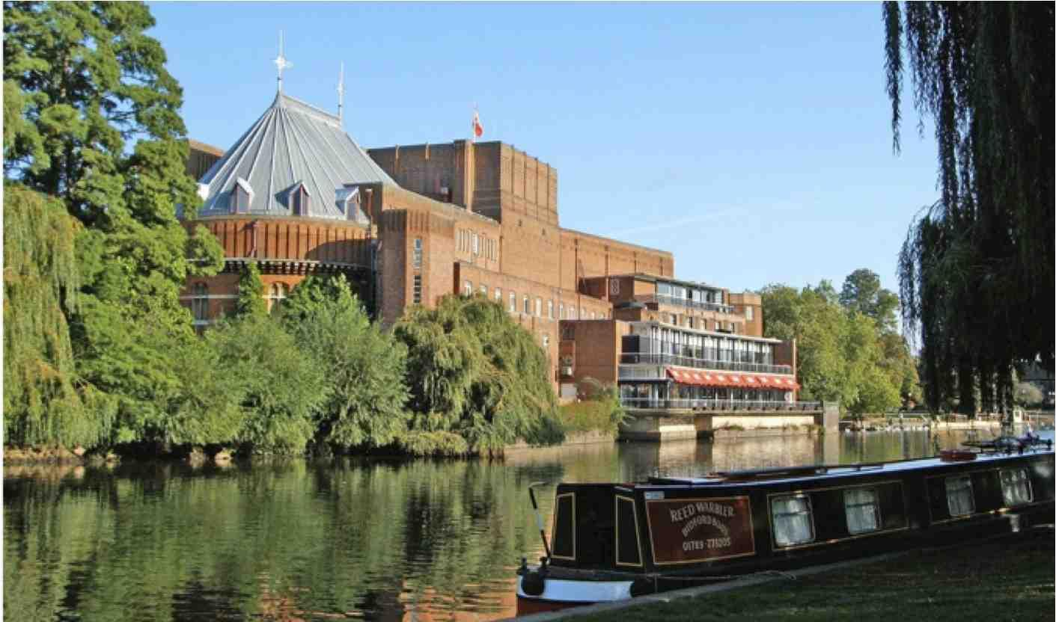
A memorial to William Shakespeare is the Royal Shakespeare Theatre in his birthplace

Slide 29
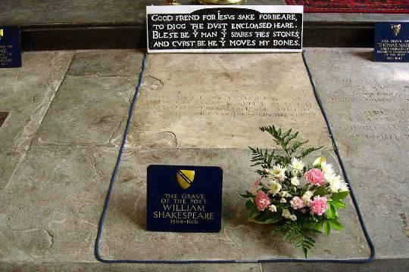
The words on Shakespeare’s grave
Good friend, for Jesus' sake forbear
To dig the dust enclosed here.
Blest be the man that spares these stones
And curst be he that moves my bones.

Slide 30
