Slide 1

Урок-викторина “Who Wants to Be the Champion?”(Doing Sport is Great!), для 7 класса
Презентация учителя английского языка ГБОУ Школа №1239 Маккавеевой Е.Е

Slide 2
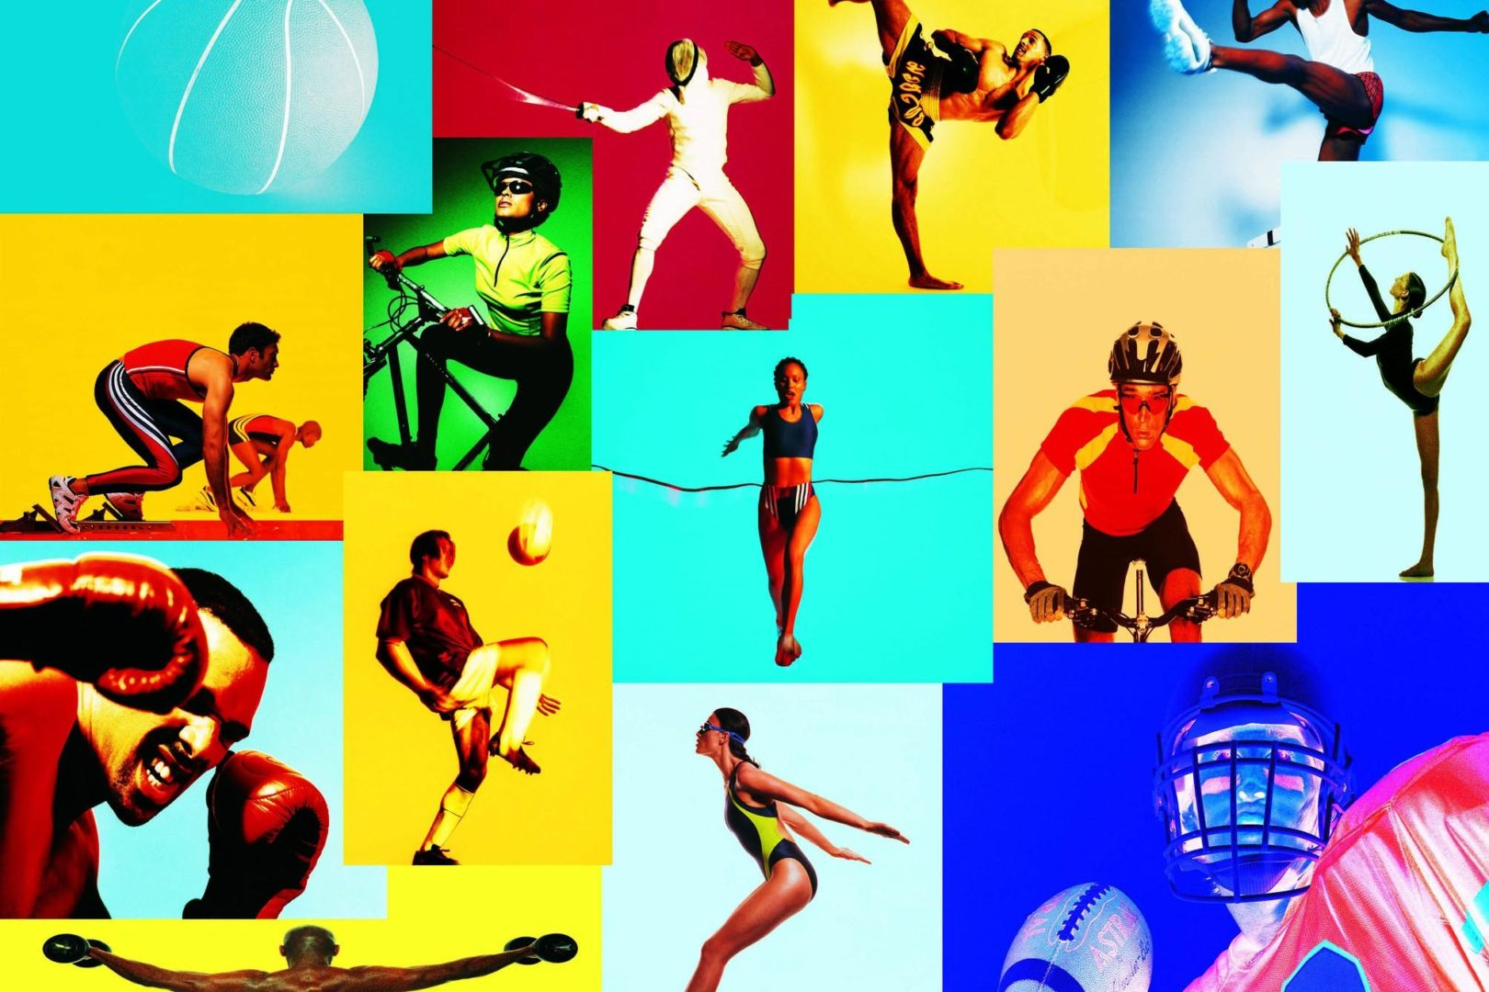
Sector 1
Preliminaries. «Go, Do or Play» Task. Different kinds of sport

Slide 3

1-1 Preliminaries. «Go, Do or Play» Task . Задание «Different kinds of sport»
See the names of different kinds of sport. Your task is to write them down into three columns. Write down the kinds of sport you play in the first column, in the second those you go. And in the third you do.

Slide 4
1-1 Preliminaries. «Go, Do or Play» Task .
Задание «Different kinds of sport».
football, cycling, cricket, swimming, badminton, basketball, rugby, aerobics,
diving, ice-hockey, skating, tennis, table tennis, skiing, billiards, horse-riding, athletics, archery, yoga, weightlifting, wrestling, golf.

Slide 5
Answers:
Play: football, rugby, basketball, ice-hockey, tennis, badminton, table tennis, cricket, billiards, golf.
Go: swimming, diving, skating, skiing, cycling, horse-riding.
Do: athletics, archery, yoga, aerobics, wrestling, weightlifting.

Slide 6
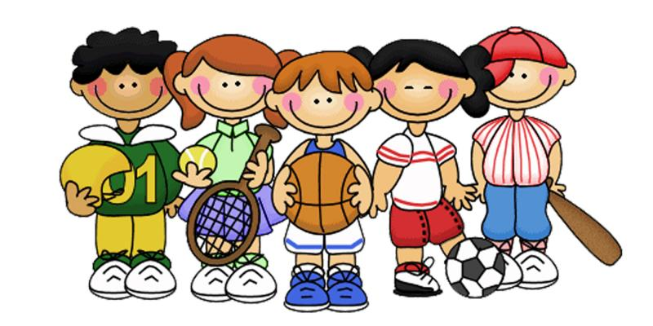
Sector 2. Guess game.

Slide 7
Guess game.
You read several sentences about the British popular sports and games but the names of them are given in the right-hand column. You read the sentences very attentively and try to guess the right name.

Slide 8
Read the sentences about the British sports attentively and try to guess the right name.
1) | People in England began to play …. as early as 1550. | golf
2) | …. is one of the oldest British sports that existed in Saxon times. | cricket
3) | …. is the sport that began to develop in Scotland. | football
4) | …. was first played in England in 1872, whose first championship was at Wimbledon. | boxing
5) | …. is a game invented and developed in England which is nowadays played all over the world. | tennis

Slide 9
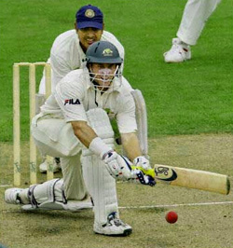
2-1 People in England began to play …. as early as 1550.
Cricket

Slide 10
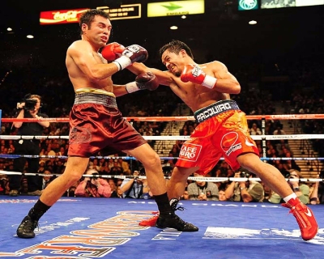
2-2. … is one of the oldest British sports that existed in Saxon times.
Boxing

Slide 11

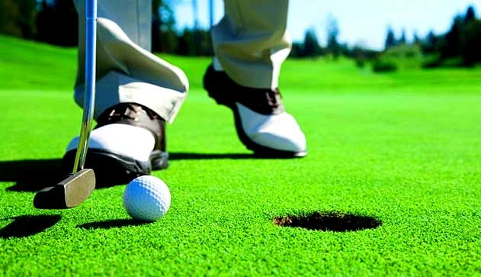
2-3 ….is the sport that began to develop in Scotland.
Golf

Slide 12
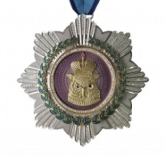
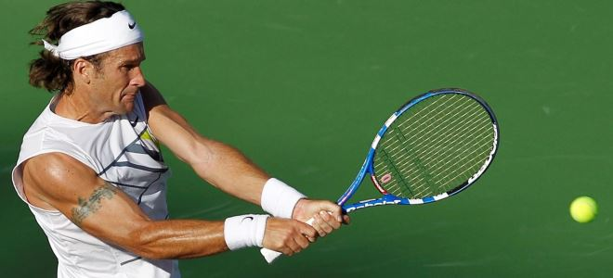
2-4…. was first played in England in 1872, whose first championship was at Wimbledon.
Tennis

Slide 13

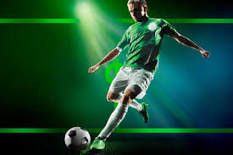
2-5… is a game invented and developed in England which is nowadays played all over the world.
Football

Slide 14

QUIZ Tasks.

Slide 15
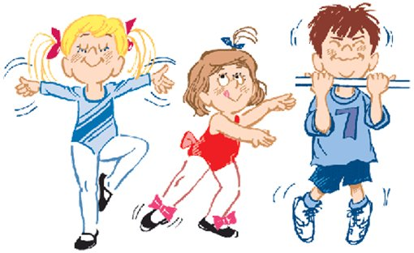
SPORT
Sector 3

Slide 16
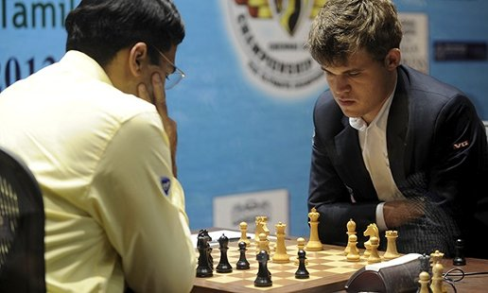
3-1 It is a game of two players. Each of them starts with 16 different playing pieces to move on a board. The aim is to move your pieces so that your opponent’s king will be taken.
(Chess)

Slide 17
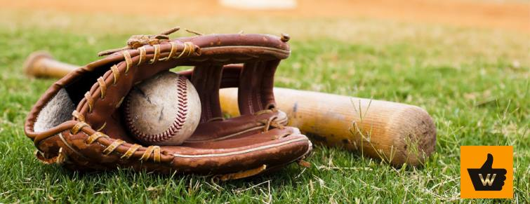
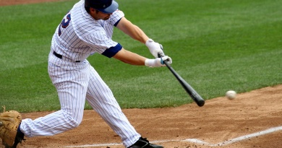
3-2 It is a game between two teams and is played on a field with a bat and a small white ball. Each team consists of 9 players. The team takes turns playing in the field and batting the ball.
(Baseball)

Slide 18
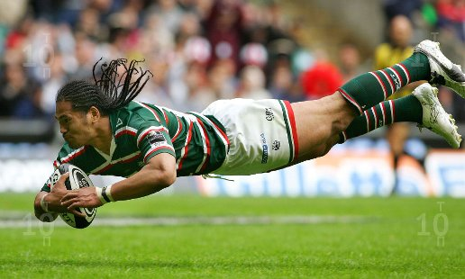
3-3 It is an outdoor game played by two teams with an oval (egg-shaped) ball that you kick or carry.
(Rugby)

Slide 19
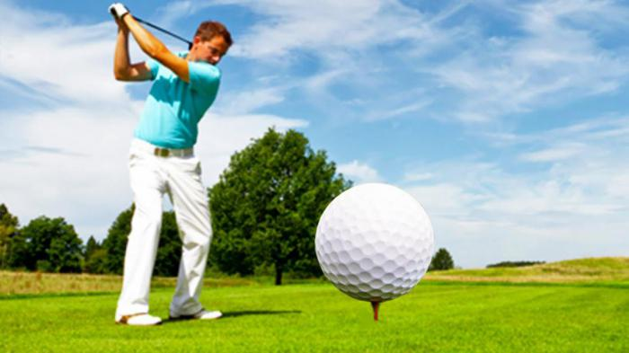
3-4 It is a game in which the players hit a small white ball into holes in the ground.
(Golf)

Slide 20
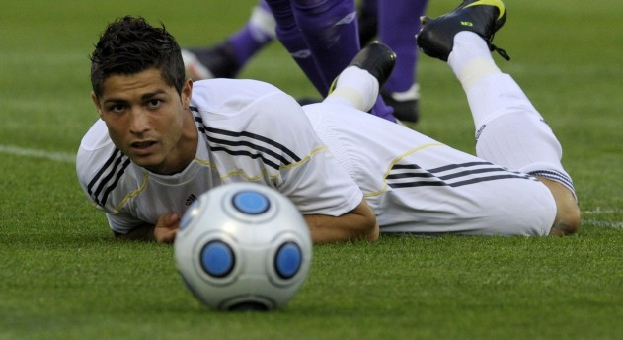
3-5 It is a game played by two teams of eleven players who try to kick a ball into the other team’s gate. The team with the most points wins.
(Football)

Slide 21
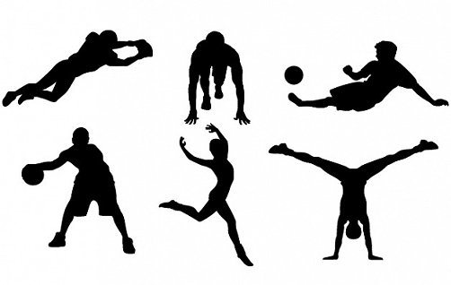
PERSON
Sector 4

Slide 22
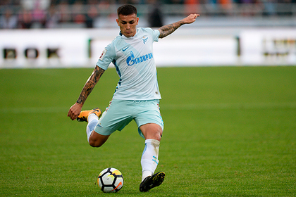
4-1 How is called a person who plays football?
a football player

Slide 23
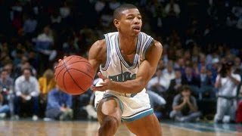
4-2 How is called a person who plays basketball?
a basketball player

Slide 24
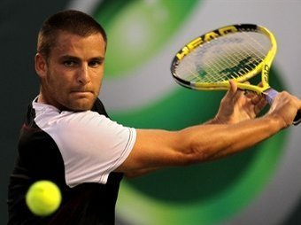
4-3 How is called a person who plays tennis?
a tennis player

Slide 25
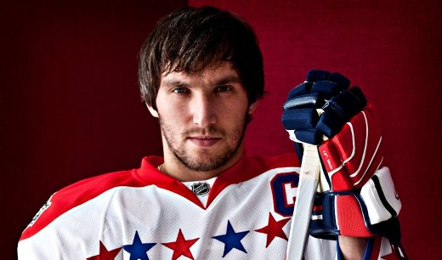
4-4 How is called a person who plays hockey?
a hockey player

Slide 26
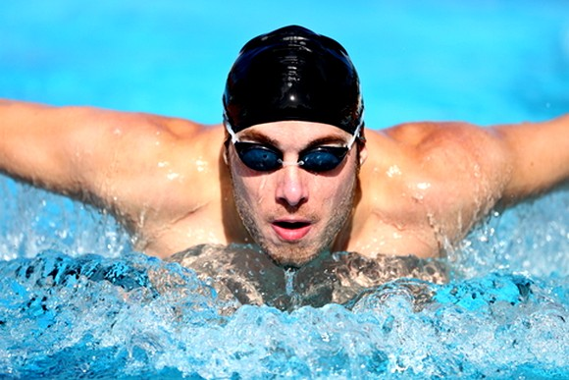
4-5 How is called a person who does swimming?
a swimmer

Slide 27
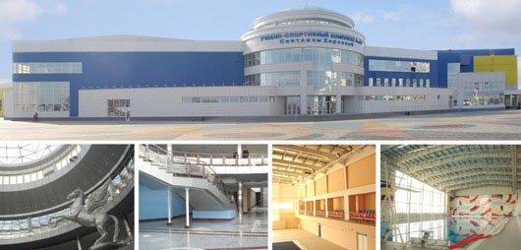
PLACE
Sector 5

Slide 28
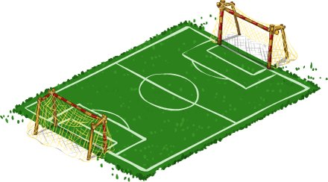
5-1 Where is football played?
on a football ground/ at the stadium

Slide 29
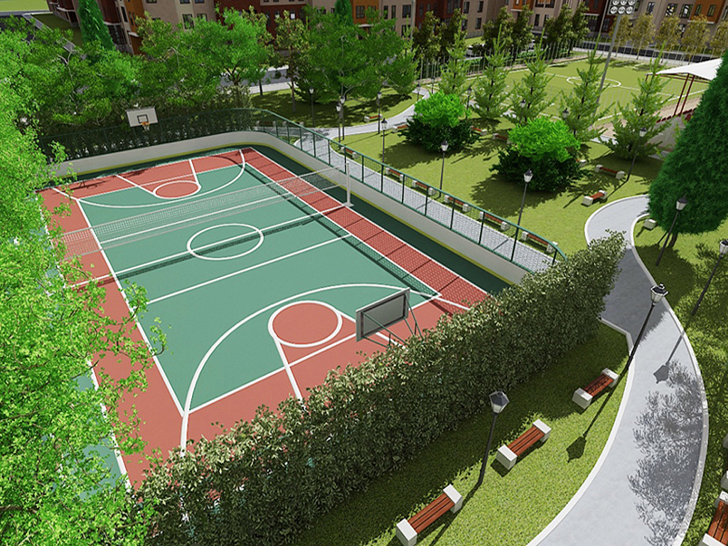
5-2 Where is basketball played?
in outdoor surfaces or on a basketball court

Slide 30
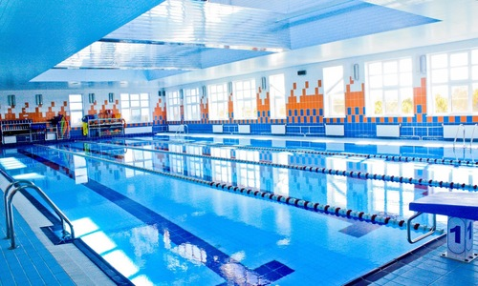
5-3 Where can you do swimming?
in a swimming-pool

Slide 31
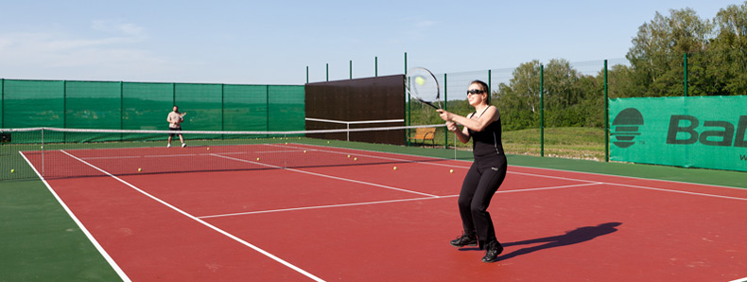
5-4 Where can you play tennis?
on a tennis court

Slide 32
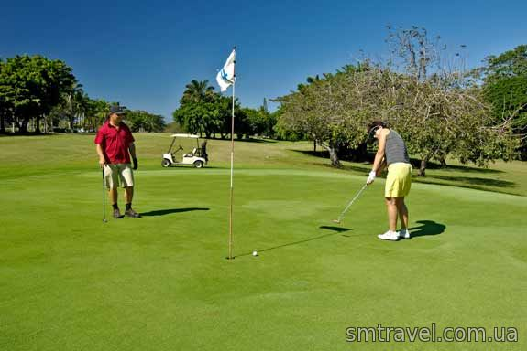
5-5 Where can you play golf?
on a golf course

Slide 33
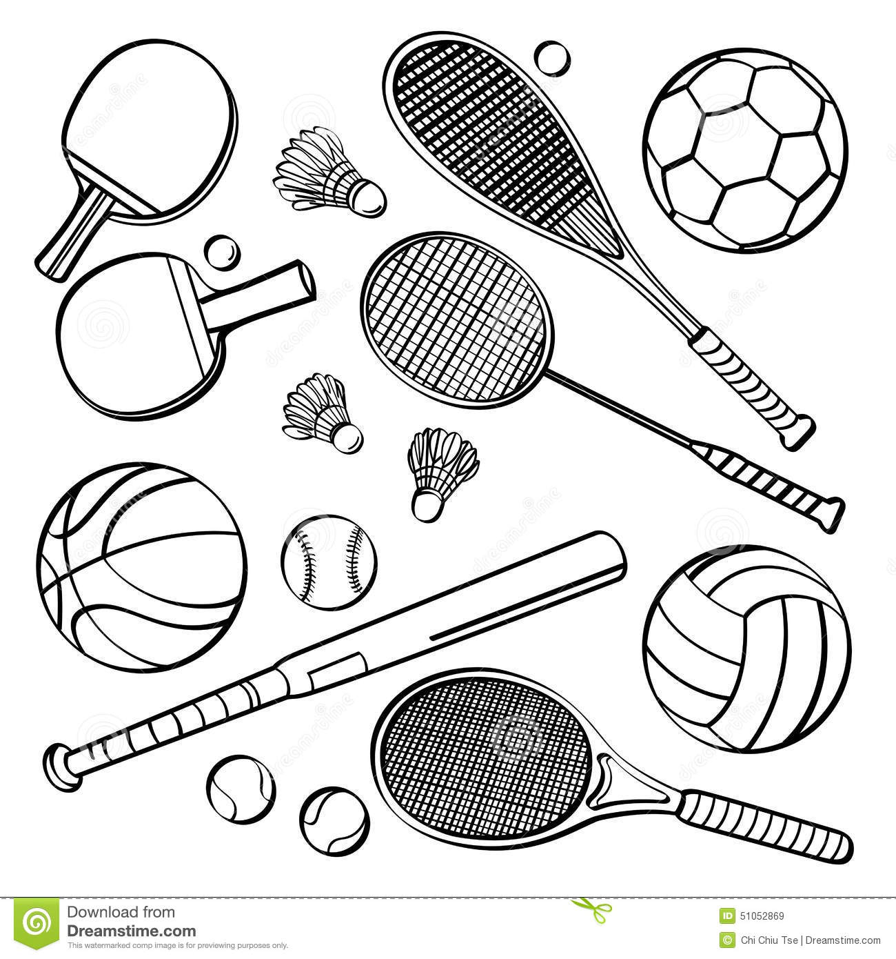
EQUIPMENT
Sector 6

Slide 34
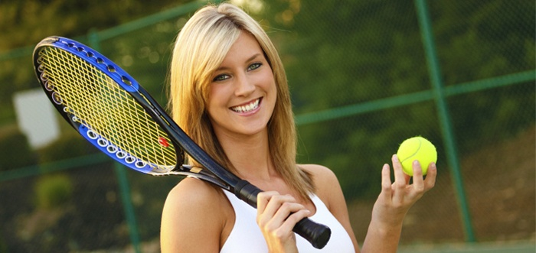
6-1 What do you need to play tennis?
a racket, a tennis ball

Slide 35
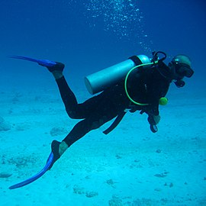
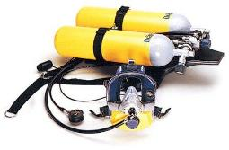
6-2 What equipment do you need for diving?
personal diving equipment
an aqualung

Slide 36

6-3 What do you need to play basketball?
the first basket
a ball
the second basket

Slide 37
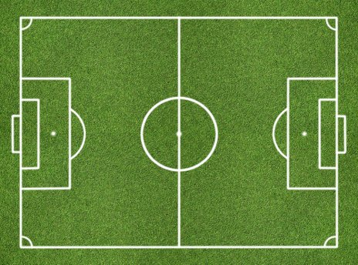
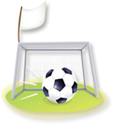
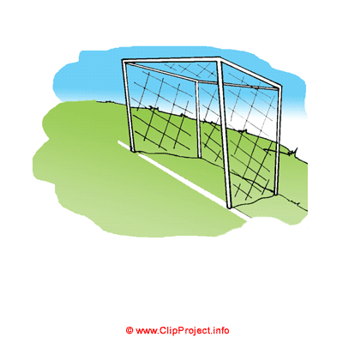
6-4 What do you need to play football?
a football ball, two gates

Slide 38
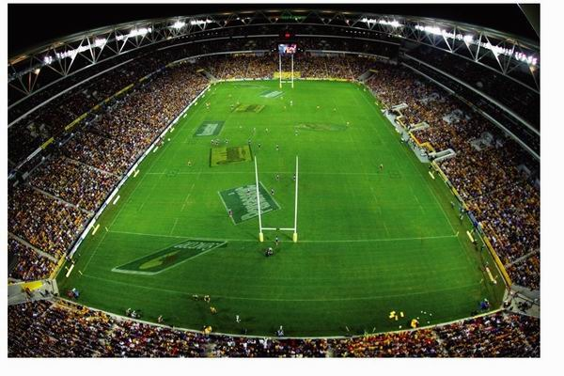

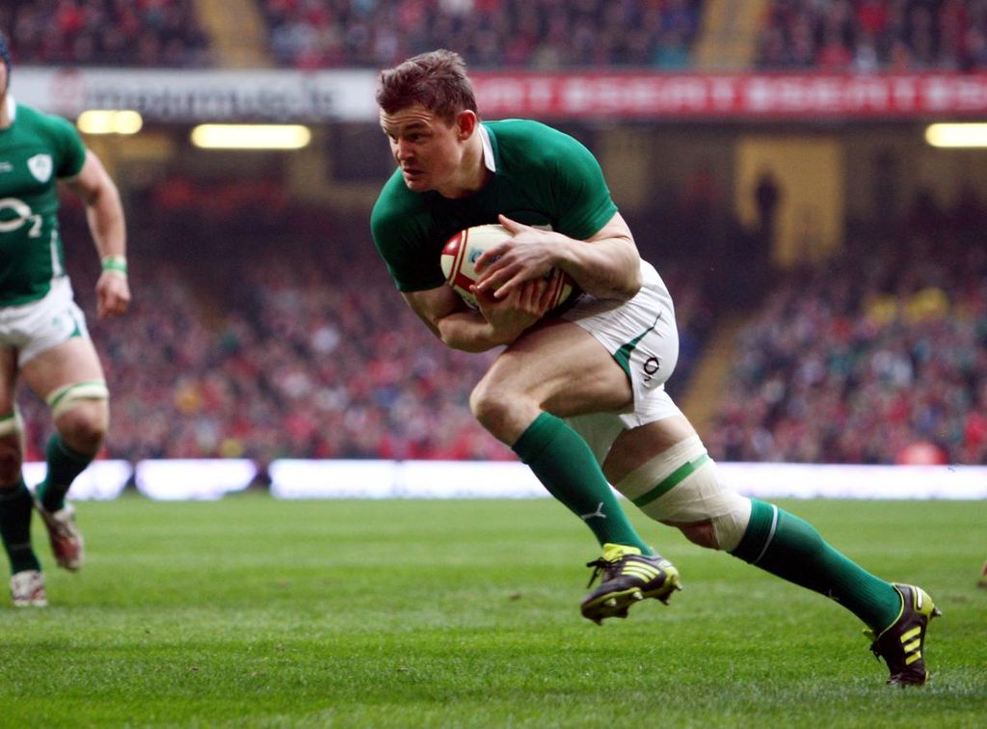
6-5 What do you need to play rugby?
а
an oval ball, two gates

Slide 39


Sector 7
Now, please, listen to the Interview and fill in the table with suitable answers.

Slide 40
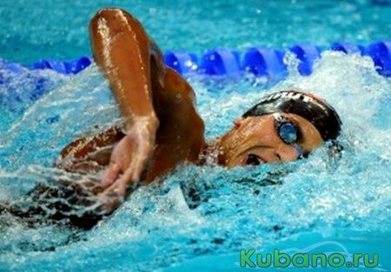
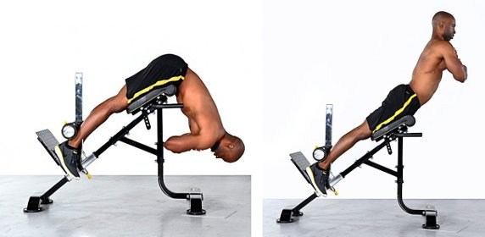
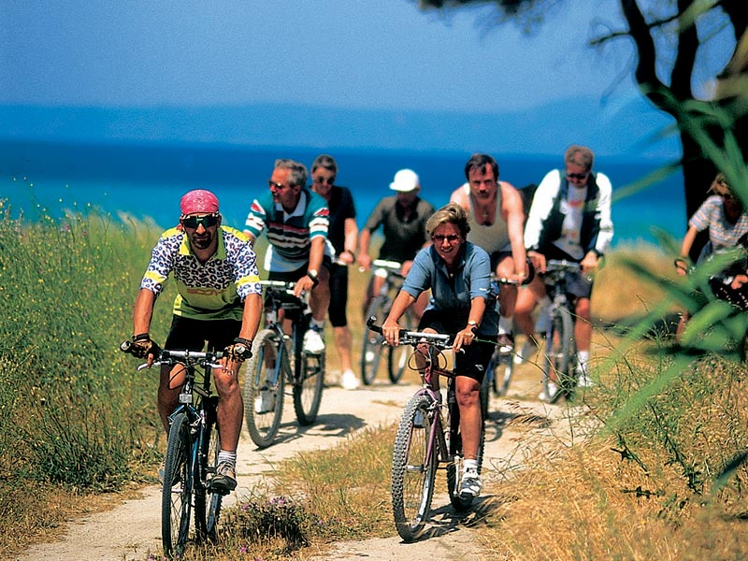

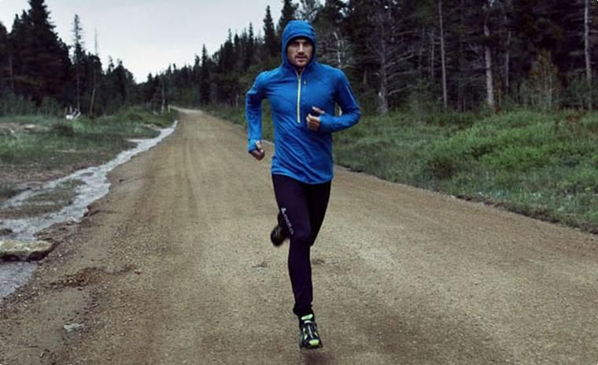
7-1 Kinds of Sport Mentioned in the Interview

Slide 41
7-2 Kinds of Sport Harry Does
Sometimes he just has a good walk

Slide 42
7-3 True or False Statements
Sport becomes more popular today. (True)
Harry is a professional sportsman. (False)
He goes to the gym once a week. (False)
On Saturday Harry plays tennis or goes for a run. (True)
Harry considers running, swimming and cycling as more effective kinds of sport. (True)
Harry thinks walking is also good for keeping fit. (True)

Slide 43

Sector 8

Slide 44
There are 12 cards on the table. In each card is written a word denoting a kind of sport ( e.g. football, cycling, running, swimming, basketball, gymnastics, diving, ice-hockey, skating, tennis, skiing, horse-riding). The task for the person is to describe or show the chosen kind of sport to your team without words. You may use gestures and mime. If the team doesn’t know the answer the second team has the right to answer.

Slide 45

Sector 9
There are some sportsmen who helped to make history in sport. They are world famous. Do you know them?

Slide 46
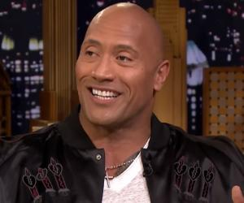
9-1 He is an American actor and retired professional wrestler.
Dwayne Johnson

Slide 47
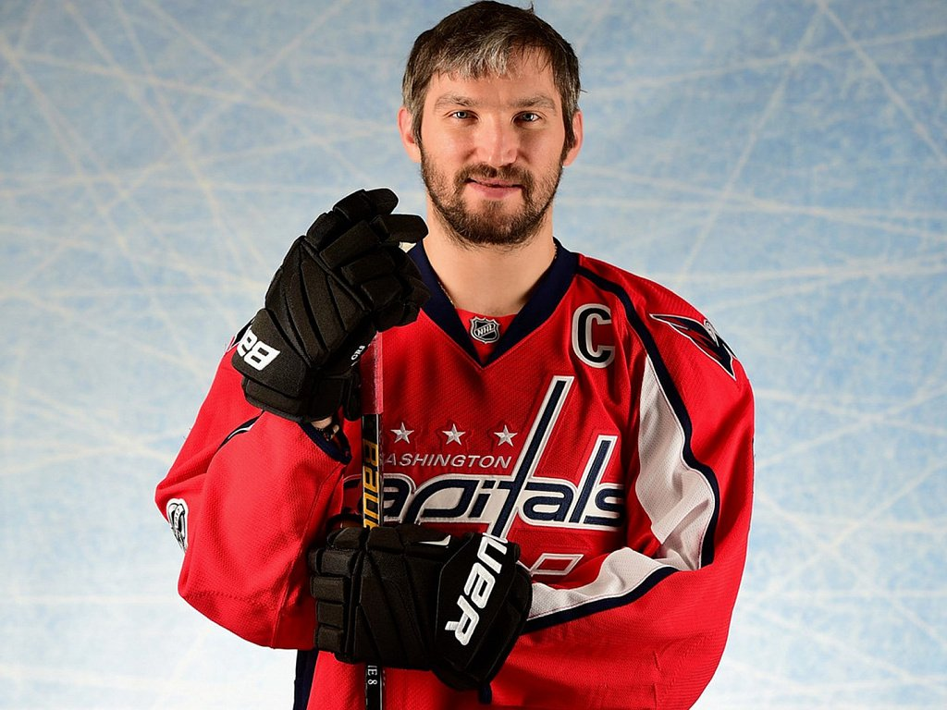
9-2 He is a famous Russian professional ice hockey player.
Alexander Ovechkin

Slide 48
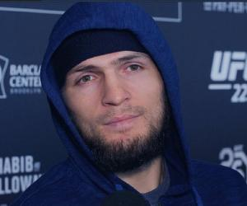
9-3 This sportsman is a Russian mixed martial artist.
Khabib Nurmagomedov

Slide 49
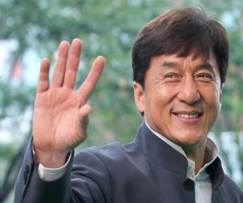
9-4 An actor, action choreographer, comedian, director, producer, martial artist, screenwriter, entrepreneur, singer and stunt performer, is a truly multi-faceted personality.
Jackie Chan, Hong Konger

Slide 50
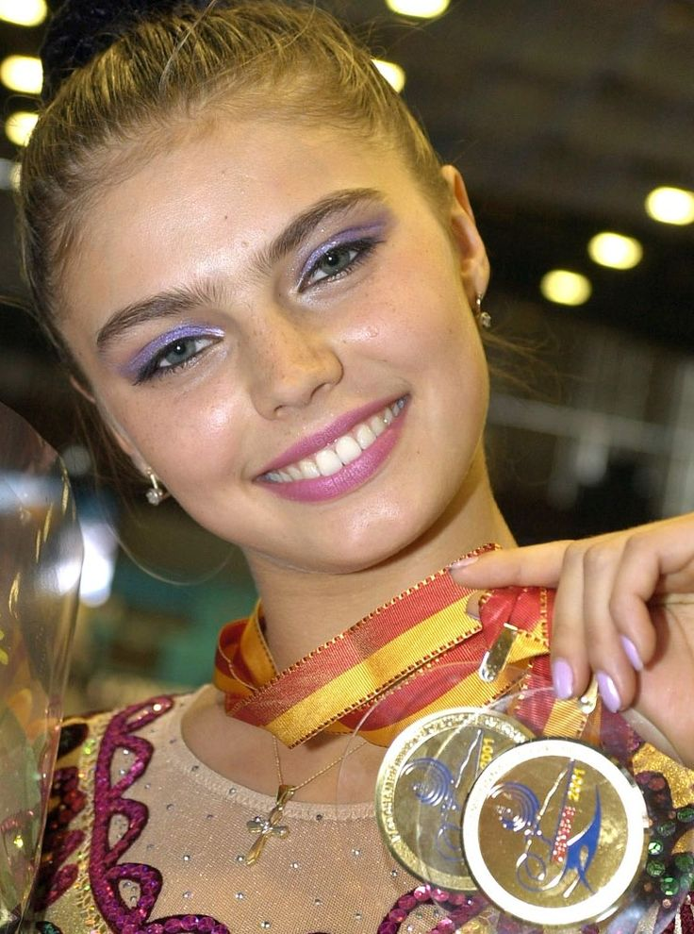
9-5 This woman is one of the most decorated gymnasts in rhythmic gymnastic history. She is twice Olympic, many times World and European medalist. She was a State Duma Deputy.
Alina Kabaeva

Slide 51

Sector 10. «Mixed up Letters»

Slide 52
10-1 Put the letters in the words on the topic “Sport” in a logical order.
еrccso (soccer);
bongxi (boxing);
rfiusng (surfing);
tmpoitinoc (competition);
rocsaebi (aerobics);
sinent (tennis);
ykeoch (hockey).

Slide 53

Sector 11. The Final.
If necessary…

Slide 54
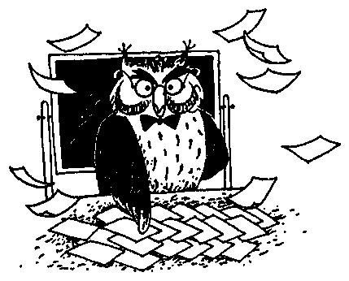
11–1 The Final
Make as many words as you can out of the word unpredictable.
Write them down.

Slide 55
Answers:
The best result is 61 words.
red, rabbit, pen, pencil, tent, ride, act, credit, cable, price, rice, nice, recite, bread, pet, tube, bat, deal, learn, dare, tap, pedal, dual, rap, liar, bun, can, nap, bear, rude, debt, bed, dune, run, tip, tap, tape, dead, deep, pub, tune, tin, beat, peel, tree, picture, in, it, blue, table, label, run, pale, nerd, read, lecture, bacteria, terra, cat, net, real.
.

Slide 56


Slide 57

The End.
Good Luck!

