Slide 1
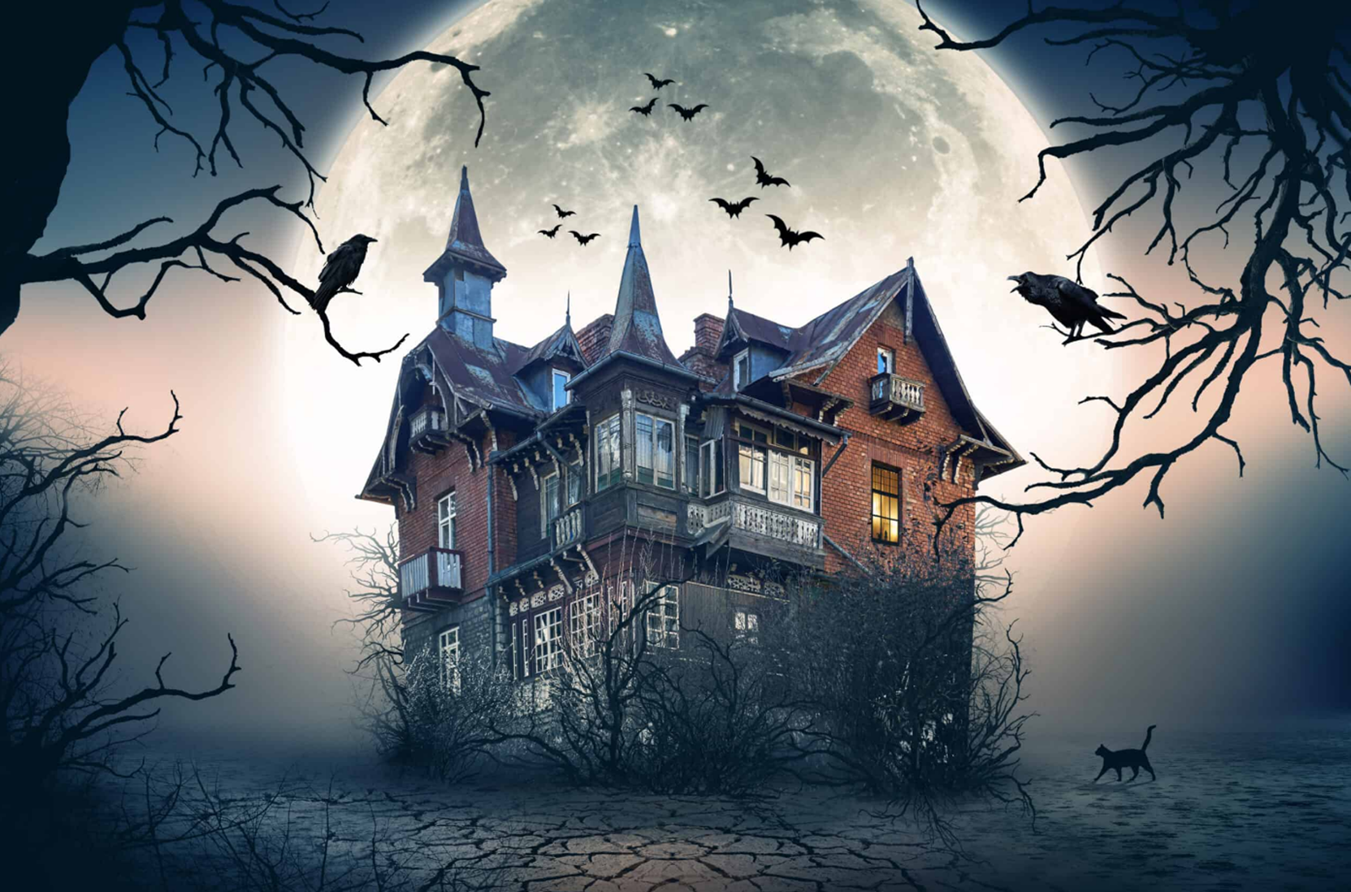


Haunted House
Mystery Box

Slide 2

How to play
Split up into teams (2 or more)
Choose one ghost and answer the question.
You have 5 sec to answer.
If your answer is correct, you will get a MYSTERY BOX.
The mystery box can be good or bad.
You can keep it or give it to another player or team.

Slide 3

MYSTERY BOX PRIZES
LOSE 100
GET 100
LOSE 200
GET 200
STEAL 100
LOSE 1/2
GET 500
LOSE ALL

Slide 4


CHOOSE ONE
1
2
3
4
5
6
7
8
9
10
11
12
13
14
15
16
17
18

Slide 5
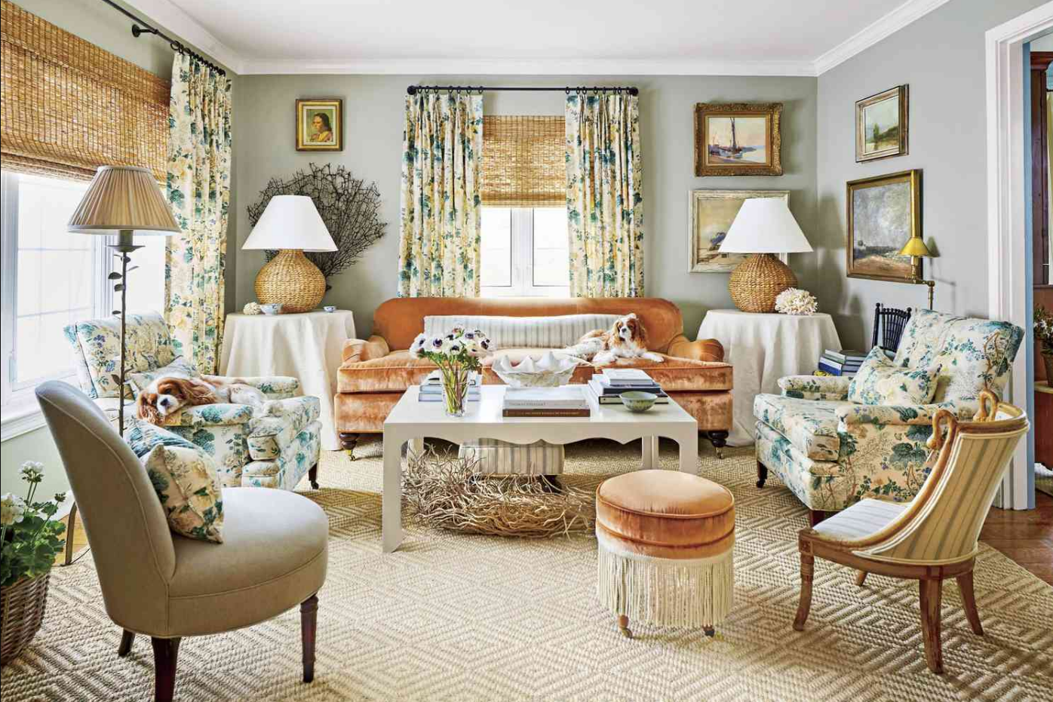
What part of house is this?
Give it
or
Keep it?
LOSE 100
Board
living room

Slide 6
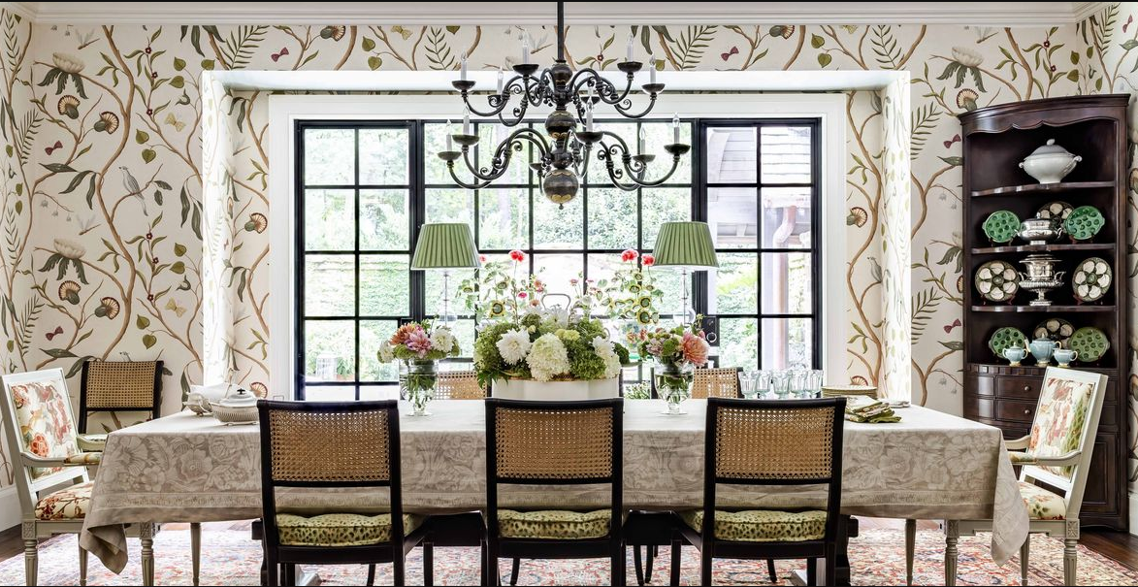
What part of house is this?
Give it
or
Keep it?
GET 500
Board
dining room

Slide 7
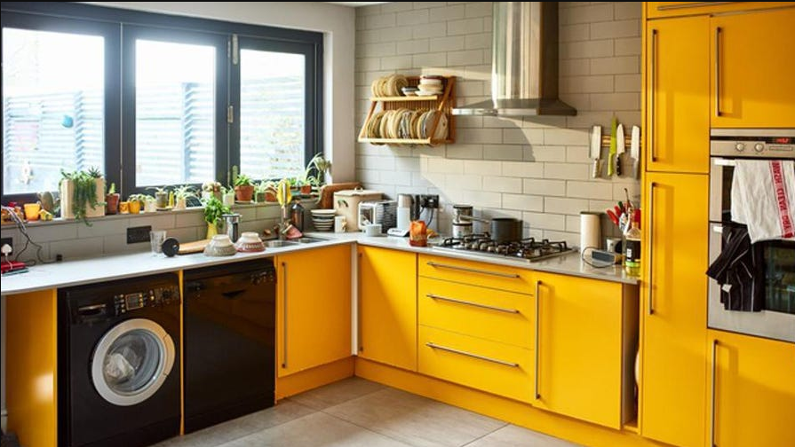

What part of house is this?
Give it
or
Keep it?
GOLDEN EGG
GET 500
kitchen
Board

Slide 8
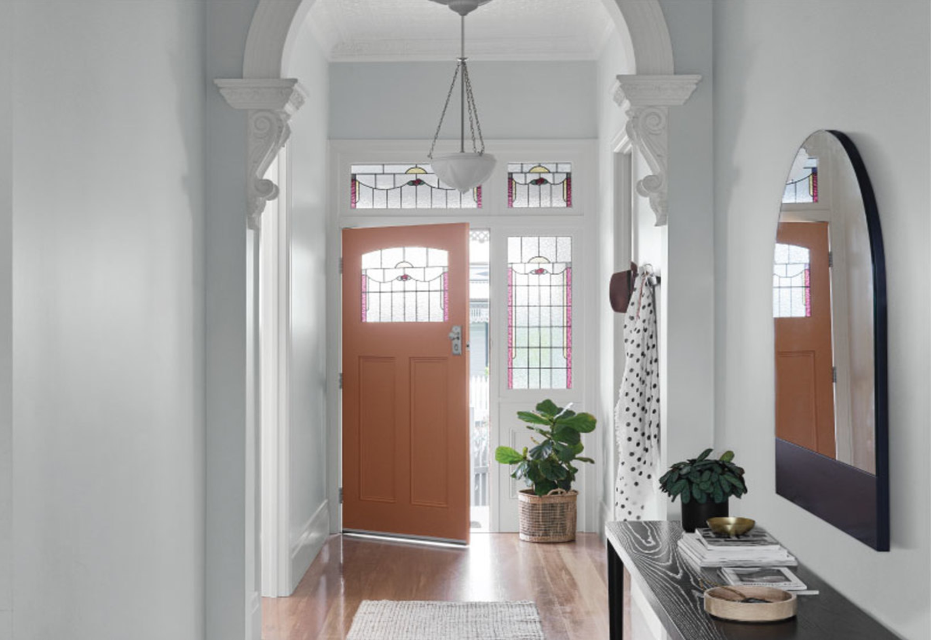
What part of house is this?
Give it
or
Keep it?
GET 100
Board
hall

Slide 9
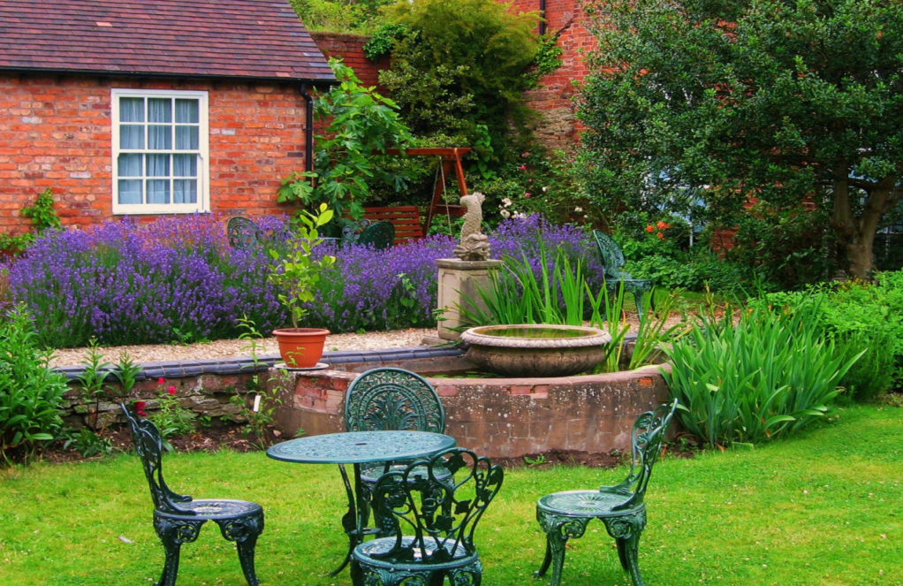
What part of house is this?
Give it
or
Keep it?
GET 200
garden
Board

Slide 10
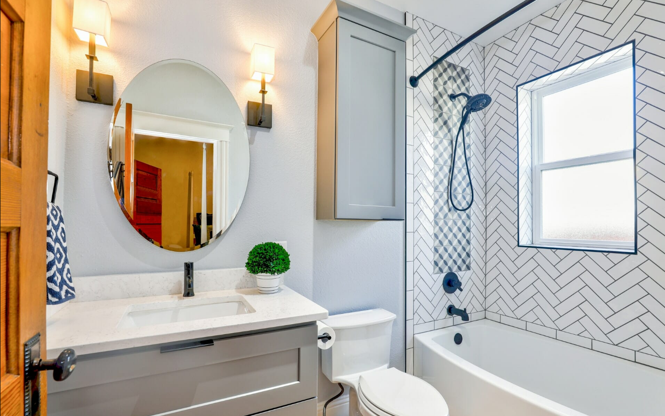
What part of house is this?
Give it
or
Keep it?
GOLDEN EGG
GET 500
Board
bathroom

Slide 11
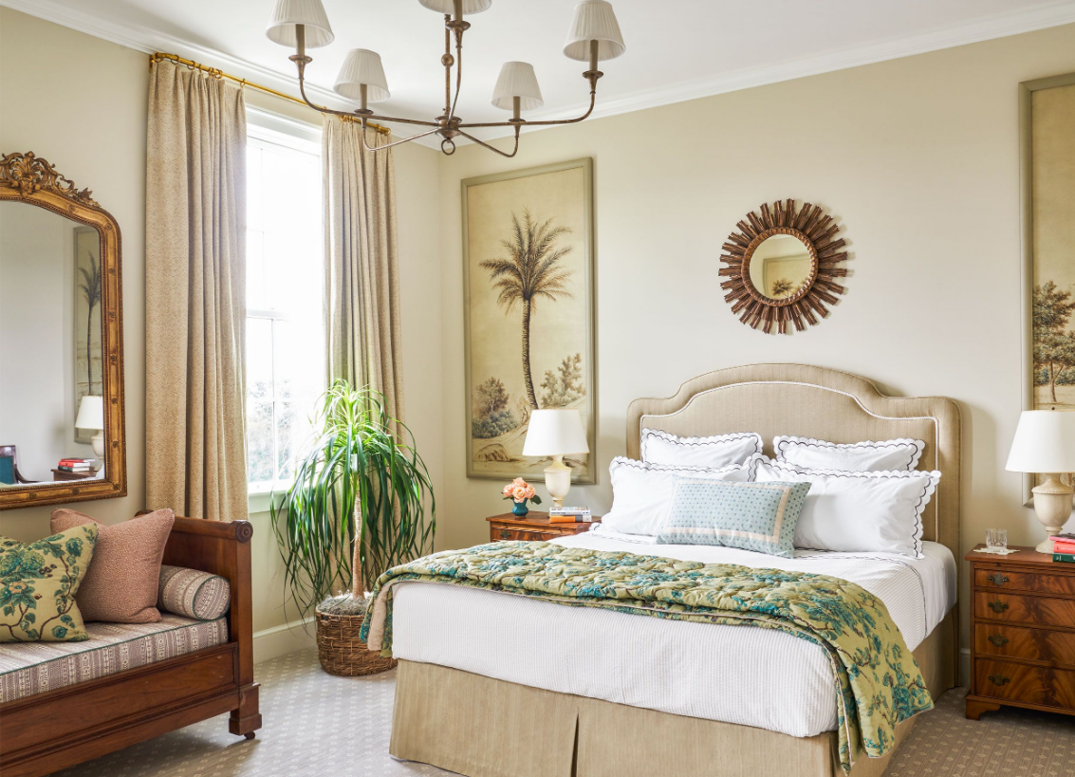
What part of house is this?
Give it
or
Keep it?
LOSE 200
Board
bedroom

Slide 12

What part of house is this?
Give it
or
Keep it?
LOSE 1/2
Board
stairs

Slide 13
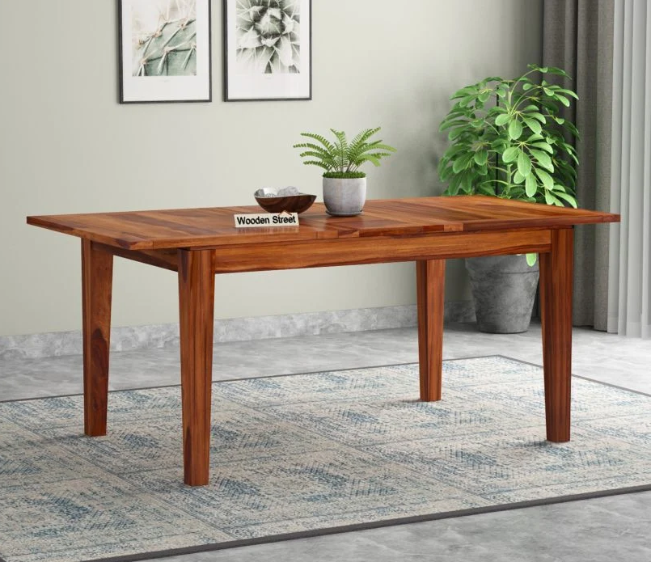
What’s this?
Give it
or
Keep it?
GET 500
Board
table

Slide 14
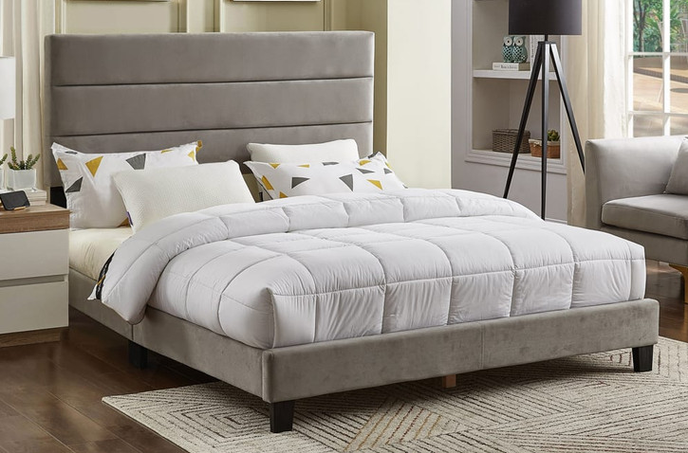
What’s this?
Give it
or
Keep it?
STEAL 100
Board
bed

Slide 15
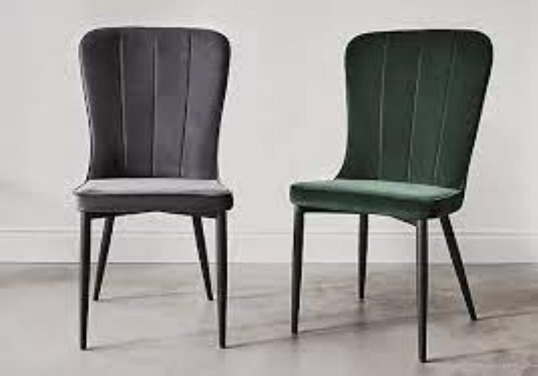
What’s this?
Give it
or
Keep it?
LOSE ALL
Board
chair

Slide 16
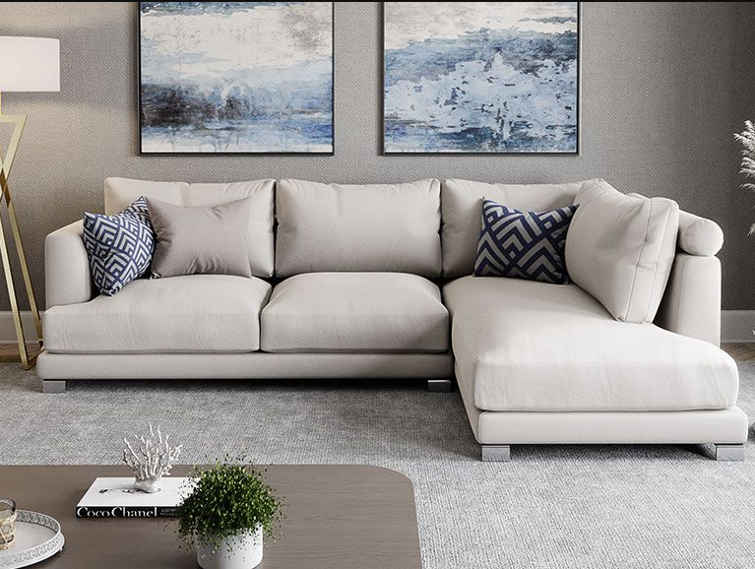
What’s this?
Give it
or
Keep it?
GET 300
Board
sofa

Slide 17
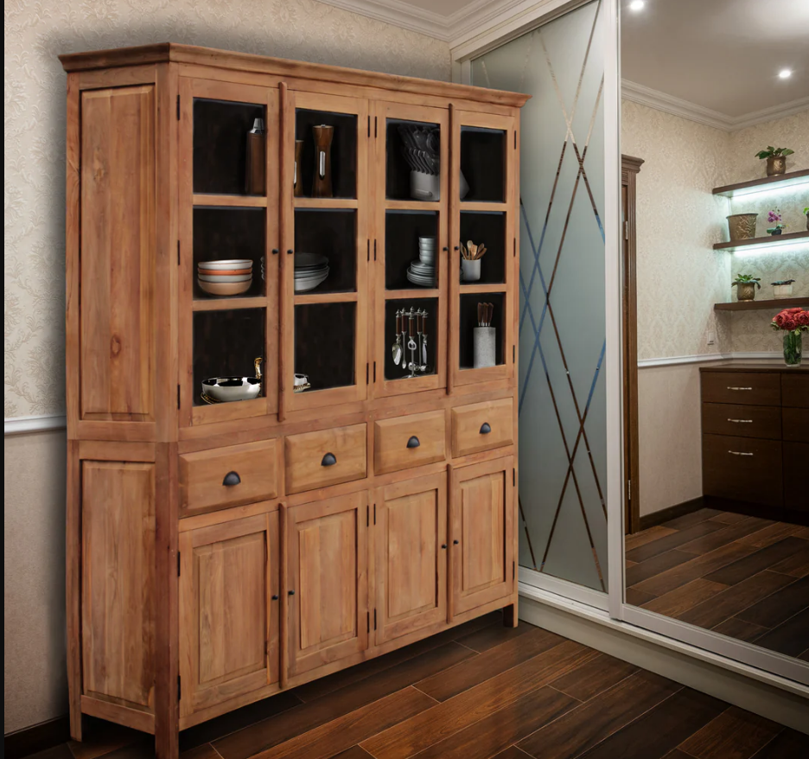
What’s this?
Give it
or
Keep it?
GET 200
Board
cupboard

Slide 18
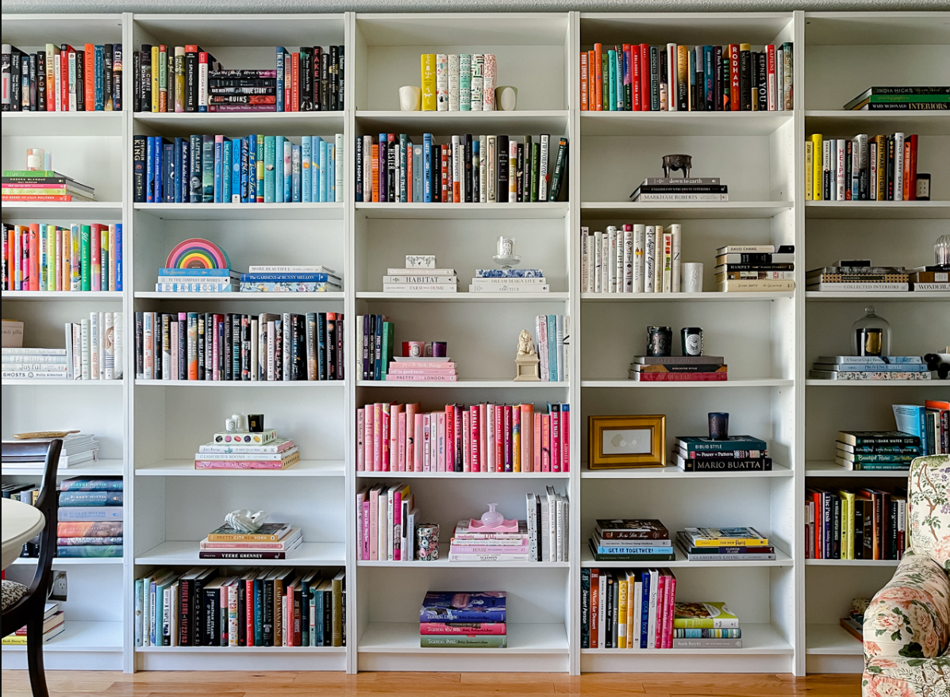
What’s this?
Give it
or
Keep it?
GOLDEN EGG
GET 500
Board
bookcase

Slide 19

What’s this?
Give it
or
Keep it?
GET 500
Board
board

Slide 20
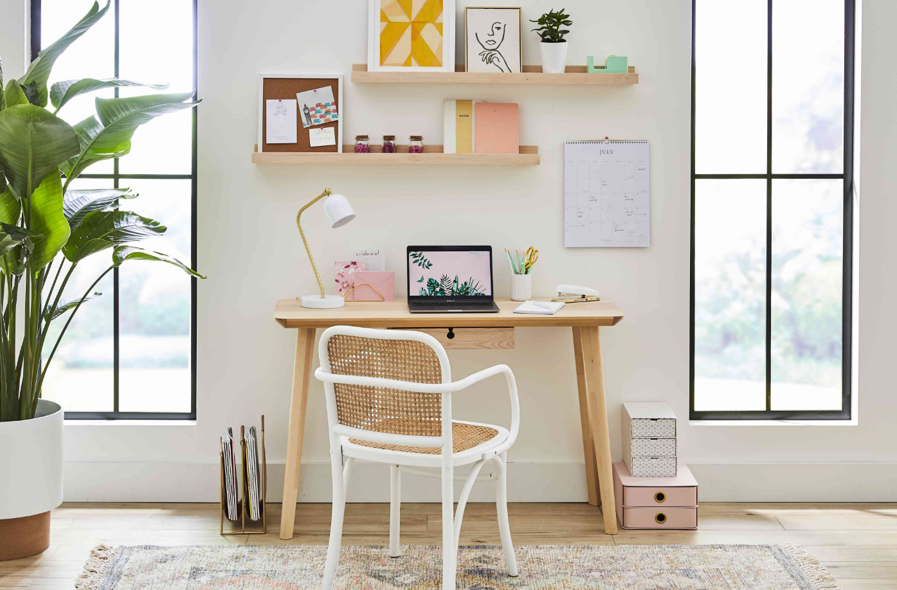
What’s this?
Give it
or
Keep it?
LOSE 100
Board
desk

Slide 21
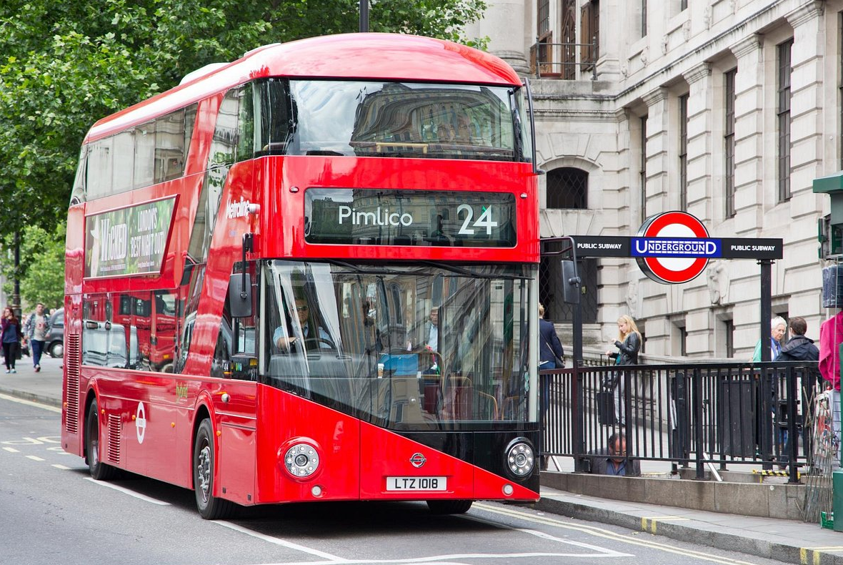
What’s this?
Give it
or
Keep it?
STEAL 100
Board
bus

Slide 22

What’s this?
Give it
or
Keep it?
GET 200
Board
flower

