Slide 1

Present Continuous
Ю.Е. Ваулина, ДЖ. Дули: - Spotlight 5 (Английский в фокусе)
Уроки 6b, 6с (стр. 79-80)
Учитель английского языка - Аносова Т.Г.

Slide 2
ng -/ŋ/ sitting, reading, coming, playing working, eating

Slide 3

Present Continuous
to be + Ving

Slide 4
1. I are swimming.
2. Tom and Sam is watching TV.
3. My brother are listening to the radio.
4. My friend am running to school.
5. We is making a cake.
Find out mistakes

Slide 5
1. I am swimming.
2. Tom and Sam are watching TV.
3. My brother is listening to the radio.
4. My friend is running to school.
5. We are making a cake.
Check yourself:

Slide 6
sit, work, run, put, come, make, take, ride, talk, ask, play, do
Write the word adding - ING
to this word in the right column

Slide 7
working coming sitting
talking making running
asking taking putting
playing riding
doing

Slide 8
Time words:
now – сейчас
at the moment – в данный момент
right now – сейчас

Slide 9
Подлежащее + am/is/are + V ing + ВЧП
Подлежащее + am/is/are + not + V ing + ВЧП
Am/Is/Are + подлежащее + V ing + ВЧП?

Slide 10

Make sentences using Present Continuous tense
1.drinking, boy, Coke, the, is .
2.the, eating, cat, fish, is .
3.in, are, bed, sleeping, the, we.
4.talking, are, they .

Slide 11
1.The boy is drinking Coke.
2.The cat is eating fish.
3.We are sleeping in the bed.
4.They are talking.
      LET’S CHECK

Slide 12
He is playing volleyball with his friends
I am writing a letter now.
She is washing up at the moment.
They are singing a song at that moment.
We are opening the window now.
Make negative sentences using Present Continuous tense

Slide 13
He is not playing volleyball with his friends
I am not writing a letter now.
She is not washing up at the moment.
They are not singing a song at that moment.
We are not opening the window now.

Slide 14

Make questions using Present Continuous tense

Slide 15

make/ Ann/now/a phone call?
5. wash/the children/the dog/now?
6. play/they/now/with their friends?

Slide 16

Use pictures to make sentences. (Present Continuous)
She is reading a book.

Slide 17
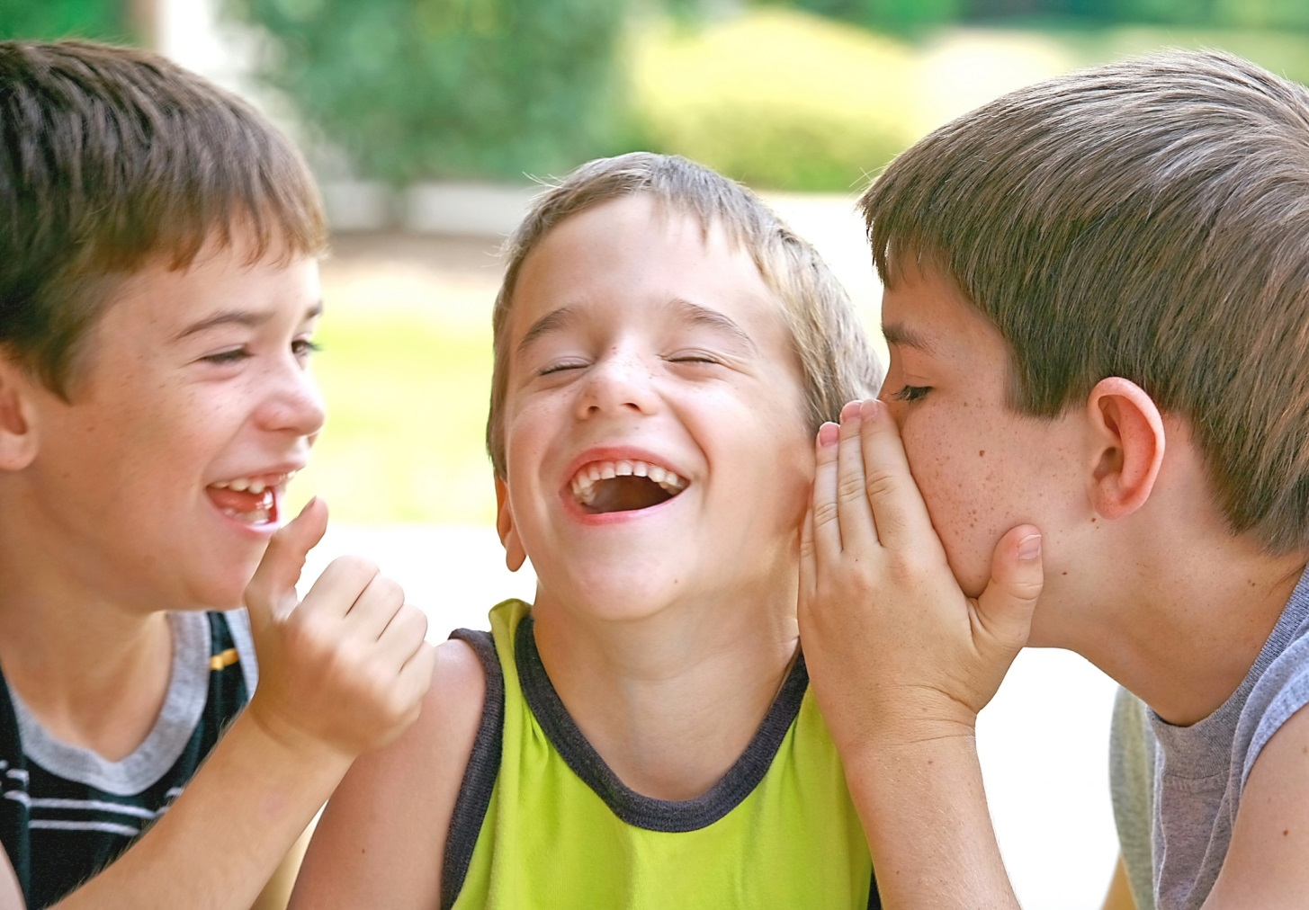
They are talking.

Slide 18
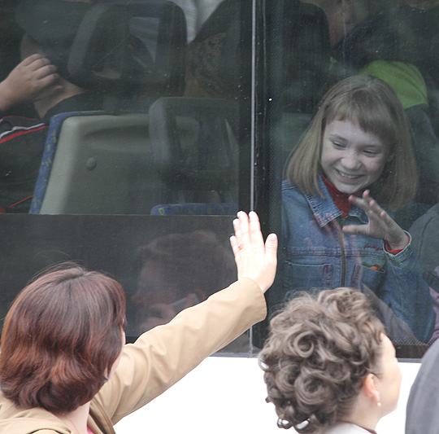
She is saying goodbye to the children.

Slide 19
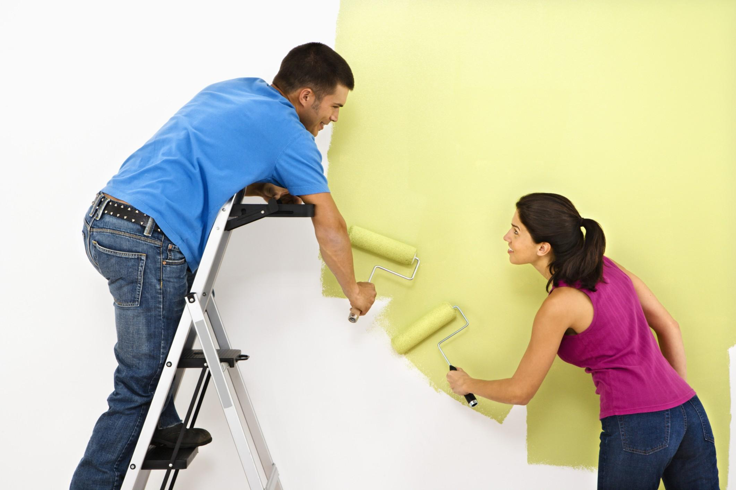
The are painting the wall.

Slide 20
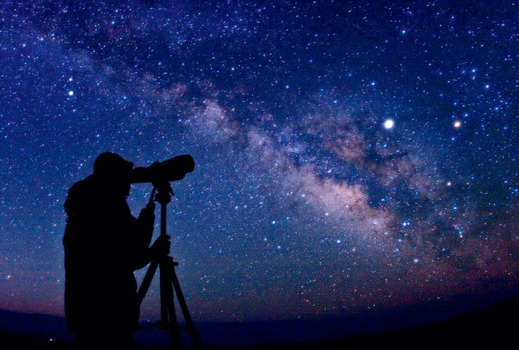
He is looking at the stars.

Slide 21
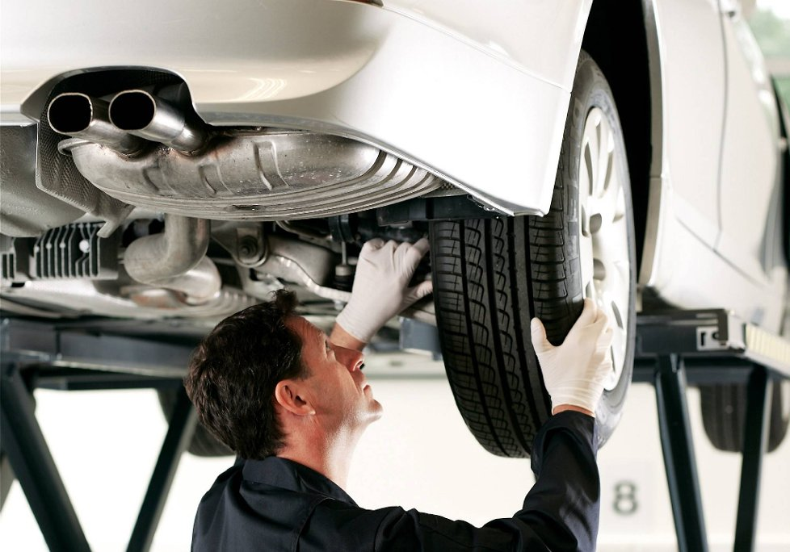
He is repairing a car.

Slide 22
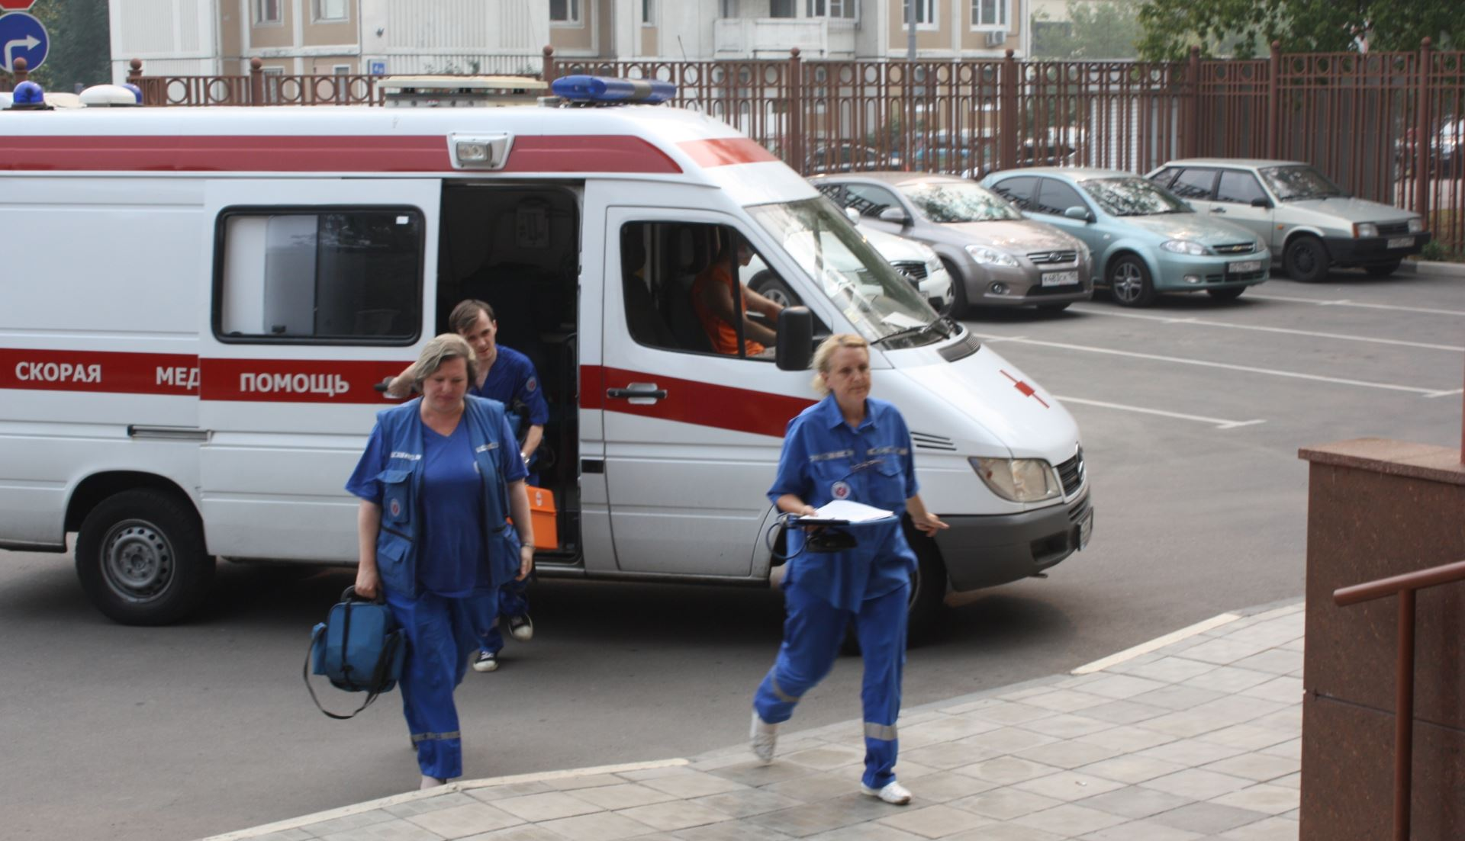
People are waiting for the ambulance.

Slide 23

The postman is delivering a letter.

Slide 24
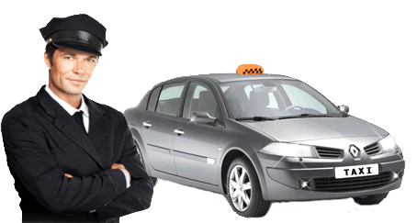
He is driving a taxi.

Slide 25
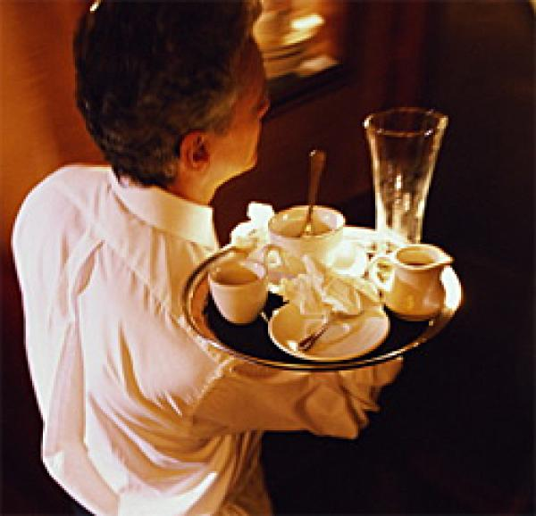
The waiter is serving drinks.

