Slide 1

Разработка Бурлаковой Е.С.

Slide 2

Professions
10
20
30
40
50
In the city
10
20
30
40
50
Present Simple
10
20
30
40
50
Past Simple
10
20
30
40
50
Disney
10
20
30
40
50
Notes:
Автор шаблона Салиш С.С., учитель начальных классов СШ №53 г. Актобе.

Slide 3

Professions
10
I bake bread and make cakes.
Who am I?

Slide 4
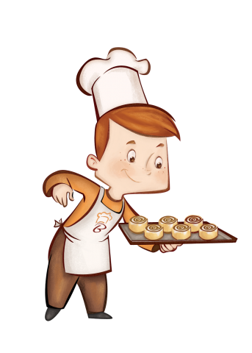
Professions
10
I’m a baker

Slide 5
Professions
20
I work in a garage. I fix cars.
Who am I?

Slide 6

Professions
20
I’m a mechanic

Slide 7

Professions
30
Who am I?
I help sick people.
I wear a white uniform.

Slide 8
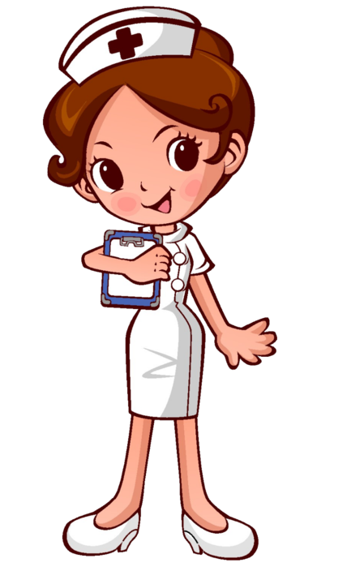
Professions
30
I am a nurse.

Slide 9
CAT IN THE BAG
40

Slide 10

Professions
40
This job is very important. People of this job must be very brave and strong, kind and clever, clean and smart, because this job is very difficult. You must work hard on Monday, Tuesday, Wednesday, Thursday, Friday, Saturday and Sunday. And you mustn’t be a couch potato. You must help sick people or animals any time.
You must wear a white uniform.
Important – важный
a couch potato – лежебока

Slide 11
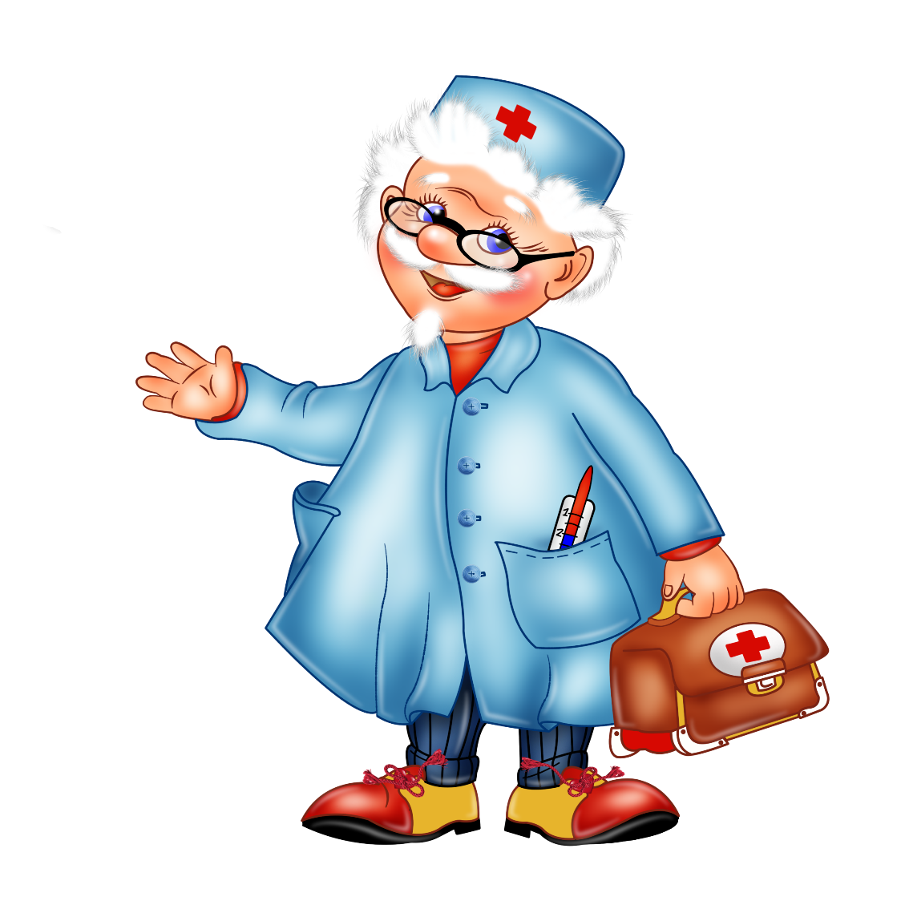
Professions
40
This person is a doctor

Slide 12
Professions
50
a teacher
a doctor
a policeman
a clown
a postman
a dancer
a fireman
a baker
a dentist
a pupil
i) He bakes bread.
f) He works in a circus.
o) He takes care of our teeth.
s) He fights fires.
n) She studies at school.
e) He delivers letters.
p) She gives pupils homework.
r) He helps sick people.
o) He protects people.
s) She works in a theatre.
1 | 2 | 3 | 4 | 5 | 6 | 7 | 8 | 9 | 10

Slide 13
Professions
50
a teacher
a doctor
a policeman
a clown
a postman
a dancer
a fireman
a baker
a dentist
a pupil
i) He bakes bread.
f) He works in a circus.
o) He takes care of our teeth.
s) He fights fires.
n) She studies at school.
e) He delivers letters.
p) She gives pupils homework.
r) He helps sick people.
o) He protects people.
s) She works in a theatre.
1 | 2 | 3 | 4 | 5 | 6 | 7 | 8 | 9 | 10
P | R | O | F | E | S | S | I | O | N

Slide 14
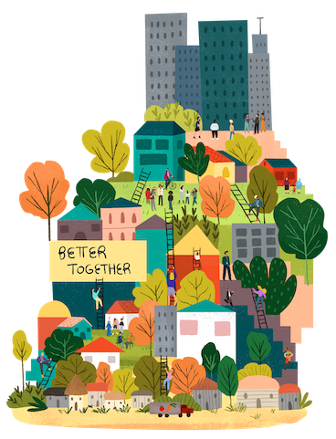
In the city
10
You can take the bus, taxi or train from here

Slide 15
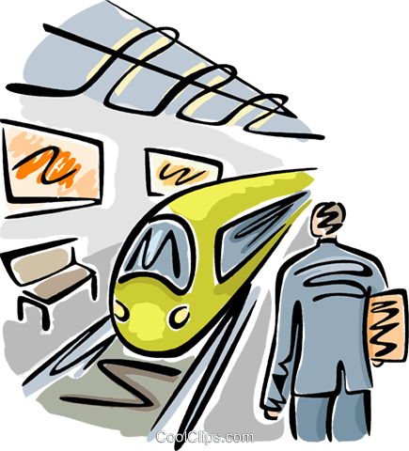
In the city
10
It’s a station.

Slide 16
In the city
20
If you need to get or take a letter you go there

Slide 17

In the city
20
A post office

Slide 18
CAT IN THE BAG
30

Slide 19

In the city
30
I have cities but no houses,
Forests but no trees,
Rivers without water,
What am I?

Slide 20
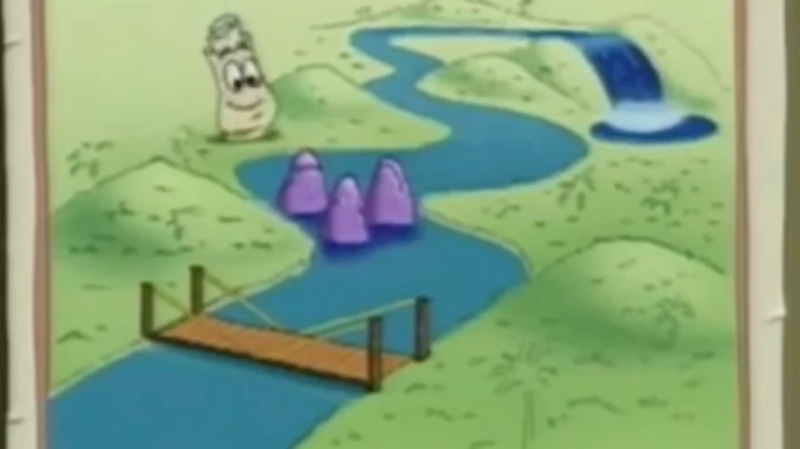
In the city
30
It’s a map.

Slide 21
In the city
40
A place where people order coffee and desserts

Slide 22
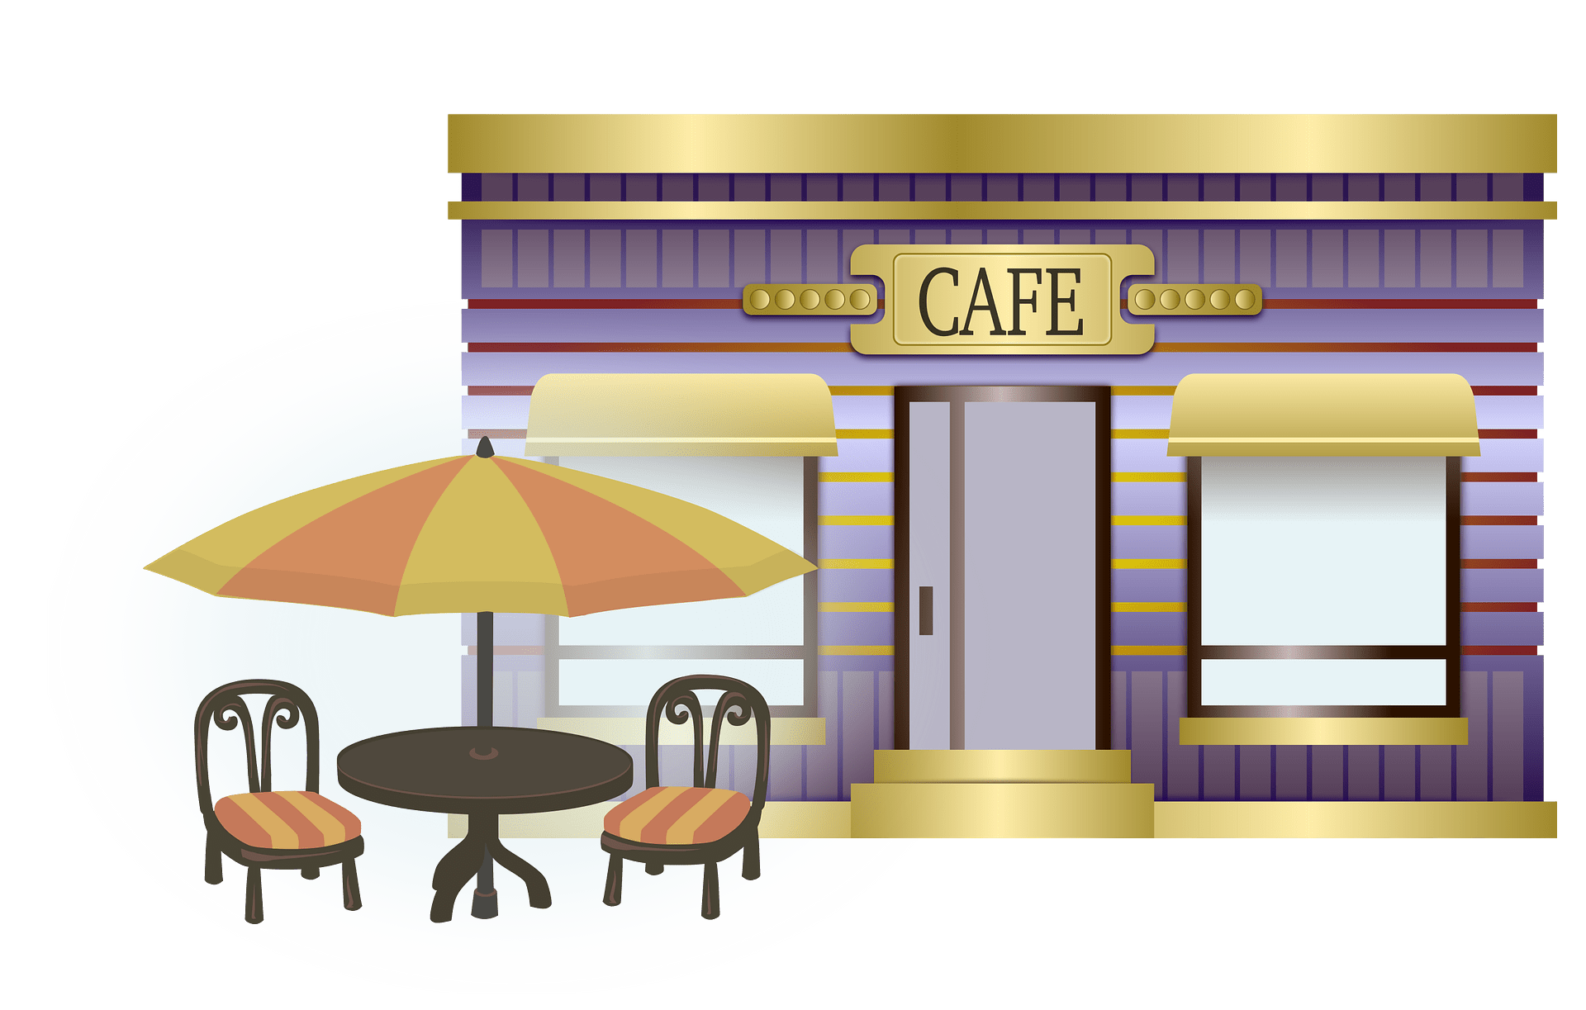
In the city
40
It’s a cafe

Slide 23

In the city
50
This building is big. There are four floor, stairs, toilets, a library and a dining room in this building.
I go to this building five times a week. I study there Art, Music and others.
And this place is …

Slide 24

In the city
50
It’s school.

Slide 25
Present Simple
10
My life is so boring - I just ________ TV every night.
watchies
watches
watch

Slide 26
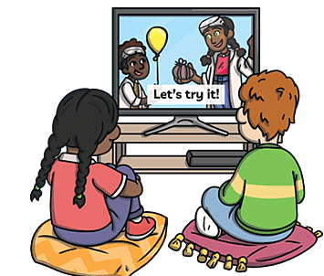
Present Simple
10
My life is so boring - I just watch TV every night.

Slide 27

Present Simple
20
Anna and Elsa _____ (not, like) bad weather.
1. doesn’t like
2. not like
3. don't like

Slide 28
Present Simple
20
Anna and Elsa don't like bad weather.

Slide 29

Present Simple
30
Where does a greengrocer work?
Where do a greengrocer work?
Where does a greengrocer works?

Slide 30

Present Simple
30
Where does a greengrocer work?

Slide 31
Present Simple
40
Translate it into English:
Медсестра не работает в кафе, она работает в больнице.

Slide 32
Present Simple
40
A nurse doesn’t work at a cafe, she works at a hospital.

Slide 33
CAT IN THE BAG
50

Slide 34

Present Simple
50
a / ? / does / sister / in / your / work / bank
go / Mark / Tom / cinema / and
/ to / the
3) doesn’t / nurse / at / work / hospital / the

Slide 35

Present Simple
50
Does your sister work in a bank?
Mark and Tom go to the cinema
3) Nurse doesn’t work at the hospital

Slide 36
CAT IN THE BAG
10

Slide 37

Past Simple
10
Tom _____ in Dublin last night
wases
were
was

Slide 38
Past Simple
10
Tom was in Dublin last night

Slide 39
Past Simple
20
1) I … (be) ill last week.
2) He …(visit) Great Britain last month.
3) My little sister … (go) to the park.
4) Our dogs …(eat) meat yesterday.
1 | 2 | 3 | 4

Slide 40
Past Simple
20
1) I was ill last week.
2) He visited Great Britain last month.
3) My little sisters went to the park
4) Our dogs ate meat yesterday.
1 | 2 | 3 | 4
was | visited | went | ate

Slide 41

Past Simple
30
Я была в школе.
2) Он гулял с собакой.
3) Она смотрела телевизор.
4) Мы ели мороженое.

Slide 42
Past Simple
30
1) I was at school.
2) He walked his dog.
3) She watched TV.
4) We ate ice-cream.

Slide 43

Past Simple
40
go
 | rode
have
 | saw
make
 | ate
give

Slide 44
Past Simple
40
go | went
ride | rode
have | had
see | saw
make | made
eat | ate
give | gave

Slide 45

Past Simple
50
my / lunch / sister / with Gerry / had
film? / like / you / Did / the /
Ann / pictures / yesterday / painted.

Slide 46
Past Simple
50
my sister had lunch with Gerry
Did you like the film?
Ann painted pictures yesterday.

Slide 47
Disney
10
This character is a funny bear. He is fat but very nice. He likes honey and doesn`t like bees. He enjoys to make up rhymes. He likes to visit his friends Rabbit and Piglet.

Slide 48

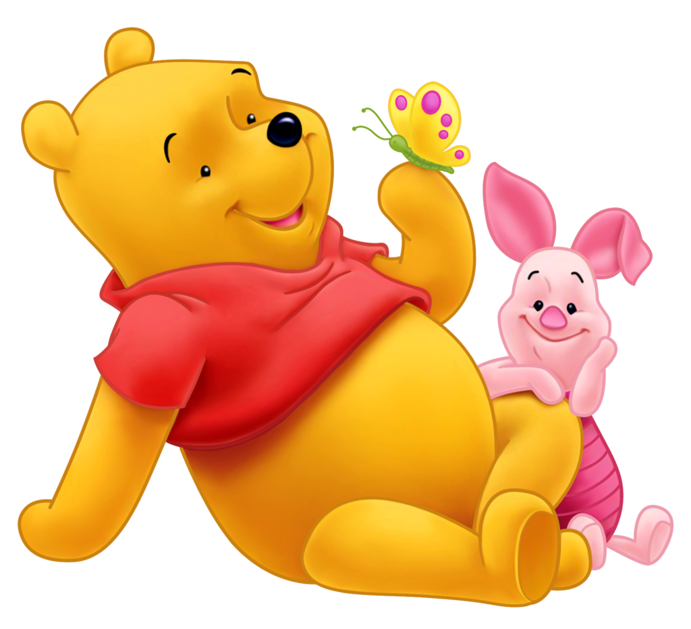
Disney
10

Slide 49
CAT IN THE BAG
20

Slide 50
Disney
20
I have brown eyes, big ears, a nose and a mouth. I am green.
I have a wife Fiona.

Slide 51
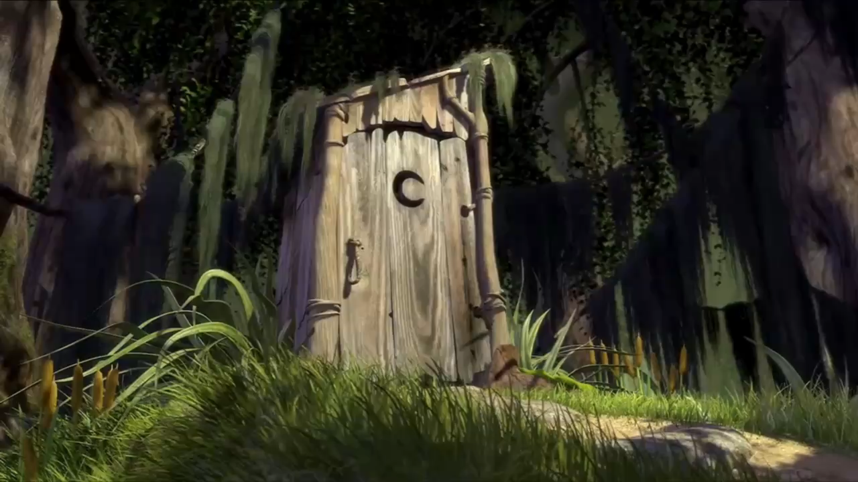
Disney
20
It’s Shrek

Slide 52
Disney
30
This is very kind girl. She is very beautiful, much more beautiful than her stepmother. That`s why her stepmother sent her to the forest. But girl found seven friends there. They were Seven dwarfs. They all lived very happily together.

Slide 53
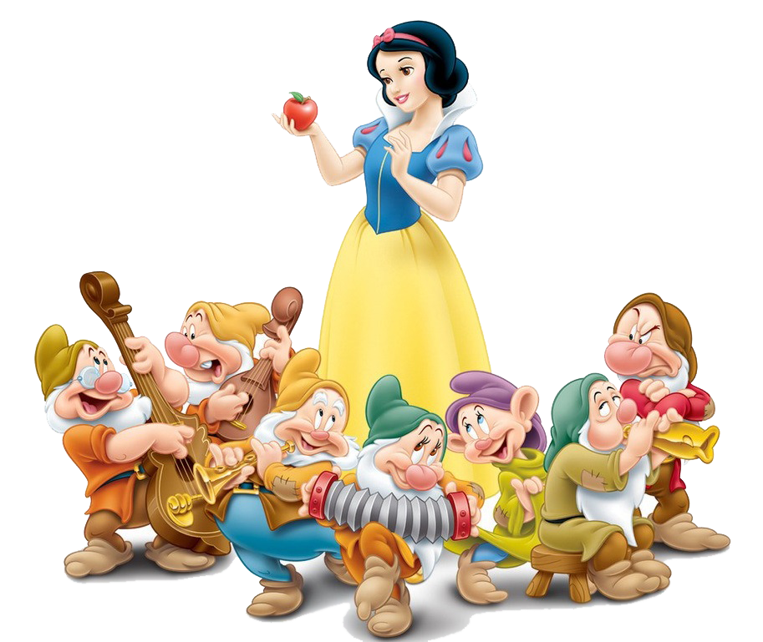

Disney
30

Slide 54
Disney
40
This funny mouse is a character of the American cartoon. This mouse was created by Walt Disney.
The mouse is very clever, but he always has a lot of problems with a cat. He has to make many tricks to run away from this cat.

Slide 55

Disney
40
It’s Jerry

Slide 56
Disney
50
I’ve got one eye and a big mouth.
I haven’t got a nose
I’ve got a round body, two long arms and two long legs.
I’m green.

Slide 57
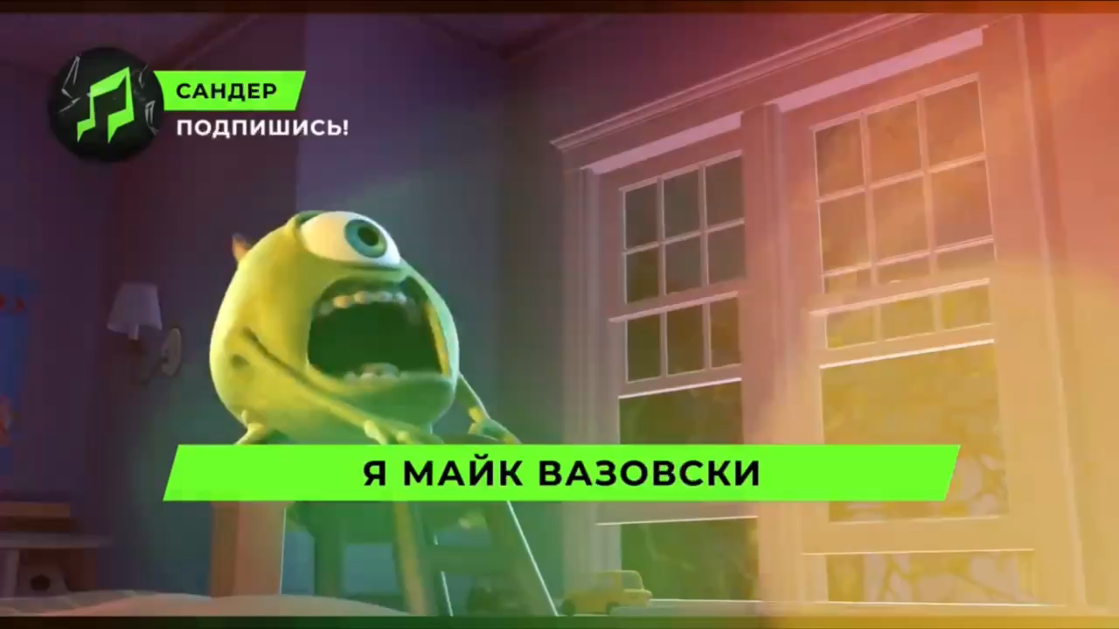
Disney
50
It’s Michael «Mike» Wazowski

