Slide 1
Passive Voice
Created by Usoltseva Svetlana Victorovna – an English teacher
and Chuprin Anna - a student
Moscow academic art college

Slide 2

Question 1
The pairs’ numbers
1
2
4
1
2
3
3
Can elephants sense storms?
5
5
7
6
7
1

Slide 3
Question 1
The story … three days ago.
was read
are read
is read
were read
1
2
1
3
4
5
6

Slide 4

Answer 1
The story was read three days ago.
1
2
1
3
4
5
6

Slide 5
Question 2
The lectures of this famous professor … to with great attention.
always are listen
are always listened
was always listened
are always listen
2
1
2
3
4
5
6

Slide 6
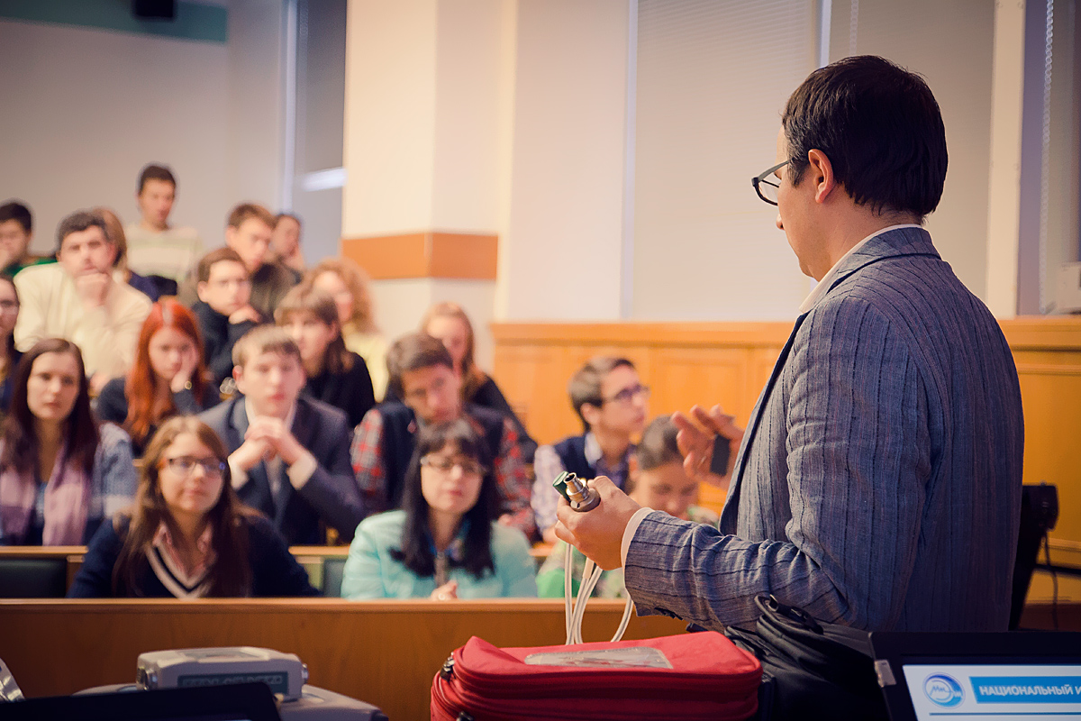
Answer 2
The lectures of this famous professor are always listened to with great attention.
2
1
2
3
4
5
6

Slide 7
Question 3
When autumn comes, Mary … fruits from their garden.
is give
will be given
was given
has given
1
2
3
3
4
5
6

Slide 8
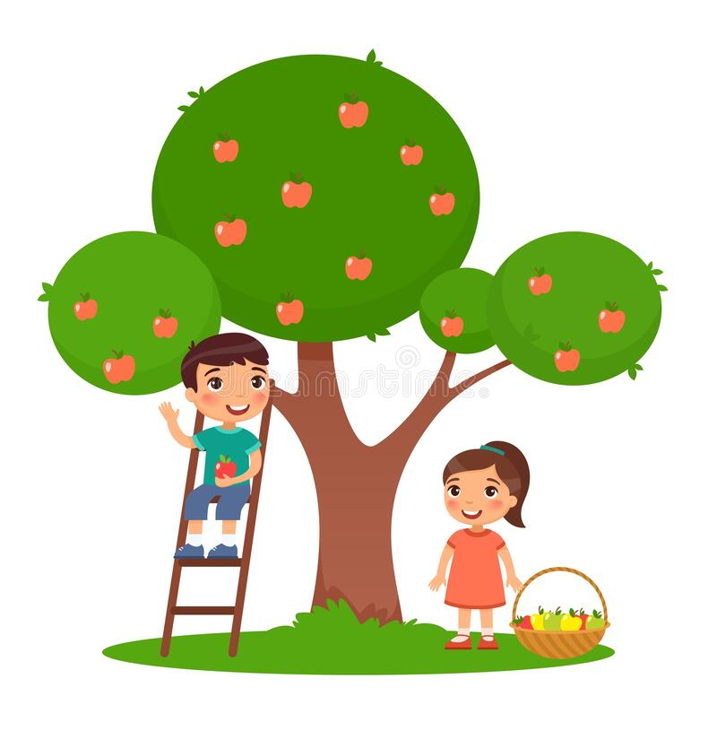
Answer 3
When autumn comes, Mary will be given fruits from their garden.
1
2
3
3
4
5
6

Slide 9
Question 4
The building of the museum … at the moment.
are being reconstructed
is being reconstructing
was being reconstructed
is being reconstructed
1
2
3
4
4
5
6

Slide 10
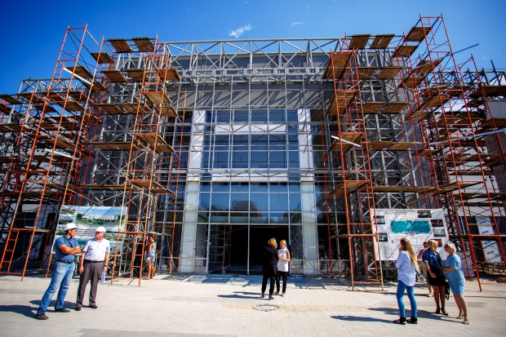
Answer 4
The building of the museum is being reconstructed at the moment.
1
2
3
4
4
5
6

Slide 11
Question 5
English … all over the world.
are spoken
has been spoken
are speak
is speak
1
2
3
4
5
5
6

Slide 12

Answer 5
English has been spoken all over the world.
1
2
3
4
5
5
6

Slide 13
Question 6
The rule … when I opened the door.
was explained
is explaining
are being explained
was being explained
1
2
3
4
5
6
6

Slide 14
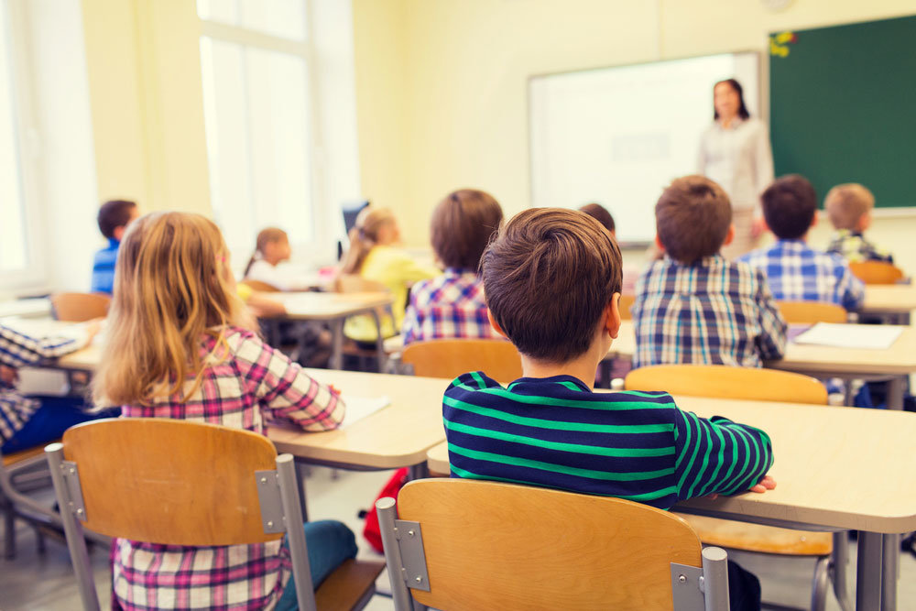
Answer 6
The rule was being explained when I opened the door.
1
2
3
4
5
6
6

Slide 15
Question 1
A new hospital … last year.
were built
are built
is built
was built
1
2
3
4
5
6

Slide 16
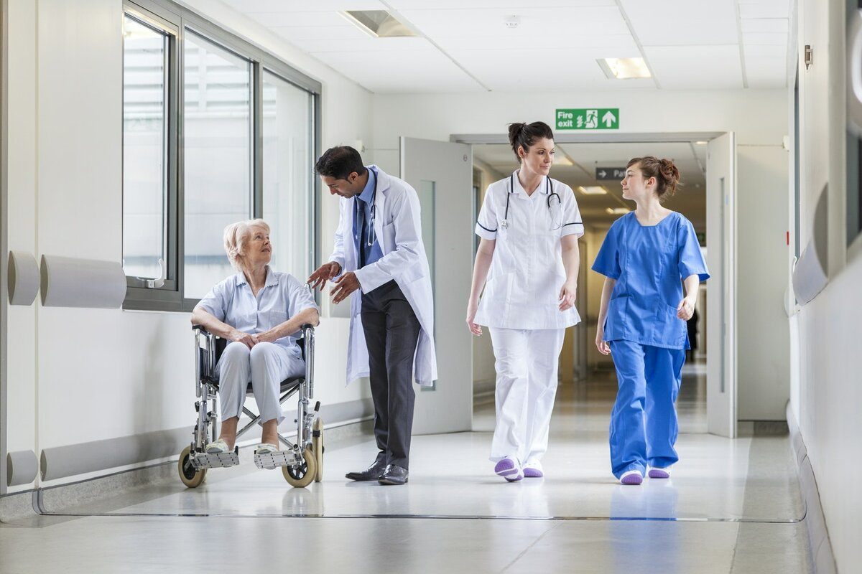
Answer 1
A new hospital was built last year.
1
2
3
4
5
6

Slide 17
Question 2
The painting … next week.
was completed
will be completed
has been completed
have completed
2
1
2
3
4
5
6

Slide 18
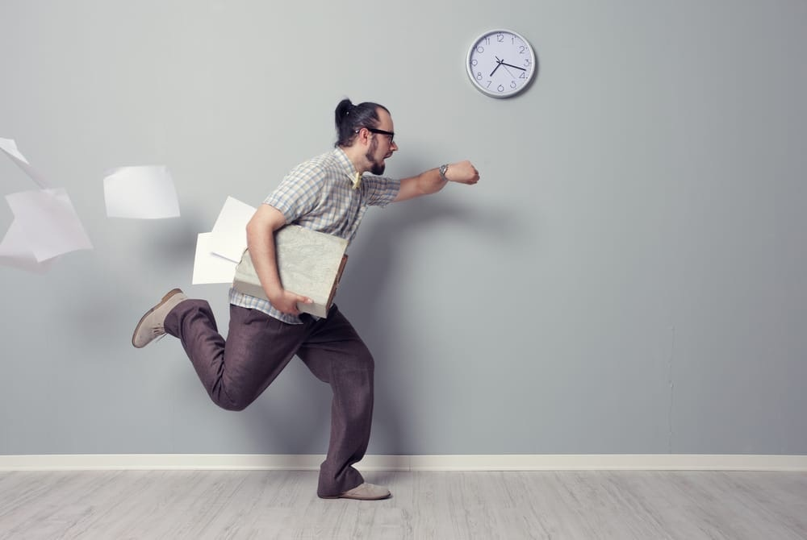
Answer 2
The painting will be completed next week.
2
1
2
3
4
5
6

Slide 19
Question 3
My homework … .
had been done
has been done
has done
have been done
1
2
3
3
4
5
6

Slide 20
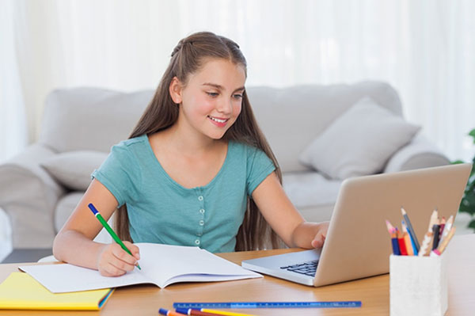
Answer 3
My homework has been done.
1
2
3
3
4
5
6

Slide 21
Question 4
The police … before the burglars ran away.
has been called
was called
had been called
was being called
1
2
3
4
4
5
6

Slide 22

Answer 4
The police had been called before the burglars ran away.
1
2
3
4
4
5
6

Slide 23
Question 5
His nose … constantly … with paint! He's such a slob!
is being stained
was stained
is stain
stained
1
2
3
4
5
5
6

Slide 24
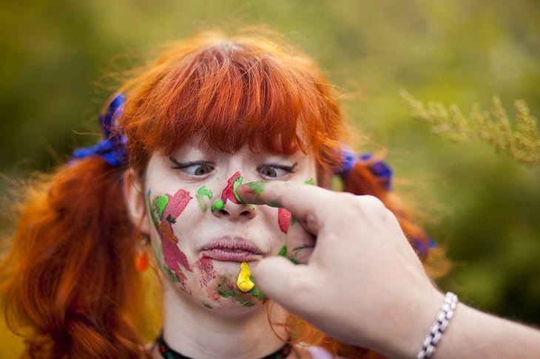
Answer 5
His nose is constantly being stained with paint! He's such a slob!
1
2
3
4
5
5
6

Slide 25
Question 6
The bathrobe is used so as not to … in paint.
be washed
was washed
is being washed
is been washed
1
2
3
4
5
6

Slide 26
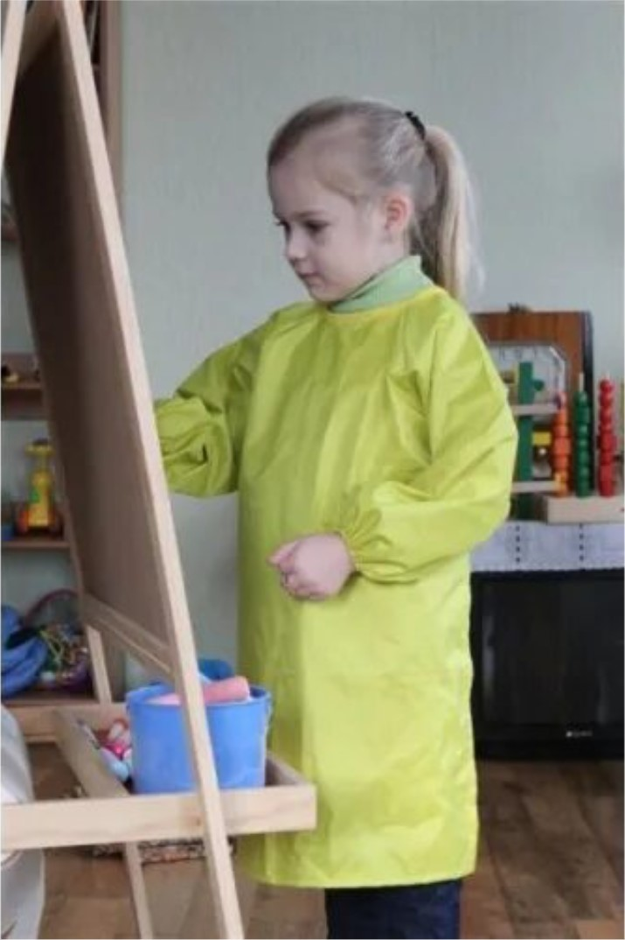
Answer 6
The bathrobe is used so as not to be washed in paint.
1
2
3
4
5
6

Slide 27
Question 1
Usually in the morning the subway … with people.
crowded
is crowded
was crowded
is crowd
1
2
1
3
4
5
6

Slide 28
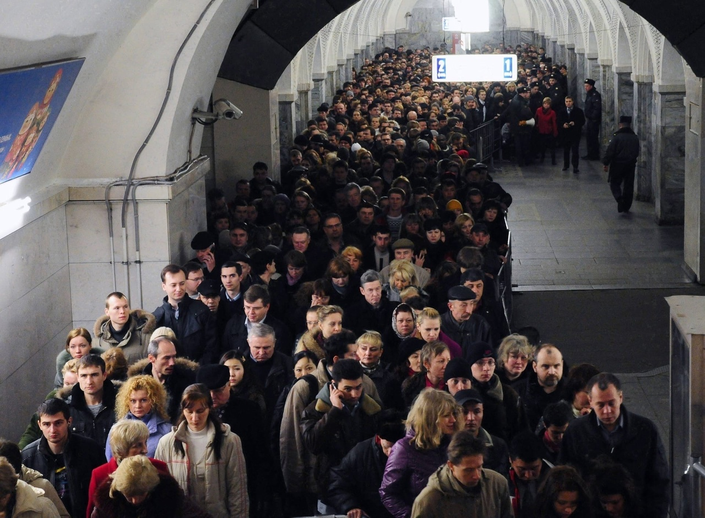
Answer 1
Usually in the morning the subway is crowded with people.
1
2
1
3
4
5
6

Slide 29
Question 2
Cows … to the meadow next spring.
was taken
are taking
will be taken
is taken
2
1
2
3
4
5
6

Slide 30
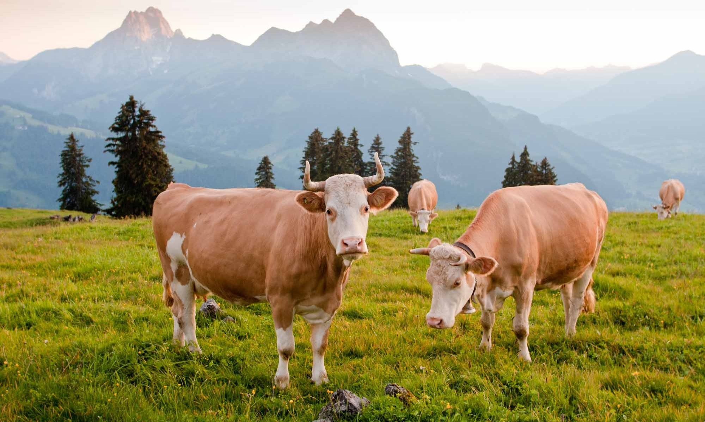
Answer 2
Cows will be taken to the meadow next spring.
2
1
2
3
4
5
6

Slide 31
Question 3
I ... a scary story last Halloween.
was told
am tell
am told
will be told
1
2
3
3
4
5
6

Slide 32
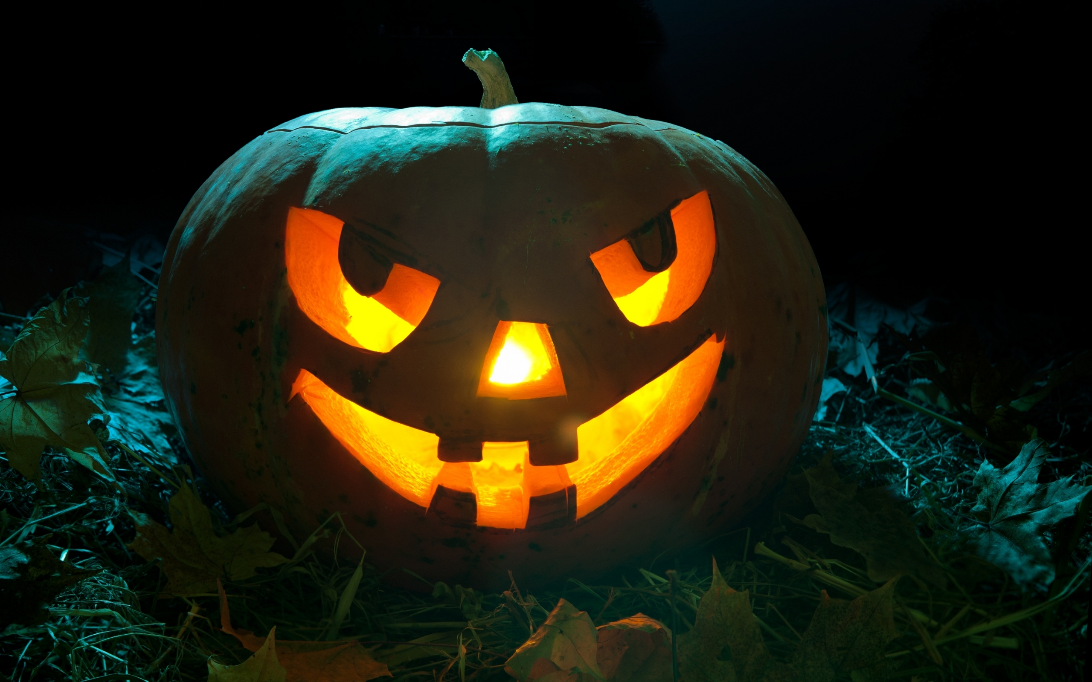
Answer 3
I was told a scary story last Halloween.
1
2
3
3
4
5
6

Slide 33
Question 4
- What has just happened, sir?
- The easel … by my cat!
was been eaten
will threw
has been turned over
thrown
1
2
3
4
4
5
6

Slide 34
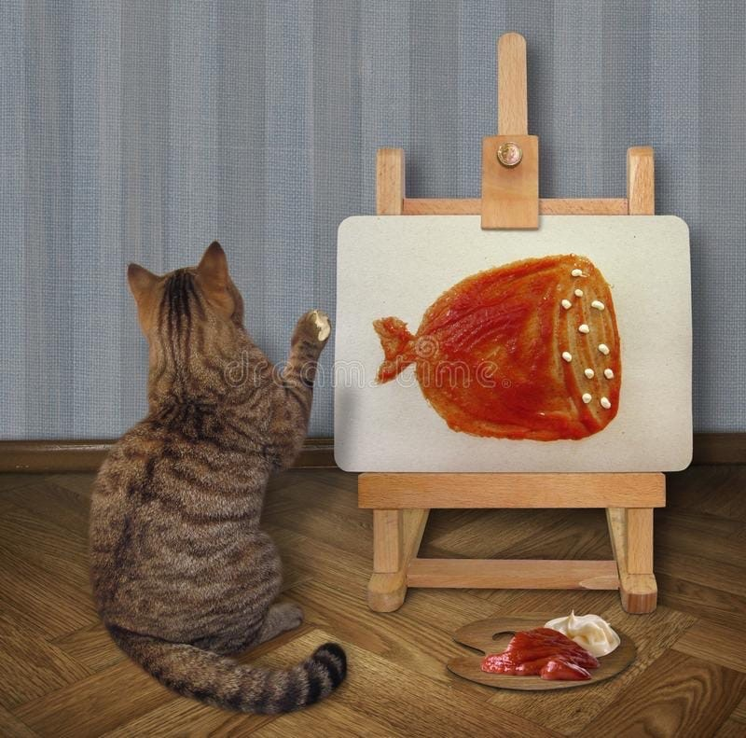
Answer 4
- What has just happened, sir?
- The easel has been turned over by my cat!
1
2
3
4
4
5
6

Slide 35
Question 5
Look! These paintings … at the moment!
were painted
are being painting
is painted
are being painted
1
2
3
4
5
5
6

Slide 36
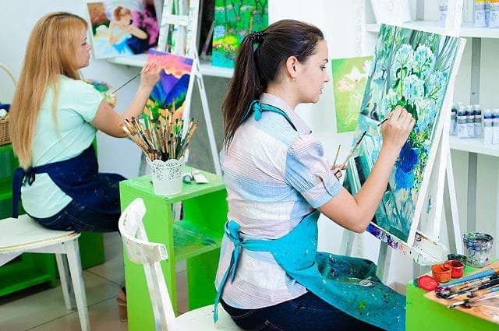
Answer 5
Look! These paintings are being painted at the moment!
1
2
3
4
5
5
6

Slide 37
Question 6
The cooker is hot! Water must … before drinking.
is boiled
will be boiled
be boiled
will boil
1
2
3
4
5
6

Slide 38
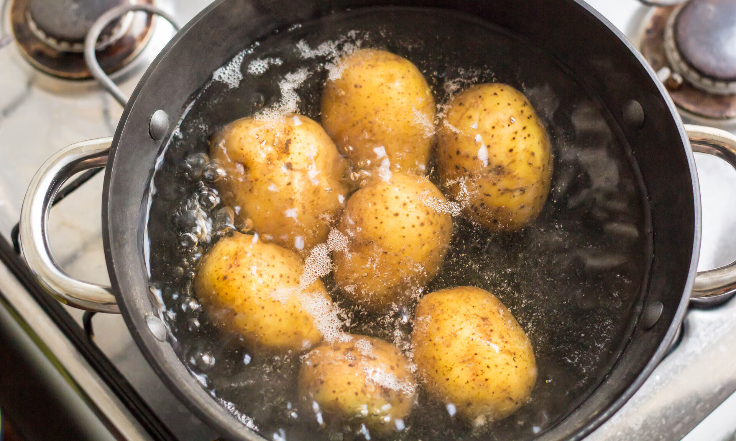
Answer 6
The cooker is hot! Water must be boiled before drinking.
1
2
3
4
5
6

Slide 39
Question 1
My sandwich ... by my cat.
were eaten
was eaten
was ate
ate
1
2
3
4
5
6

Slide 40
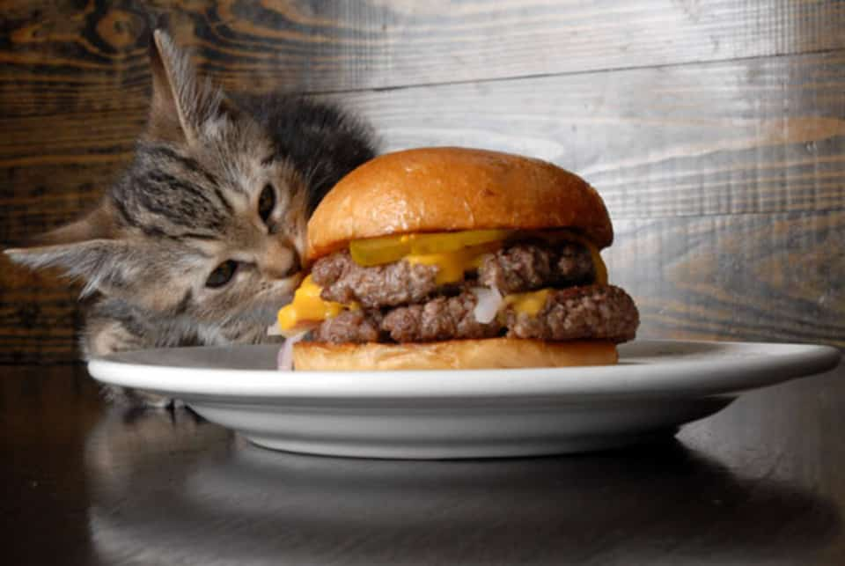
Answer 1
My sandwich was eaten by my cat.
1
2
3
4
5
6

Slide 41
Question 2
Such an enormous cake ... by the guests at the wedding party!
were being eaten
were ate
was ate
will be eaten
2
1
2
3
4
5
6

Slide 42
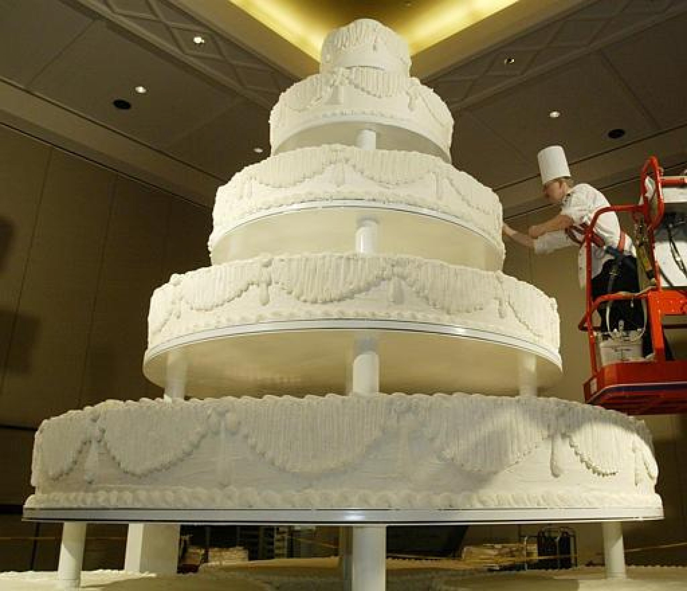
Answer 2
Such an enormous cake will be eaten by the guests at the wedding party!
2
1
2
3
4
5
6

Slide 43
Question 3
The chocolate cake will ...already ... by evening.
have … been cooked
has ... cooked
have ... cooked
has been ... cooked
1
2
3
3
4
5
6

Slide 44
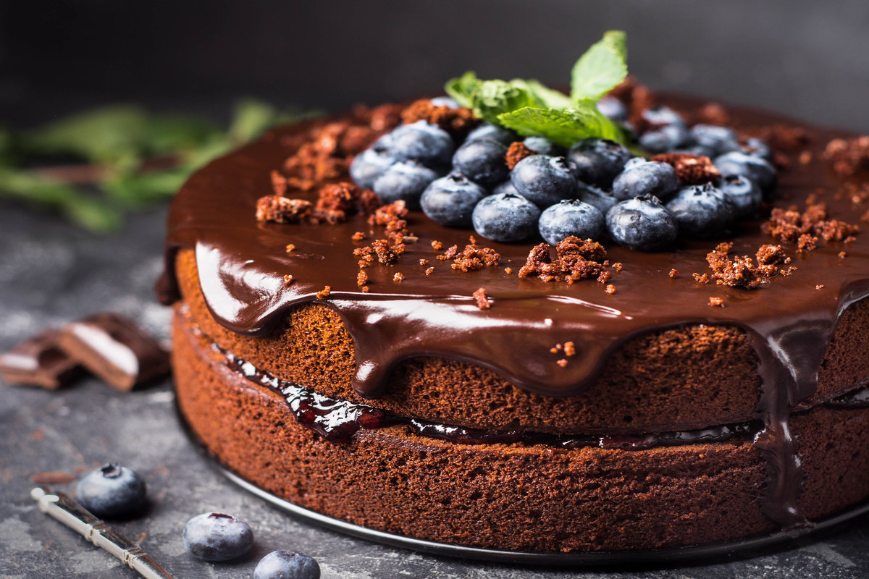
Answer 3
The chocolate cake will have already been cooked by evening.
1
2
3
3
4
5
6

Slide 45
Question 4
A table ... before the guests arrived.
has been served
has served
had been served
had served
1
2
3
4
5
6

Slide 46
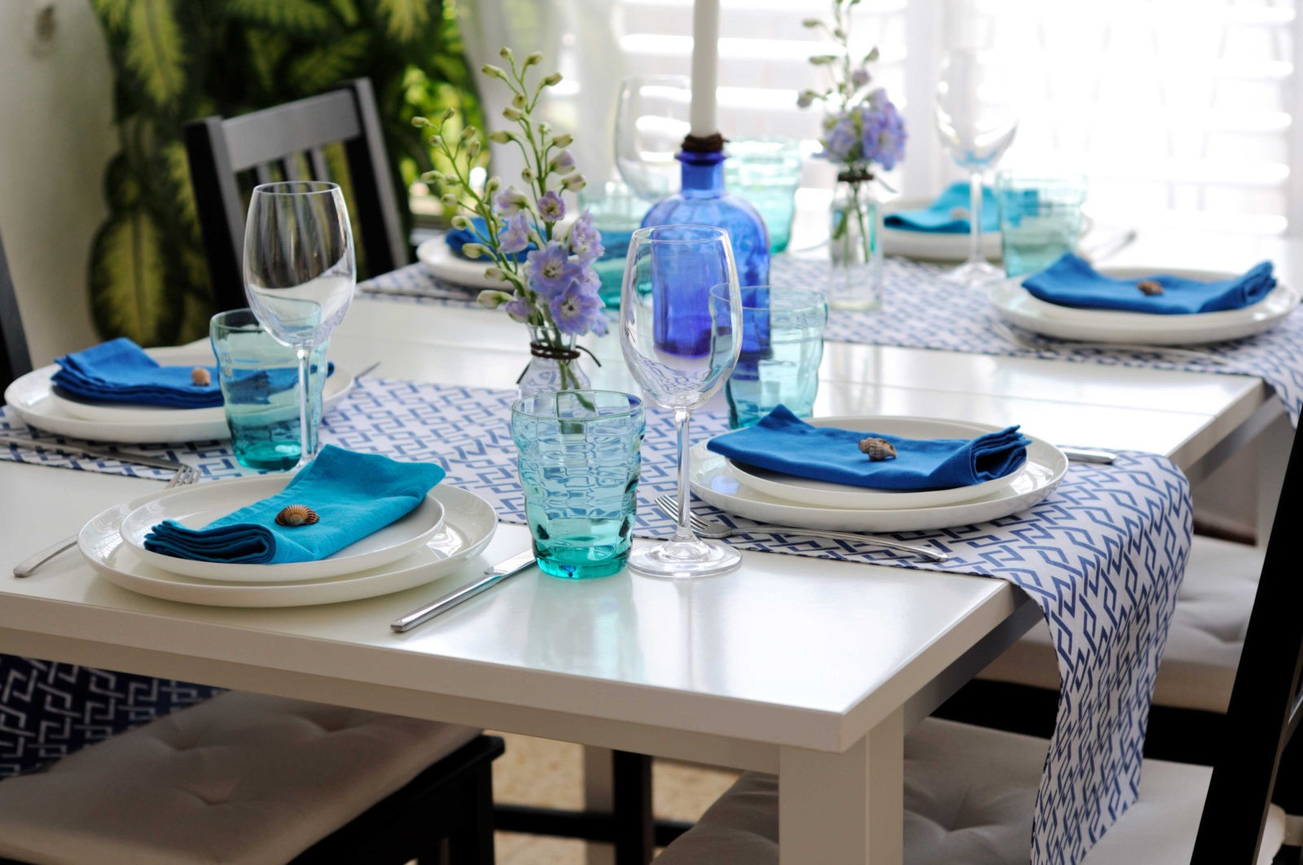
Answer 4
A table had been served before the guests arrived.
1
2
3
4
5
6

Slide 47
Question 5
The sketch ... in 20 minutes.
has been made
are made
is made
will be made
1
2
3
4
5
5
6

Slide 48
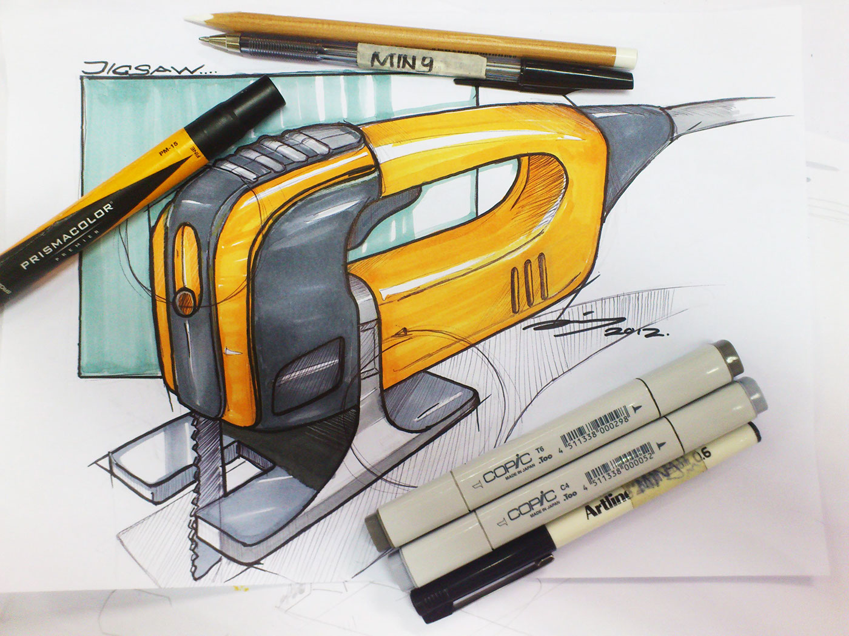
Answer 5
The sketch has been made for 20 minutes.
1
2
3
4
5
5
6

Slide 49
Question 6
My car … by a mechanic.
is fixing
is being fixed
are being fixed
fixed
1
2
3
4
5
6

Slide 50
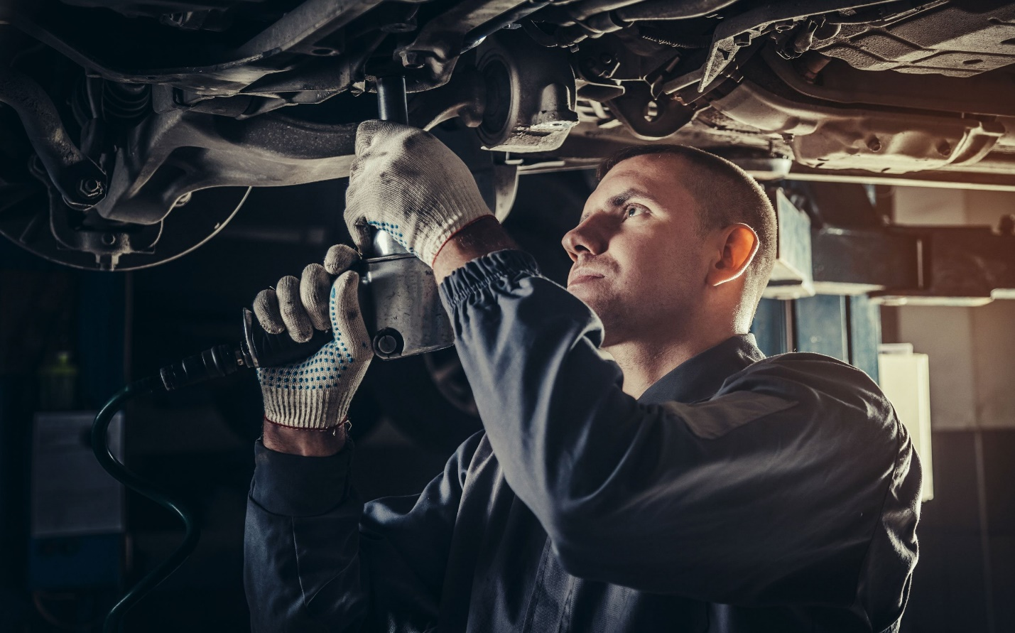
Answer 6
My car is being fixed by a mechanic.
1
2
3
4
5
6

Slide 51
Question 1
Avatar … by James Cameron.
is directed
was directing
was directed
was direct
1
2
3
4
5
6

Slide 52
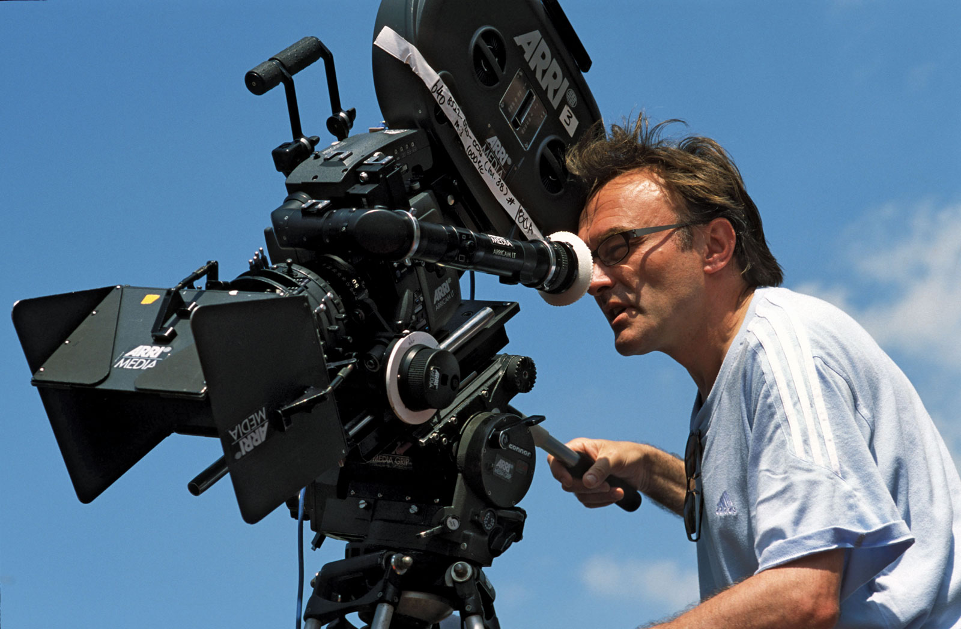
Answer 1
Avatar was directed by James Cameron.
1
2
3
4
5
6

Slide 53
Question 2
Soon the guests … at the airport.
is being met
was met
were met
will be met
2
1
2
3
4
5
6

Slide 54
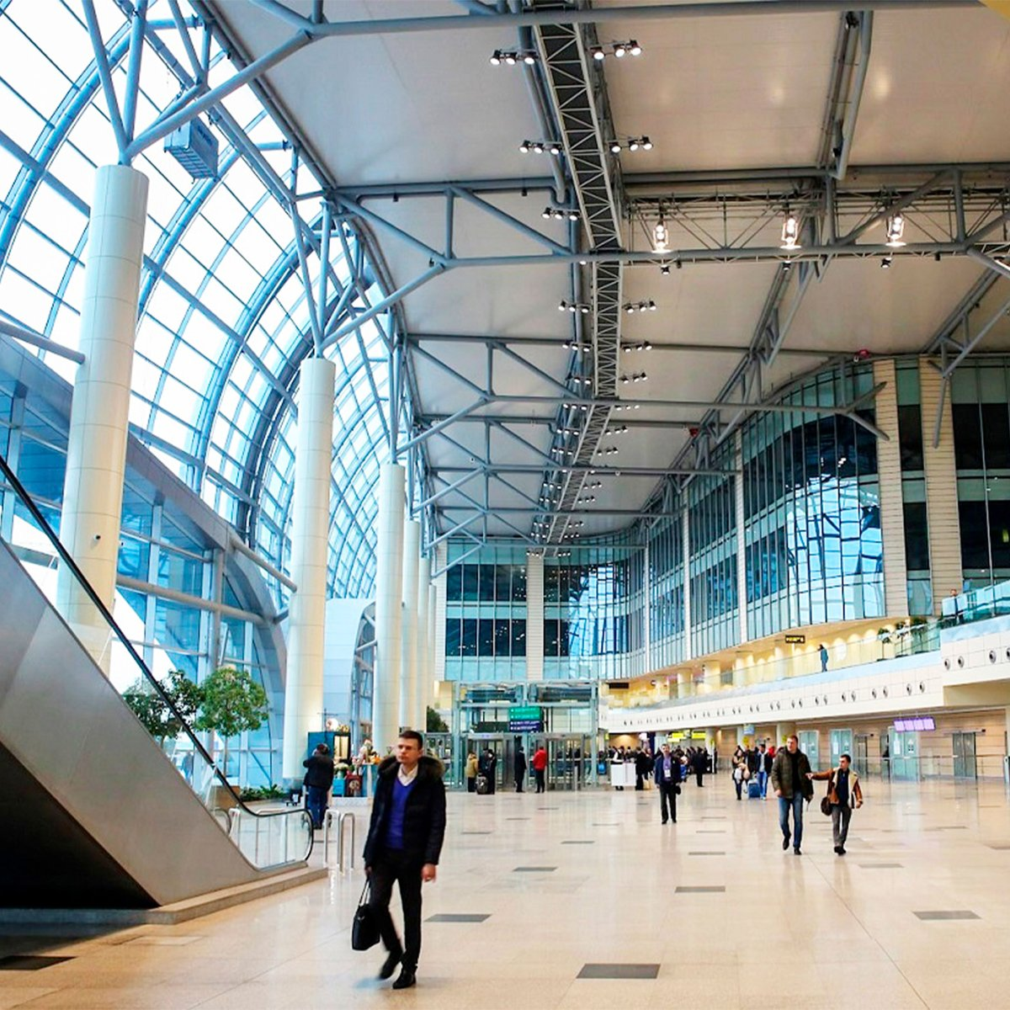
Answer 2
Soon the guests will be met at the airport.
2
1
2
3
4
5
6

Slide 55
Question 3
They said the window … already … .
had … been cleaned
was … cleaned
is … cleaning
had been … cleaned
1
2
3
3
4
5
6

Slide 56
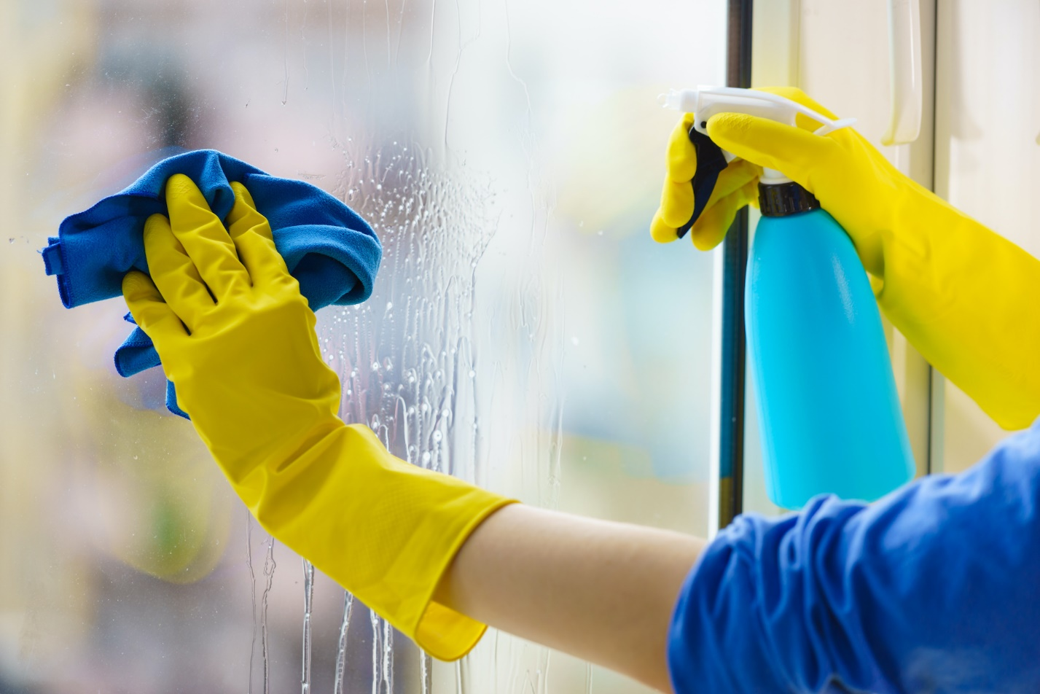
Answer 3
They said the window had already been cleaned.
1
2
3
3
4
5
6

Slide 57
Question 4
This canvas … of expensive fabric.
will be made
was made
are made
is made
1
2
3
4
5
4
6

Slide 58

Answer 4
This canvas is made of expensive fabric.
1
2
3
4
5
4
6

Slide 59
Question 5
My car … right now.
is being wash
was washed
is being washed
is been washed
1
2
3
4
5
5
6

Slide 60
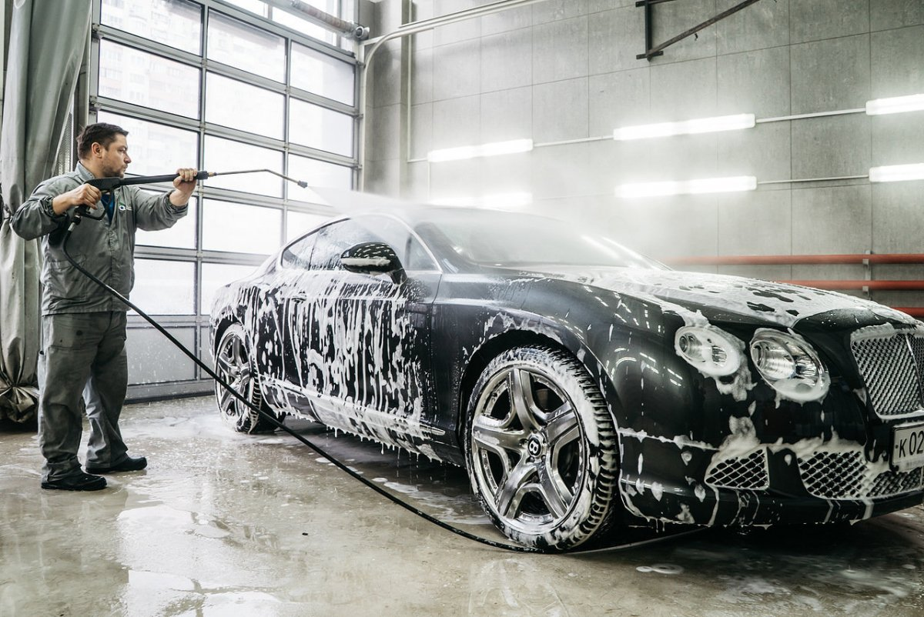
Answer 5
My car is being washed right now.
1
2
3
4
5
5
6

Slide 61
Question 6
The door … .
has been locked
was being locked
had locked
locked
1
2
3
4
5
6
6

Slide 62
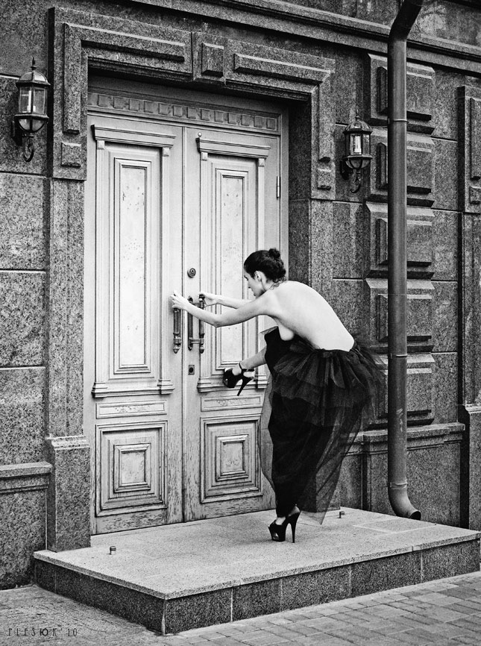
Answer 6
The door has been locked.
1
2
3
4
5
6
6

Slide 63
Question 1
This new still life … a week ago.
will be delivered
was delivered
is delivered
be delivered
1
2
3
4
5
6

Slide 64
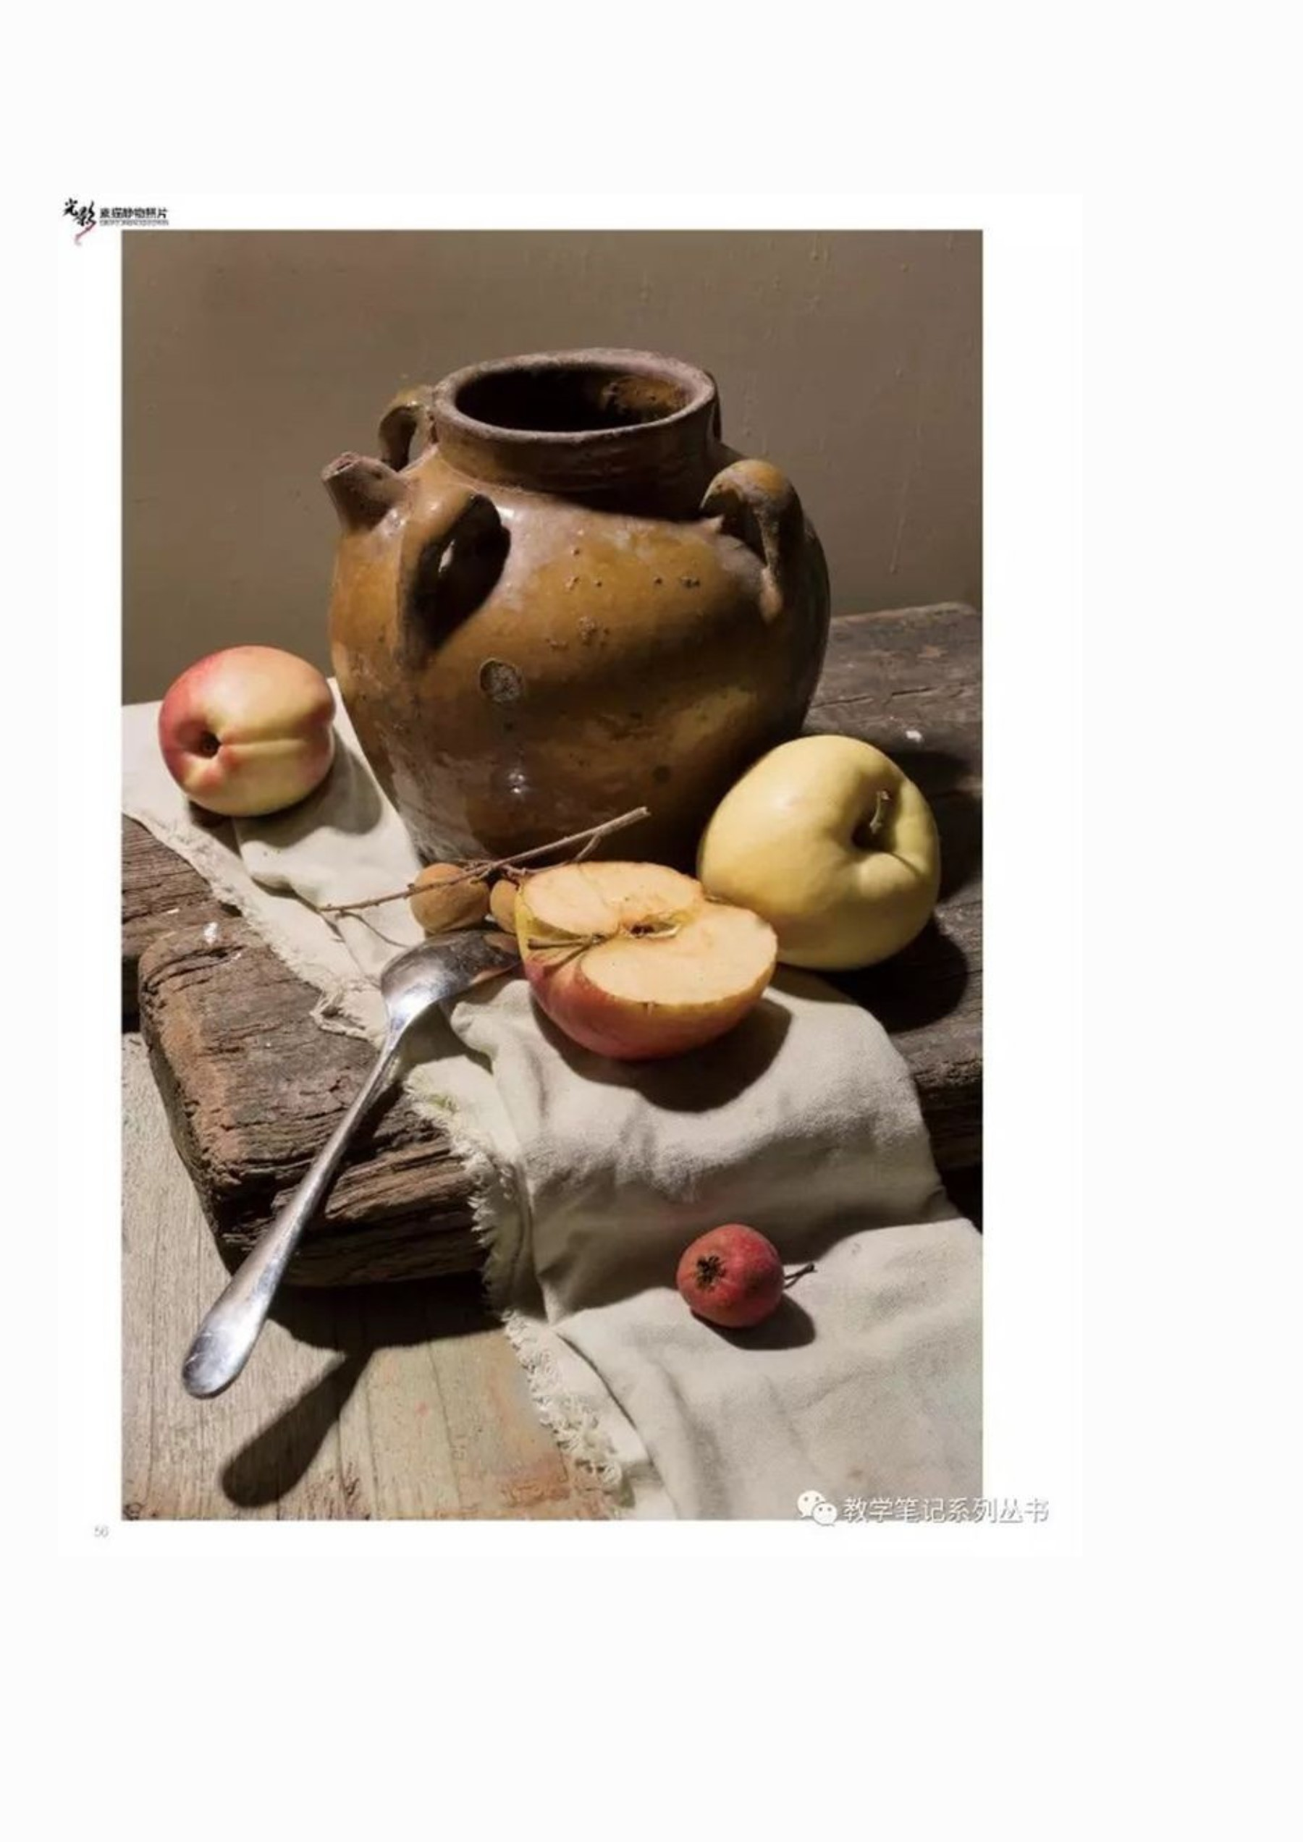
Answer 1
This new still life was delivered a week ago.
1
2
3
4
5
6

Slide 65
Question 2
Look! The palette … after yesterday’s art class.
was stained
is stained
will be stained
is staining
2
1
2
3
4
5
6

Slide 66
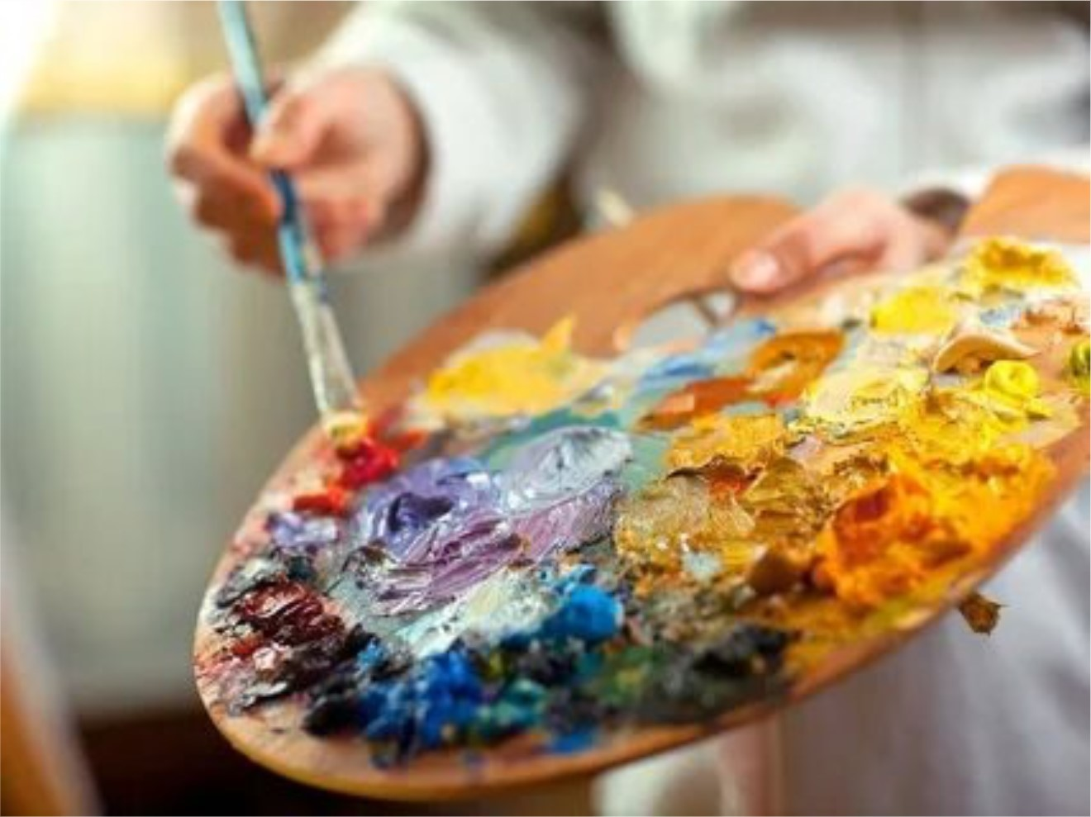
Answer 2
Look! The palette is stained after yesterday’s art class.
2
1
2
3
4
5
6

Slide 67
Question 3
The contract … next Monday.
will be signed
was signed
were signed
will be sign
1
2
3
3
4
5
6

Slide 68
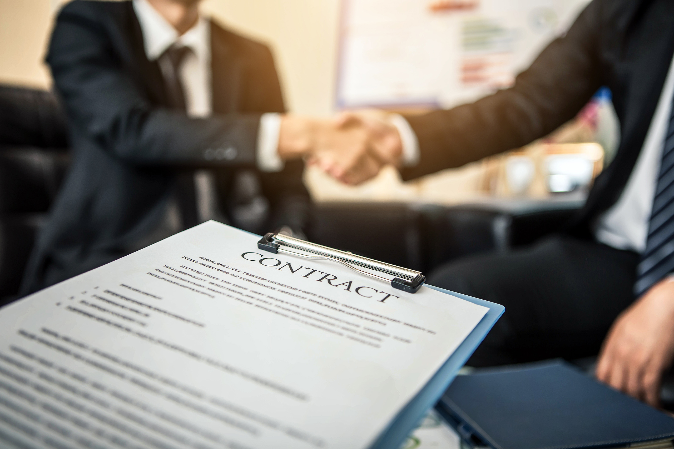
Answer 3
The contract will be signed next Monday.
1
2
3
3
4
5
6

Slide 69
Question 4
Pancakes … .
were being cooked
are cooked
is cooked
was being cooked
1
2
3
4
5
4
6

Slide 70
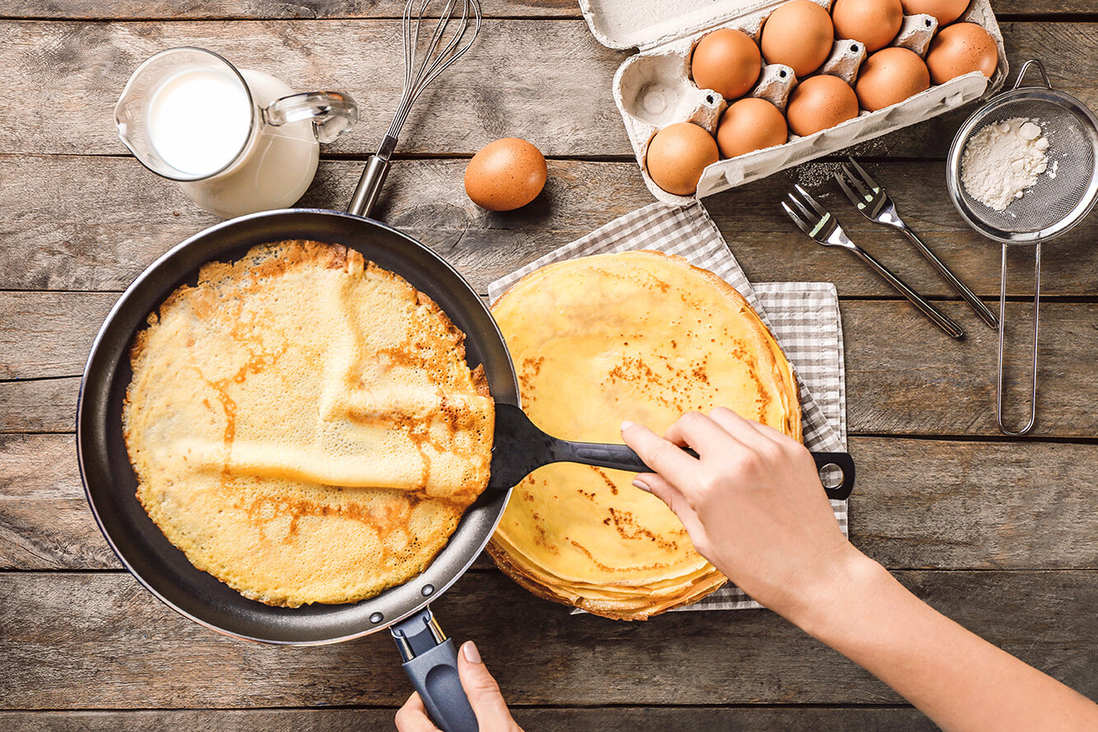
Answer 4
Pancakes were being cooked.
1
2
3
4
5
4
6

Slide 71
Question 5
My work … up by someone! What a nightmare!
will be torn
is torn
has been torn
are torn
1
2
3
4
5
5
6

Slide 72
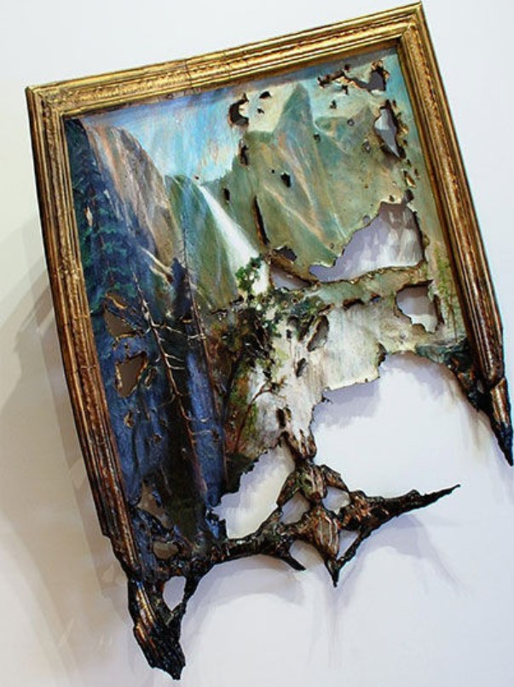
Answer 5
My work has been torn up by someone! What a nightmare!
1
2
3
4
5
5
6

Slide 73
Question 6
The package … before he came.
was brought
has been brought
had been brought
are being brought
1
2
3
4
5
6
6

Slide 74
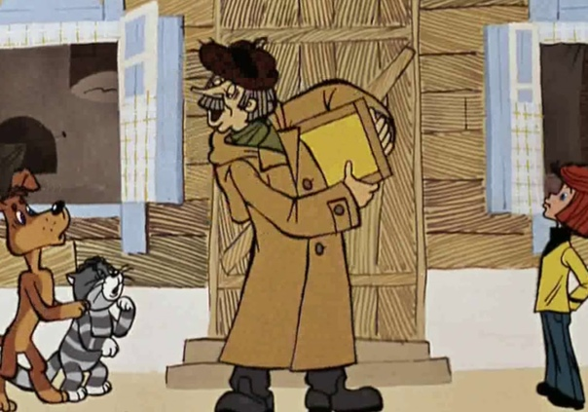
Answer 6
The package had been brought before he came.
1
2
3
4
5
6
6

Slide 75
Question 1
Hamlet … by William Shakespeare.
was written
was writen
is written
is being written
1
2
3
4
5
6

Slide 76
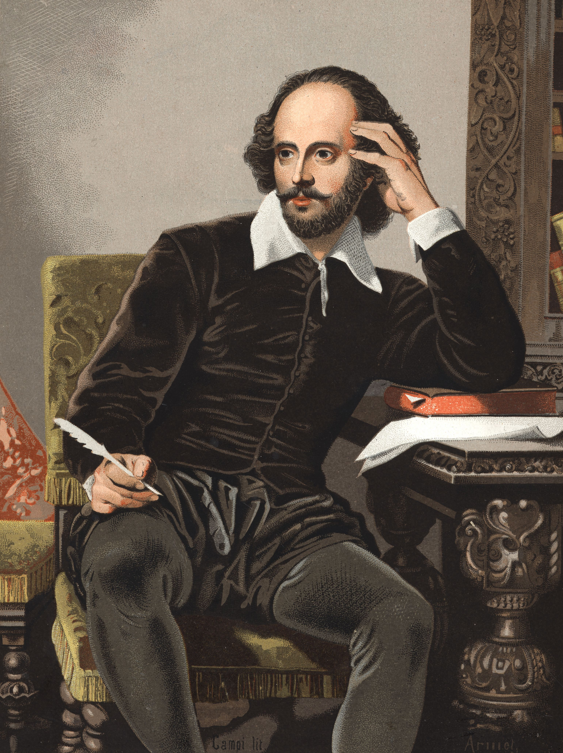
Answer 1
Hamlet was written by William Shakespeare.
1
2
3
4
5
6

Slide 77
Question 2
The boat … by huge waves.
is carried away
was carried over
was carried away
are carried away
1
2
3
4
5
6

Slide 78
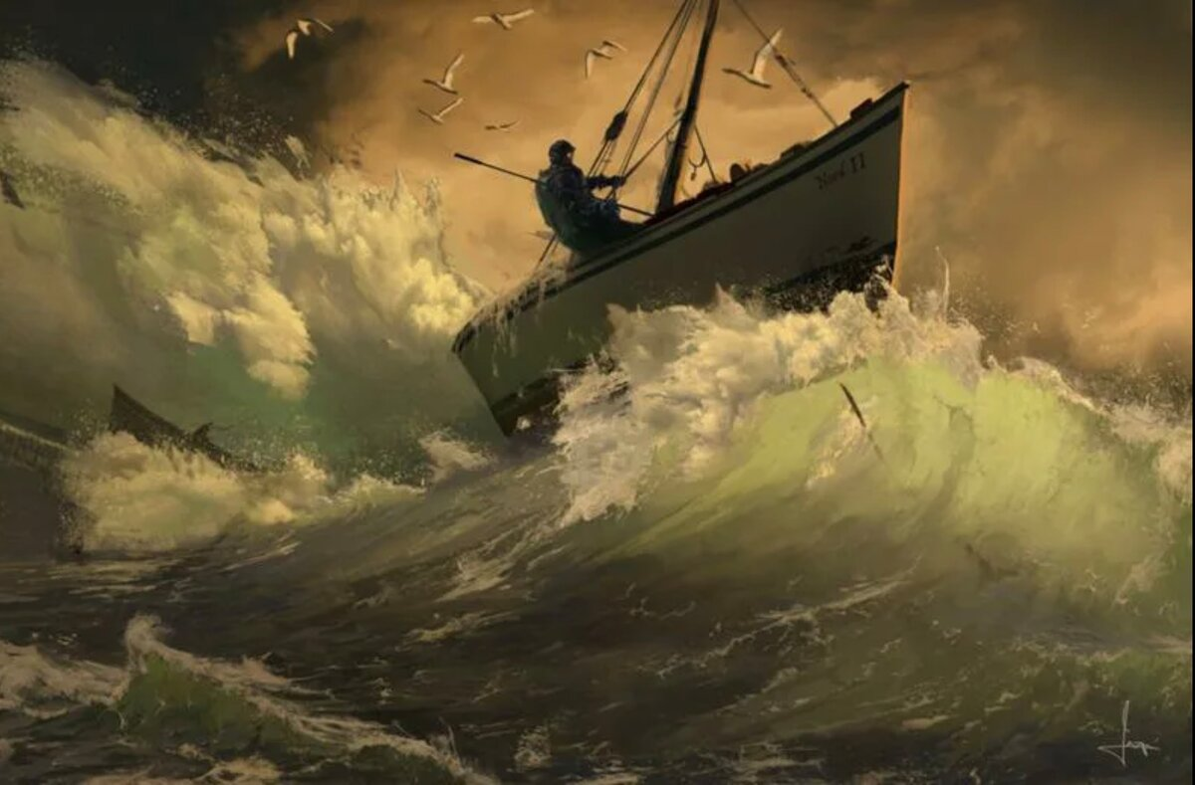
Answer 2
The boat is carried away by huge waves.
1
2
3
4
5
6

Slide 79
Question 3
Tomorrow the table… for 5 people.
has been set
will be set
is set
was set
1
2
3
4
5
6

Slide 80
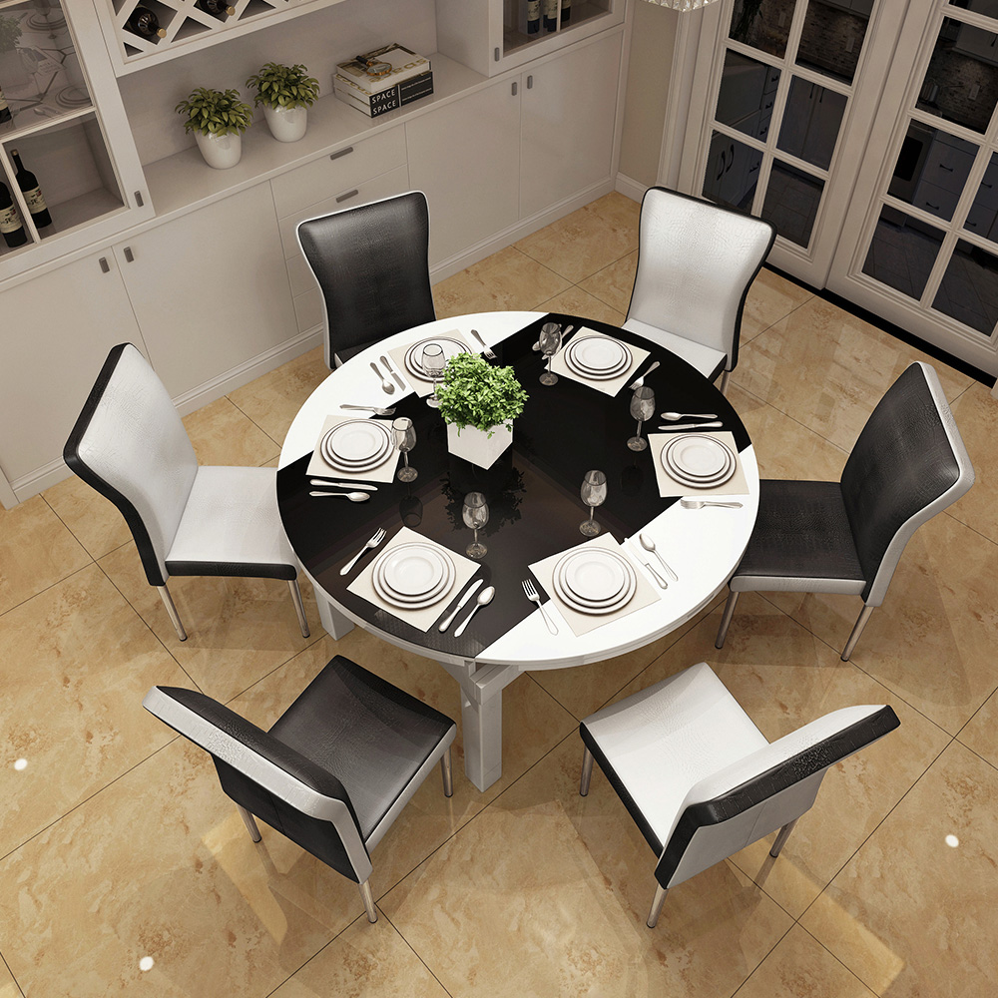
Answer 3
Tomorrow the table will be set for 5 people.
1
2
3
4
5
6

Slide 81
Question 4
Tickets … online.
can be bought
can be buy
had be bought
can bought
1
2
3
4
5
6

Slide 82
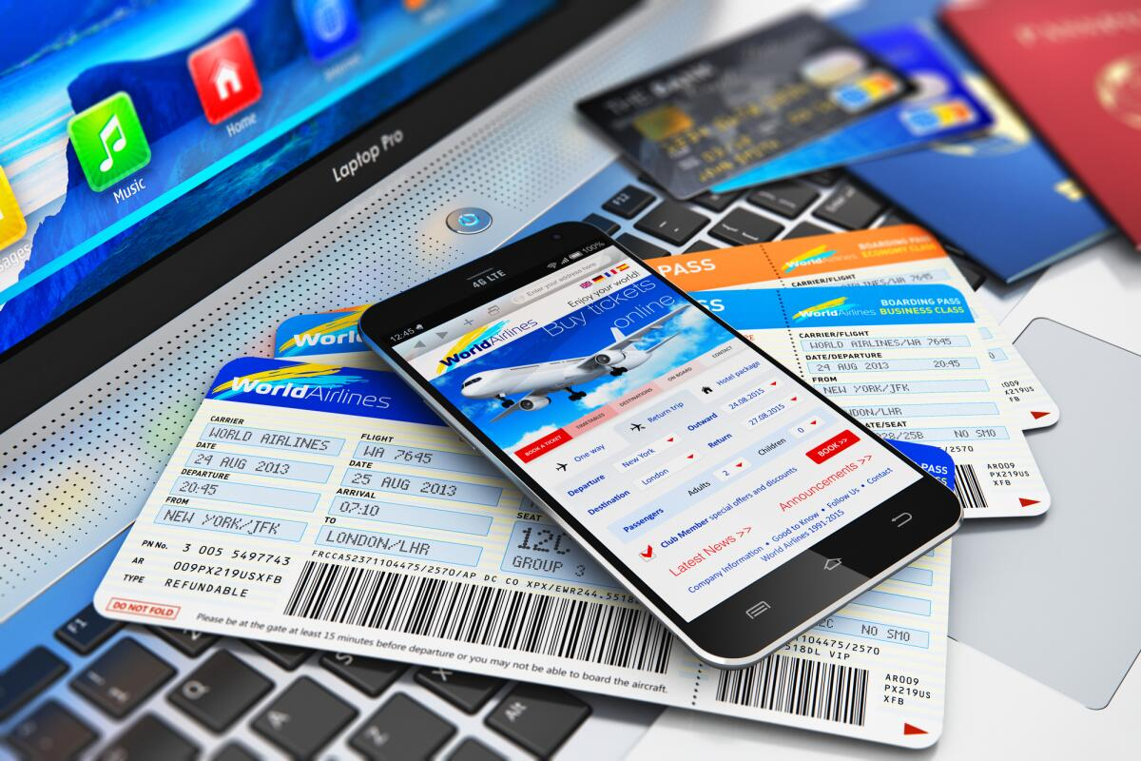
Answer 4
Tickets can be bought online.
1
2
3
4
5
6

Slide 83
Question 5
The letter … at 5 p.m. yesterday.
hasn’t been writen
hasn’t written
hasn’t being written
was being written
1
2
3
4
5
6

Slide 84
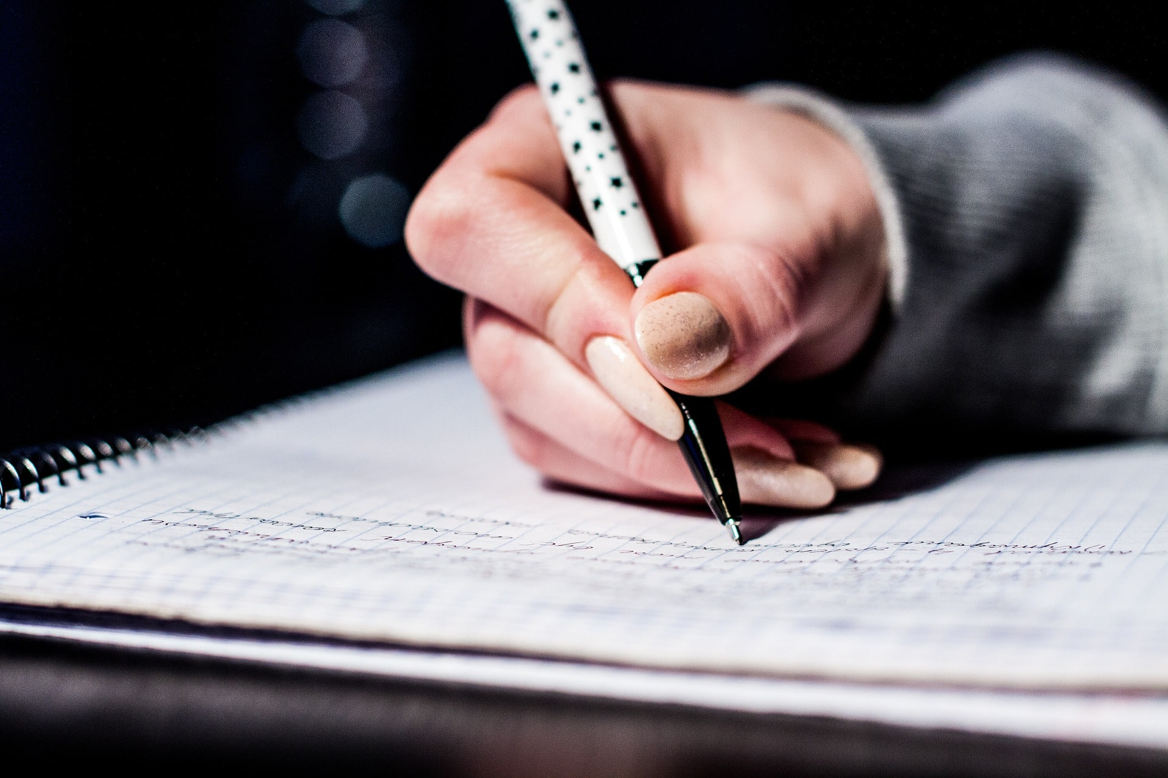
Answer 5
The letter was being written at 5 p.m. yesterday.
1
2
3
4
5
6

Slide 85
Question 6
The article … yet.
hasn’t been writen
hasn’t written
hasn’t being written
hasn’t been written
1
2
3
4
5
6
6

Slide 86

Answer 6
The article hasn’t been written yet.
1
2
3
4
5
6
6

Slide 87
Question 1
THE GAME IS OVER!
Can elephants sense storms?
1

Slide 88
Question 1
Can elephants sense storms?
1

