Slide 1
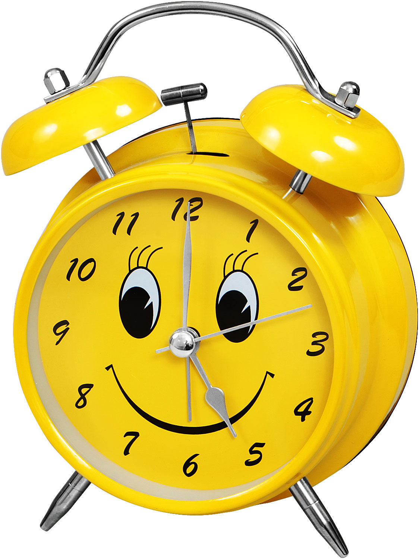
What time is it?
It’s seven o’clock in the morning ___________
It’s half past seven in the morning ___________
It’s half past eight in the morning __________
It’s two o’clock in the afternoon __________
It’s a quarter to six in the evening __________
It’s ten o’clock in the evening ___________

Slide 2
Before school | At school | After school
Get up Wash hands and face Clean my teeth Get dressed Have breakfast | Have 5 or 6 lessons Read and write Listen to the teacher Have lunch Sit at the desk | Come home Do homework Help my mother Watch TV Go to bed

Slide 3
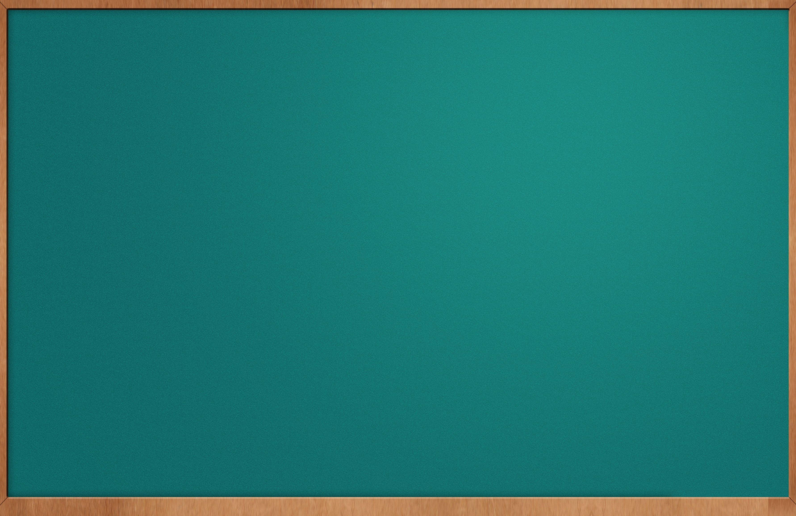
My day

Slide 4
Must / Mustn`t (must not)
We _________ go to bed late.
We _________ forget to wash hands before meal.
We _________ go in for sports.
We _________ eat fruit and vegetables.
We _________ do our homework every day.
We _________ forget to say “Please”, “Thank You”.
We _________ be late for lessons.

Slide 5
Jack`s weekend.
Last Sunday Jack (1) got up at nine o`clock in the morning. He (2) ______________, (3) _______________, (4)_______________. Then Jack (5) __________ his breakfast, (6) __________a cup of tea and (7)_________ a cheese sandwich. After that he (8) ___________ his dog and (9)_________ for a walk with his friends. In the evening Jack (10) _________ computer games. | get up get dressed, wash, clean his teeth have, drink eat feed go play

