Slide 1


ECOLOGICAL PROBLEMS
Master-Class
10th form
15.02.2021
F.L. Tabulova

Slide 2

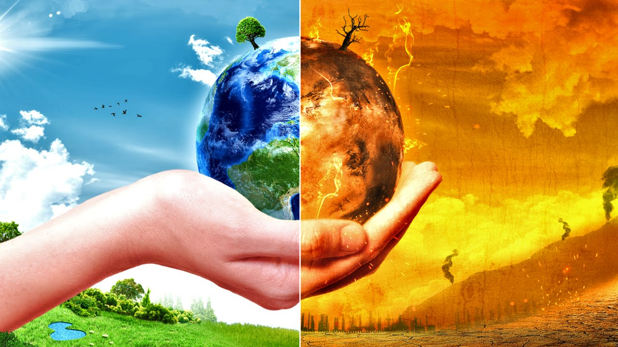
What a wonderful world we live in!

Slide 3
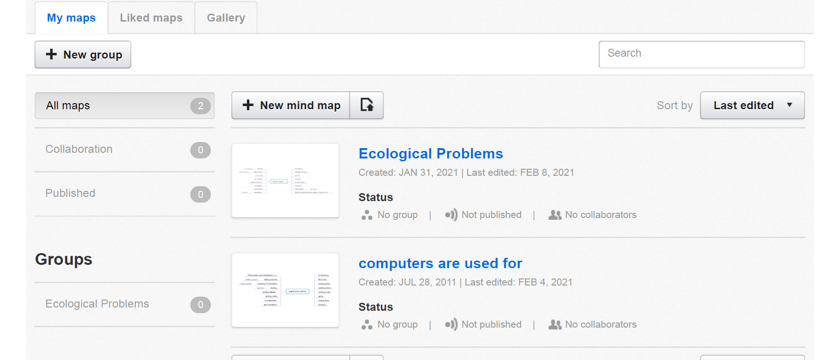
Ecological Problems
Mind42:

Slide 4

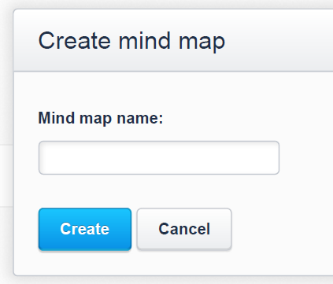
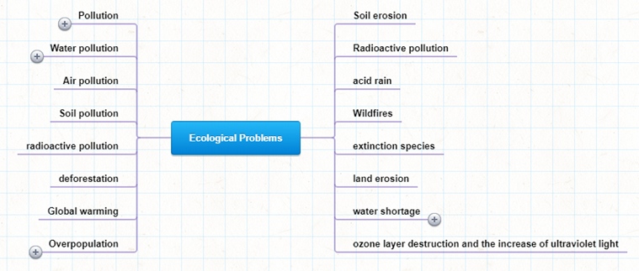
Mind-mapping (mind [maɪnd] -разум; умственные способности; map [mæp] карта)

Slide 5

Make up the list of ecological problems.
ECOLOGICAL PROBLEMS

Slide 6
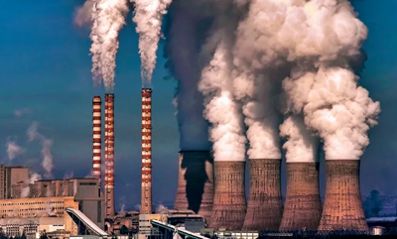
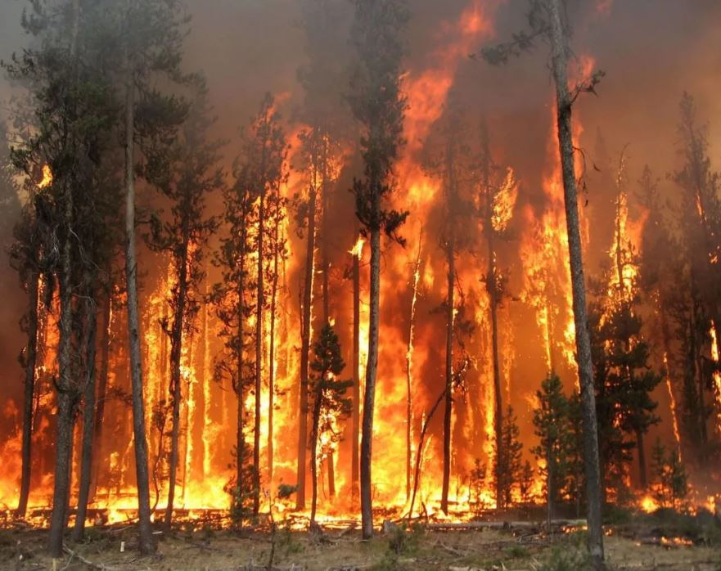
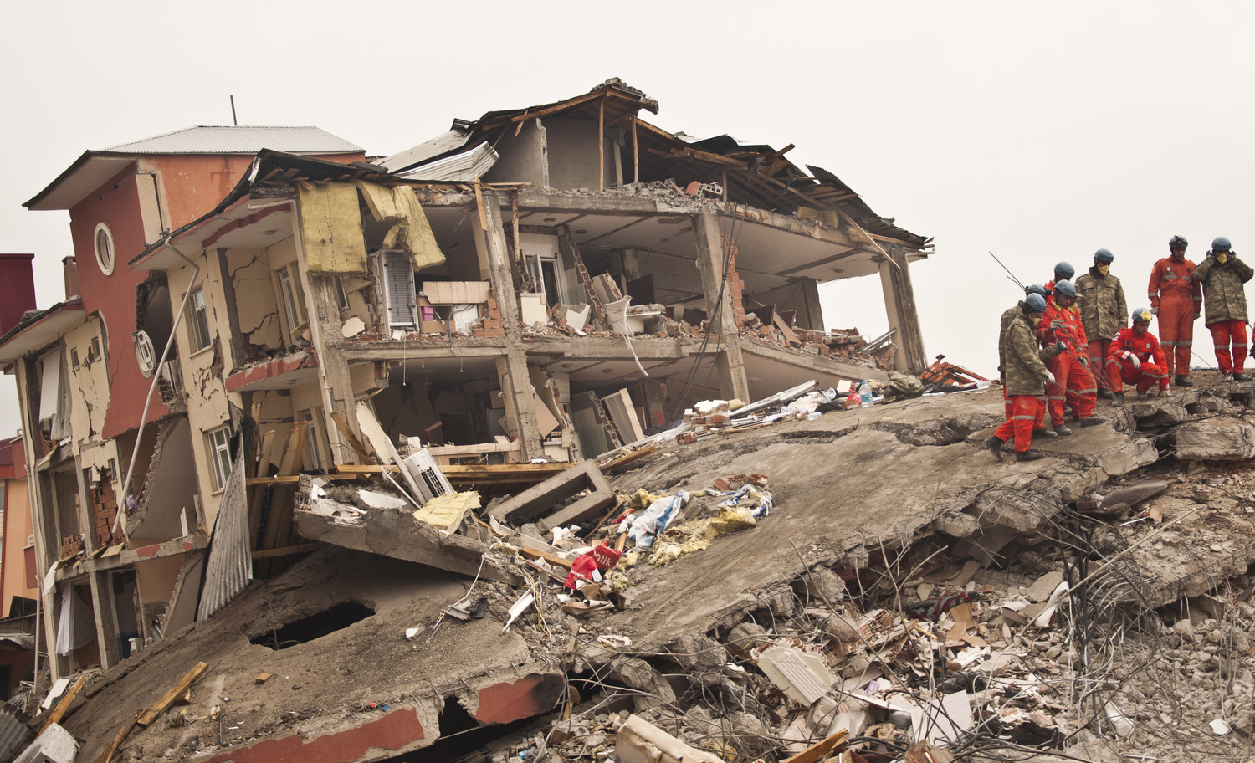
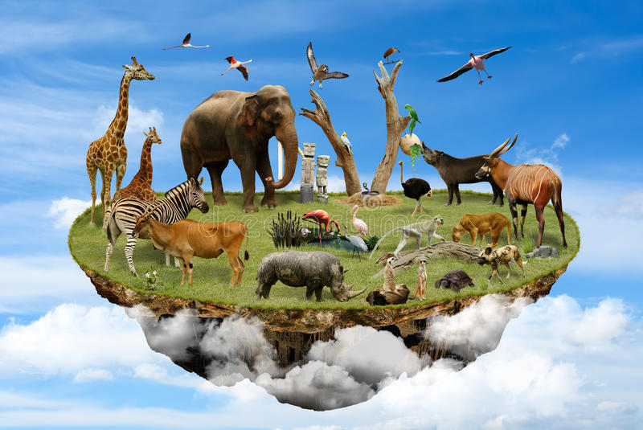
Listening. Listen to the texts and match the statements with the speakers. There is one statement you do not need
Speaker E | Extra speaker | Speaker F | Speaker B | Speaker C | Speaker A | Speaker D
1. There are a lot of them on the face of the Earth, and they are dangerous.
2. People are the cause and they can find a solution, too.
3. People's view on the ways of decreasing pollution.
4. Forest fires produce a lot of damage to nature.
5. Lack of plants can lead to a species extinction.
6. Time for the mankind to save the Earth.
7. Let's do an experiment to see how this vehicle pollutes the environment.
bamboo [bæm'buː] - бамбук
decrease [dɪ'kriːs] - уменьшаться, убывать, сокращаться
vehicle ['viːɪkl] - транспортное средство; автомобиль

Slide 7
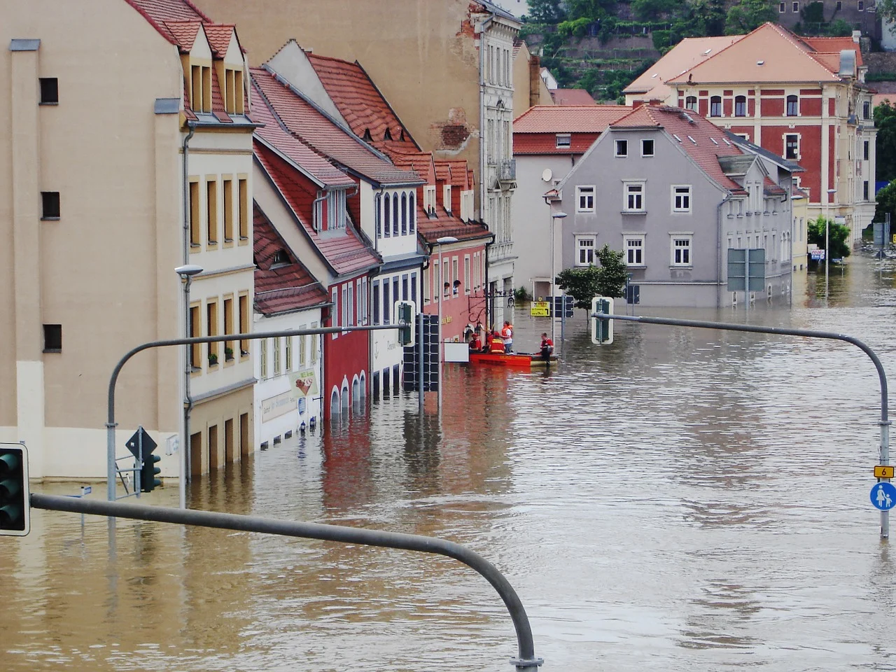
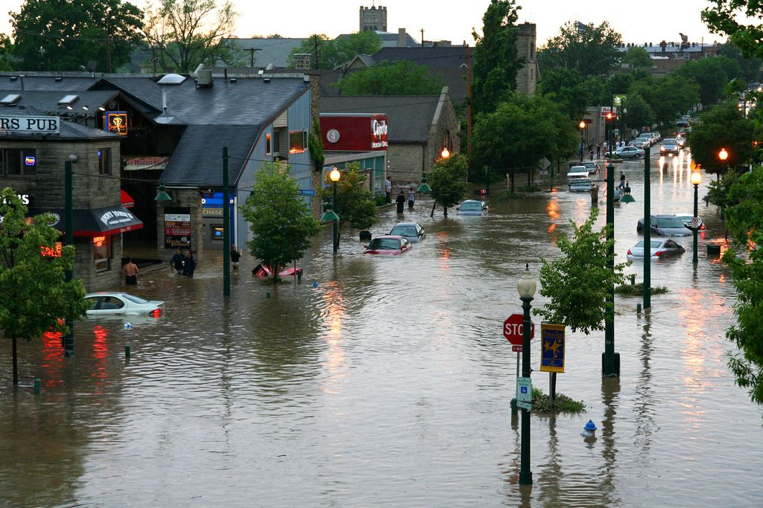
Reading. Fill in the gaps with the words given in the box.
rescue homeless supplies floods lost drowned
Heavy rains have hit Angola this week. The rains have caused
in many parts of the country. Many people have died. Thousands have their houses. These rains are the worst Angola has experienced in the last twenty years. Thousands of people have been left and many animals have .
teams have been trying to save as many people as they possibly can who still remain trapped in their homes. Many countries are now sending food, medicines and other
to the area.
drowned [draund] - утонувший;
to trap [træp] – задержаться, застрять

Slide 8
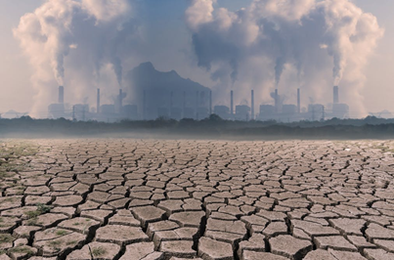

Speaking. Ex. 46, p. 136 Say how the phenomena in both the columns can be connected and comment on them.
1. global warming | a) water shortages
2. earthquakes | b) climate change
3. destruction of forests | c) heat waves, intense rainstorms and floods
4. highly developed and booming economy | d) growing demand for energy
5. world population growth | e) land erosion
6. agricultural mismanagement | f) increasing production of carbon dioxide
7. development of new technologies | g) growing demand of comfort, electric devices, machines, etc.
8. consumer society | h) tsunamis
carbon dioxide [daɪ'ɔksaɪd] - углекислый газ
land erosion [ɪ'rəuʒ(ə)n - эрозия почвы, размыв, выветривание грунта
agricultural mismanagement [ˌmɪs'mænɪʤmənt] плохое управление
boom [buːm] – процветать
consumer society [kən'sjuːmə] - потребительcкое общество

Slide 9
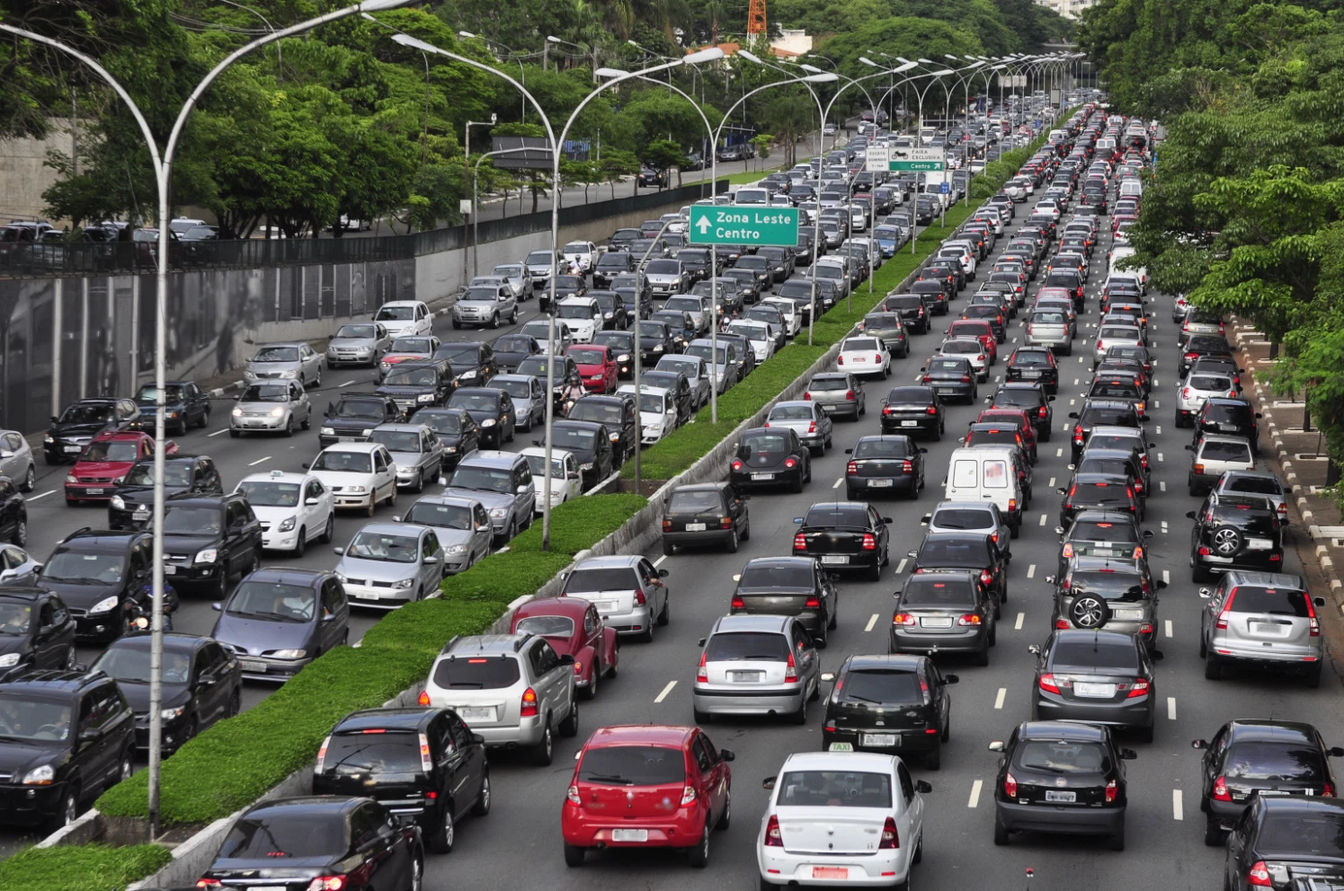
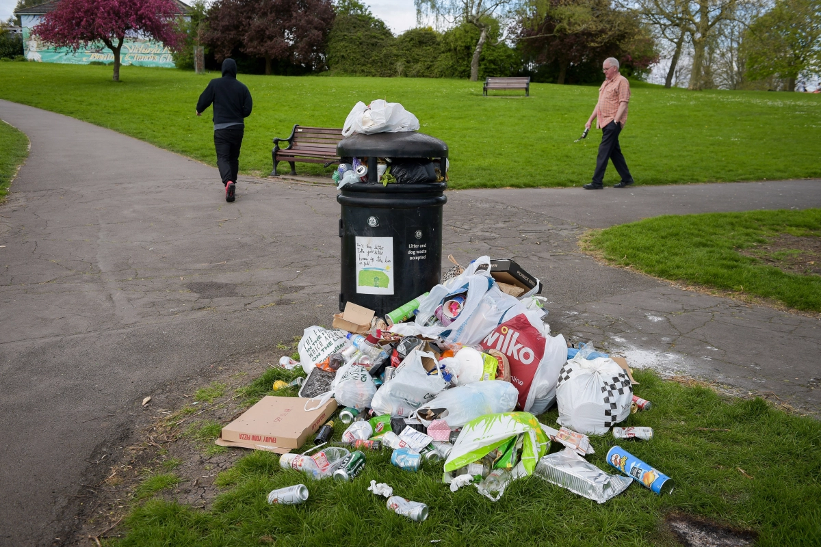
Situations for discussion
a) What can we do to reduce traffic in our town?
b) What are we going to do with all this litter?
to ban cars from
- to pay a tax
- car parks outside
improve public transport
- costs money.
to use buses, trams or trains
to leave their cars outside the city.
four people in four cars / one car with four people
fine people
-clean-up activities
recycling centers
biodegradable [ˌbaɪəudɪ'greɪdəbəl] (разлагаемый) packaging
- have to pay
- keep the parks clean and tidy
- reduce the household rubbish

Slide 10
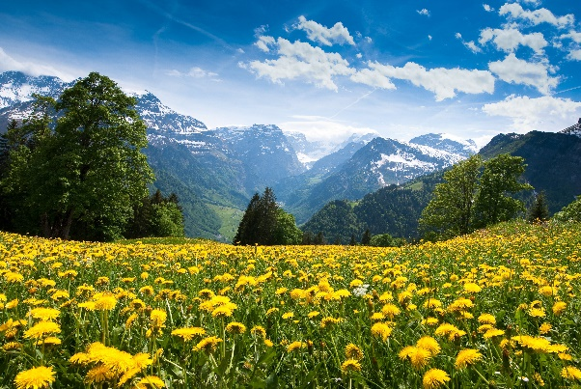
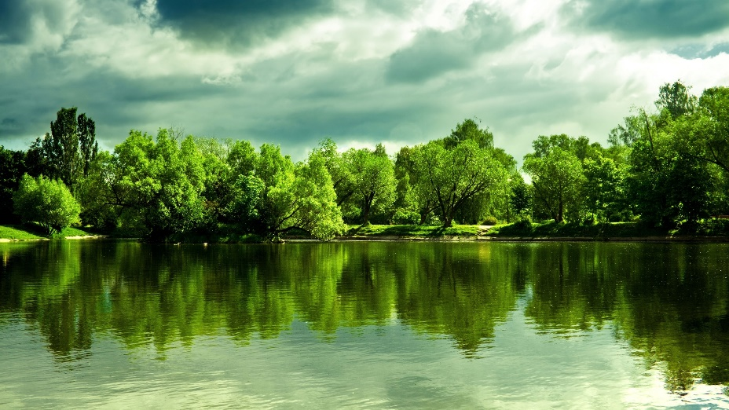
Self-assessment Card
At the lesson I was …
The results of my work …
The lesson seemed … to me.
The information I`ve got is …
I know the topical vocabulary …
I can talk about types of ecological problems …
HOMEWORK:
to write an essay “Human Being and Nature”

Slide 11

Thank you for your attention!

