Slide 1
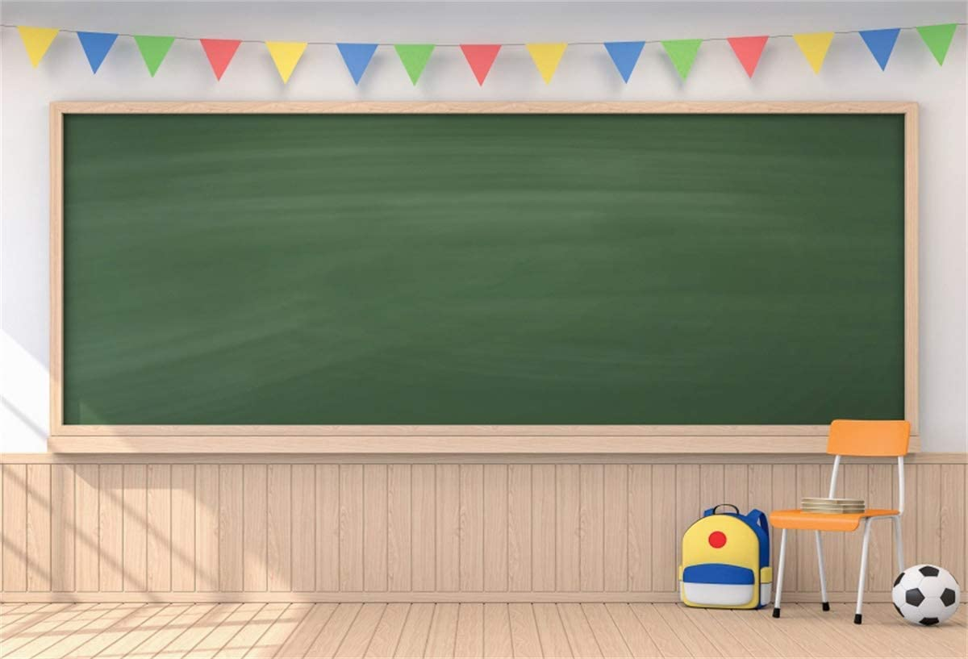
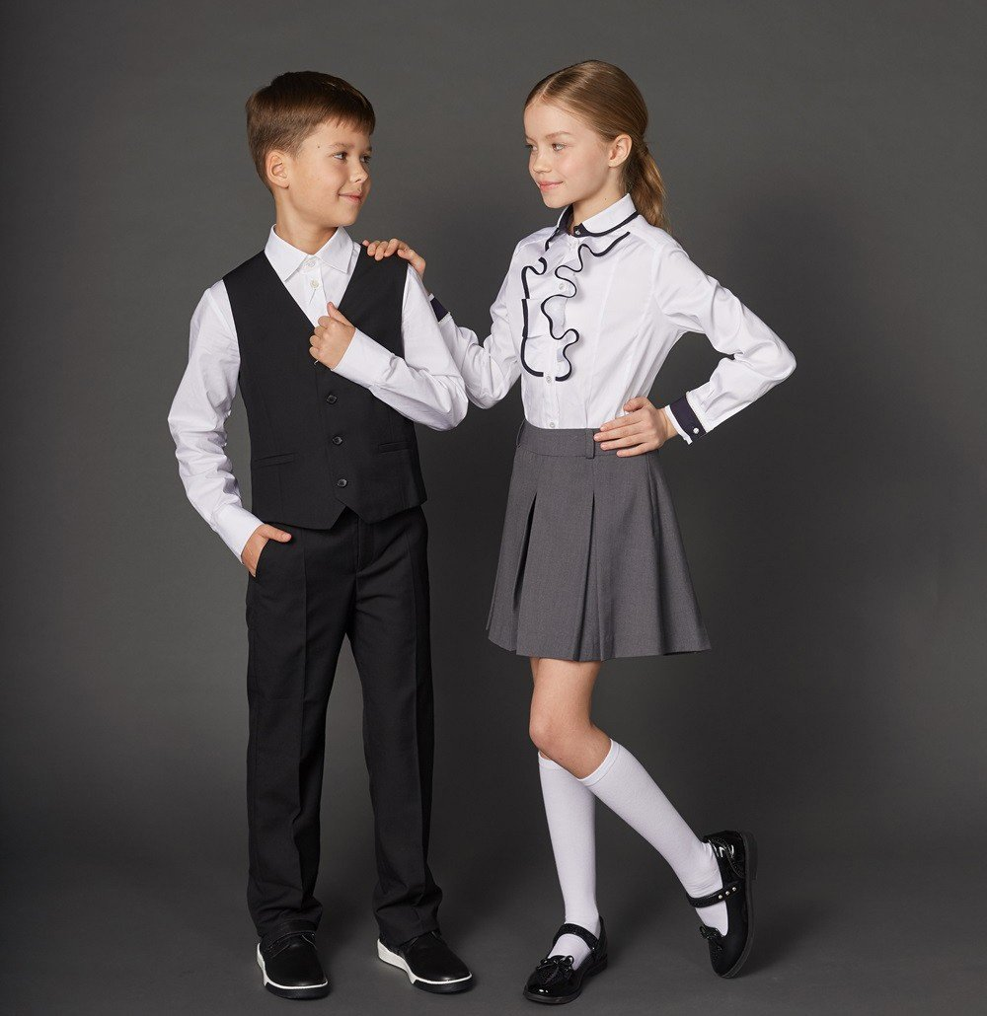
School uniform

Slide 2
Chit-Chat. Ask and answer.
Why are school uniforms a good idea?
What do girls wear at schools?
What do boys wear at schools?
What do students wear when they have PE classes?

Slide 3
Check these words.
English | Russian
uniform | школьная форма
reason | причина
team | команда
dress nicely | одеваться красиво
save money | копить деньги
tights | колготы
tie | галстук
bow tie | галстук-бабочка
pinafore | платье-сарафан

Slide 4
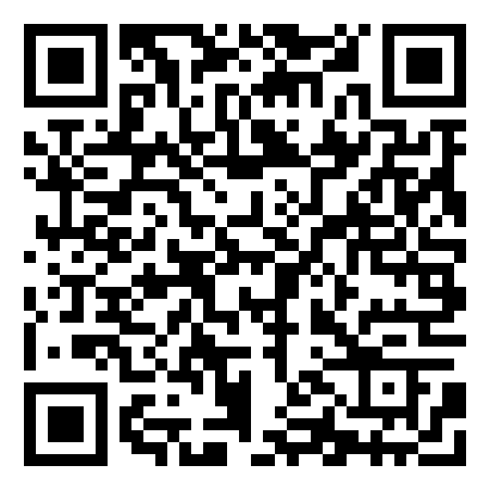
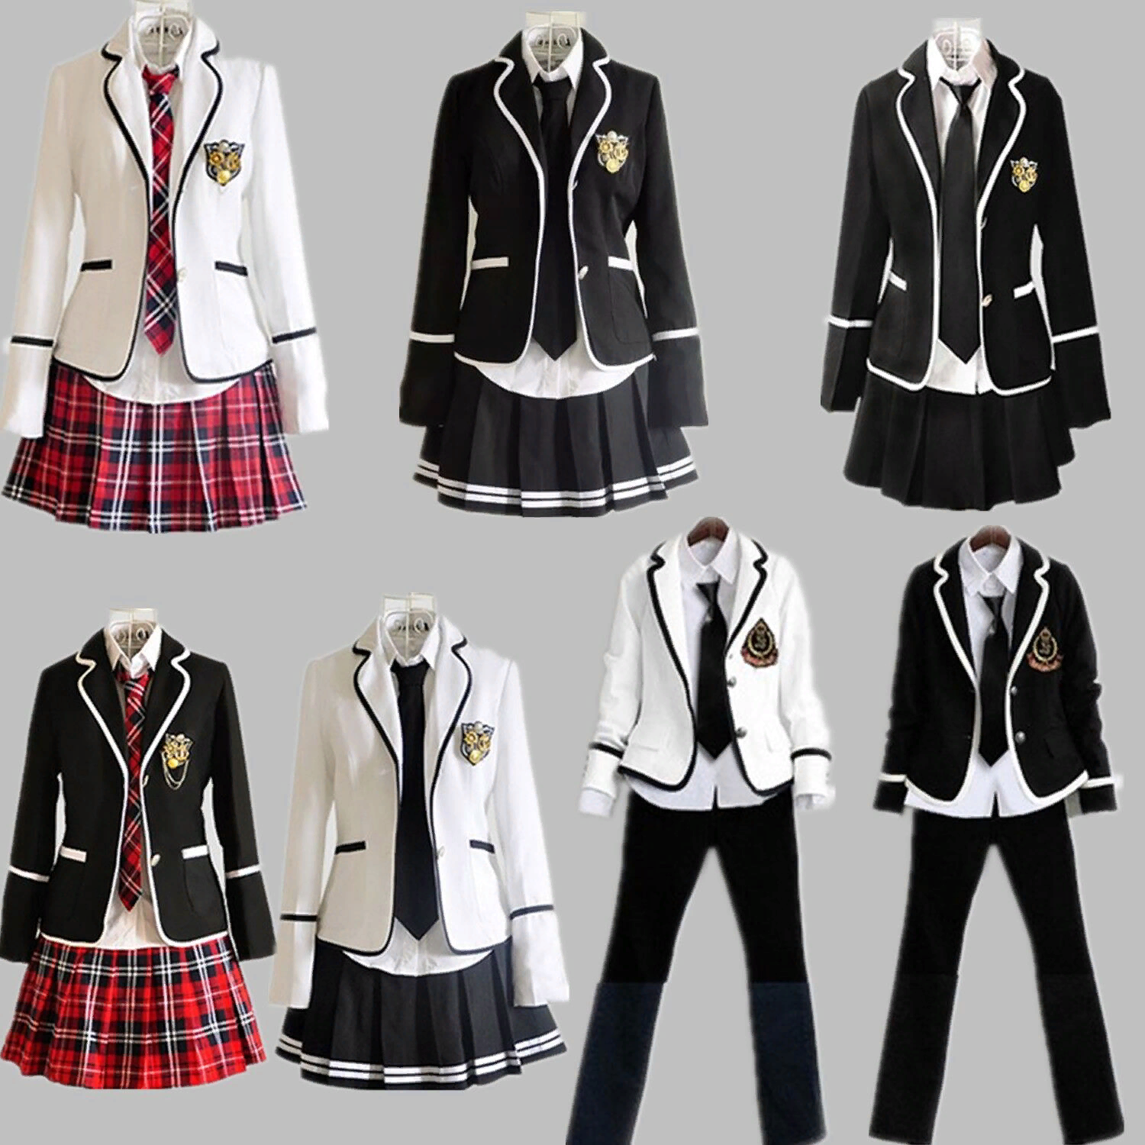
Let’s practise!
https://learningapps.org/display?v=pra3kdya521

Slide 5

Listen and complete the text.
School Uniforms
In Moscow Schools
Almost all Moscow students go to school in school 1) ______ . School uniforms are a good idea for a number of reasons. In the morning you always know what to wear. You feel part of the team in your class and you learn to dress nicely. You also help your parents to save money on clothes.
Girls in Moscow schools wear blouses, jackets, skirts or trousers or 2) ______, tights and smart shoes. Boys wear shirts, jackets, trousers and smart shoes. They can wear a tie or a 3) _____ . On special days and holidays all the pupils wear white 4) _____ and shirts. If students have PE classes, they wear their sport uniform: a 5) _____, sport shorts or trousers, and 6) _____.

Slide 6
Let’s check!
School Uniforms
In Moscow Schools
Almost all Moscow students go to school in school 1) uniforms . School uniforms are a good idea for a number of reasons. In the morning you always know what to wear. You feel part of the team in your class and you learn to dress nicely. You also help your parents to save money on clothes.
Girls in Moscow schools wear blouses, jackets, skirts or trousers or 2) pinafores, tights and smart shoes. Boys wear shirts, jackets, trousers and smart shoes. They can wear a tie or a 3) bow tie . On special days and holidays all the pupils wear white 4) shirts and shirts. If students have PE classes, they wear their sport uniform: a 5) T-shirt, sport shorts or trousers, and 6) trainers.

Slide 7
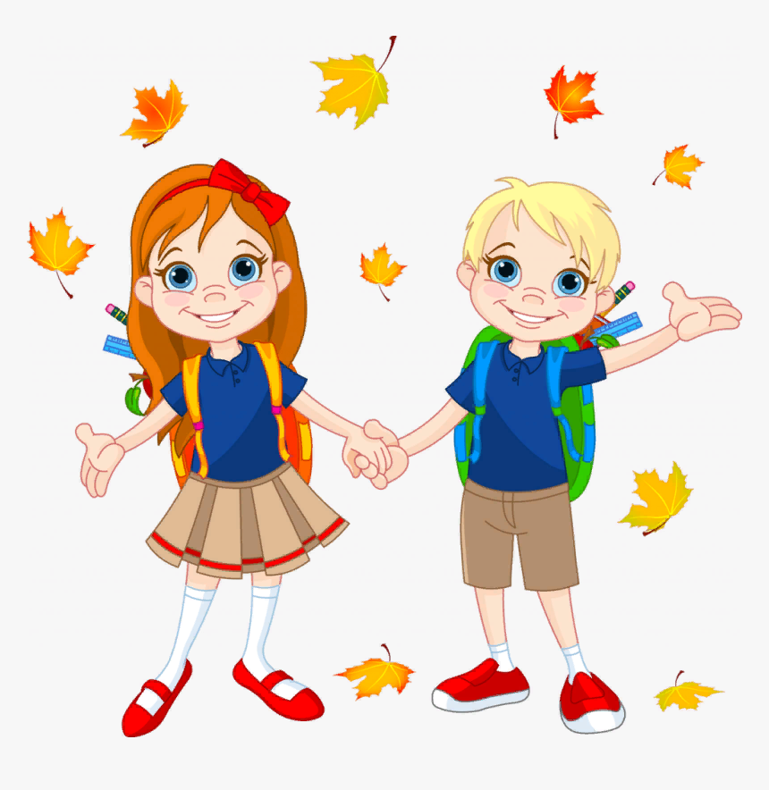
Work in groups.
Work in groups of 3. Draw your dream school uniform for boys and girls. Write 5-7 sentences. Present it to your class.
For example:
He’s wearing a blue T-shirt and brown shorts. She’s wearing a brown skirt and red shoes.

Slide 8
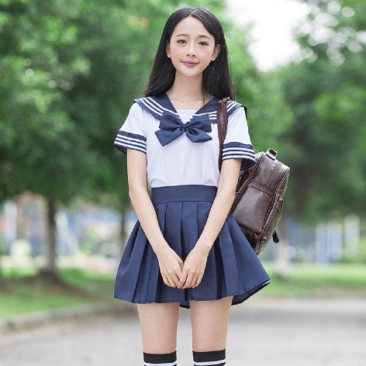
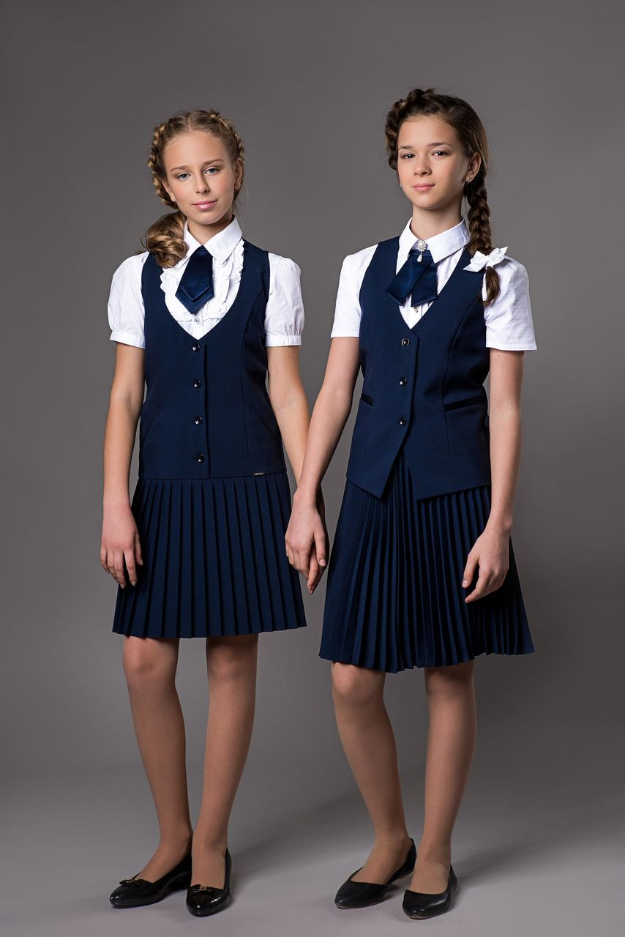
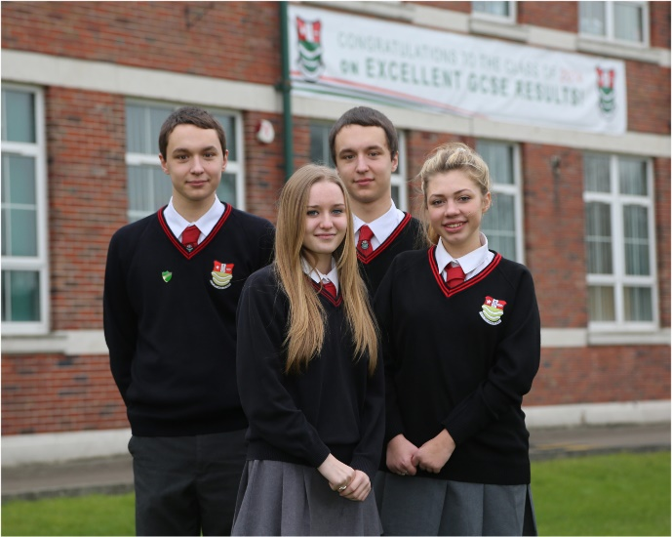
Pupils at most British schools have to wear a school uniform. This usually means a white blouse for girls with a dark-coloured skirt and a pullover. Pupils also wear blazers (a kind of a jacket).
Read and answer.
Choose the best illustration for the text. Explain your choice.

Slide 9

Pupils at most British schools have to wear a school uniform. This usually means a white blouse for girls with a dark-coloured skirt and a pullover. Pupils also wear blazers (a kind of a jacket).
Read and answer.
Let’s check!
Choose the best illustration for the text. Explain your choice.

Slide 10
Consolidation.
3
Translate.
Девочки в московских школах носят блузки, юбки или платья.
1
Say 5 words from today’s active vocabulary.
4
Complete the sentence: “ If students have PE classes, they wear…”
2
You use it to pay for food or things in a supermarket.

Slide 11
CREATIVE HOMEWORK
Design a uniform for your school. Present it to your class.
Say 5-7 sentences.

