Slide 1
In search of Nessie and other mysterious monsters!
English teacher: Natalie Ivanova
School 2070
Moscow

Slide 2
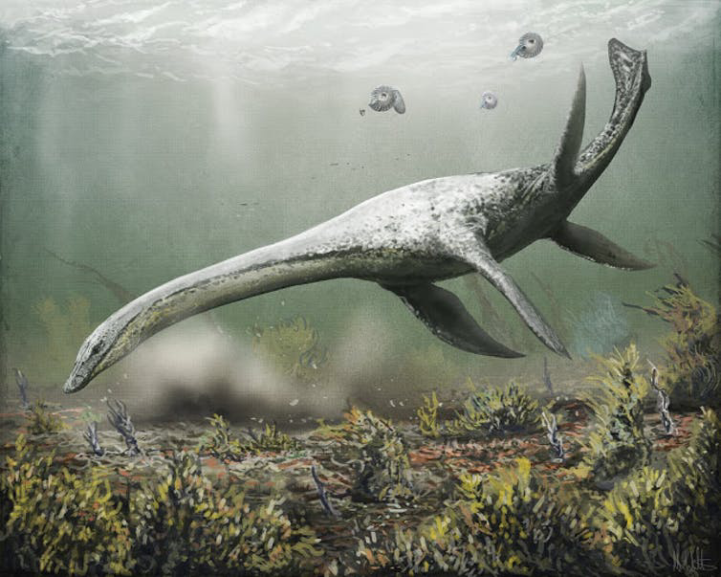
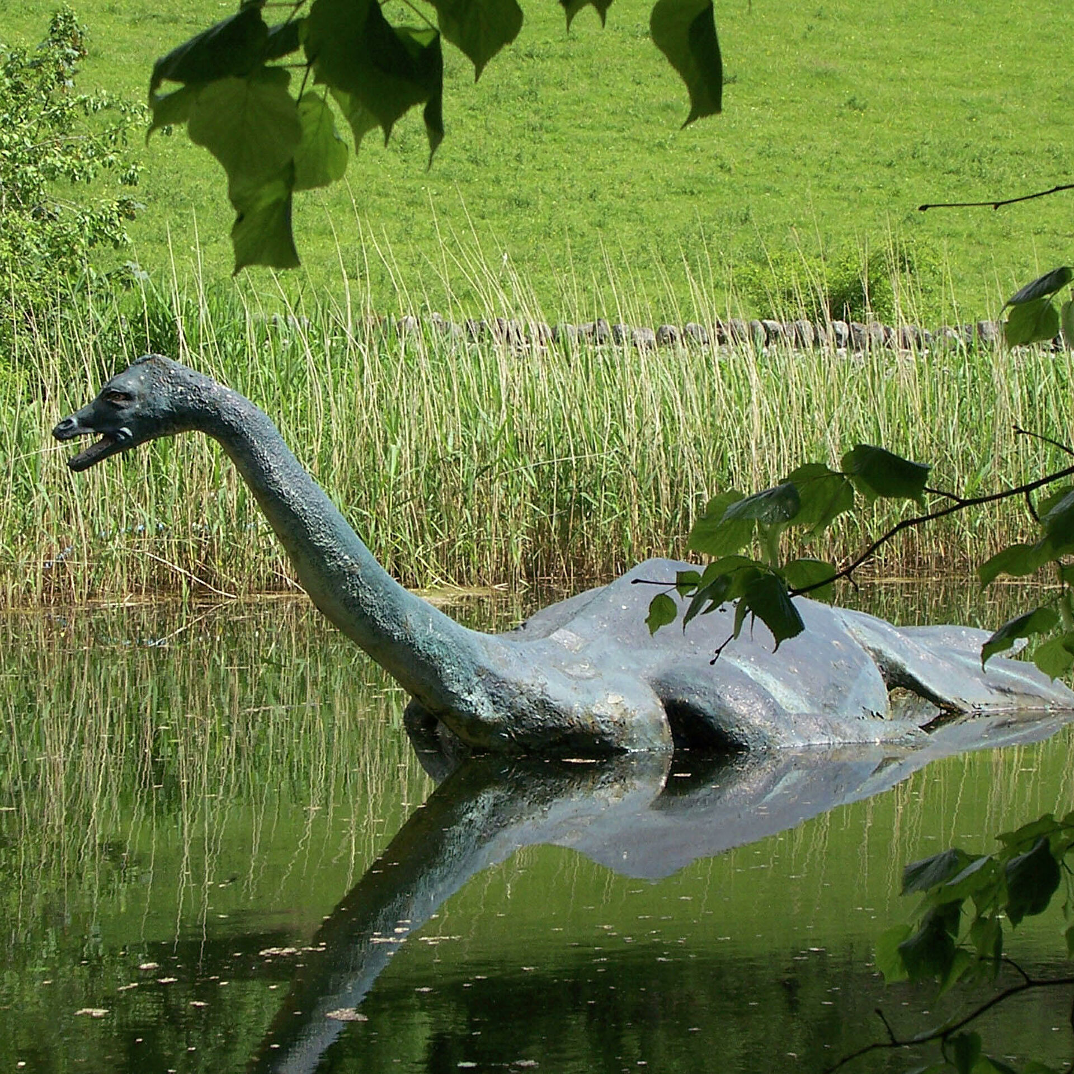
The loch ness monster
The animal is believed to inhabit the Scottish Loch Ness, the largest freshwater reservoir in the UK by volume. All over the world, many people believe in the existence of this animal.

Slide 3
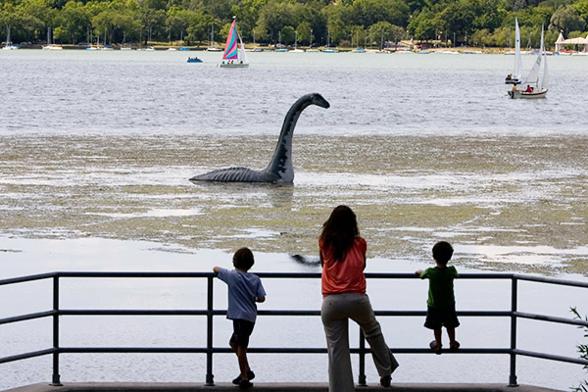
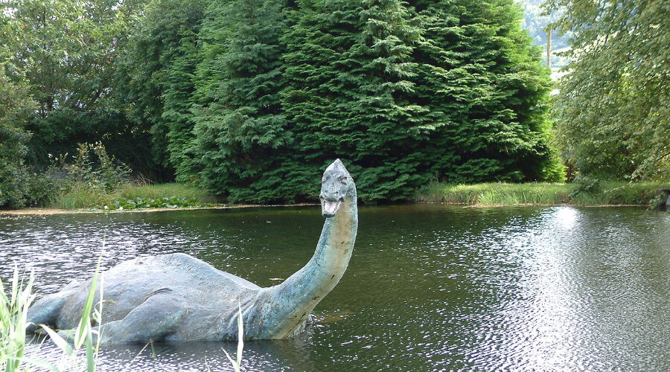
People have been reporting sightings of this strange monster since the 6th century! The first modern sighting occurred in 1933, when a couple on their way home saw a creature rolling and diving in a lake. Since then, more than a thousand sightings and even several photographs of Nessie have been recorded. Some people believe that Nessie is a dinosaur called a plesiosaur that somehow survived in Loch Ness, but the truth is still a mystery.

Slide 4
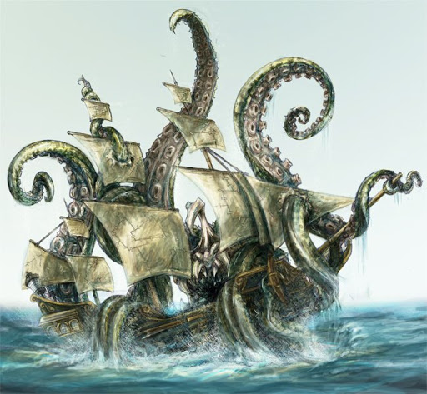
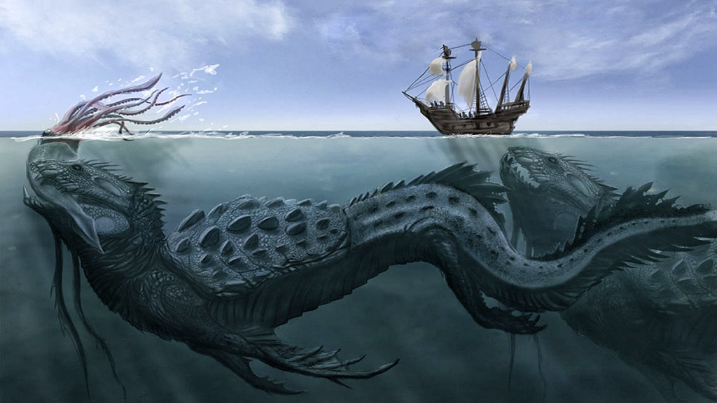
The kraken
The legendary mythical sea monster of gigantic proportions, a cephalopod mollusk, known from the descriptions of Icelandic sailors, from whose language its name derives. Appears in books, movies, games and other works.

Slide 5
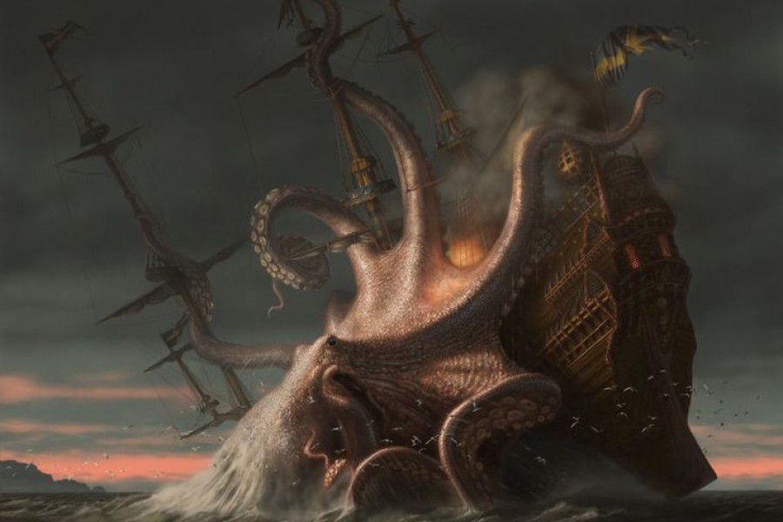
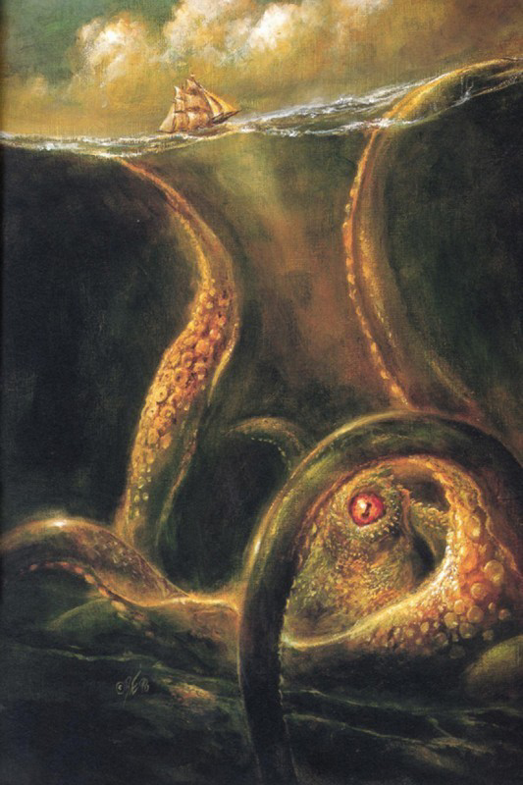
As the ships approached, the kraken wrapped its gigantic tentacles around them or created a powerful whirlpool to drag them to the bottom of the ocean. Kraken is a type of giant squid. In 2007, fishermen caught a ten-meter long squid with eyes the size of dinner plates and sharp hooks on its tentacles off the coast of Antarctica. There is no doubt that giant squids exist, but how big they can grow to and whether they have destroyed ships is still a mystery.

Slide 6
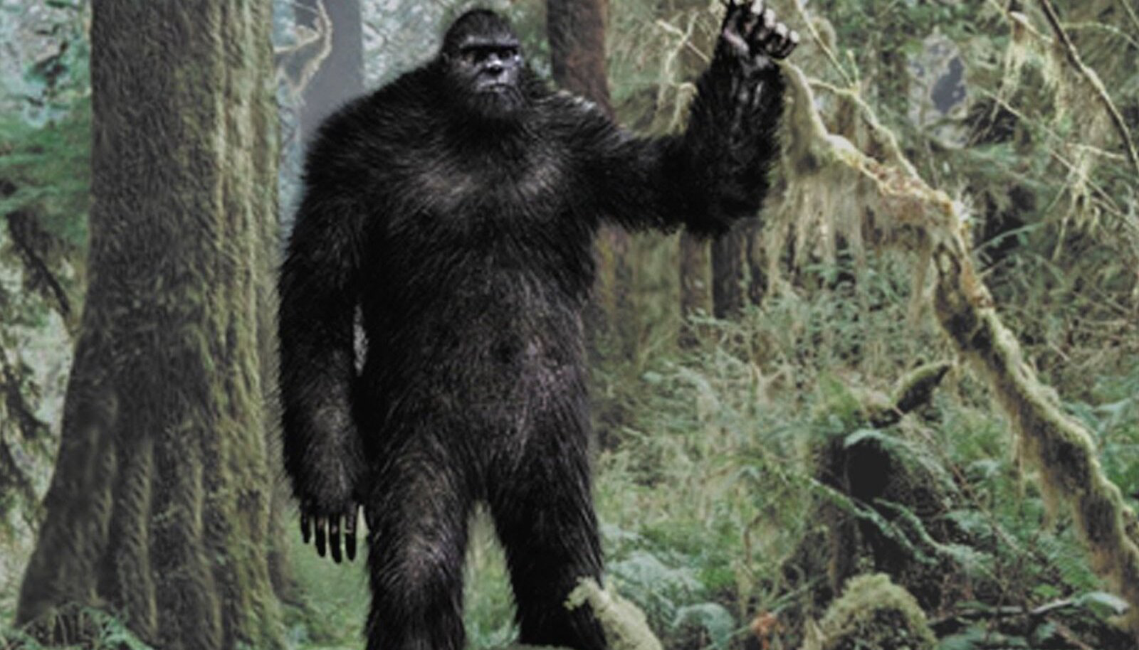
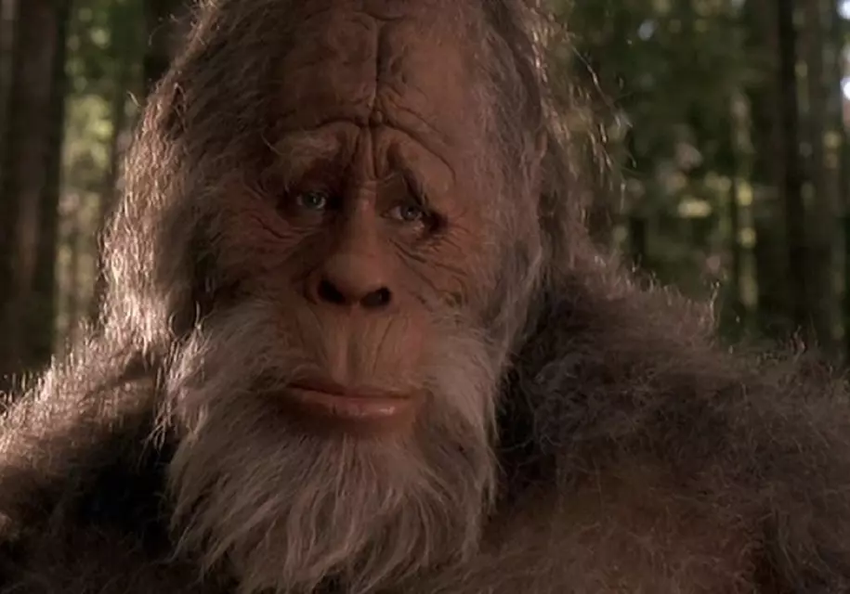
Bigfoot
A mythical humanoid creature probably lives in the northwestern part of the United States and western Canada. It is usually described as a large hairy Ape that can walk on two legs.

Slide 7
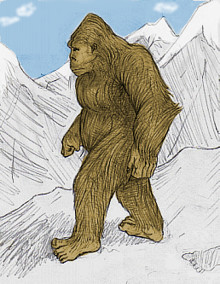
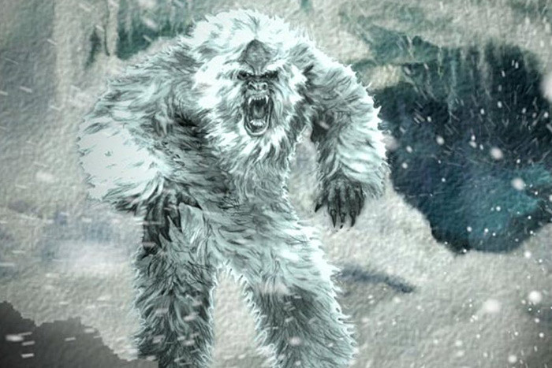
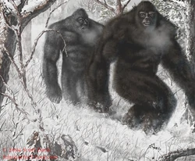
Bigfoot (or sasquatch) has been part of American folklore for many years. Since 1800s, there have been more than 3,000 sightings of Bigfoot, who most witnesses describe as being a two-legged creature two to three metres tall that has long arms and a short neck. Investigators say there’s no way that its footprints, at around 40cm long, could be human prints! Some scientists believe that Bigfoot could be a species of extinct ape, but unfortunately so far no one has found a Bigfoot body, fossil or skeleton.

Slide 8
Thanks for attention!

