Slide 1
Prince William Arthur Philip Louis of the United Kingdom
English teacher: Natalie Ivanova
School 2070
Moscow

Slide 2
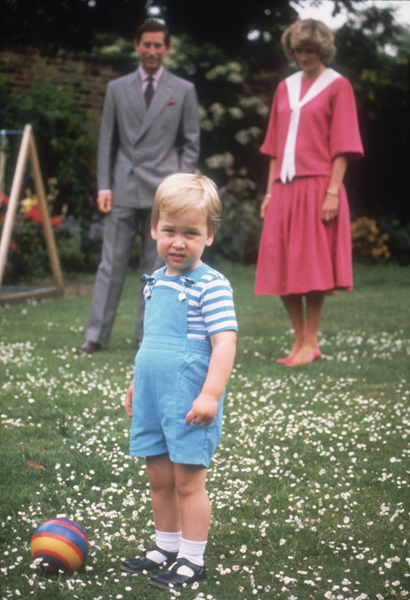
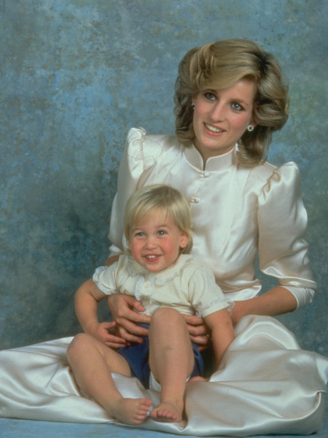
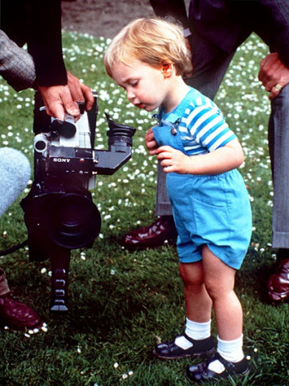
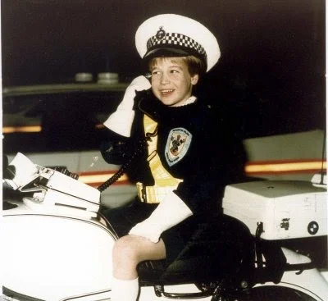
Biography
Born June 21, 1982 at 9 pm, in London, in the Paddington area. William was the first crown prince to be born outside the royal palace - he was born in London's St. Mary's Hospital.

Slide 3
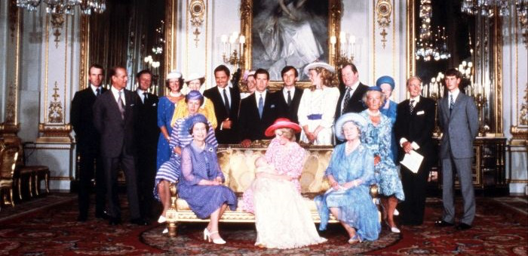
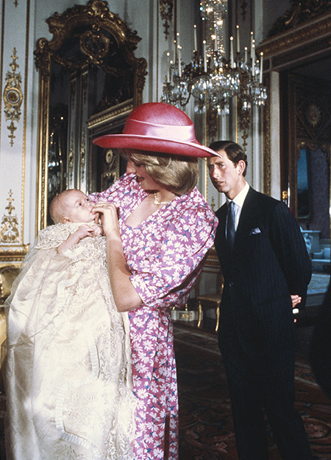
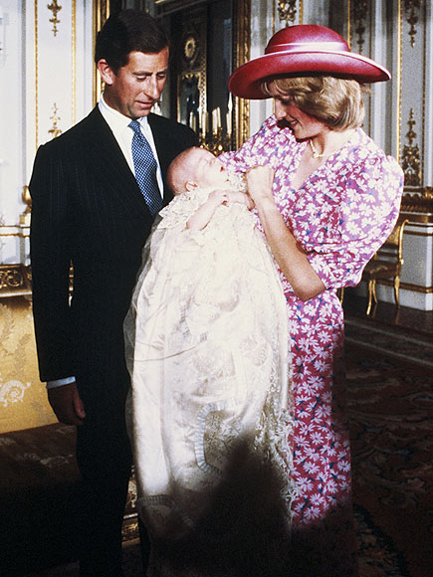
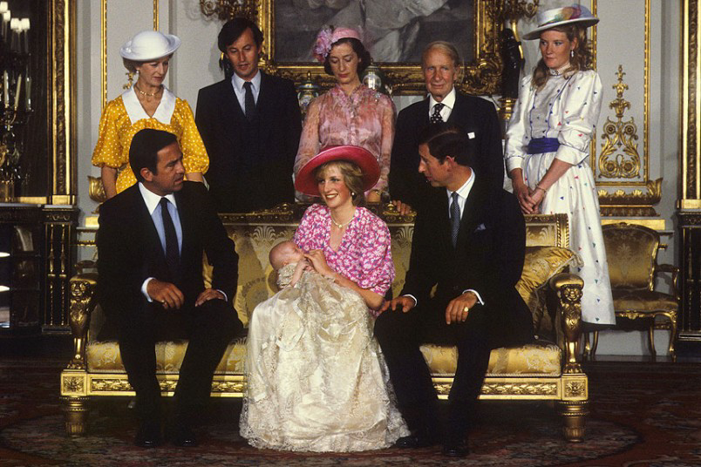
On August 4, 1982, the prince was baptized by the Archbishop of Canterbury at Buckingham Palace and named William Arthur Philip Louis.

Slide 4
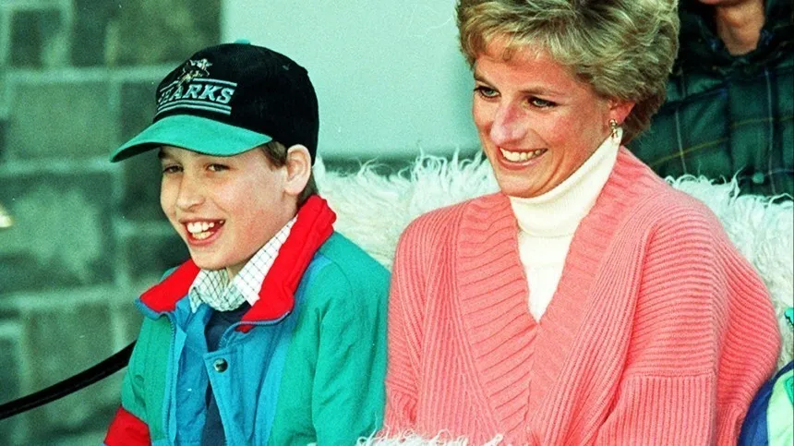
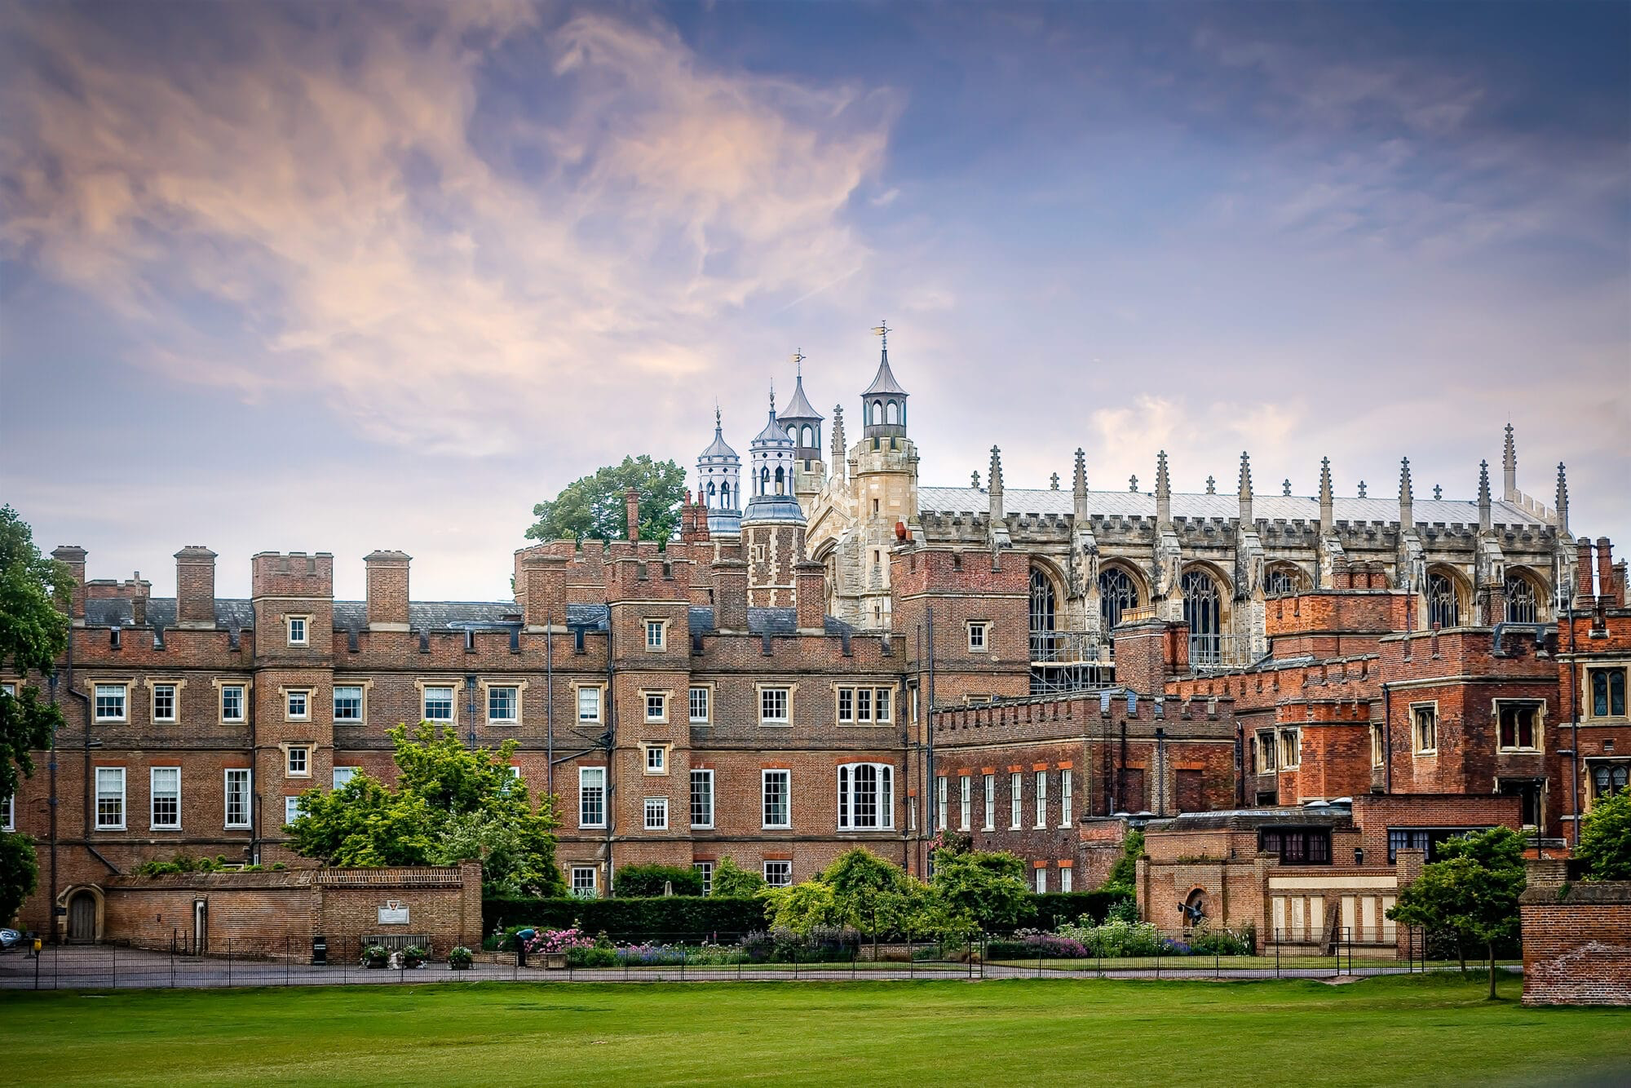
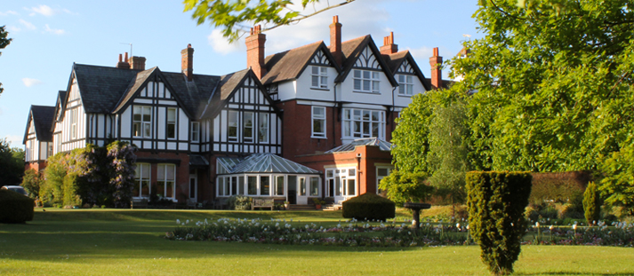
Study
From 1990 to 1995, the prince attended Ludgrove School in Berkshire. It was a boarding school, and William did everything on an equal basis with the others, living in a room with four other students.
After school, William entered the famous Eton College, where he studied geography, biology and art history. The prince was always a diligent student and received good grades both in specialized subjects and in upbringing.
In July 2000, after graduating from Eton College, the prince, like many students, decided to take a break from his studies for a year. After a year, Prince William decided to enter the prestigious University of St Andrews in Scotland, and soon became a student.

Slide 5
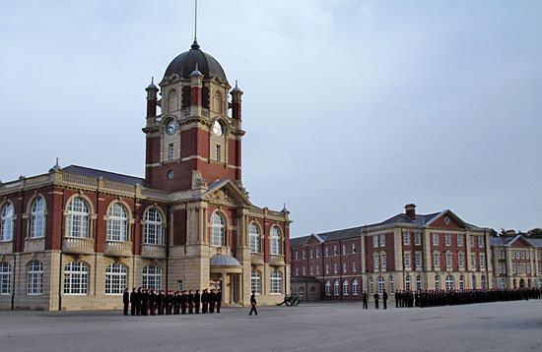
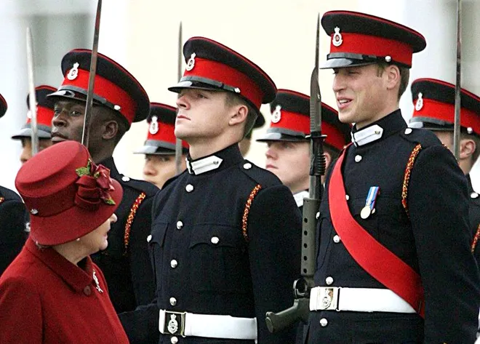
In May 2006, Prince William entered the Royal Military Academy Sandhurst. He was promoted to officer rank in December 2006 and enlisted in the Royal and Blues Regiment.
In 2009, after graduating from flight school at Cranwell, Ruen was transferred to the Royal Air Force and promoted to the rank of captain. Until September 2013 he was a pilot of a rescue helicopter, at the end of November 2011 he took part in the operation to rescue Russian sailors from the sunken ship Swanland.
Then, from 2015 to 2017, the prince was a pilot of an ambulance helicopter for the charity East Anglian Air Ambulance.
In May 2006, Prince William succeeded his uncle, the Duke of York, as President of the Football Association of England.

Slide 6
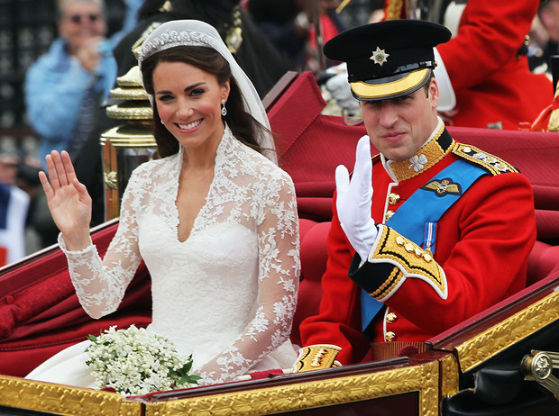
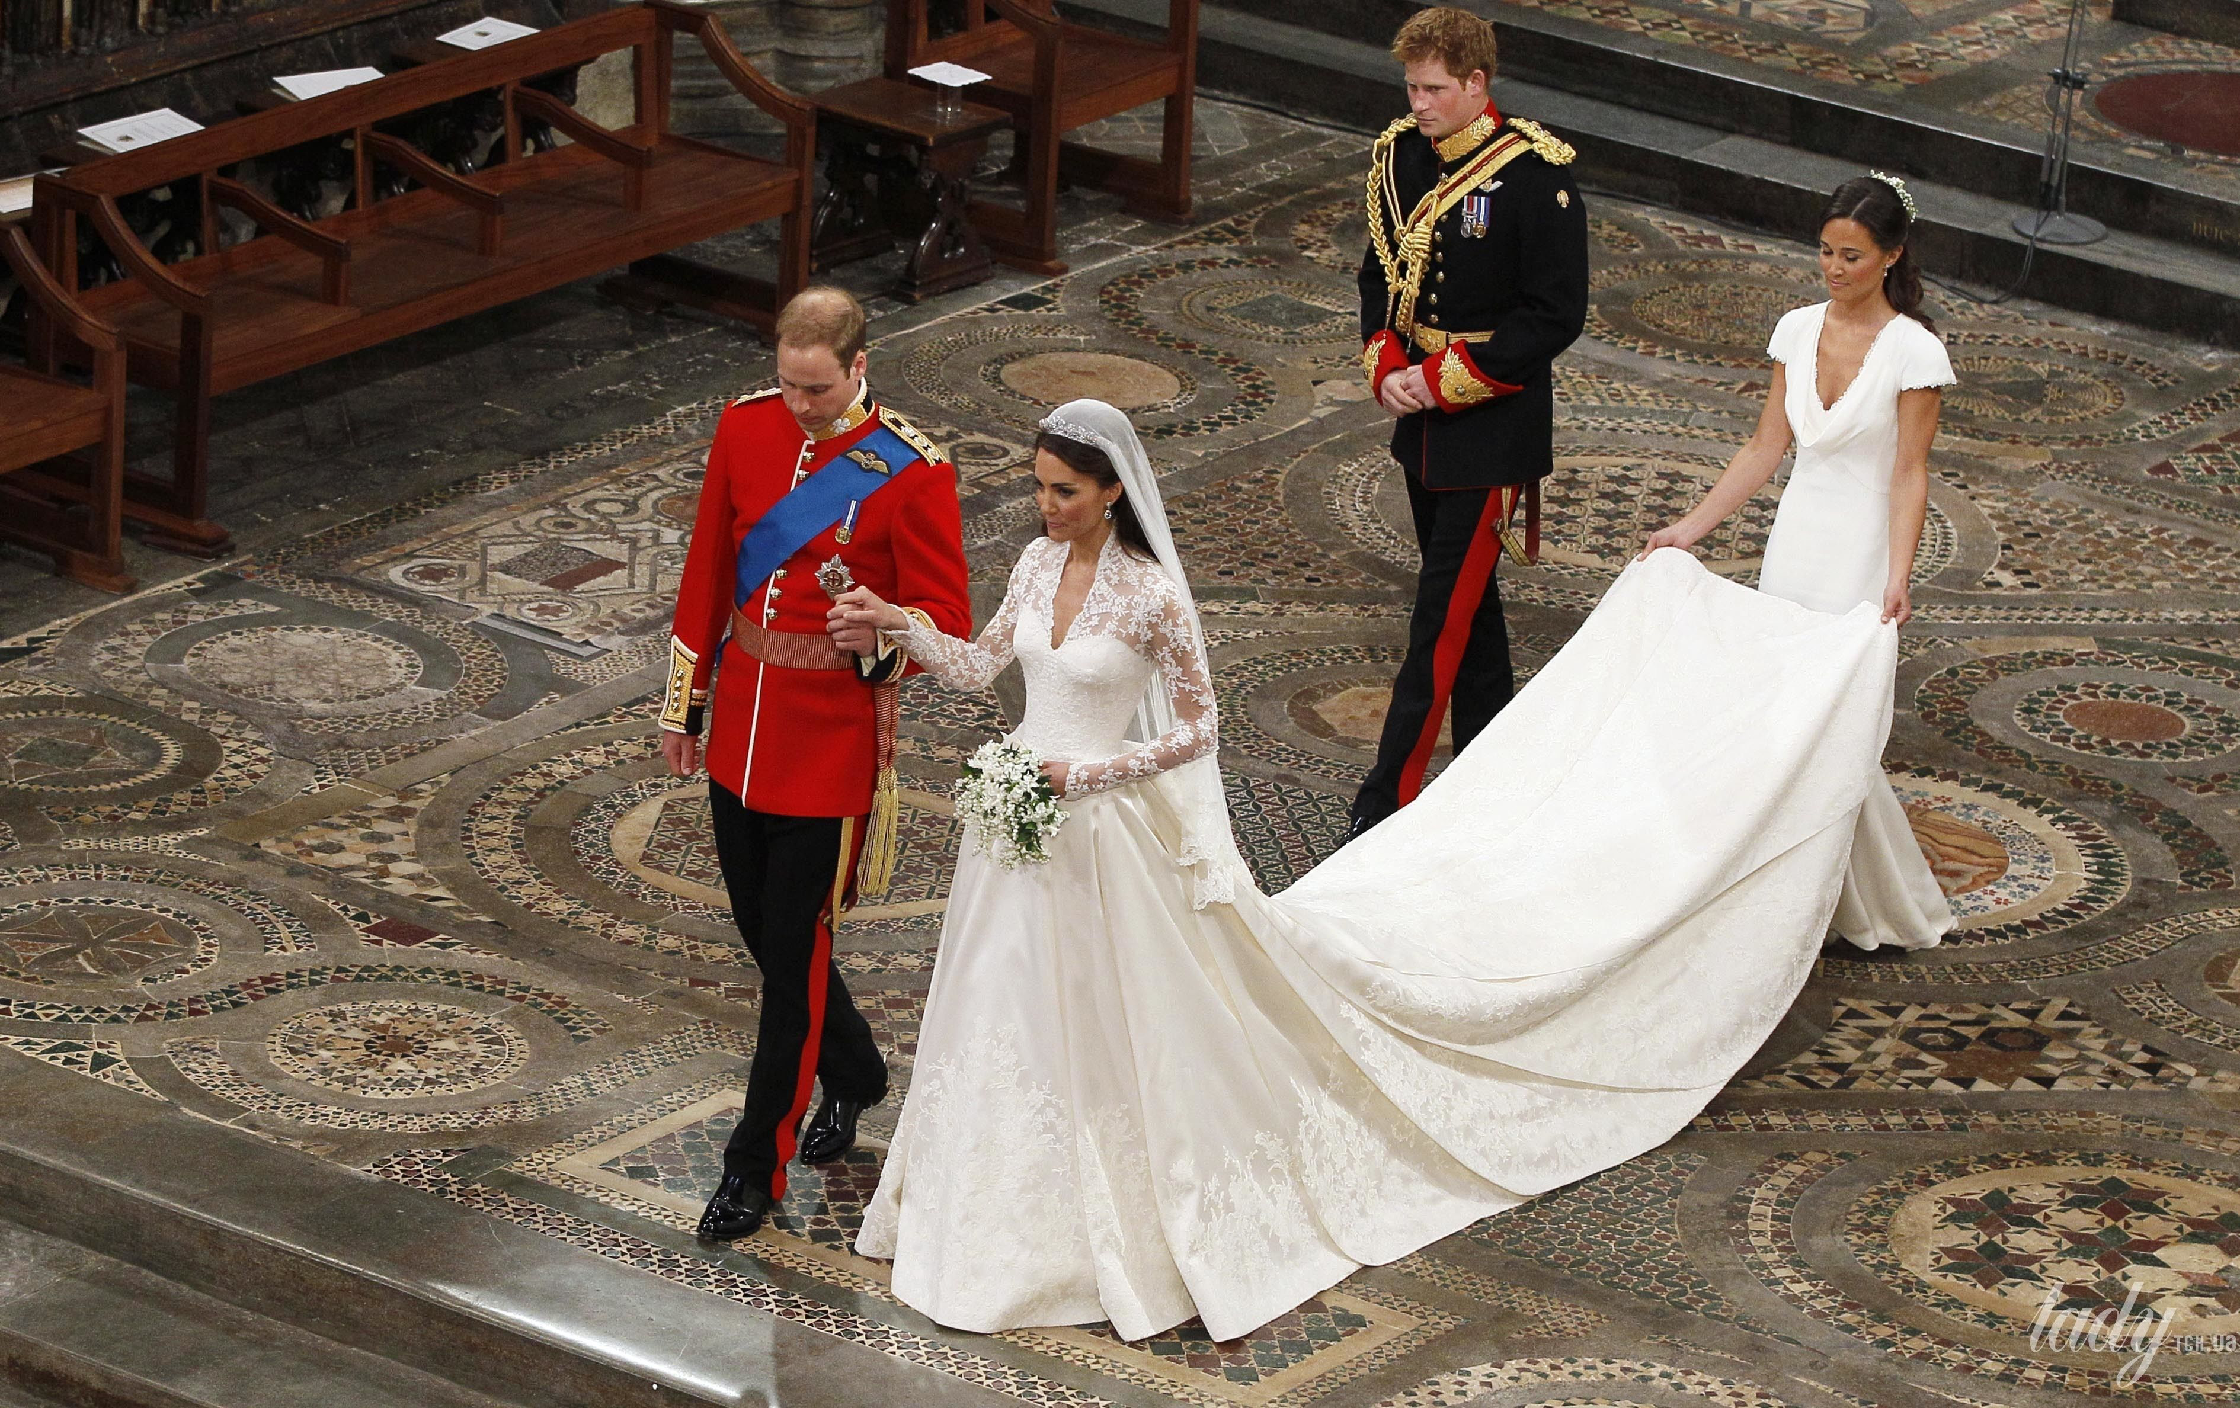
Family
On November 16, 2010, Clarence House announced the engagement of Prince William and his longtime girlfriend Kate Middleton. The wedding of Prince William and Catherine Middleton took place on April 29, 2011 at London's St Peter's Cathedral Church in Westminster Abbey.

Slide 7
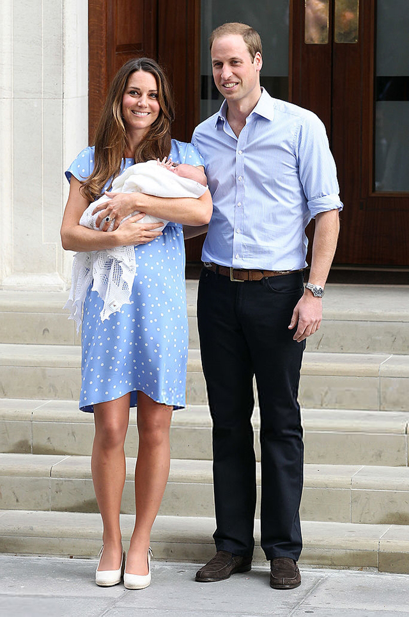
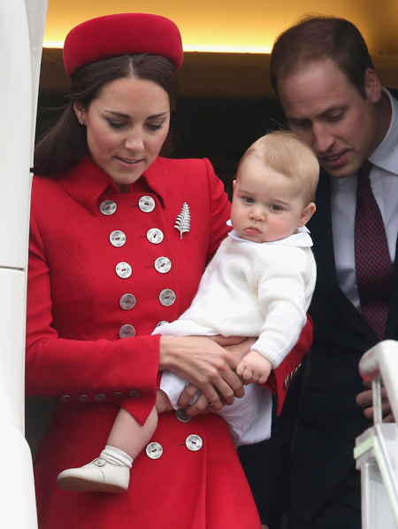
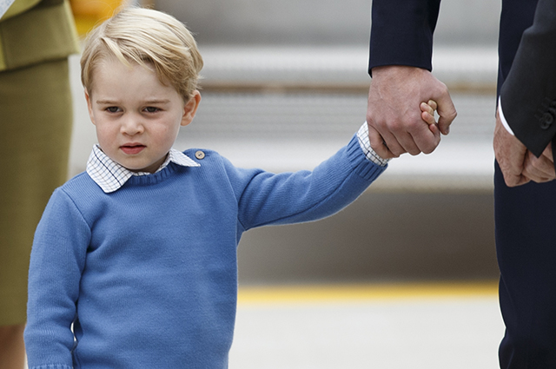
Children
On July 22, 2013, the couple had a son, George.

Slide 8
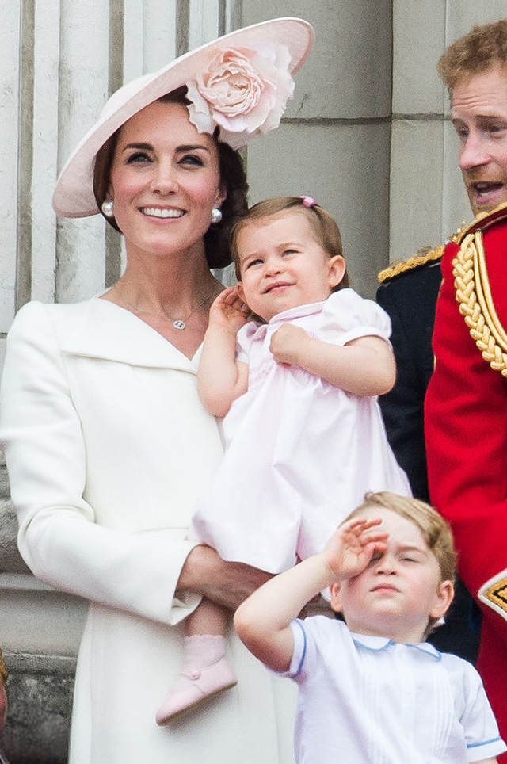
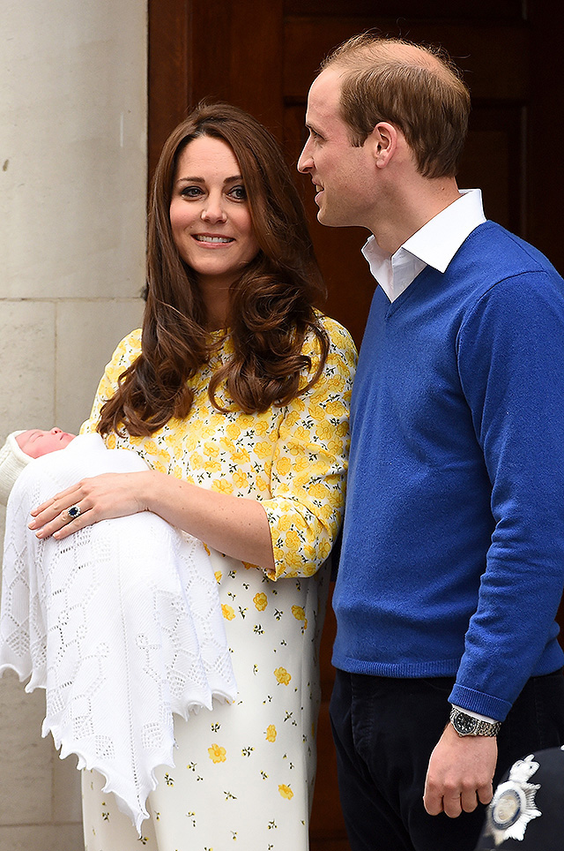
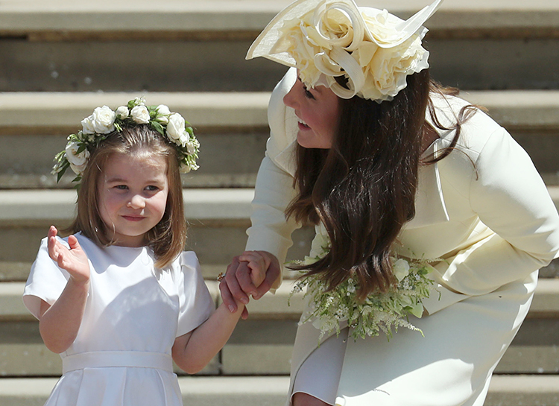
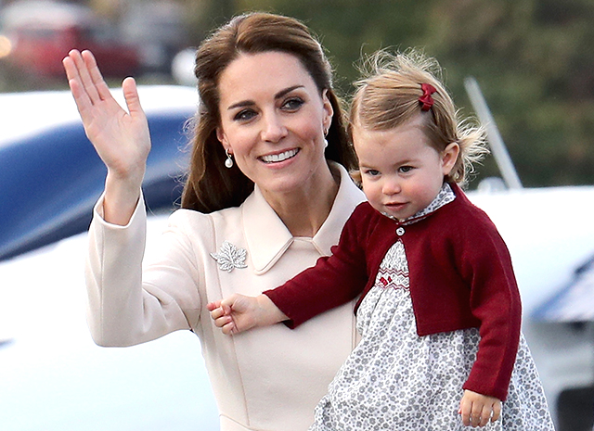
On May 2, 2015, their daughter Charlotte was born.

Slide 9
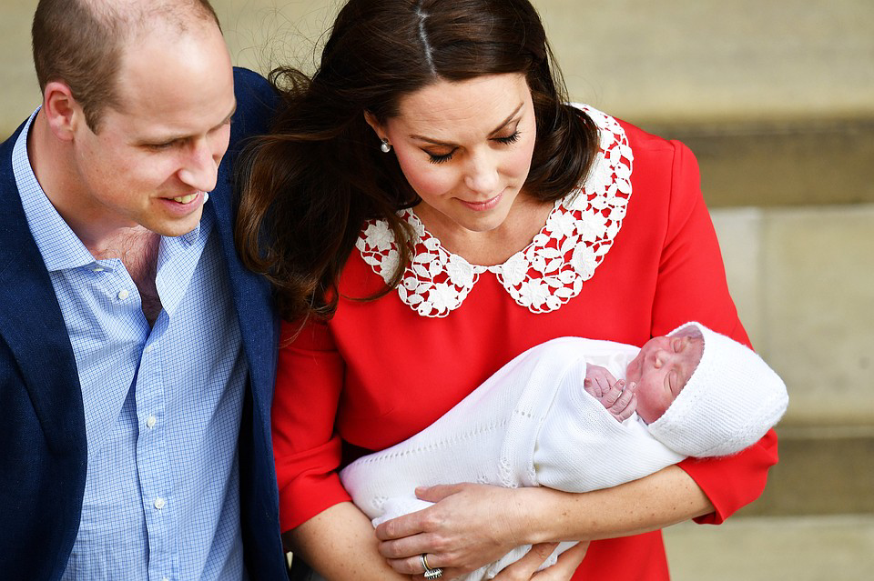
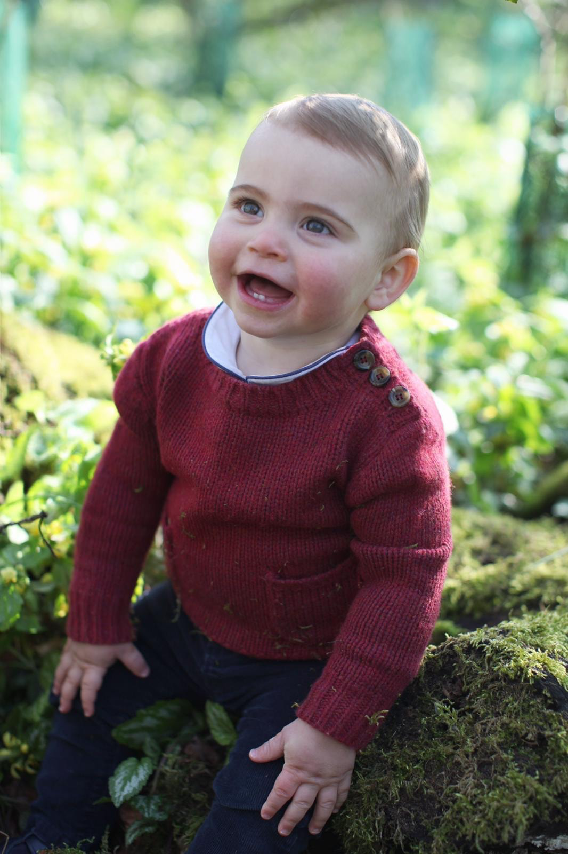
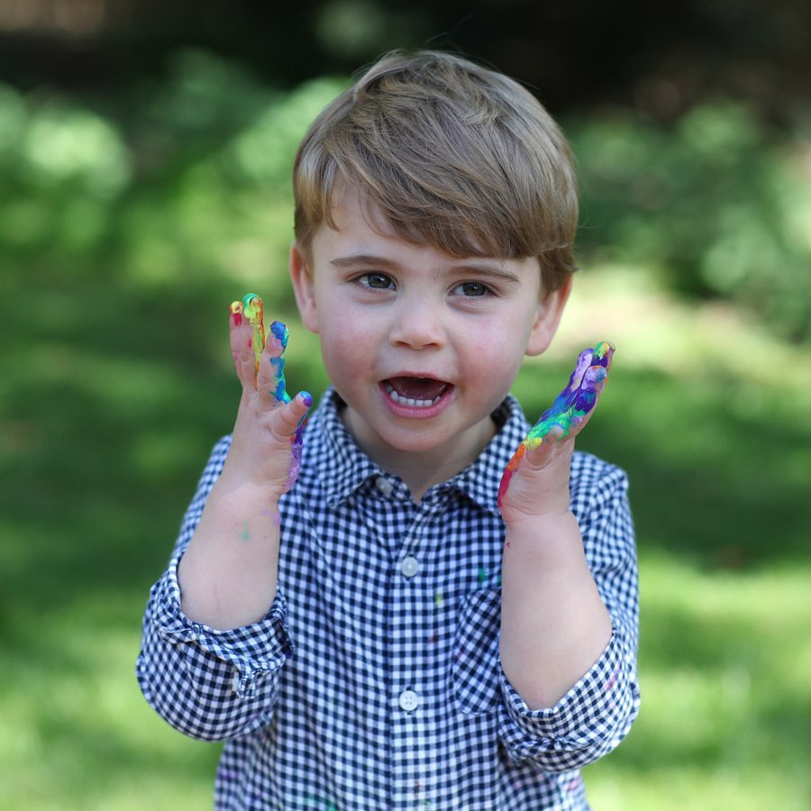
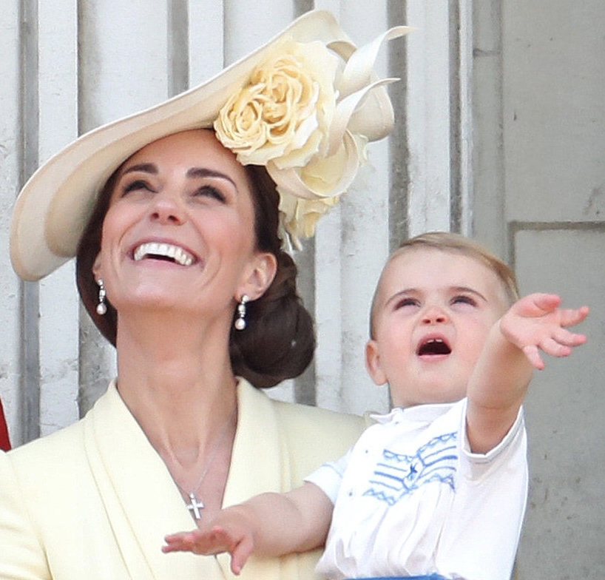
On April 23, 2018, William and Kate had a son, Louis.

Slide 10
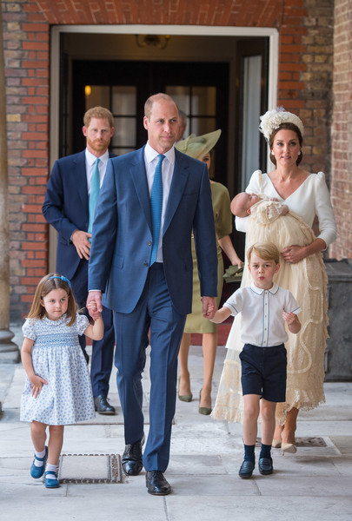
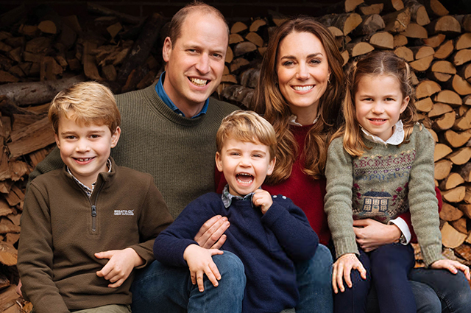
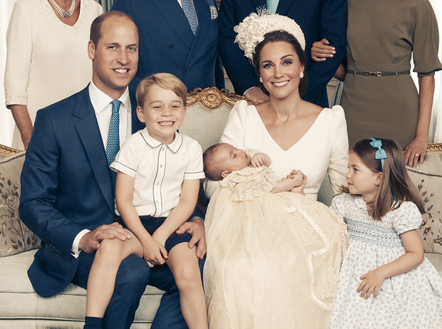
Prince William and Kate Middleton with children

Slide 11
Thanks for attention!

