Slide 1
Diana, Princess of Wales
English teacher: Natalie Ivanova
School 2070
Moscow

Slide 2
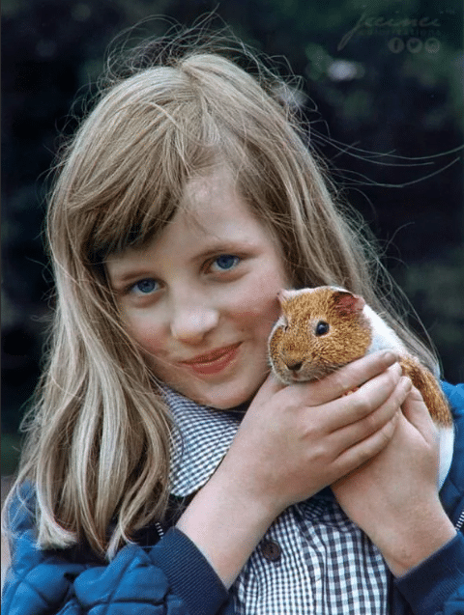
Biography
Diana was born on July 1, 1961 in Sandringham, Norfolk in the family of John Spencer. Her father was Viscount Elthorp, a member of one of the branches of the same Spencer family.
Diana spent her childhood in Sandringham, where she received her primary education at home. She continued her education in Silfield, at a private school near King's Line, then at Riddlesworth Hall Preparatory School.
When Diana was 8 years old, her parents divorced. She stayed with her father, along with her sisters and brother.
At the age of 12, the future princess was admitted to a privileged girls' school in West Hill, in Sevenoaks, Kent. Here she turned out to be a bad student and could not graduate.

Slide 3
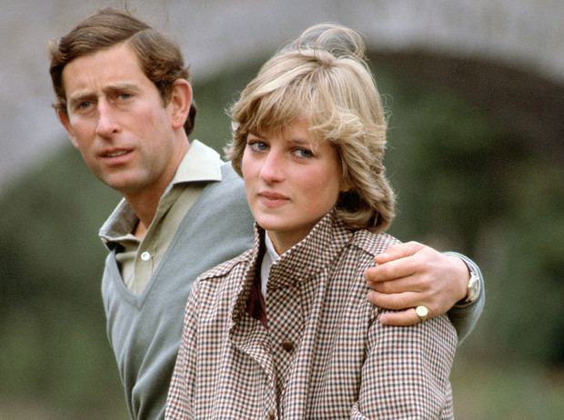
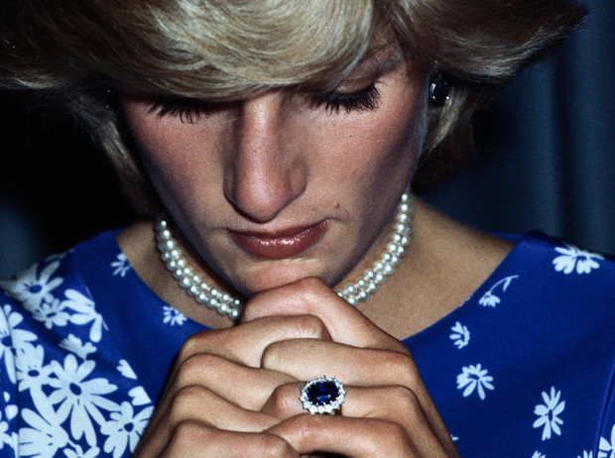
Engagement and wedding
Lady Diana was warmly received by the Queen, Duke of Edinburgh and Queen Mother. Prince Charles subsequently courted Diana in London and proposed on 6 February 1981, which Diana accepted, but their engagement was kept in secret for the next few weeks.
Their engagement was officially announced on February 24, 1981. Diana chose a large 18K white gold engagement ring set with a 12K oval Ceylon sapphire set with fourteen diamonds to resemble her mother's engagement ring.
After the engagement, Diana quit her job as a kindergarten teacher and lived for a time at Clarence House, the Westminster residence of the British royal family.
On July 29, 1981, twenty-year-old Diana married Charles, Prince of Wales, and became Princess of Wales.

Slide 4
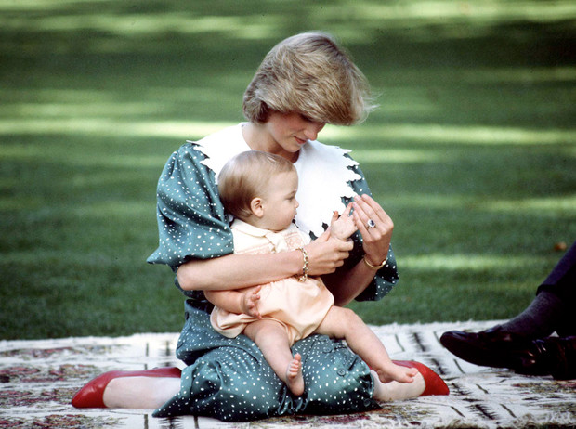
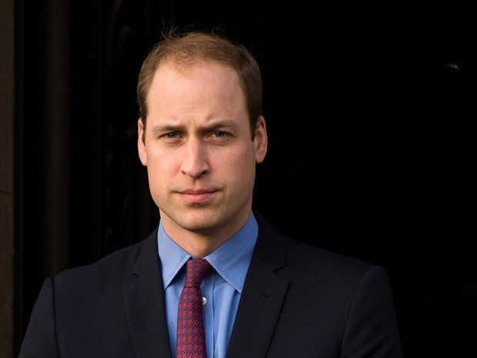
Children
On June 21, 1982, in the private wing of St. Mary's Hospital in the Paddington district of London, under Pinker's supervision, the couple's firstborn and heir, Prince William Arthur Philip Louis, was born.

Slide 5
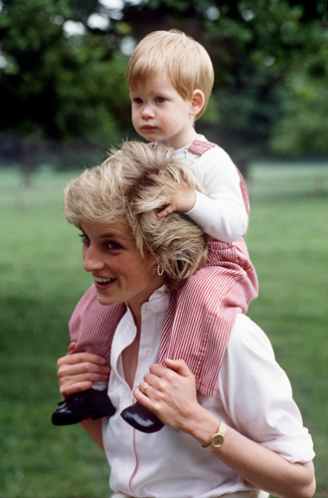
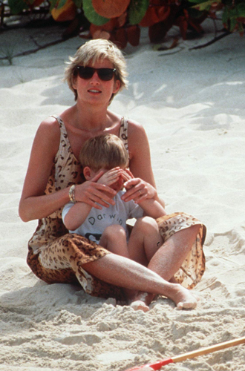
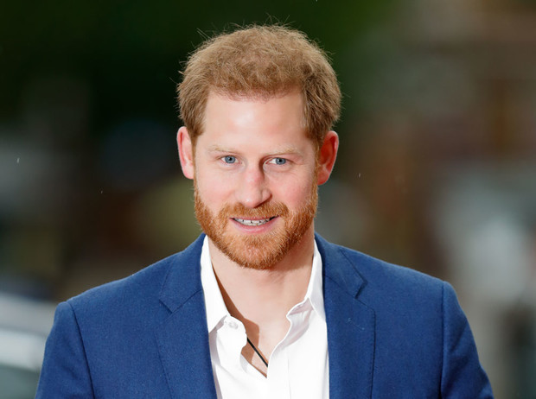
The second son, Prince Henry Charles Albert David, was born on September 15, 1984. She knew that their second child would be a boy, but she didn't tell anyone, not even Charles.

Slide 6
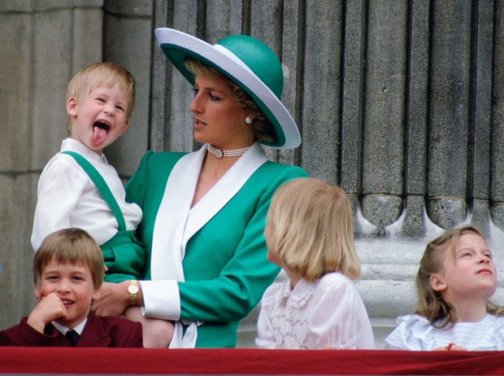
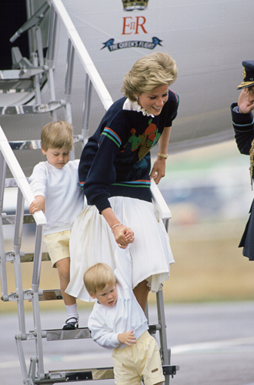
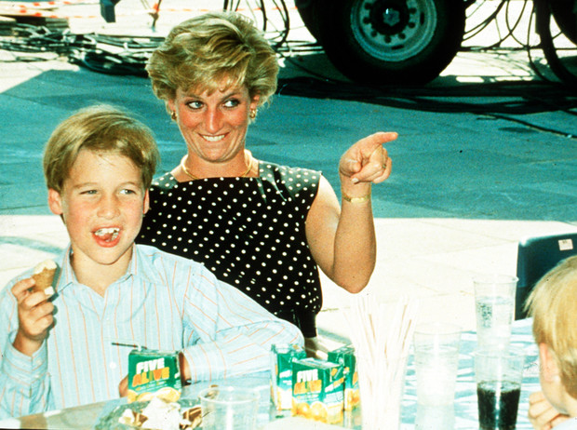
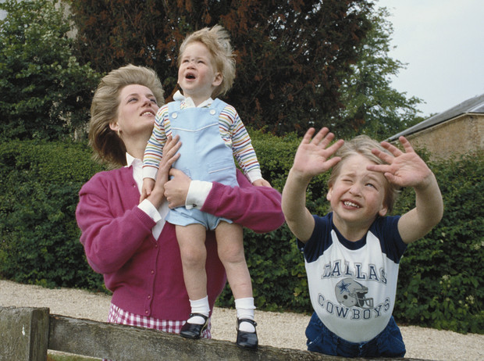
Diana and her sons

Slide 7
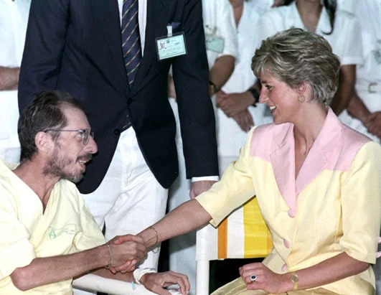
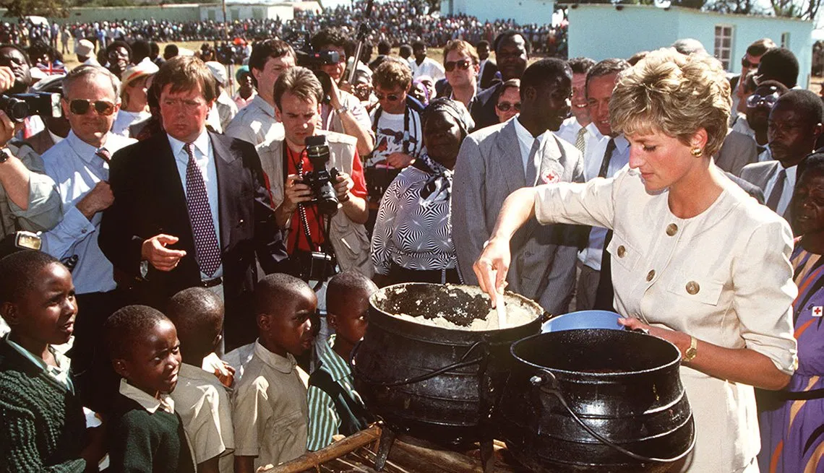
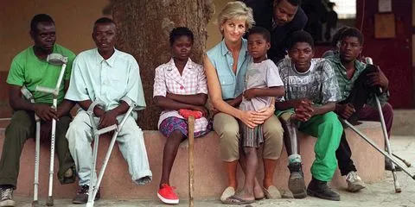
Public role
Diana was actively involved in charitable and peacekeeping activities (in particular, she was an activist in the fight against AIDS and the movement to stop the production of anti-personnel mines).

Slide 8
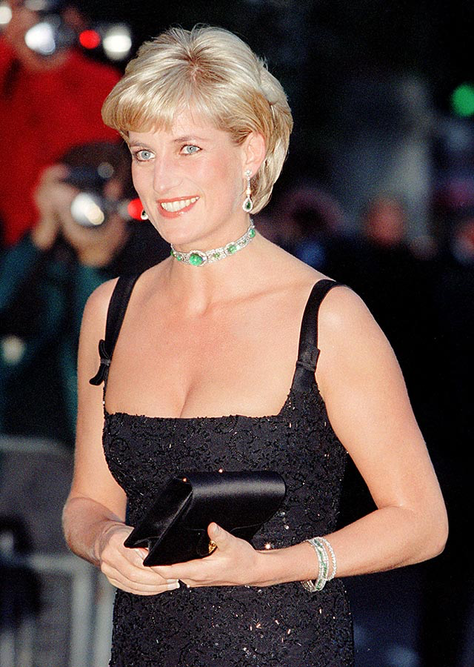
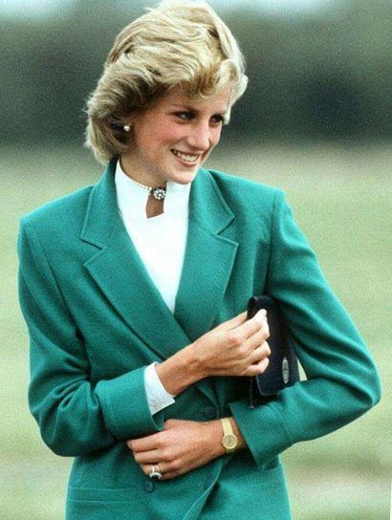
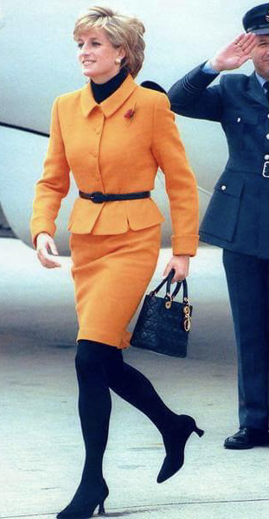
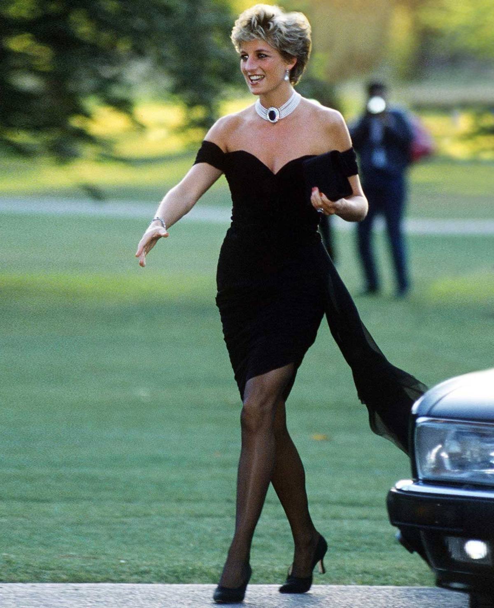
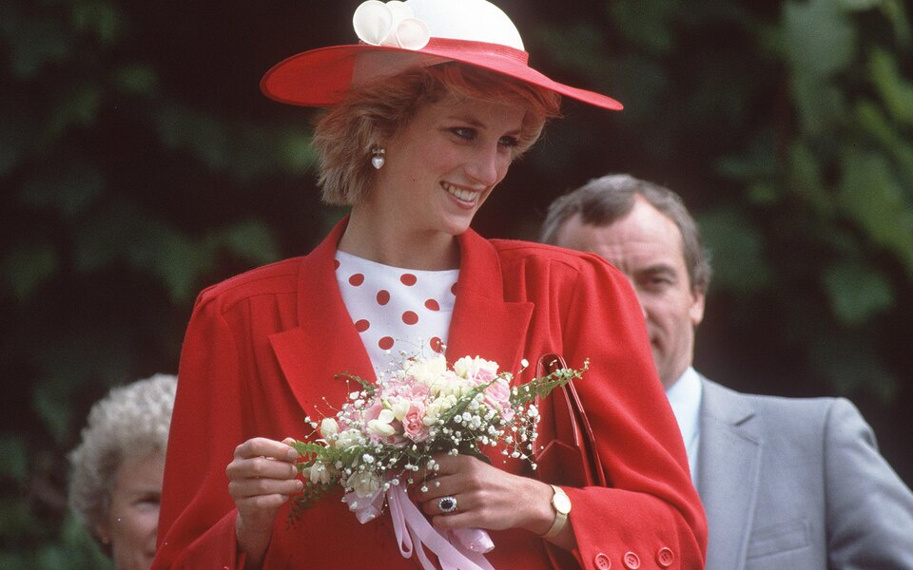
She was one of the most popular women in the world of her time. In Great Britain she was always considered the most popular member of the royal family, she was called "the queen of human hearts".

Slide 9
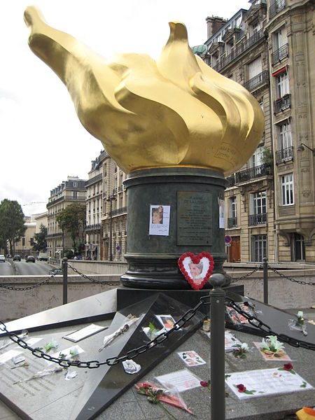
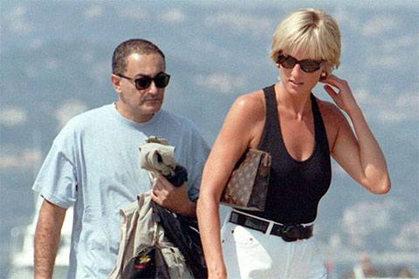
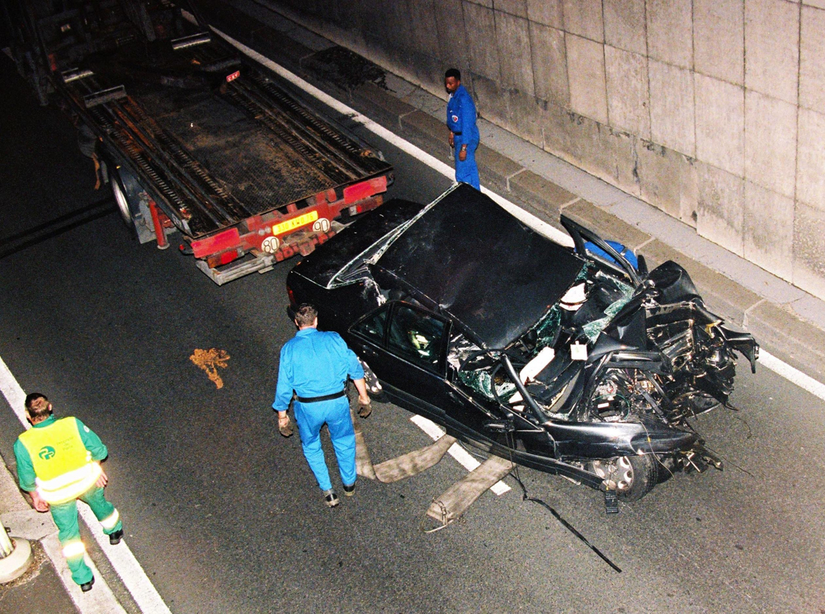
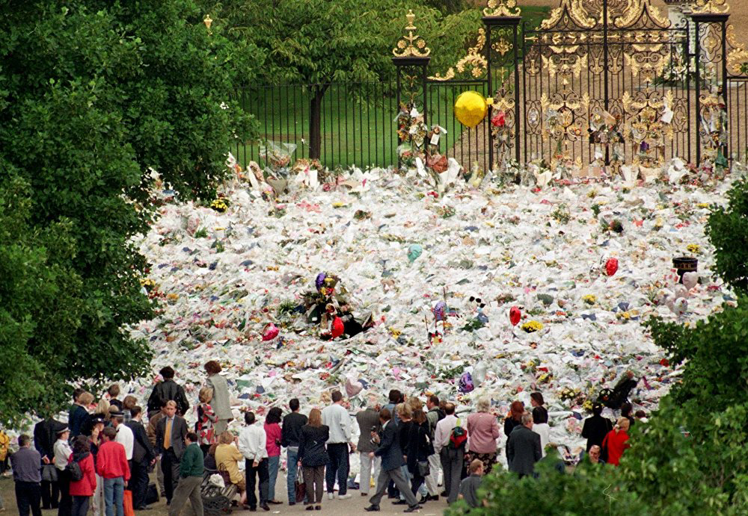
Doom
On August 31, 1997, Diana was in a car accident in Paris with Dodi al-Fayed and driver Henri Paul.
Princess Diana was buried on 6 September 1997 at the Spencer Althorp family estate in Northamptonshire, on a secluded island.

Slide 10
Thanks for attention!

