Slide 1
Choosing a career.
The world of jobs.
( Мир профессий. Выбор профессии )
Выполнила: Баринова О.В.,
Преподаватель ин. языка (англ.)
ГБПОУ ПУ №39 п. Центральный Хазан

Slide 2

The purpose of the lesson
Today we`re going to talk about the world of professions. You will do some lexical exercises to improve your speech. At the end you will choose different words to write a composition “My future profession”.

Slide 3

Poem “I want to be”
Some people often say to mе:
"Have уоu decided what уоu want to bе?"
I usually answer, "I don't know,"
But it isn't really so.
I want to win аn Olympic race,
I want to see the Earth from space,
I want to travel to Katmandu
I want to bе rich and famous, too.
I want to bеоn Hollywood's screen,
I want to invent а new machine,
I want to bе very clever and wise,
I want to win the Nobel prize,
But most of all, I want to bе
Healthy and strong, and nice.

Slide 4

The difference between the words: profession, job and occupation
Profession – a job that needs a special education and training.
Job – the regular paid work that you do for an employer.
Occupation – a job or profession. What is your mother’s occupation? Work – to do the job that you are paid for.

Slide 5
Now answer the questions
1
What is your mother by profession?
2
What is your father by profession?
3
What company does your father work for?
4
Is it an easy matter to get a job now a days?
5
What profession will you choose?

Slide 6

What profession is it?
Now it`s time for a guessing-game “What profession is it?”
I`ll describe you a profession and you will give me the word.
Here are some professions: journalist, bricklayer, architect, fashion designer, conductor, manager, accountant, sports instructor, cashier, programmer, decorator, car mechanics, physicist, interpreter, pharmacist.

Slide 7
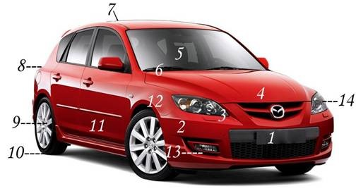
Appearance of the car
fog light, hood, headlight, sunroof, hubcap, tire, bumper, parking light, windscreen, windscreen wiper, door, wing, indicator, reflector, side mirror, trunk, petrol cap

Slide 8
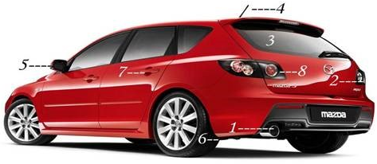
Appearance of the car (part 2 )
exhaust pipe ,brake light, mud flap, antenna, number plate, door handle, rear light, rear window

Slide 9
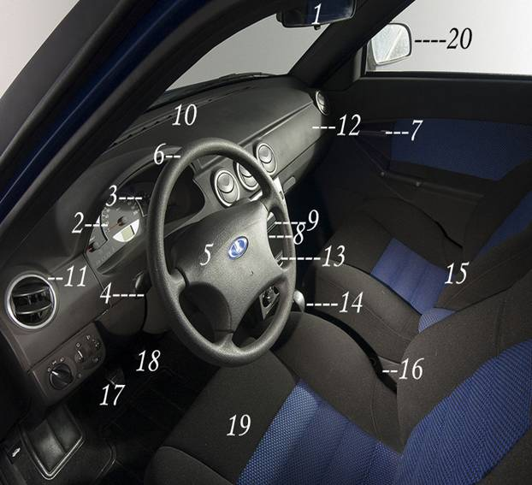
Car interior components
rearview mirror, speedometer, odometer, indicator, horn, ignition, headrest, gas pedal, break, CD player, air vent, dashboard, heater, seat belt, driver`s seat, passenger seat, gear stick, handbrake, accelerator, fuel gauge

Slide 10
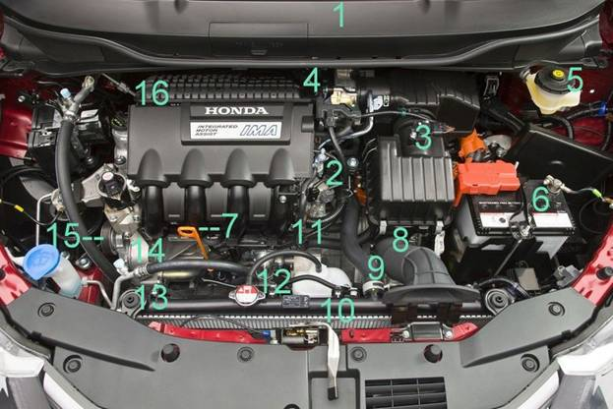
Car engine
bonnet, carburetor, radiator, coil, header tank, dipstick, fan, windscreen wiper motor, air filter, battery, oil filter, fuel pump, starter motor, engine, fan belt, alternator

Slide 11

You should choose the right answer.
Work in pairs
1. The engine is under the…
a) oil filter
b) hood
c) fuel tank
2. The headlight is near the…
a) fog light
b) brake light
c) rear light
4. The lever is between the…
a) shelf and the back seat
b) back seat and the passenger seat
c) driver seat and the passenger seat
3. The sunroof is above the…
a) hood
b) trunk
c) passenger seat

Slide 12
You should choose the right answer.
Work in pairs (part 2 )
5. The battery…the oil filter
a) is near
b) is under
c) is above
6. The fuel tank… the back seat
a) is near
b) is under
c) is above
7. The wheel…the side mirror and the glove compartment
is near
b) is above
c) is between
8. The wing…the damp
is under
b) isabove
c) isbetween

Slide 13

Imagine a car. Which sentences are right and which ones are wrong?
1. The exhaust pipe is under the hood.
2. The wheel is above the rearview mirror.
3. The fog light is between the gas pedal and the brake pedal.
4. The lever is between the number plate and the bumper.
5. The fuel tank is near the engine.
6. The tire is above air filter.
7. The battery is between the back seat and the muffler.
8. The ignition is near the shelf.
9. The glove compartment is under the rear window.
10. The dashboard is above the hubcap.
11. The handbrake is near the sunroof.
12. The fan is between the hood and the trunk.
13. The damp is near the gearbox.

Slide 14
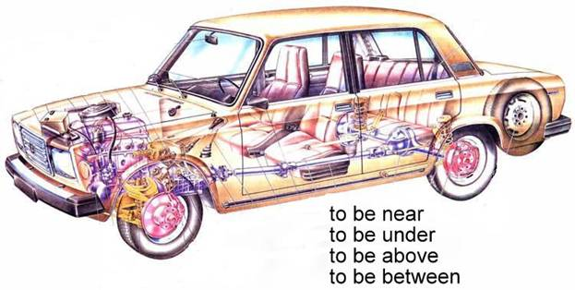
The constructions «to be near, to be under, to be above, to be between»
Make sentences with these constructions. For example:
- The engine is under the hood.
- The fog light is between the bumper and the hood.
- The rearview mirror is above the dashboard.

Slide 15


