Slide 1
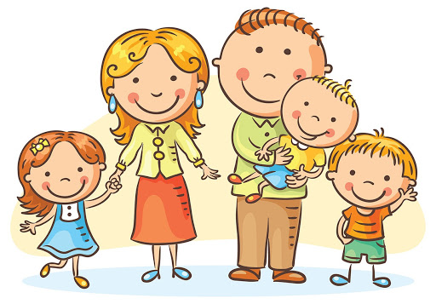
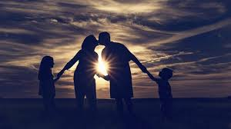
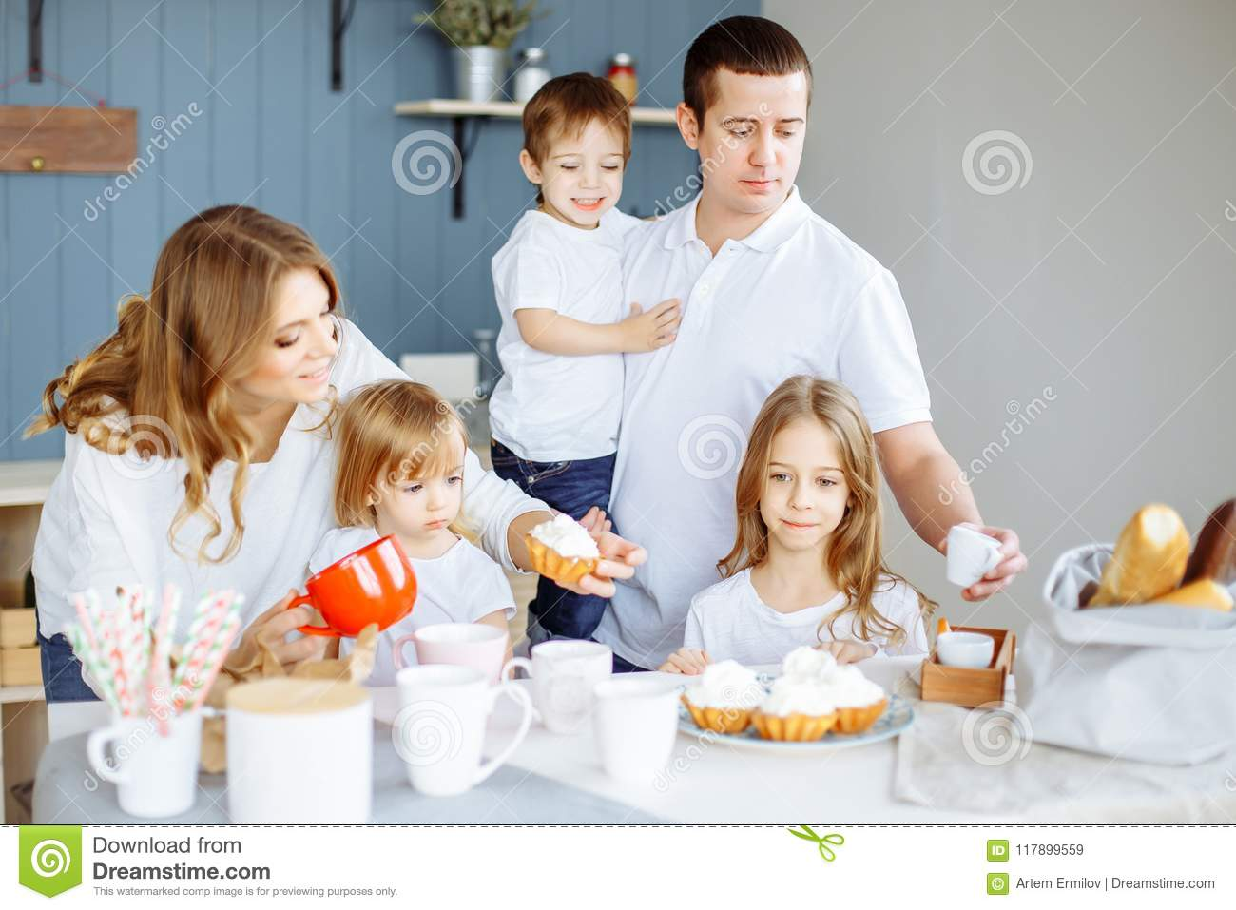
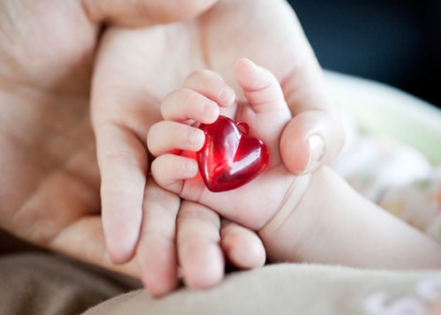
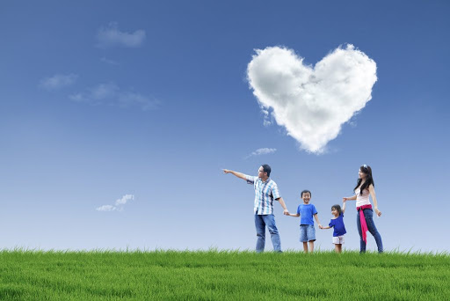

Slide 2

What’s the theme of our lesson?Let’s suggest!
F y A m L I

Slide 3
Phonetic Drill
My Family.
This is my father,
this is my mother,
This is my brother Paul.
This is my sister, this is my brother,

Slide 4
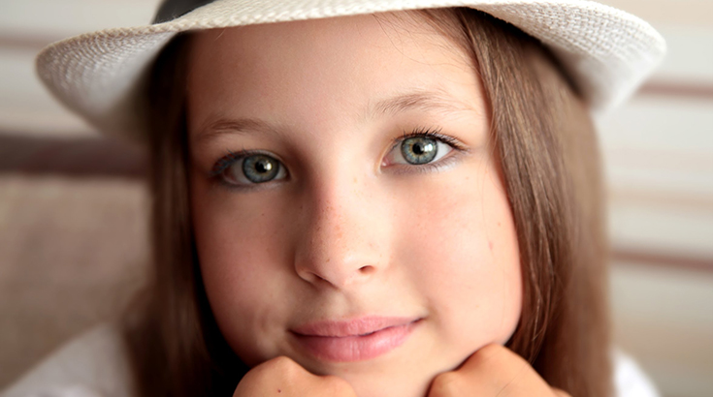
Laura Black, 12 a pupil, friendly, kind playing the guitar

Slide 5
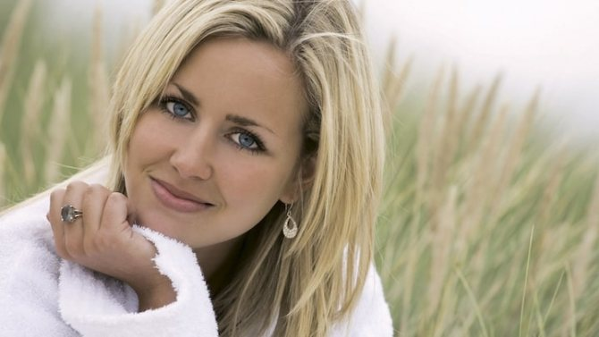
Laura’s mother,
Jane
35 very funny, plays the piano nurse

Slide 6

Laura’s father,
David,
42 a doctor,
Spanish and French, funny

Slide 7
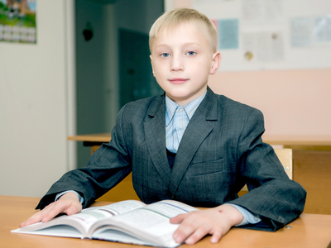
Laura’s little brother, John,
9 a student primary school, computer games, kind and friendly

Slide 8
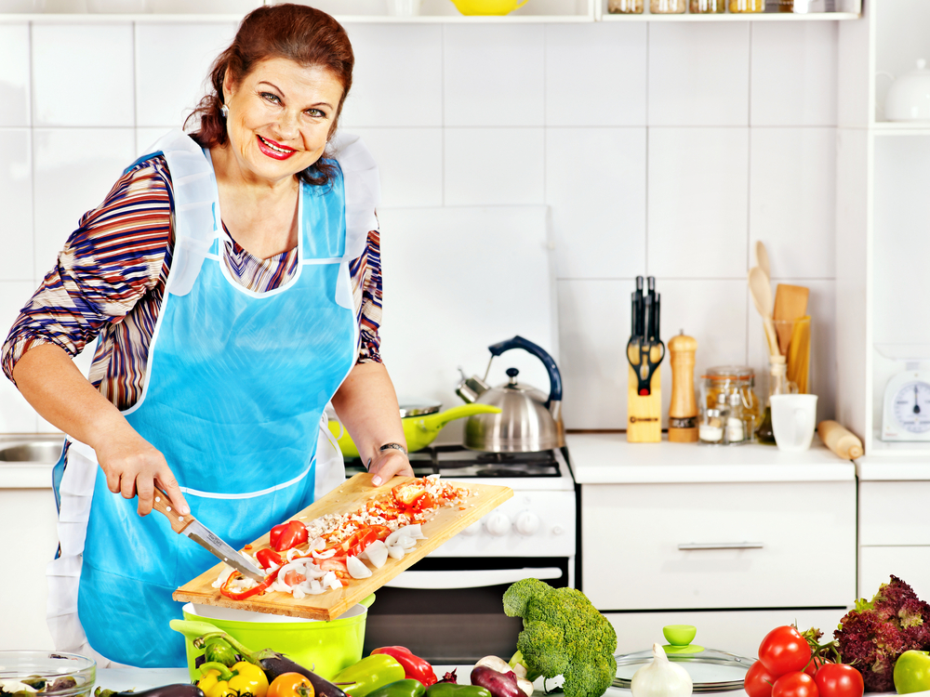
Laura’s grandmother,
Betty, 70 kind, friendly doesn’t work, makes cookies

Slide 9
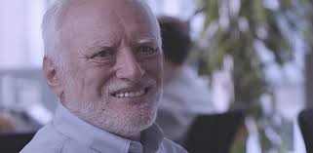
Laura’s grandfather,
Jim,70 really funny, plays Monopoly well

Slide 10
1 Clever - умный
2 Cool - классный
3 Naughty - непослушный
4 Caring - заботливый
5 Kind - добрый
6 Friendly - дружелюбный
7 Funny - веселый
8 Noisy - шумный
9 Sweet - милый

Slide 11
Let’s talk about your family!
I am .....
I have got a...
He/She is.......
He/She is .....
He/She is a .......

Slide 12
Homework
Выучить прилагательные
Упр.1,2 с.35 р.т.

