Slide 1
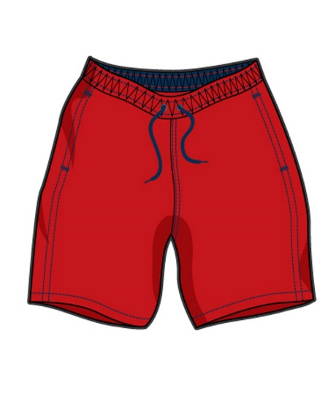
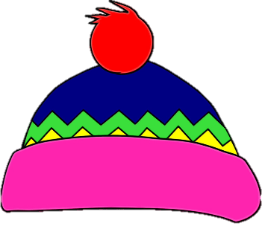
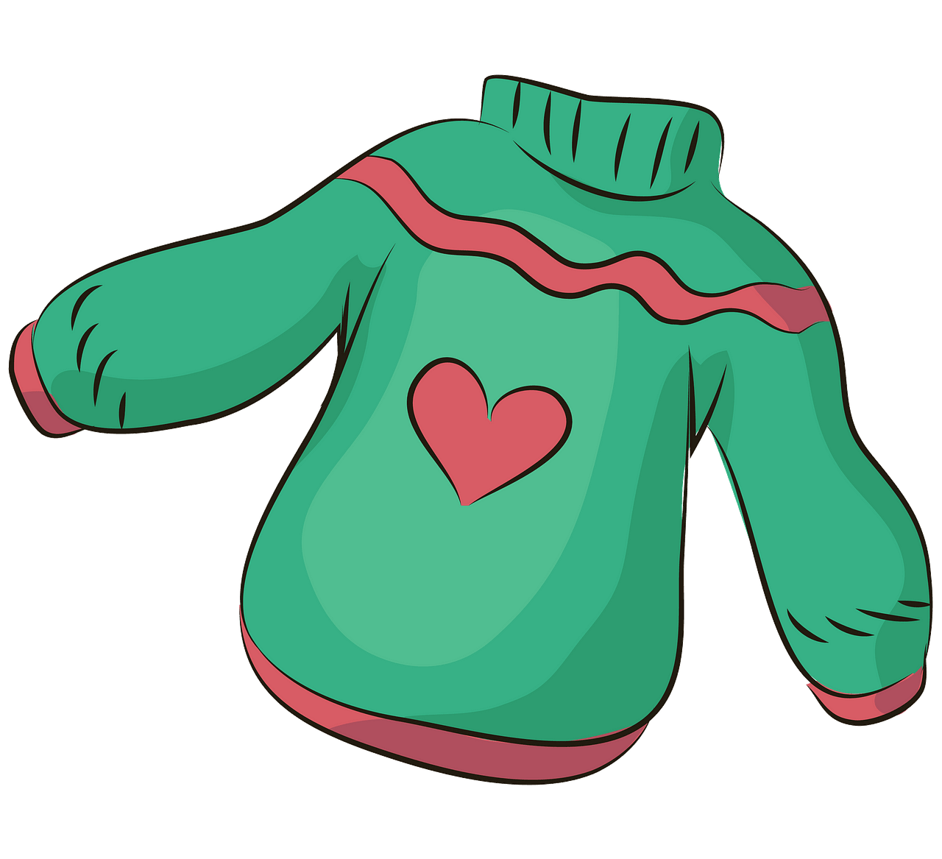
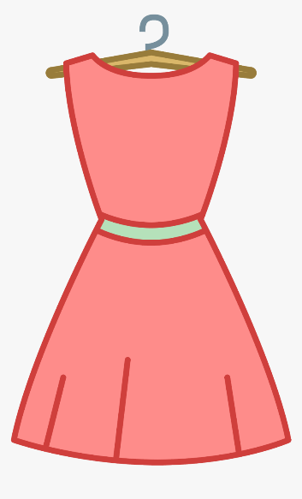
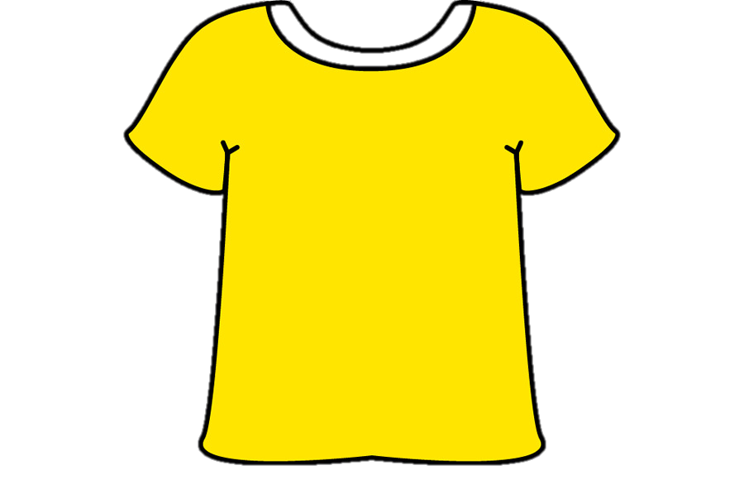
Clothes
Презентация составлена
учителем английского языка
ГБОУ Школа № 2051 г. Москвы
Кавас Л.В.

Slide 2
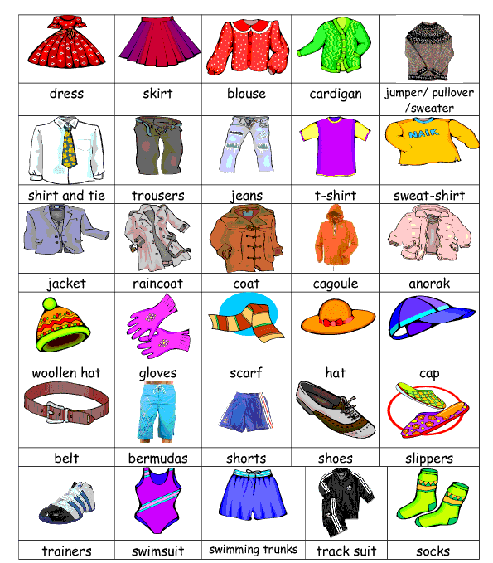
Listen and repeat the new words after the teacher.

Slide 3
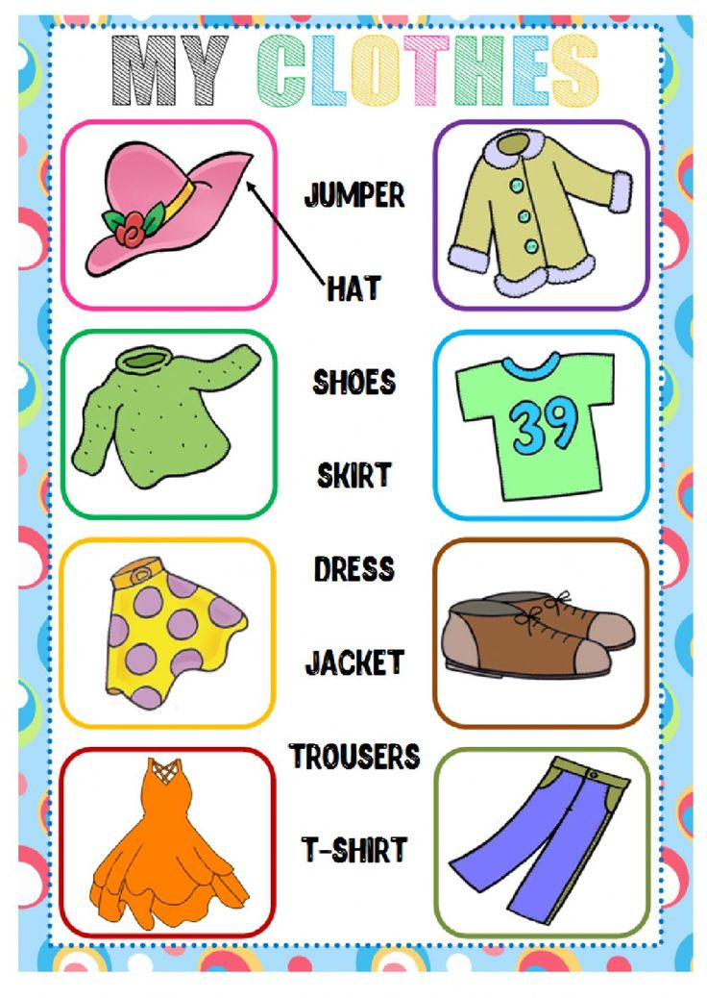
New vocabulary check. Match the words to the pictures.

Slide 4
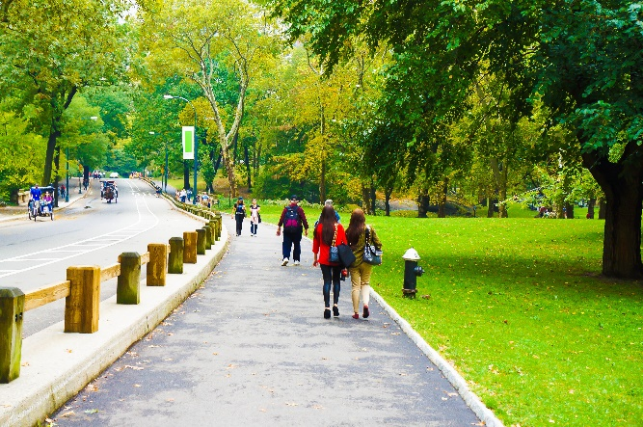
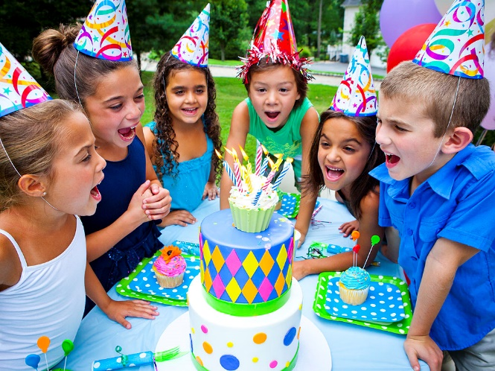
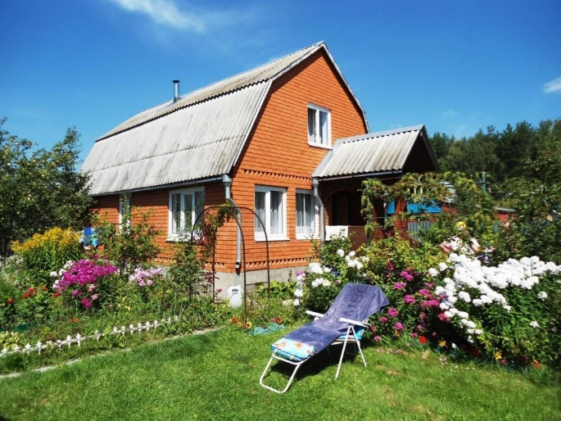
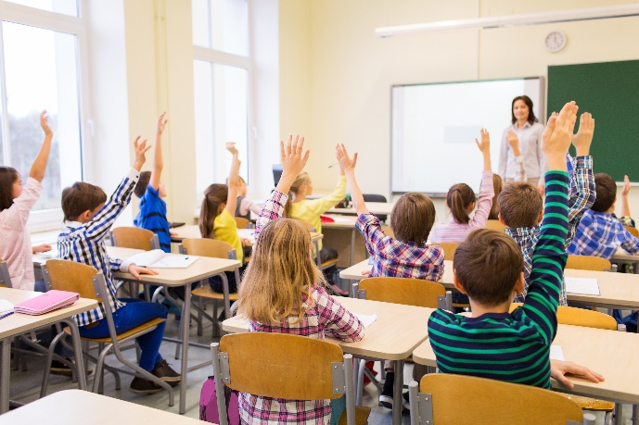
Brainstorming: What do you put on when you go to…
e.g. I put on my hat, a coat and shoes.
park?
birthday party?
country house?
school?

Slide 5
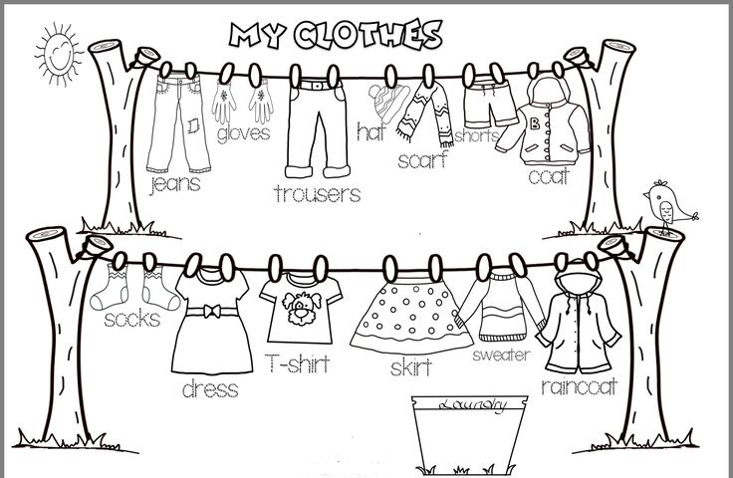
Listen and colour the clothes. Trace the words.

Slide 6
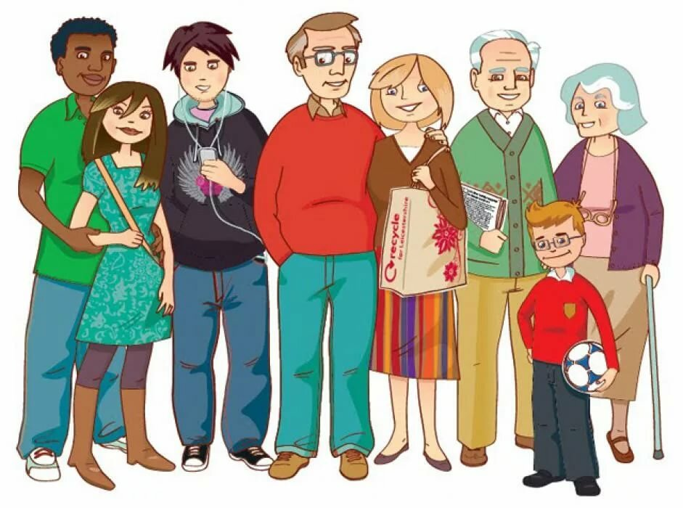
Write down the descriptions of the people.
He’s wearing a green ____ and blue____.
She’s wearing a green____ and brown____.
He’s wearing a black______ and blue _____.
He’s wearing glasses, a red _____ and brown___.
He’s wearing a green _____ and brown ____.
He’s wearing glasses and a red ______ with black _____.

Slide 7
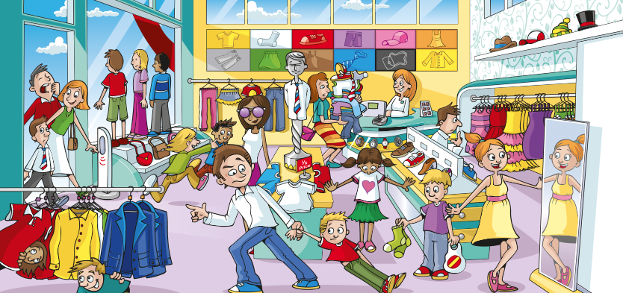
Describe a person to your partner. Listen and guess.
He’s wearing…/She’s wearing…
e.g. He’s wearing a white shirt, blue jeans and blue shoes.

Slide 8
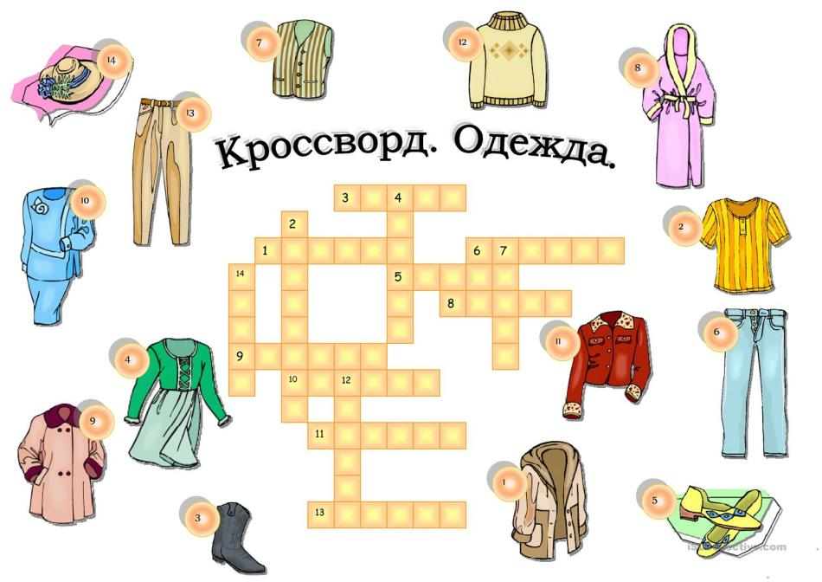
Homework: learn the new vocabulary and solve the crossword puzzle.

