Slide 1

The environmental problems in Kuzbass and China

Slide 2

Kuzbass

Slide 3
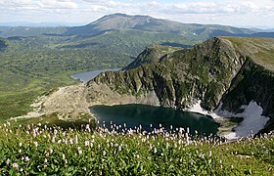
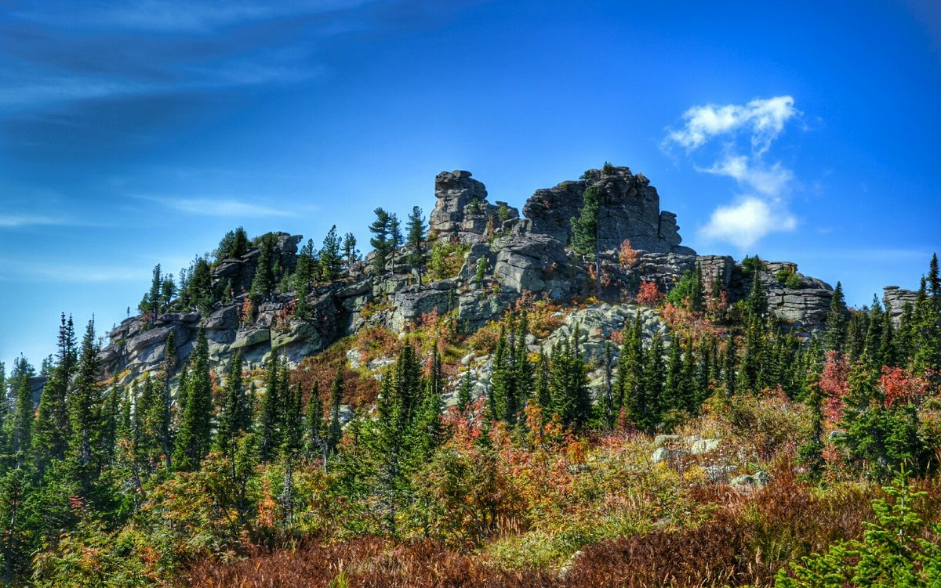
Protected areas
Kuznetski Alatau and Gornaya Shoria

Slide 4
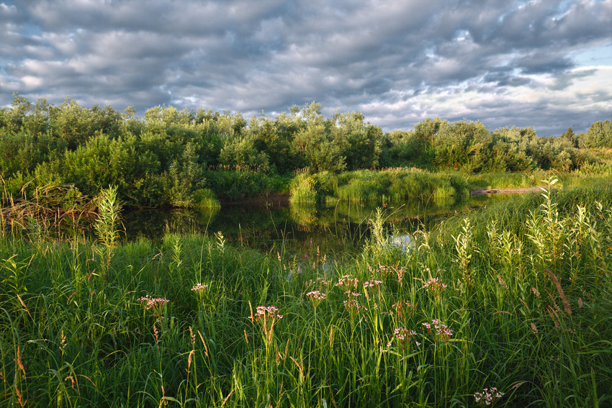
Nizhnetomsky State Reserve
It was established in 1964 to protect roe, heath-cock, partridge and willow ptarmigan

Slide 5
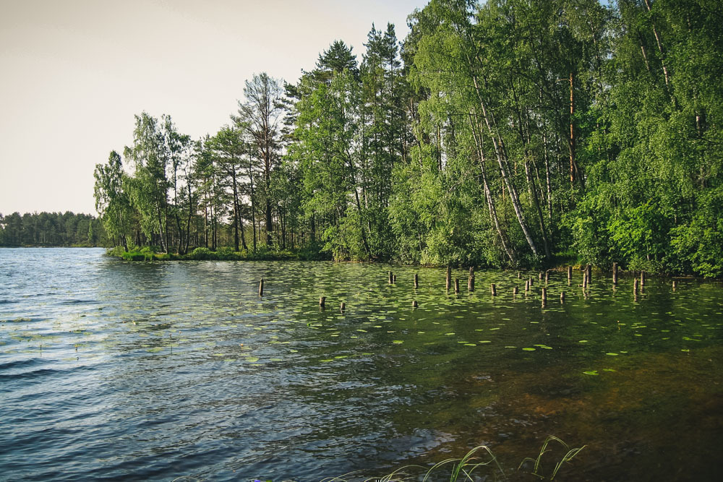
Tersinsky State Reserve
This reserve was established in 1979 to protect beaver, maral, reindeer, sable, wood-grouse, willow-ptarmigan and rare fish.

Slide 6
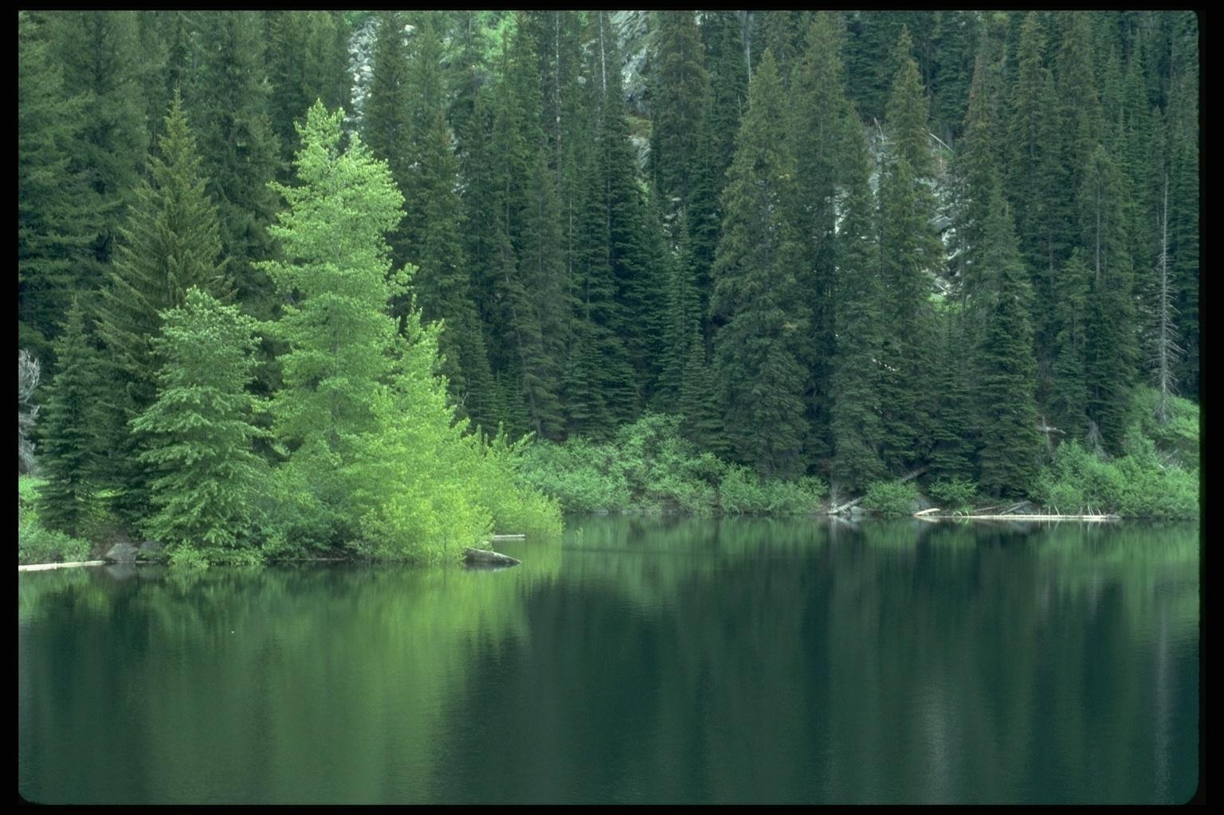
Ust-Sosnovsky State Reserve
It was established in 1964. In birch and asp groves live elks, roes, heath-cocks, partridges, willow ptarmigans and cranes.

Slide 7
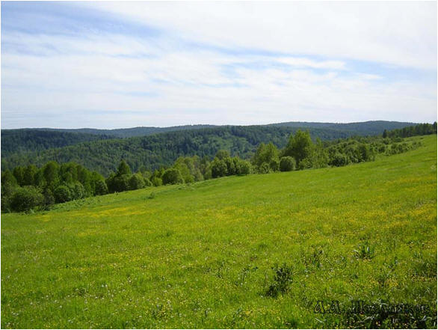
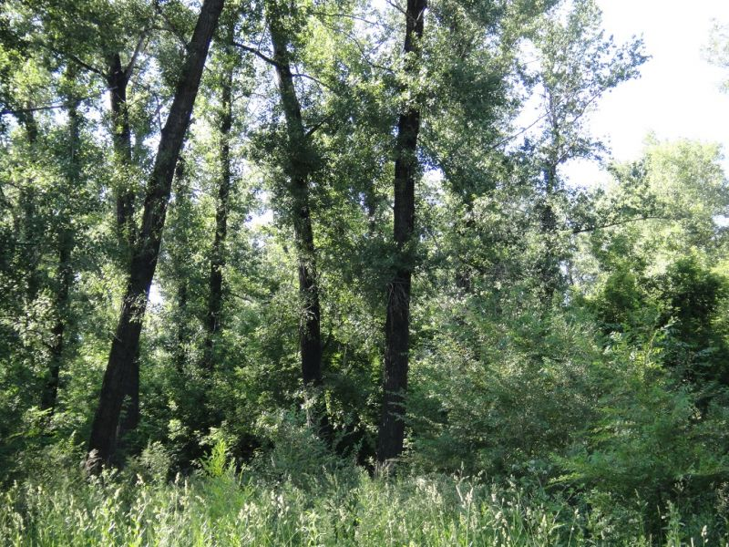
Natural Memorial Places
The Island of Lime Trees – the grove of tertiary flora
Topolniki – the grove of black poplars

Slide 8
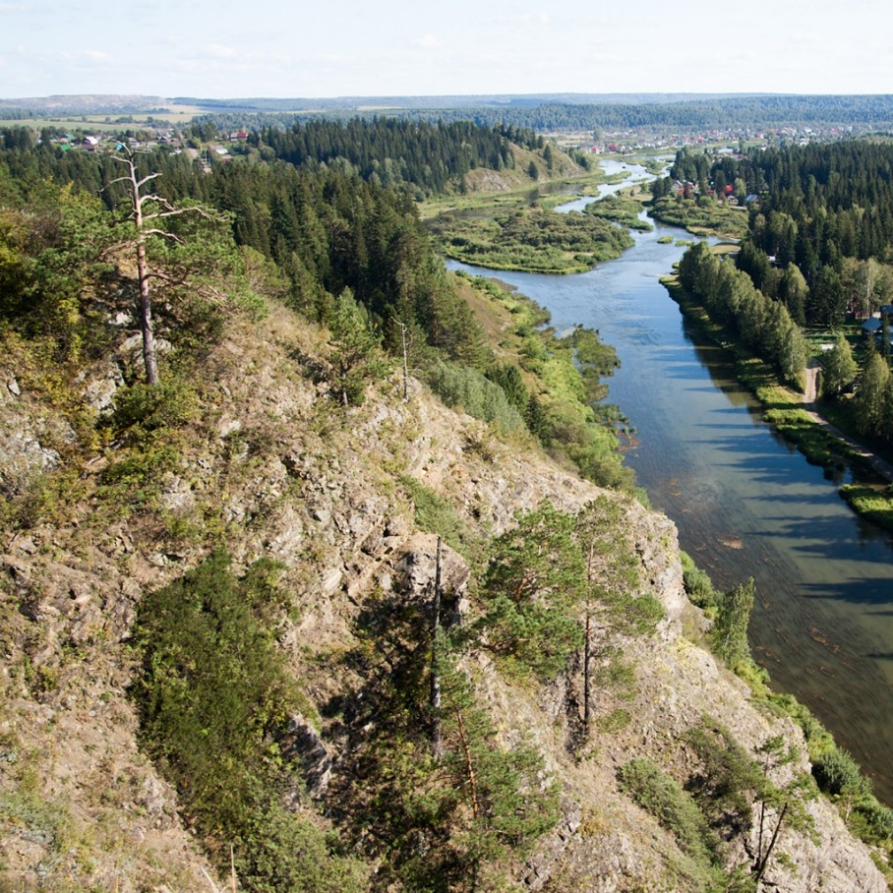
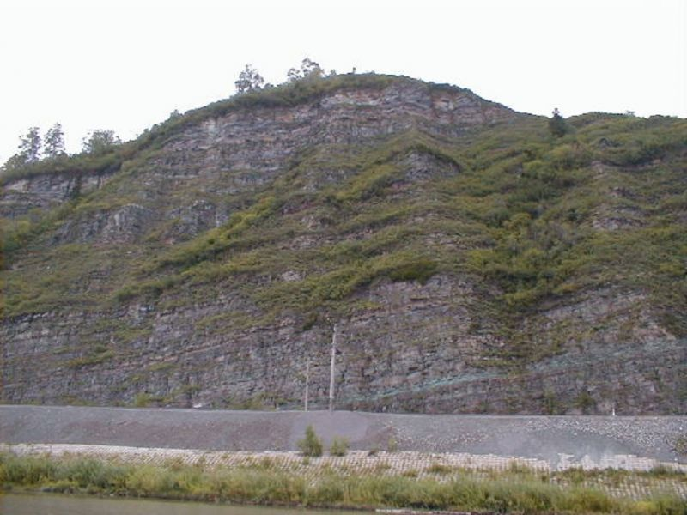
Blue Rocks on the river Shooting Stone
Chumysh

Slide 9
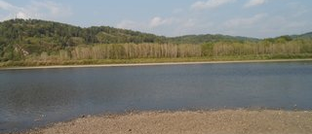
The Messerschmidt Fire Mountain

Slide 10
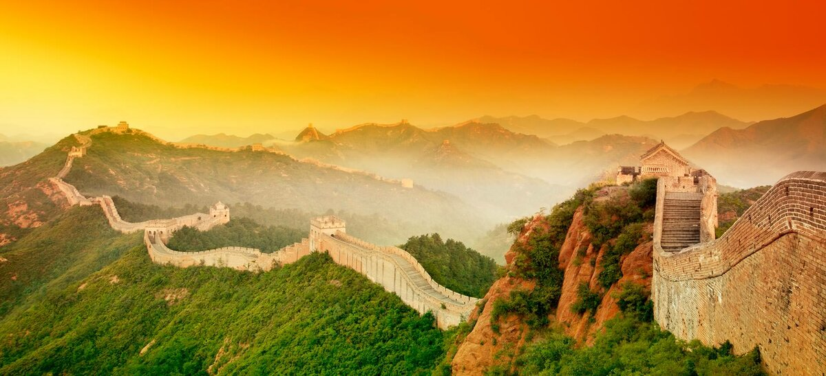
China 中国

Slide 11
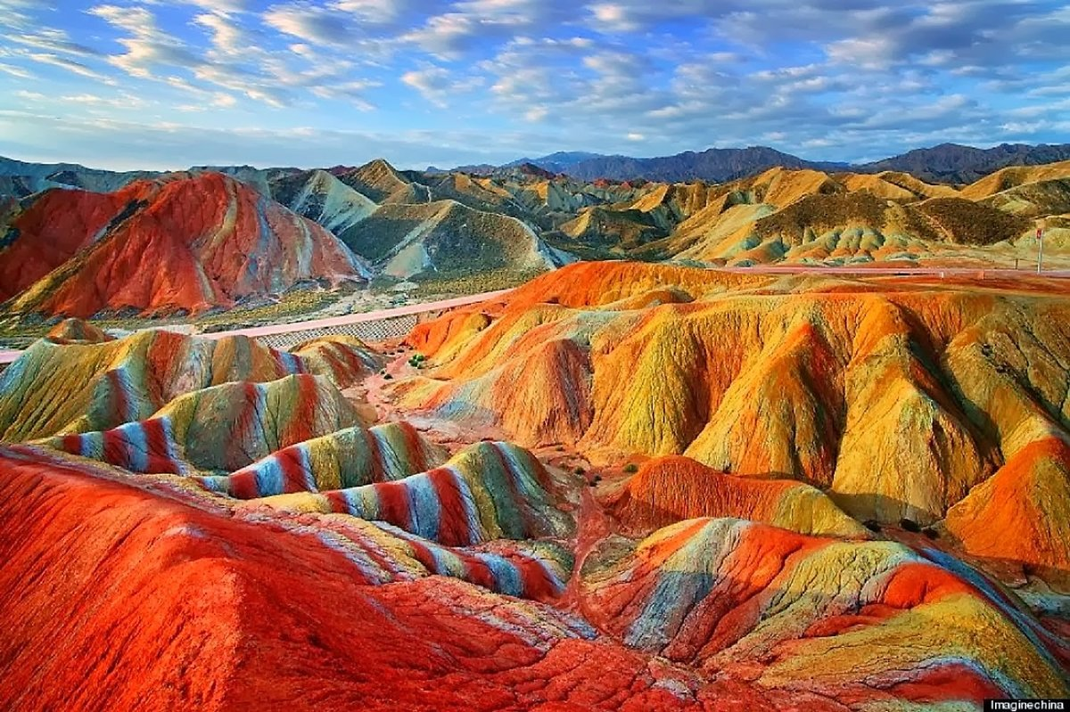
张掖丹霞国家地质公园

Slide 12
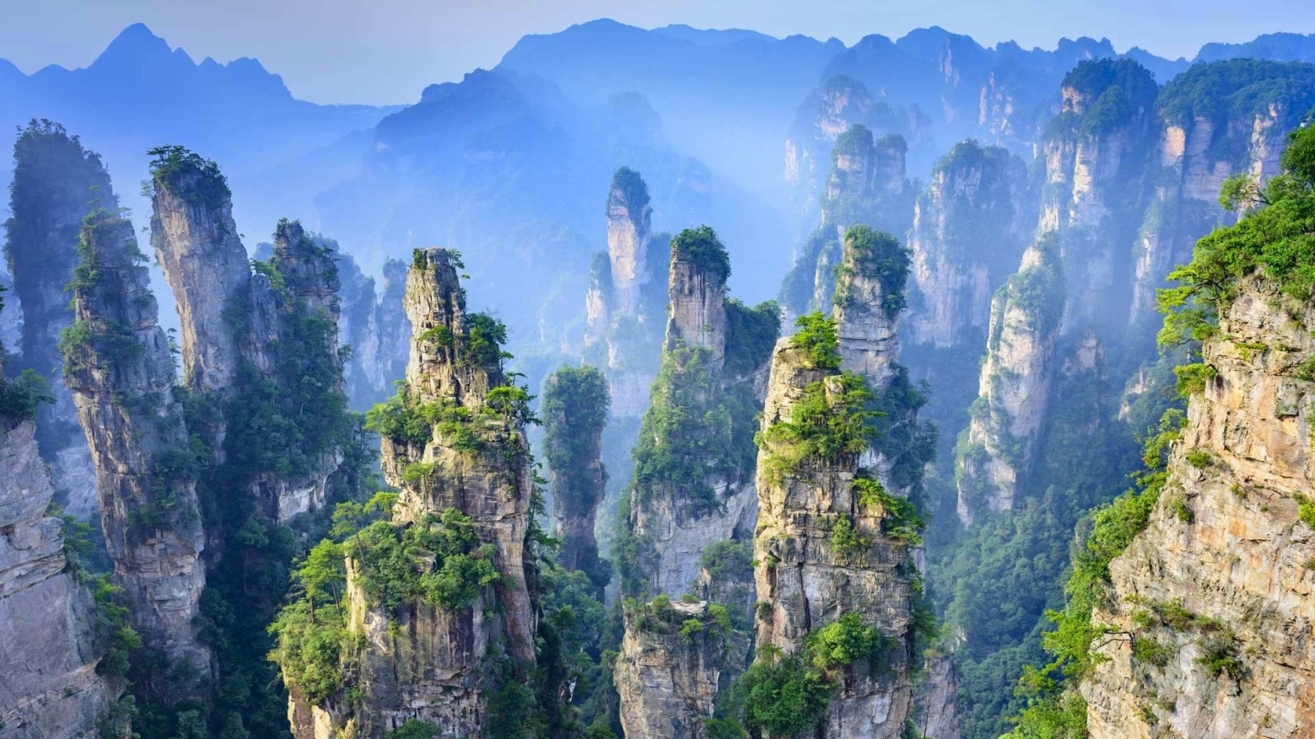
张家界国家森林公园

Slide 13
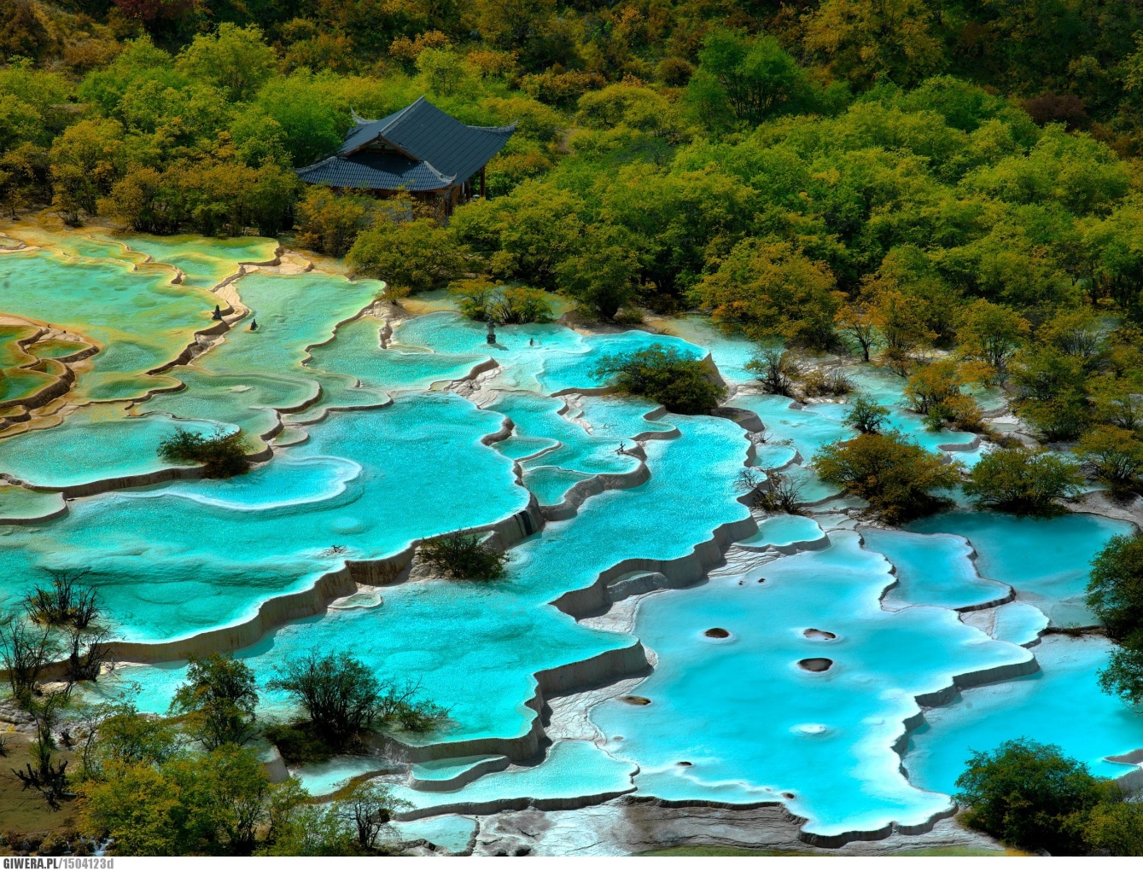
黄龙

Slide 14
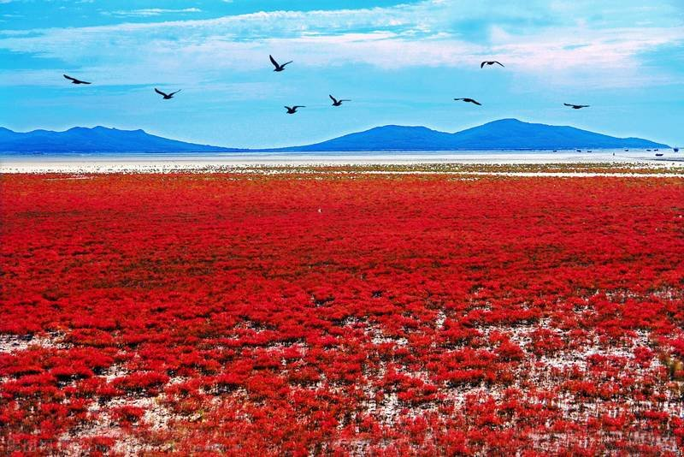
双台河口湿地

Slide 15
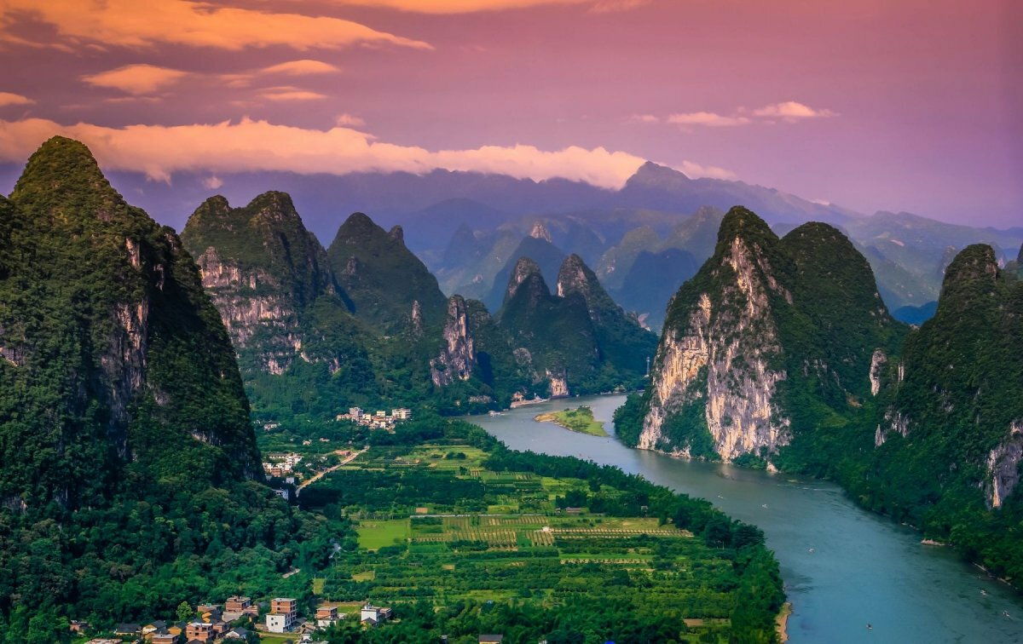
桂林

Slide 16
Protect the wild nature in Kuzbass
. During the last 30 years, 200 rivers (out of 905) have died, many rivers have been polluted, soil near large industrial centres has also been polluted, about 69,000-75,000 hectars of land have been damaged, 10% of forests have disappeared, especially forests of abies, some forests have been cut down, some animals and birds have migrated.
The wild nature of Kemerovo region needs protection and care. Man’s activities did great harm to the environment. Industry concentration in our region gave rise to many ecological problems: air pollution, water pollution, disappearing forests, rivers and wild animals.

Slide 17
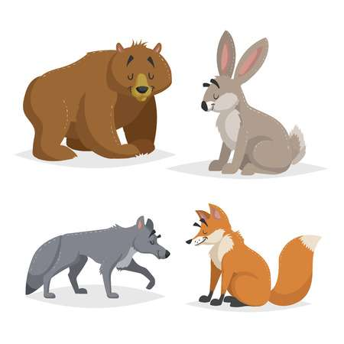
If we do not stop environmental degradation, future degradations will learn about wolf, bear, fox and hare only from Russian fairy tales and see them only in pictures.

Slide 18
Not only plants and mines destroy the wild nature
Wild life is damaged by poaches, who kill protected animals and destroy trees, by some hikers and campers, who pick wild flowers, break branches of trees, frighten wild animals, litter the ground with paper, cans or bottles, sometimes leave the campfire burning, which causes a forest fire.

Slide 19
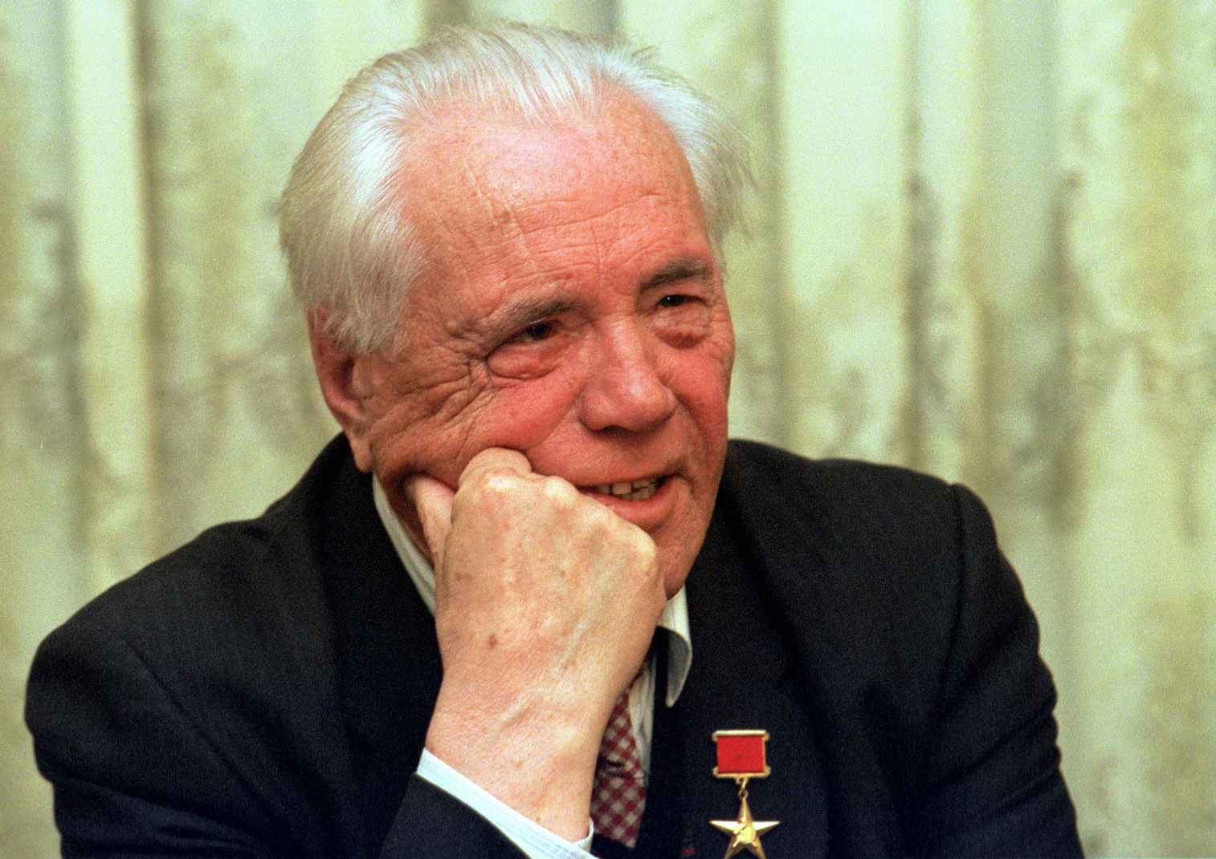
“We have not understood yet and do not want to understand that animals, birds, fish, plants can live without us, but we cannot survive without them even a day.” (Victor Astafyiev)

Slide 20
What can you do to protect wildlife?
Plant more trees.
Feed birds in winter and help them survive in the cold.
All woods are home to animals. So, behave as guests.
When you hike, leave the place clean.
When you make a fire, don’t forget to put out and cover it with earth before you go away.
Clear rubbish from lakes and rivers.
Don’t break plants and don’t pick wild flowers.
Don’t frighten wild animals.

Slide 21

Protection of nature means the protection of our Motherland!

Slide 22






Posters about ecological problems of the day

Slide 23
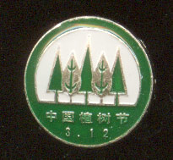
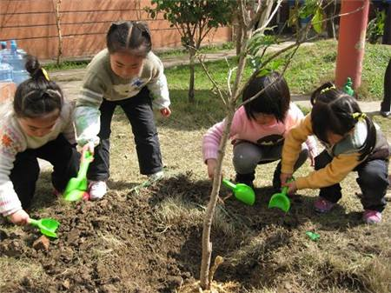
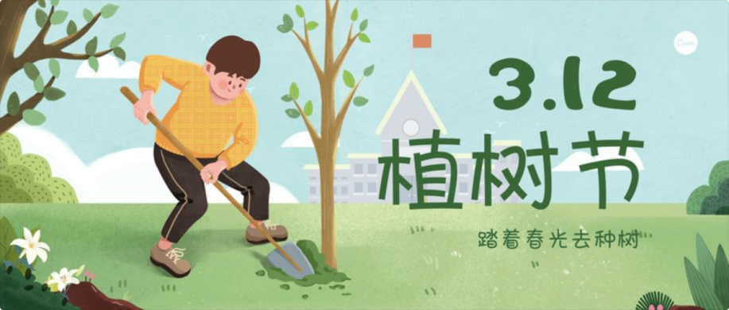
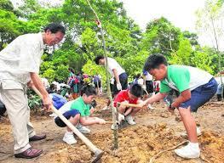
植树节, Zhíshù-jié

Slide 24
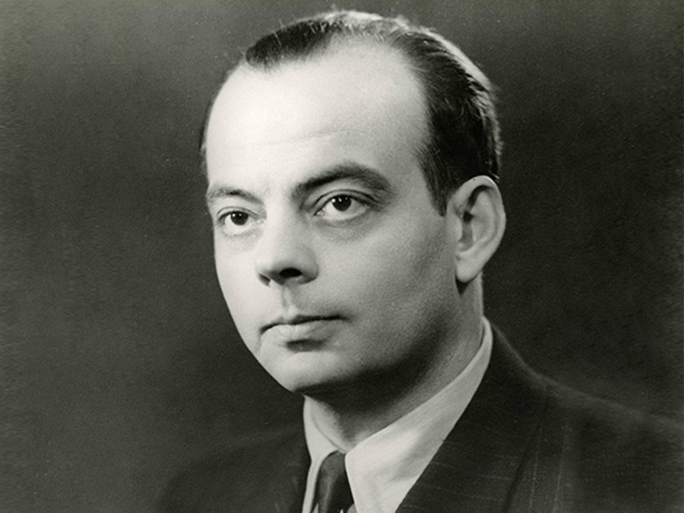
“There is a rule you got up washed, made order in yourself - at once, make order in your planet” Antoine de Saint – Exupery

Slide 25

Thanks for your attention!

