Slide 1
Урок английского языка
по теме
«Погода. Одевайся правильно!»
5 класс
Автор:
Васильева Е. В.
учитель ГБОУ лицея № 419 Петродворцового района
Санкт-Петербурга

Slide 2
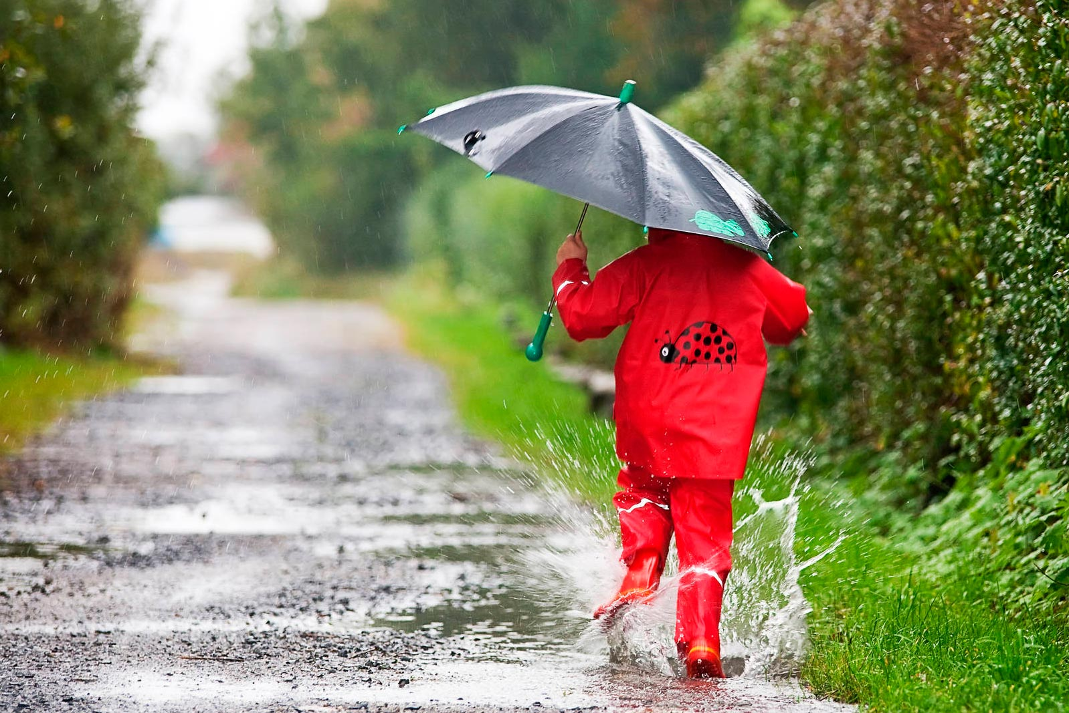

Slide 3
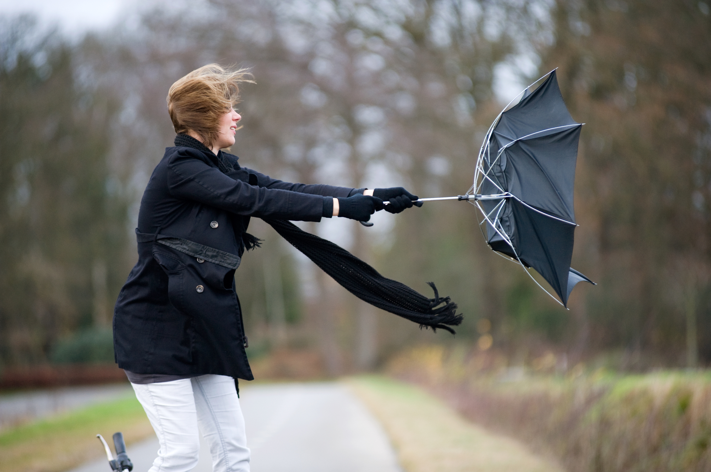

Slide 4
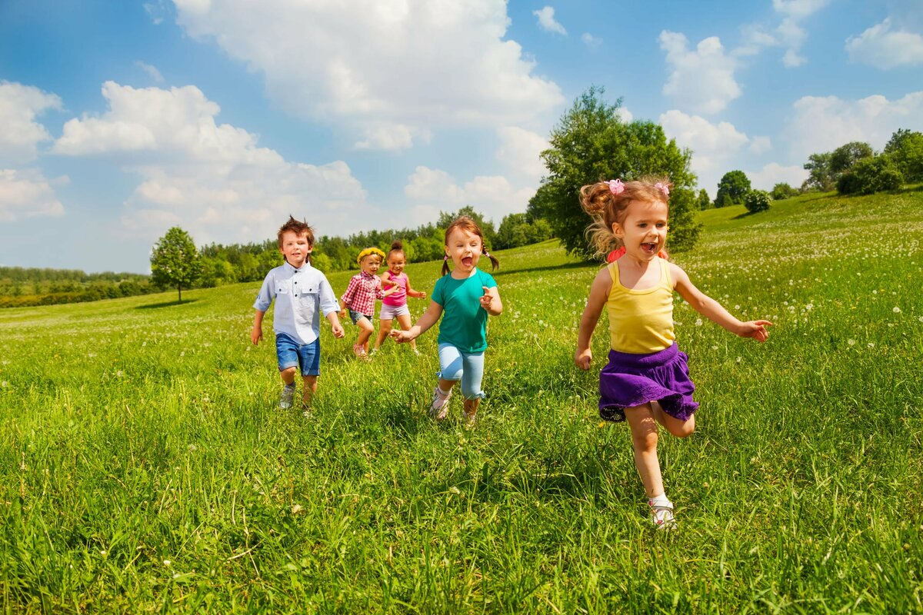

Slide 5
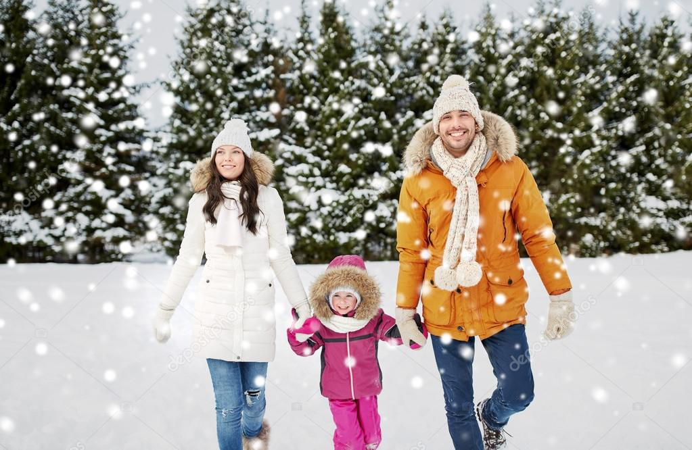

Slide 6
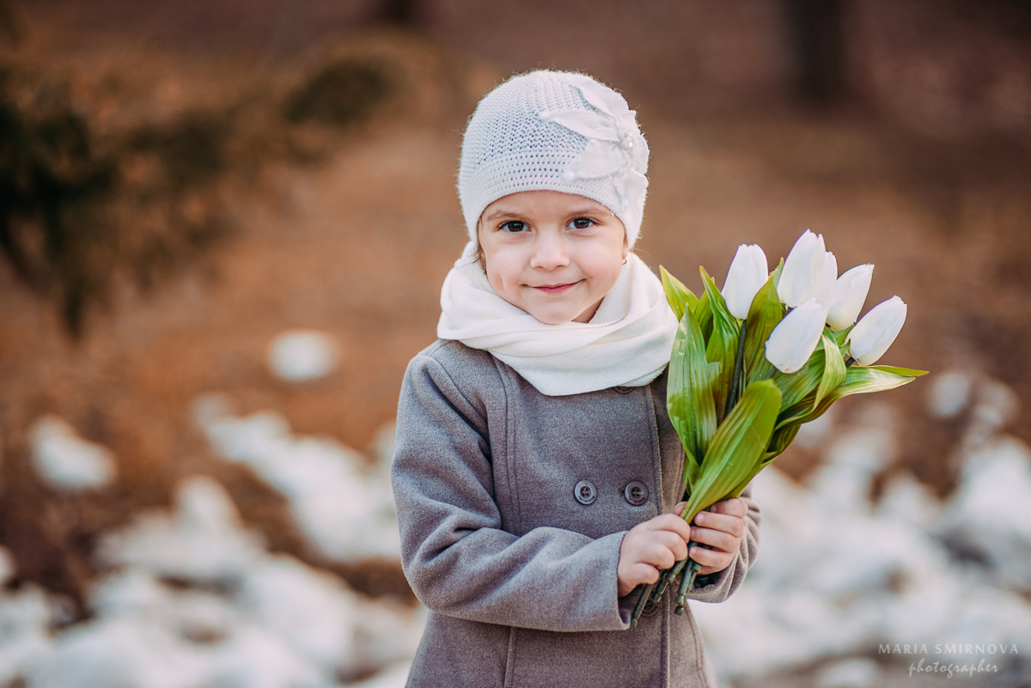

Slide 7
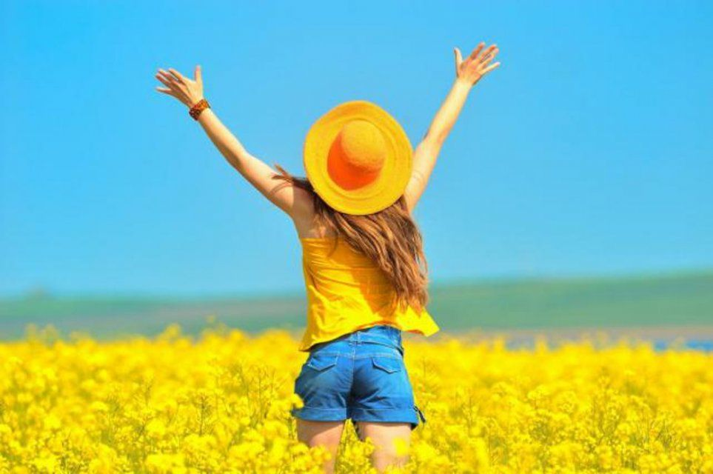
Weather. Dress right!

Slide 8


Read the text, fill in the correct words:
1) winter;
2) cold x 2;
3) nice;
4) shines;
5) hot x 2;
6) flowers;
7) cool;
8) yellow, red and brown;

Slide 9
Weather and clothes
December, January and February are 1) winter months. The weather is 2) cold. It usually snows. The rivers and lakes freeze and we can go skating and skiing.
March, April and May are spring months. Spring is a 3) nice season. The weather is warm. The sun 4) shines brightly. The birds sing songs everywhere.
June, July and August are summer months. In summer it is usually 5) hot. The sky is blue. The days are long and the nights are short. There are many 6) flowers in the parks and gardens.
September, October and November are autumn months. The weather is 7) cool. It often rains. The birds prepare to fly to the South. You can see 8) yellow, red and brown leaves on the trees.
When it is 9) cold, people wear coats, jumpers, trousers and boots. When it is 10) hot, people wear T-shirts, shorts and light dresses.
Some people like to wear comfortable clothes, others prefer fashionable one. There are clothes for boys and girls, for men and women. But everybody likes to wear jeans. Also there are clothes for sport. It is a tracksuit and trainers.

Slide 10
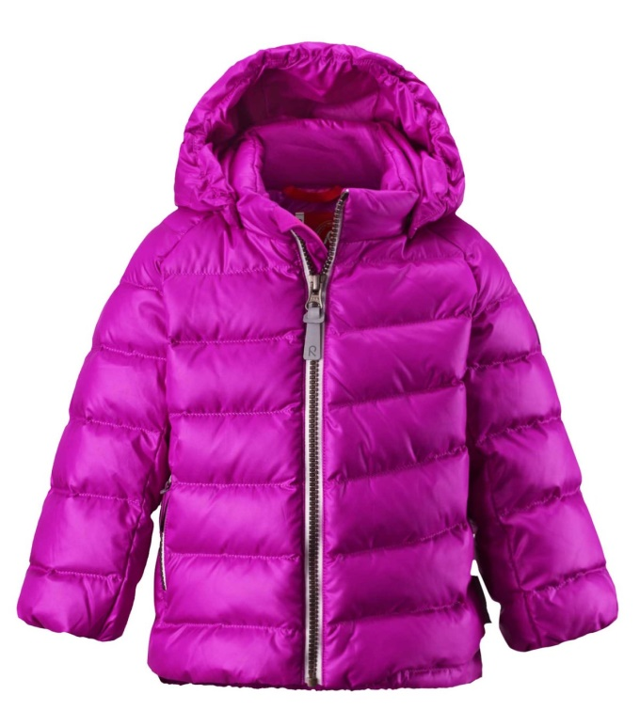
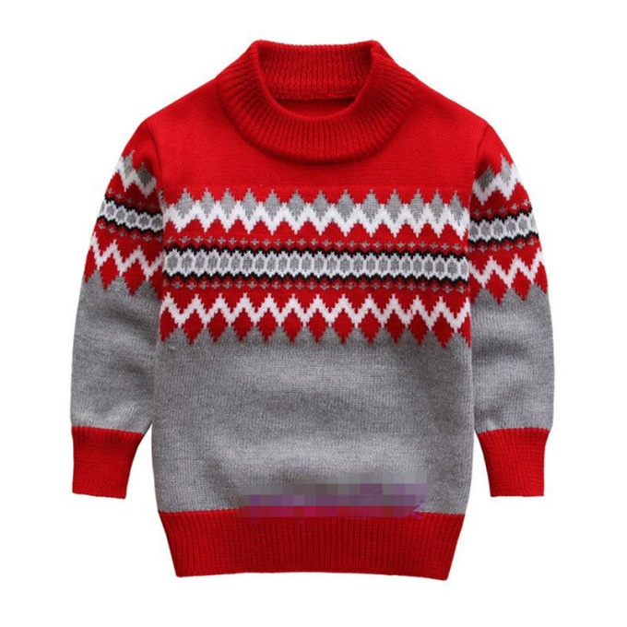
Сlothes
Jacket
Sweater

Slide 11
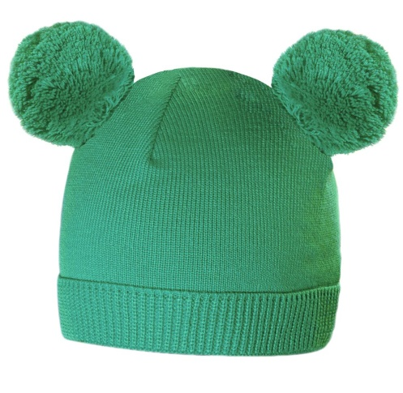
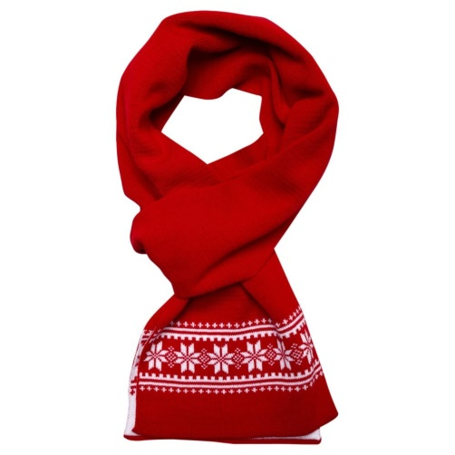
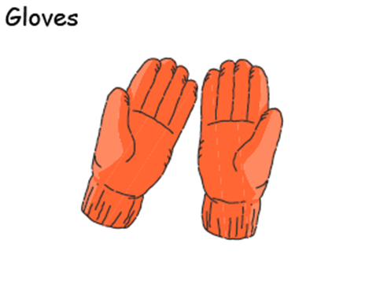
Warm hat
Scarf
Gloves

Slide 12
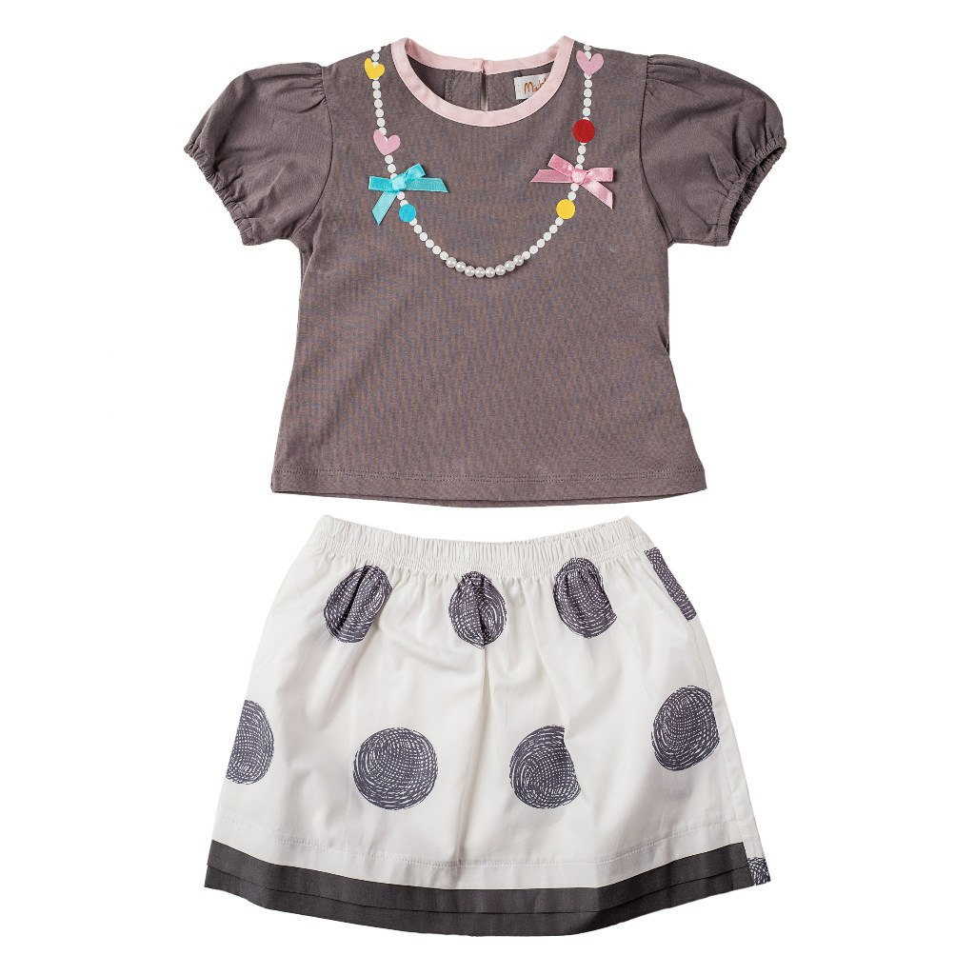
T-shirt
Skirt

Slide 13
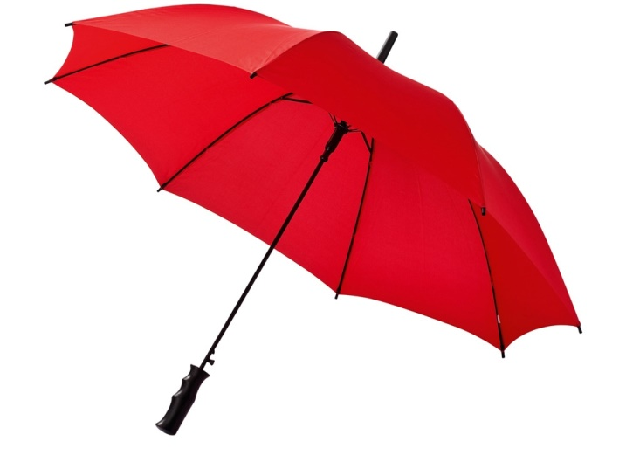
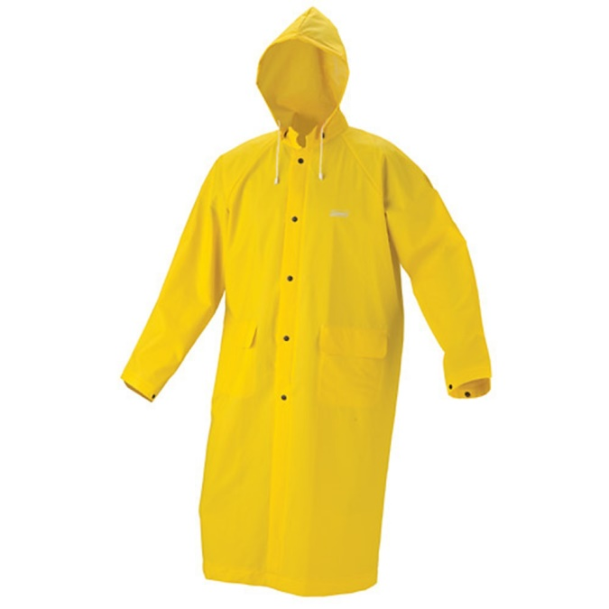
Umbrella
Raincoat

Slide 14
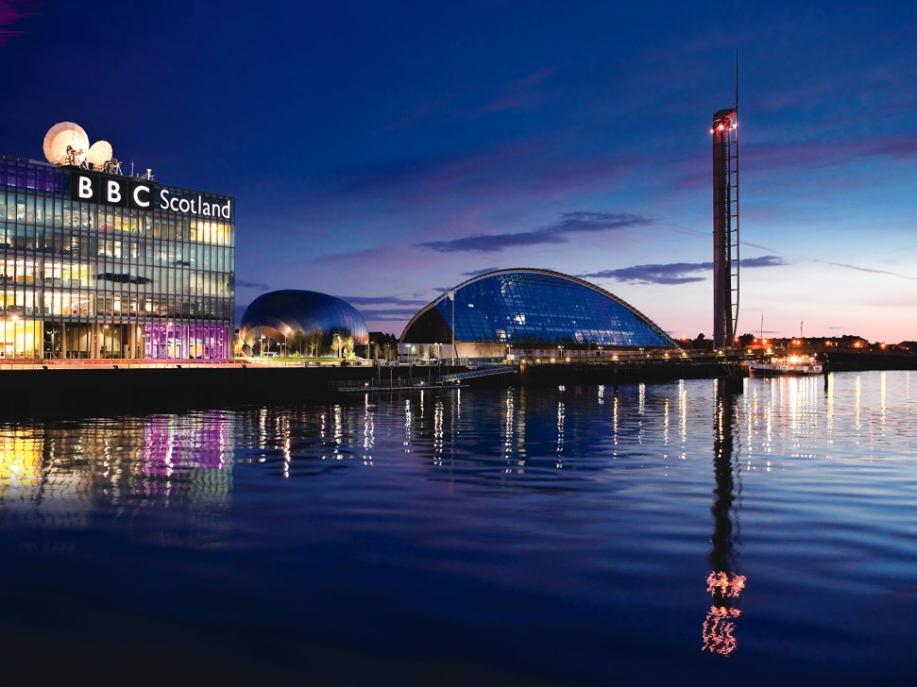
Listen and answer:
What city is it?

Slide 15

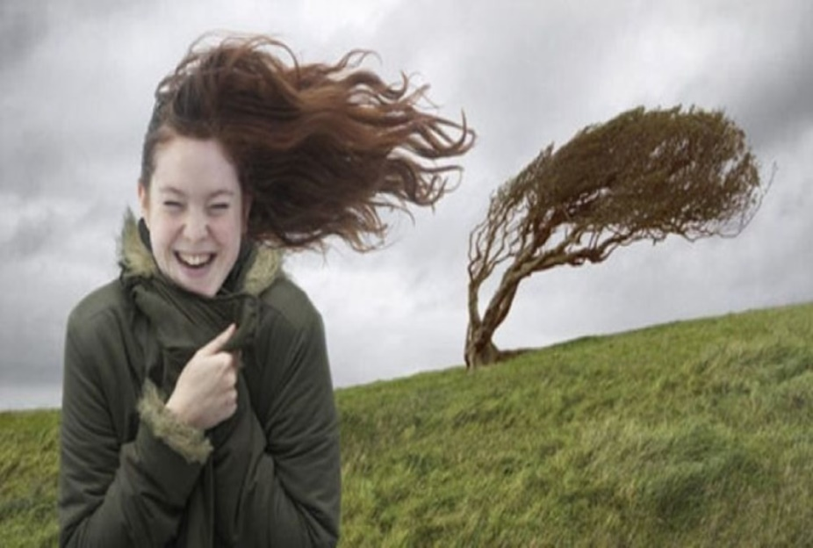
Listen and answer:
What is the weather like?

Slide 16
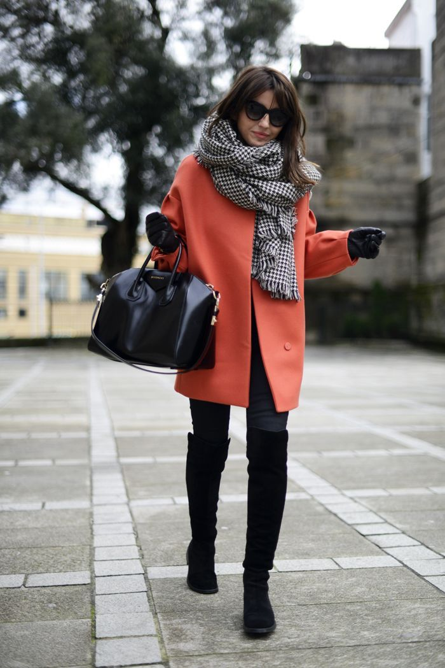
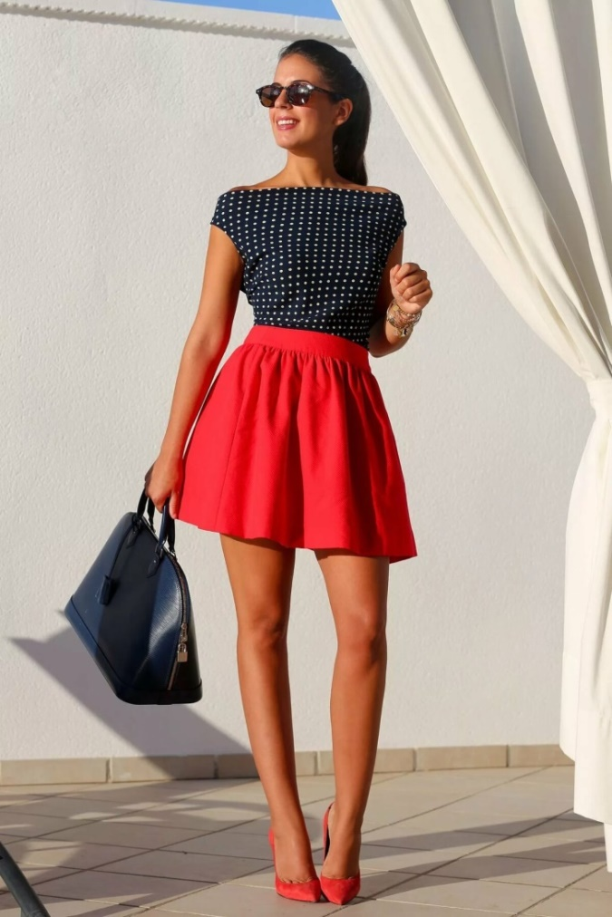
Listen and answer:
What clothes is Patsy wearing?

Slide 17
“Dress right!”
St.-Petersburg is in Russia.
The weather is different in St.-Petersburg.
It often rains (snows) in St.-Petersburg.
It’s warm (hot, cold) and sunny (windy, frosty) in summer (winter, spring, autumn).
If it’s warm (hot, cold, rainy) we wear …….., but
girls wear……., boys wear…….

Slide 18

What was interesting?

Slide 19

What was difficult?

Slide 20

What was easy?

Slide 21
Thank you

