Slide 1
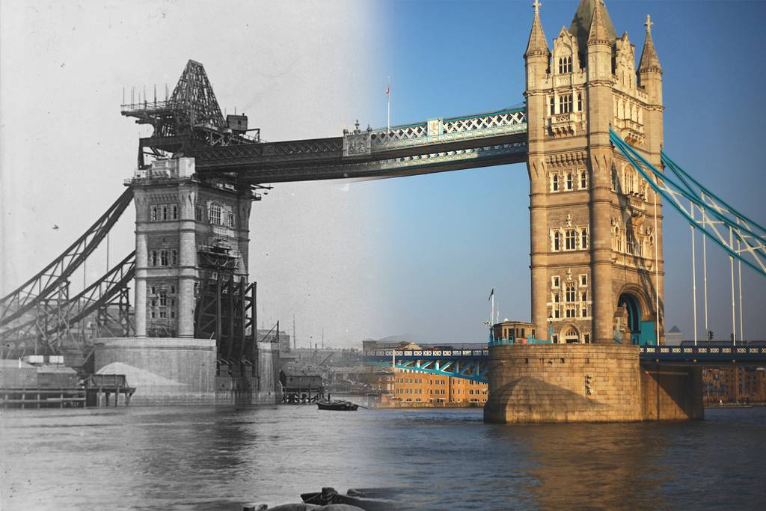
PAST ACTIONS IN ENGLISH
Учитель английского языка
Меттыева А.В.
ГБОУ Школа №2070

Slide 2
Времена глагола в РЯ
Прошедшее ← Настоящее → Будущее
Past ← Present → Future

Slide 3

Измерения (Dimensions)
1D-измерение

Slide 4

Измерения (Dimensions)
1D-измерение
4D-пространство
(3D в движении)

Slide 5
Система времён в АЯ
В АЯ существуют 4 группы времён для каждого из 3х названных выше времён. Каждая из таких систем существует отдельно для Active Voice, отдельно для Passive Voice.
Общая схема
1 2 3 4
время глагола ↗ в АЯ ↓ ( Tense ) | Simple простая / Indefinite неопределённая | Continuous продолженная, длительная / Progressive в развитии | Perfect (Simple) завершённая/ совершённая (простая) | Perfect Continuous / Perfect Progressive
Past ↑ |  |  | ПРЕдпрошедшее
∙ Present
Future ↓
Future in the Past
*для согласования времён в плане прошедшего времени

Slide 6
Tense in English
Имя/Name:
Past ← Present → Future
Отчество/Patronymic:
Simple, Continuous, Perfect, Perfect Continuous
Фамилия/Surname:
Active, Passive

Slide 7
Трудности обучения
Трансференция («транс-» – через; от лат. “transfero” - переносить, перевозить) – положительное влияние ранее усвоенных языков.
Интерференция («интер-» – между; от лат. “interferio” – взаимно ударяться, вмешиваться) – отрицательное влияние ранее усвоенных языков, которое приводит к ошибкам.

Slide 8
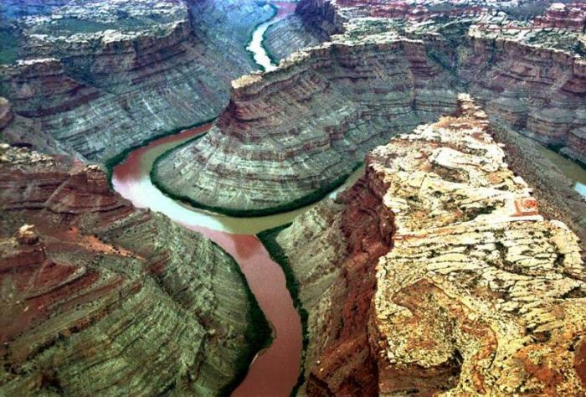
The Two Rivers’ “Meeting”

Slide 9
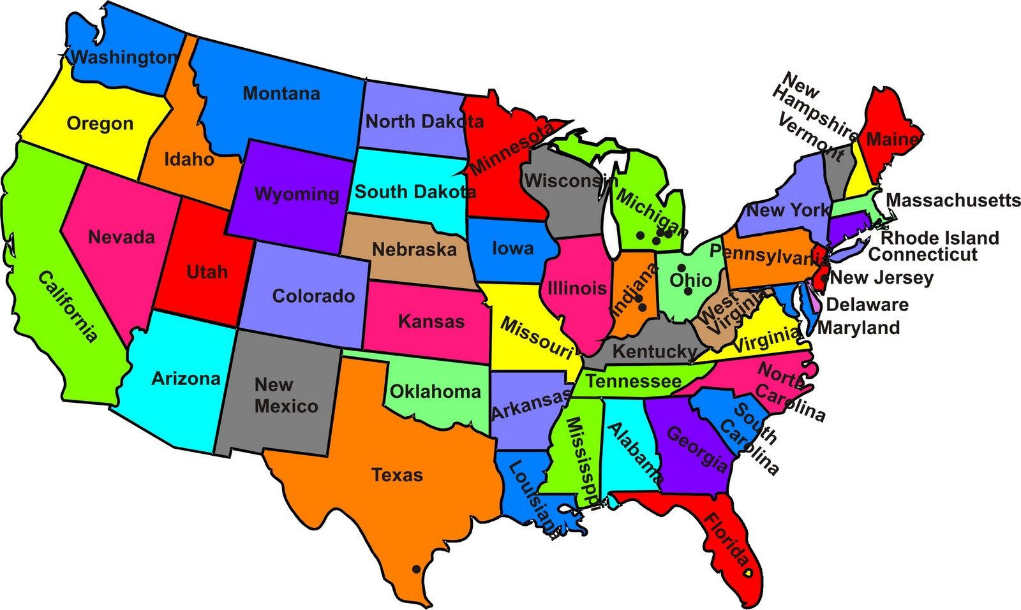
The Green and The Colorado, the National Park, Utah, the USA.

Slide 10
АЯ как ИЯ
(английский язык) (иностранный язык)
РЯ
(родной язык /
русский язык)

Slide 11
АЯ как ИЯ
(английский язык) (иностранный язык)
РЯ
(родной язык /
русский язык)
АЯ
(английский язык)

Slide 12
Система времён в АЯ
В АЯ существуют 4 группы времён для каждого из 3х названных выше времён. Каждая из таких систем существует отдельно для Active Voice, отдельно для Passive Voice.
Общая схема
1 2 3 4
время глагола ↗ в АЯ ↓ ( Tense ) | Simple простая / Indefinite неопределённая | Continuous продолженная, длительная / Progressive в развитии | Perfect (Simple) завершённая/ совершённая (простая) | Perfect Continuous / Perfect Progressive
Past ↑ |  |  | ПРЕдпрошедшее
∙ Present
Future ↓
Future in the Past
*для согласования времён в плане прошедшего времени

Slide 13
Система времён в АЯ
В АЯ существуют 4 группы времён для каждого из 3х названных выше времён. Каждая из таких систем существует отдельно для Active Voice, отдельно для Passive Voice.
Общая схема
1 2 3 4
время глагола ↗ в АЯ ↓ ( Tense ) | Simple простая / Indefinite неопределённая | Continuous продолженная, длительная / Progressive в развитии | Perfect (Simple) завершённая/ совершённая (простая) | Perfect Continuous / Perfect Progressive
Past ↑ |  |  | ПРЕдпрошедшее
∙ Present
Future ↓
Future in the Past
*для согласования времён в плане прошедшего времени

Slide 14
Система времён в АЯ
В АЯ существуют 4 группы времён для каждого из 3х названных выше времён. Каждая из таких систем существует отдельно для Active Voice, отдельно для Passive Voice.
Общая схема
1 2 3 4
время глагола ↗ в АЯ ↓ ( Tense ) | Simple простая / Indefinite неопределённая | Continuous продолженная, длительная / Progressive в развитии | Perfect (Simple) завершённая/ совершённая (простая) | Perfect Continuous / Perfect Progressive
Past ↑ |  |  | ПРЕдпрошедшее
∙ Present
Future ↓
Future in the Past
*для согласования времён в плане прошедшего времени

Slide 15
время глагола ↗ в АЯ ↓ ( Tense ) | Simple простая / Indefinite неопределённая | Continuous продолженная, длительная / Progressive в развитии | Perfect (Simple) завершённая/ совершённая (простая) | Perfect Continuous / Perfect Progressive
Past ↑ | -V2 (неправ.гл.) -V2: V1 + -ed/d | -was (ед.ч.) } + V4 -were (мн.ч.) | -had + V3 | -had been + V4
∙ Present | -V1 -V1 + -es/s (he/she/it) | -am (I) -is( he/she/it) } + V4 -are (мн.ч.) | -have } + V3 -has (he/she/it) | -have } been + V4 -has (he/she/it)
Future ↓ | -shall (I/we) (Brit.En.) } + V1 -will (все) (Amer.En.) | -shall (I/we) } be + V4 -will (все) | -shall (I/we) } have + V3 -will (все) | -shall (I/we) } have been + V4 -will (все)
Future in the Past | -should (I/we) } + V1 -would (все) | -should (I/we) } be+ V4 -would (все) | -should (I/we) } have + V3 -would (все) | -should (I/we) } have been + V4 -would (все)
* Эти формы употребляются редко

Slide 16
Active Voice
время глагола ↗ в АЯ ↓ ( Tense ) | Simple простая / Indefinite неопределённая | Continuous продолженная, длительная / Progressive в развитии | Perfect (Simple) завершённая/ совершённая (простая) | Perfect Continuous / Perfect Progressive
Past ↑ | -V2 (неправ.гл.) -V2: V1 + -ed/d | -was (ед.ч.) } + V4 -were (мн.ч.) | -had + V3 | -had been + V4
∙ Present | -V1 -V1 + -es/s (he/she/it) | -am (I) -is( he/she/it) } + V4 -are (мн.ч.) | -have } + V3 -has (he/she/it) | -have } been + V4 -has (he/she/it)
Future ↓ | -shall (I/we) (Brit.En.) } + V1 -will (все) (Amer.En.) | -shall (I/we) } be + V4 -will (все) | -shall (I/we) } have + V3 -will (все) | -shall (I/we) } have been + V4 -will (все)
Future in the Past | -should (I/we) } + V1 -would (все) | -should (I/we) } be+ V4 -would (все) | -should (I/we) } have + V3 -would (все) | -should (I/we) } have been + V4 -would (все)
* Эти формы употребляются редко

Slide 17
Общие схемы образования сказуемого
Active Voice
Общая схема
1 2 3 4
время глагола ↗ в АЯ ↓ ( Tense ) | Simple простая / Indefinite неопределённая | Continuous продолженная, длительная / Progressive в развитии | Perfect (Simple) завершённая/ совершённая (простая) | Perfect Continuous / Perfect Progressive
Past ↑ | -V2( неправ.гл.) -V2:V1 + -ed/d | to be + V4 Simple/Indefinite | to have + V3 Simple/Indefinite | to have + been + V4 Simple/Indefinite
∙ Present | -V1 -V1 + -es/s ( he/she/it)
Future ↓ | -shall (I/we) (Brit.En.) } + V1 -will (все) (Amer.En.)

Slide 18


Slide 19
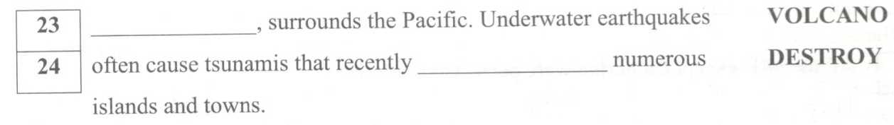

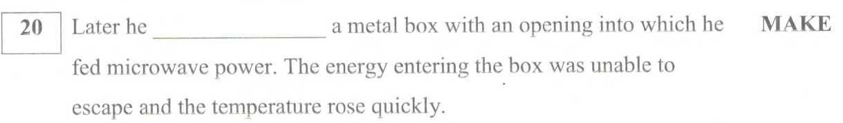
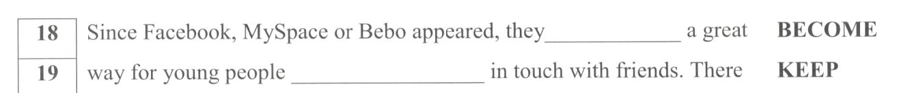
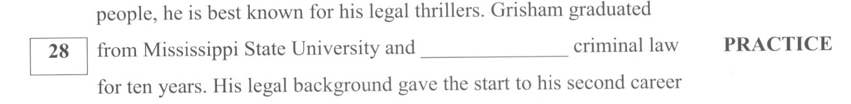

Slide 20
Система времён в АЯ
В АЯ существуют 4 группы времён для каждого из 3х названных выше времён. Каждая из таких систем существует отдельно для Active Voice, отдельно для Passive Voice.
Общая схема
1 2 3 4
время глагола ↗ в АЯ ↓ ( Tense ) | Simple простая / Indefinite неопределённая | Continuous продолженная, длительная / Progressive в развитии | Perfect (Simple) завершённая/ совершённая (простая) | Perfect Continuous / Perfect Progressive
Past ↑ |  |  | ПРЕдпрошедшее
∙ Present
Future ↓
Future in the Past
*для согласования времён в плане прошедшего времени

Slide 21
Past Tenses
Past Simple vs Past Continuous
(Active)
Основной признак для дифференциации:
Отсутствие/Наличие длительности

Slide 22
Past Tenses | Past Simple | Past Continuous
вопрос на РЯ | что сделал / делал (тогда)? | что делал (в тот период времени)?
употребление | окончательно законченное действие (что сделал?) | продолжительное действие в прошлом (что был делающий тогда?) середина др. действия в прошлом
особые случаи употребления со Статичными глаголами (глаголами состояния) |  | Не употребляется
спутники/указатели | in + год (в …), … ago (тому назад), last … (в прошлый/последний), yesterday (вчера), the day before yesterday (позавчера), long ago (давным-давно), Once upon a time (Жили-были…) | as (тогда как), all (day ), whole … (целый + временной промежуток), when, while, at … (в + точное время) yesterday, at that time, on … (в + день), from … to … yesterday
формула утвердительного сказуемого | V2/V-ed 1 слово | was/were + V-ing 2 слова
Признаки времен глагола

Slide 23
Ex.#1 Choose the right answer:
1. Just as Bob … the street, a car came round the corner.
а) crossed b) was crossing
2. While I … about my next actions, somebody knocked.
а) thought b) was thinking
3. Then I … a man standing nearby the shop.
а) saw b) was seeing
4. Something very strange … to me on my way home.
а) happened b) was happening
5. They … at the table when I began to tell this story.
а) sat b) were sitting

Slide 24
Ex.#1 Choose the right answer:
1. в процессе
1. Just as Bob … the street, a car came round the corner.
а) crossed b) was crossing
2. While I … about my next actions, somebody knocked.
а) thought b) was thinking
3. Then I … a man standing nearby the shop.
а) saw b) was seeing
4. Something very strange … to me on my way home.
а) happened b) was happening
5. They … at the table when I began to tell this story.
а) sat b) were sitting

Slide 25
Ex.#1 Choose the right answer:
1. в процессе
2. в процессе
1. Just as Bob … the street, a car came round the corner.
а) crossed b) was crossing
2. While I … about my next actions, somebody knocked.
а) thought b) was thinking
3. Then I … a man standing nearby the shop.
а) saw b) was seeing
4. Something very strange … to me on my way home.
а) happened b) was happening
5. They … at the table when I began to tell this story.
а) sat b) were sitting

Slide 26
Ex.#1 Choose the right answer:
1. в процессе
2. в процессе
3. мгновенно, статич. глагол
1. Just as Bob … the street, a car came round the corner.
а) crossed b) was crossing
2. While I … about my next actions, somebody knocked.
а) thought b) was thinking
3. Then I … a man standing nearby the shop.
а) saw b) was seeing
4. Something very strange … to me on my way home.
а) happened b) was happening
5. They … at the table when I began to tell this story.
а) sat b) were sitting

Slide 27
Ex.#1 Choose the right answer:
1. в процессе
2. в процессе
3. мгновенно, статич. глагол
4. мгновенно
1. Just as Bob … the street, a car came round the corner.
а) crossed b) was crossing
2. While I … about my next actions, somebody knocked.
а) thought b) was thinking
3. Then I … a man standing nearby the shop.
а) saw b) was seeing
4. Something very strange … to me on my way home.
а) happened b) was happening
5. They … at the table when I began to tell this story.
а) sat b) were sitting

Slide 28
Ex.#1 Choose the right answer:
1. в процессе
2. в процессе
3. мгновенно, статич. глагол
4. мгновенно
5. во время процесса
1. Just as Bob … the street, a car came round the corner.
а) crossed b) was crossing
2. While I … about my next actions, somebody knocked.
а) thought b) was thinking
3. Then I … a man standing nearby the shop.
а) saw b) was seeing
4. Something very strange … to me on my way home.
а) happened b) was happening
5. They … at the table when I began to tell this story.
а) sat b) were sitting

Slide 29
Past Tenses
Past Simple vs Past Perfect
(Active)
Основной признак для дифференциации:
Отсутствие/Наличие предшествования

Slide 30
Past Tenses | Past Simple | Past Perfect
вопрос на РЯ | что сделал / делал (тогда)? | что сделал (до этого)?
употребление | окончательно законченное действие (что сделал?) | действия начались в прошлом и результат очевиден на момент прошлого действие завершилось к определённому моменту в прошлом (указан обстоятельством времени или другим прошедшим действием – Предпрошедшим)
особые случаи употребления со Статичными глаголами (глаголами состояния) |  | употребляются, чтобы подчеркнуть длительность ситуации с прошлого по настоящий момент
спутники/указатели | in + год (в …), … ago (тому назад), last … (в прошлый/последний), yesterday (вчера), the day before yesterday (позавчера), long ago (давным-давно), Once upon a time (Жили-были…) | ever (когда-либо), never (никогда), just (только что), before (до), after (после), already (уже), when (когда), that week/ that … (на той…), for + временное выражение… (в течение…), since (с, с тех пор), till/until (до тех пор пока), by the time / by … (ко времени/к моменту …), другое действие в Past Simple
формула утвердительного сказуемого | V2/V-ed 1 слово | had + V3/V-ed 2 слова
Признаки времен глагола

Slide 31
Ex.#2 Choose the right answer:
1. While I was listening to the music, somebody … into the room.
а) came b) had come
2. She … as a nurse before she became a doctor.
а) worked b) had worked
3. The teacher … that the pupil didn’t know the lesson.
а) understood b) had understood
4. I … my composition by the end of the lesson.
а) wrote b) had written
5. At first I … the book, then I watched the film.
а) read b) had read

Slide 32
Ex.#2 Choose the right answer:
1. мгновенно
1. While I was listening to the music, somebody … into the room.
а) came b) had come
2. She … as a nurse before she became a doctor.
а) worked b) had worked
3. The teacher … that the pupil didn’t know the lesson.
а) understood b) had understood
4. I … my composition by the end of the lesson.
а) wrote b) had written
5. At first I … the book, then I watched the film.
а) read b) had read

Slide 33
Ex.#2 Choose the right answer:
1. мгновенно
2. предпрошедшее
1. While I was listening to the music, somebody … into the room.
а) came b) had come
2. She … as a nurse before she became a doctor.
а) worked b) had worked
3. The teacher … that the pupil didn’t know the lesson.
а) understood b) had understood
4. I … my composition by the end of the lesson.
а) wrote b) had written
5. At first I … the book, then I watched the film.
а) read b) had read

Slide 34
Ex.#2 Choose the right answer:
1. мгновенно
2. предпрошедшее
3. одновременность
1. While I was listening to the music, somebody … into the room.
а) came b) had come
2. She … as a nurse before she became a doctor.
а) worked b) had worked
3. The teacher … that the pupil didn’t know the lesson.
а) understood b) had understood
4. I … my composition by the end of the lesson.
а) wrote b) had written
5. At first I … the book, then I watched the film.
а) read b) had read

Slide 35
Ex.#2 Choose the right answer:
1. мгновенно
2. предпрошедшее
3. одновременность
4. by
1. While I was listening to the music, somebody … into the room.
а) came b) had come
2. She … as a nurse before she became a doctor.
а) worked b) had worked
3. The teacher … that the pupil didn’t know the lesson.
а) understood b) had understood
4. I … my composition by the end of the lesson.
а) wrote b) had written
5. At first I … the book, then I watched the film.
а) read b) had read

Slide 36
Ex.#2 Choose the right answer:
1. мгновенно
2. предпрошедшее
3. одновременность
4. by
5. предпрошедшее
1. While I was listening to the music, somebody … into the room.
а) came b) had come
2. She … as a nurse before she became a doctor.
а) worked b) had worked
3. The teacher … that the pupil didn’t know the lesson.
а) understood b) had understood
4. I … my composition by the end of the lesson.
а) wrote b) had written
5. At first I … the book, then I watched the film.
а) read b) had read

Slide 37
Past Tenses
Past Perfect:
Simple vs Continuous
(Active)
Основные признаки для дифференциации:
1. Отсутствие/Наличие длительности
при завершённости действия
2. Статичность глагола

Slide 38
Past Tenses | Past Perfect (Simple) | Past Perfect Continuous
вопрос на РЯ | что сделал (до этого)? | что ПРОделывал (до этого)?
употребление | действия начались в прошлом и результат очевиден на момент прошлого
 | действие завершилось к определённому моменту в прошлом (указан обстоятельством времени или другим прошедшим действием – Предпрошедшим) | длительная ситуация
особые случаи употребления со Статичными глаголами (глаголами состояния) | употребляются, чтобы подчеркнуть длительность ситуации с прошлого по настоящий момент | Не употребляется
спутники/указатели | ever (когда-либо), never (никогда), just (только что), before (до), after (после), already (уже), when (когда), that week/ that … (на той…), for + временное выражение… (в течение…), since (с, с тех пор), till/until (до тех пор пока), by the time / by … (ко времени/к моменту …), другое действие в Past Simple | for + временное выражение… (в течение…), since (с, с тех пор), how long (как долго)
формула утвердительного сказуемого | had + V3/V-ed 2 слова | had + been + V-ing 3 слова
Признаки времен глагола

Slide 39
Ex.#3 Choose the right answer:
1. The flat was dirty. They hadn’t … (cleaned/been cleaning) it for weeks.
2. I knew all those facts because I had … (read/been reading) about it in the report.
3. She was sitting on the ground and was out of breath because she had … (run/been running) the marathon.
4. The roads were wet and dangerous because it had … (rained/been raining) all night.
5. When I arrived at the party, Ann had already … (left/been leaving).

Slide 40
Ex.#3 Choose the right answer:
1. результат + длительность (for)
1. The flat was dirty. They hadn’t … (cleaned/been cleaning) it for weeks.
2. I knew all those facts because I had … (read/been reading) about it in the report.
3. She was sitting on the ground and was out of breath because she had … (run/been running) the marathon.
4. The roads were wet and dangerous because it had … (rained/been raining) all night.
5. When I arrived at the party, Ann had already … (left/been leaving).

Slide 41
Ex.#3 Choose the right answer:
1. результат + длительность (for)
2. результат + нет длительности
1. The flat was dirty. They hadn’t … (cleaned/been cleaning) it for weeks.
2. I knew all those facts because I had … (read/been reading) about it in the report.
3. She was sitting on the ground and was out of breath because she had … (run/been running) the marathon.
4. The roads were wet and dangerous because it had … (rained/been raining) all night.
5. When I arrived at the party, Ann had already … (left/been leaving).

Slide 42
Ex.#3 Choose the right answer:
1. результат + длительность (for)
2. результат + нет длительности
3. результат + длительность
1. The flat was dirty. They hadn’t … (cleaned/been cleaning) it for weeks.
2. I knew all those facts because I had … (read/been reading) about it in the report.
3. She was sitting on the ground and was out of breath because she had … (run/been running) the marathon.
4. The roads were wet and dangerous because it had … (rained/been raining) all night.
5. When I arrived at the party, Ann had already … (left/been leaving).

Slide 43
Ex.#3 Choose the right answer:
1. результат + длительность (for)
2. результат + нет длительности
3. результат + длительность
4. результат + длительность
1. The flat was dirty. They hadn’t … (cleaned/been cleaning) it for weeks.
2. I knew all those facts because I had … (read/been reading) about it in the report.
3. She was sitting on the ground and was out of breath because she had … (run/been running) the marathon.
4. The roads were wet and dangerous because it had … (rained/been raining) all night.
5. When I arrived at the party, Ann had already … (left/been leaving).

Slide 44
Ex.#3 Choose the right answer:
1. результат + длительность (for)
2. результат + нет длительности
3. результат + длительность
4. результат + длительность
5. already
1. The flat was dirty. They hadn’t … (cleaned/been cleaning) it for weeks.
2. I knew all those facts because I had … (read/been reading) about it in the report.
3. She was sitting on the ground and was out of breath because she had … (run/been running) the marathon.
4. The roads were wet and dangerous because it had … (rained/been raining) all night.
5. When I arrived at the party, Ann had already … (left/been leaving).

Slide 45
Past Tenses
Review

Slide 46
Ex.#4 Choose the right answer:
1. Tom … down the road when he fell.
а) walked b) was walking c) had walked
2. He was happy because he … his exam.
а) passed b) was passing c) had passed
3. Bob had missed the flight by the time he … at the airport.
а) arrived b) was arriving c) had walking
4. They … to a new CD when Max came in.
а) listened b) were listening c) had listened
5. As soon as I got home, I … to bed.
а) went b) was … going c) had listened

Slide 47
Ex.#4 Choose the right answer:
1. в процессе
1. Tom … down the road when he fell.
а) walked b) was walking c) had walked
2. He was happy because he … his exam.
а) passed b) was passing c) had passed
3. Bob had missed the flight by the time he … at the airport.
а) arrived b) was arriving c) had walking
4. They … to a new CD when Max came in.
а) listened b) were listening c) had listened
5. As soon as I got home, I … to bed.
а) went b) was … going c) had listened

Slide 48
Ex.#4 Choose the right answer:
1. в процессе
2. предпрошедшее
1. Tom … down the road when he fell.
а) walked b) was walking c) had walked
2. He was happy because he … his exam.
а) passed b) was passing c) had passed
3. Bob had missed the flight by the time he … at the airport.
а) arrived b) was arriving c) had walking
4. They … to a new CD when Max came in.
а) listened b) were listening c) had listened
5. As soon as I got home, I … to bed.
а) went b) was … going c) had listened

Slide 49
Ex.#4 Choose the right answer:
1. в процессе
2. Предпрошедшее
3. позже другого прошедшего
1. Tom … down the road when he fell.
а) walked b) was walking c) had walked
2. He was happy because he … his exam.
а) passed b) was passing c) had passed
3. Bob had missed the flight by the time he … at the airport.
а) arrived b) was arriving c) had walking
4. They … to a new CD when Max came in.
а) listened b) were listening c) had listened
5. As soon as I got home, I … to bed.
а) went b) was … going c) had listened

Slide 50
Ex.#4 Choose the right answer:
1. в процессе
2. Предпрошедшее
3. позже другого прошедшего
4. в процессе
1. Tom … down the road when he fell.
а) walked b) was walking c) had walked
2. He was happy because he … his exam.
а) passed b) was passing c) had passed
3. Bob had missed the flight by the time he … at the airport.
а) arrived b) was arriving c) had walking
4. They … to a new CD when Max came in.
а) listened b) were listening c) had listened
5. As soon as I got home, I … to bed.
а) went b) was … going c) had listened

Slide 51
Ex.#4 Choose the right answer:
1. в процессе
2. Предпрошедшее
3. позже другого прошедшего
4. в процессе
5. перечисление прошедших действий
1. Tom … down the road when he fell.
а) walked b) was walking c) had walked
2. He was happy because he … his exam.
а) passed b) was passing c) had passed
3. Bob had missed the flight by the time he … at the airport.
а) arrived b) was arriving c) had walking
4. They … to a new CD when Max came in.
а) listened b) were listening c) had listened
5. As soon as I got home, I … to bed.
а) went b) was … going c) had listened

Slide 52
Система времён в АЯ
В АЯ существуют 4 группы времён для каждого из 3х названных выше времён. Каждая из таких систем существует отдельно для Active Voice, отдельно для Passive Voice.
Общая схема
1 2 3 4
время глагола ↗ в АЯ ↓ ( Tense ) | Simple простая / Indefinite неопределённая | Continuous продолженная, длительная / Progressive в развитии | Perfect (Simple) завершённая/ совершённая (простая) | Perfect Continuous / Perfect Progressive
Past ↑ |  |  | ПРЕдпрошедшее
∙ Present
Future ↓
Future in the Past
*для согласования времён в плане прошедшего времени

Slide 53

Past Tenses + Present Tenses = Past Actions
Past Simple vs Present Perfect
(Active)
Основной признак для дифференциации:
Особенности употребления Present Perfect

Slide 54
Tenses | Past Simple | Present Perfect
вопрос на РЯ | что сделал / делал (тогда)? | Что делаю (до сих пор)? Что (уже) сделал?
употребление | окончательно законченное действие (что сделал?) | неизвестно, когда точно произошло важен результат прошлого действия в настоящем личный опыт, переживания
особые случаи употребления со Статичными глаголами (глаголами состояния) |  | начало в прошлом и продолжение в настоящем с глаголом “to be” в значении «побывать»
спутники/указатели | in + год (в …), … ago (тому назад), last … (в прошлый/последний), yesterday (вчера), the day before yesterday (позавчера), long ago (давным-давно), Once upon a time (Жили-были…) | ever, never, just, before, recently/lately, already, for, this week/ this …, many times, once, till/until, up to now, by, so far, today, yet, for the last (time), since (с, с тех пор)
формула утвердительного сказуемого | V2/V-ed 1 слово | has/have + V3/V-ed 2 слова
Признаки времен глагола

Slide 55
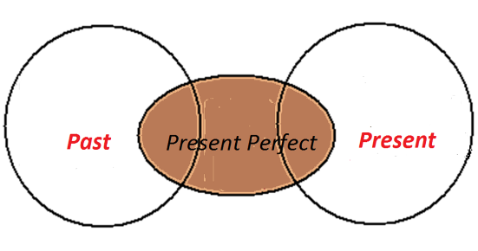
Tenses | Past Simple | Present Perfect
вопрос на РЯ | что сделал / делал (тогда)? | Что делаю (до сих пор)? Что (уже) сделал?
употребление | окончательно законченное действие (что сделал?) | неизвестно, когда точно произошло важен результат прошлого действия в настоящем личный опыт, переживания
особые случаи употребления со Статичными глаголами (глаголами состояния) |  | начало в прошлом и продолжение в настоящем с глаголом “to be” в значении «побывать»
спутники/указатели | in + год (в …), … ago (тому назад), last … (в прошлый/последний), yesterday (вчера), the day before yesterday (позавчера), long ago (давным-давно), Once upon a time (Жили-были…) | ever, never, just, before, recently/lately, already, for, this week/ this …, many times, once, till/until, up to now, by, so far, today, yet, for the last (time), since (с, с тех пор)
формула утвердительного сказуемого | V2/V-ed 1 слово | has/have + V3/V-ed 2 слова
началось (что Сделал?) результат!
Признаки времен глагола

Slide 56

Tenses | Past Simple | Present Perfect
вопрос на РЯ | что сделал / делал (тогда)? | Что делаю (до сих пор)? Что (уже) сделал?
употребление | окончательно законченное действие (что сделал?) | неизвестно, когда точно произошло важен результат прошлого действия в настоящем личный опыт, переживания
особые случаи употребления со Статичными глаголами (глаголами состояния) |  | начало в прошлом и продолжение в настоящем с глаголом “to be” в значении «побывать»
спутники/указатели | in + год (в …), … ago (тому назад), last … (в прошлый/последний), yesterday (вчера), the day before yesterday (позавчера), long ago (давным-давно), Once upon a time (Жили-были…) | ever, never, just, before, recently/lately, already, for, this week/ this …, many times, once, till/until, up to now, by, so far, today, yet, for the last (time), since (с, с тех пор)
формула утвердительного сказуемого | V2/V-ed 1 слово | has/have + V3/V-ed 2 слова
началось (что Сделал?) результат!
Признаки времен глагола

Slide 57
Tenses | Past Simple | Present Perfect
вопрос на РЯ | что сделал / делал (тогда)? | Что делаю (до сих пор)? Что (уже) сделал?
употребление | окончательно законченное действие (что сделал?) | неизвестно, когда точно произошло важен результат прошлого действия в настоящем личный опыт, переживания
особые случаи употребления со Статичными глаголами (глаголами состояния) |  | начало в прошлом и продолжение в настоящем с глаголом “to be” в значении «побывать»
спутники/указатели | in + год (в …), … ago (тому назад), last … (в прошлый/последний), yesterday (вчера), the day before yesterday (позавчера), long ago (давным-давно), Once upon a time (Жили-были…) | ever, never, just, before, recently/lately, already, for, this week/ this …, many times, once, till/until, up to now, by, so far, today, yet, for the last (time), since (с, с тех пор)
формула утвердительного сказуемого | V2/V-ed 1 слово | has/have + V3/V-ed 2 слова
началось (что Сделал?) результат!
Ever, never, yet, before,
Just, already, since, by, for –
Read them, learn them, don’t be mistaken,
Perfect’s used with the words you’ve taken.
[ipk.admin.tstu.ru/resurs/experience/foren/doneckaya.doc]
Признаки времен глагола

Slide 58
Ex.#5 Open the brackets:
1. Don’t worry about the present. I … (buy) it the day before yesterday.
Don’t worry about the present. I bought it the day before yesterday.
2. Have you got any money? – Yes, I … (receive) salary already.
Have you got any money? – Yes, I have received salary already.
3. I know this place. I … (be) there many times.
I know this place. I have been there many times.
4. When I was a child, I … (be) always late for school.
When I was a child, I was always late for school.
5. The children are dirty because they … (play) in the garden.
The children are dirty because they have played in the garden.

Slide 59
Ex.#5 Open the brackets:
1. the day before yesterday
1. Don’t worry about the present. I … (buy) it the day before yesterday.
Don’t worry about the present. I bought it the day before yesterday.
2. Have you got any money? – Yes, I … (receive) salary already.
Have you got any money? – Yes, I have received salary already.
3. I know this place. I … (be) there many times.
I know this place. I have been there many times.
4. When I was a child, I … (be) always late for school.
When I was a child, I was always late for school.
5. The children are dirty because they … (play) in the garden.
The children are dirty because they have played in the garden.

Slide 60
Ex.#5 Open the brackets:
1. the day before yesterday
2. already
1. Don’t worry about the present. I … (buy) it the day before yesterday.
Don’t worry about the present. I bought it the day before yesterday.
2. Have you got any money? – Yes, I … (receive) salary already.
Have you got any money? – Yes, I have received salary already.
3. I know this place. I … (be) there many times.
I know this place. I have been there many times.
4. When I was a child, I … (be) always late for school.
When I was a child, I was always late for school.
5. The children are dirty because they … (play) in the garden.
The children are dirty because they have played in the garden.

Slide 61
Ex.#5 Open the brackets:
1. the day before yesterday
2. already
3. «побывал»
1. Don’t worry about the present. I … (buy) it the day before yesterday.
Don’t worry about the present. I bought it the day before yesterday.
2. Have you got any money? – Yes, I … (receive) salary already.
Have you got any money? – Yes, I have received salary already.
3. I know this place. I … (be) there many times.
I know this place. I have been there many times.
4. When I was a child, I … (be) always late for school.
When I was a child, I was always late for school.
5. The children are dirty because they … (play) in the garden.
The children are dirty because they have played in the garden.

Slide 62
Ex.#5 Open the brackets:
1. the day before yesterday
2. already
3. «побывал»
4. окончательное далёкое прошлое
1. Don’t worry about the present. I … (buy) it the day before yesterday.
Don’t worry about the present. I bought it the day before yesterday.
2. Have you got any money? – Yes, I … (receive) salary already.
Have you got any money? – Yes, I have received salary already.
3. I know this place. I … (be) there many times.
I know this place. I have been there many times.
4. When I was a child, I … (be) always late for school.
When I was a child, I was always late for school.
5. The children are dirty because they … (play) in the garden.
The children are dirty because they have played in the garden.

Slide 63
Ex.#5 Open the brackets:
1. the day before yesterday
2. already
3. «побывал»
4. окончательное далёкое прошлое
5. результат
1. Don’t worry about the present. I … (buy) it the day before yesterday.
Don’t worry about the present. I bought it the day before yesterday.
2. Have you got any money? – Yes, I … (receive) salary already.
Have you got any money? – Yes, I have received salary already.
3. I know this place. I … (be) there many times.
I know this place. I have been there many times.
4. When I was a child, I … (be) always late for school.
When I was a child, I was always late for school.
5. The children are dirty because they … (play) in the garden.
The children are dirty because they have played in the garden.

Slide 64
Present Tenses = Past Actions
Present Perfect:
Simple vs Continuous
(Active)
Основные признаки для дифференциации:
1. Особенности употребления Present Perfect
2. Отсутствие/Наличие длительности
при завершённости действия
3. Статичность глагола

Slide 65
Present Tenses | Present Perfect (Simple) | Present Perfect Continuous
вопрос на РЯ | Что делаю (до сих пор)? Что (уже) сделал? | Что ПРОделываю / делаю (до сих пор)?
употребление | неизвестно, когда точно произошло важен результат прошлого действия в настоящем личный опыт, переживания | начало в прошлом и продолжение в настоящем с видимым результатом длительная ситуация для выражения раздражения, недовольства
особые случаи употребления со Статичными глаголами (глаголами состояния) | начало в прошлом и продолжение в настоящем с глаголом “to be” в значении «побывать» | Не употребляется
спутники/указатели | ever, never, just, before, recently/lately, already, for, this week/ this …, many times, once, till/until, up to now, by, so far, today, yet, for the last (time), since (с, с тех пор) | for … (в течение), since … (c, c тех пор), How long … ?, lately, all morning/all …
формула утвердительного сказуемого | has/have + V3/V-ed 2 слова | have/has + been + V-ing 3 слова
Признаки времен глагола

Slide 66
Ex.#6 Choose the right answer:
1. I’m very sorry that I have … (broken/been breaking) your cup.
2. You have … (written/been writing) this composition for the whole day.
3. He has … (known/been knowing) her for many years.
4. You are very red. Have you … (run/been running)?
5. Where have you been? - I have … (waited/been waiting) for you for ages.

Slide 67
Ex.#6 Choose the right answer:
1. I’m very sorry that I have … (broken/been breaking) your cup.
2. You have … (written/been writing) this composition for the whole day.
3. He has … (known/been knowing) her for many years.
4. You are very red. Have you … (run/been running)?
5. Where have you been? - I have … (waited/been waiting) for you for ages.
1. результат

Slide 68
Ex.#6 Choose the right answer:
1. I’m very sorry that I have … (broken/been breaking) your cup.
2. You have … (written/been writing) this composition for the whole day.
3. He has … (known/been knowing) her for many years.
4. You are very red. Have you … (run/been running)?
5. Where have you been? - I have … (waited/been waiting) for you for ages.
1. результат
2. длительность – for

Slide 69
Ex.#6 Choose the right answer:
1. I’m very sorry that I have … (broken/been breaking) your cup.
2. You have … (written/been writing) this composition for the whole day.
3. He has … (known/been knowing) her for many years.
4. You are very red. Have you … (run/been running)?
5. Where have you been? - I have … (waited/been waiting) for you for ages.
1. результат
2. длительность – for
3. статичный глагол

Slide 70
Ex.#6 Choose the right answer:
1. I’m very sorry that I have … (broken/been breaking) your cup.
2. You have … (written/been writing) this composition for the whole day.
3. He has … (known/been knowing) her for many years.
4. You are very red. Have you … (run/been running)?
5. Where have you been? - I have … (waited/been waiting) for you for ages.
1. результат
2. длительность – for
3. статичный глагол
4. результат длительного действия

Slide 71
Ex.#6 Choose the right answer:
1. I’m very sorry that I have … (broken/been breaking) your cup.
2. You have … (written/been writing) this composition for the whole day.
3. He has … (known/been knowing) her for many years.
4. You are very red. Have you … (run/been running)?
5. Where have you been? - I have … (waited/been waiting) for you for ages.
1. результат
2. длительность – for
3. статичный глагол
4. результат длительного действия
5. длительность – for

Slide 72
Past Tenses + Present Tenses = Past Actions
Review

Slide 73
Ex.#7 Open the brackets:
1. It … (rain) when the accident happened.
It was raining when the accident happened.
2. When I … (come) in, everyone was talking about me.
When I came in, everyone was talking about me.
3. He … (smoke/not) since last year.
He hasn’t smoked since last year.
4. We visited this place for the first time – we … (be/not) there before.
We visited this place for the first time – we hadn’t been there before.
5. He … (live) here for many years but he doesn’t know the language well.
He has been living here for many years but he doesn’t know the language well.

Slide 74
Ex.#7 Open the brackets:
1. в процессе
1. It … (rain) when the accident happened.
It was raining when the accident happened.
2. When I … (come) in, everyone was talking about me.
When I came in, everyone was talking about me.
3. He … (smoke/not) since last year.
He hasn’t smoked since last year.
4. We visited this place for the first time – we … (be/not) there before.
We visited this place for the first time – we hadn’t been there before.
5. He … (live) here for many years but he doesn’t know the language well.
He has been living here for many years but he doesn’t know the language well.

Slide 75
Ex.#7 Open the brackets:
1. в процессе
2. мгновенно
1. It … (rain) when the accident happened.
It was raining when the accident happened.
2. When I … (come) in, everyone was talking about me.
When I came in, everyone was talking about me.
3. He … (smoke/not) since last year.
He hasn’t smoked since last year.
4. We visited this place for the first time – we … (be/not) there before.
We visited this place for the first time – we hadn’t been there before.
5. He … (live) here for many years but he doesn’t know the language well.
He has been living here for many years but he doesn’t know the language well.

Slide 76
Ex.#7 Open the brackets:
1. в процессе
2. мгновенно
3. since
1. It … (rain) when the accident happened.
It was raining when the accident happened.
2. When I … (come) in, everyone was talking about me.
When I came in, everyone was talking about me.
3. He … (smoke/not) since last year.
He hasn’t smoked since last year.
4. We visited this place for the first time – we … (be/not) there before.
We visited this place for the first time – we hadn’t been there before.
5. He … (live) here for many years but he doesn’t know the language well.
He has been living here for many years but he doesn’t know the language well.

Slide 77
Ex.#7 Open the brackets:
1. в процессе
2. мгновенно
3. since
4. предпрошедшее
1. It … (rain) when the accident happened.
It was raining when the accident happened.
2. When I … (come) in, everyone was talking about me.
When I came in, everyone was talking about me.
3. He … (smoke/not) since last year.
He hasn’t smoked since last year.
4. We visited this place for the first time – we … (be/not) there before.
We visited this place for the first time – we hadn’t been there before.
5. He … (live) here for many years but he doesn’t know the language well.
He has been living here for many years but he doesn’t know the language well.

Slide 78
Ex.#7 Open the brackets:
1. в процессе
2. мгновенно
3. since
4. предпрошедшее
5. результат длительного действия
1. It … (rain) when the accident happened.
It was raining when the accident happened.
2. When I … (come) in, everyone was talking about me.
When I came in, everyone was talking about me.
3. He … (smoke/not) since last year.
He hasn’t smoked since last year.
4. We visited this place for the first time – we … (be/not) there before.
We visited this place for the first time – we hadn’t been there before.
5. He … (live) here for many years but he doesn’t know the language well.
He has been living here for many years but he doesn’t know the language well.

Slide 80
have destroyed
discovered
was testing
made
have become
Без связи с настоящим!
practiced/
practised

Slide 81
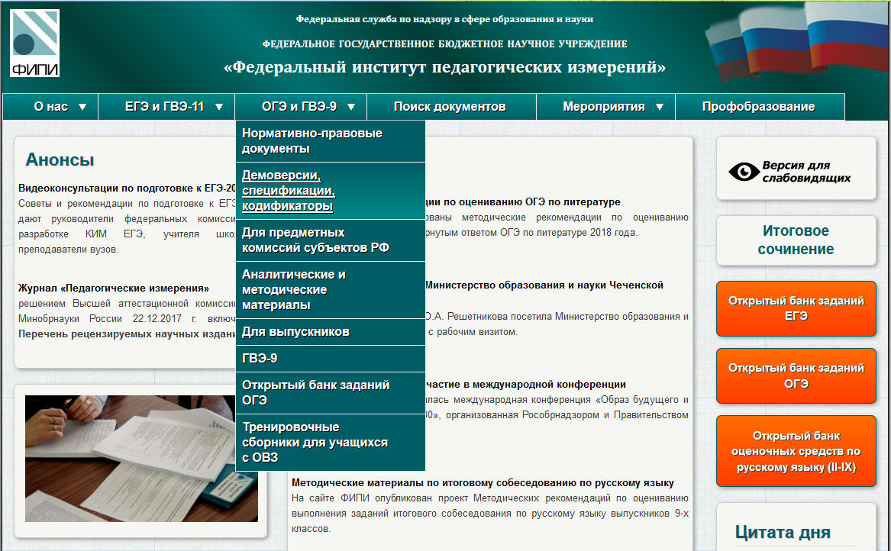

Slide 82
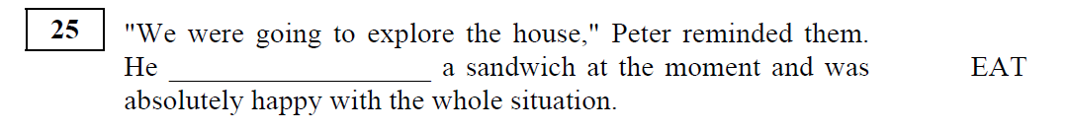



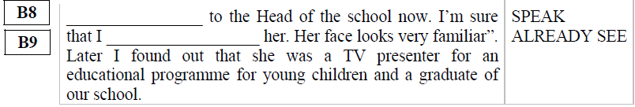


Slide 83
didn’t have
was eating
Результат!
began
has taken
have just bought
have already seen
have read

Slide 84



I wish you coped well with all difficulties at the exam
And I’m sure one day you’ll say: ‘A new day has come!’
“A new day has come
Where it was dark now there's light
Where there was pain now there's joy
Where there was weakness, I found my strength…”

Slide 85
I wish you coped well with all difficulties at the exam
And I’m sure one day you’ll say: ‘A new day has come!’
“A new day has come
Where it was dark now there's light
Where there was pain now there's joy
Where there was weakness, I found my strength…”

Slide 86

I wish you coped well with all difficulties at the exam
And I’m sure one day you’ll say: ‘A new day has come!’
“A new day has come
Where it was dark now there's light
Where there was pain now there's joy
Where there was weakness, I found my strength…”

