Slide 1

Презентация
«Present Continuous»

Slide 2
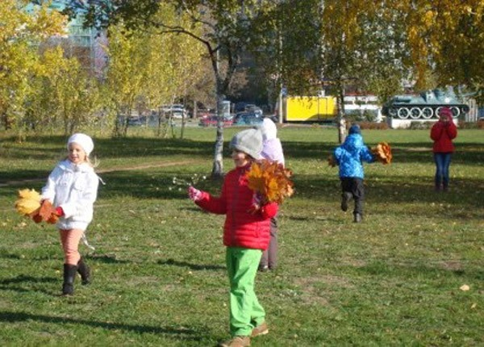
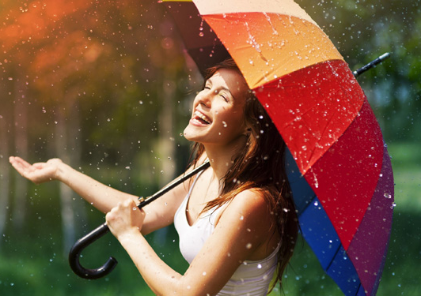
Present Continuous употребляется:
Для выражения действий,
происходящих в момент речи:
They are working in the park now.
2. Для выражения действий в процессе:
It is raining.

Slide 3
Образование Present Continuous
I
am
V - ing
He
She
It
is
We
You
They
are

Slide 4
Правописание
si
Make + ing = making
Lie + y + ing = lying
Sing + ing = singing | Run + n + ing = running
Добавьте к этим глаголам -ing и впишите их в соответствующую графу в таблице:
Watch, sit, buy, come, carry, put, wear, start, write,
die, stop, look, play, see, begin, study, smoke, type, drink, listen, work, take, shop, cut, done.

Slide 5
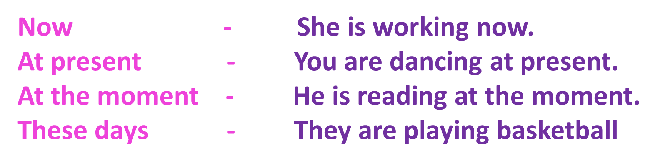
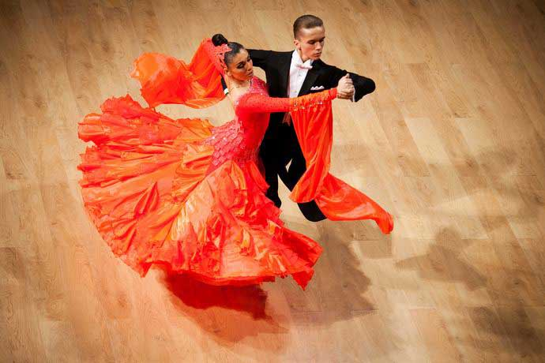
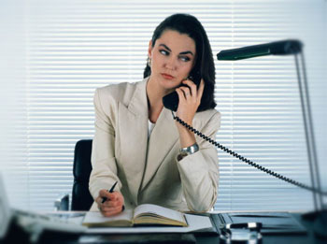
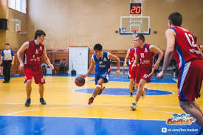
Указатели времени в Present Continuous
these days.

Slide 6
Вставьте глаголы в Present Continuous
1. He ……. is sitting…….. (sit) at the desk.
2. She ……………… (eat) dinner.
3. The dog …………….(sleep).
4. Tony …………………(write) a letter.
5. The birds ………………….(sing).
6. I …………………(watch) TV.
7. Mum ……………(make) a cake.
8. Ann ………….(swim) now.

Slide 7

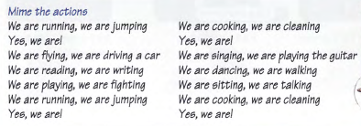
Listen to the music and find verbs in Present Continuous

Slide 8
Put the words in the correct order
1. Coming/the train/is?
2. Why/is barking/the dog?
3. Suitcases/are/packing/they/their.
4. Where/your/staying/are/friends?
5. You/going/shops/are/to/the?
6. Learning/am/at the moment/play/I/to/golf.

Slide 9
Write questions. Then match them to the answers.
(Tom/study)……for the history test. A. Yes, I am.
(Mum/work)……..today? B. Yes, he is.
(You/write)…….a letter? С. No, they aren’t.
(They/laugh)………..? D. Yes, you are.
(It/rain). The sky is grey? E. No, she isn’t.
(I/sit)………..on the your chair? F. Yes, it is.

Slide 10
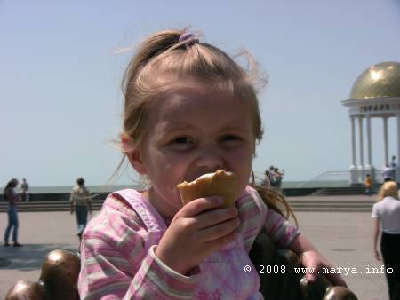
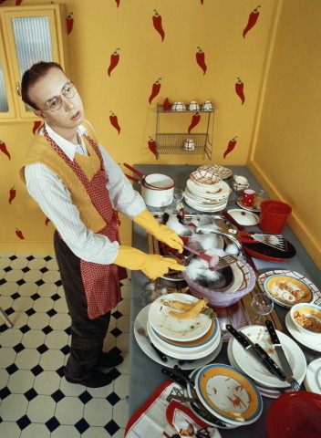
C глаголами love, like, hate, don’t like + doing something.
I hate going to the dentist.
I love eating ice-cream.
I don’t like washing the dishes.
I like reading books.

Slide 11
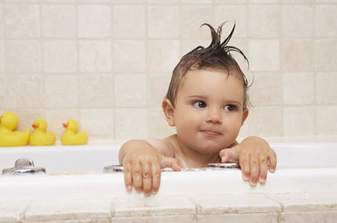
С глаголом Have
Если глагол have употребляется в форме Present Continuous, он выражает действие, а не принадлежность.
I’m having a bath. ( Я принимаю ванну).
I’m having a shower. ( Я принимаю душ).
I’m having a lesson. (Я делаю уроки).
I’m having breakfast/lunch/dinner/

Slide 12
Put the verbs into the Present Simple or the Present Continuous
Bob………..(wash) his car at the moment.
My sister………..(eat) her dinner now.
I always…………(do) my homework in the evening.

Slide 13

4.Mother usually………….(do) the housework at the weekend.
5.Kate………..(tidy) his room now.
6.They usually……………(go) on holiday in August.
7.Jane always………….. (go) to the bed early.
8.He……………(write) an email at present.

Slide 14

Present Simple or Present Continuous
Zoe’s dad usually ……. his car to work (drive).
Today he ……. his bike (ride).

Slide 15

Brian usually ……. an apple for breakfast (eat).
Today he…….. a banana(eat).

Slide 16
Zoe and Vicky usually……. jeans (wear).
Today they……..dresses (wear).

Slide 17
Zoe usually ……. orange juice in the afternoon (drink).
Today she ………. milk (drink).

Slide 18
The boys usually .… football (play).
Today they ……. tennis (play).

Slide 19
Thank you for the lesson!

Slide 20
Список использованных интернет-ресурсов:
https://encrypted-tbn3.gstatic.com/images?q=tbn:ANd9GcTdu2-tJhnFZ5q1ewDLj94ND0htD8I8vabKd4nCJi8Ik_gOVMJJ
http://cdn.bolshoyvopros.ru/files/users/images/88/6c/886cc6ddaaf1759bbd06154d3b33e2c9.jpg
http://marya.info/photo/IMG_0620.jpg
http://iledebeaute.ru/files/images/pub/part_3/60015/src/lori-0011170654-smallwww.jpg?434_288
http://xn----8sbaabynedfc7bjr3anx9e2i.xn--p1ai/wp-content/uploads/2014/03/motto.net_.ua-57605.jpg
http://www.weekend.com.ua/old_photos/articles/8/86/86054/01-c1_tanty.jpg
http://super-mens.ru/images/stories/1a-jenshina-rabotaet.jpg

