Slide 1
Презентация к уроку английского языка в 3 классе по учебнику «ENGLISH» И.Н.Верещагиной
Clothing
Одежда
Автор: Дворникова Анна Эдуардовна,
учитель английского языка,
МБОУ Редькинская СОШ, г.о.Озёры

Slide 2
Фонетическая зарядка
|iː| jeans, season, speak
|e| sweater, head, weather
|æ| jacket
|kləʊ(ð)z| clothes
|ɜː| skirt, shirt
|uː| boot, shoe
|ɔː| shorts
|aʊ| blouse, trousers

Slide 3
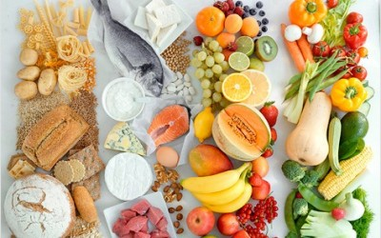
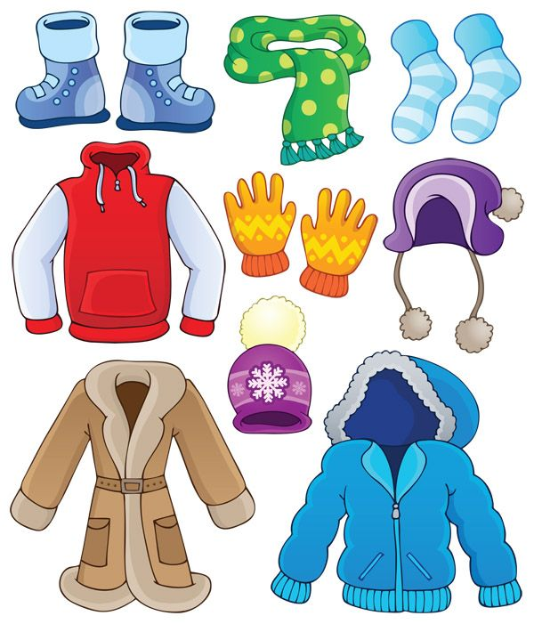

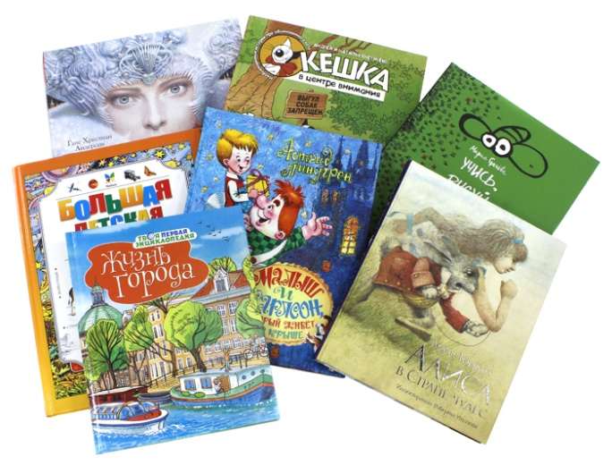
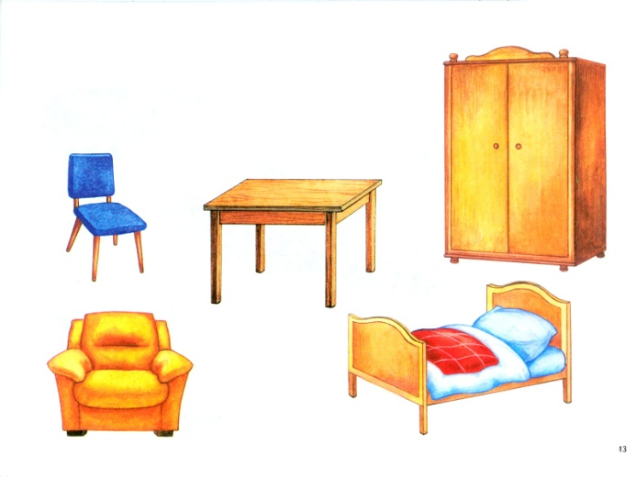
What can you buy in the shop?

Slide 4
«Good clothes open all doors!» Хорошая одежда открывает все двери.
«There is no bad weather, there are bad clothes»
У природы нет плохой погоды.

Slide 5

a hat

Slide 6

a cap

Slide 7
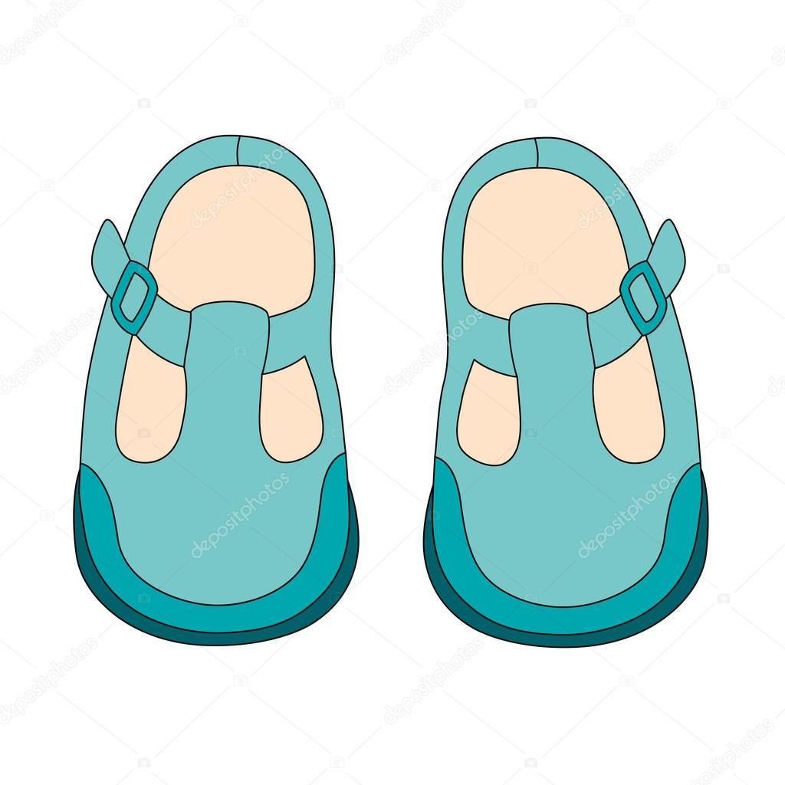
shoes

Slide 8
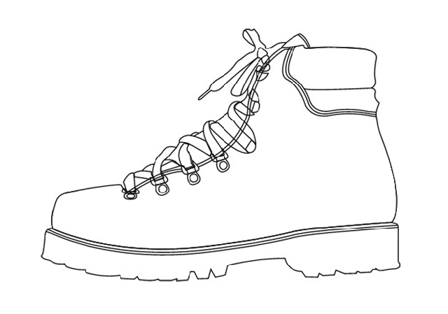
a boot

Slide 9

gloves

Slide 10

mittens

Slide 11
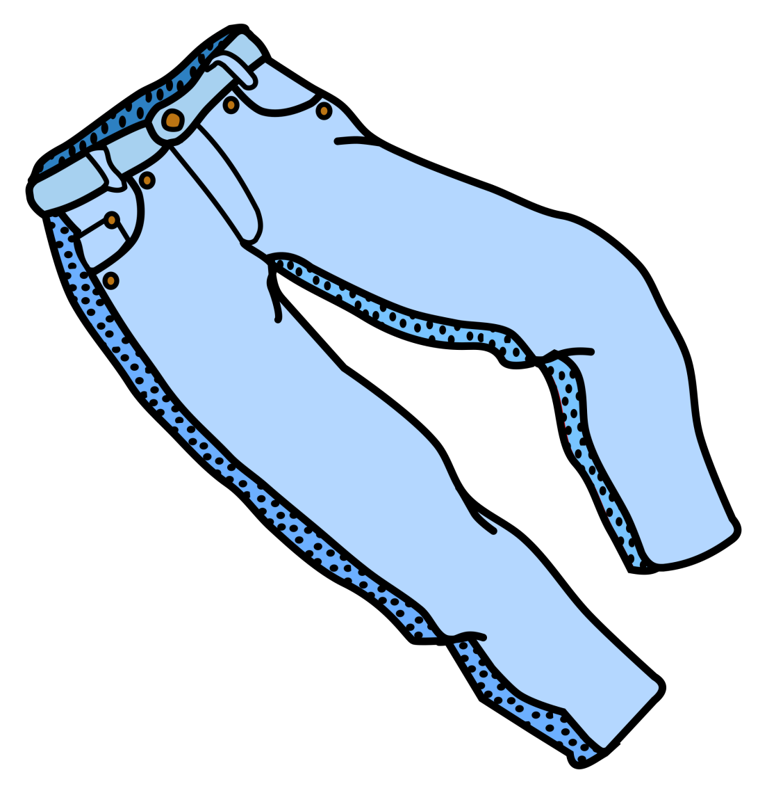
jeans

Slide 12
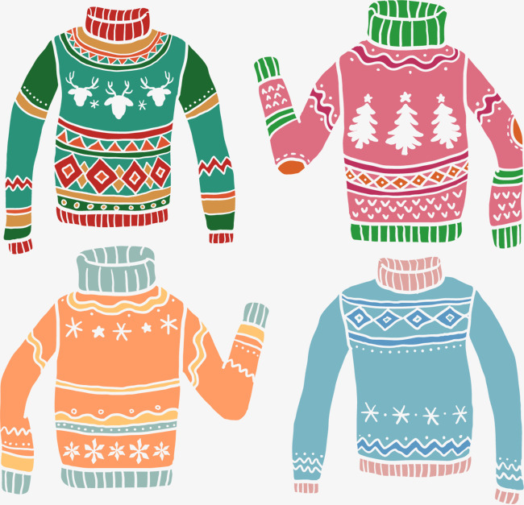
a sweater

Slide 13
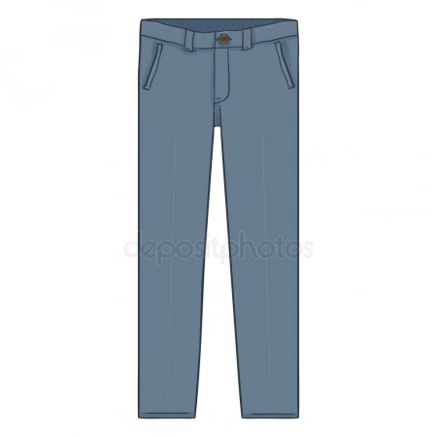
trousers

Slide 14
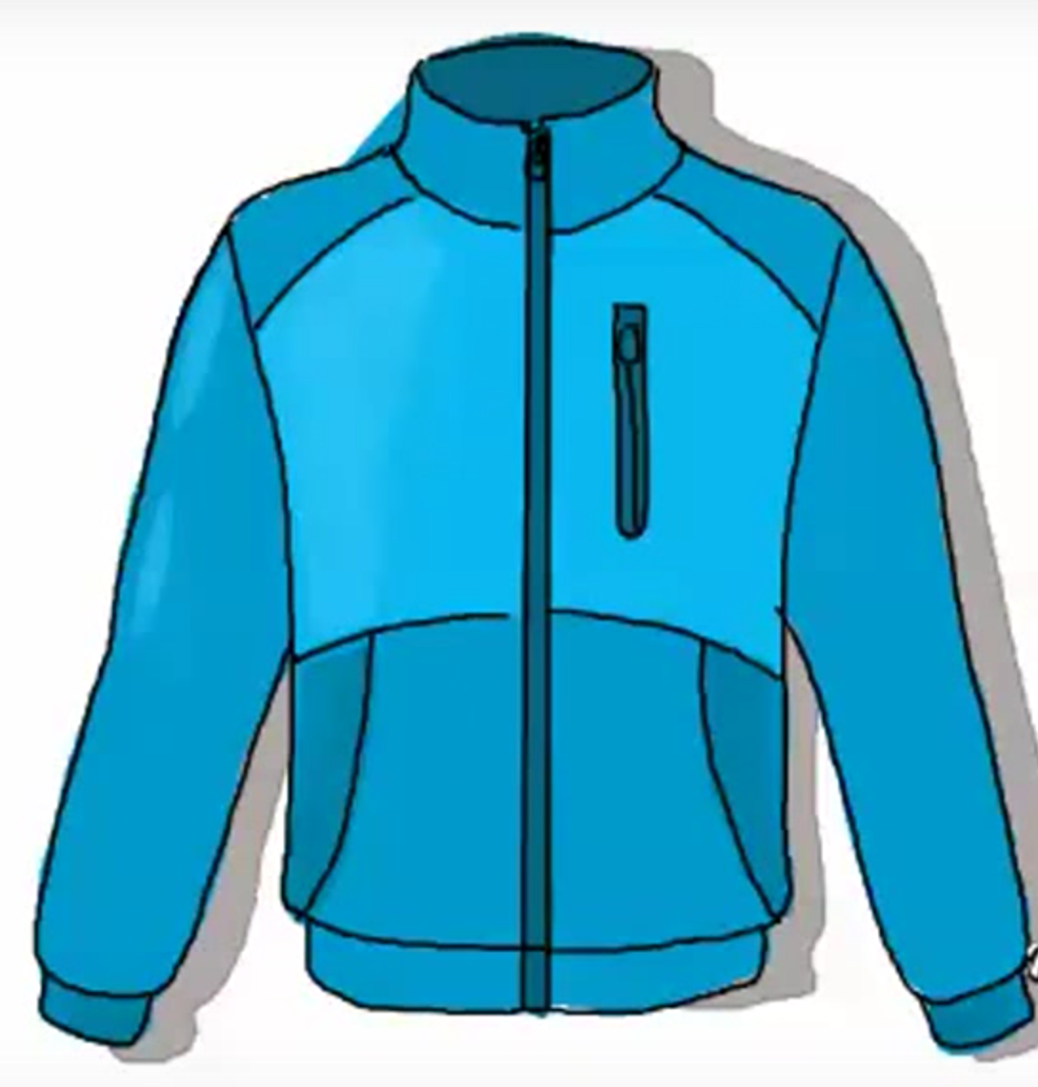
a jacket

Slide 15
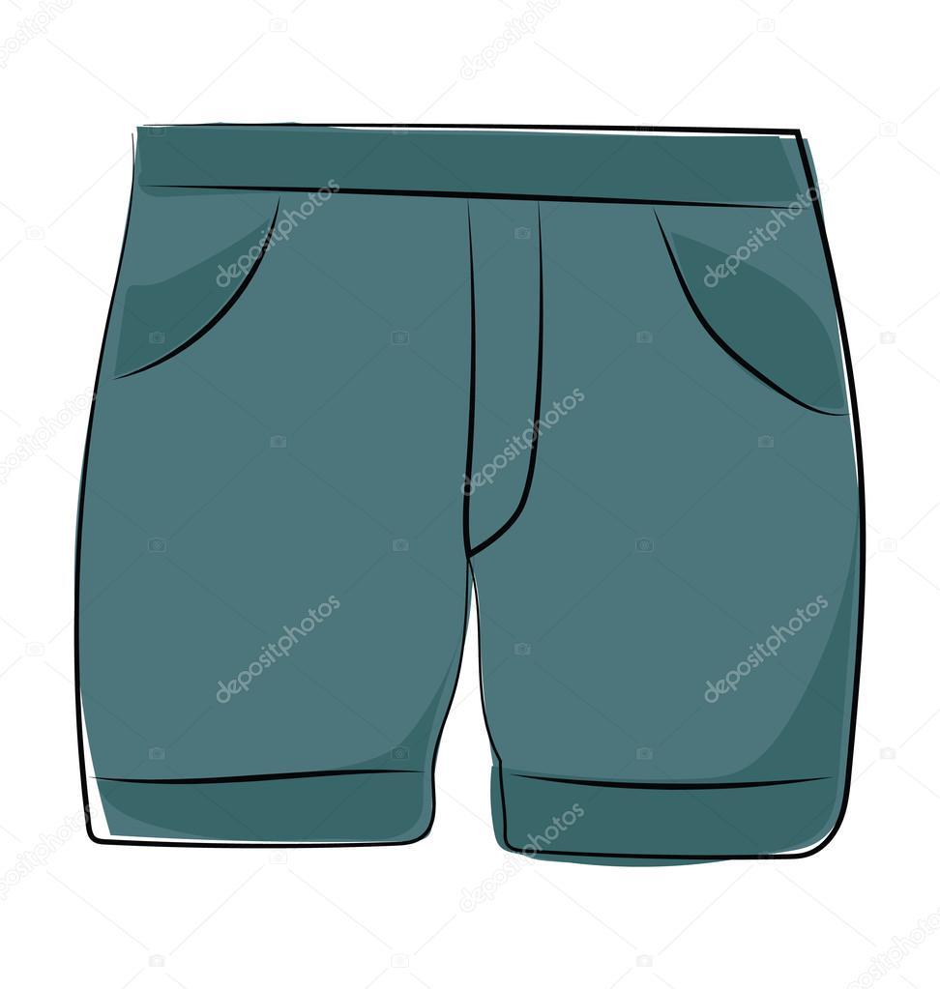
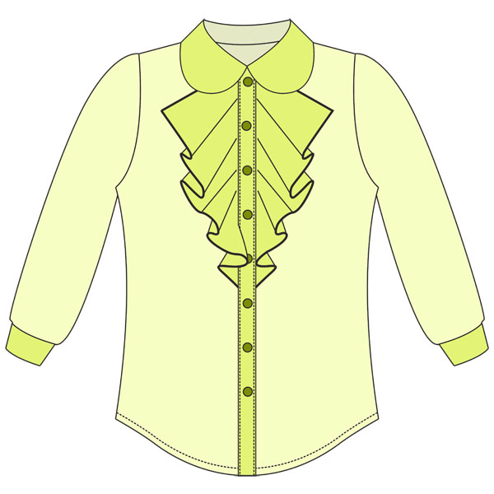
SHORTS
BLOUSE

Slide 16
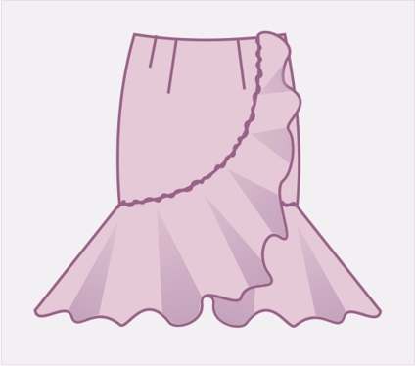

SKIRT
SOCK

Slide 17
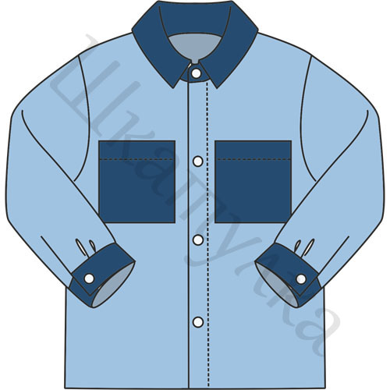
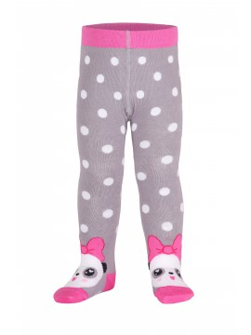
SHIRT
TIGHTS

Slide 18

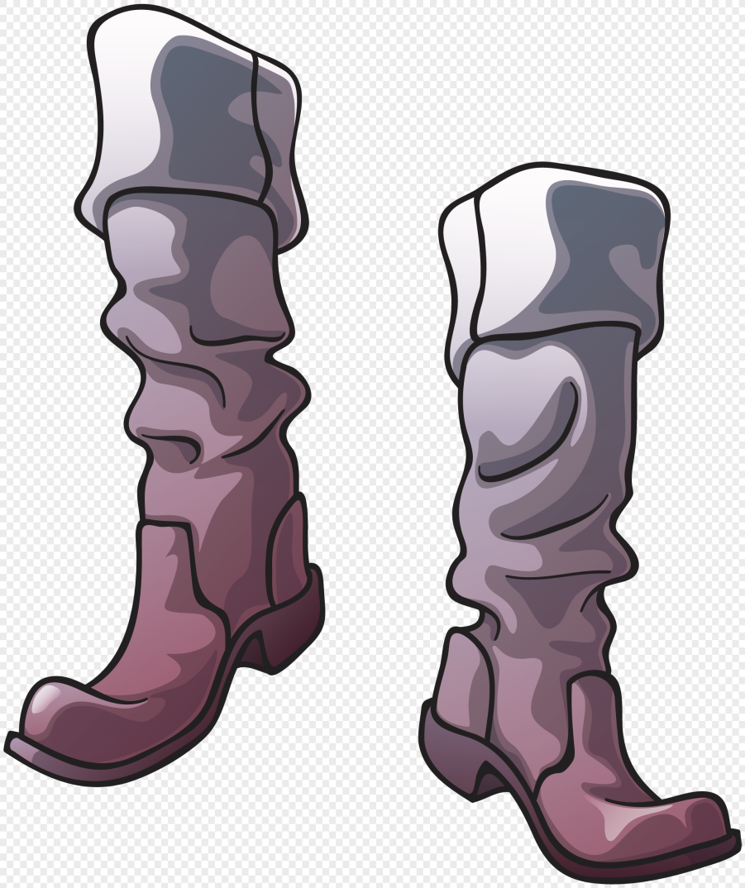
T-SHIRT
HIGH BOOTS

Slide 19


Slide 20
When it’s … I wear …

Slide 21

What does Mrs Grey want to buy?
What color is it?
What size is it?

Slide 23
At the shop
Mrs Grey: I’d like a pair of shoes, please.
Shop assistant: What color would you like?
Mrs Grey: Brown
Shop assistant: And what size do you want?
Mrs Grey: Five. Can I try them on?
Shop assistant: Of course.

Slide 24
NOW I KNOW…
NOW I CAN…
IT WAS INTERESTING FOR ME…

Slide 25

GOOD BYE!

